Slide 1
INFO20003 Database Systems
Kuoyuan Li
Tutorial 11

Slide 2
Agenda
Understand the fundamentals of dimensional modeling
Design a dimensional model using Kimball’s four-step design process
Discuss the impact of grain on fact tables
Notes:
What does this data growth imply? It implies that finding useful information is equal to….

Slide 3
Understand the fundamentals of dimensional modeling
1. Data warehouse
A single database of organizational data
Allows all of the organization’s data to be stored in a form that supports managers’ decision making.
Integrated from multiple sources internal and external to the organization by converting it into a common format and validating before storing it to ensure credibility of the warehouse.
Keeps historical data and is available to the managers of the organization to support high-level decision-making processes and data analysis.
Unlike an ER model, where data is organized around conceptual entities, the data in a data warehouse is organized around business processes such as sales, finance, or marketing.
Notes:
Today data is incorporated in our aspects of our lives. Just think of your daily actions… examples…
And on top of it there is this big business of extracting value from the data - call it business analytics, data driven decision making – anything you like, the point is to extract the hidden cold stored in this data
- Think of amazon recommended products, Netflix movies to watch.. All this is driven by your actions and the data you generate
Data exhaust
44 zb by 2020 digital universe
To put things in perspective 1 zb when it is burn on stack of cds it would be 4.1 million km high – which is high enough to reach from the earth to the moon and back 5 times

Slide 4
Understand the fundamentals of dimensional modeling
2. Business events
Data warehouses store information about Business events
An event that occurs as part of a business process
For the sales business process, an individual order or sale would be considered a business event
For finance, a payment would be a business event
For a marketing data warehouse, it might be a view of a webpage or a click on an online ad.
Notes:
Today data is incorporated in our aspects of our lives. Just think of your daily actions… examples…
And on top of it there is this big business of extracting value from the data - call it business analytics, data driven decision making – anything you like, the point is to extract the hidden cold stored in this data
- Think of amazon recommended products, Netflix movies to watch.. All this is driven by your actions and the data you generate
Data exhaust
44 zb by 2020 digital universe
To put things in perspective 1 zb when it is burn on stack of cds it would be 4.1 million km high – which is high enough to reach from the earth to the moon and back 5 times

Slide 5
Understand the fundamentals of dimensional modeling
3. Dimensions, dimension tables and hierarchies
A dimension is an entity that describes and gives context to a business event.
Examples: time, customers, products and locations
Example 1: if a CEO is interested in a comparison of revenue of a new model of the product with the older model in every quarter of the year by customer demographic group, the relevant dimensions are Time (quarter of the year), Product (product version) and Customer (customer demographic).
Example 2: for an insurance company, an example of a key measurement is claims, and the dimensions could be agent, policy, customer, and time
Notes:
Today data is incorporated in our aspects of our lives. Just think of your daily actions… examples…
And on top of it there is this big business of extracting value from the data - call it business analytics, data driven decision making – anything you like, the point is to extract the hidden cold stored in this data
- Think of amazon recommended products, Netflix movies to watch.. All this is driven by your actions and the data you generate
Data exhaust
44 zb by 2020 digital universe
To put things in perspective 1 zb when it is burn on stack of cds it would be 4.1 million km high – which is high enough to reach from the earth to the moon and back 5 times

Slide 6
Understand the fundamentals of dimensional modeling
3. Dimensions, dimension tables and hierarchies
Dimensions are represented in the data warehouse as dimension tables
A sequence of attributes that describes a dimension across different levels of detail is called a hierarchy
Example 1: for the dimension table ‘Location’, the data can be stored at various levels such as city, state, or much higher level of country and so on
Example 2: Time dimension will have a hierarchy of day, week, month, quarter and year.
These hierarchies are used for selecting and aggregating data at the desired level of detail. In other words, hierarchies help with slicing and dicing the data.
Notes:
Today data is incorporated in our aspects of our lives. Just think of your daily actions… examples…
And on top of it there is this big business of extracting value from the data - call it business analytics, data driven decision making – anything you like, the point is to extract the hidden cold stored in this data
- Think of amazon recommended products, Netflix movies to watch.. All this is driven by your actions and the data you generate
Data exhaust
44 zb by 2020 digital universe
To put things in perspective 1 zb when it is burn on stack of cds it would be 4.1 million km high – which is high enough to reach from the earth to the moon and back 5 times

Slide 7
Understand the fundamentals of dimensional modeling
4. Facts, fact tables and granularity
A fact is a numeric measurement of a meaningful and significant business event
Example: customer buys a product at a certain location at a certain time. The intersection of these four dimensions constitutes a sale (the business event). The sale can be measured in terms of the amount of revenue generated, number of items sold, total profit earned, etc – these are all facts relating to the sale
The facts (numerical performance measurements) of a business are stored in a fact table. A row in a fact table corresponds to one or more business events.
Notes:
Today data is incorporated in our aspects of our lives. Just think of your daily actions… examples…
And on top of it there is this big business of extracting value from the data - call it business analytics, data driven decision making – anything you like, the point is to extract the hidden cold stored in this data
- Think of amazon recommended products, Netflix movies to watch.. All this is driven by your actions and the data you generate
Data exhaust
44 zb by 2020 digital universe
To put things in perspective 1 zb when it is burn on stack of cds it would be 4.1 million km high – which is high enough to reach from the earth to the moon and back 5 times

Slide 8
Understand the fundamentals of dimensional modeling
4. Facts, fact tables and granularity
A data warehouse fact table is defined as an intersection of the dimensions that describe the business event. In general, the fact table has a PK made up of the foreign keys connecting it to the dimension tables.
The level of detail present in a fact table is referred to as grain or granularity
The fact table can store each business event in its own row (for example, preserving each sales event as an individual row) or it can store many business events aggregated together (if sales data is aggregated down to one row per hour or per day).
The finer the granularity is, the more precisely a query can extract details from the database.
Notes:
Today data is incorporated in our aspects of our lives. Just think of your daily actions… examples…
And on top of it there is this big business of extracting value from the data - call it business analytics, data driven decision making – anything you like, the point is to extract the hidden cold stored in this data
- Think of amazon recommended products, Netflix movies to watch.. All this is driven by your actions and the data you generate
Data exhaust
44 zb by 2020 digital universe
To put things in perspective 1 zb when it is burn on stack of cds it would be 4.1 million km high – which is high enough to reach from the earth to the moon and back 5 times

Slide 9
Understand the fundamentals of dimensional modeling
4. Dimensional modeling – the star schema
The model in which the fact table consisting of numeric measurements is related to all the dimension tables storing descriptive attributes is called the dimensional model
The fact table is at the centre and the dimensional tables are on the sides, making a star schema
Notes:
Today data is incorporated in our aspects of our lives. Just think of your daily actions… examples…
And on top of it there is this big business of extracting value from the data - call it business analytics, data driven decision making – anything you like, the point is to extract the hidden cold stored in this data
- Think of amazon recommended products, Netflix movies to watch.. All this is driven by your actions and the data you generate
Data exhaust
44 zb by 2020 digital universe
To put things in perspective 1 zb when it is burn on stack of cds it would be 4.1 million km high – which is high enough to reach from the earth to the moon and back 5 times

Slide 10
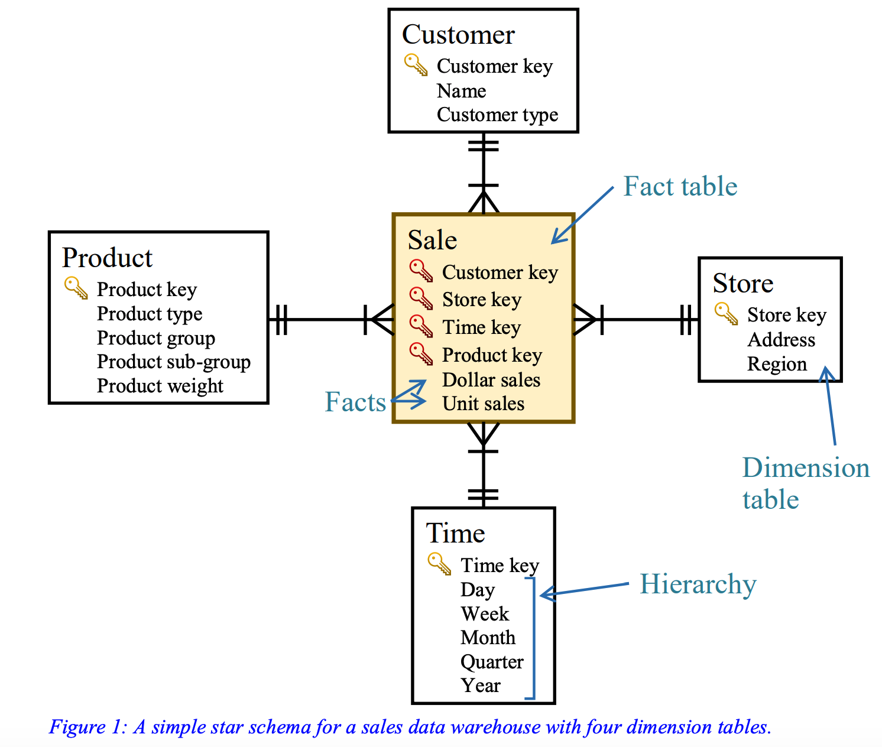
Understand the fundamentals of dimensional modeling
4. Dimensional modeling – the star schema
Notes:
Today data is incorporated in our aspects of our lives. Just think of your daily actions… examples…
And on top of it there is this big business of extracting value from the data - call it business analytics, data driven decision making – anything you like, the point is to extract the hidden cold stored in this data
- Think of amazon recommended products, Netflix movies to watch.. All this is driven by your actions and the data you generate
Data exhaust
44 zb by 2020 digital universe
To put things in perspective 1 zb when it is burn on stack of cds it would be 4.1 million km high – which is high enough to reach from the earth to the moon and back 5 times

Slide 11
Understand the fundamentals of dimensional modeling
Any questions?
Notes:
Today data is incorporated in our aspects of our lives. Just think of your daily actions… examples…
And on top of it there is this big business of extracting value from the data - call it business analytics, data driven decision making – anything you like, the point is to extract the hidden cold stored in this data
- Think of amazon recommended products, Netflix movies to watch.. All this is driven by your actions and the data you generate
Data exhaust
44 zb by 2020 digital universe
To put things in perspective 1 zb when it is burn on stack of cds it would be 4.1 million km high – which is high enough to reach from the earth to the moon and back 5 times

Slide 12
Design a dimensional model
1. Designing a dimensional model Exercise
Wimmera Wines is a large company that takes deliveries of grapes from wine growers, produces and bottles wine, and sells those bottles to retailers and restaurants. They produce many different types of wine at a range of price points, from cheap cask wine to top-of-the-range vintage bottles. Wimmera Wines’ day-to-day OLTP(Online transaction processing) database uses the following ER model
Notes:
Today data is incorporated in our aspects of our lives. Just think of your daily actions… examples…
And on top of it there is this big business of extracting value from the data - call it business analytics, data driven decision making – anything you like, the point is to extract the hidden cold stored in this data
- Think of amazon recommended products, Netflix movies to watch.. All this is driven by your actions and the data you generate
Data exhaust
44 zb by 2020 digital universe
To put things in perspective 1 zb when it is burn on stack of cds it would be 4.1 million km high – which is high enough to reach from the earth to the moon and back 5 times

Slide 13
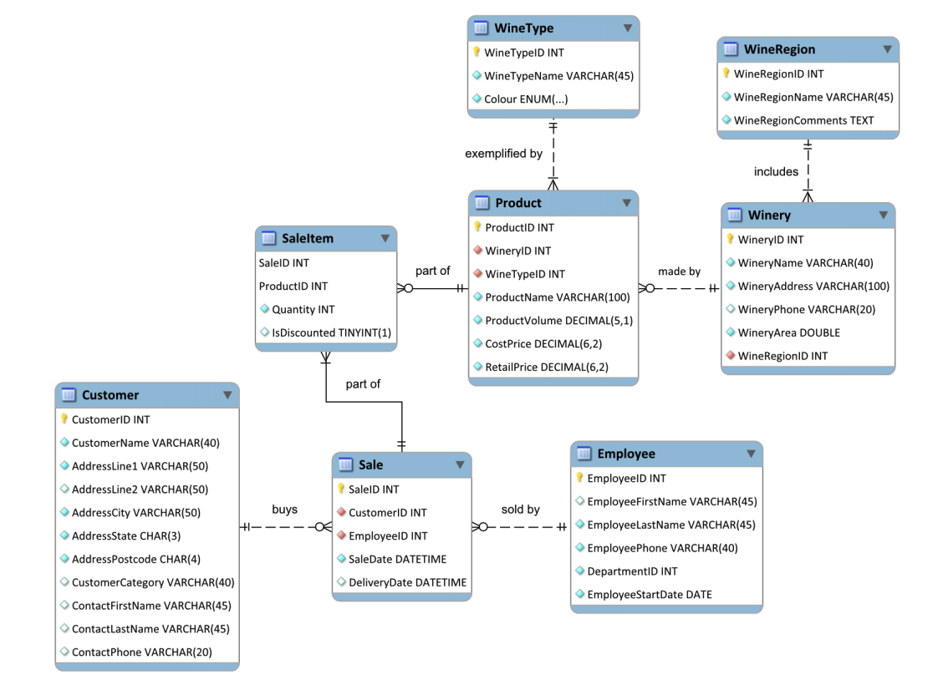
Design a dimensional model
1. Designing a dimensional model Exercise

Slide 14
Design a dimensional model
1. Designing a dimensional model Exercise
The company is aiming to increase their product sales by 20% in comparison to the last 3 years. To help the business achieve their aim, you have been hired to design a data warehouse that can help business managers analyze data related to the sales theme.
The company is keen to understand all the aspects of their business that contribute to strong sales. For example, two business measures that have been mentioned are “total number of units of each product sold” and “revenue generated by each employee per year”.
Notes:
Today data is incorporated in our aspects of our lives. Just think of your daily actions… examples…
And on top of it there is this big business of extracting value from the data - call it business analytics, data driven decision making – anything you like, the point is to extract the hidden cold stored in this data
- Think of amazon recommended products, Netflix movies to watch.. All this is driven by your actions and the data you generate
Data exhaust
44 zb by 2020 digital universe
To put things in perspective 1 zb when it is burn on stack of cds it would be 4.1 million km high – which is high enough to reach from the earth to the moon and back 5 times

Slide 15
Design a dimensional model
1. Designing a dimensional model Exercise
a. As a class, brainstorm some more business measures that Wimmera Wines managers might need if they are to achieve their aim
total number of units of each product sold
revenue generated by each employee per year
Notes:
Today data is incorporated in our aspects of our lives. Just think of your daily actions… examples…
And on top of it there is this big business of extracting value from the data - call it business analytics, data driven decision making – anything you like, the point is to extract the hidden cold stored in this data
- Think of amazon recommended products, Netflix movies to watch.. All this is driven by your actions and the data you generate
Data exhaust
44 zb by 2020 digital universe
To put things in perspective 1 zb when it is burn on stack of cds it would be 4.1 million km high – which is high enough to reach from the earth to the moon and back 5 times

Slide 16
Design a dimensional model
1. Designing a dimensional model Exercise
a. As a class, brainstorm some more business measures that Wimmera Wines managers might need if they are to achieve their aim
Number of products sold per year
Sales by a particular state
Sales of a product in a given quarter of a year
Revenue generated from a particular customer category
Which product is selling the best (hence generating the most revenue)?
…
Notes:
Today data is incorporated in our aspects of our lives. Just think of your daily actions… examples…
And on top of it there is this big business of extracting value from the data - call it business analytics, data driven decision making – anything you like, the point is to extract the hidden cold stored in this data
- Think of amazon recommended products, Netflix movies to watch.. All this is driven by your actions and the data you generate
Data exhaust
44 zb by 2020 digital universe
To put things in perspective 1 zb when it is burn on stack of cds it would be 4.1 million km high – which is high enough to reach from the earth to the moon and back 5 times

Slide 17
Design a dimensional model
1. Designing a dimensional model Exercise
b. Use Kimball’s four-step dimensional design process to design a dimensional model for Wimmera Wines’ product sales subject area.
i. Select and explain the business process.
ii. Declare the grain and justify your choice.
iii. Identify and explain the dimensions.
iv. Identify and explain the facts.
Notes:
Today data is incorporated in our aspects of our lives. Just think of your daily actions… examples…
And on top of it there is this big business of extracting value from the data - call it business analytics, data driven decision making – anything you like, the point is to extract the hidden cold stored in this data
- Think of amazon recommended products, Netflix movies to watch.. All this is driven by your actions and the data you generate
Data exhaust
44 zb by 2020 digital universe
To put things in perspective 1 zb when it is burn on stack of cds it would be 4.1 million km high – which is high enough to reach from the earth to the moon and back 5 times

Slide 18
Design a dimensional model
1. Designing a dimensional model Exercise
b. Use Kimball’s four-step dimensional design process to design a dimensional model for Wimmera Wines’ product sales subject area.
i. Select and explain the business process.
Notes:
Today data is incorporated in our aspects of our lives. Just think of your daily actions… examples…
And on top of it there is this big business of extracting value from the data - call it business analytics, data driven decision making – anything you like, the point is to extract the hidden cold stored in this data
- Think of amazon recommended products, Netflix movies to watch.. All this is driven by your actions and the data you generate
Data exhaust
44 zb by 2020 digital universe
To put things in perspective 1 zb when it is burn on stack of cds it would be 4.1 million km high – which is high enough to reach from the earth to the moon and back 5 times

Slide 19
Design a dimensional model
1. Designing a dimensional model Exercise
b. Use Kimball’s four-step dimensional design process to design a dimensional model for Wimmera Wines’ product sales subject area.
i. Select and explain the business process.
As stated in the case study, product sales is the business process. Analyses related to sales can be of varying natures and may use different measures associated with Sales.
Notes:
Today data is incorporated in our aspects of our lives. Just think of your daily actions… examples…
And on top of it there is this big business of extracting value from the data - call it business analytics, data driven decision making – anything you like, the point is to extract the hidden cold stored in this data
- Think of amazon recommended products, Netflix movies to watch.. All this is driven by your actions and the data you generate
Data exhaust
44 zb by 2020 digital universe
To put things in perspective 1 zb when it is burn on stack of cds it would be 4.1 million km high – which is high enough to reach from the earth to the moon and back 5 times

Slide 20
Design a dimensional model
1. Designing a dimensional model Exercise
b. Use Kimball’s four-step dimensional design process to design a dimensional model for Wimmera Wines’ product sales subject area.
ii. Declare the grain and justify your choice.
Notes:
Today data is incorporated in our aspects of our lives. Just think of your daily actions… examples…
And on top of it there is this big business of extracting value from the data - call it business analytics, data driven decision making – anything you like, the point is to extract the hidden cold stored in this data
- Think of amazon recommended products, Netflix movies to watch.. All this is driven by your actions and the data you generate
Data exhaust
44 zb by 2020 digital universe
To put things in perspective 1 zb when it is burn on stack of cds it would be 4.1 million km high – which is high enough to reach from the earth to the moon and back 5 times

Slide 21
Design a dimensional model
1. Designing a dimensional model Exercise
b. Use Kimball’s four-step dimensional design process to design a dimensional model for Wimmera Wines’ product sales subject area.
ii. Declare the grain and justify your choice.
Because Wimmera Wines sells to retailers and restaurants, they would not make a large number of sales (but each individual sale can include large quantities of items). It is appropriate to store each sale item as its own row in the fact table with no aggregation. If however we do not require such detailed information, and perhaps weekly sales are sufficient, the data would be aggregated by week.
Notes:
Today data is incorporated in our aspects of our lives. Just think of your daily actions… examples…
And on top of it there is this big business of extracting value from the data - call it business analytics, data driven decision making – anything you like, the point is to extract the hidden cold stored in this data
- Think of amazon recommended products, Netflix movies to watch.. All this is driven by your actions and the data you generate
Data exhaust
44 zb by 2020 digital universe
To put things in perspective 1 zb when it is burn on stack of cds it would be 4.1 million km high – which is high enough to reach from the earth to the moon and back 5 times

Slide 22
Design a dimensional model
1. Designing a dimensional model Exercise
b. Use Kimball’s four-step dimensional design process to design a dimensional model for Wimmera Wines’ product sales subject area.
iii. Identify and explain the dimensions.
Notes:
Today data is incorporated in our aspects of our lives. Just think of your daily actions… examples…
And on top of it there is this big business of extracting value from the data - call it business analytics, data driven decision making – anything you like, the point is to extract the hidden cold stored in this data
- Think of amazon recommended products, Netflix movies to watch.. All this is driven by your actions and the data you generate
Data exhaust
44 zb by 2020 digital universe
To put things in perspective 1 zb when it is burn on stack of cds it would be 4.1 million km high – which is high enough to reach from the earth to the moon and back 5 times

Slide 23
Design a dimensional model
1. Designing a dimensional model Exercise
b. Use Kimball’s four-step dimensional design process to design a dimensional model for Wimmera Wines’ product sales subject area.
iii. Identify and explain the dimensions.
Looking at the data available from the given ER model of the existing database, and consider the business process (sales), the following dimensions are relevant for evaluating business measures related to Sales:
Employee
Customer
Time
Product
Notes:
Today data is incorporated in our aspects of our lives. Just think of your daily actions… examples…
And on top of it there is this big business of extracting value from the data - call it business analytics, data driven decision making – anything you like, the point is to extract the hidden cold stored in this data
- Think of amazon recommended products, Netflix movies to watch.. All this is driven by your actions and the data you generate
Data exhaust
44 zb by 2020 digital universe
To put things in perspective 1 zb when it is burn on stack of cds it would be 4.1 million km high – which is high enough to reach from the earth to the moon and back 5 times

Slide 24
Design a dimensional model
1. Designing a dimensional model Exercise
b. Use Kimball’s four-step dimensional design process to design a dimensional model for Wimmera Wines’ product sales subject area.
iv. Identify and explain the facts.
Notes:
Today data is incorporated in our aspects of our lives. Just think of your daily actions… examples…
And on top of it there is this big business of extracting value from the data - call it business analytics, data driven decision making – anything you like, the point is to extract the hidden cold stored in this data
- Think of amazon recommended products, Netflix movies to watch.. All this is driven by your actions and the data you generate
Data exhaust
44 zb by 2020 digital universe
To put things in perspective 1 zb when it is burn on stack of cds it would be 4.1 million km high – which is high enough to reach from the earth to the moon and back 5 times

Slide 25
Design a dimensional model
1. Designing a dimensional model Exercise
b. Use Kimball’s four-step dimensional design process to design a dimensional model for Wimmera Wines’ product sales subject area.
iv. Identify and explain the facts.
The following sales-related facts can be extracted from the source database:
Unit sales
Dollar sales
Profit amount
Discount indicator (non-additive fact)
Notes:
Today data is incorporated in our aspects of our lives. Just think of your daily actions… examples…
And on top of it there is this big business of extracting value from the data - call it business analytics, data driven decision making – anything you like, the point is to extract the hidden cold stored in this data
- Think of amazon recommended products, Netflix movies to watch.. All this is driven by your actions and the data you generate
Data exhaust
44 zb by 2020 digital universe
To put things in perspective 1 zb when it is burn on stack of cds it would be 4.1 million km high – which is high enough to reach from the earth to the moon and back 5 times

Slide 26
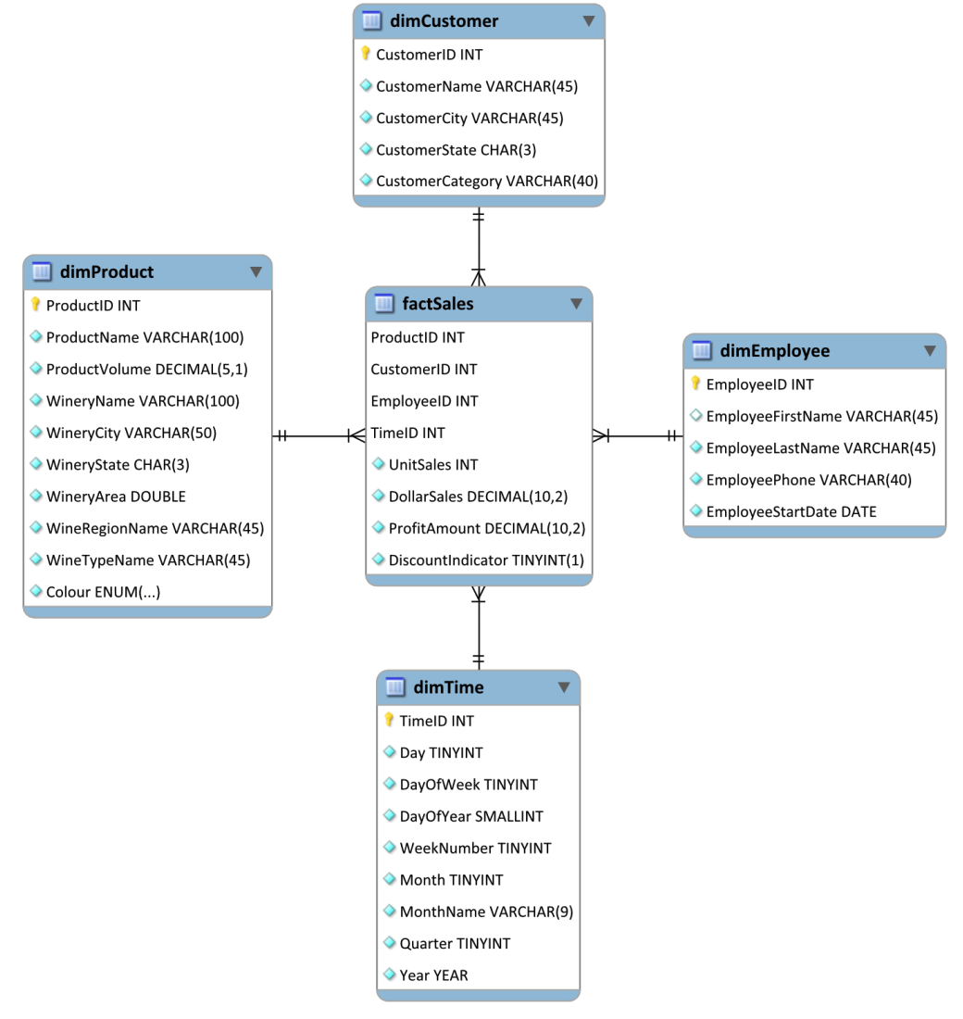
Design a dimensional model
1. Designing a dimensional model Exercise
Notes:
Today data is incorporated in our aspects of our lives. Just think of your daily actions… examples…
And on top of it there is this big business of extracting value from the data - call it business analytics, data driven decision making – anything you like, the point is to extract the hidden cold stored in this data
- Think of amazon recommended products, Netflix movies to watch.. All this is driven by your actions and the data you generate
Data exhaust
44 zb by 2020 digital universe
To put things in perspective 1 zb when it is burn on stack of cds it would be 4.1 million km high – which is high enough to reach from the earth to the moon and back 5 times

Slide 27
Design a dimensional model
Any questions?
Notes:
Today data is incorporated in our aspects of our lives. Just think of your daily actions… examples…
And on top of it there is this big business of extracting value from the data - call it business analytics, data driven decision making – anything you like, the point is to extract the hidden cold stored in this data
- Think of amazon recommended products, Netflix movies to watch.. All this is driven by your actions and the data you generate
Data exhaust
44 zb by 2020 digital universe
To put things in perspective 1 zb when it is burn on stack of cds it would be 4.1 million km high – which is high enough to reach from the earth to the moon and back 5 times

Slide 28
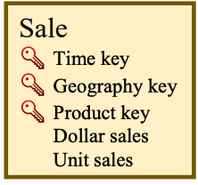
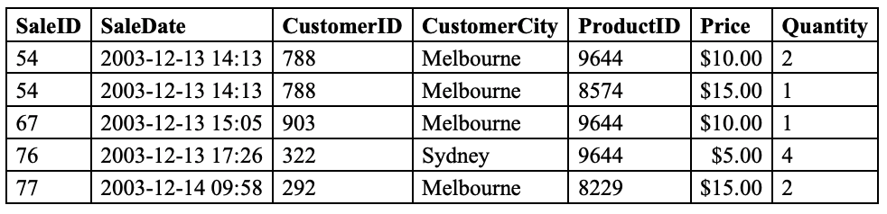
Discuss the impact of grain on fact tables
2. Fact tables in practice
Consider the following fact table:
Suppose the following sales data has been extracted from the business’s operational database:
Notes:
Today data is incorporated in our aspects of our lives. Just think of your daily actions… examples…
And on top of it there is this big business of extracting value from the data - call it business analytics, data driven decision making – anything you like, the point is to extract the hidden cold stored in this data
- Think of amazon recommended products, Netflix movies to watch.. All this is driven by your actions and the data you generate
Data exhaust
44 zb by 2020 digital universe
To put things in perspective 1 zb when it is burn on stack of cds it would be 4.1 million km high – which is high enough to reach from the earth to the moon and back 5 times

Slide 29
Discuss the impact of grain on fact tables
Fact tables in practice
a. Starting from this source data, how many rows will be inserted into the fact table if an hourly grain is selected?
Notes:
Today data is incorporated in our aspects of our lives. Just think of your daily actions… examples…
And on top of it there is this big business of extracting value from the data - call it business analytics, data driven decision making – anything you like, the point is to extract the hidden cold stored in this data
- Think of amazon recommended products, Netflix movies to watch.. All this is driven by your actions and the data you generate
Data exhaust
44 zb by 2020 digital universe
To put things in perspective 1 zb when it is burn on stack of cds it would be 4.1 million km high – which is high enough to reach from the earth to the moon and back 5 times

Slide 30
Discuss the impact of grain on fact tables
Fact tables in practice
a. Starting from this source data, how many rows will be inserted into the fact table if an hourly grain is selected?
None of these sale-item rows share the same hour, geography and product. No aggregation can be performed. Five rows will be inserted into the fact table.
Notes:
Today data is incorporated in our aspects of our lives. Just think of your daily actions… examples…
And on top of it there is this big business of extracting value from the data - call it business analytics, data driven decision making – anything you like, the point is to extract the hidden cold stored in this data
- Think of amazon recommended products, Netflix movies to watch.. All this is driven by your actions and the data you generate
Data exhaust
44 zb by 2020 digital universe
To put things in perspective 1 zb when it is burn on stack of cds it would be 4.1 million km high – which is high enough to reach from the earth to the moon and back 5 times

Slide 31
Discuss the impact of grain on fact tables
Fact tables in practice
b. How many rows will be inserted into the fact table if a daily grain is selected?
Notes:
Today data is incorporated in our aspects of our lives. Just think of your daily actions… examples…
And on top of it there is this big business of extracting value from the data - call it business analytics, data driven decision making – anything you like, the point is to extract the hidden cold stored in this data
- Think of amazon recommended products, Netflix movies to watch.. All this is driven by your actions and the data you generate
Data exhaust
44 zb by 2020 digital universe
To put things in perspective 1 zb when it is burn on stack of cds it would be 4.1 million km high – which is high enough to reach from the earth to the moon and back 5 times

Slide 32
Discuss the impact of grain on fact tables
Fact tables in practice
b. How many rows will be inserted into the fact table if a daily grain is selected?
The first sale-item of sale 54, and the sale-item of sale 67, took place on the same day and relate to the same product. These two rows will be aggregated into a single row in the fact table with Dollar Sales = $30.00 and Quantity = 3. In total, four rows will be inserted into the fact table.
While there are more products sold on that day, note that we cannot aggregate such records because they are:
for a different product (two sale-items of sale 54 for products 9644 and 8574), or
for a different region (sale 76 is for the Sydney region).
Notes:
Today data is incorporated in our aspects of our lives. Just think of your daily actions… examples…
And on top of it there is this big business of extracting value from the data - call it business analytics, data driven decision making – anything you like, the point is to extract the hidden cold stored in this data
- Think of amazon recommended products, Netflix movies to watch.. All this is driven by your actions and the data you generate
Data exhaust
44 zb by 2020 digital universe
To put things in perspective 1 zb when it is burn on stack of cds it would be 4.1 million km high – which is high enough to reach from the earth to the moon and back 5 times

Slide 33
Discuss the impact of grain on fact tables
Fact tables in practice
c. At which level of granularity can we answer questions about hourly sales? At which level of granularity can we answer questions about daily sales?
Notes:
Today data is incorporated in our aspects of our lives. Just think of your daily actions… examples…
And on top of it there is this big business of extracting value from the data - call it business analytics, data driven decision making – anything you like, the point is to extract the hidden cold stored in this data
- Think of amazon recommended products, Netflix movies to watch.. All this is driven by your actions and the data you generate
Data exhaust
44 zb by 2020 digital universe
To put things in perspective 1 zb when it is burn on stack of cds it would be 4.1 million km high – which is high enough to reach from the earth to the moon and back 5 times

Slide 34
Discuss the impact of grain on fact tables
Fact tables in practice
c. At which level of granularity can we answer questions about hourly sales? At which level of granularity can we answer questions about daily sales?
Information about the hour when a sale was made is not stored if a daily grain is used. Questions about hourly sales can only be answered when the grain is hourly (or finer).
We can answer questions about daily sales when the grain is daily. We can also answer these questions from an hourly-grain fact table – up to 24 hourly rows can be combined (aggregated) into a single daily row when the fact table is queried, using a GROUP BY clause.
Notes:
Today data is incorporated in our aspects of our lives. Just think of your daily actions… examples…
And on top of it there is this big business of extracting value from the data - call it business analytics, data driven decision making – anything you like, the point is to extract the hidden cold stored in this data
- Think of amazon recommended products, Netflix movies to watch.. All this is driven by your actions and the data you generate
Data exhaust
44 zb by 2020 digital universe
To put things in perspective 1 zb when it is burn on stack of cds it would be 4.1 million km high – which is high enough to reach from the earth to the moon and back 5 times

Slide 35
Discuss the impact of grain on fact tables
Any questions?
Notes:
Today data is incorporated in our aspects of our lives. Just think of your daily actions… examples…
And on top of it there is this big business of extracting value from the data - call it business analytics, data driven decision making – anything you like, the point is to extract the hidden cold stored in this data
- Think of amazon recommended products, Netflix movies to watch.. All this is driven by your actions and the data you generate
Data exhaust
44 zb by 2020 digital universe
To put things in perspective 1 zb when it is burn on stack of cds it would be 4.1 million km high – which is high enough to reach from the earth to the moon and back 5 times

