Slide 1
INFO20003 Database Systems
Kuoyuan Li
Week 3

Slide 2
Agenda Today
Entity-Relationship (ER) modelling review
Case study – based on previous week’s case study
Convert the conceptual model to a logical model

Slide 3
ER-modelling
Entity, weak entity, Attribute
Entities: real-world object or concept distinguishable from other objects or concepts
Concrete: student, book, person
Abstract: holiday, concept
Weak Entities: entities that require other entities to exist
example: a company insurance policy that insures an employee and any dependents
Attribute: characteristics representing an entity

Slide 4
ER-modelling
Business rules to relationships:
key constraints and participating constraints
Key constraints:
“upper bound” of the number of relationship that one entity could participant in
At most
Key symbol: arrow
One-to-one, One-to-many, Many-to-many

Slide 5
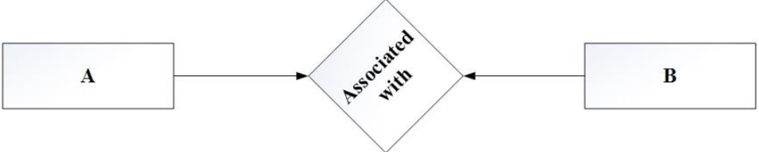
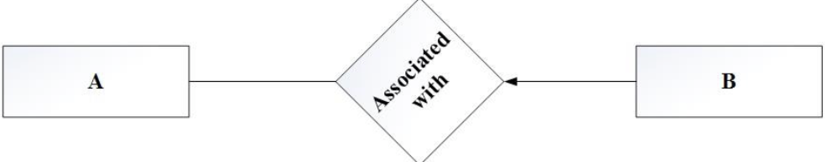
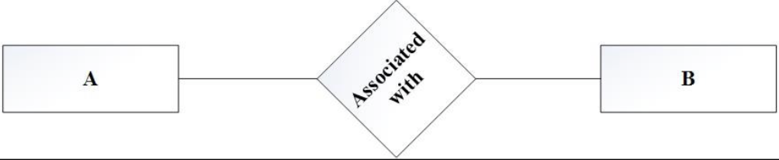
ER-modelling
Key constraints:
One-to-one
One-to-many
Many-to-many

Slide 6
ER-modelling
Business rules to relationships:
key constraints and participating constraints
Participating constraints:
“lower bound” of the number of relationship that one entity have to participant in
“At least”
Key symbol: bold/regular line
Total / Partial

Slide 7
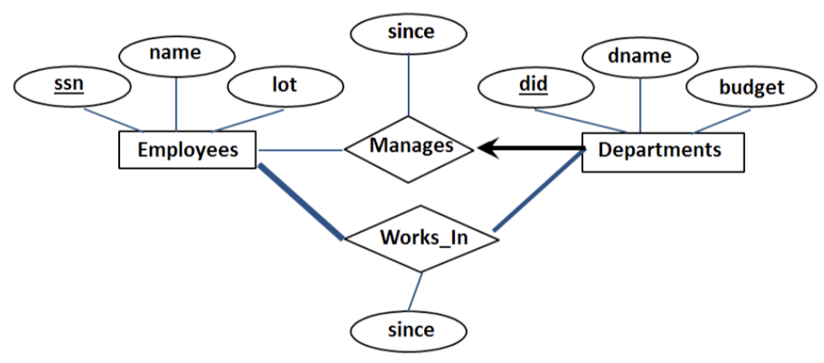
ER-modelling
Participating constraints:
Partial participation
Total participation

Slide 8
ER-modelling
Questions?

Slide 9
Case study
Group/Individual case study
I will randomly assign you to a breakout room
1. Already have a study group/Want to do it with a friend?
Choose the room where you friends in and jump into it
2. Don’t want be in a group for now?
Although I strongly encourage you to do it in a group, if you want to do it alone, you can come to the main room and mute yourself.

Slide 10
Case study
A cinema chain operates a number of cinemas. Each cinema has several screens, numbered starting from 1. The chain keeps track of the size (in feet) and seating capacity of every screen, as well as whether the screen offers the Gold Class experience.
The cinema chain owns hundreds of movie projectors – both film projectors (16 mm and 35 mm) and digital projectors (2D and 3D). The chain stores key information about each projector, namely its serial number, model number, resolution and hours of use. Each movie screen has space for a single projector; technicians must be able to identify which screen each projector is currently projecting onto.
A wide range of movies are shown at these cinemas. The system should keep track of the last time a movie was shown on a particular screen. The marketing department needs to know the movie’s title and year of release, along with the movie’s rating (G, PG, M, MA15+ or R18+).
Each cinema has a numeric ID, name and address. For cinemas that are not owned outright, the business also keeps track of yearly rent. The system needs to be able to generate weekly activity reports for the chain’s chief operating officer.

Slide 11
Case study
Revise last week’s identified entities.
• Cinema
• Screen • Projector
• Movie

Slide 12
Case study
b. Form relationships between entities.
“Each cinema has several screens”
→ screen is located in cinema
“Technicians must be able to identify which movie screen each projector is currently projecting onto”
→ projector projects onto movie screen
The system should keep track of the last time a movie was shown on a particular screen
→ screen shows movie
Note: Avoid using vague words like “has” to label your relationships.

Slide 13
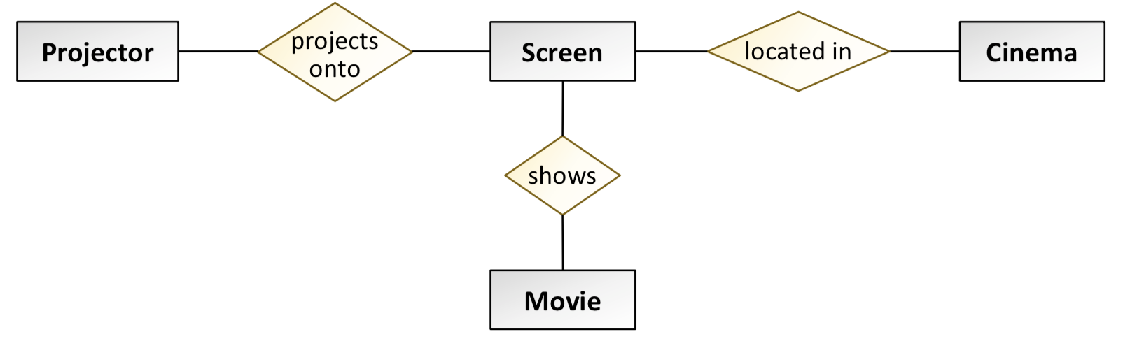
Case study
b. Form relationships between entities.
screen is located in cinema
projector projects onto movie screen
screen shows movie

Slide 14
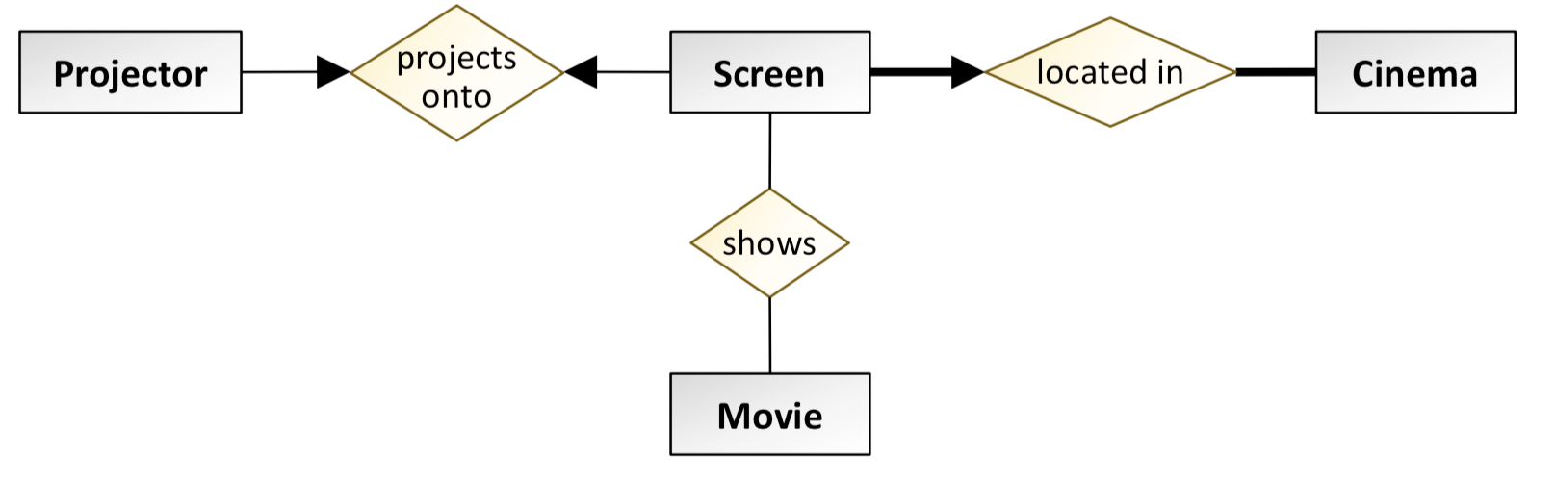
Case study
c. Apply constraints (key constraints and participation constraints) to the relationships

Slide 15
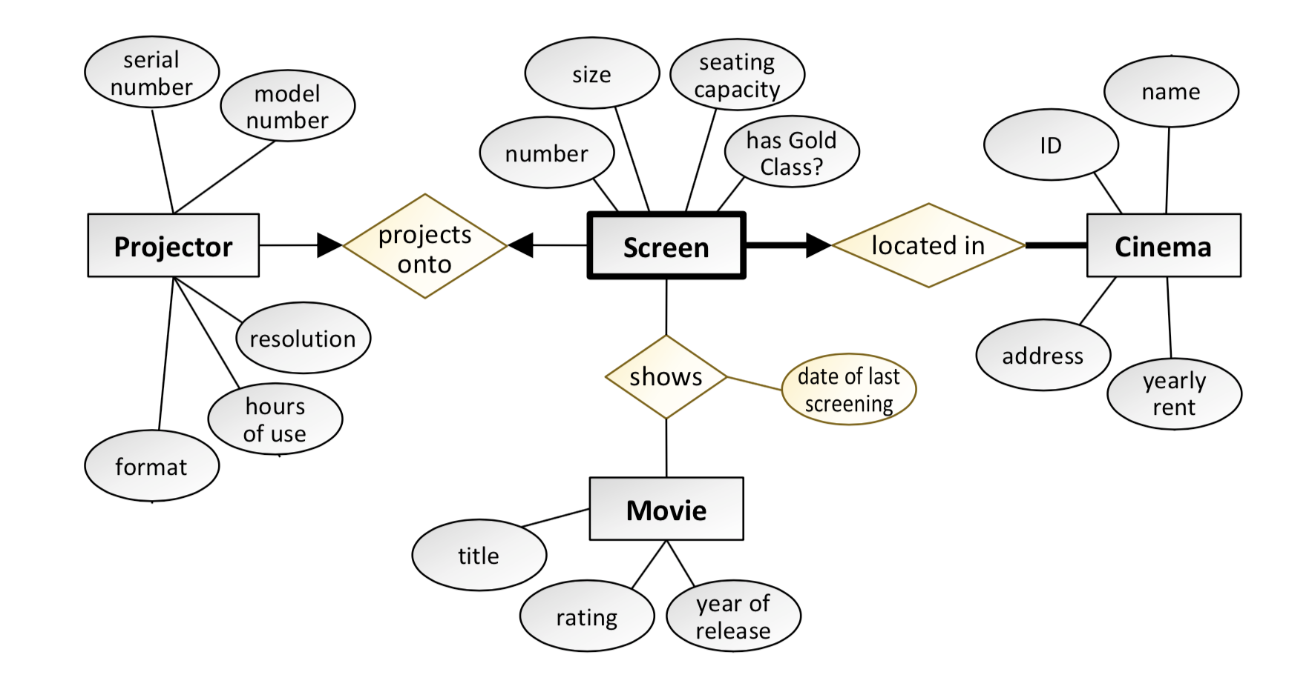
Case study
d. Add attributes which describe the entities and relationships.
Don’t forget to look for attributes for the relationships in your model, not just the entities!

Slide 16
Case study
e. Finalize your conceptual model by marking weak entities, identifying relationships and key attributes.
Business rules first, carefully consider all the entities with bold arrows coming out of them. Some of these could be weak entities

Slide 17
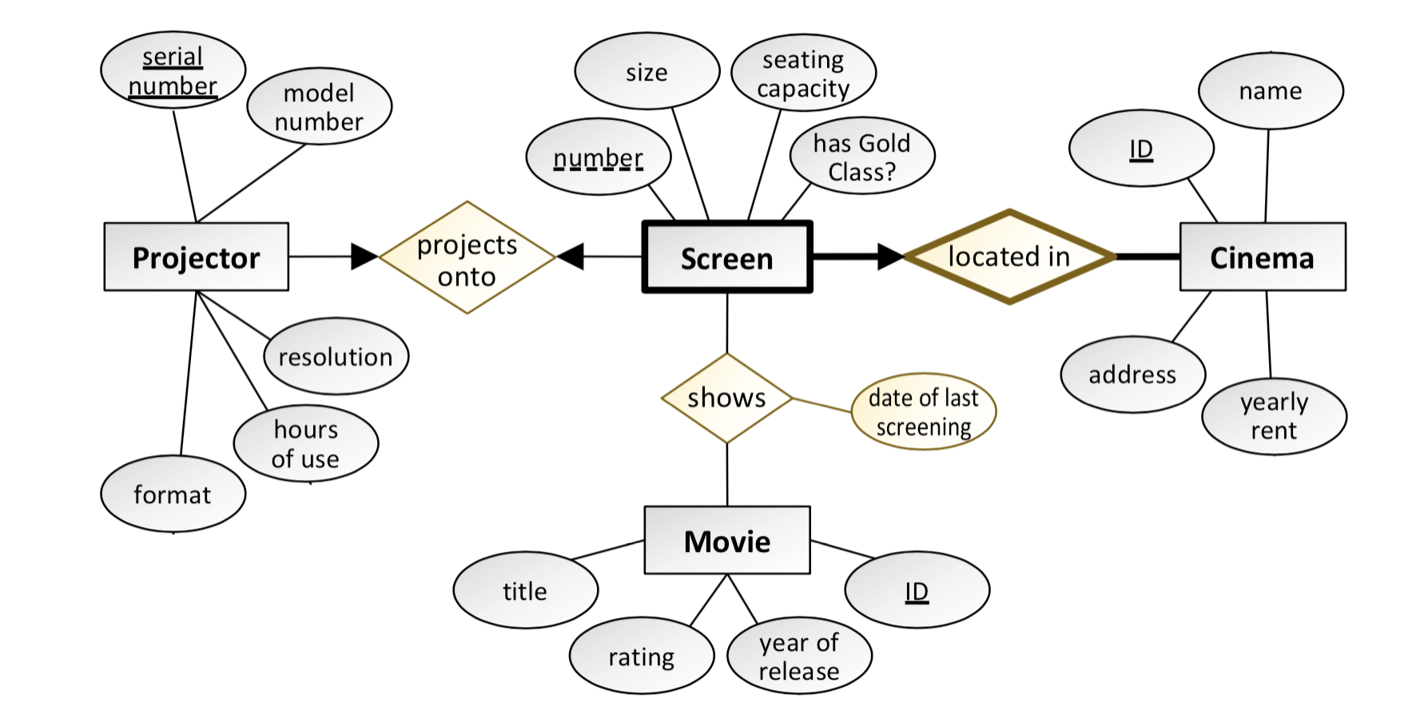
Case study
e. Finalize your conceptual model by marking weak entities, identifying relationships and key attributes.
Each weak entity must have at least one weak (identifying) relationship!

Slide 18
Logical and physical modeling
a. What needs to be changed to convert a conceptual design to a logical design? Develop a logical design for the above case study.
Resolve multivalued attributes by splitting them into separate tables.
Resolve composite attributes by redrawing the component parts as separate attributes.
Resolve relationships by adding foreign keys and associative entities to the model, and placing relationship attributes in the correct location.

Slide 19
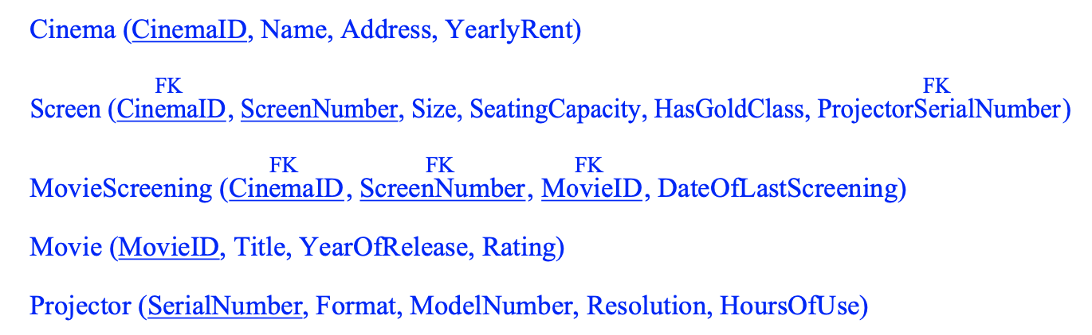
Logical and physical modeling
a. What needs to be changed to convert a conceptual design to a logical design? Develop a logical design for the above case study.

Slide 20
Logical and physical modeling
b. What will you change in the logical model to generate a physical model?
The main change is to go through every column and add a data type and NULL/NOT NULL constraint

Slide 21
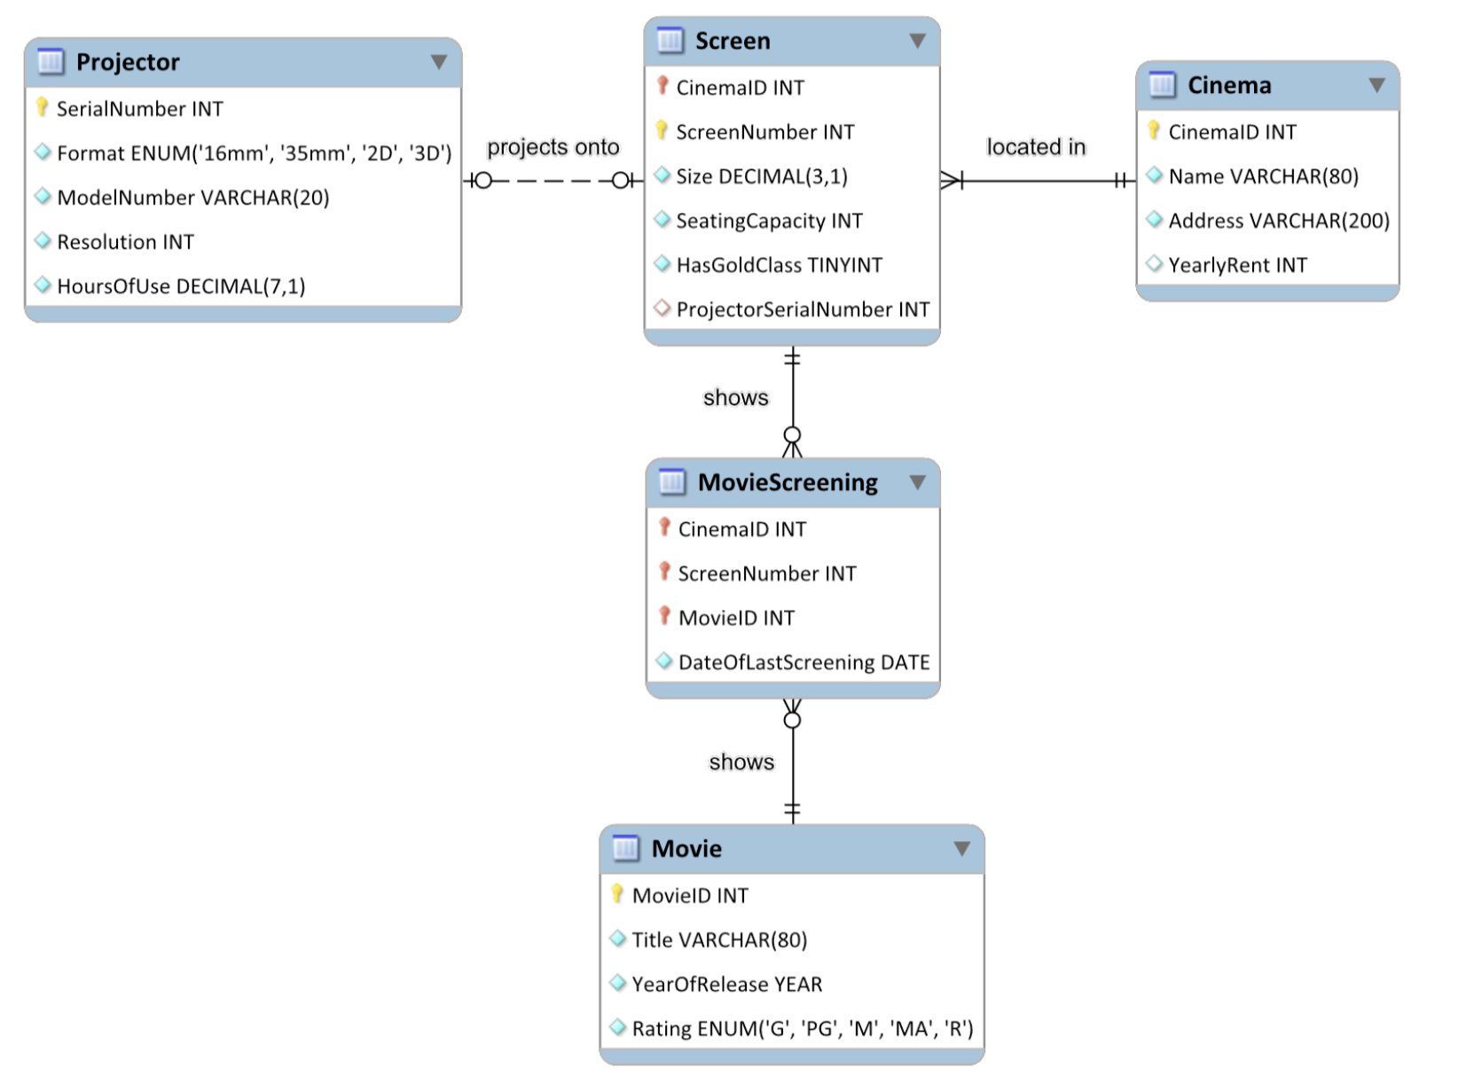
Logical and physical modeling
Using MySQL Workbench to draw a physical model for this case study.

Slide 22
Logical and physical modeling
Questions?

