Slide 1
INFO20003 Database Systems
Kuoyuan Li
Tutorial 9

Slide 2
Agenda
Review of normalization concepts
Normalisation exercises

Slide 3
Review of normalization concepts
1. Anomalies
What are them?
Why we need to identify anomalies and how to fix them?
Types of Anomalies:
Something wrong with the existing database
Like redundancy, error occurrence when manipulating data
Why? Make database more efficient and less error-prone
How: Normalization
1. update anomaly
2. deletion anomaly
3. insertion anomaly

Slide 4
Review of normalization concepts
1. Anomalies Types:
Update anomaly: Data inconsistency that results from data redundancy and partial update (one or more instances of duplicated data are updated but not all).
Deletion anomaly: unintentional loss of certain attribute values due to the deletion of other data for other attributes.
Insertion anomaly: the inability to add certain attributes to a database due to absence of other attributes.

Slide 5
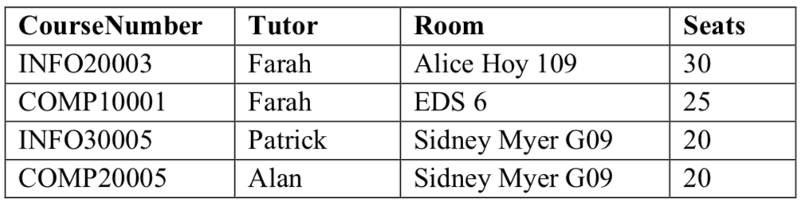
Review of normalization concepts
1. Anomalies Example:
Update anomaly: suppose the room Sidney Myer G09 has been improved, and there are now 30 seats. In this single entity, we will have to update all other rows where room = Sidney Myer G09.
Deletion anomaly: If we remove COMP10001 from the above table, the details of room EDS 6 are also deleted. Insertion anomaly: a new room “NewAlice109” has been built but has not yet been timetabled for any course or members of staff.

Slide 6

Review of normalization concepts
2. Functional dependency:
Occurs when a subset of R’s attributes {A1, A2, ..., An} determine attributes {B1, B2, ..., Bn}
If two records have the same A1, A2, ..., An then they have the same B1, B2, ..., Bn.
A relation R satisfies a functional dependency (FD) if and only if the FD is true for every instance of R.
Written as:
Notes:
Today data is incorporated in our aspects of our lives. Just think of your daily actions… examples…
And on top of it there is this big business of extracting value from the data - call it business analytics, data driven decision making – anything you like, the point is to extract the hidden cold stored in this data
- Think of amazon recommended products, Netflix movies to watch.. All this is driven by your actions and the data you generate
Data exhaust
44 zb by 2020 digital universe
To put things in perspective 1 zb when it is burn on stack of cds it would be 4.1 million km high – which is high enough to reach from the earth to the moon and back 5 times

Slide 7
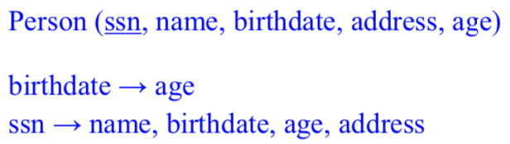
Review of normalization concepts
3. Functional dependency definitions: Determinants:
Attributes that determine the value of other attributes are called determinants
Example:
birthdate and ssn are determinants, as birthdate determines age and ssn determines the rest of the attributes.
Notes:
Today data is incorporated in our aspects of our lives. Just think of your daily actions… examples…
And on top of it there is this big business of extracting value from the data - call it business analytics, data driven decision making – anything you like, the point is to extract the hidden cold stored in this data
- Think of amazon recommended products, Netflix movies to watch.. All this is driven by your actions and the data you generate
Data exhaust
44 zb by 2020 digital universe
To put things in perspective 1 zb when it is burn on stack of cds it would be 4.1 million km high – which is high enough to reach from the earth to the moon and back 5 times

Slide 8
Review of normalization concepts
4. Key and non-key attributes:
A key is a set of attributes {A1, A2, ..., An} for a relation R
such that {A1, A2, ..., An} functionally determines all other attributes of R and no subset of {A1, A2, ..., An} functionally determines all other attributes of R. The key must be minimal.
Example:
Person (ssn, name, birthdate, address, age)
ssn is the minimal key of the Person relation
but {ssn, name} is not (it is a “super key”).
Notes:
Today data is incorporated in our aspects of our lives. Just think of your daily actions… examples…
And on top of it there is this big business of extracting value from the data - call it business analytics, data driven decision making – anything you like, the point is to extract the hidden cold stored in this data
- Think of amazon recommended products, Netflix movies to watch.. All this is driven by your actions and the data you generate
Data exhaust
44 zb by 2020 digital universe
To put things in perspective 1 zb when it is burn on stack of cds it would be 4.1 million km high – which is high enough to reach from the earth to the moon and back 5 times

Slide 9
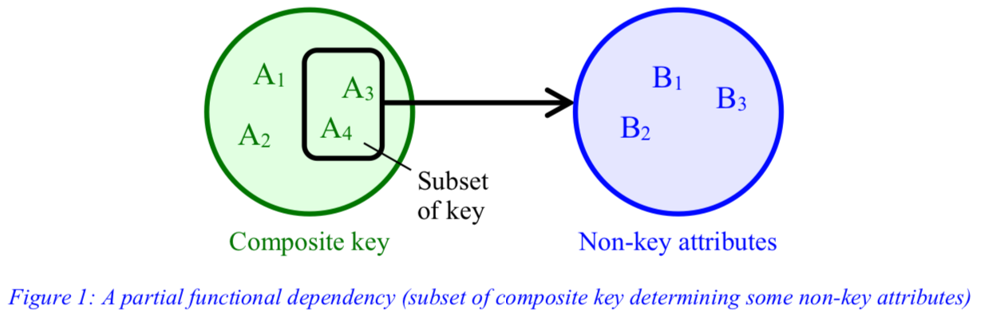
Review of normalization concepts
5. Partial functional dependency
Arises when one or more non-key attributes are functionally determined by a subset of the primary key.
Notes:
Today data is incorporated in our aspects of our lives. Just think of your daily actions… examples…
And on top of it there is this big business of extracting value from the data - call it business analytics, data driven decision making – anything you like, the point is to extract the hidden cold stored in this data
- Think of amazon recommended products, Netflix movies to watch.. All this is driven by your actions and the data you generate
Data exhaust
44 zb by 2020 digital universe
To put things in perspective 1 zb when it is burn on stack of cds it would be 4.1 million km high – which is high enough to reach from the earth to the moon and back 5 times

Slide 10
Review of normalization concepts
5. Partial functional dependency Examples:
R (A, B, C, D)
composite primary key: (A, D)
functional dependencies: A → B, D → C.
AD determines BC (AD → BC: AD can uniquely identify BC).
Functional dependencies like A → B and D → C are called partial functional dependencies.
Order (Order#, Item#, Desc, Qty)
Order# and Item# are the keys.
item description, Desc, can be determined by Item# alone (partial functional dependencies)
Notes:
Today data is incorporated in our aspects of our lives. Just think of your daily actions… examples…
And on top of it there is this big business of extracting value from the data - call it business analytics, data driven decision making – anything you like, the point is to extract the hidden cold stored in this data
- Think of amazon recommended products, Netflix movies to watch.. All this is driven by your actions and the data you generate
Data exhaust
44 zb by 2020 digital universe
To put things in perspective 1 zb when it is burn on stack of cds it would be 4.1 million km high – which is high enough to reach from the earth to the moon and back 5 times

Slide 11
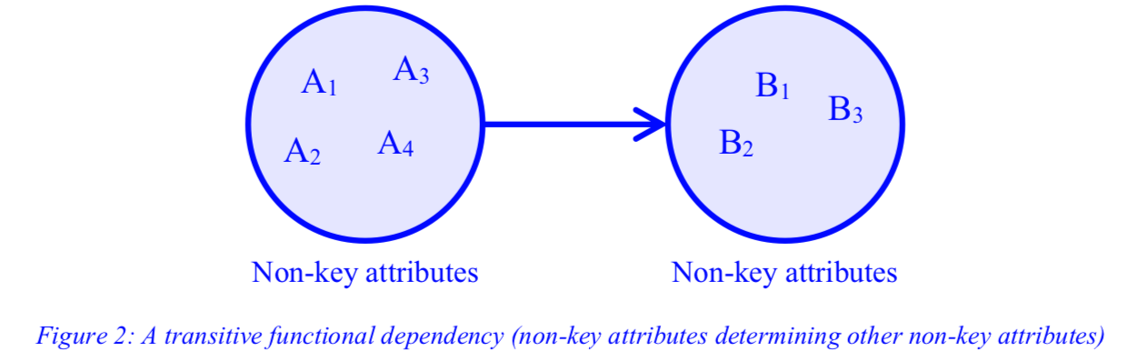
Review of normalization concepts
6. Transitive functional dependency
A non-key attribute is determined by another non-key attribute (or by a subset of PK and non-key attributes), such a dependency is called a transitive functional dependency.
Notes:
Today data is incorporated in our aspects of our lives. Just think of your daily actions… examples…
And on top of it there is this big business of extracting value from the data - call it business analytics, data driven decision making – anything you like, the point is to extract the hidden cold stored in this data
- Think of amazon recommended products, Netflix movies to watch.. All this is driven by your actions and the data you generate
Data exhaust
44 zb by 2020 digital universe
To put things in perspective 1 zb when it is burn on stack of cds it would be 4.1 million km high – which is high enough to reach from the earth to the moon and back 5 times

Slide 12
Review of normalization concepts
7. Armstrong’s Axioms
What is it used for?
Types:
Given a relation and a set of functional dependencies (FDs), we can discover new functional dependencies using some rules generally known as Armstrong’s Axioms.
Reflexivity (also known as “trivial FDs”)
Augmentation
Transitivity
Notes:
Today data is incorporated in our aspects of our lives. Just think of your daily actions… examples…
And on top of it there is this big business of extracting value from the data - call it business analytics, data driven decision making – anything you like, the point is to extract the hidden cold stored in this data
- Think of amazon recommended products, Netflix movies to watch.. All this is driven by your actions and the data you generate
Data exhaust
44 zb by 2020 digital universe
To put things in perspective 1 zb when it is burn on stack of cds it would be 4.1 million km high – which is high enough to reach from the earth to the moon and back 5 times

Slide 13


Review of normalization concepts
7. Armstrong’s Axioms
Reflexivity
R ( {A₁, A₂, ..., A_{n}} and {B₁, B₂, ..., B_{n}} ), B is a subset of A
Example: Person (ssn, name, birthdate, address, age)
ssn, name → name
Augmentation
Consider another subset of attributes {C₁, C₂, ..., C_{n}}
Example: Person (ssn, name, birthdate, address, age)
ssn, age → name, age
ssn→ name
Notes:
Today data is incorporated in our aspects of our lives. Just think of your daily actions… examples…
And on top of it there is this big business of extracting value from the data - call it business analytics, data driven decision making – anything you like, the point is to extract the hidden cold stored in this data
- Think of amazon recommended products, Netflix movies to watch.. All this is driven by your actions and the data you generate
Data exhaust
44 zb by 2020 digital universe
To put things in perspective 1 zb when it is burn on stack of cds it would be 4.1 million km high – which is high enough to reach from the earth to the moon and back 5 times

Slide 14

Review of normalization concepts
7. Armstrong’s Axioms
Transitivity
Example: Person (ssn, name, birthdate, address, age)
ssn → birthdate, birthdate → age ⟹ ssn → age
Notes:
Today data is incorporated in our aspects of our lives. Just think of your daily actions… examples…
And on top of it there is this big business of extracting value from the data - call it business analytics, data driven decision making – anything you like, the point is to extract the hidden cold stored in this data
- Think of amazon recommended products, Netflix movies to watch.. All this is driven by your actions and the data you generate
Data exhaust
44 zb by 2020 digital universe
To put things in perspective 1 zb when it is burn on stack of cds it would be 4.1 million km high – which is high enough to reach from the earth to the moon and back 5 times

Slide 15
Review of normalization concepts
8. Normalization and normal forms
Normalization: a technique used to iteratively improve relations to remove undesired redundancy by decomposing relations and eliminating anomalies.
Process is iterative
Process can be performed in stages generally referred to as Normal Forms.
Notes:
Today data is incorporated in our aspects of our lives. Just think of your daily actions… examples…
And on top of it there is this big business of extracting value from the data - call it business analytics, data driven decision making – anything you like, the point is to extract the hidden cold stored in this data
- Think of amazon recommended products, Netflix movies to watch.. All this is driven by your actions and the data you generate
Data exhaust
44 zb by 2020 digital universe
To put things in perspective 1 zb when it is burn on stack of cds it would be 4.1 million km high – which is high enough to reach from the earth to the moon and back 5 times

Slide 16
Review of normalization concepts
8. Normalization and normal forms
First Normal Form (1NF):the relation is analysed and all repeating groups are identified to be decomposed into new relations.
Second Normal Form (2NF) all the partial dependencies are resolved/removed.
Third Normal Form (3NF): all the transitive dependencies are removed.
Notes:
Today data is incorporated in our aspects of our lives. Just think of your daily actions… examples…
And on top of it there is this big business of extracting value from the data - call it business analytics, data driven decision making – anything you like, the point is to extract the hidden cold stored in this data
- Think of amazon recommended products, Netflix movies to watch.. All this is driven by your actions and the data you generate
Data exhaust
44 zb by 2020 digital universe
To put things in perspective 1 zb when it is burn on stack of cds it would be 4.1 million km high – which is high enough to reach from the earth to the moon and back 5 times

Slide 17
Review of normalization concepts
Any questions?
Notes:
Today data is incorporated in our aspects of our lives. Just think of your daily actions… examples…
And on top of it there is this big business of extracting value from the data - call it business analytics, data driven decision making – anything you like, the point is to extract the hidden cold stored in this data
- Think of amazon recommended products, Netflix movies to watch.. All this is driven by your actions and the data you generate
Data exhaust
44 zb by 2020 digital universe
To put things in perspective 1 zb when it is burn on stack of cds it would be 4.1 million km high – which is high enough to reach from the earth to the moon and back 5 times

Slide 18
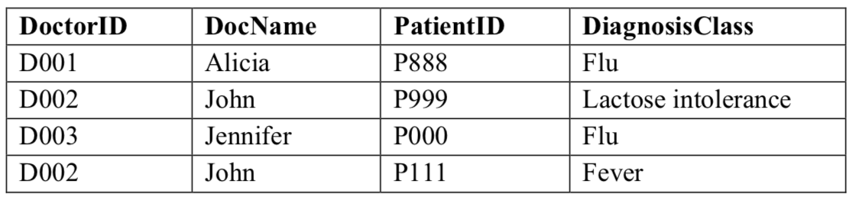
Normalisation exercises
1. Consider the relation Diagnosis with the schema
Diagnosis (DoctorID, DocName, PatientID, DiagnosisClass)
and the following functional dependencies: DoctorID → DocName DoctorID, PatientID → DiagnosisClass Consider the following instance of Diagnosis:
Identify different anomalies that can arise from this schema using the above instance.
Notes:
Today data is incorporated in our aspects of our lives. Just think of your daily actions… examples…
And on top of it there is this big business of extracting value from the data - call it business analytics, data driven decision making – anything you like, the point is to extract the hidden cold stored in this data
- Think of amazon recommended products, Netflix movies to watch.. All this is driven by your actions and the data you generate
Data exhaust
44 zb by 2020 digital universe
To put things in perspective 1 zb when it is burn on stack of cds it would be 4.1 million km high – which is high enough to reach from the earth to the moon and back 5 times

Slide 19
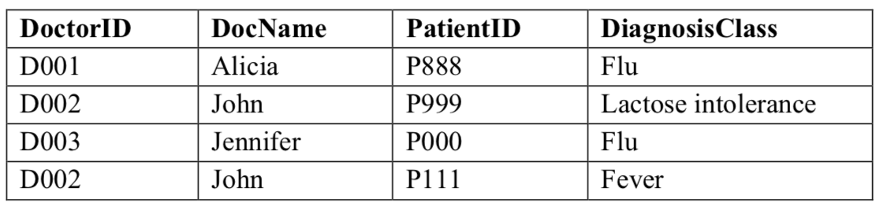
Normalisation exercises
Q1: What is the key for Diagnosis
Note: Key: Attribute(or a set of attributes)that is (are) sufficient to uniquely identify each record
Notes:
Today data is incorporated in our aspects of our lives. Just think of your daily actions… examples…
And on top of it there is this big business of extracting value from the data - call it business analytics, data driven decision making – anything you like, the point is to extract the hidden cold stored in this data
- Think of amazon recommended products, Netflix movies to watch.. All this is driven by your actions and the data you generate
Data exhaust
44 zb by 2020 digital universe
To put things in perspective 1 zb when it is burn on stack of cds it would be 4.1 million km high – which is high enough to reach from the earth to the moon and back 5 times

Slide 20
Normalisation exercises
Q1: What is the key for Diagnosis
(DoctorID, PatientID)
since together they are sufficient to uniquely identify each record
Note: In this example PatientID can uniquely identify each record(I think this is a bug by accident). We assume some patients may visit 2 doctors.
Notes:
Today data is incorporated in our aspects of our lives. Just think of your daily actions… examples…
And on top of it there is this big business of extracting value from the data - call it business analytics, data driven decision making – anything you like, the point is to extract the hidden cold stored in this data
- Think of amazon recommended products, Netflix movies to watch.. All this is driven by your actions and the data you generate
Data exhaust
44 zb by 2020 digital universe
To put things in perspective 1 zb when it is burn on stack of cds it would be 4.1 million km high – which is high enough to reach from the earth to the moon and back 5 times

Slide 21
Normalisation exercises
Q2: Does Insertion anomaly exist? What is it?(Give an example)
Notes:
Today data is incorporated in our aspects of our lives. Just think of your daily actions… examples…
And on top of it there is this big business of extracting value from the data - call it business analytics, data driven decision making – anything you like, the point is to extract the hidden cold stored in this data
- Think of amazon recommended products, Netflix movies to watch.. All this is driven by your actions and the data you generate
Data exhaust
44 zb by 2020 digital universe
To put things in perspective 1 zb when it is burn on stack of cds it would be 4.1 million km high – which is high enough to reach from the earth to the moon and back 5 times

Slide 22
Normalisation exercises
Q2: Does Insertion anomaly exist? What is it?
Yes.
Example:
Inserting data for a new doctor like DoctorID and DocName, we must insert data of at least one patient associated with the doctor.
Inability to insert records of particular fields is insertion anomaly.
Notes:
Today data is incorporated in our aspects of our lives. Just think of your daily actions… examples…
And on top of it there is this big business of extracting value from the data - call it business analytics, data driven decision making – anything you like, the point is to extract the hidden cold stored in this data
- Think of amazon recommended products, Netflix movies to watch.. All this is driven by your actions and the data you generate
Data exhaust
44 zb by 2020 digital universe
To put things in perspective 1 zb when it is burn on stack of cds it would be 4.1 million km high – which is high enough to reach from the earth to the moon and back 5 times

Slide 23
Normalisation exercises
Q3: Does Deletion anomaly exist? What is it?
Notes:
Today data is incorporated in our aspects of our lives. Just think of your daily actions… examples…
And on top of it there is this big business of extracting value from the data - call it business analytics, data driven decision making – anything you like, the point is to extract the hidden cold stored in this data
- Think of amazon recommended products, Netflix movies to watch.. All this is driven by your actions and the data you generate
Data exhaust
44 zb by 2020 digital universe
To put things in perspective 1 zb when it is burn on stack of cds it would be 4.1 million km high – which is high enough to reach from the earth to the moon and back 5 times

Slide 24
Normalisation exercises
Q3: Does Deletion anomaly exist? What is it?
Yes.
Example:
Deleting patient’s data can result in the loss of doctor’s data as well resulting in deletion anomaly.
If delete P888 data -> lose record for the doctor named Alicia
Notes:
Today data is incorporated in our aspects of our lives. Just think of your daily actions… examples…
And on top of it there is this big business of extracting value from the data - call it business analytics, data driven decision making – anything you like, the point is to extract the hidden cold stored in this data
- Think of amazon recommended products, Netflix movies to watch.. All this is driven by your actions and the data you generate
Data exhaust
44 zb by 2020 digital universe
To put things in perspective 1 zb when it is burn on stack of cds it would be 4.1 million km high – which is high enough to reach from the earth to the moon and back 5 times

Slide 25
Normalisation exercises
Q4: Does Update anomaly exist? What is it?
Notes:
Today data is incorporated in our aspects of our lives. Just think of your daily actions… examples…
And on top of it there is this big business of extracting value from the data - call it business analytics, data driven decision making – anything you like, the point is to extract the hidden cold stored in this data
- Think of amazon recommended products, Netflix movies to watch.. All this is driven by your actions and the data you generate
Data exhaust
44 zb by 2020 digital universe
To put things in perspective 1 zb when it is burn on stack of cds it would be 4.1 million km high – which is high enough to reach from the earth to the moon and back 5 times

Slide 26
Normalisation exercises
Q4: Does Update anomaly exist? What is it?
Yes.
Example:
One doctor may be associated with more than one patient.
An update anomaly may result if a doctor’s name is changed for only one patient.
If fail to change the doctor’s name from “John” to “John Miller” for both two records -> update anomaly.
Notes:
Today data is incorporated in our aspects of our lives. Just think of your daily actions… examples…
And on top of it there is this big business of extracting value from the data - call it business analytics, data driven decision making – anything you like, the point is to extract the hidden cold stored in this data
- Think of amazon recommended products, Netflix movies to watch.. All this is driven by your actions and the data you generate
Data exhaust
44 zb by 2020 digital universe
To put things in perspective 1 zb when it is burn on stack of cds it would be 4.1 million km high – which is high enough to reach from the earth to the moon and back 5 times

Slide 27
Normalisation exercises
2. Consider a relation R (A, B, C, D) with the following FDs: AB → C, AC → B, BC → A, B → D The possible candidate keys of R are AB, AC, and BC, since each of those combinations is sufficient to uniquely identify each record.
Let’s consider AB for instance. From AB → C we see that AB uniquely identifies C, and since B alone uniquely identifies D, AB together have covered CD, i.e. the entire set of attributes.
List all the functional dependencies that violate 3NF. If any, decompose R accordingly. After decomposition, check if the resulting relations are in 3NF, if not decompose further.
Notes:
Today data is incorporated in our aspects of our lives. Just think of your daily actions… examples…
And on top of it there is this big business of extracting value from the data - call it business analytics, data driven decision making – anything you like, the point is to extract the hidden cold stored in this data
- Think of amazon recommended products, Netflix movies to watch.. All this is driven by your actions and the data you generate
Data exhaust
44 zb by 2020 digital universe
To put things in perspective 1 zb when it is burn on stack of cds it would be 4.1 million km high – which is high enough to reach from the earth to the moon and back 5 times

Slide 28
Normalisation exercises
2. Consider a relation R (A, B, C, D) with the following FDs: AB → C, AC → B, BC → A, B → D
Notice: To be in 3NF, a relation should be in 2NF and all the transitive functional dependencies should be removed
Q1: Is This relation in 2NF?
Notes:
Today data is incorporated in our aspects of our lives. Just think of your daily actions… examples…
And on top of it there is this big business of extracting value from the data - call it business analytics, data driven decision making – anything you like, the point is to extract the hidden cold stored in this data
- Think of amazon recommended products, Netflix movies to watch.. All this is driven by your actions and the data you generate
Data exhaust
44 zb by 2020 digital universe
To put things in perspective 1 zb when it is burn on stack of cds it would be 4.1 million km high – which is high enough to reach from the earth to the moon and back 5 times

Slide 29
Normalisation exercises
2. Consider a relation R (A, B, C, D) with the following FDs: AB → C, AC → B, BC → A, B → D
Notice: To be in 3NF, a relation should be in 2NF and all the transitive functional dependencies should be removed
Q1: Is This relation in 2NF?
No.
partial functional dependency B → D
Notes:
Today data is incorporated in our aspects of our lives. Just think of your daily actions… examples…
And on top of it there is this big business of extracting value from the data - call it business analytics, data driven decision making – anything you like, the point is to extract the hidden cold stored in this data
- Think of amazon recommended products, Netflix movies to watch.. All this is driven by your actions and the data you generate
Data exhaust
44 zb by 2020 digital universe
To put things in perspective 1 zb when it is burn on stack of cds it would be 4.1 million km high – which is high enough to reach from the earth to the moon and back 5 times

Slide 30
Normalisation exercises
2. Consider a relation R (A, B, C, D) with the following FDs: AB → C, AC → B, BC → A, B → D
Notice: To be in 3NF, a relation should be in 2NF and all the transitive functional dependencies should be removed
Q1: Is This relation in 2NF?
No.
partial functional dependency B → D
Q2: How to decompose it?
Notes:
Today data is incorporated in our aspects of our lives. Just think of your daily actions… examples…
And on top of it there is this big business of extracting value from the data - call it business analytics, data driven decision making – anything you like, the point is to extract the hidden cold stored in this data
- Think of amazon recommended products, Netflix movies to watch.. All this is driven by your actions and the data you generate
Data exhaust
44 zb by 2020 digital universe
To put things in perspective 1 zb when it is burn on stack of cds it would be 4.1 million km high – which is high enough to reach from the earth to the moon and back 5 times

Slide 31
Normalisation exercises
2. Consider a relation R (A, B, C, D) with the following FDs: AB → C, AC → B, BC → A, B → D
Notice: To be in 3NF, a relation should be in 2NF and all the transitive functional dependencies should be removed
Q1: Is This relation in 2NF?
No.
partial functional dependency B → D
Q2: How to decompose it?
Another relation
R1 (A, B, C) and R2 (B, D). And this is in 3NF as well.
Notes:
Today data is incorporated in our aspects of our lives. Just think of your daily actions… examples…
And on top of it there is this big business of extracting value from the data - call it business analytics, data driven decision making – anything you like, the point is to extract the hidden cold stored in this data
- Think of amazon recommended products, Netflix movies to watch.. All this is driven by your actions and the data you generate
Data exhaust
44 zb by 2020 digital universe
To put things in perspective 1 zb when it is burn on stack of cds it would be 4.1 million km high – which is high enough to reach from the earth to the moon and back 5 times

Slide 32
Normalisation exercises
3. Consider the following relation StaffPropertyInspection:
StaffPropertyInspection (propertyNo, pAddress, iDate, iTime, comments, staffNo, sName)
The FDs stated below hold for this relation:
propertyNo, iDate → iTime, comments, staffNo, sName
propertyNo → pAddress staffNo → sName
From these FDs, it is safe to assume that propertyNo and iDate can serve as a primary key.
Your task is to normalise this relation to 3NF. Remember in order to achieve 3NF, you first need to achieve 1NF and 2NF.
Notes:
Today data is incorporated in our aspects of our lives. Just think of your daily actions… examples…
And on top of it there is this big business of extracting value from the data - call it business analytics, data driven decision making – anything you like, the point is to extract the hidden cold stored in this data
- Think of amazon recommended products, Netflix movies to watch.. All this is driven by your actions and the data you generate
Data exhaust
44 zb by 2020 digital universe
To put things in perspective 1 zb when it is burn on stack of cds it would be 4.1 million km high – which is high enough to reach from the earth to the moon and back 5 times

Slide 33
Normalisation exercises
3. Consider the following relation StaffPropertyInspection:
StaffPropertyInspection (propertyNo, pAddress, iDate, iTime, comments, staffNo, sName)
propertyNo, iDate → iTime, comments, staffNo, sName
propertyNo → pAddress staffNo → sName
Q1: Is this relation in 1NF (repeating groups)?
Notes:
Today data is incorporated in our aspects of our lives. Just think of your daily actions… examples…
And on top of it there is this big business of extracting value from the data - call it business analytics, data driven decision making – anything you like, the point is to extract the hidden cold stored in this data
- Think of amazon recommended products, Netflix movies to watch.. All this is driven by your actions and the data you generate
Data exhaust
44 zb by 2020 digital universe
To put things in perspective 1 zb when it is burn on stack of cds it would be 4.1 million km high – which is high enough to reach from the earth to the moon and back 5 times

Slide 34
Normalisation exercises
3. Consider the following relation StaffPropertyInspection:
StaffPropertyInspection (propertyNo, pAddress, iDate, iTime, comments, staffNo, sName)
propertyNo, iDate → iTime, comments, staffNo, sName
propertyNo → pAddress staffNo → sName
Q1: Is this relation in 1NF (repeating groups)?
Yes, no repeating groups
Notes:
Today data is incorporated in our aspects of our lives. Just think of your daily actions… examples…
And on top of it there is this big business of extracting value from the data - call it business analytics, data driven decision making – anything you like, the point is to extract the hidden cold stored in this data
- Think of amazon recommended products, Netflix movies to watch.. All this is driven by your actions and the data you generate
Data exhaust
44 zb by 2020 digital universe
To put things in perspective 1 zb when it is burn on stack of cds it would be 4.1 million km high – which is high enough to reach from the earth to the moon and back 5 times

Slide 35
Normalisation exercises
3. Consider the following relation StaffPropertyInspection:
StaffPropertyInspection (propertyNo, pAddress, iDate, iTime, comments, staffNo, sName)
propertyNo, iDate → iTime, comments, staffNo, sName
propertyNo → pAddress staffNo → sName
Q2: Is this relation in 2NF (no partial dependencies)?
Notes:
Today data is incorporated in our aspects of our lives. Just think of your daily actions… examples…
And on top of it there is this big business of extracting value from the data - call it business analytics, data driven decision making – anything you like, the point is to extract the hidden cold stored in this data
- Think of amazon recommended products, Netflix movies to watch.. All this is driven by your actions and the data you generate
Data exhaust
44 zb by 2020 digital universe
To put things in perspective 1 zb when it is burn on stack of cds it would be 4.1 million km high – which is high enough to reach from the earth to the moon and back 5 times

Slide 36
Normalisation exercises
3. Consider the following relation StaffPropertyInspection:
StaffPropertyInspection (propertyNo, pAddress, iDate, iTime, comments, staffNo, sName)
propertyNo, iDate → iTime, comments, staffNo, sName
propertyNo → pAddress staffNo → sName
Q2: Is this relation in 2NF (no partial dependencies)?
No. pAddress is determined by part of the key(propertyNo).
Notes:
Today data is incorporated in our aspects of our lives. Just think of your daily actions… examples…
And on top of it there is this big business of extracting value from the data - call it business analytics, data driven decision making – anything you like, the point is to extract the hidden cold stored in this data
- Think of amazon recommended products, Netflix movies to watch.. All this is driven by your actions and the data you generate
Data exhaust
44 zb by 2020 digital universe
To put things in perspective 1 zb when it is burn on stack of cds it would be 4.1 million km high – which is high enough to reach from the earth to the moon and back 5 times

Slide 37
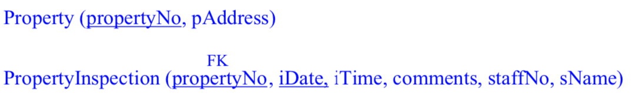
Normalisation exercises
3. Consider the following relation StaffPropertyInspection:
StaffPropertyInspection (propertyNo, pAddress, iDate, iTime, comments, staffNo, sName)
propertyNo, iDate → iTime, comments, staffNo, sName
propertyNo → pAddress staffNo → sName
Q2: Is this relation in 2NF (no partial dependencies)?
No. pAddress shows that pAddress is determined by part of the key.
It can be decomposed as:
Notes:
Today data is incorporated in our aspects of our lives. Just think of your daily actions… examples…
And on top of it there is this big business of extracting value from the data - call it business analytics, data driven decision making – anything you like, the point is to extract the hidden cold stored in this data
- Think of amazon recommended products, Netflix movies to watch.. All this is driven by your actions and the data you generate
Data exhaust
44 zb by 2020 digital universe
To put things in perspective 1 zb when it is burn on stack of cds it would be 4.1 million km high – which is high enough to reach from the earth to the moon and back 5 times

Slide 38
Normalisation exercises
3. Consider the following relation StaffPropertyInspection:
StaffPropertyInspection (propertyNo, pAddress, iDate, iTime, comments, staffNo, sName)
propertyNo, iDate → iTime, comments, staffNo, sName
propertyNo → pAddress staffNo → sName
Q3: Is this relation in 3NF (transitive dependencies)?
Notes:
Today data is incorporated in our aspects of our lives. Just think of your daily actions… examples…
And on top of it there is this big business of extracting value from the data - call it business analytics, data driven decision making – anything you like, the point is to extract the hidden cold stored in this data
- Think of amazon recommended products, Netflix movies to watch.. All this is driven by your actions and the data you generate
Data exhaust
44 zb by 2020 digital universe
To put things in perspective 1 zb when it is burn on stack of cds it would be 4.1 million km high – which is high enough to reach from the earth to the moon and back 5 times

Slide 39
Normalisation exercises
3. Consider the following relation StaffPropertyInspection:
StaffPropertyInspection (propertyNo, pAddress, iDate, iTime, comments, staffNo, sName)
propertyNo, iDate → iTime, comments, staffNo, sName
propertyNo → pAddress staffNo → sName
Q3: Is this relation in 3NF (transitive dependencies)?
No
staffNo → sName
Notes:
Today data is incorporated in our aspects of our lives. Just think of your daily actions… examples…
And on top of it there is this big business of extracting value from the data - call it business analytics, data driven decision making – anything you like, the point is to extract the hidden cold stored in this data
- Think of amazon recommended products, Netflix movies to watch.. All this is driven by your actions and the data you generate
Data exhaust
44 zb by 2020 digital universe
To put things in perspective 1 zb when it is burn on stack of cds it would be 4.1 million km high – which is high enough to reach from the earth to the moon and back 5 times

Slide 40
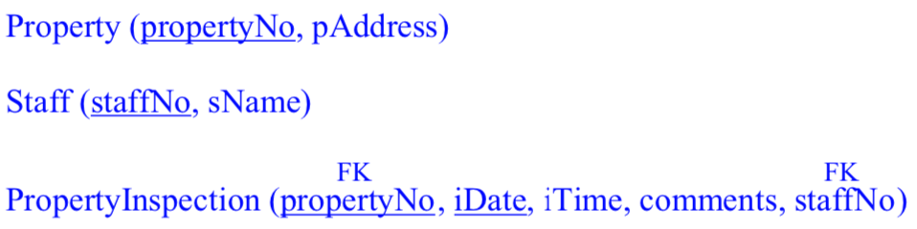
Normalisation exercises
3. Consider the following relation StaffPropertyInspection:
StaffPropertyInspection (propertyNo, pAddress, iDate, iTime, comments, staffNo, sName)
propertyNo, iDate → iTime, comments, staffNo, sName
propertyNo → pAddress staffNo → sName
A3: Decompose into 3 relations:
Notes:
Today data is incorporated in our aspects of our lives. Just think of your daily actions… examples…
And on top of it there is this big business of extracting value from the data - call it business analytics, data driven decision making – anything you like, the point is to extract the hidden cold stored in this data
- Think of amazon recommended products, Netflix movies to watch.. All this is driven by your actions and the data you generate
Data exhaust
44 zb by 2020 digital universe
To put things in perspective 1 zb when it is burn on stack of cds it would be 4.1 million km high – which is high enough to reach from the earth to the moon and back 5 times

Slide 41
Normalisation exercises
Any questions?
Notes:
Today data is incorporated in our aspects of our lives. Just think of your daily actions… examples…
And on top of it there is this big business of extracting value from the data - call it business analytics, data driven decision making – anything you like, the point is to extract the hidden cold stored in this data
- Think of amazon recommended products, Netflix movies to watch.. All this is driven by your actions and the data you generate
Data exhaust
44 zb by 2020 digital universe
To put things in perspective 1 zb when it is burn on stack of cds it would be 4.1 million km high – which is high enough to reach from the earth to the moon and back 5 times

Slide 42
Break
Break - 5min
Notes:
Today data is incorporated in our aspects of our lives. Just think of your daily actions… examples…
And on top of it there is this big business of extracting value from the data - call it business analytics, data driven decision making – anything you like, the point is to extract the hidden cold stored in this data
- Think of amazon recommended products, Netflix movies to watch.. All this is driven by your actions and the data you generate
Data exhaust
44 zb by 2020 digital universe
To put things in perspective 1 zb when it is burn on stack of cds it would be 4.1 million km high – which is high enough to reach from the earth to the moon and back 5 times

Slide 43
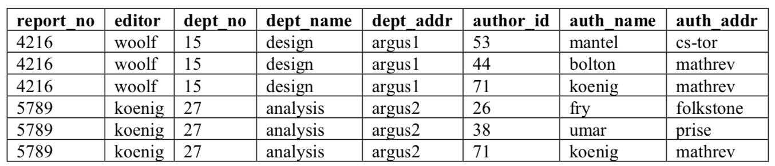
Normalisation exercises
4. The following Report table is used by a publishing house to keep track of the editing and design of books by a number of authors:
Functional dependencies:
report_no → editor, dept_no dept_no → dept_name, dept_addr
author_id → auth_name, author_addr
candidate key: (report_no, author_id)
Report (report_no, editor, dept_no, dept_name, dept_addr, author_id, auth_name, auth_addr)
Notes:
Today data is incorporated in our aspects of our lives. Just think of your daily actions… examples…
And on top of it there is this big business of extracting value from the data - call it business analytics, data driven decision making – anything you like, the point is to extract the hidden cold stored in this data
- Think of amazon recommended products, Netflix movies to watch.. All this is driven by your actions and the data you generate
Data exhaust
44 zb by 2020 digital universe
To put things in perspective 1 zb when it is burn on stack of cds it would be 4.1 million km high – which is high enough to reach from the earth to the moon and back 5 times

Slide 44
Normalisation exercises
4.
report_no → editor, dept_no dept_no → dept_name, dept_addr
author_id → auth_name, author_addr
Report (report_no, editor, dept_no, dept_name, dept_addr, author_id, auth_name, auth_addr)
Q1: Is the Report table in 1NF? If not, put the table in 1NF.
A1: Yes
Notes:
Today data is incorporated in our aspects of our lives. Just think of your daily actions… examples…
And on top of it there is this big business of extracting value from the data - call it business analytics, data driven decision making – anything you like, the point is to extract the hidden cold stored in this data
- Think of amazon recommended products, Netflix movies to watch.. All this is driven by your actions and the data you generate
Data exhaust
44 zb by 2020 digital universe
To put things in perspective 1 zb when it is burn on stack of cds it would be 4.1 million km high – which is high enough to reach from the earth to the moon and back 5 times

Slide 45
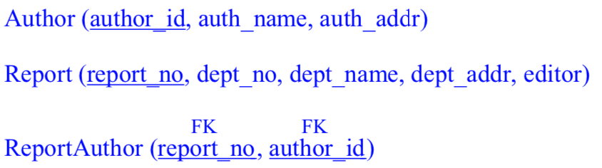
Normalisation exercises
4.
report_no → editor, dept_no dept_no → dept_name, dept_addr
author_id → auth_name, author_addr
Report (report_no, editor, dept_no, dept_name, dept_addr, author_id, auth_name, auth_addr)
Q2: Is the Report table in 2NF? If not, put the table in 2NF.
A2: No
Notes:
Today data is incorporated in our aspects of our lives. Just think of your daily actions… examples…
And on top of it there is this big business of extracting value from the data - call it business analytics, data driven decision making – anything you like, the point is to extract the hidden cold stored in this data
- Think of amazon recommended products, Netflix movies to watch.. All this is driven by your actions and the data you generate
Data exhaust
44 zb by 2020 digital universe
To put things in perspective 1 zb when it is burn on stack of cds it would be 4.1 million km high – which is high enough to reach from the earth to the moon and back 5 times

Slide 46
Normalisation exercises
4.
Q3: Are there any insert, update or delete anomalies with these 2NF relations?
A3: Yes, because of the transitive dependency
Delete a record from the report table might delete the information about a department. We can’t insert a new department until we have a report for it, etc.
Solution: normalize to 3NF
Notes:
Today data is incorporated in our aspects of our lives. Just think of your daily actions… examples…
And on top of it there is this big business of extracting value from the data - call it business analytics, data driven decision making – anything you like, the point is to extract the hidden cold stored in this data
- Think of amazon recommended products, Netflix movies to watch.. All this is driven by your actions and the data you generate
Data exhaust
44 zb by 2020 digital universe
To put things in perspective 1 zb when it is burn on stack of cds it would be 4.1 million km high – which is high enough to reach from the earth to the moon and back 5 times

Slide 47
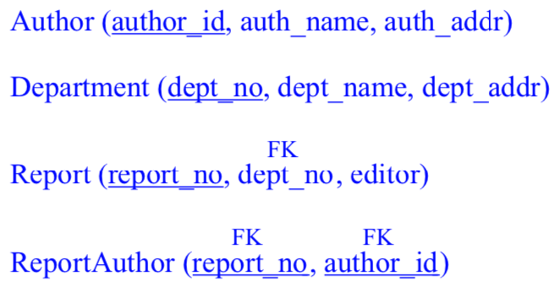
Normalisation exercises
4.
Notes:
Today data is incorporated in our aspects of our lives. Just think of your daily actions… examples…
And on top of it there is this big business of extracting value from the data - call it business analytics, data driven decision making – anything you like, the point is to extract the hidden cold stored in this data
- Think of amazon recommended products, Netflix movies to watch.. All this is driven by your actions and the data you generate
Data exhaust
44 zb by 2020 digital universe
To put things in perspective 1 zb when it is burn on stack of cds it would be 4.1 million km high – which is high enough to reach from the earth to the moon and back 5 times

Slide 48
Normalisation exercises
5. Consider the following relation:
Class (courseNumber, roomNumber, instructorName, studentNumber, workshopNumber, grade, tutor)
The following functional dependencies hold for this relation:
workshopNumber → tutor
studentNumber, courseNumber → grade, workshopNumber
courseNumber → roomNumber, instructorName
Normalise this relation into 3NF.
Notes:
Today data is incorporated in our aspects of our lives. Just think of your daily actions… examples…
And on top of it there is this big business of extracting value from the data - call it business analytics, data driven decision making – anything you like, the point is to extract the hidden cold stored in this data
- Think of amazon recommended products, Netflix movies to watch.. All this is driven by your actions and the data you generate
Data exhaust
44 zb by 2020 digital universe
To put things in perspective 1 zb when it is burn on stack of cds it would be 4.1 million km high – which is high enough to reach from the earth to the moon and back 5 times

Slide 49
Normalisation exercises
5.
Class (courseNumber, roomNumber, instructorName, studentNumber, workshopNumber, grade, tutor)
workshopNumber → tutor
studentNumber, courseNumber → grade, workshopNumber
courseNumber → roomNumber, instructorName
Q1: Is it in 1NF?
A1: Yes
Notes:
Today data is incorporated in our aspects of our lives. Just think of your daily actions… examples…
And on top of it there is this big business of extracting value from the data - call it business analytics, data driven decision making – anything you like, the point is to extract the hidden cold stored in this data
- Think of amazon recommended products, Netflix movies to watch.. All this is driven by your actions and the data you generate
Data exhaust
44 zb by 2020 digital universe
To put things in perspective 1 zb when it is burn on stack of cds it would be 4.1 million km high – which is high enough to reach from the earth to the moon and back 5 times

Slide 50
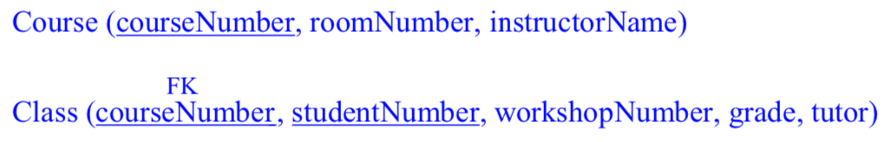
Normalisation exercises
5.
Class (courseNumber, roomNumber, instructorName, studentNumber, workshopNumber, grade, tutor)
workshopNumber → tutor
studentNumber, courseNumber → grade, workshopNumber
courseNumber → roomNumber, instructorName
Q2: Is it in 2NF?
A2: No
Notes:
Today data is incorporated in our aspects of our lives. Just think of your daily actions… examples…
And on top of it there is this big business of extracting value from the data - call it business analytics, data driven decision making – anything you like, the point is to extract the hidden cold stored in this data
- Think of amazon recommended products, Netflix movies to watch.. All this is driven by your actions and the data you generate
Data exhaust
44 zb by 2020 digital universe
To put things in perspective 1 zb when it is burn on stack of cds it would be 4.1 million km high – which is high enough to reach from the earth to the moon and back 5 times

Slide 51
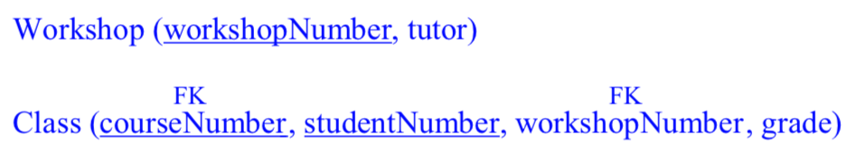
Normalisation exercises
5.
Class (courseNumber, roomNumber, instructorName, studentNumber, workshopNumber, grade, tutor)
workshopNumber → tutor
studentNumber, courseNumber → grade, workshopNumber
courseNumber → roomNumber, instructorName
Q3: Is it in 3NF?
A3: No
Notes:
Today data is incorporated in our aspects of our lives. Just think of your daily actions… examples…
And on top of it there is this big business of extracting value from the data - call it business analytics, data driven decision making – anything you like, the point is to extract the hidden cold stored in this data
- Think of amazon recommended products, Netflix movies to watch.. All this is driven by your actions and the data you generate
Data exhaust
44 zb by 2020 digital universe
To put things in perspective 1 zb when it is burn on stack of cds it would be 4.1 million km high – which is high enough to reach from the earth to the moon and back 5 times

Slide 52
Normalisation exercises
Any questions?
Notes:
Today data is incorporated in our aspects of our lives. Just think of your daily actions… examples…
And on top of it there is this big business of extracting value from the data - call it business analytics, data driven decision making – anything you like, the point is to extract the hidden cold stored in this data
- Think of amazon recommended products, Netflix movies to watch.. All this is driven by your actions and the data you generate
Data exhaust
44 zb by 2020 digital universe
To put things in perspective 1 zb when it is burn on stack of cds it would be 4.1 million km high – which is high enough to reach from the earth to the moon and back 5 times

Slide 53
Lab Time
No Lab Today!
Let me know if you encounter with
any problem
Notes:
What does this data growth imply? It implies that finding useful information is equal to….

