Slide 1
INFO20003 Database Systems
Kuoyuan Li
Tutorial 10

Slide 2
Agenda
Review capacity planning concepts
Apply capacity planning concepts
Review of backup & recovery concepts
Apply backup & recovery concepts to case studies
Review transactions concept
Apply transactions concepts
Notes:
What does this data growth imply? It implies that finding useful information is equal to….

Slide 3
Capacity Planning
Capacity Planning: the process of predicting when future load levels will saturate the system and determining the most cost-effective way of delaying system saturation as much as possible.
To calculate database size:
Treat database size as the sum of all table sizes
Each table size = number of rows * average row width
Consider the growth of some tables
Notes:
Planning for Day 1 and Day 10001 Average lifespan is 5-7 years but can last for 20 years
Data is stored on disc. OLTP (Operational Systems – sales, inventory, marketing, warehouse distribution)
Transaction throughput: db server is hit by sql queries at some rate and you need to predicate and monitor what that transaction load is
And whether your server can cope with it.

Slide 4
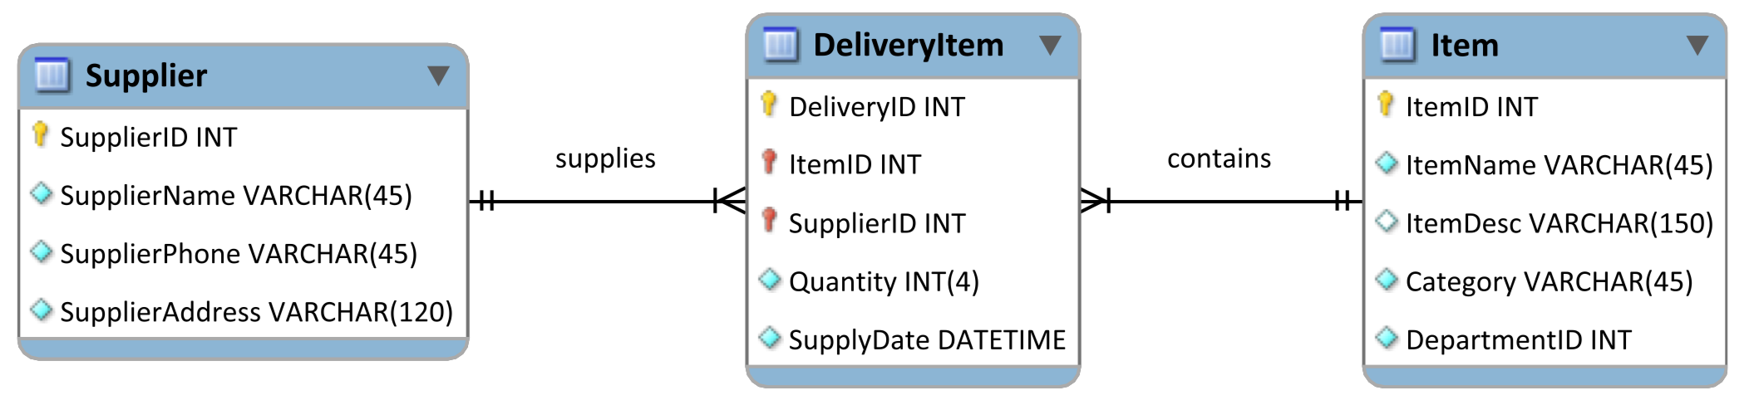
Apply capacity planning concepts
1. Exercise
50 distinct suppliers that provide 2000 distinct items. The average delivery is of 40 distinct items and each supplier delivers approximately once a week (this to be 50 deliveries a year). For each delivery, there are on average 40 rows added to the DeliveryItem table. While the Item and Supplier tables stay constant in size, the DeliveryItem table grows by 100,000 rows every year.
(100,000 = 50*50*40)
This assumes that suppliers and items stay constant; however, if the business is successful, the suppliers and frequency of deliveries and number of distinct items delivered can be expected to grow. If we know the length of each row, we can estimate how big each table will be year by year.
Notes:
Today data is incorporated in our aspects of our lives. Just think of your daily actions… examples…
And on top of it there is this big business of extracting value from the data - call it business analytics, data driven decision making – anything you like, the point is to extract the hidden cold stored in this data
- Think of amazon recommended products, Netflix movies to watch.. All this is driven by your actions and the data you generate
Data exhaust
44 zb by 2020 digital universe
To put things in perspective 1 zb when it is burn on stack of cds it would be 4.1 million km high – which is high enough to reach from the earth to the moon and back 5 times

Slide 5
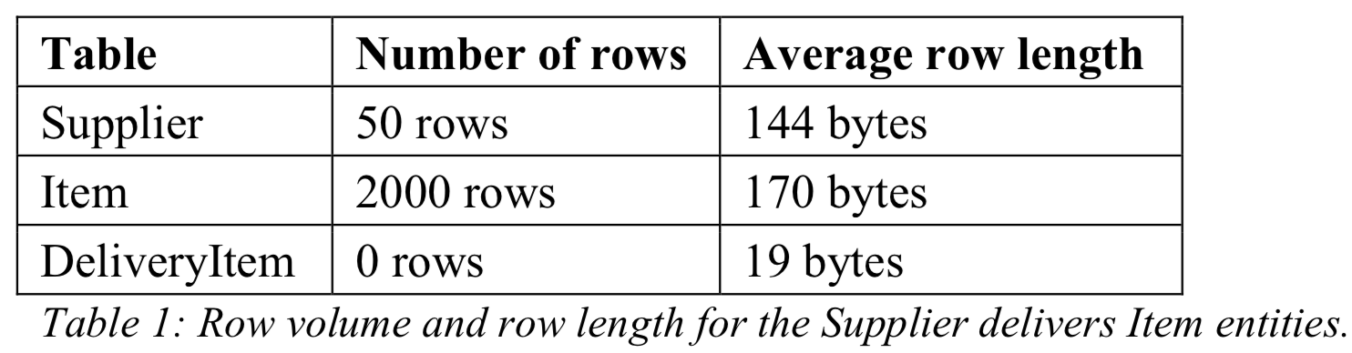
Apply capacity planning concepts
1. Exercise
Using the MySQL information about data type storage and information from the data dictionary, the analyst has determined the following average row lengths of each table:
Note: only DeliveryItem grow: 100,000 rows / year
Assume that the number of suppliers and number of items do not change from year to year, and that the delivery schedule remains the same. Calculate the size of the three tables:
Notes:
Today data is incorporated in our aspects of our lives. Just think of your daily actions… examples…
And on top of it there is this big business of extracting value from the data - call it business analytics, data driven decision making – anything you like, the point is to extract the hidden cold stored in this data
- Think of amazon recommended products, Netflix movies to watch.. All this is driven by your actions and the data you generate
Data exhaust
44 zb by 2020 digital universe
To put things in perspective 1 zb when it is burn on stack of cds it would be 4.1 million km high – which is high enough to reach from the earth to the moon and back 5 times

Slide 6
Apply capacity planning concepts
1. Exercise
Note: only DeliveryItem grow: 100,000 rows / year
a. When database use begins (year 0)
Notes:
Today data is incorporated in our aspects of our lives. Just think of your daily actions… examples…
And on top of it there is this big business of extracting value from the data - call it business analytics, data driven decision making – anything you like, the point is to extract the hidden cold stored in this data
- Think of amazon recommended products, Netflix movies to watch.. All this is driven by your actions and the data you generate
Data exhaust
44 zb by 2020 digital universe
To put things in perspective 1 zb when it is burn on stack of cds it would be 4.1 million km high – which is high enough to reach from the earth to the moon and back 5 times

Slide 7
Apply capacity planning concepts
1. Exercise
Note: only DeliveryItem grow: 100,000 rows / year
a. When database use begins (year 0)
Size(R) = # initial rows × avg length of row
Supplier = 50 × 144 bytes = 7200 bytes (approx. 7 KB
– Note: 1 KB = 1024 bytes)
Item = 2000 × 170 bytes = 340,000 bytes (approx. 332 KB)
DeliveryItem = 0 × 19 bytes = 0 bytes
Notes:
Today data is incorporated in our aspects of our lives. Just think of your daily actions… examples…
And on top of it there is this big business of extracting value from the data - call it business analytics, data driven decision making – anything you like, the point is to extract the hidden cold stored in this data
- Think of amazon recommended products, Netflix movies to watch.. All this is driven by your actions and the data you generate
Data exhaust
44 zb by 2020 digital universe
To put things in perspective 1 zb when it is burn on stack of cds it would be 4.1 million km high – which is high enough to reach from the earth to the moon and back 5 times

Slide 8
Apply capacity planning concepts
1. Exercise
Note: only Deliver grow: 100,000 rows / year
b. After one year of database use:
Notes:
Today data is incorporated in our aspects of our lives. Just think of your daily actions… examples…
And on top of it there is this big business of extracting value from the data - call it business analytics, data driven decision making – anything you like, the point is to extract the hidden cold stored in this data
- Think of amazon recommended products, Netflix movies to watch.. All this is driven by your actions and the data you generate
Data exhaust
44 zb by 2020 digital universe
To put things in perspective 1 zb when it is burn on stack of cds it would be 4.1 million km high – which is high enough to reach from the earth to the moon and back 5 times

Slide 9
Apply capacity planning concepts
1. Exercise
Note: only Deliver grow: 100,000 rows / year
b. After one year of database use:
Size(R) = initial size + grow speed × time × avg length of row
DeliveryItem = 0 + 100,000 × 1 × 19 bytes = 1,900,000 bytes
(approx. 1.8 MB – Note: 1 MB = 1024 KB = 1,048,576 bytes)
Supplier = 7200 + 0 bytes = 7 KB unchanged
Item = 340,000 + 0 bytes = 332 KB unchanged
Notes:
Today data is incorporated in our aspects of our lives. Just think of your daily actions… examples…
And on top of it there is this big business of extracting value from the data - call it business analytics, data driven decision making – anything you like, the point is to extract the hidden cold stored in this data
- Think of amazon recommended products, Netflix movies to watch.. All this is driven by your actions and the data you generate
Data exhaust
44 zb by 2020 digital universe
To put things in perspective 1 zb when it is burn on stack of cds it would be 4.1 million km high – which is high enough to reach from the earth to the moon and back 5 times

Slide 10
Apply capacity planning concepts
1. Exercise
Note: only Deliver grow: 100,000 rows / year
c. After five years of database use:
Notes:
Today data is incorporated in our aspects of our lives. Just think of your daily actions… examples…
And on top of it there is this big business of extracting value from the data - call it business analytics, data driven decision making – anything you like, the point is to extract the hidden cold stored in this data
- Think of amazon recommended products, Netflix movies to watch.. All this is driven by your actions and the data you generate
Data exhaust
44 zb by 2020 digital universe
To put things in perspective 1 zb when it is burn on stack of cds it would be 4.1 million km high – which is high enough to reach from the earth to the moon and back 5 times

Slide 11
Apply capacity planning concepts
1. Exercise
Note: only Deliver grow: 100,000 rows / year
c. After five years of database use:
Size(R) = initial size + grow speed × time × avg length of row
DeliveryItem = 0 + 100,000 × 5 × 19 bytes = 9,500,000 bytes
(approx. 9.1 MB)
Supplier = 7200 + 0 bytes = 7 KB unchanged
Item = 340,000 + 0 bytes = 332 KB unchanged
Notes:
Today data is incorporated in our aspects of our lives. Just think of your daily actions… examples…
And on top of it there is this big business of extracting value from the data - call it business analytics, data driven decision making – anything you like, the point is to extract the hidden cold stored in this data
- Think of amazon recommended products, Netflix movies to watch.. All this is driven by your actions and the data you generate
Data exhaust
44 zb by 2020 digital universe
To put things in perspective 1 zb when it is burn on stack of cds it would be 4.1 million km high – which is high enough to reach from the earth to the moon and back 5 times

Slide 12
Apply capacity planning concepts
1. Exercise
Note: only Deliver grow: 100,000 rows / year
Tables such as: DeliveryItem table(in this example), Order-Item table
are known as event tables
because they record events (sales, deliveries, orders, academic results).
The event tables need to be given special attention when applying capacity planning concepts, because they are expected to grow rapidly.
Notes:
Today data is incorporated in our aspects of our lives. Just think of your daily actions… examples…
And on top of it there is this big business of extracting value from the data - call it business analytics, data driven decision making – anything you like, the point is to extract the hidden cold stored in this data
- Think of amazon recommended products, Netflix movies to watch.. All this is driven by your actions and the data you generate
Data exhaust
44 zb by 2020 digital universe
To put things in perspective 1 zb when it is burn on stack of cds it would be 4.1 million km high – which is high enough to reach from the earth to the moon and back 5 times

Slide 13
Apply capacity planning concepts
Any questions?
Notes:
Today data is incorporated in our aspects of our lives. Just think of your daily actions… examples…
And on top of it there is this big business of extracting value from the data - call it business analytics, data driven decision making – anything you like, the point is to extract the hidden cold stored in this data
- Think of amazon recommended products, Netflix movies to watch.. All this is driven by your actions and the data you generate
Data exhaust
44 zb by 2020 digital universe
To put things in perspective 1 zb when it is burn on stack of cds it would be 4.1 million km high – which is high enough to reach from the earth to the moon and back 5 times

Slide 14
Review of backup & recovery concepts
2. Key Concepts of backup & recovery
a. Why do we need a backup of our database?
Backups of databases are required so that in the event of failure of the database system there can be a full recovery of the database so that there is no loss of data. (If we cannot make a full database recovery, we may end up with data integrity errors and data mismatch)
Notes:
Today data is incorporated in our aspects of our lives. Just think of your daily actions… examples…
And on top of it there is this big business of extracting value from the data - call it business analytics, data driven decision making – anything you like, the point is to extract the hidden cold stored in this data
- Think of amazon recommended products, Netflix movies to watch.. All this is driven by your actions and the data you generate
Data exhaust
44 zb by 2020 digital universe
To put things in perspective 1 zb when it is burn on stack of cds it would be 4.1 million km high – which is high enough to reach from the earth to the moon and back 5 times

Slide 15
Review of backup & recovery concepts
2. Key Concepts of backup & recovery
b Backup Types
i. Physical
Raw copy of the physical database files on the disk.
Fastest way to make a copy of the database using the operating system.
In database failure, the physical copies can be restored to their original location, and the DBA can then replay all the transactions using the Crash Recovery log. (The Crash Recovery log is an area in memory that records every change we make in the database)
To make a physical copy of the database we can either shut down the MySQL server (cold backup, preferable) or perform an open (sometimes called ‘hot’) backup.
Notes:
Today data is incorporated in our aspects of our lives. Just think of your daily actions… examples…
And on top of it there is this big business of extracting value from the data - call it business analytics, data driven decision making – anything you like, the point is to extract the hidden cold stored in this data
- Think of amazon recommended products, Netflix movies to watch.. All this is driven by your actions and the data you generate
Data exhaust
44 zb by 2020 digital universe
To put things in perspective 1 zb when it is burn on stack of cds it would be 4.1 million km high – which is high enough to reach from the earth to the moon and back 5 times

Slide 16
Review of backup & recovery concepts
2. Key Concepts of backup & recovery
b Backup Types
ii. Logical
Save rows as they are displayed to users and the associated metadata information (column name, data types, indexes columns, type of indexes).
Include the structure of the table – its relationship to other entities, index information, data types.
Useful when we want to move data from one to another operating system. (Physical backup cannot do that as the file format is usually unique to each operating system and database engines).
Very good for migrating data from one database to a completely different database and environment.
Notes:
Today data is incorporated in our aspects of our lives. Just think of your daily actions… examples…
And on top of it there is this big business of extracting value from the data - call it business analytics, data driven decision making – anything you like, the point is to extract the hidden cold stored in this data
- Think of amazon recommended products, Netflix movies to watch.. All this is driven by your actions and the data you generate
Data exhaust
44 zb by 2020 digital universe
To put things in perspective 1 zb when it is burn on stack of cds it would be 4.1 million km high – which is high enough to reach from the earth to the moon and back 5 times

Slide 17
Review of backup & recovery concepts
2. Key Concepts of backup & recovery
c. Backup Modes
i. online
Online backups mean that the users are still connected and are unaffected by the backup operations. There is no loss of availability of the database.
Offline backups mean that the database server process is shut down while the physical copy of the file is made. No users can connect to the database or process any queries while a database is offline.
ii. offline
Notes:
Today data is incorporated in our aspects of our lives. Just think of your daily actions… examples…
And on top of it there is this big business of extracting value from the data - call it business analytics, data driven decision making – anything you like, the point is to extract the hidden cold stored in this data
- Think of amazon recommended products, Netflix movies to watch.. All this is driven by your actions and the data you generate
Data exhaust
44 zb by 2020 digital universe
To put things in perspective 1 zb when it is burn on stack of cds it would be 4.1 million km high – which is high enough to reach from the earth to the moon and back 5 times

Slide 18
Review of backup & recovery concepts
2. Key Concepts of backup & recovery
d. Backup Location
i. onsite
Onsite backups are stored on the same premises – but not the same machine – as the database.
Offsite backups are stored in a remote location (usually more than 160 km away from the primary site).
ii. offsite
Notes:
Today data is incorporated in our aspects of our lives. Just think of your daily actions… examples…
And on top of it there is this big business of extracting value from the data - call it business analytics, data driven decision making – anything you like, the point is to extract the hidden cold stored in this data
- Think of amazon recommended products, Netflix movies to watch.. All this is driven by your actions and the data you generate
Data exhaust
44 zb by 2020 digital universe
To put things in perspective 1 zb when it is burn on stack of cds it would be 4.1 million km high – which is high enough to reach from the earth to the moon and back 5 times

Slide 19
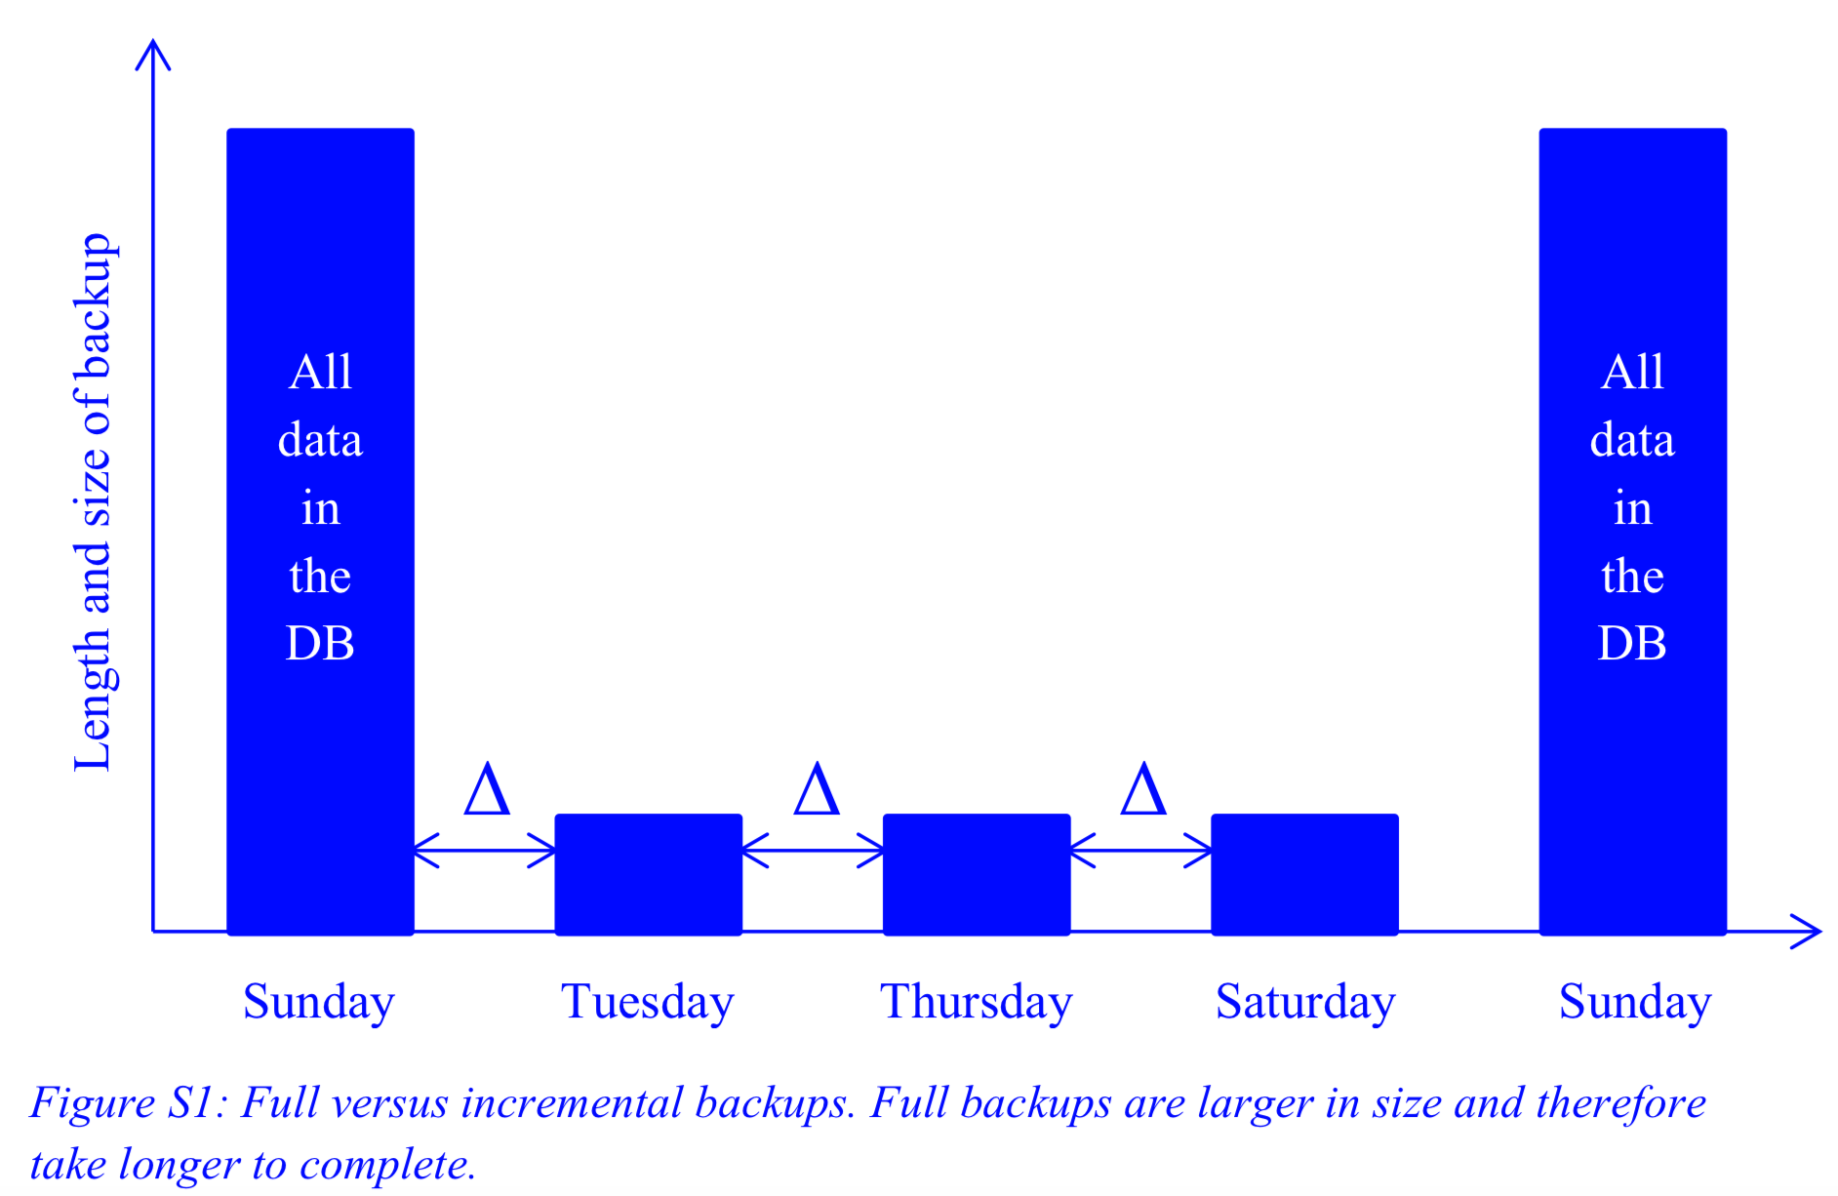
Review of backup & recovery concepts
2. Key Concepts of backup & recovery
e. Backup Choices
i. Full backups
Back up all data in our database
Only backs up the
changes since the last
backup.
smaller in size
shorter in duration
back up only chosen tables
ii. Incremental backups
iii. Partial backups
Notes:
Today data is incorporated in our aspects of our lives. Just think of your daily actions… examples…
And on top of it there is this big business of extracting value from the data - call it business analytics, data driven decision making – anything you like, the point is to extract the hidden cold stored in this data
- Think of amazon recommended products, Netflix movies to watch.. All this is driven by your actions and the data you generate
Data exhaust
44 zb by 2020 digital universe
To put things in perspective 1 zb when it is burn on stack of cds it would be 4.1 million km high – which is high enough to reach from the earth to the moon and back 5 times

Slide 20
Review of backup & recovery concepts
2. Key Concepts of backup & recovery
f. How does database recovery work?
Recovery of databases is nearly always in two phases: restore the backup then recover to the point of failure using the recovery log.
The first phase is the restoration of the backup to the database server machine.
The second phase is the recovery up until the point of the database failure (known as a full recovery). No committed data in the database should be lost.
Notes:
Today data is incorporated in our aspects of our lives. Just think of your daily actions… examples…
And on top of it there is this big business of extracting value from the data - call it business analytics, data driven decision making – anything you like, the point is to extract the hidden cold stored in this data
- Think of amazon recommended products, Netflix movies to watch.. All this is driven by your actions and the data you generate
Data exhaust
44 zb by 2020 digital universe
To put things in perspective 1 zb when it is burn on stack of cds it would be 4.1 million km high – which is high enough to reach from the earth to the moon and back 5 times

Slide 21
Review of backup & recovery concepts
Any questions?
Notes:
Today data is incorporated in our aspects of our lives. Just think of your daily actions… examples…
And on top of it there is this big business of extracting value from the data - call it business analytics, data driven decision making – anything you like, the point is to extract the hidden cold stored in this data
- Think of amazon recommended products, Netflix movies to watch.. All this is driven by your actions and the data you generate
Data exhaust
44 zb by 2020 digital universe
To put things in perspective 1 zb when it is burn on stack of cds it would be 4.1 million km high – which is high enough to reach from the earth to the moon and back 5 times

Slide 22
Apply backup & recovery concepts to case studies
3. Backup and recovery case study
ACME Manufacturing makes widgets in its factory. The factory runs 24 hours a day, 7 days a week in three shifts. The quietest shift is the Sunday night shift, which runs from midnight Sunday to 8am Monday. While ACME manufactures widgets, the database must run. This is ACME’s only widget factory.
The database administrator has implemented a backup policy that takes a full backup every Sunday at 3am during the night shift, and then an incremental backup on Tuesday, Thursday and Saturday mornings at 3am.
The backup strategy has determined that if there is a database failure, restoration of the database is time-critical. ACME must have the shortest outage time to restore and recover the database. This means the database must be restored quickly so that the manufacturing can continue. ACME must have the smallest elapsed time from the point of failure to the database being fully operational and useable.
Notes:
Today data is incorporated in our aspects of our lives. Just think of your daily actions… examples…
And on top of it there is this big business of extracting value from the data - call it business analytics, data driven decision making – anything you like, the point is to extract the hidden cold stored in this data
- Think of amazon recommended products, Netflix movies to watch.. All this is driven by your actions and the data you generate
Data exhaust
44 zb by 2020 digital universe
To put things in perspective 1 zb when it is burn on stack of cds it would be 4.1 million km high – which is high enough to reach from the earth to the moon and back 5 times

Slide 23
Apply backup & recovery concepts to case studies
3. Backup and recovery case study
a. Given the business requirements and the database administrator’s backup policy, what database backup type, mode and site would you recommend?
Notes:
Today data is incorporated in our aspects of our lives. Just think of your daily actions… examples…
And on top of it there is this big business of extracting value from the data - call it business analytics, data driven decision making – anything you like, the point is to extract the hidden cold stored in this data
- Think of amazon recommended products, Netflix movies to watch.. All this is driven by your actions and the data you generate
Data exhaust
44 zb by 2020 digital universe
To put things in perspective 1 zb when it is burn on stack of cds it would be 4.1 million km high – which is high enough to reach from the earth to the moon and back 5 times

Slide 24
Apply backup & recovery concepts to case studies
3. Backup and recovery case study
a. Given the business requirements and the database administrator’s backup policy, what database backup type, mode and site would you recommend?
online, offsite, physical backup.
The online backup would mean there would be no interruption of operations at ACME.
The physical backup is the preferred type of backup because it is the fastest to backup and restore.
While having an onsite backup creates a risk of a single point of failure, it is ACME’s only widget factory, so if it was to be destroyed ACME does not have anywhere else to make widgets. An offsite backup provides little advantage.
Notes:
Today data is incorporated in our aspects of our lives. Just think of your daily actions… examples…
And on top of it there is this big business of extracting value from the data - call it business analytics, data driven decision making – anything you like, the point is to extract the hidden cold stored in this data
- Think of amazon recommended products, Netflix movies to watch.. All this is driven by your actions and the data you generate
Data exhaust
44 zb by 2020 digital universe
To put things in perspective 1 zb when it is burn on stack of cds it would be 4.1 million km high – which is high enough to reach from the earth to the moon and back 5 times

Slide 25
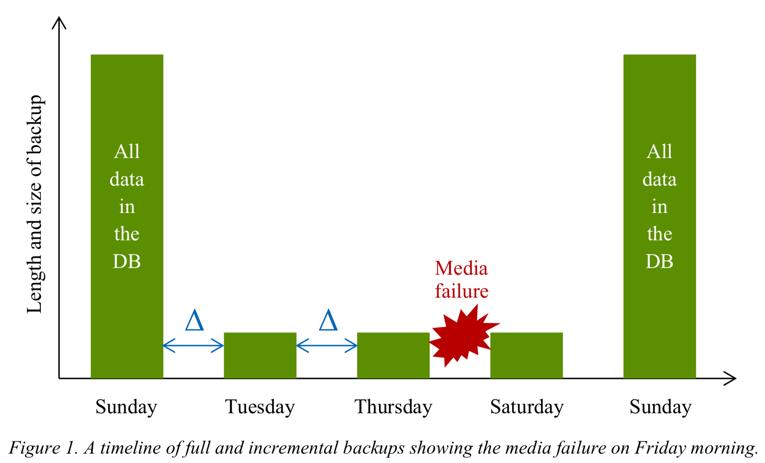
Apply backup & recovery concepts to case studies
3. Backup and recovery case study
b. Consider the Full and Incremental backup timeline in Figure 1. If the database suffered a media failure on Friday at 9:23am, how many backups would need to be restored?
Notes:
Today data is incorporated in our aspects of our lives. Just think of your daily actions… examples…
And on top of it there is this big business of extracting value from the data - call it business analytics, data driven decision making – anything you like, the point is to extract the hidden cold stored in this data
- Think of amazon recommended products, Netflix movies to watch.. All this is driven by your actions and the data you generate
Data exhaust
44 zb by 2020 digital universe
To put things in perspective 1 zb when it is burn on stack of cds it would be 4.1 million km high – which is high enough to reach from the earth to the moon and back 5 times

Slide 26
Apply backup & recovery concepts to case studies
3. Backup and recovery case study
b. Consider the Full and Incremental backup timeline in Figure 1. If the database suffered a media failure on Friday at 9:23am, how many backups would need to be restored?
Three backups would need to be
restored:
The Sunday full backup
The Tuesday incremental backup
The Thursday incremental backup
The DBA would also replay the crash recovery logs from Friday morning until Friday 9:23am.
Notes:
Today data is incorporated in our aspects of our lives. Just think of your daily actions… examples…
And on top of it there is this big business of extracting value from the data - call it business analytics, data driven decision making – anything you like, the point is to extract the hidden cold stored in this data
- Think of amazon recommended products, Netflix movies to watch.. All this is driven by your actions and the data you generate
Data exhaust
44 zb by 2020 digital universe
To put things in perspective 1 zb when it is burn on stack of cds it would be 4.1 million km high – which is high enough to reach from the earth to the moon and back 5 times

Slide 27
Apply backup & recovery concepts to case studies
3. Backup and recovery case study
c. Given the same failure, what would be the benefits and costs of changing the backup strategy to do full backups on Sunday, Tuesday, Thursday and Saturday mornings at 3am?
Notes:
Today data is incorporated in our aspects of our lives. Just think of your daily actions… examples…
And on top of it there is this big business of extracting value from the data - call it business analytics, data driven decision making – anything you like, the point is to extract the hidden cold stored in this data
- Think of amazon recommended products, Netflix movies to watch.. All this is driven by your actions and the data you generate
Data exhaust
44 zb by 2020 digital universe
To put things in perspective 1 zb when it is burn on stack of cds it would be 4.1 million km high – which is high enough to reach from the earth to the moon and back 5 times

Slide 28
Apply backup & recovery concepts to case studies
3. Backup and recovery case study
c. Given the same failure, what would be the benefits and costs of changing the backup strategy to do full backups on Sunday, Tuesday, Thursday and Saturday mornings at 3am?
Benefits: In the restore and recovery phase, this strategy would reduce the time to fully restore the database from the last full backup and apply the crash recovery logs. This would mean ACME are going to be fully operational faster than if the Full and Incremental strategy was used.
Costs: More space would be required to back up the database as the backup will take everything and not just the changes. As there is more data to copy, the backup will take longer to complete. There is a risk that if we don’t remove the backups from the database server, we could fill up the file system.
Notes:
Today data is incorporated in our aspects of our lives. Just think of your daily actions… examples…
And on top of it there is this big business of extracting value from the data - call it business analytics, data driven decision making – anything you like, the point is to extract the hidden cold stored in this data
- Think of amazon recommended products, Netflix movies to watch.. All this is driven by your actions and the data you generate
Data exhaust
44 zb by 2020 digital universe
To put things in perspective 1 zb when it is burn on stack of cds it would be 4.1 million km high – which is high enough to reach from the earth to the moon and back 5 times

Slide 29
Apply backup & recovery concepts to case studies
Any questions?
Notes:
Today data is incorporated in our aspects of our lives. Just think of your daily actions… examples…
And on top of it there is this big business of extracting value from the data - call it business analytics, data driven decision making – anything you like, the point is to extract the hidden cold stored in this data
- Think of amazon recommended products, Netflix movies to watch.. All this is driven by your actions and the data you generate
Data exhaust
44 zb by 2020 digital universe
To put things in perspective 1 zb when it is burn on stack of cds it would be 4.1 million km high – which is high enough to reach from the earth to the moon and back 5 times

Slide 30
Review transactions concept
4. Transaction Key Concepts
a. What is a transaction?
A transaction is a logical unit of work that must either be entirely completed or aborted.
A transaction usually corresponds to a single “action” that involves several changes to the database, for example, removing an employee and all their related data from the database, or an actual financial transaction that removes funds from one account and adds them to another.
Transactions adhere to the ACID principles.
Notes:
Today data is incorporated in our aspects of our lives. Just think of your daily actions… examples…
And on top of it there is this big business of extracting value from the data - call it business analytics, data driven decision making – anything you like, the point is to extract the hidden cold stored in this data
- Think of amazon recommended products, Netflix movies to watch.. All this is driven by your actions and the data you generate
Data exhaust
44 zb by 2020 digital universe
To put things in perspective 1 zb when it is burn on stack of cds it would be 4.1 million km high – which is high enough to reach from the earth to the moon and back 5 times

Slide 31
Review transactions concept
4. Transaction Key Concepts
b. What is ACID
Four desirable properties of transactions. DBMS that implements transactions that achieve these properties is “ACID-compliant”
Atomic – Each transaction either entirely succeeds or entirely fails. If a failure occurs mid- transaction, the DBMS must discard (roll back) all of the transaction’s changes up to that point.
Consistent – Upon completion, a transaction must respect data integrity rules (constraints) and leave the database in a consistent state.
Notes:
Today data is incorporated in our aspects of our lives. Just think of your daily actions… examples…
And on top of it there is this big business of extracting value from the data - call it business analytics, data driven decision making – anything you like, the point is to extract the hidden cold stored in this data
- Think of amazon recommended products, Netflix movies to watch.. All this is driven by your actions and the data you generate
Data exhaust
44 zb by 2020 digital universe
To put things in perspective 1 zb when it is burn on stack of cds it would be 4.1 million km high – which is high enough to reach from the earth to the moon and back 5 times

Slide 32
Review transactions concept
4. Transaction Key Concepts
b. What is ACID
Isolated – Changes made in one transaction cannot be seen from within other transactions. Transactions give the impression of being executed side-by-side simultaneously, although in practice, the need for data locking means that some transactions might be delayed by other transactions as they wait for locks to be released.
Durable – Once transaction is committed, the changes carried out in that transaction persist permanently in database.
Notes:
Today data is incorporated in our aspects of our lives. Just think of your daily actions… examples…
And on top of it there is this big business of extracting value from the data - call it business analytics, data driven decision making – anything you like, the point is to extract the hidden cold stored in this data
- Think of amazon recommended products, Netflix movies to watch.. All this is driven by your actions and the data you generate
Data exhaust
44 zb by 2020 digital universe
To put things in perspective 1 zb when it is burn on stack of cds it would be 4.1 million km high – which is high enough to reach from the earth to the moon and back 5 times

Slide 33
Review transactions concept
4. Transaction Key Concepts
c. Concurrency
Concurrency
Ability to allow many users to connect to and work with the database simultaneously.
It is possible for a database to allow concurrent access and still satisfy the ACID properties, but the isolation property creates particular challenges.
Notes:
Today data is incorporated in our aspects of our lives. Just think of your daily actions… examples…
And on top of it there is this big business of extracting value from the data - call it business analytics, data driven decision making – anything you like, the point is to extract the hidden cold stored in this data
- Think of amazon recommended products, Netflix movies to watch.. All this is driven by your actions and the data you generate
Data exhaust
44 zb by 2020 digital universe
To put things in perspective 1 zb when it is burn on stack of cds it would be 4.1 million km high – which is high enough to reach from the earth to the moon and back 5 times

Slide 34
Review transactions concept
4. Transaction Key Concepts
d. The lost update problem
When two users attempt to update the same piece of data in the database at the same time, they might conflict with each other. One user changes the data value, and the other user does not see this update before writing their own update to that database. The first user’s update is lost.
Notes:
Today data is incorporated in our aspects of our lives. Just think of your daily actions… examples…
And on top of it there is this big business of extracting value from the data - call it business analytics, data driven decision making – anything you like, the point is to extract the hidden cold stored in this data
- Think of amazon recommended products, Netflix movies to watch.. All this is driven by your actions and the data you generate
Data exhaust
44 zb by 2020 digital universe
To put things in perspective 1 zb when it is burn on stack of cds it would be 4.1 million km high – which is high enough to reach from the earth to the moon and back 5 times

Slide 35
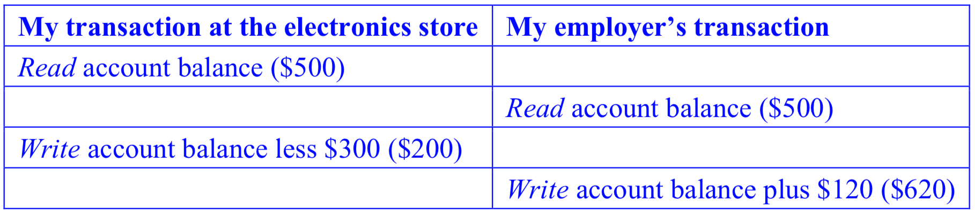
Review transactions concept
4. Transaction Key Concepts
d. The lost update problem
Example: two people are accessing the same bank account. Suppose my bank account contains $500. I am at an electronics store buying a $300 TV; at exactly the same time, my employer is paying me $120 in wages.
Instead of being $180 poorer, I am now $120 richer! This is not my fault – it’s up to the bank to make sure the isolation property of ACID is satisfied and lost updates cannot happen.
Notes:
Today data is incorporated in our aspects of our lives. Just think of your daily actions… examples…
And on top of it there is this big business of extracting value from the data - call it business analytics, data driven decision making – anything you like, the point is to extract the hidden cold stored in this data
- Think of amazon recommended products, Netflix movies to watch.. All this is driven by your actions and the data you generate
Data exhaust
44 zb by 2020 digital universe
To put things in perspective 1 zb when it is burn on stack of cds it would be 4.1 million km high – which is high enough to reach from the earth to the moon and back 5 times

Slide 36
Review transactions concept
Any questions?
Notes:
Today data is incorporated in our aspects of our lives. Just think of your daily actions… examples…
And on top of it there is this big business of extracting value from the data - call it business analytics, data driven decision making – anything you like, the point is to extract the hidden cold stored in this data
- Think of amazon recommended products, Netflix movies to watch.. All this is driven by your actions and the data you generate
Data exhaust
44 zb by 2020 digital universe
To put things in perspective 1 zb when it is burn on stack of cds it would be 4.1 million km high – which is high enough to reach from the earth to the moon and back 5 times

Slide 37
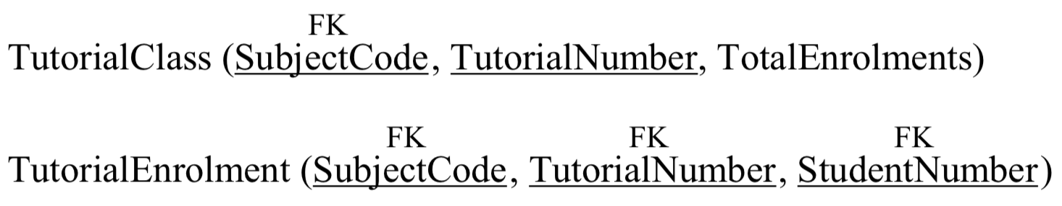
Apply transactions concepts
5. Transaction Exercises
It’s class registration day, when UniMelb students register in tutorial classes for the upcoming semester. In one particular subject, each tutorial class can fit a maximum of 24 students.
Eamonn and Jacqueline both wish to register in the Wednesday 10am tutorial class for this subject. This class already has 23 students enrolled – just one place remains.
Suppose the database contains tables like this:
Notes:
Today data is incorporated in our aspects of our lives. Just think of your daily actions… examples…
And on top of it there is this big business of extracting value from the data - call it business analytics, data driven decision making – anything you like, the point is to extract the hidden cold stored in this data
- Think of amazon recommended products, Netflix movies to watch.. All this is driven by your actions and the data you generate
Data exhaust
44 zb by 2020 digital universe
To put things in perspective 1 zb when it is burn on stack of cds it would be 4.1 million km high – which is high enough to reach from the earth to the moon and back 5 times

Slide 38
Apply transactions concepts
5. Transaction Exercises
a. Describe how a lost update could occur in this database when Eamonn and Jacqueline try to simultaneously register in the Wednesday 10am tutorial.
Notes:
Today data is incorporated in our aspects of our lives. Just think of your daily actions… examples…
And on top of it there is this big business of extracting value from the data - call it business analytics, data driven decision making – anything you like, the point is to extract the hidden cold stored in this data
- Think of amazon recommended products, Netflix movies to watch.. All this is driven by your actions and the data you generate
Data exhaust
44 zb by 2020 digital universe
To put things in perspective 1 zb when it is burn on stack of cds it would be 4.1 million km high – which is high enough to reach from the earth to the moon and back 5 times

Slide 39
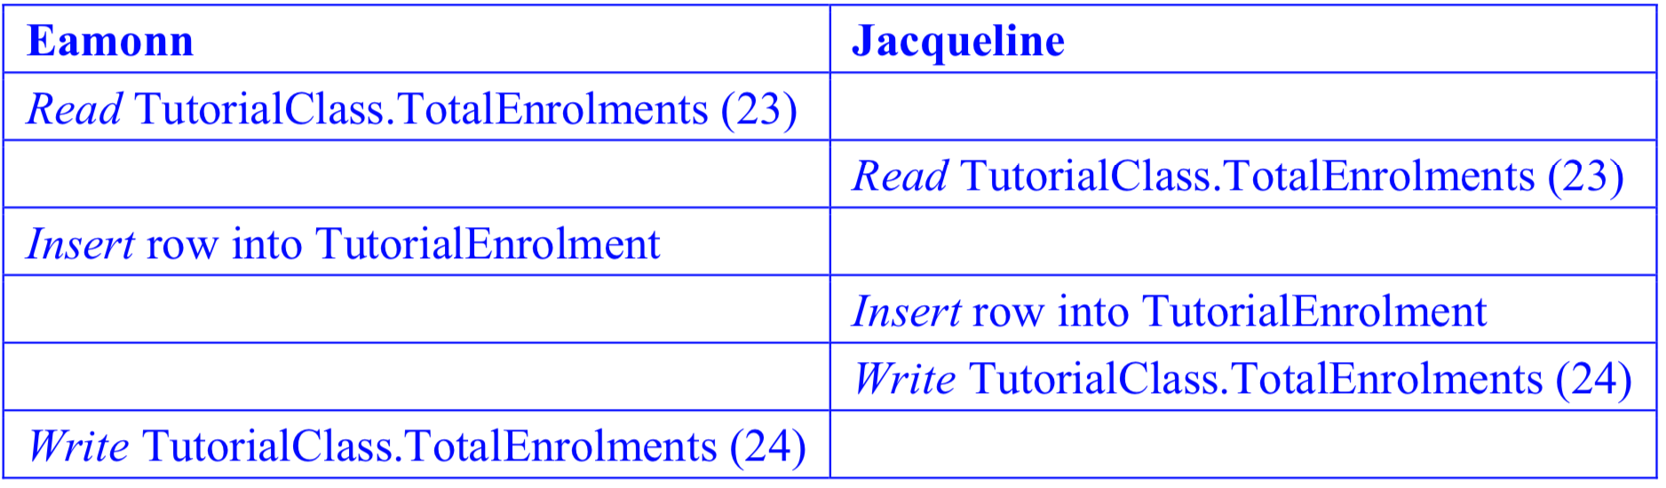
Apply transactions concepts
5. Transaction Exercises
a. Describe how a lost update could occur in this database when Eamonn and Jacqueline try to simultaneously register in the Wednesday 10am tutorial.
Even though there are now 25 students enrolled in the class, the value of TotalEnrolments for this class is equal to 24. A lost update has occurred.
Notes:
Today data is incorporated in our aspects of our lives. Just think of your daily actions… examples…
And on top of it there is this big business of extracting value from the data - call it business analytics, data driven decision making – anything you like, the point is to extract the hidden cold stored in this data
- Think of amazon recommended products, Netflix movies to watch.. All this is driven by your actions and the data you generate
Data exhaust
44 zb by 2020 digital universe
To put things in perspective 1 zb when it is burn on stack of cds it would be 4.1 million km high – which is high enough to reach from the earth to the moon and back 5 times

Slide 40
Apply transactions concepts
5. Transaction Exercises
b. How could the lost update problem be avoided in this situation?
Notes:
Today data is incorporated in our aspects of our lives. Just think of your daily actions… examples…
And on top of it there is this big business of extracting value from the data - call it business analytics, data driven decision making – anything you like, the point is to extract the hidden cold stored in this data
- Think of amazon recommended products, Netflix movies to watch.. All this is driven by your actions and the data you generate
Data exhaust
44 zb by 2020 digital universe
To put things in perspective 1 zb when it is burn on stack of cds it would be 4.1 million km high – which is high enough to reach from the earth to the moon and back 5 times

Slide 41
Apply transactions concepts
5. Transaction Exercises
b. How could the lost update problem be avoided in this situation?
Enforce serial execution, only one transaction is executed at a time.
very inefficient, but will guarantee that the isolation of ACID is satisfied.
2. Use locking. When a transaction wishes to read the TotalEnrolments value for a class, it takes out a lock on that row of the TutorialClass table. This prevents other transactions from modifying that row. Once the transaction has finished writing to the row, it releases the lock.
more efficient, as a student’s enrolment request only has to wait for the completion of other requests to enrol in the same class, instead of waiting for all other requests in the system.
Notes:
Today data is incorporated in our aspects of our lives. Just think of your daily actions… examples…
And on top of it there is this big business of extracting value from the data - call it business analytics, data driven decision making – anything you like, the point is to extract the hidden cold stored in this data
- Think of amazon recommended products, Netflix movies to watch.. All this is driven by your actions and the data you generate
Data exhaust
44 zb by 2020 digital universe
To put things in perspective 1 zb when it is burn on stack of cds it would be 4.1 million km high – which is high enough to reach from the earth to the moon and back 5 times

Slide 42
Apply transactions concepts
5. Transaction Exercises
b. How could the lost update problem be avoided in this situation?
3. Use the other concurrency control methods outlined in the lecture
timestamps (if the timestamp of TotalEnrolments changes between when Eamonn reads it and when he is about to write it, Eamonn’s transaction would abort and restart)
optimistic concurrency control (if TotalEnrolments is no longer equal to its original value when Eamonn is about to write it, Eamonn’s transaction would abort and restart).
Notes:
Today data is incorporated in our aspects of our lives. Just think of your daily actions… examples…
And on top of it there is this big business of extracting value from the data - call it business analytics, data driven decision making – anything you like, the point is to extract the hidden cold stored in this data
- Think of amazon recommended products, Netflix movies to watch.. All this is driven by your actions and the data you generate
Data exhaust
44 zb by 2020 digital universe
To put things in perspective 1 zb when it is burn on stack of cds it would be 4.1 million km high – which is high enough to reach from the earth to the moon and back 5 times

Slide 43
Apply transactions concepts
Any questions?
Notes:
Today data is incorporated in our aspects of our lives. Just think of your daily actions… examples…
And on top of it there is this big business of extracting value from the data - call it business analytics, data driven decision making – anything you like, the point is to extract the hidden cold stored in this data
- Think of amazon recommended products, Netflix movies to watch.. All this is driven by your actions and the data you generate
Data exhaust
44 zb by 2020 digital universe
To put things in perspective 1 zb when it is burn on stack of cds it would be 4.1 million km high – which is high enough to reach from the earth to the moon and back 5 times

