Slide 1
Design and calibration of stochastic models for DNA methylation patterns
Masterseminar by Andrea Kupitz
Supervisors: Prof. Dr. Verena Wolf, Alexander Lück
Notes:
Welcome
Andrea
Master seminar about

Slide 2
Overview
Problem:
Method of operation of DNMTs unclear
Measure distances between methylation pattern distributions
Approach:
MCMC algorithm to simulate cell cycle
Parameter estimation using ABC
Results:
Parameters of MCMC difficult to identify
Outlook:
Validation of ABC method
Notes:
-Overview of what talk is about
-1. Figure out how DNMTs work, 2.
-simulate method of operation using MCMC
-Estimate parameters for DNMTs with ABC
-Findings: Parameters -> Validation

Slide 3

Introduction – Epigenetics
Histon modifications
Histon methylation
Histon acetylation
…
DNA modifications
DNA methylation
DNA
Parents
Environment
Epigenetic modifications
Cell differentiation
Notes:
-DNA inherited by parents, no change, same for all cells -> how cells differentiate: modifications occuring dependent on environment
-Differentiate: histon, DNA
-Following: focus on methylation

Slide 4
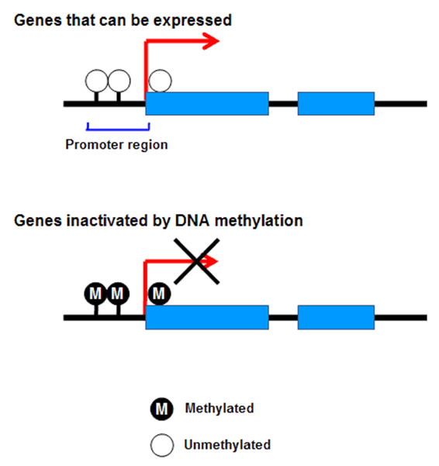
Introduction - Methylation
Influences gene expression
Indicator for diseases
Heritable
Notes:
-Why methylation important: methylation in promotor region inactivates genes
-Changes in methylation pattern => indicator for deseases(cancer)

Slide 5
Introduction - Methylation
M M
C-G-A-A-C-G-T-A
G-C-T-T-G-C-A-T
M
DNA methylation at CpG
Methylation transmitted by DNMTs
Method of operation of DNMTs unclear
Notes:
-Happens on CpG: Cytosin beneath Guanin in seq. -> no change in DNA
-Fully methylated/hemi methylated/unmethylated
-DNMT: DNA methyltransferase; transfer a methyl group to DNA; DNMT1, DNMT3a/b -> work differntly

Slide 6
Introduction - DNMTs
Methylation
Maintainance:
De novo:
M
M
M
M
?
?
?
?
M
Notes:
-Methylates only CpGs, where complementary CpG methylated
-methylation at unmethylated and methylated sides, both strands

Slide 7
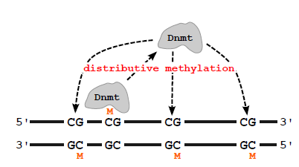
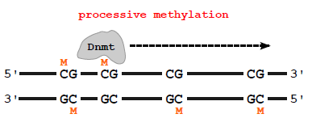
Introduction - DNMTs
Processivity
High:
Low:
Notes:
-DNMT doesn‘t disassociate, methylates multiple CpGs without falling off
-DNMT is bound and falls off
->how to simulate?

Slide 8

Methods – Markov Chain
ρ – Dissociation probability
DNMT
Not bound
DNMT
Bound
Position 1 2 3
ρ
ρ
ρ
1-ρ
1-ρ
Notes:
-Construct Markov chain: each CpG position 2 states: either bound or unbound
-Call disass. Prob.: State bound->unbound, rho

Slide 9
Methods – Markov Chain
τ – Association probability
DNMT
Not bound
DNMT
Bound
Position 1 2 3
1-τ
1-τ
τ
τ
Notes:
-Call Ass. Prob.: DNMT binds at next CpG, tau

Slide 10
Methods – Markov Chain
μ - Maintenance methylation probability
δ – De novo methylation probability
M
M
M
M
?
?
M
M
?
?
M
Notes:
-If DNMT bound, DNMT meth. With prob. Mhy, delta
-Parameters of Markov chain

Slide 11
Methods - MCMC
Markov chain Monte Carlo
Given:
Measured methylation pattern distribution before cell divisions
Simulation parameters ρ, τ, δ and μ
Aim:
Simulate a pattern distribution after cell division
Notes:
-simulation
Measured wildtype data: in vitro?

Slide 12
Methods - MCMC
Workflow:
1. Sample from pattern distribution
2. Simulate t cell divisions
Draw RN and decide using ρ, τ, δ and μ if DNMT binds/methylates
3. Repeat 1 and 2 10000 times
Notes:
1. Draw starting meth. Pattern from measured pattern distribution
3. To generate pattern distribution after cell division

Slide 13

Methods – MCMC
1. 2. 3.
6. 5.
4.
1
3
M
M
M
M
M
M
M
M
M
M
M
M
M
M
M
M
M
M
3
M
M
M
M
M
M
Notes:
1 – data: draw one meth. Pattern from distr., other strand unmethylated, 4 – cell divisides, 5 – strand duplication, 6 – random cell selected for next simulation run

Slide 14
Results - MCMC
DMNT3 - Expectations
Low processivity:
Result:
Ρ high (0.89)
τ low (0.28)
De novo methylation/few maintenance methylation activity:
Result:
μ high (0.78)
δ high (1.00)
M
?
?
Notes:
Tau - association

Slide 15
Results - MCMC
DMNT1 - Expectations
High processivity:
Result:
Ρ low (0.23)
τ high (1.00)
Maintenance methylation:
Result:
μ high (0.75)
δ low (0.43)
M
M
M
Notes:
During replication
Delta higher than expected

Slide 16
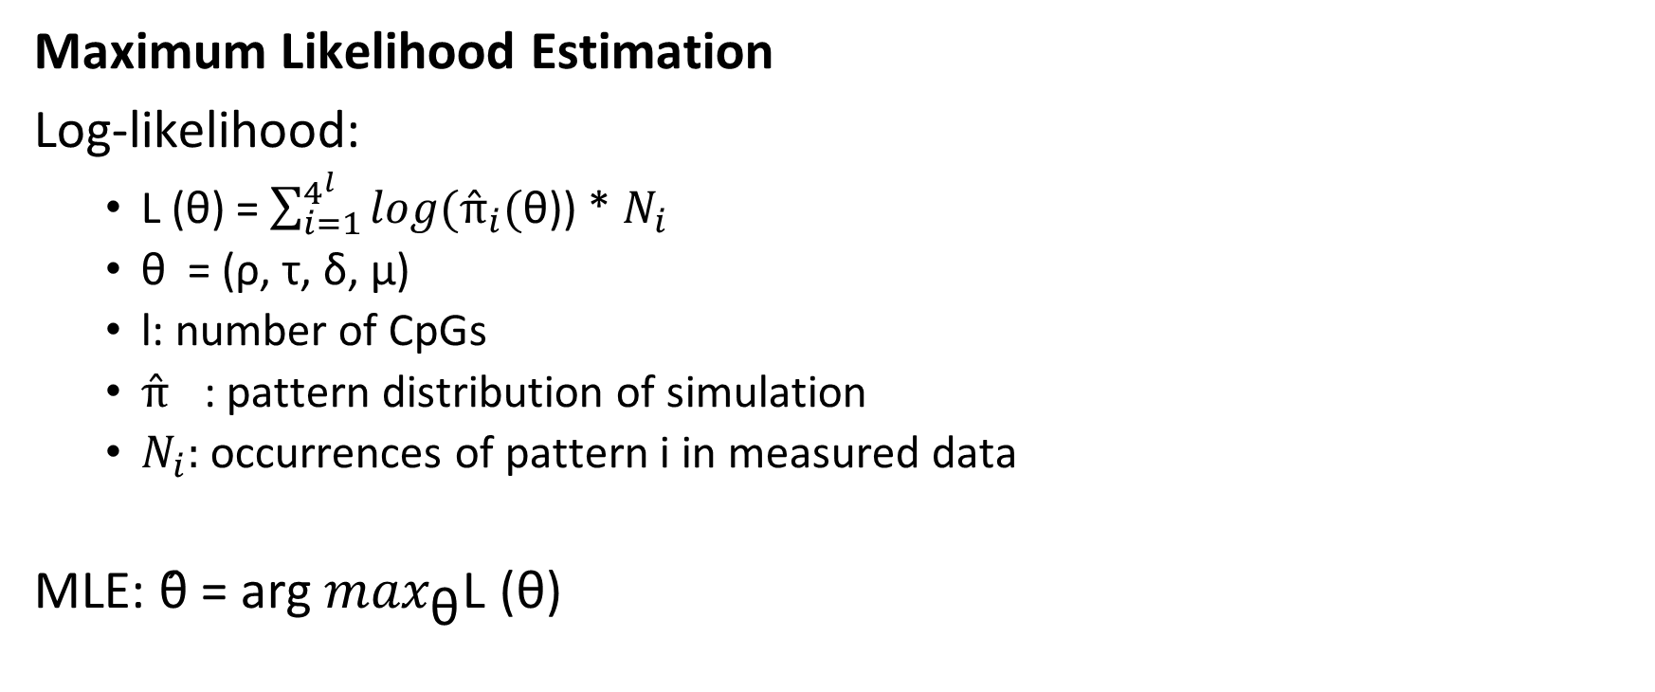
Methods - MLE
Maximum Likelihood Estimation
Log-likelihood:
L (θ) = $\sum_{i=1}^{4^{l}}{log({π̂}_{i}(}$θ)) * $N_{i}$
θ = (ρ, τ, δ, μ)
l: number of CpGs
${π̂}_{}$: pattern distribution of simulation
$N_{i}:$ occurrences of pattern i in measured data
MLE: θ̂ = arg$\max_{\text{θ}}$L (θ)
Notes:
Most proabable parameters computed using MLE
L: measures similarity of simulated and measured data
Θ head = parameters rho, tau, delta and mhy that maximizes L; most probable parameters

Slide 17
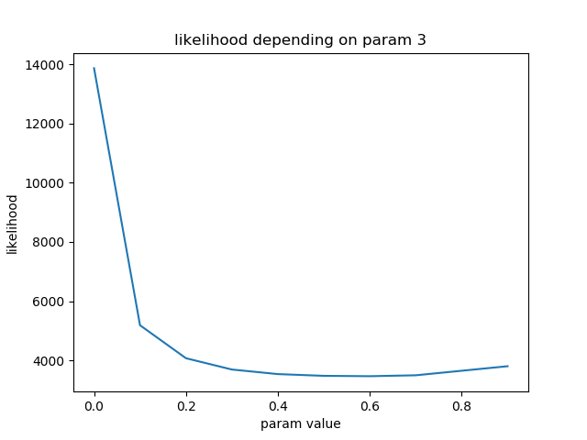
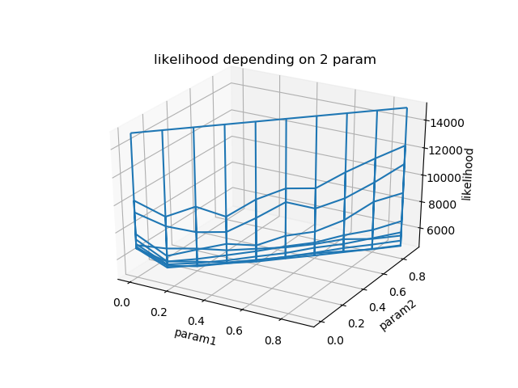
Results - MLE
Param 3: δ
ρ, τ and μ fixed
Neg. log-likelihood
Large interval for δ
Notes:
Neg. log-likelihood depending on param. Delta
Neg L => minimize L
Delta, de novo methylation prob., difficult to identify

Slide 18
Results - MLE
Param 1: ρ
Param 2: μ
τ and δ fixed
Neg. log-likelihood
ρ and μ linear dependent
Notes:
Model can’t differentiate between DNMT bound but doesn’t methylate and DNMT not bound -> rho and tau difficult to identify
Rho – association prob., mhy – maintenance methylation prob.

Slide 19
Methods - ABC
Approximate Bayesian Computation
Given:
Measured methylation pattern distribution after cell division
Function simulating cell division
Needed:
Distance between pattern distributions
Output:
Best parameters
Notes:
Function: takes: parameters; aim: simulate DNMTs; result: simulated methylation patterns after cell division
Output: Parameters resulting in minimal distances between pattern distribution
->needed

Slide 20
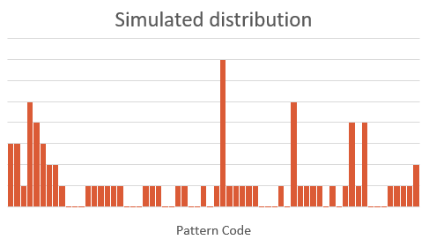
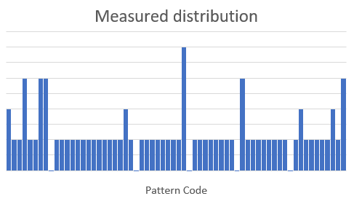
Methods - ABC
Pattern distributions – distance function
dist = ?
Notes:
Histograms of 2 pattern distributions; each bar a pattern; height probability of pattern

Slide 21
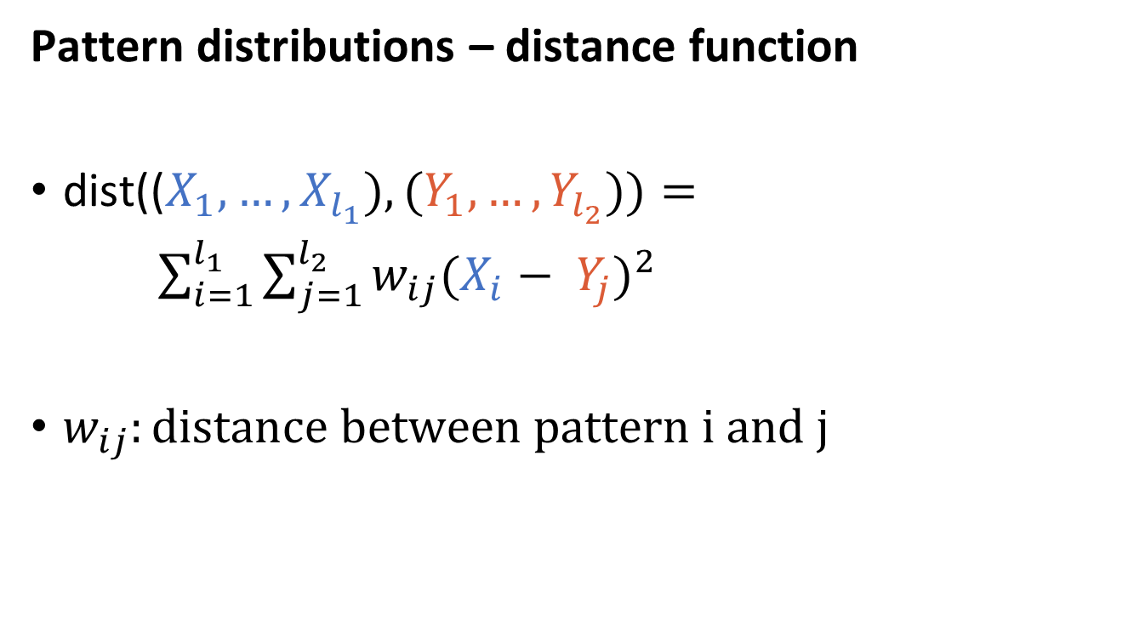
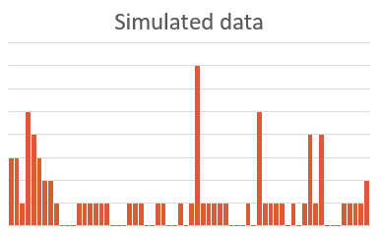
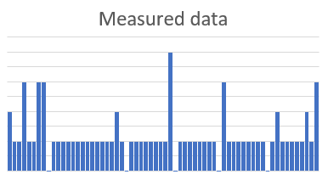
Methods - ABC
Pattern distributions – distance function
dist(($X_{1},…, X_{l_{1}}), (Y_{1}, …, Y_{l_{2}}))=$
$\sum_{i=1}^{l_{1}}{\sum_{j=1}^{l_{2}}{w_{ij}{(X_{i}− Y_{j})}^{2}}}$
$w_{ij}:distance between pattern i and j$
Notes:
X: probability of a pattern in measured data, Y: probability of pattern in simulated data

Slide 22

Methods - ABC
Methylation patterns – distance function
dist(i, j) = $w_{ij}$
M
 | M
M
M
 | M
Notes:
W: how similar are two meth. Patterns?
Row: CpG; Column: DNA-strand

Slide 23
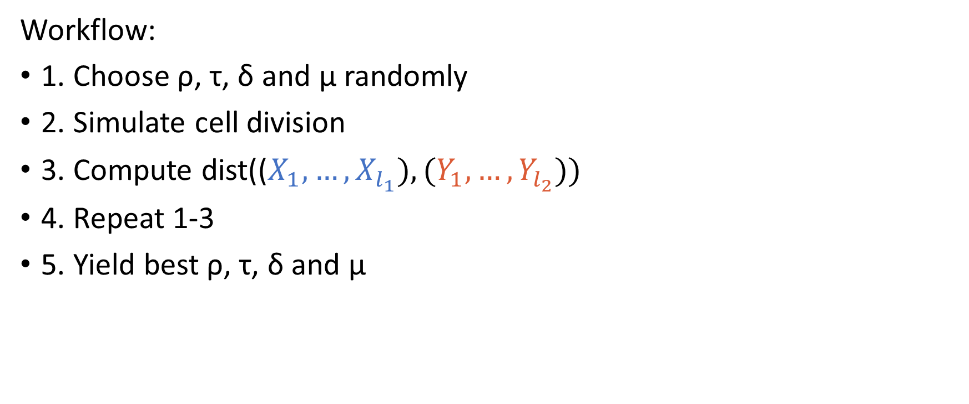
Methods - ABC
Workflow:
1. Choose ρ, τ, δ and μ randomly
2. Simulate cell division
3. Compute dist(($X_{1},…, X_{l_{1}}), (Y_{1}, …, Y_{l_{2}}))$
4. Repeat 1-3
5. Yield best ρ, τ, δ and μ
Notes:
Remember parameters with lowest distances

Slide 24

Outlook
Implement distance function $w_{ij}$ for ABC
Use distance function to validate results from MCMC
Test ABC for artificial data
Notes:
-approach: euclidean distance or similar
-compare pattern distributions of simulation and measurement
-to prove that ABC can find valid parameters

Slide 25
References
A. Lück et al., A Stochastic Model for the Formation of Spatial Methylation Patterns
A. Q. Fu et al., DNA Methyltransferases from Double-Stranded Methylation Patterns
https://de.wikipedia.org/wiki/MCMC-Verfahren
https://de.wikipedia.org/wiki/DNA-Methylierung
https://en.wikipedia.org/wiki/DNA_methyltransferase

Slide 26
Pictorial sources
Slide 2: https://www.biomol.de/die-top-10-der-dna-farbstoffe-und-sonden.html?id=821
Slide 3: https://www.ncc.go.jp/en/ri/division/epigenomics/project/230/20170913152903.html
Slide 7–9, 11, 14, 15: A. Lück et al., A Stochastic Model for the Formation of Spatial Methylation Patterns, p.3
Slide 22: https://www.cartoonstock.com/cartoonview.asp?catref=cwln5040

Slide 27
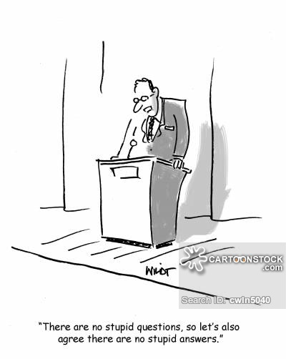
Thank you! Any Questions?

