Slide 1
FINAL PROJECT
V. KUPPUSAMY
613521104015

Slide 2
PROJECT TITLE
IPL SCORE PREDICTION USING DEEP
LEARNING

Slide 3
AGENDA
1. Problem Statement
2. Project Overview
3. End Users
4. Prediction
5. Modeling
6. Results

Slide 4
PROBLEM STATEMENT
Develop a deep learning model to predict IPL cricket match scores based on historical match data, player statistics, and match conditions.

Slide 5
PROJECT OVERVIEW
Data Collection:
Gather comprehensive data spanning multiple IPL seasons, including match details, player statistics, and environmental factors like weather conditions and pitch reports. This dataset serves as the foundation for training and evaluating our model.
Data Preprocessing:
Cleanse and preprocess the collected data to handle missing values, normalize numerical features, and encode categorical variables. Additionally, perform feature engineering to extract relevant insights that could influence match outcomes.

Slide 6
Model Development:
Design and implement a deep learning architecture tailored for time-series prediction tasks. Experiment with various architectures such as recurrent neural networks (RNNs), long short-term memory networks (LSTMs), and attention mechanisms to effectively capture temporal dependencies and feature interactions. Model Training:
Train the deep learning model using historical IPL match data, optimizing performance metrics through techniques like hyperparameter tuning and regularization. Employ cross-validation to assess the model's robustness and generalization capabilities. Model Evaluation:
Evaluate the trained model's performance on a separate validation dataset using appropriate evaluation metrics such as mean absolute error (MAE) or root mean square error (RMSE). Analyze prediction accuracy across different match scenarios and identify potential areas for improvement.

Slide 7
END USERS
Cricket Enthusiasts and Fans
Fantasy Cricket Players
Betting and Gambling Platforms
Team Management and Coaches
Advertisers and Sponsors
Analytics and Sports Science Professionals

Slide 8
YOUR SOLUTION AND ITS VALUE PREDICTION
Improved Betting Accuracy
Data-Driven Decision Making
Enhanced Viewer Engagement
User-Friendly Interface
Continuous Improvement
Integration with Existing Platforms

Slide 9
THE WOW OF THE PROJECT
Real-Time Score Updates
Player Performance Analysis
Predictive Analytics Dashboard
Community Engagement Features
Interactive Visualization

Slide 10
MODELING
Data Preparation - Data Cleaning
Model Architecture – Deep Learning
Training Strategy - Dataset Split
Model Evaluation – Visualization
Fine-Tuning and Iteration - Iterative Improvement
Monitoring

Slide 11
RESULTS AND DEPLOYMENT
Upon achieving satisfactory performance, deploy the trained model as a user-friendly application or API accessible to cricket enthusiasts.
Users can input relevant match details, and the system will generate predicted scores based on the underlying deep learning model.
Continuously monitor the model's performance in real-world scenarios and incorporate feedback to enhance its predictive capabilities further.

Slide 12
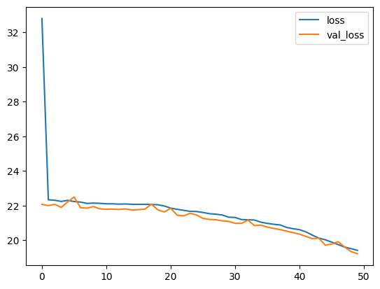

Slide 13
CONCLUSION
In conclusion, this project aims to demonstrate the effectiveness of deep learning techniques in predicting IPL match scores, offering valuable insights for stakeholders and enhancing the overall cricket-watching experience. By leveraging to the ongoing innovation in sports analytics and predictive modeling.

Slide 14
THANK YOU!

