Slide 1

PHYS204 Final Course project
By Harrison Olvera
Prof. James Karagiannes

Slide 2
Introduction
This project encompasses the basics of the Linux operating system within a virtualized setting. It involves tasks like traversing the Linux file system, creating shell scripts, overseeing user and group administration, grasping IP configurations, and supervising system efficiency. This forms the basis for comprehending upcoming innovations like Virtualization and Cloud Computing.

Slide 3

Linux filesystem hierarchy

Slide 4
Navigate the linux filesystem tree
1. What is the pwd command an acronym for? What about the cd command?
Answer here:
The pwd command is used to verify the directory.
The cd command is used to change directory.
2. Explain the differences between a relative path and an absolute/full path in Linux.
Answer here:
A relative path only describes the path from the current directory, while the absolute/full path will show the path from the home directory.
References:
1. codingrooms.com
2. Module 2 Project steps

Slide 5
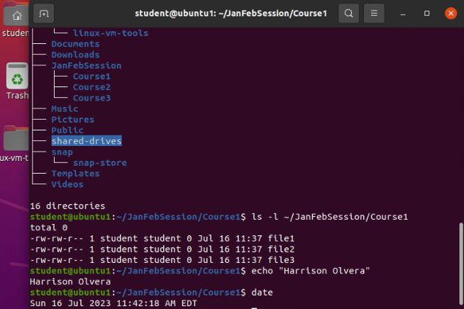
Create directories and files

Slide 6
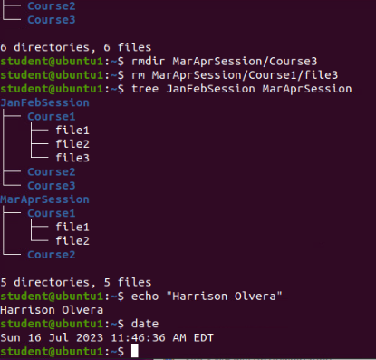
Copy and remove directories and files

Slide 7
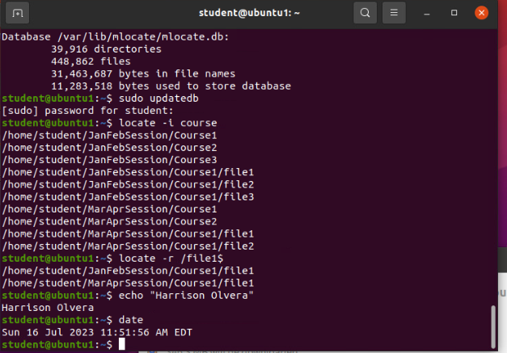
Locate directories and files

Slide 8
Linux shell scripts

Slide 9
Create a shell script
1. What are the file permissions of the script?
Answer here: Read and Write for owner and group. Read for everyone else.
2. What’s the name of the user-defined variable in the script?
Answer here: text
3. Which redirection meta-character is used in the script? What does it do?
Answer here: >> -- Redirects to the file and appends it.
References:
1. Recorded video

Slide 10
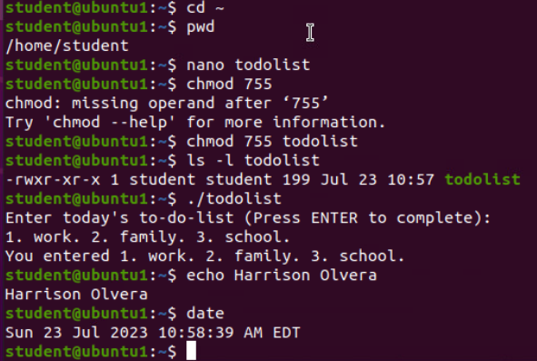
Change script file permissions

Slide 11
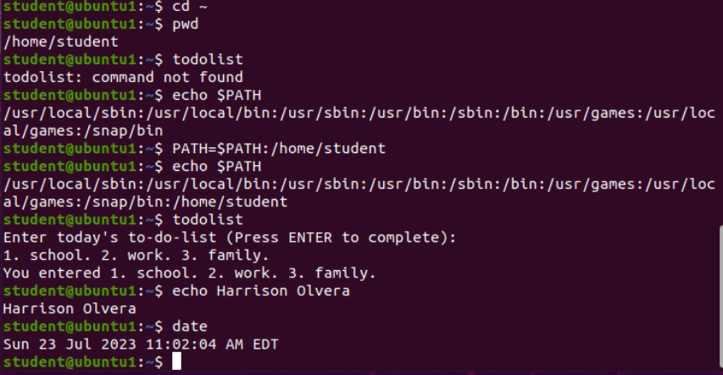
Set the path variable

Slide 12
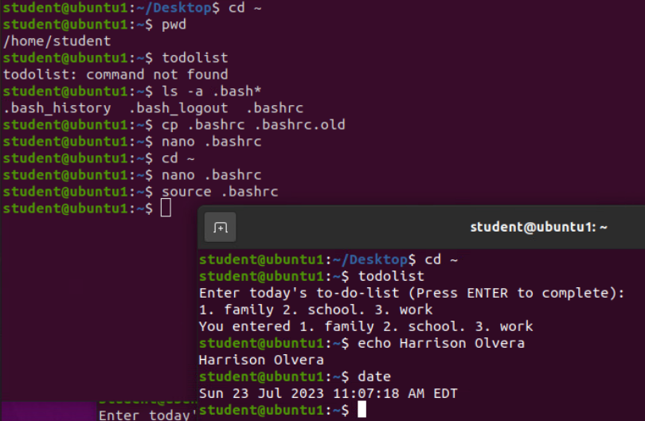
Make the path variable permanent

Slide 13
User and group management

Slide 14
Add users and groups in cli
1. What does the –m option in the useradd command do?
Answer here: It creates a home directory for new user.
2. What does the -3 option in the tail command do?
Answer here: Shows last 3 lines from the end of the file.
3. Which line of the /etc/group file lists members of the “students” group? Copy it here.
Answer here:
References:
1. Project video

Slide 15
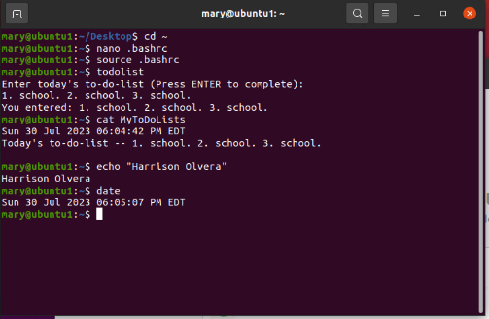
Test user and group settings

Slide 16
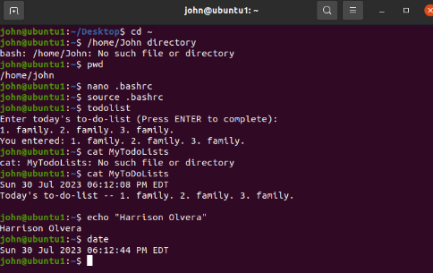
Add users in gui

Slide 17
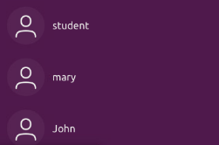
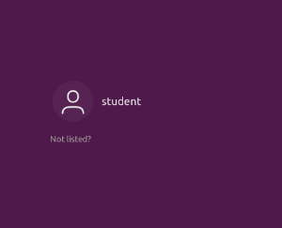
Remove users and groups

Slide 18
Network configuration

Slide 19
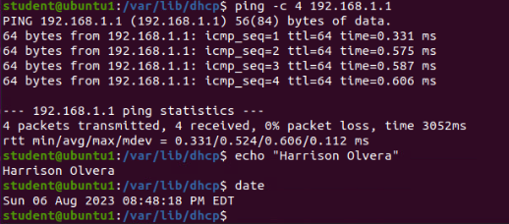
Discover host ip configurations
1. What is the IP address of your Ubuntu machine?
Answer here: 192.168.1.7
2. What is the IP address of its default gateway?
Answer here: 192.168.1.1
3. What is the IP address of its DHCP server?
Answer here:192.168.1.1
4. What is the IP address of its DNS server?
Answer here:192.168.1.1

Slide 20
Manage network interfaces
1. Which DHCP message is shown in the output of the sudo dhclient –v –r ens33 command?
Answer here: DHCPRELEASE
2. Which four DHCP messages are shown in the output of the sudo dhclient –v ens33 command?
Answer here:
DHCPDISCOVER
DHCPOFFER
DHCPREQUEST
DHCPACK

Slide 21
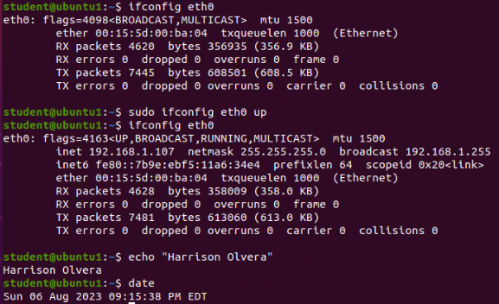
Use network utilities

Slide 22
System performance monitoring

Slide 23
Monitor linux processes
1. What is the default action of the 15 SIGTERM kill signal?
Answer here: Kill the highlighted process
2. In the System Monitor window, click on % CPU to sort the processes by CPU load. Which process shows the highest percentage of CPU usage?
Answer here: gnome-shell (GUI)
References:
1. Project video

Slide 24
Monitor user activities
Issue the sudo accton on command to turn on GNC accounting. Run the sudo updatedb command. Enter lastcomm updatedb to check if the updatedb command was executed before. Remember to turn off GNC accounting (sudo accton off) after answering the questions.
1. What flag value is displayed in the output?
Answer here: S for superuser
2. Why is the name of the user who ran the processes shown as root, not student?
Answer here: superuser because we typed sudo in front of the command
References:
1. Project video

Slide 25
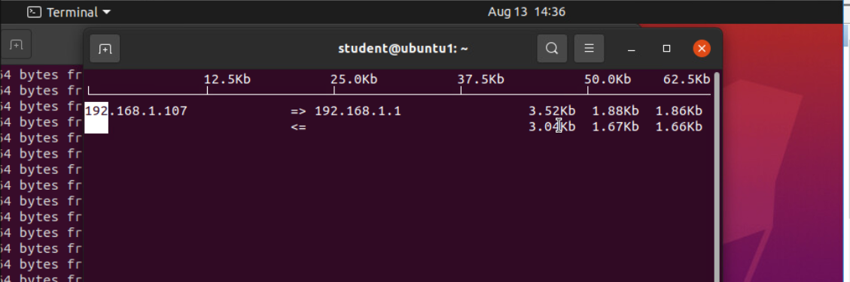
Monitor network bandwidth usage

Slide 26
Challenges/lessons learned
What challenges did you face while working on the project?
Learning when and where Linux is case sensitive
Memorizing most of the common Linux scripts
How did you overcome these challenges?
By having the on-hands experience of working with the virtual Linux machine I was able to learn how to correctly utilize Linux in the CLI
What lessons did you learn?
How to use both the CLI and GLI to perform administrative actions
How to configure network servers to run virtual machines
How to identify and mitigate security risks
How to navigate the Linux filesystem tree

Slide 27
Career skills
Command Line Proficiency
File System Navigation
Shell Scripting
User and Group Management
Security Fundamentals
Troubleshooting
Text Processing

Slide 28
Conclusion
Mastering the basics of Linux has helped open a gateway to an environment full of skills essential for success in the IT world. From honing command line and scripting prowess to jumping into network and security fundamentals, this journey has equipped me with a versatile skill set. As an aspiring developer, the foundational knowledge of Linux will undoubtedly grant me the opportunity towards a promising and dynamic career path.

Slide 29
References
Devry University project videos and classes
Codingrooms.com

