Slide 1

CEIS110 Course project
By Harrison Olvera
Prof. Gusteau Duclos

Slide 2
Introduction
This project encompasses the utilization of Python in building IoT systems, analyzing test results, learning alternative solutions, and experimentation.

Slide 3

Design and setup

Slide 4
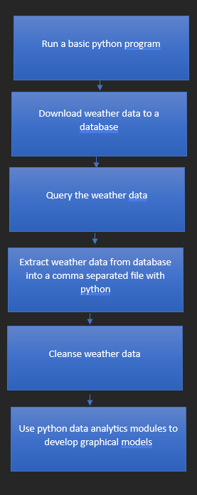
flowchart
Include the following processes:
Run a basic python program
Download weather data to a database.
Query the weather data
Extract weather data from database into a comma separated file with python
Cleanse weather data
Use python data analytics modules to develop graphical models

Slide 5
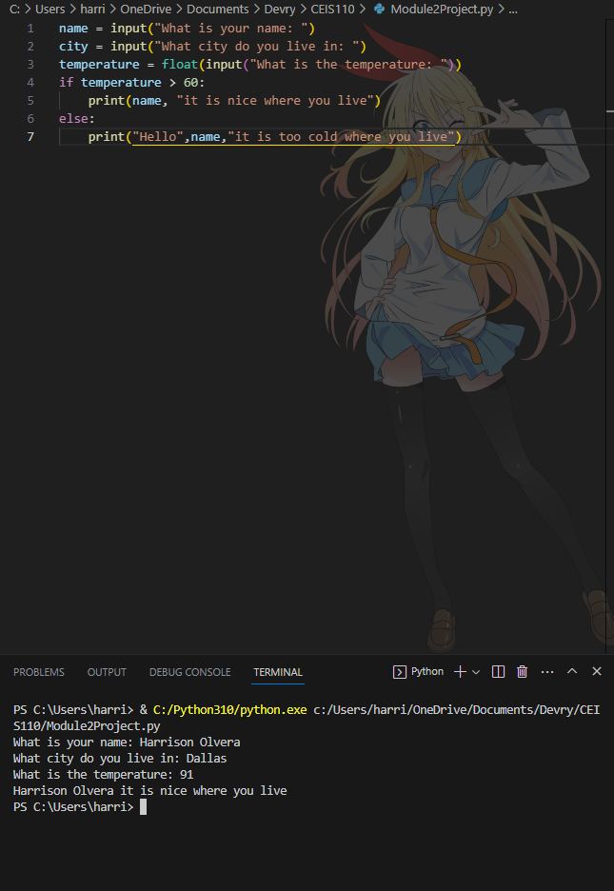
Python program (Screenshot)

Slide 6
Downloading weather data

Slide 7
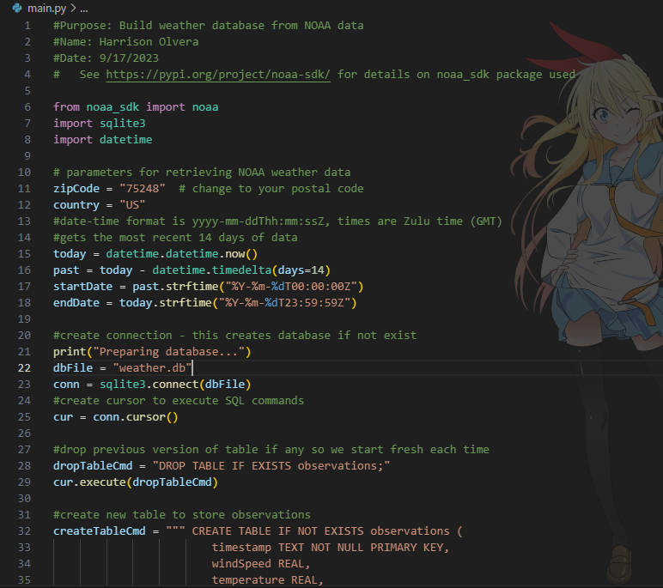
BuildWeatherDb.py Code (Screenshot)

Slide 8
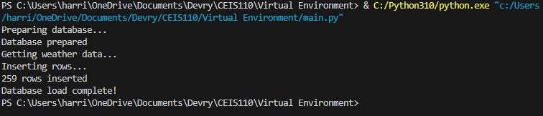
Python Console (Screenshot)

Slide 9
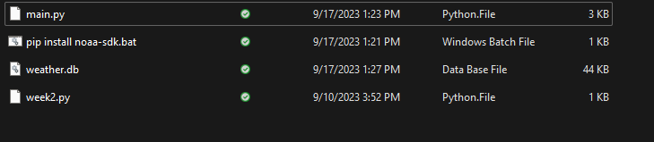
Weather.db File (Screenshot)

Slide 10
Querying the database with sql

Slide 11
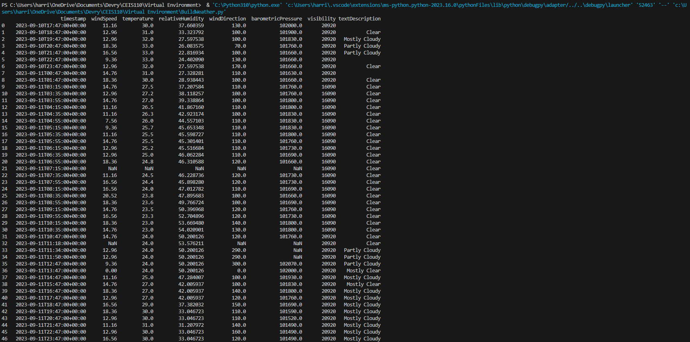
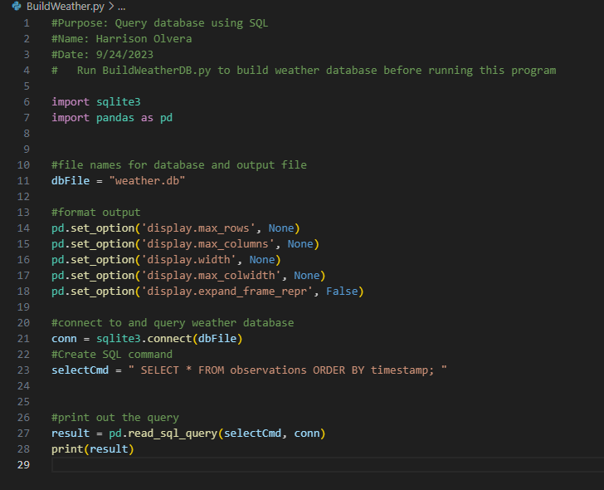
Query to retrieve all columns and all rows (Screenshot)

Slide 12
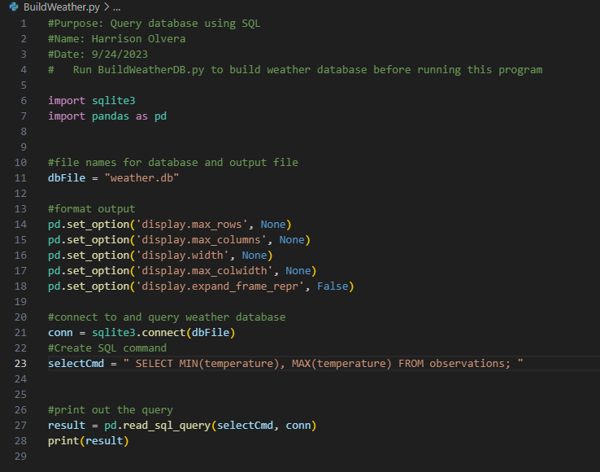
Query to retrieve lowest and highest temperatures (Screenshot)

Slide 13
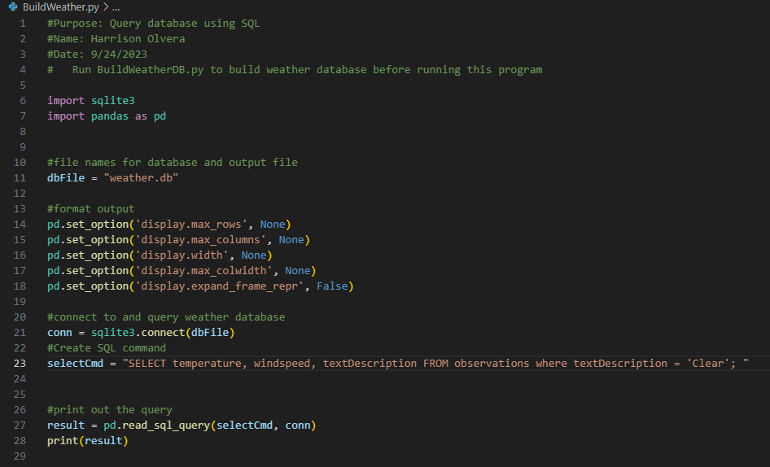
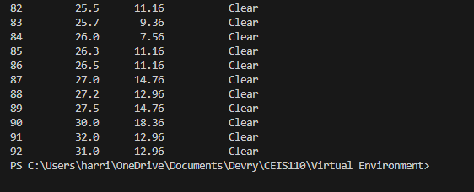
Query to retrieve all clear days (Screenshot)

Slide 14
Querying and manipulating data with SQL and Python

Slide 15
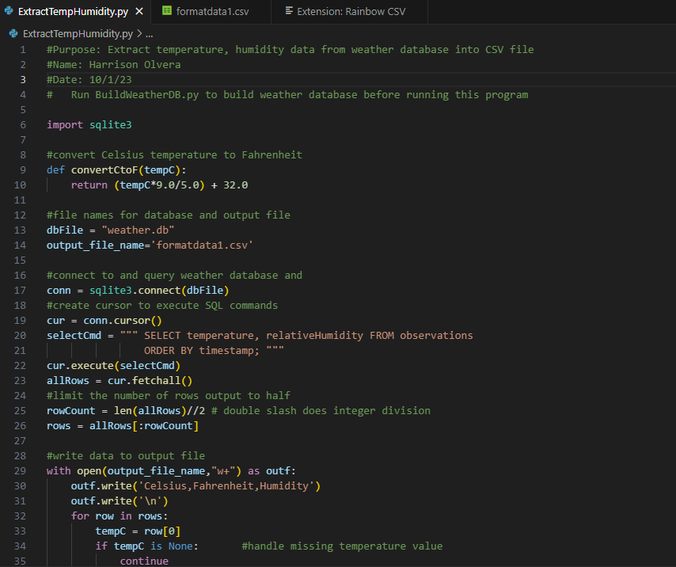
Python code (Screenshot or file)

Slide 16
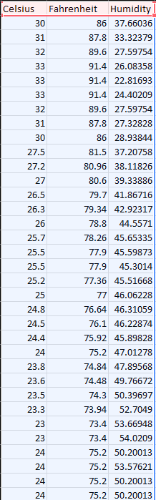
Retrieve and Convert Data to CSV Format (Screenshot)

Slide 17
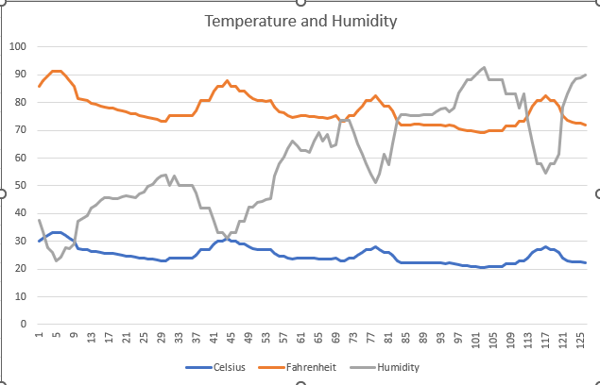
Temperature and Humidity Chart (Graph)

Slide 18
Develop Graphical Models and Interpret Results

Slide 19
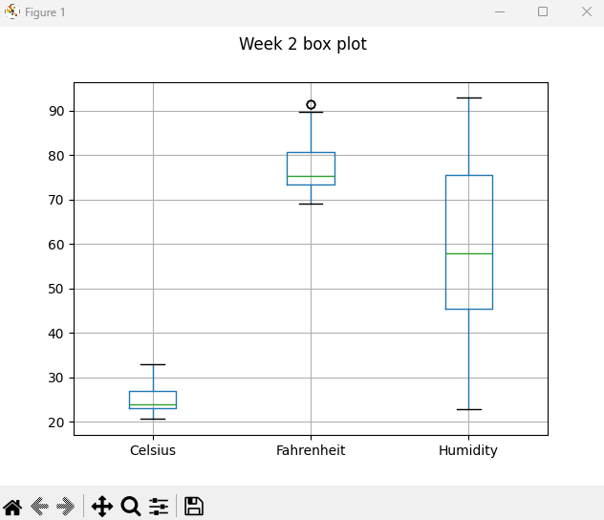
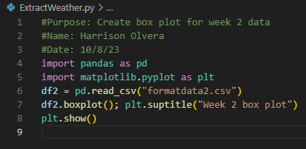
Plot #1

Slide 20
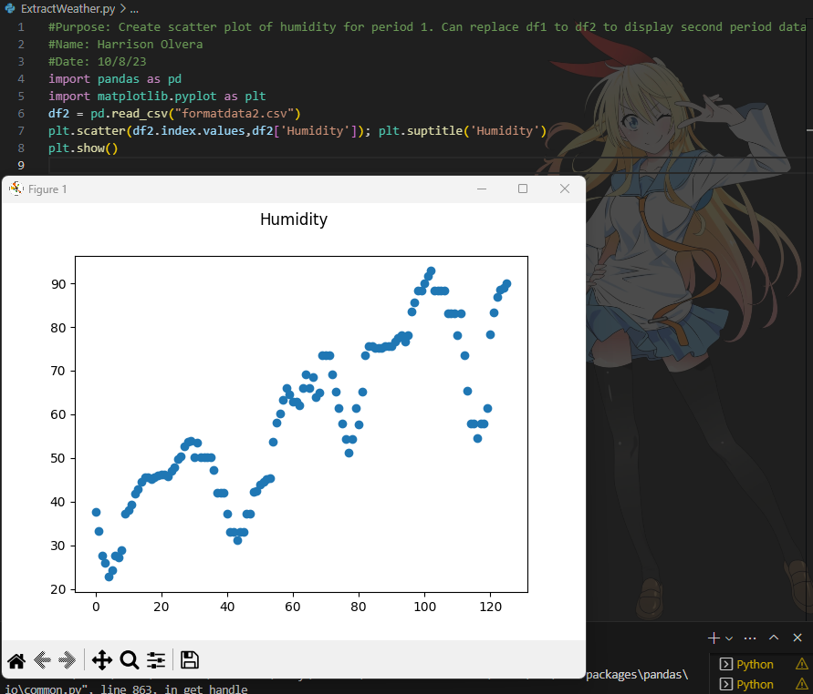
Plot #2 (Screenshots)

Slide 21
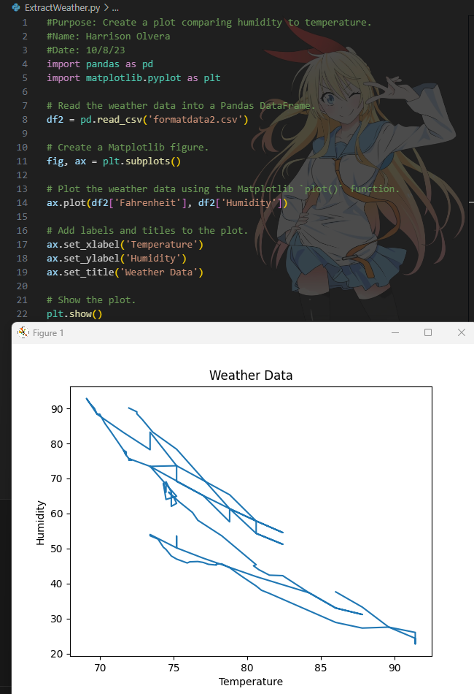
Analysis
Think of your own question and create a chart/graph to answer it
Your own question:
How is humidity compared to temperature? Does it get more humid during higher temperatures?
Answer supported by Chart:
It’s more humid during colder temperatures.

Slide 22
Prediction
Develop a prediction based on the data. What variations in temperature and humidity do you expect over the next few hours or days? How would humidity change if the temperature goes up or down?
I expect the humidity to go up over the next couple of days as the temperature goes down.

Slide 23
Challenges/lessons learned
What challenges did you face while working on the project?
Although the project was more focused on using software like Anaconda and Spyder, I chose to stick with using VS Code. Because of this, I had to learn to import weather.db, pandas, and such.
How did you overcome these challenges?
After looking up different articles that explained the steps to install from the command line, I was able to overcome the challenge and complete the project successfully.
What lessons did you learn?
How to create an IoT system utilizing principles of technology.
How to analyze the results of tests and experimentation.
How to differentiate alternative solutions to problems.

Slide 24
Career skills
Command Line Proficiency
Problem Solving
Python Proficiency
Creating Flowcharts
Formatting Data Results
Error Troubleshooting

Slide 25
Conclusion
Mastering Python has been a challenging path. I have learned that there is a whole lot more to learn in the coding world. Having different alternatives to achieve certain results has been extremely eye-opening. Utilizing articles that explain common problems has been a great help as well.

Slide 26
References
Devry University project videos and classes
Stack Overflow

