Slide 1

Title
Team members

Slide 2
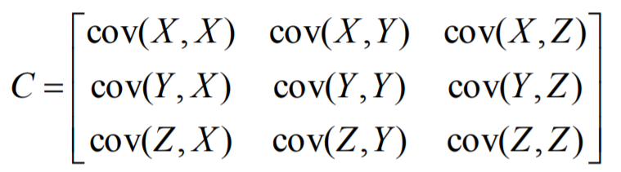
PCA application (10 marks)
Apply PCA on your features.
What eigen values did you select and why?
Write inference based on Sum of upper triangle values of covariance matrix before and after PCA.
What is the effect of normalization?

Slide 3
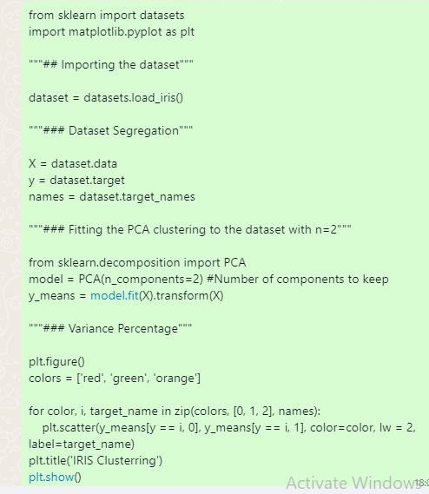

Slide 4
Clustering ( 10 marks)
Apply k-means clustering on your features.
Which value of K did you choose. Why?
What is the effect of PCA and/or normalization?
Which one is related to number of classes given in the original dataset.

Slide 5
Python
import pandas as pd
import numpy as np
import matplotlib.pyplot as plt
import seaborn as sn
customers_df = pd.read_csv( "customers.csv" )
customers_df.head( 5 )
#sn.lmplot( "age", "income", data=customers_df, fit_reg = False, size = 4 );
from sklearn.cluster import KMeans
clusters = KMeans( 3 )
clusters.fit( customers_df )
customers_df["clusterid"] = clusters.labels_
customers_df[0:5]

Slide 6
Python
markers = ['+','^','.']
sn.lmplot( "age", "income", data=customers_df,
hue = "clusterid", fit_reg=False, markers = markers,
size = 4 );

Slide 7
Python – Normalized Values
from sklearn.preprocessing import StandardScaler
scaler = StandardScaler()
scaled_customers_df = scaler.fit_transform(
customers_df[["age", "income"]] )
scaled_customers_df[0:5]
from sklearn.cluster import KMeans
clusters_new = KMeans( 3, random_state=42 )
clusters_new.fit( scaled_customers_df )
customers_df["clusterid_new"] = clusters_new.labels_
markers = ['+','^','.']
sn.lmplot( "age", "income", data=customers_df,
hue = "clusterid_new",fit_reg=False, markers = markers,
size = 4 );

