Slide 1

Heart Disease Prediction
Group No. 6
Achanta Sai Krishna – CB.EN.U4ELC20004
Kuralanbu S – CB.EN.U4ELC20033
Vimal Dharshan N – CB.EN.U4ELC20081

Slide 2
CA1 Summary
We have researched about Knn classifier and Normalization inferred the following:
The Minkowski Distance is a metric in a normed vector space that uses both Manhattan and Euclidean distance in a generalized form for calculation.
Splitting the dataset into training and testing, where 70% for training and 30% for testing.
Cross Validation(cv): Re-sampling procedure used to evaluate a model.
For various values of K, the accuracy rates change, and the best case was found by plotting all the values.
The confusion matrix is used to determine the performance of the classification models for a given set of test data.
Normalization is a scaling technique where all the data in the dataset is scaled between a range that is 0 and 1.

Slide 3
References
Dataset:
https://www.kaggle.com/datasets/aasheesh200/framingham-heart-study-dataset
Reference:
https://www.geeksforgeeks.org/ml-principal-component-analysispca/ https://www.elastic.co/guide/en/elasticsearch/reference/current/coerce.html

Slide 4
Problem Formulation
Objective: To identify Heart Disease of a patient based on the given features
Dataset details:
No. of rows: 4239
No. of columns: 17
No. of Class: 02
Method of data collection is unknown
Assumptions:
From the link mentioned for dataset, “framingham.csv” was considered for solving
In features, “Male” is changed to “Sex”
In features, “TenYearCHD” is changed to “target”.
In features, “Education” is changed to “Chest Pain Type”.

Slide 5
Problem Formulation
Assumptions:
Missing data were filled with the mean of the rest of the corresponding data.
Link to full code mentioned in slides:
https://colab.research.google.com/drive/1LQE3ZlfJMKcVebWDTYiN2gSTh9R_c3vy#scrollTo=rn2cTWr-j_xu
https://colab.research.google.com/drive/1mq0485r2WlABTFt6FzbX85SF2COhHe4w#scrollTo=Uu61gVSazlNK
https://colab.research.google.com/drive/1APUqgwjLrax2i9cOLqrIHnJM_8NiDZ4h#scrollTo=NHpdMRJbp8Lo

Slide 6
Feature Description
sex – The person’s sex (0 = female; 1 = male)
age – The person’s age in years
Chest Pain Type – 1: Typical Angina, 2: Atypical Angina, 3:Non-Angina Pain, 4:Asymptomatic
currentSmoker – The person is currently smoking (0 = false; 1 = true)
cigsPerDay – Amount of cigarettes smoked per day by a person
BPMeds – The person is taking medicine for blood pressure (0 = false; 1 = true)
prevalentStroke – The person has a common stroke (0 = false; 1 = true)
prevalentHyp – The person has common hypertension (0 = false; 1 = true)
diabetes – The person has diabetes (0 = false; 1 = true)

Slide 7
Feature Description
totChol – Total cholesterol of a person (in mg/dl)
sysBP – Systolic blood pressure of a person (in mm Hg)
diaBP – Diastolic blood pressure of a person (in mm Hg)
BP – Total blood pressure of a person (sysBP/diaBP)
BMI – Body Mass Index of a person (kg/m ² )
heartRate – Total heart rate achieved by a person (bpm)
glucose – Fasting blood sugar level of a person (mg/dl)
target – Heart Disease of a person (0 = false; 1 = true)

Slide 8
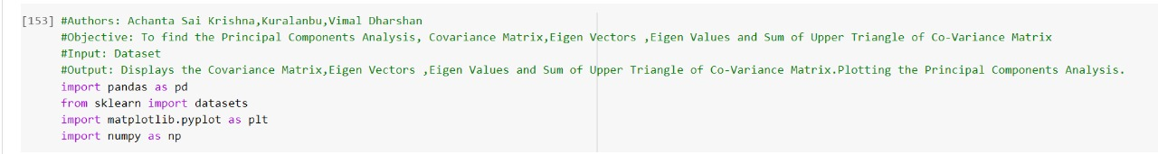
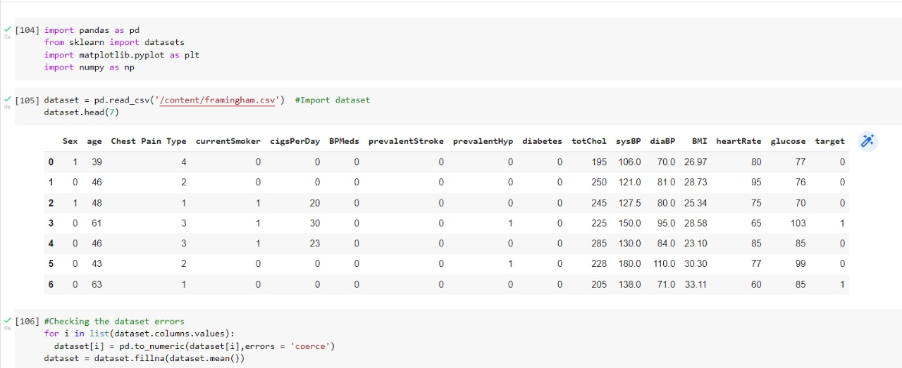
PCA

Slide 9
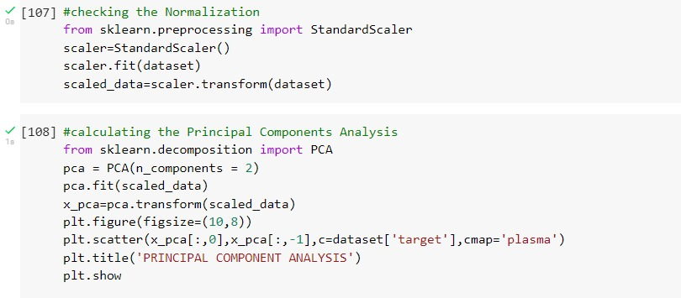

Slide 10
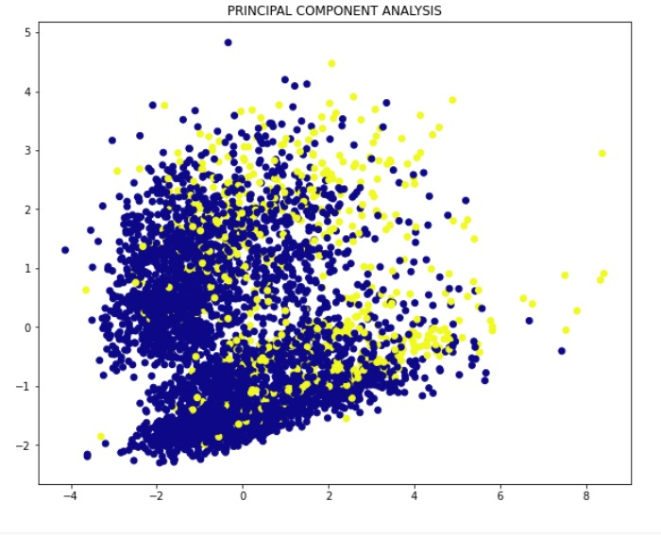

Slide 11
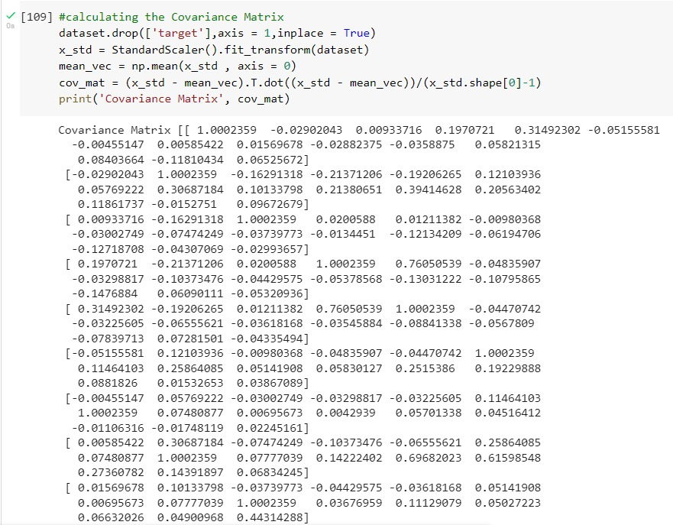
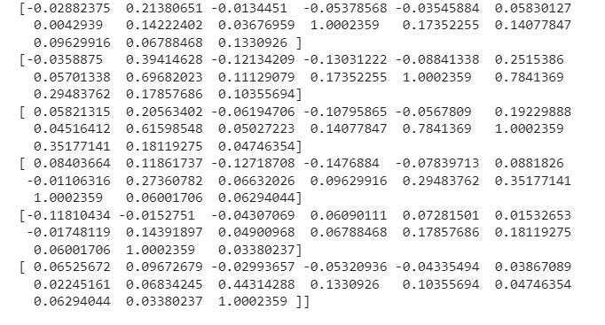

Slide 12
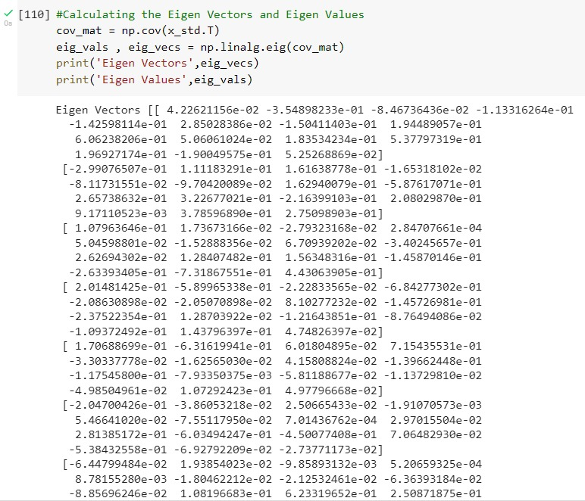

Slide 13
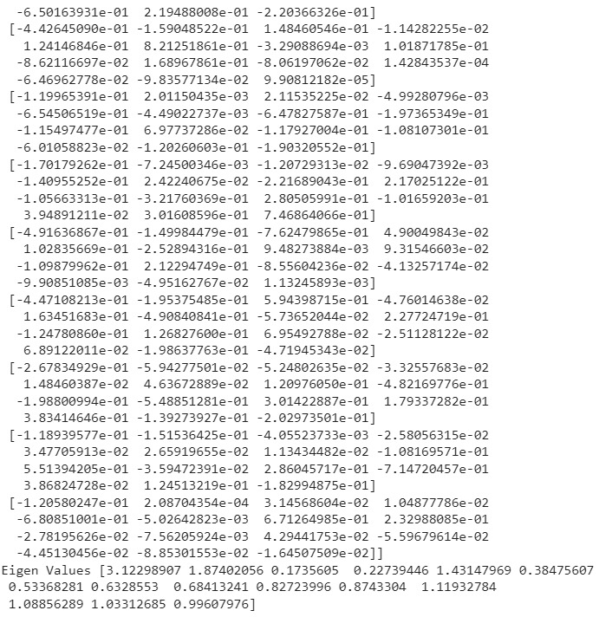

Slide 14
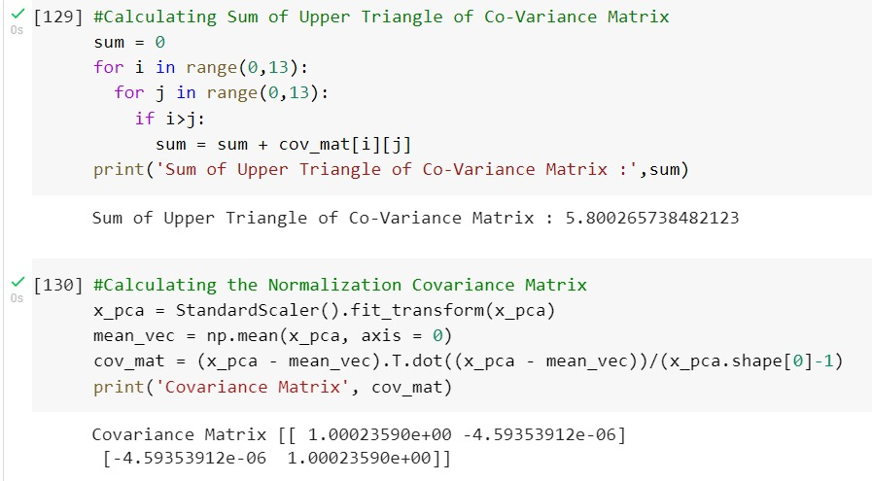
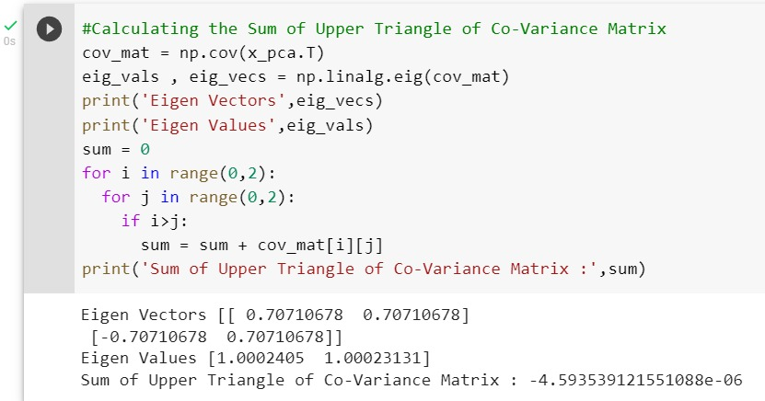

Slide 15
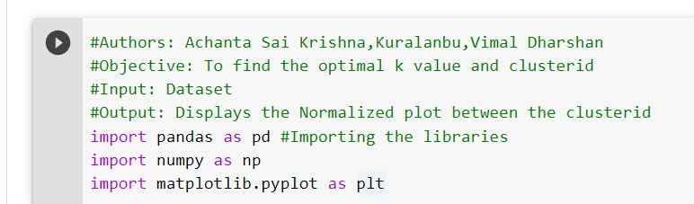
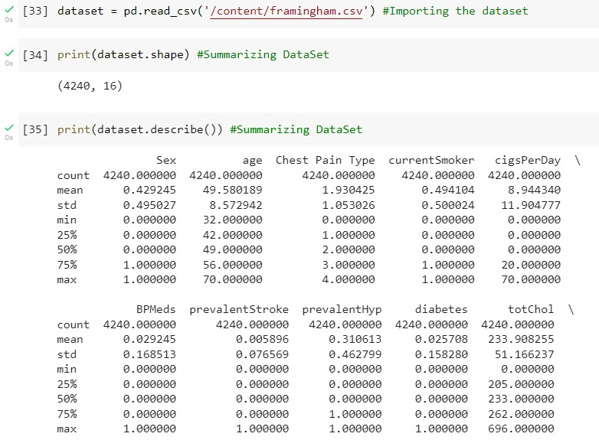
Clustering

Slide 16
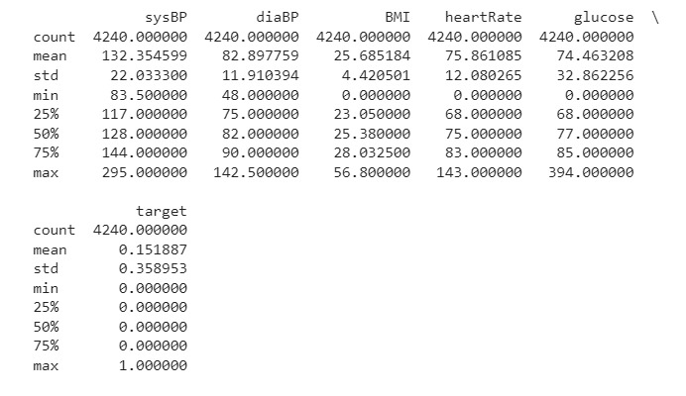

Slide 17
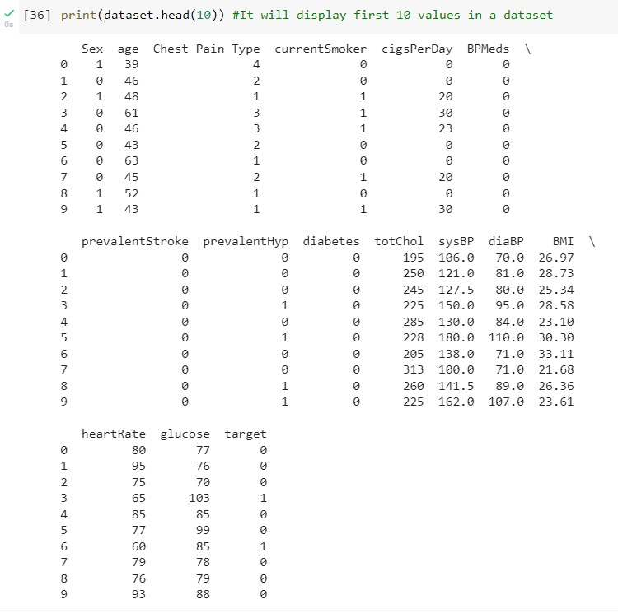

Slide 18
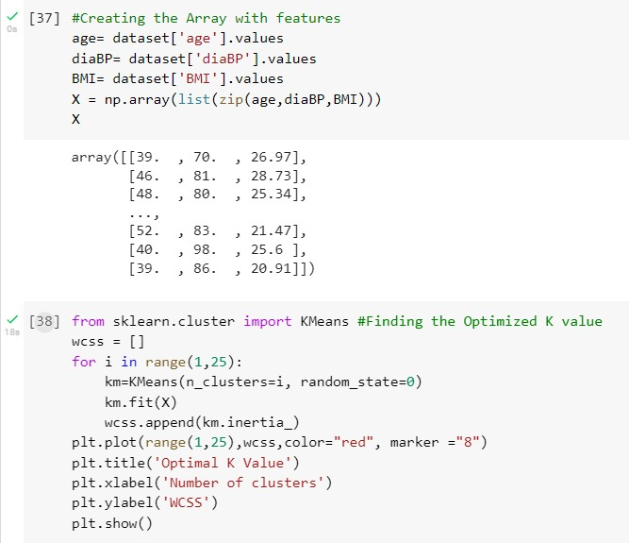
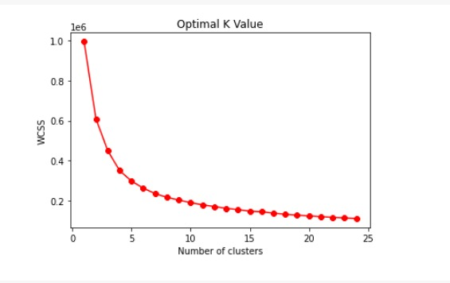

Slide 19
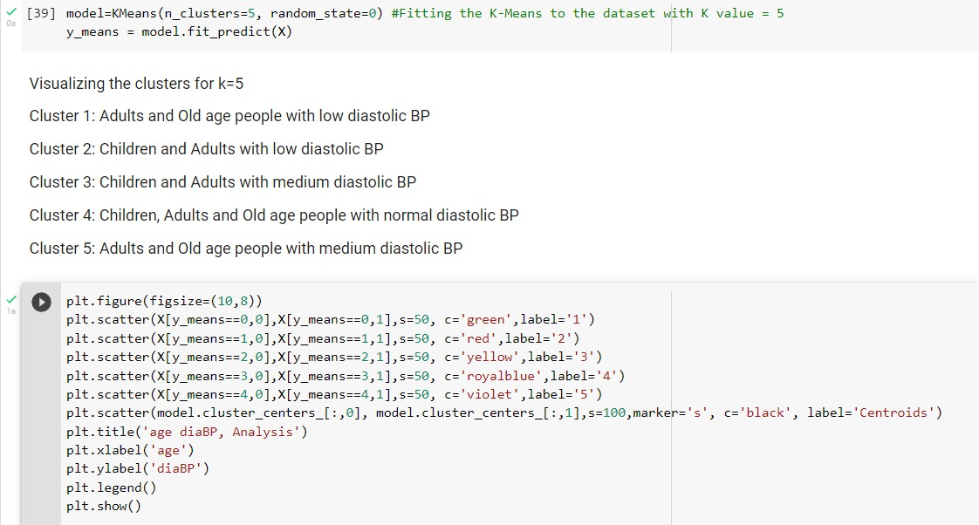

Slide 20
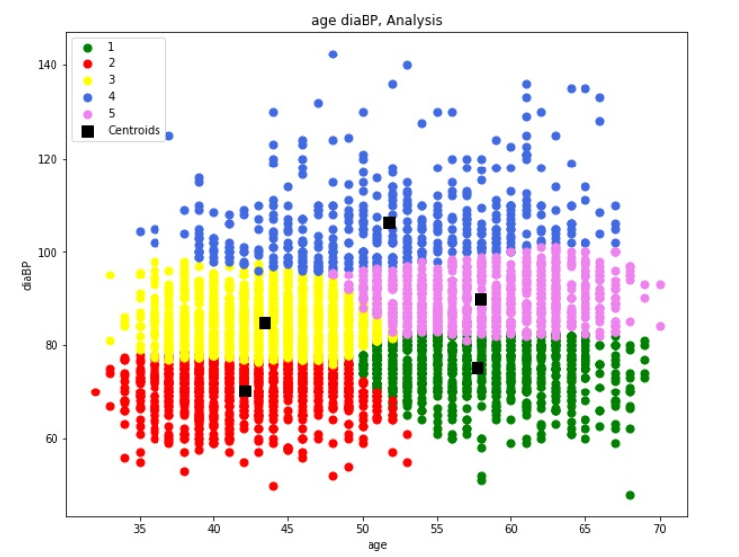

Slide 21
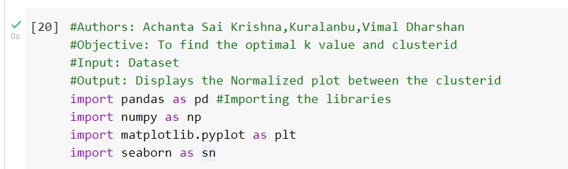
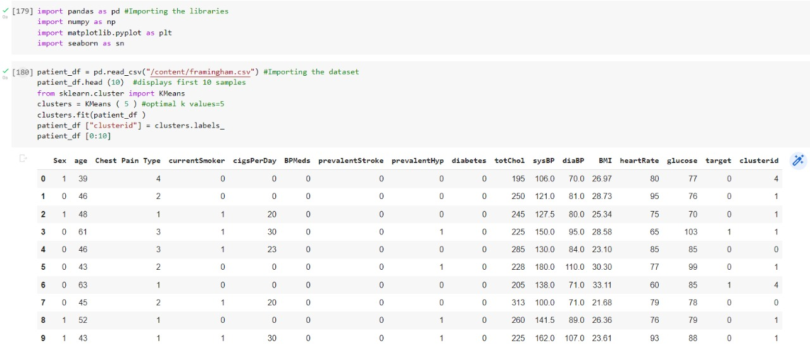
Clustering

Slide 22
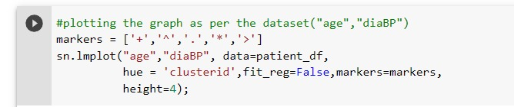
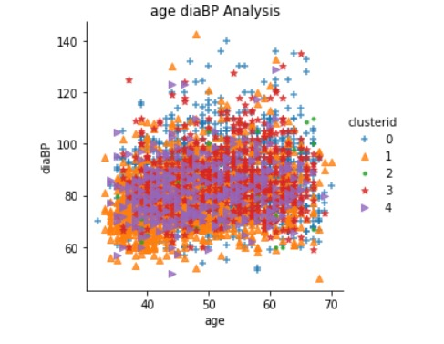

Slide 23
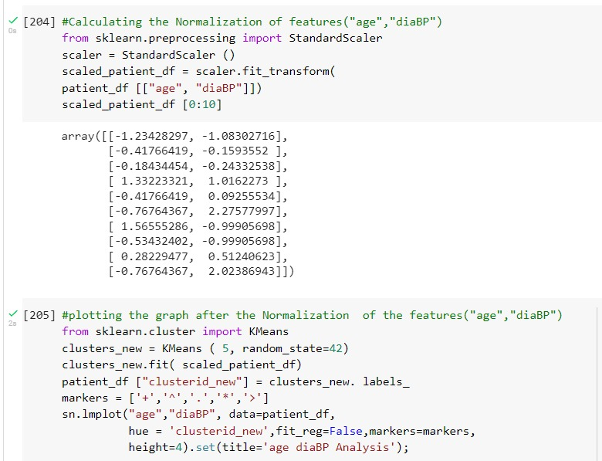

Slide 24
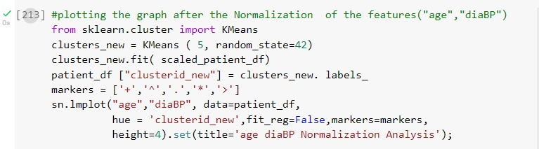
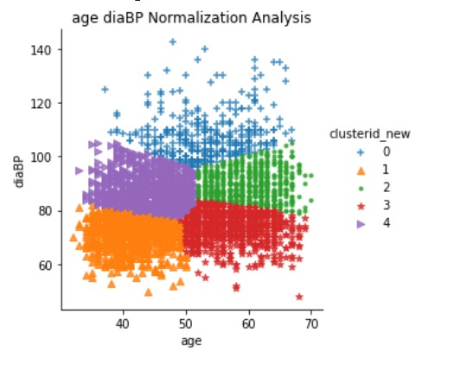

Slide 25
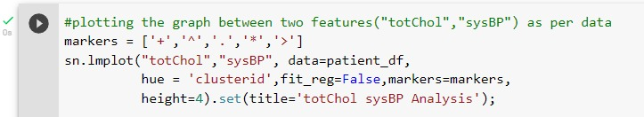
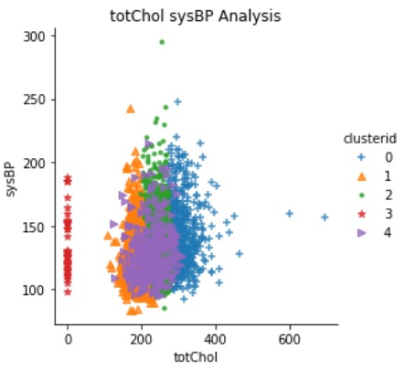

Slide 26
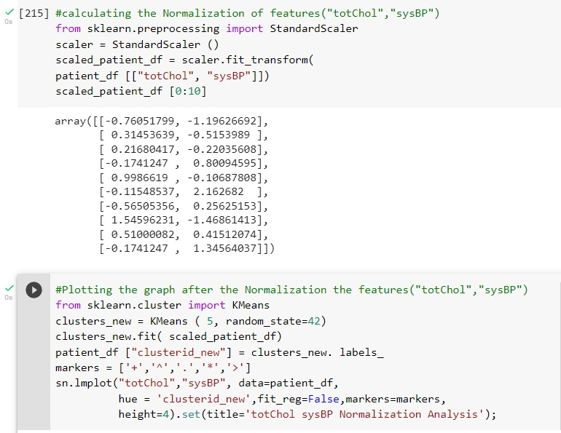

Slide 27
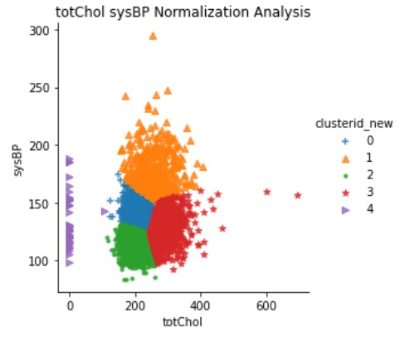

Slide 28
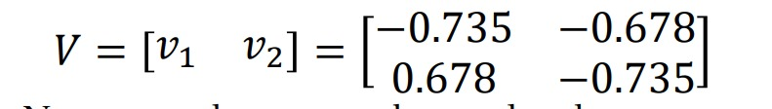
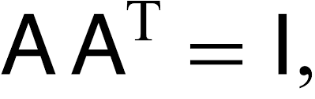
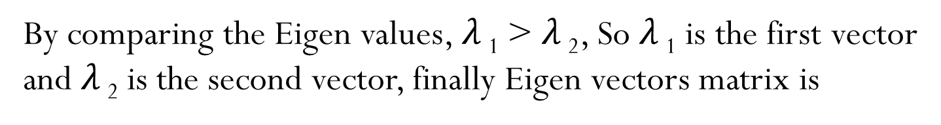
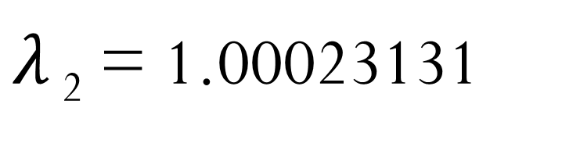
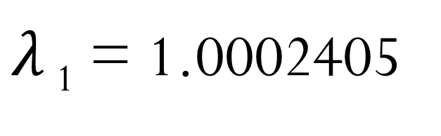
PCA: What eigen values did you select and why?
Eigen Vectors:
0.70710678
0.70710678
-0.70710678
0.70710678
Because
and
are orthogonal or
orthonormal.
Orthogonal matrix:
The matrix is said to be an orthogonal matrix if the product of a matrix and its transpose gives an identity value.
Orthogonal matrix is also known as Orthonormal matrix
Eigen Values:
$λ$ ₁ = 1.0002405
$λ$ ₂ = 1.00023131
By comparing the Eigen values, $λ$ ₁ > $λ$ ₂, So $λ$ ₁ is the first vector
and $λ$ ₂ is the second vector, finally Eigen vectors matrix is

Slide 29
PCA: Write inference based on the Sum of upper triangle values of the covariance matrix before and after PCA.
Before the Principal Component Analysis, the sum of the upper triangle values of the covariance matrix is positive.
And after the Principal Component Analysis, the sum of the upper triangle values of the covariance matrix is negative.

Slide 30
PCA: What is the effect of normalization?
Before the effect of normalization, the covariance matrix and eigenvector matrix print all the dataset’s features, i.e., 16x16 matrix.
After using the normalization PCA, according to our project, we reduced the features to 2, so the covariance matrix and the eigenvector matrix are printed to a 2x2 matrix.

Slide 31
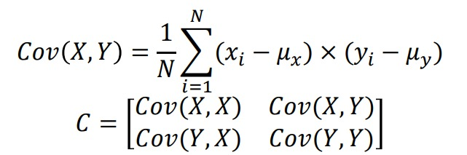
PCA Inference:
Except ‘totChol’ feature in our dataset remaining feature’s standard deviation is very low and accepted as good features.
The covariance matrix ranges from -1 to 1.
Eigen Vector with highest Eigen value is called Principal Component of the data.
As the features are increased while calculating the sum of upper triangle of Co-Variances will changes
After the standardization the covariance matrix is changed and the sum of the upper triangle matrix is changed to negative value.

Slide 32
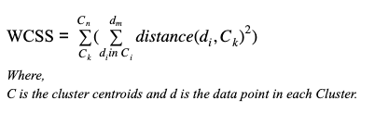
Clustering: Which value of K did you choose. Why?
When we compute and plot the Within-Cluster-Sum-of-Squares (WCSS) against the different values of k (starting from 1). The optimal number of clusters is given by the sharp turn in the Elbow graph.
According to our project, the optimal number (K) is 5.

Slide 33
Clustering: What is the effect of PCA and/or normalization?
After fitting the K-Means value, where K=5, i.e., clusters are divided into five types, and each cluster id is labelled to each sample in the dataset.
Before normalization, the plot between two samples(with relatively the same values) is not able to distinguish the clusters properly.
When we consider two features (with relatively the same values), after standardization, the value changes from -2 to +2.
After normalization, the plot between the two samples distinguishes the clusters properly.

Slide 34
Clustering: Which one is related to number of classes given in the original dataset.
While observing the plotted normalized graph, the number of samples in cluster 1 is greatest compared to the remaining clusters.
After the normalized graph is plotted, the cluster having the least sample is considered as cluster 5.
For each cluster, the centroid has been plotted and calculated by K-Means.

Slide 35
Clustering Inference
The main objective of clustering is to create heterogeneous subsets(clusters) from the original dataset such that data samples within a cluster are homogeneous.
Clustering is important as it determines the intrinsic grouping among the present un-labelled data.
K-Means Clustering Algorithm:
It’s the simplest unsupervised algorithm that solves the clustering problem.
K-Means algorithm partitions (n) samples into (K) clusters where each sample belongs to the cluster with the nearest mean acta as a centroid of the cluster.

Slide 36
Miscellaneous - PCA
PCA is an unsupervised linear dimensionally reduction algorithm to transform the original variables to a linear combination of these independent variables.
Number of principal components is always less than or equal to the number of attributes.
The priority of principal components decreases as their numbers increase.
Principal components are orthogonal.
PCA reduces the computational complexity by dropping low variance dimensions, as well as creating better visualization.

Slide 37
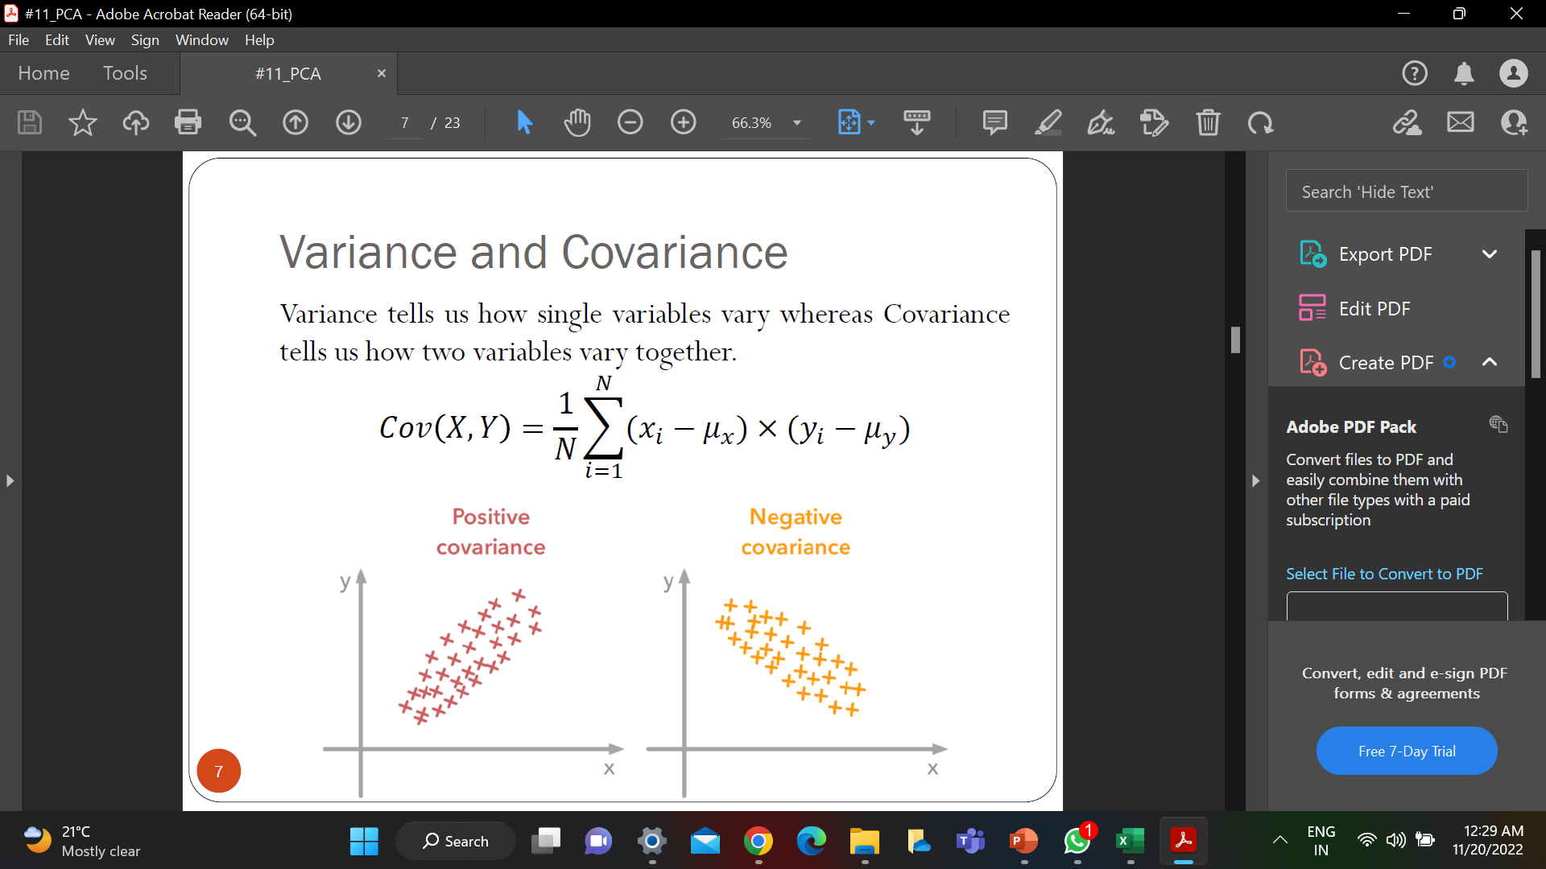
Miscellaneous - PCA
Covariance Matrix is a matrix used to represent the covariance values between pairs of elements given in a random vector.
A covariance matrix is usually a square matrix. It is also positive, semi-definite, and symmetric.
Coercion attempts to clean up dirty values to fit the data type of a field. For instance:
Strings will be coerced to numbers.
Floating points will be truncated for integer values.
Using errors=‘coerce’. It will replace all non-numeric values with mean.

Slide 38

Miscellaneous - PCA
Eigenvalues and Eigenvectors:
Eigenvalues and Eigenvectors as these concepts are used in one of the most popular dimensionality reduction techniques – Principal Component Analysis (PCA).
Eigenvalues and Eigenvectors concepts are keys to training computationally efficient and high-performing machine learning models.
The eigenvectors are called principal axes or principal directions of the data. Projections of the data on the principal axes are called principal components.

Slide 39
Miscellaneous - PCA
Sum of Upper Triangular of Co-Variance Matrix:
Formula to find sum of all elements matrix A inside the red triangular area is given by -sum = sum + Aij (Where i<j)
Upper Triangular Matrix:
A matrix whose all elements below diagonal elements are zeros (i.e. a_ij = 0 for i > j).

Slide 40
Miscellaneous - Libraries
from sklearn.preprocessing import StandardScaler:
The preprocessing module provides the StandardScaler utility class to perform the operation on an array-like dataset and standardize the dataset’s features onto a unit scale (mean = 0 and variance = 1).
from sklearn.decomposition import PCA:
We need to select the required number of principal components. Usually, n_components is chosen to be 2 for better visualization, but it matters and depends on the data. By the fit and transform method, the attributes are passed.
from sklearn.cluster import K-Means:
The k-Means algorithm is very fast (one of the fastest clustering algorithms available) but falls in local minima. That’s why it can be useful to restart it several times.

Slide 41
Miscellaneous - Clustering
Within-Cluster-Sum-of-Squares (WCSS). WCSS is the sum of squares of the distances of each data point in all clusters to their respective centroids. The idea is to minimize the sum.
km_inertia: Inertia measures how well a dataset was clustered by K-Means. It is calculated by measuring the distance between each data point and its centroid, squaring this distance, and summing these squares across one cluster.

