Slide 1
Spatial scale in crime location choice research
Wim Bernasco, NSCR / VU
K Kuralarasan, Ghent University

Slide 2
What is crime location choice?
Prelude
Literature
How did prior studies deal with spatial scale?
Theory
What does choice theory say about spatial scale?
Analysis
How should we deal with spatial scale?

Slide 3
What is crime location choice?
Question: What makes offenders chose a crime location?
Answer: Attributes of potential locations and offenders
Idiosyncratic features (offender awareness of locations)
Rational choices (utility maximization)
Discrete choice model (conditional logit, or mixed logit)
Disaggregated (individual) data
Locations must be discrete, mutually exclusive and collectively exhaustive
Locations can be any size and shape (street, block, city)

Slide 4
How did prior studies deal with spatial scale?
Literature search
Ruiter (2017; 17 studies) and Google Scholar search
Quantitative empirical studies using discrete choice framework
Result: 33 crime location choice studies (some use same data)
Code
Label of spatial unit (e.g., street segment, neighbourhood)
Average size of spatial unit
Number of spatial units
Number of crimes

Slide 5
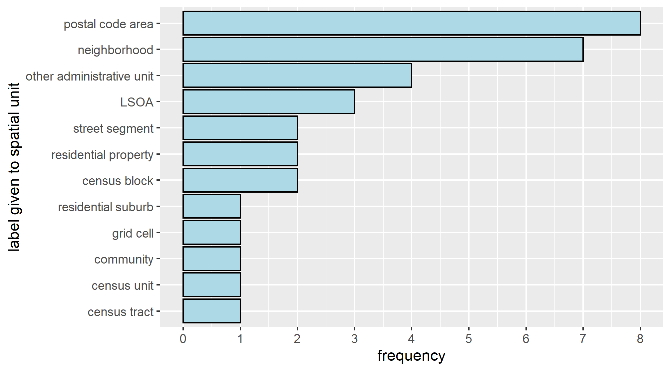
How have spatial units been labelled?

Slide 6
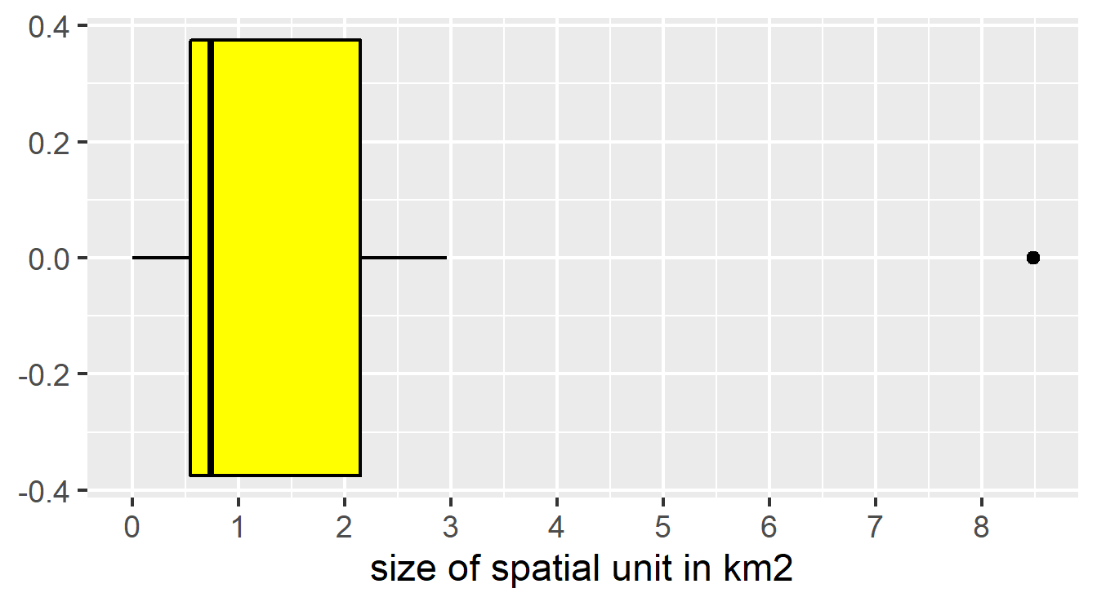
What were sizes of spatial units*?
* Note: No size details in 11 of the 33 studies

Slide 7
MAUP in crime location choice?
Potentially yes!
No studies checked for MAUP (all conducted single-scale analysis)
MAUP is a theoretical issue

Slide 8
Theory: main assumption
Offenders choose elemental spatial alternatives
Researchers aggregate spatial alternatives

Slide 9
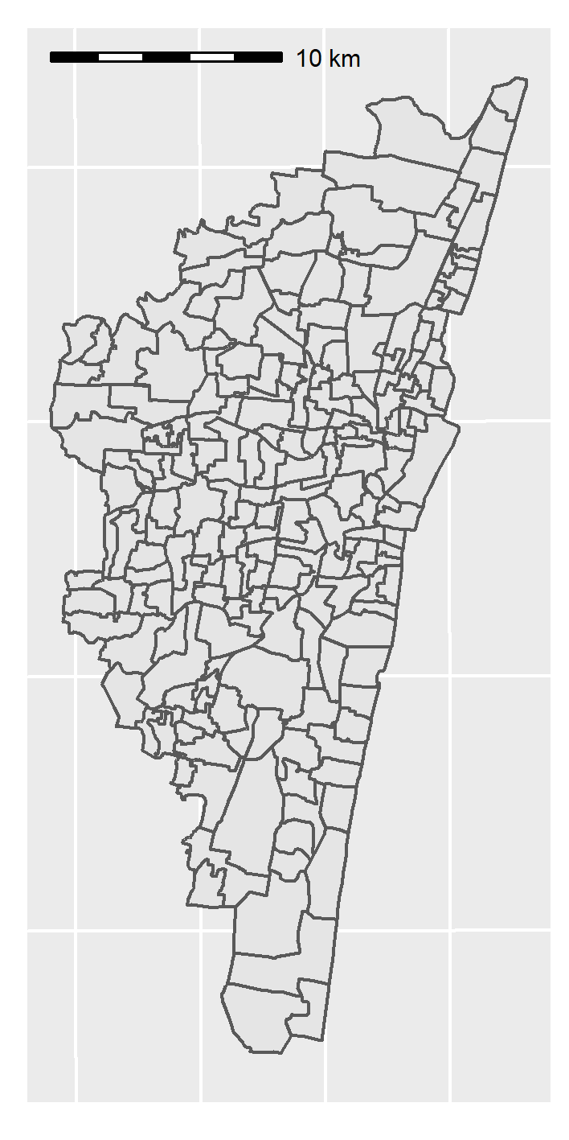
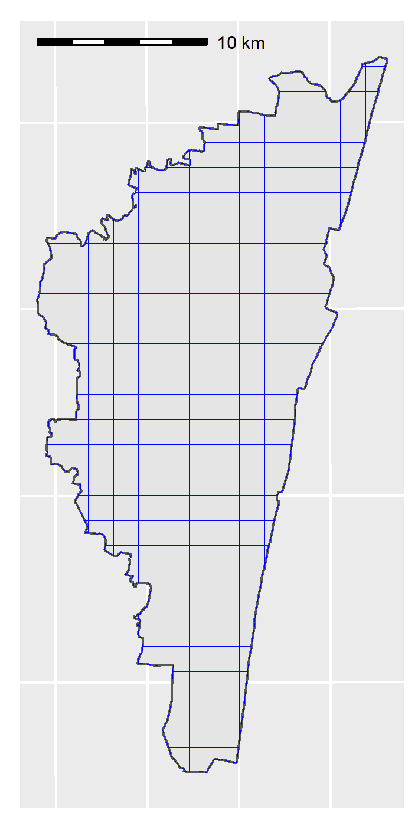
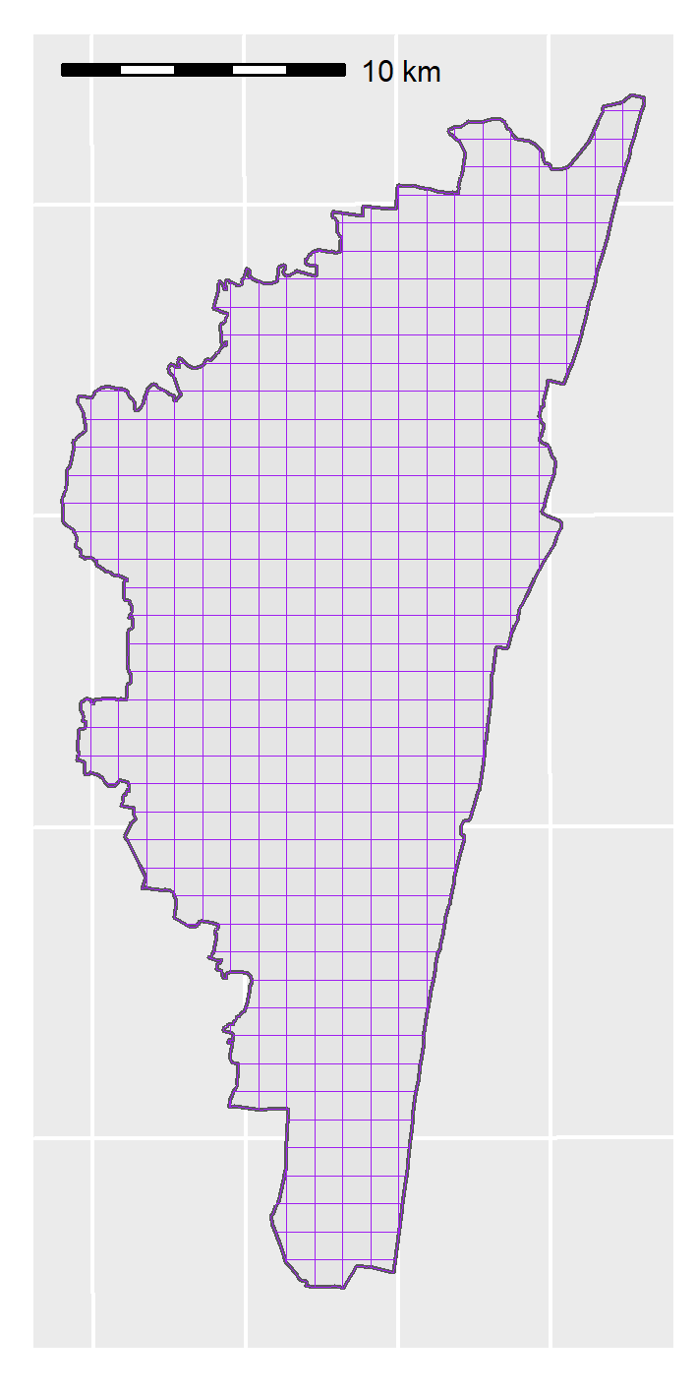
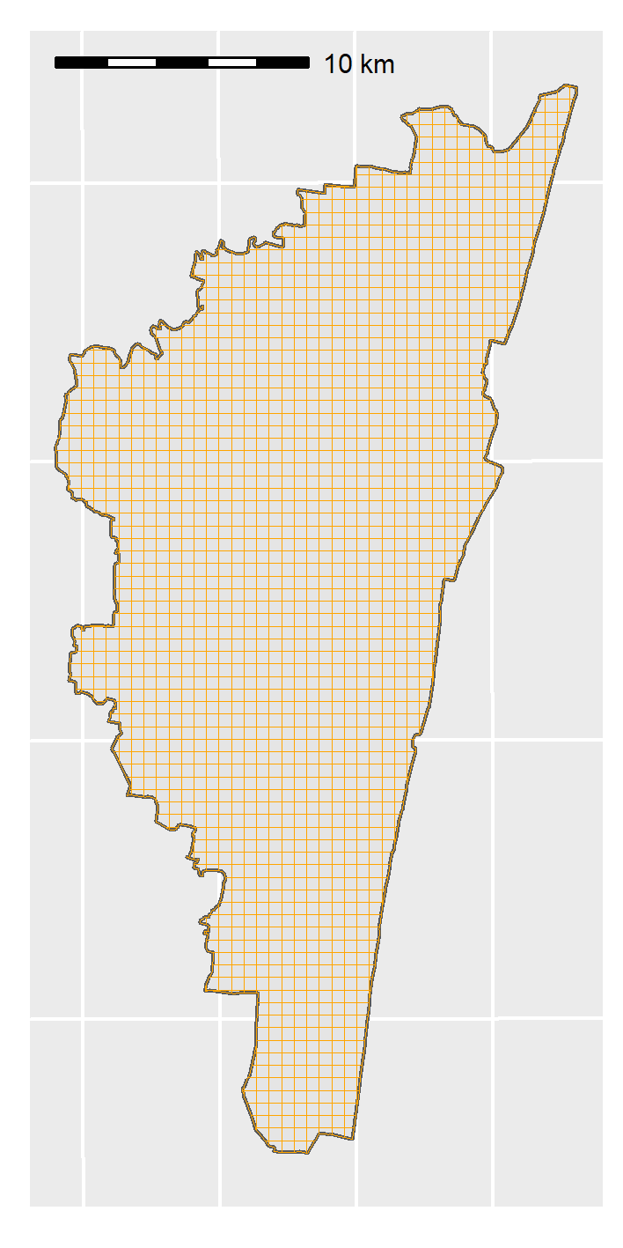
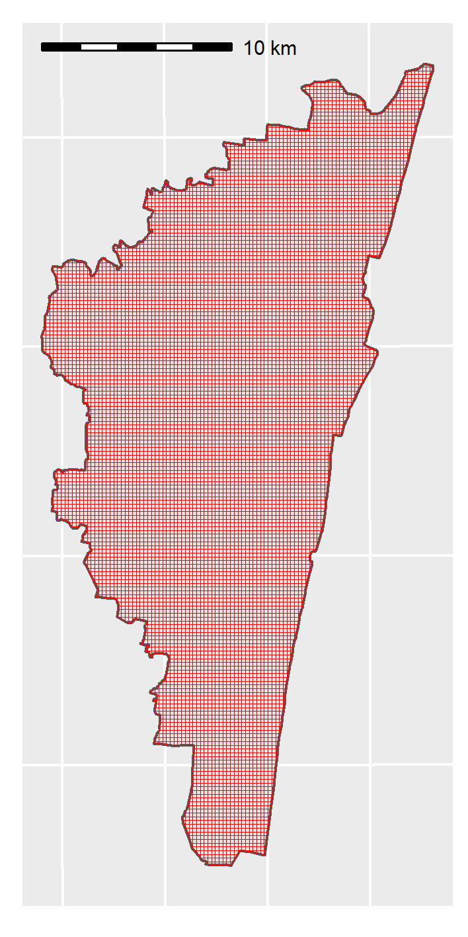
Wards and four alternative grid sizes
Chennai wards
1500m × 1500m
1000m × 1000m
500m × 500m
200m × 200m
Ward geometry

Slide 10
Wards and four alternative grid sizes
Chennai wards
1500m × 1500m
1000m × 1000m
500m × 500m
200m × 200m
Computational nightmare

Slide 11
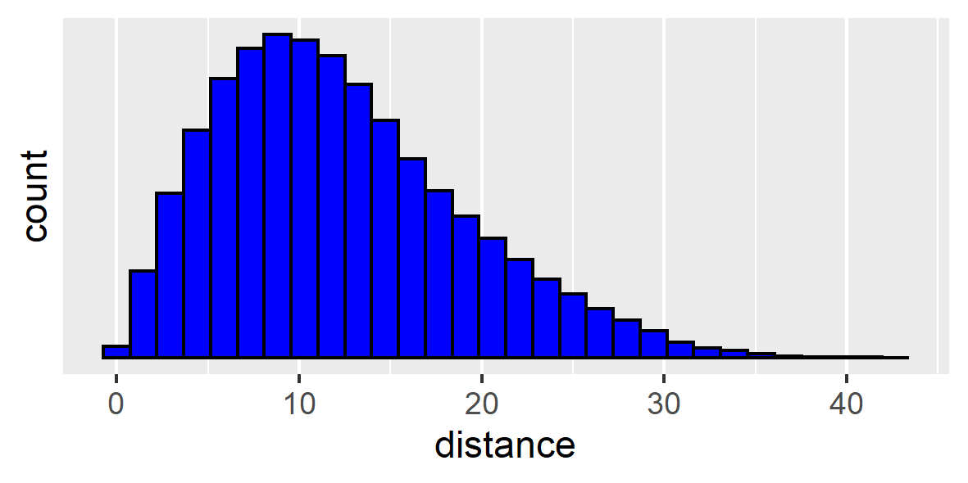
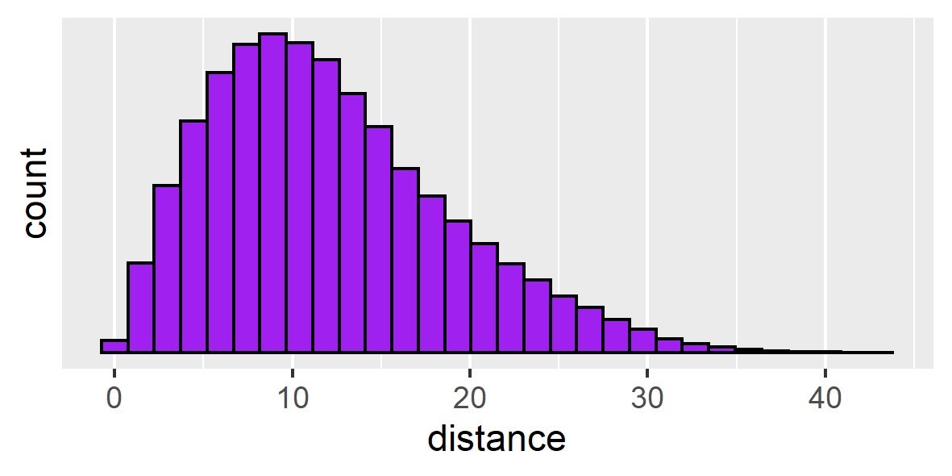
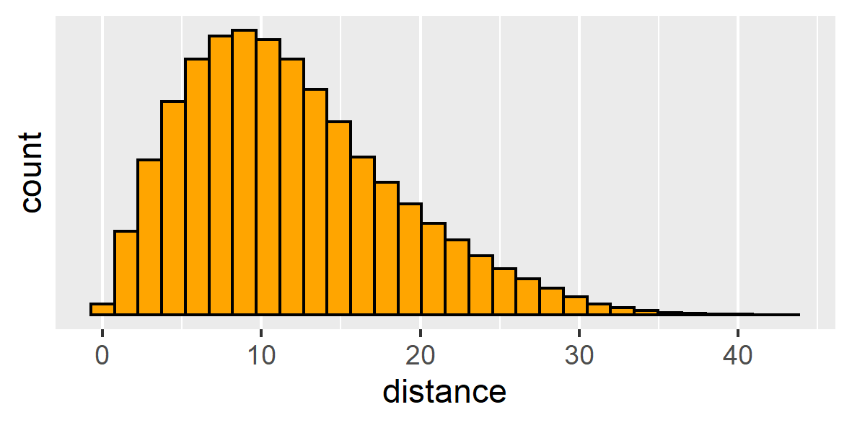
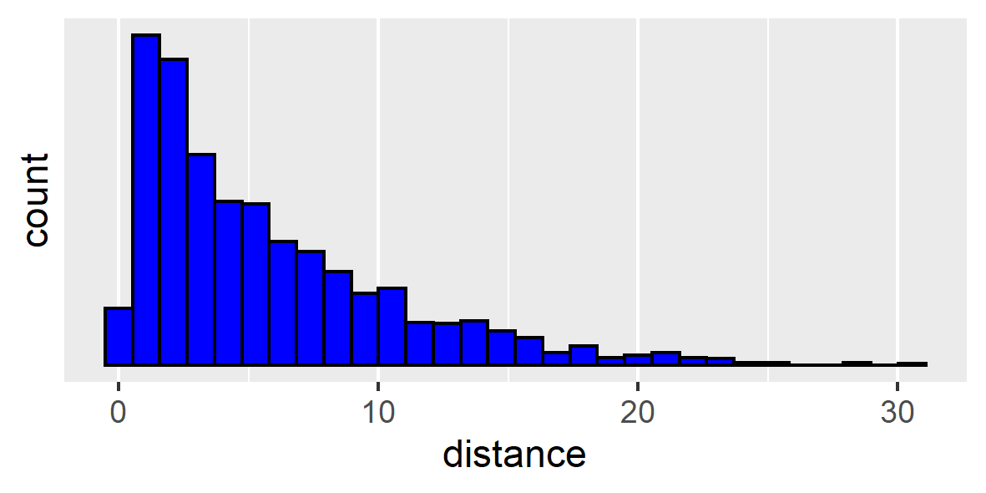
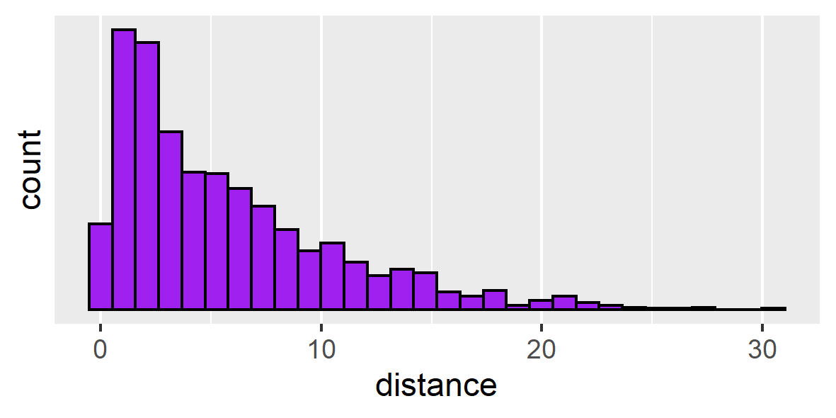
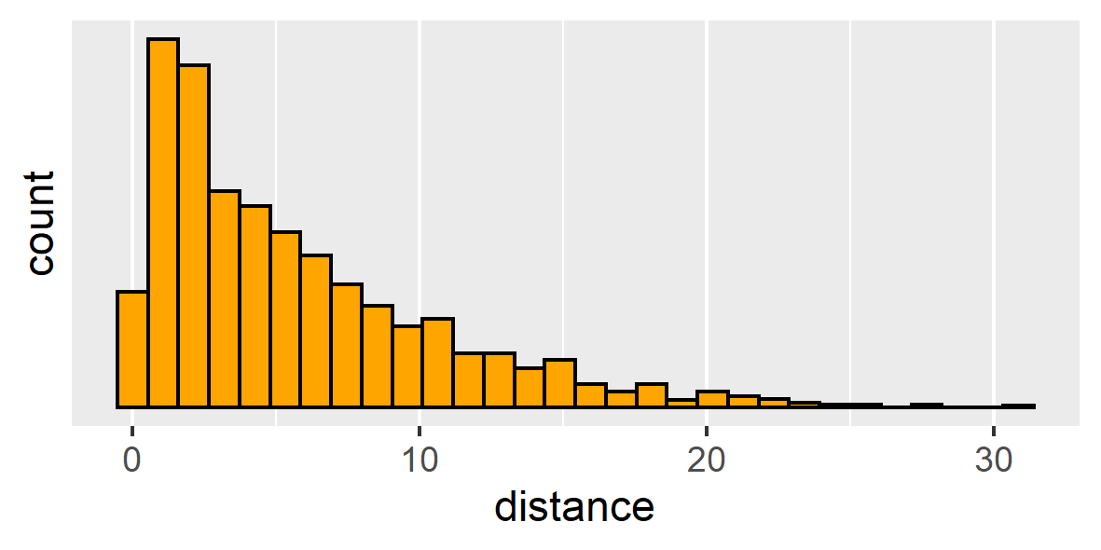
Distances between all grid cells
1500m × 1500m
1000m × 1000m
500m × 500m
Distance to crime

Slide 12
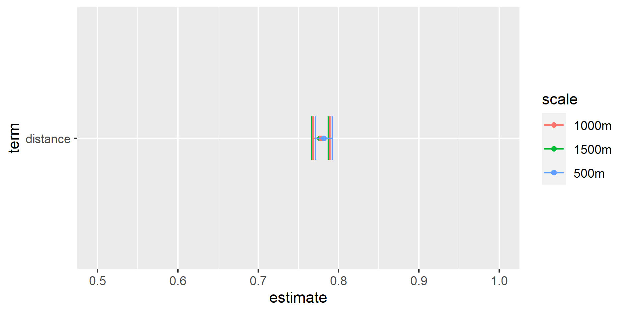
Model 1: Only distance to offender home

Slide 13
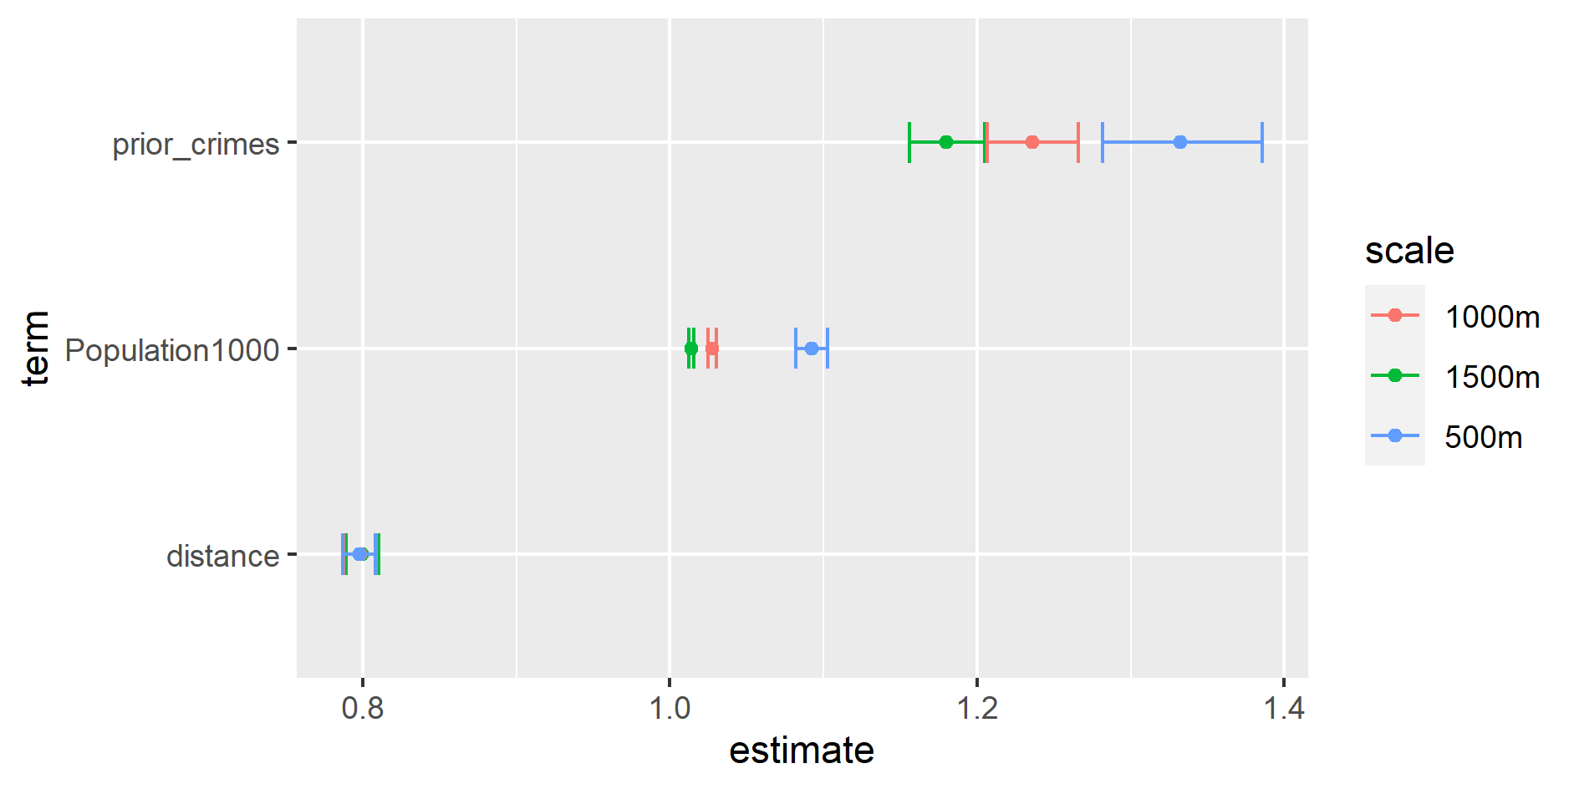
Model 2:Distance, population and prior crimes

Slide 14
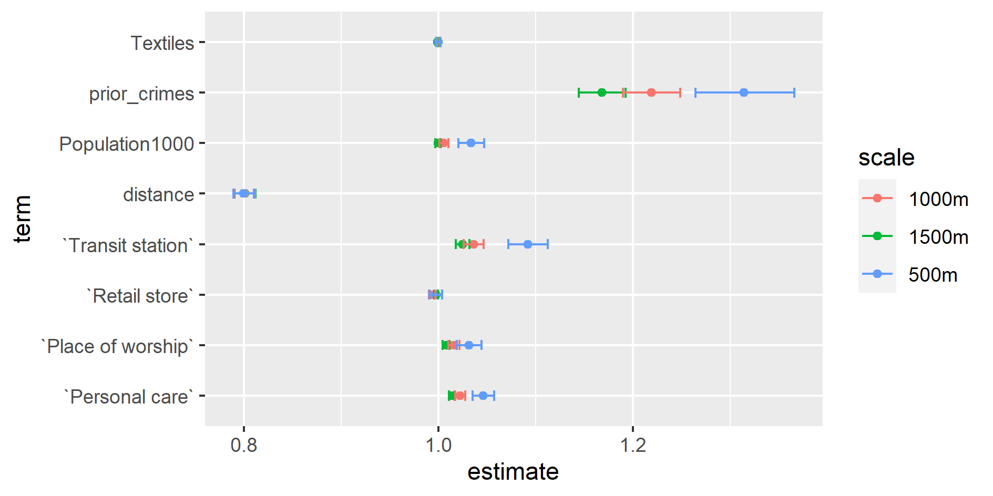
Model 3: Distance, population, prior crimes and crime attractors

Slide 15
Conclusions and future work
Directions and significance levels correspond between scales
Larger units: smaller confidence intervals, smaller estimates
Differences are generally small
Occasionally confidence intervals do not overlap
Do simulations to study MAUP
Replicate on other datasets
Study other shapes than grids

Slide 16
Thanks!

Slide 17
References
Ben-Akiva, M. E., & Lerman, S. R. (1994). Discrete Choice Analysis: Theory and Applications to Travel Demand. Cambridge, MA: MIT Press.
Ferguson, M. R., & Kanaroglou, P. S. (1995). Utility Variability within Aggregate Spatial Units and its Relevance to Discrete Models of Destination Choice. In L. Anselin & R. J. G. M. Florax (Eds.), New Directions in Spatial Econometrics (pp. 243-269). Berlin, Heidelberg: Springer Berlin Heidelberg. DOI: https://doi.org/10.1007/978-3-642-79877-1_11
Ferguson, M. R., & Kanaroglou, P. S. (1997). An Empirical Evaluation of the Aggregated Spatial Choice Model. International Regional Science Review, 20(1-2), 53-75. DOI: https://doi.org/10.1177/016001769702000104
Ferguson, M. R., & Kanaroglou, P. S. (1998). Representing the Shape and Orientation of Destinations in Spatial Choice Models. Geographical Analysis, 30(2), 119-137. DOI: https://doi.org/10.1111/j.1538-4632.1998.tb00392.x
Kanaroglou, P. S., & Ferguson, M. R. (1996). Discrete spatial choice models for aggregate destinations. Journal of Regional Science, 36(2), 271-290. doi: https://doi.org/10.1111/j.1467-9787.1996.tb01269.x

