Slide 1
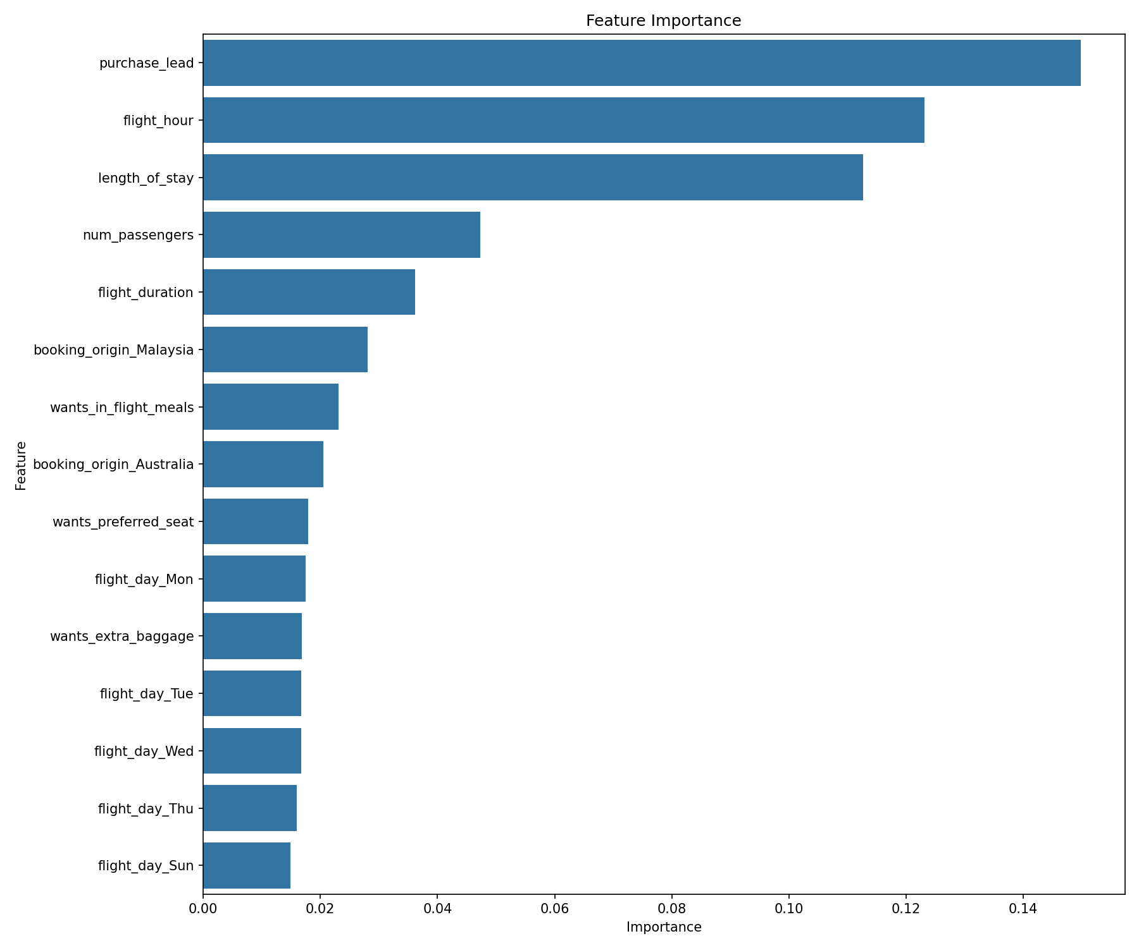
Customer Buying Behaviour Prediction Summary
Total Samples: 50000
Test Accuracy: 0.86
Mean CV Score: 0.74
Key Predictive Variables shown in the feature importance plot.

