Slide 1


A
AlgoLab

Slide 2



















Slide 3













Slide 4





Slide 5
A

Slide 6


Slide 7



Slide 8
Thank you for choosing AlgoLab! Your AlgoLab OTP Code is:
772742
dwdwdw
772742

Slide 9
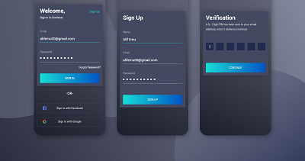

Slide 10
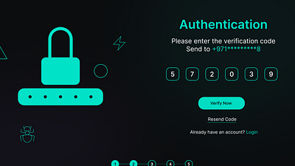

Slide 11
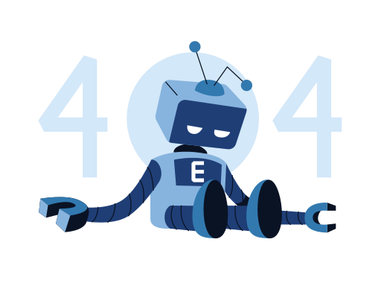

Slide 12



