Slide 1
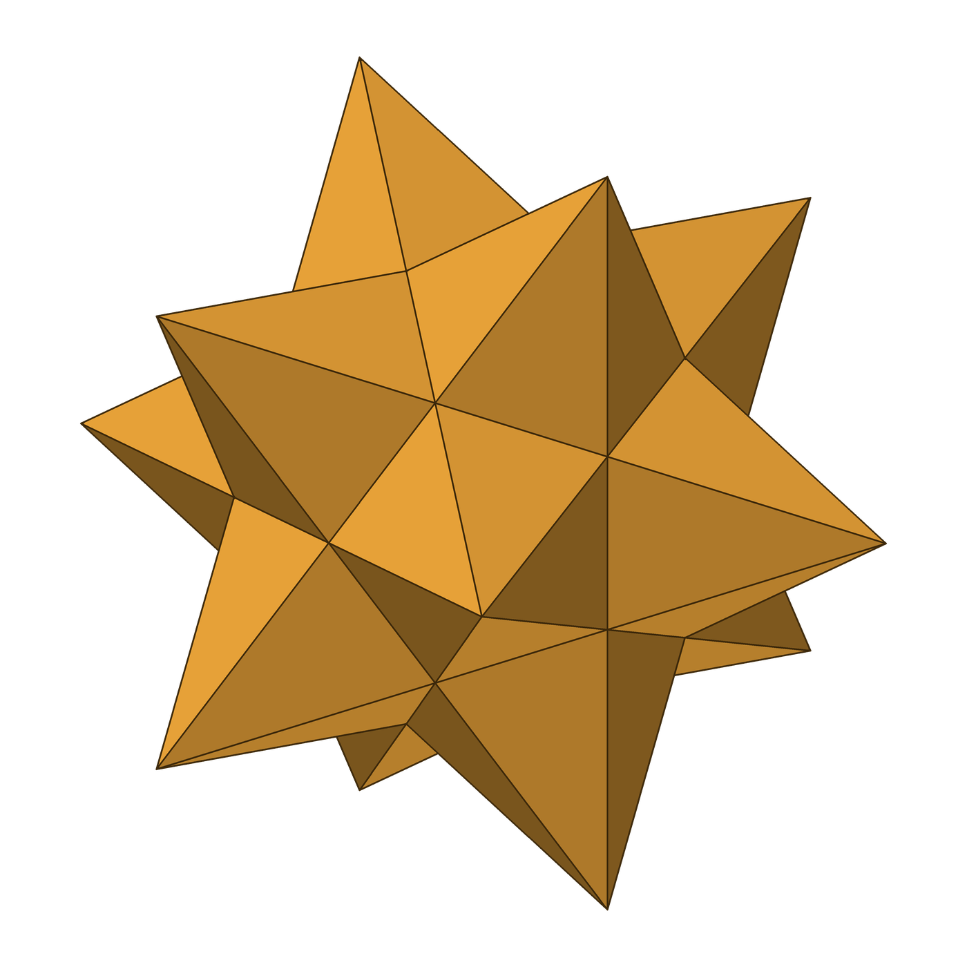
Wanderers Star
A laser-cut, light-up small stellated dodecahedron: 60 golden triangles, 60 patterns
Sector67 show-and-tell
Notes:
~30 s. Introduce yourself and the project. 'Wanderers' nods to the planets (Greek planētēs = wanderers) and to Kepler, who first described this star polyhedron in 1619.
Roadmap: what I made, why, how, and what's next.

Slide 2

A small stellated dodecahedron
60
12
12
golden-triangle panels, each with its own pattern
star points, 5 panels each
pentagon bases hidden in the core
≈75 cm
36
1
tip to tip
addressable RGB LEDs, 3 per point
ESP32 running the light shows
Notes:
~1.5 min. PLUG IN THE STAR before this slide.
Geometry: a dodecahedron (pentagon edge 150 mm) with a five-sided pyramid on each of its 12 faces. Every pyramid face is a golden triangle, so 12 × 5 = 60 panels. Teal = one panel. It's Kepler's star polyhedron (1619); as a Kepler–Poinsot solid it counts as 12 pentagram faces, 12 vertices, 30 edges.
Tip-to-tip ≈ 747 mm, computed from the 150 mm edge; measure the real one to confirm.
Lights: 12 groups × 3 LEDs = 36 WS2812B pixels on an ESP32.

Slide 3
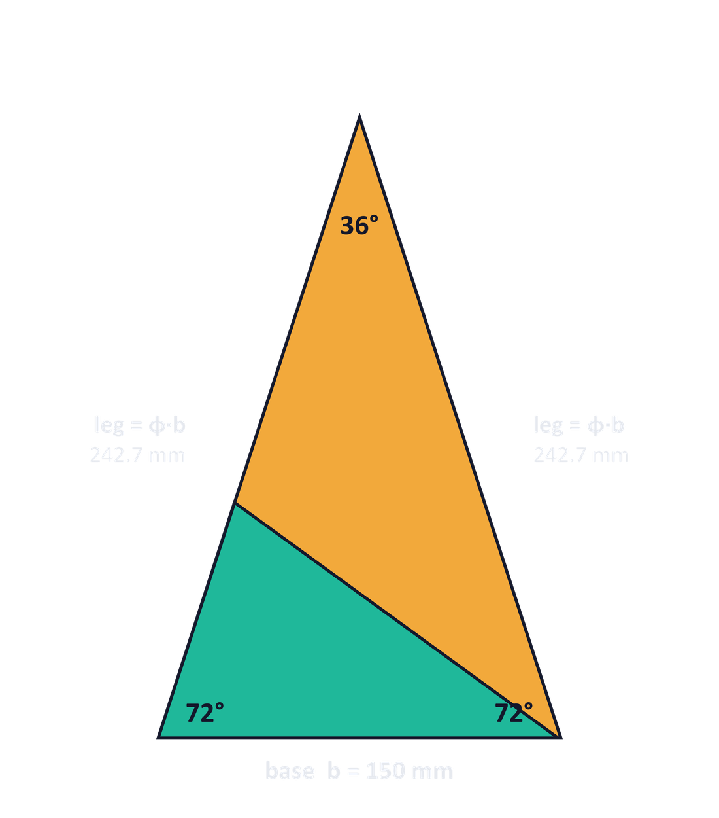
Every panel is a golden triangle
ANGLES
36° · 72° · 72°
Angles in a 1 : 2 : 2 ratio; the apex is 36° = 180° ÷ 5
RATIO
leg ÷ base = φ ≈ 1.618
φ = (1 + √5) ÷ 2, the golden ratio
MY PANEL
150 × 242.7 × 242.7 mm
Base × legs; height 230.8 mm, area ≈ 173 cm²
SELF-SIMILAR
Bisect a 72° corner
You get a smaller golden triangle (teal) plus a 36°-36°-108° golden gnomon
Notes:
~1.5 min. A golden triangle is the isosceles triangle with a 36° apex and two 72° base angles. Leg ÷ base is exactly the golden ratio φ ≈ 1.618. With a 150 mm base, the legs are 242.7 mm and the height is 230.8 mm.
It's the triangle in a pentagram, which is why it builds a pentagonal star. Five 36° tips meet at every point: 5 × 36° = 180°, which is why the points are so sharp.
Cut off a base angle with its bisector and you get a smaller golden triangle plus a 36-36-108 'golden gnomon'. It repeats forever.

Slide 4

Notes:
~2 min 10 s. VIDEO: click to play (or set Playback > Start: Automatically). Each of the 60 patterns fills the screen for 2 s, then the full 60-pattern grid holds for 10 s. 60 panels, 60 patterns. Point out favourites: MapleQuilt is a nod to the quilts; SixtySeven is for Sector67.

Slide 5
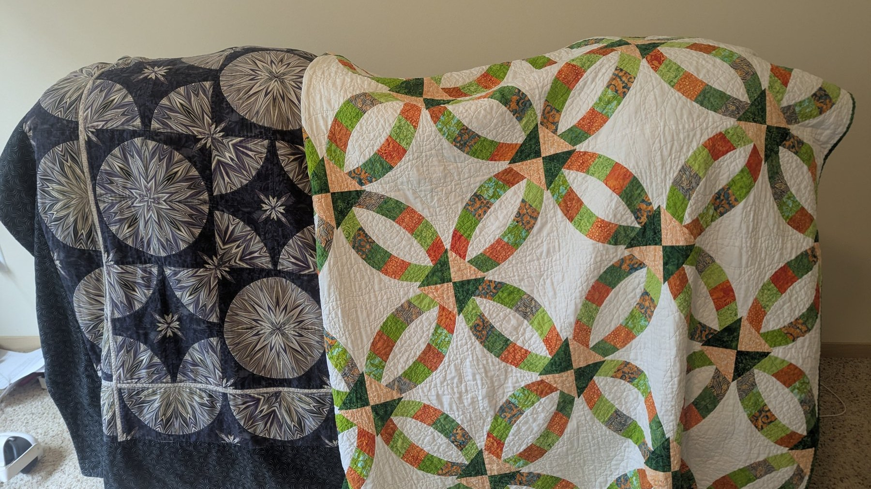
Notes:
~1 min. My mother's quilts. Repeating blocks, rotated, mirrored and repeated: the same symmetry that drives every panel on the star. Point out the kaleidoscope stars (left) and the double wedding ring (right).

Slide 6

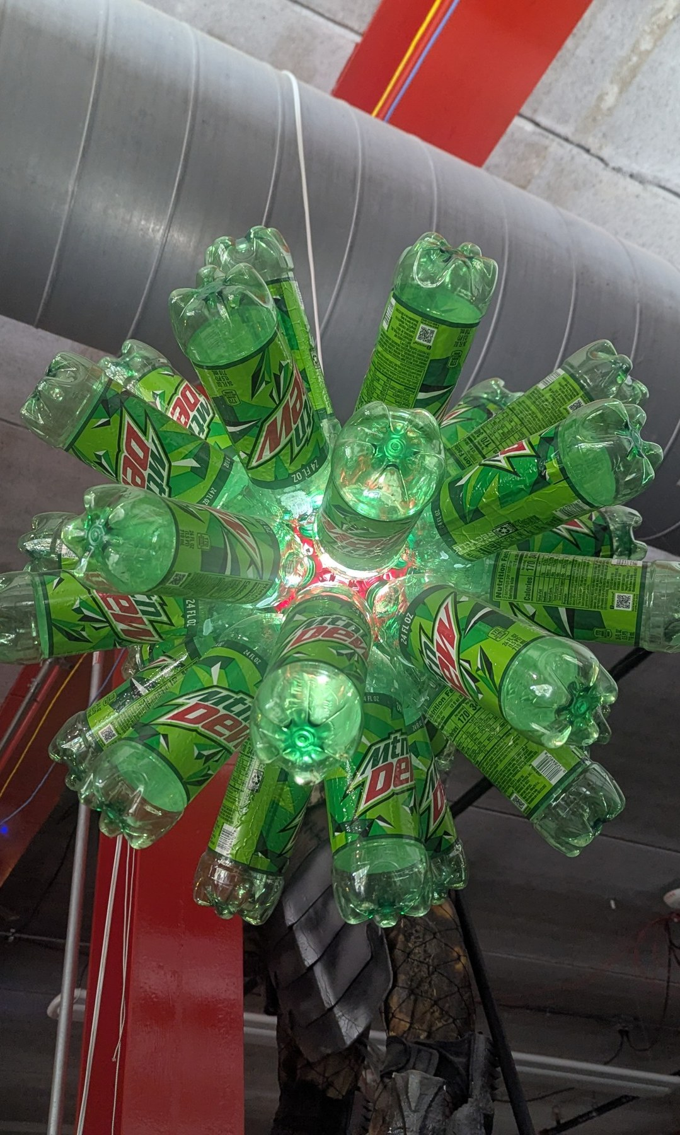
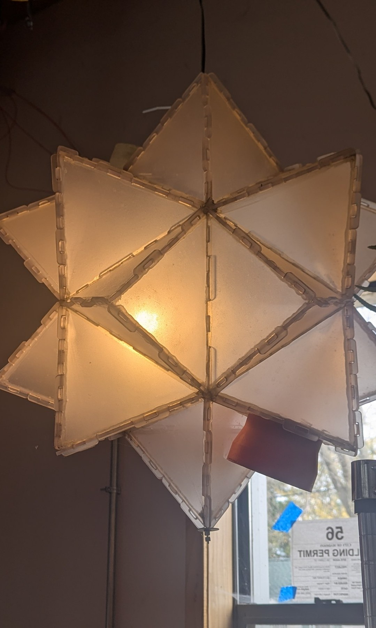
Notes:
~45 s. The lamps of Sector67: lamps other members built here inspired this one. Credit the makers if you know them.

Slide 7







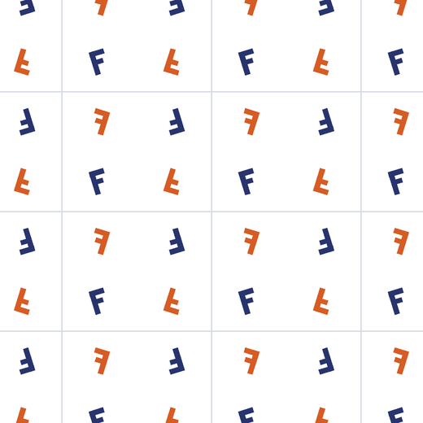


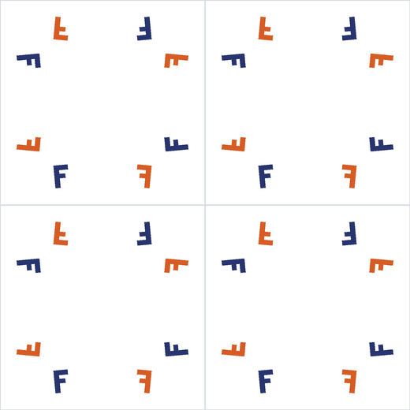



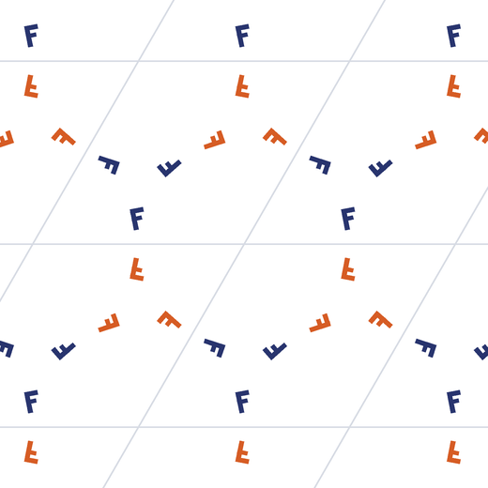

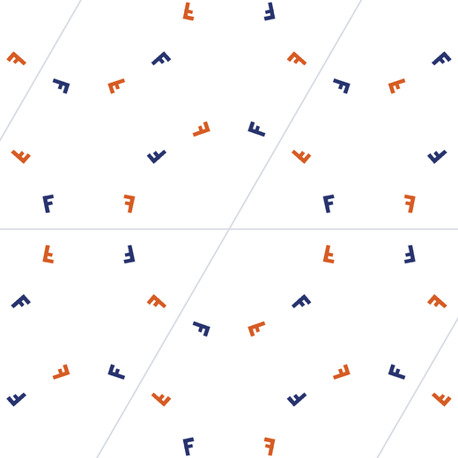
Notes:
~1.5 min. The 17 wallpaper groups. Every repeating pattern on a flat surface uses exactly one of them; the pattern editor has a template for each.
Order (left to right, top to bottom): p1, p2, pm, pg, cm, pmm / pmg, pgg, cmm, p4, p4m, p4g / p3, p3m1, p31m, p6, p6m.
The letter-F trick: an F has no symmetry of its own, so every copy is created by the group. Orange Fs are mirror images, so groups with no orange (p1, p2, p3, p4, p6) have only rotations and translations.

Slide 8
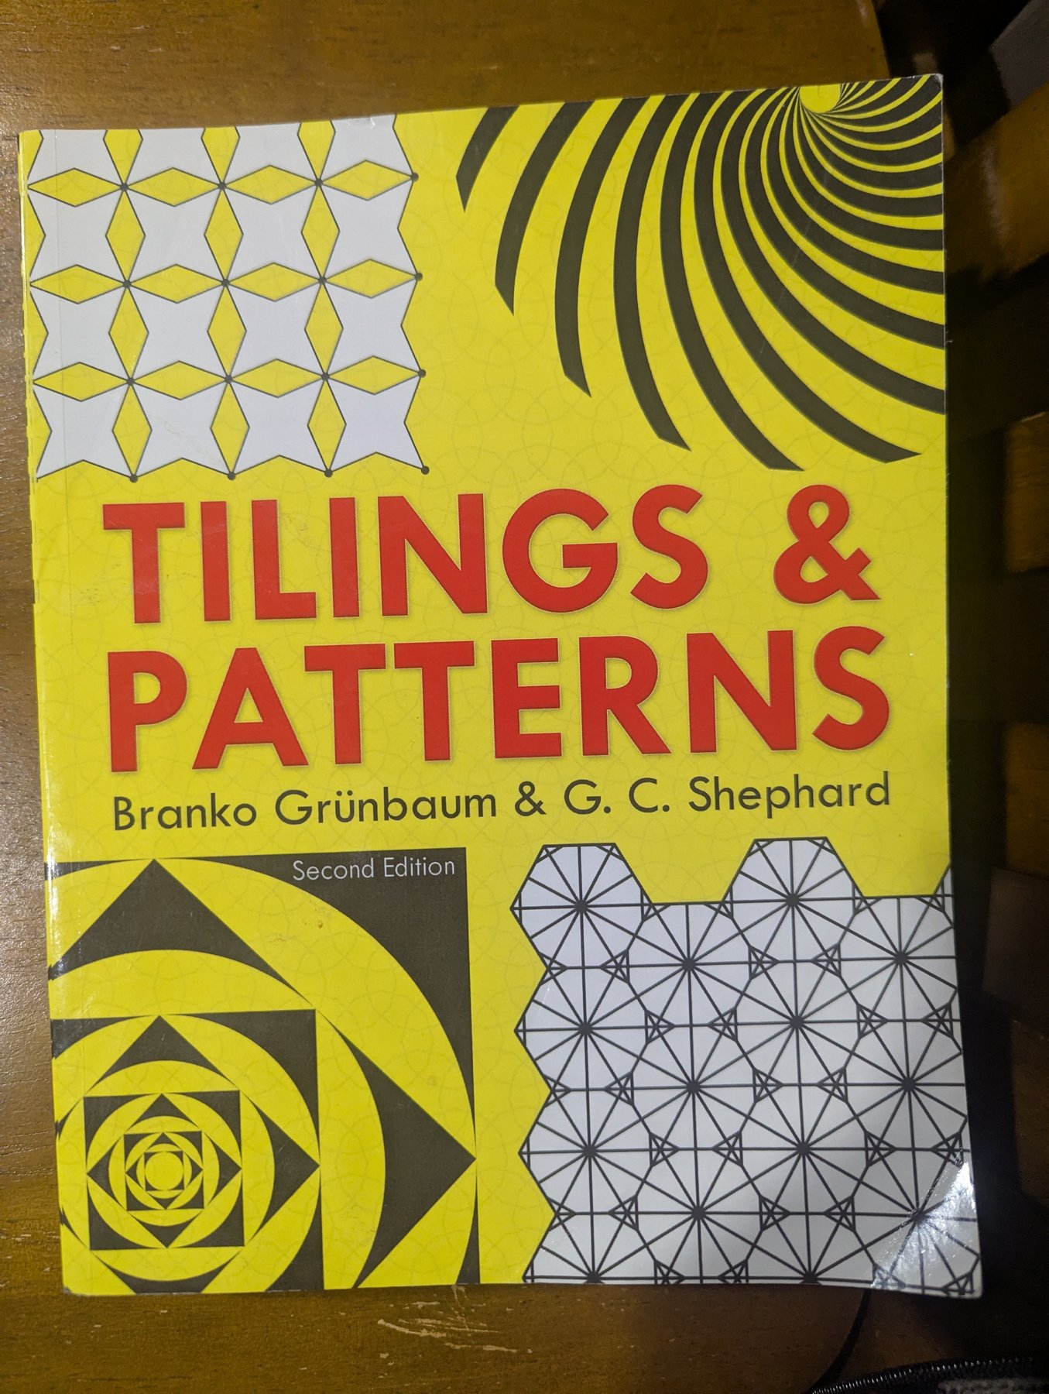
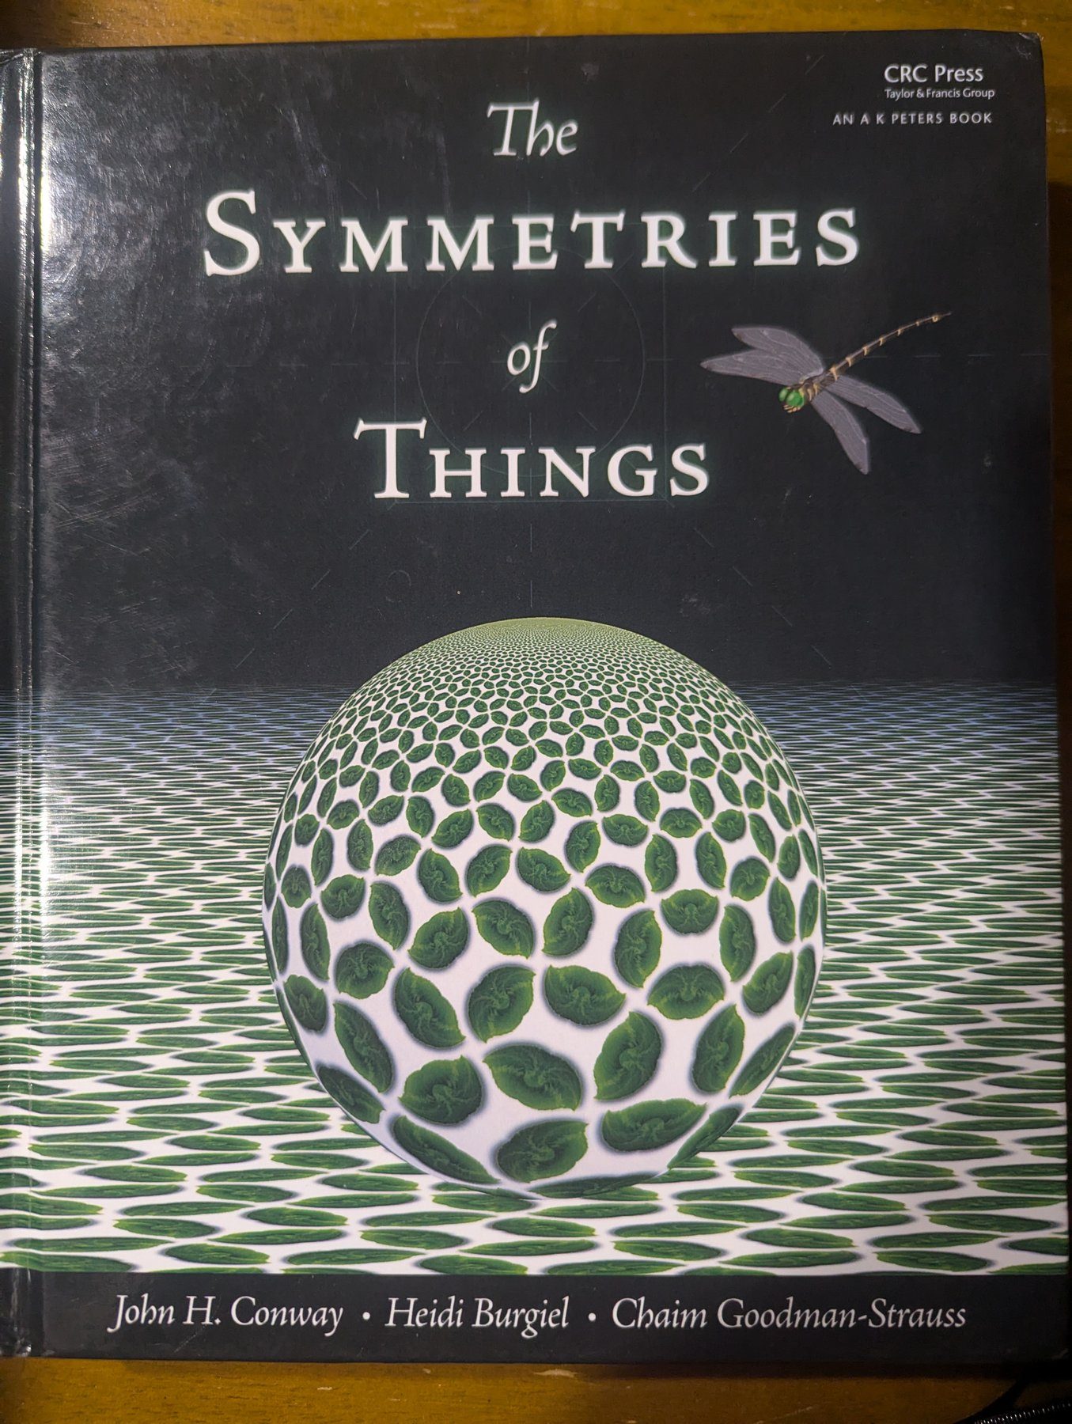

Notes:
~45 s. Three books:
• Tilings & Patterns, Branko Grünbaum & G. C. Shephard: the encyclopedic reference.
• The Symmetries of Things, John H. Conway, Heidi Burgiel & Chaim Goodman-Strauss: orbifold notation (the *442-style names).
• Symmetry: A Mathematical Exploration, Kristopher Tapp: the friendliest intro to the group theory.

Slide 9
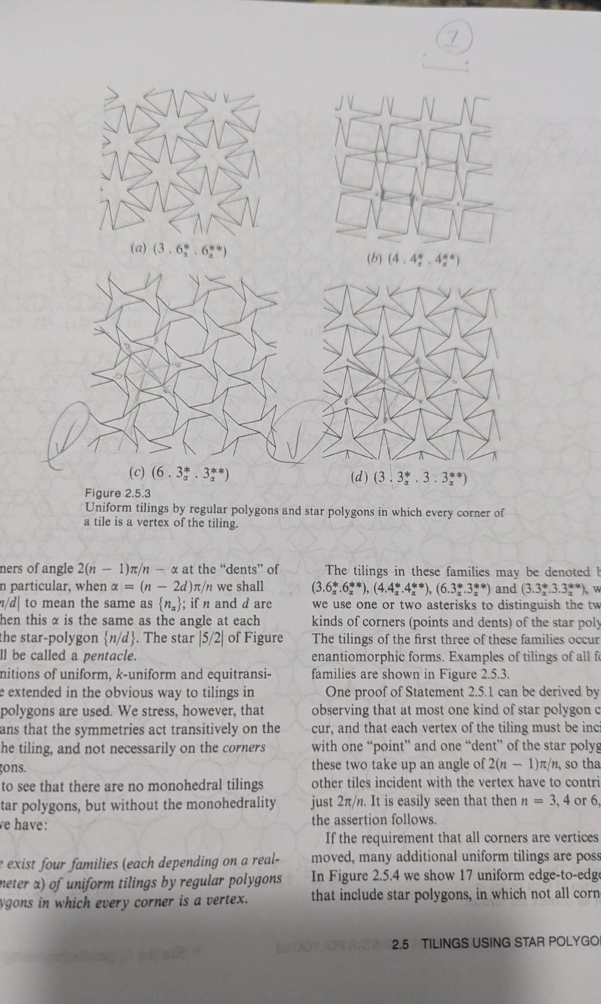
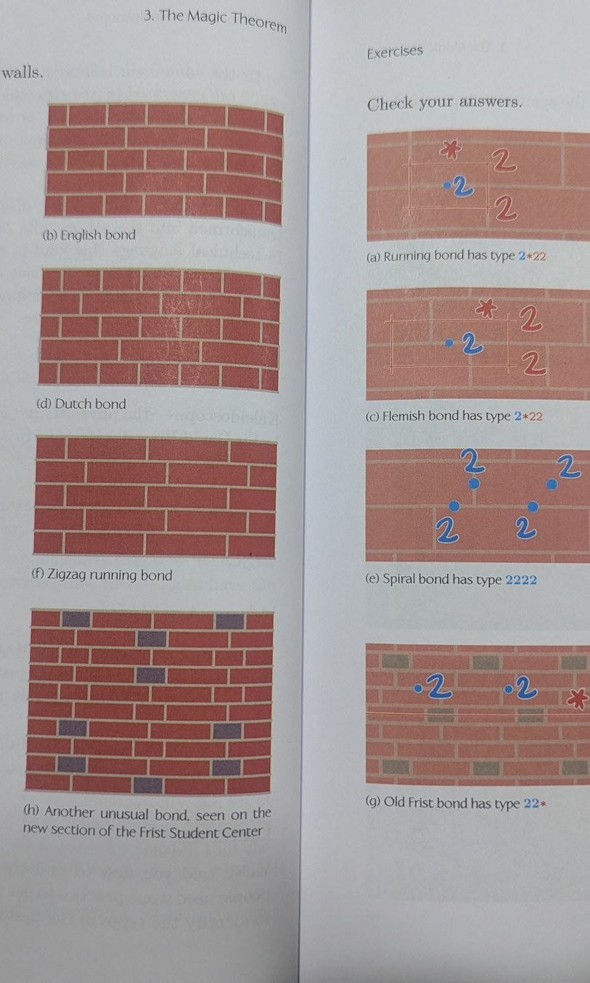
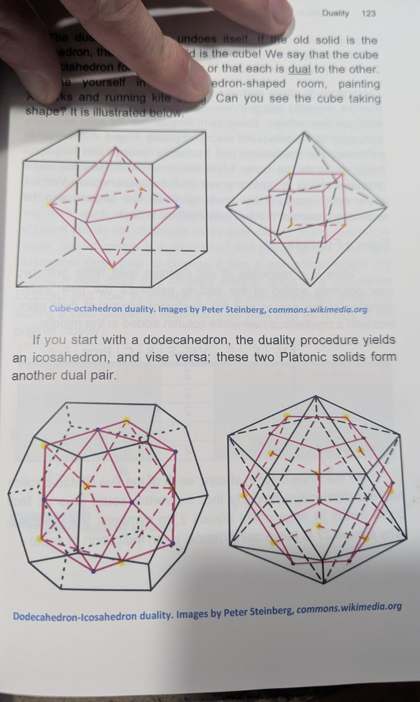
Notes:
~45 s. What I took from them: star-polygon tilings (Tilings & Patterns), brick bonds classified as orbifolds 2*22 and 22* (Symmetries of Things), dodecahedron/icosahedron duality (Symmetry).

Slide 10
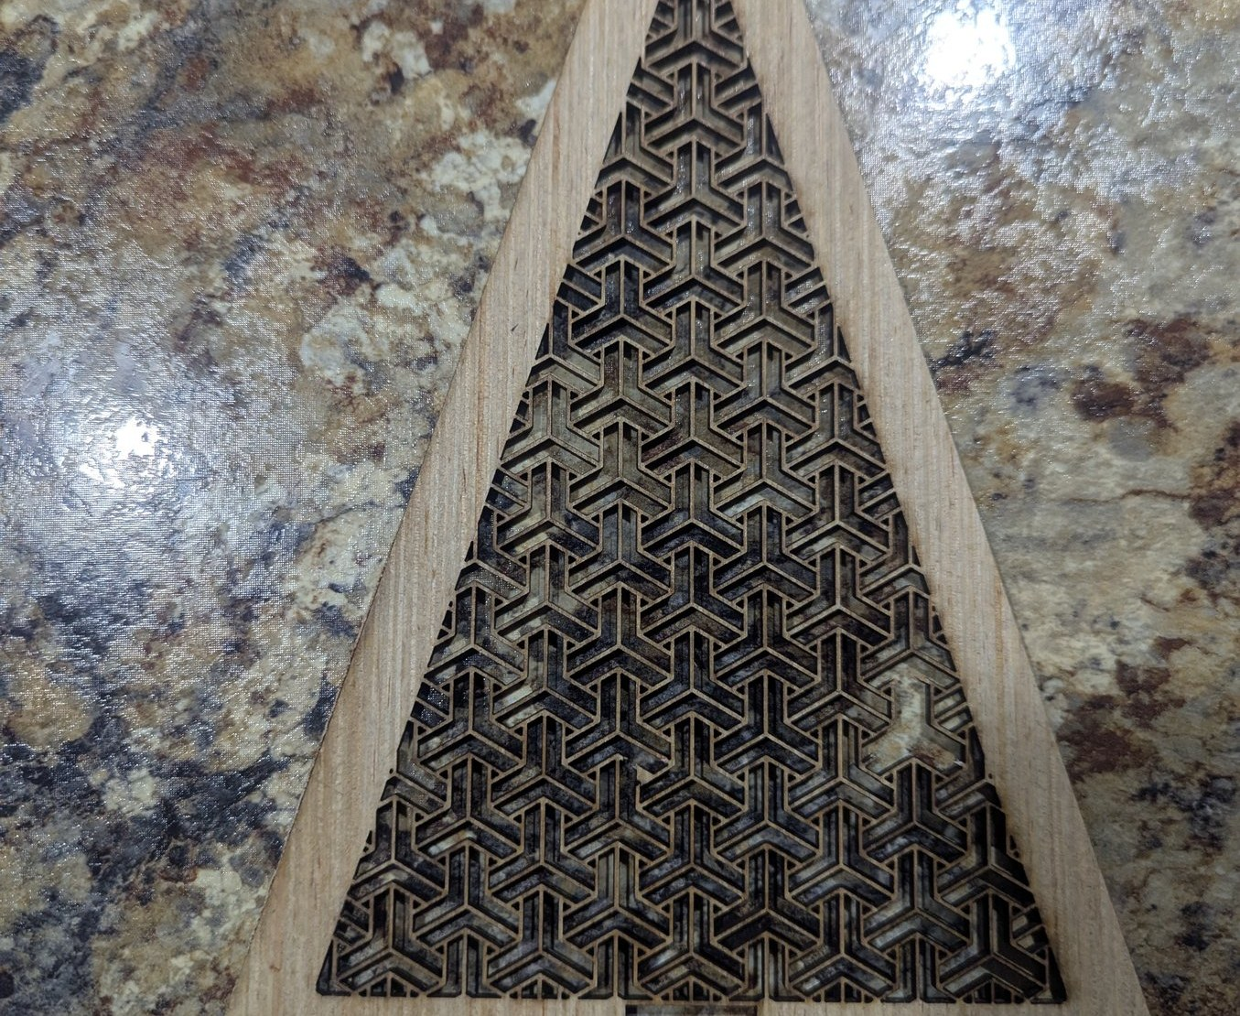
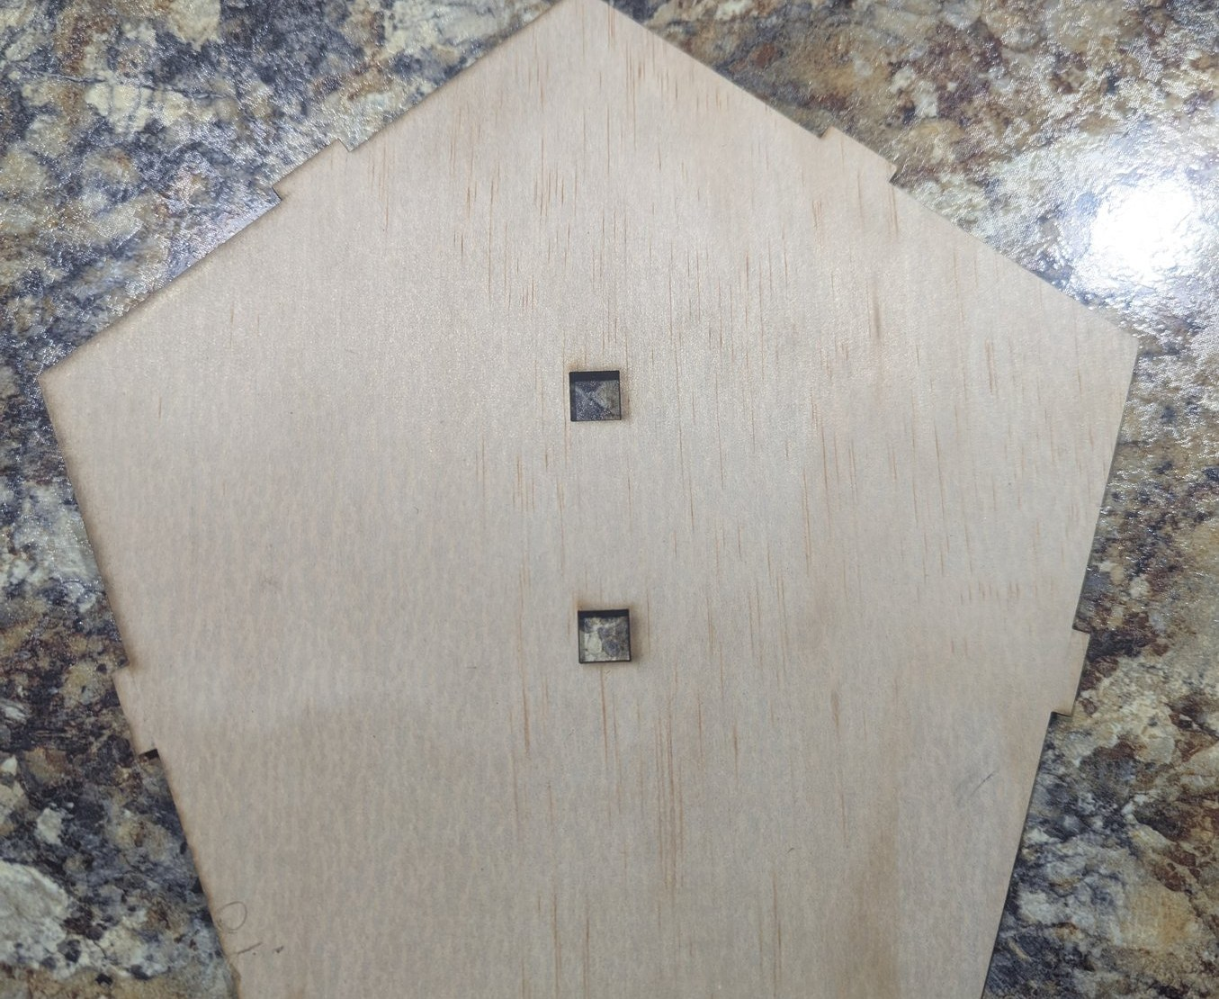
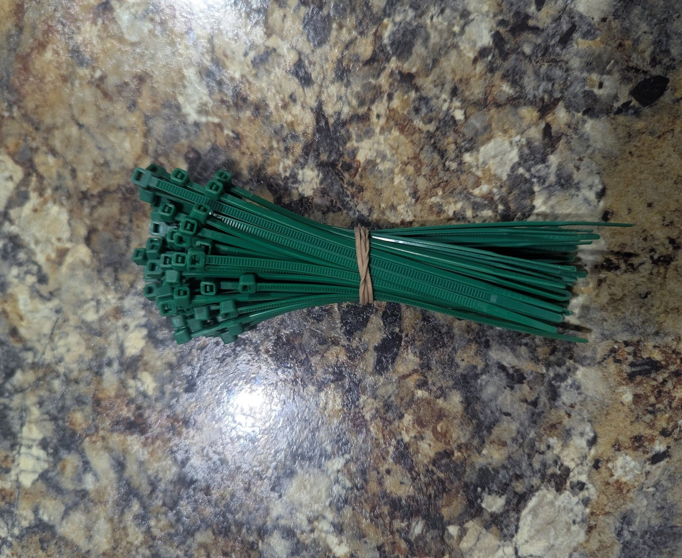
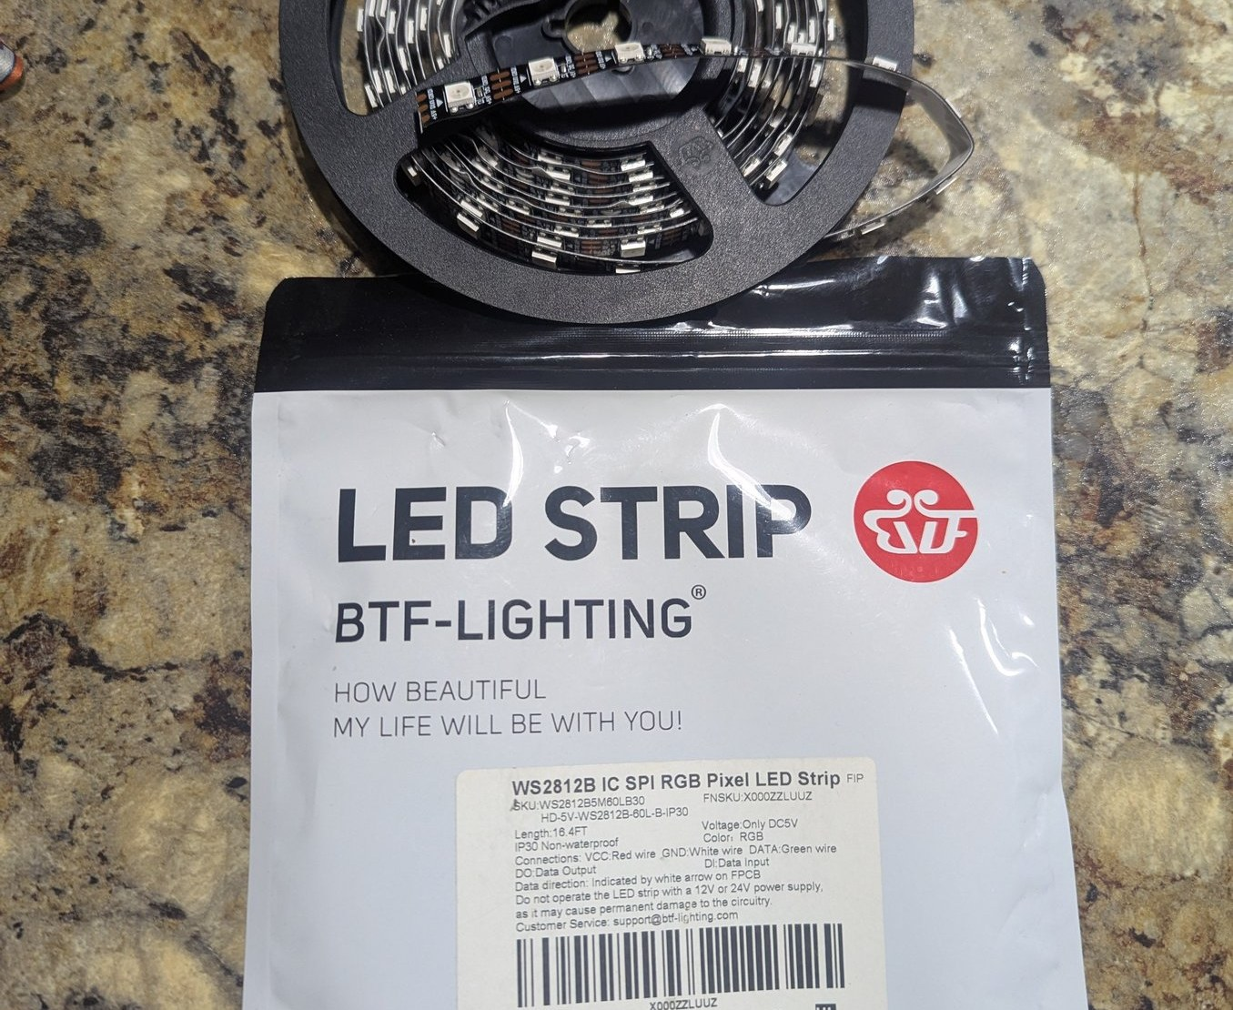
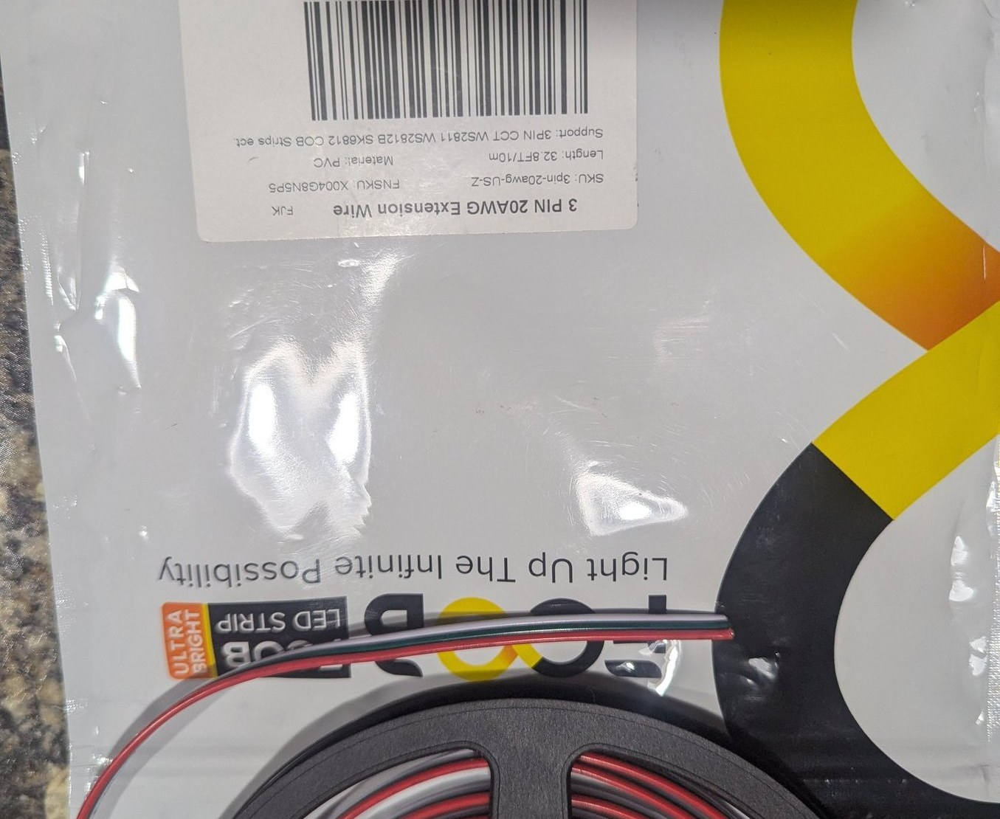
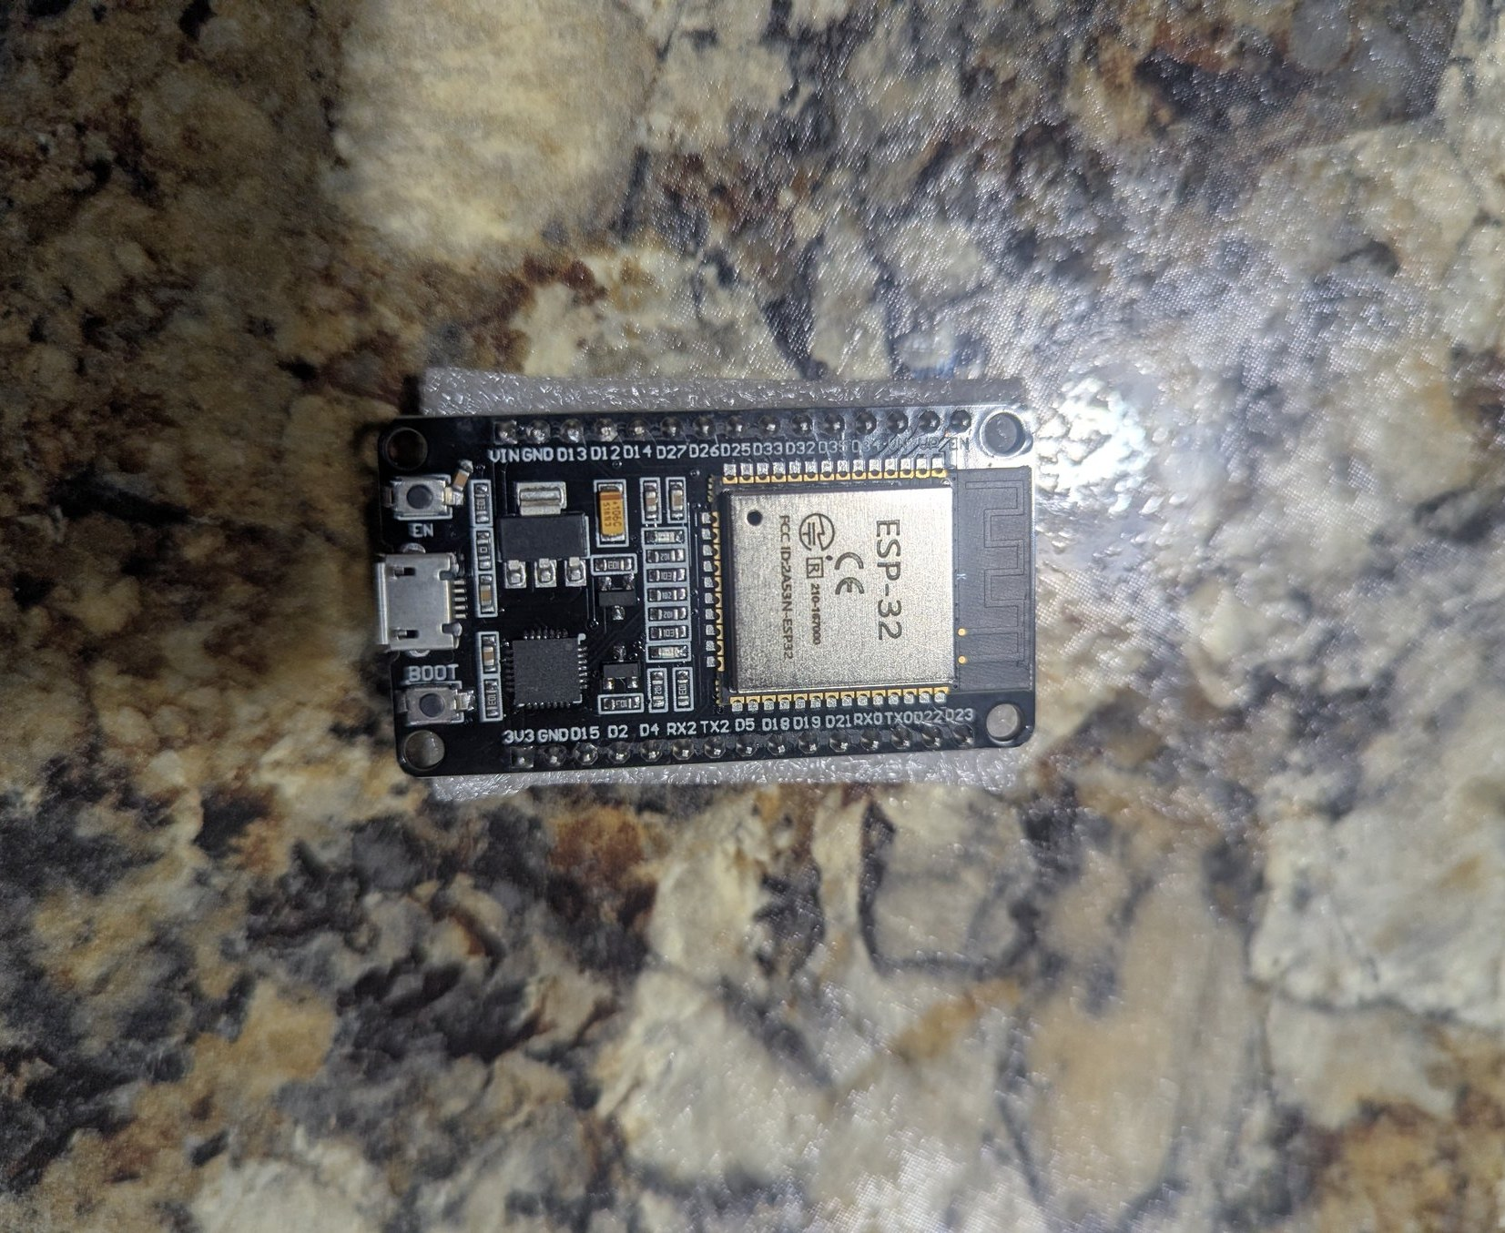
Notes:
~1 min. Materials: laser-cut plywood panels (60) and pentagon bases (12), zip ties (current joinery), WS2812B addressable LED strip, 3-pin 20 AWG extension wire, ESP32 dev board.

Slide 11
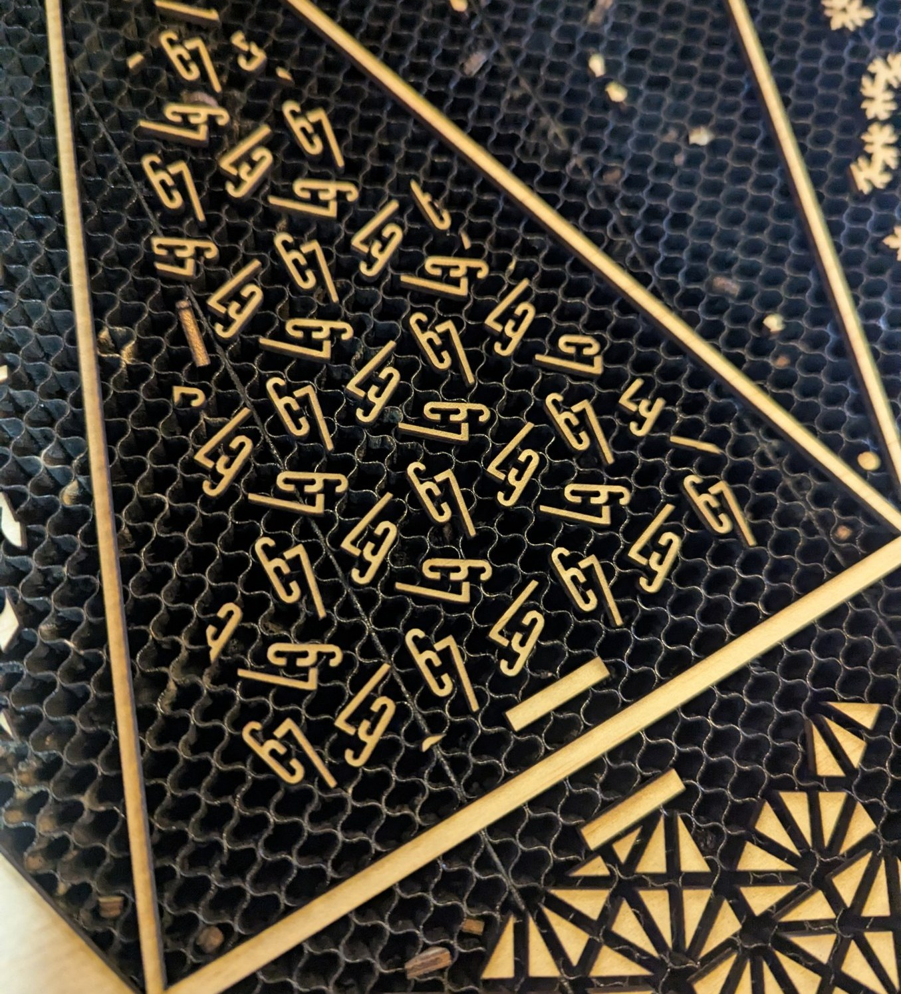
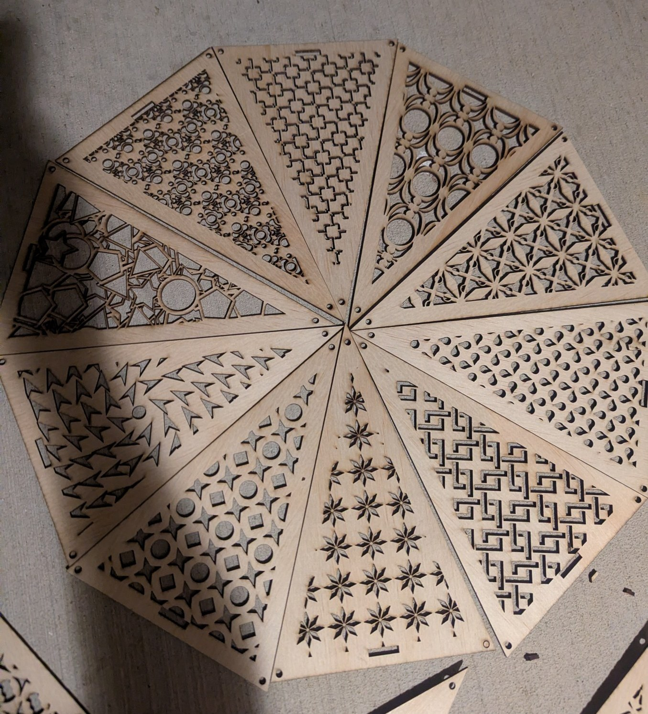
Notes:
~1 min. Tools: the Sector67 laser cutter. Software: OpenSCAD (every panel is a script), my pattern editor, Python scripts that nest panels onto sheets and export LightBurn files, LightBurn to drive the laser, Arduino IDE for the ESP32.

Slide 12
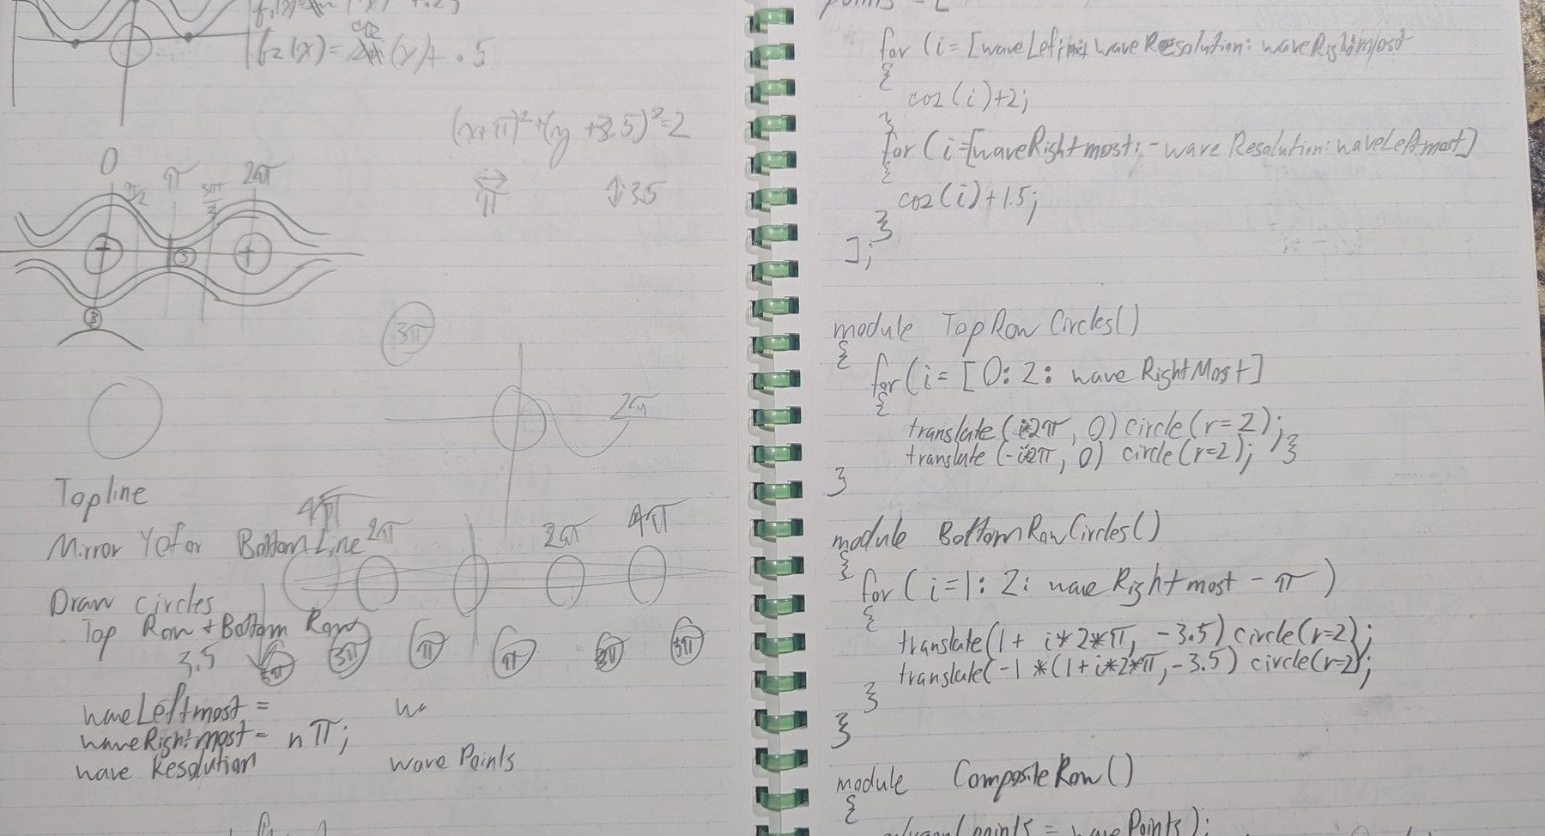
Notes:
~1 min. It starts in the notebook: pick a wallpaper group, sketch the fundamental domain, hand-write the OpenSCAD modules (FundamentalDomain, FundamentalCut, CompletedTile, PatternArray), then tile, clip to the golden triangle, and cut.

Slide 13
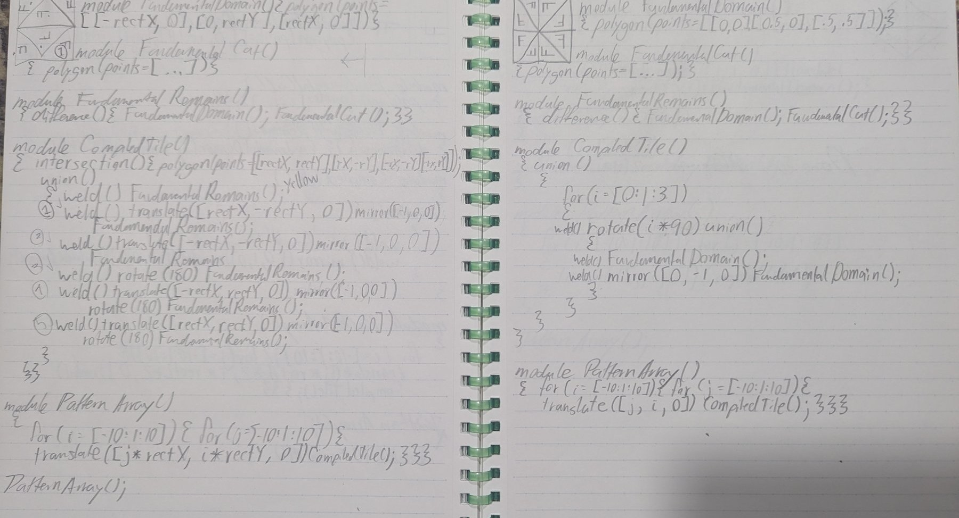
Notes:
~1 min. It starts in the notebook: pick a wallpaper group, sketch the fundamental domain, hand-write the OpenSCAD modules (FundamentalDomain, FundamentalCut, CompletedTile, PatternArray), then tile, clip to the golden triangle, and cut.

Slide 14
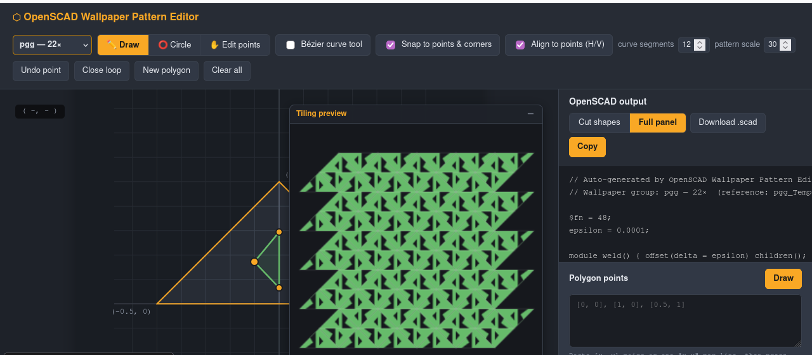
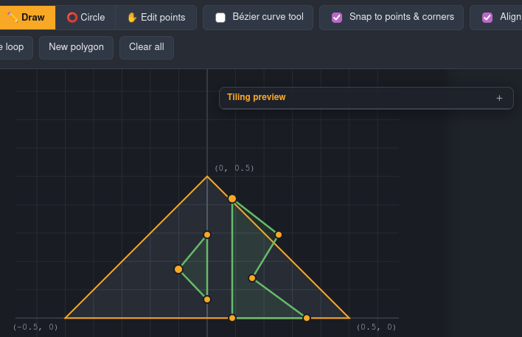
Notes:
~1 min. Then I built a tool for it: choose any of the 17 groups, draw polygons, Bézier curves and circles in the fundamental domain, see the tiling update live, export a framed ready-to-cut .scad panel.
kuri148.github.io/Wanderers-Star-Laser-Cutting-Summer

Slide 15
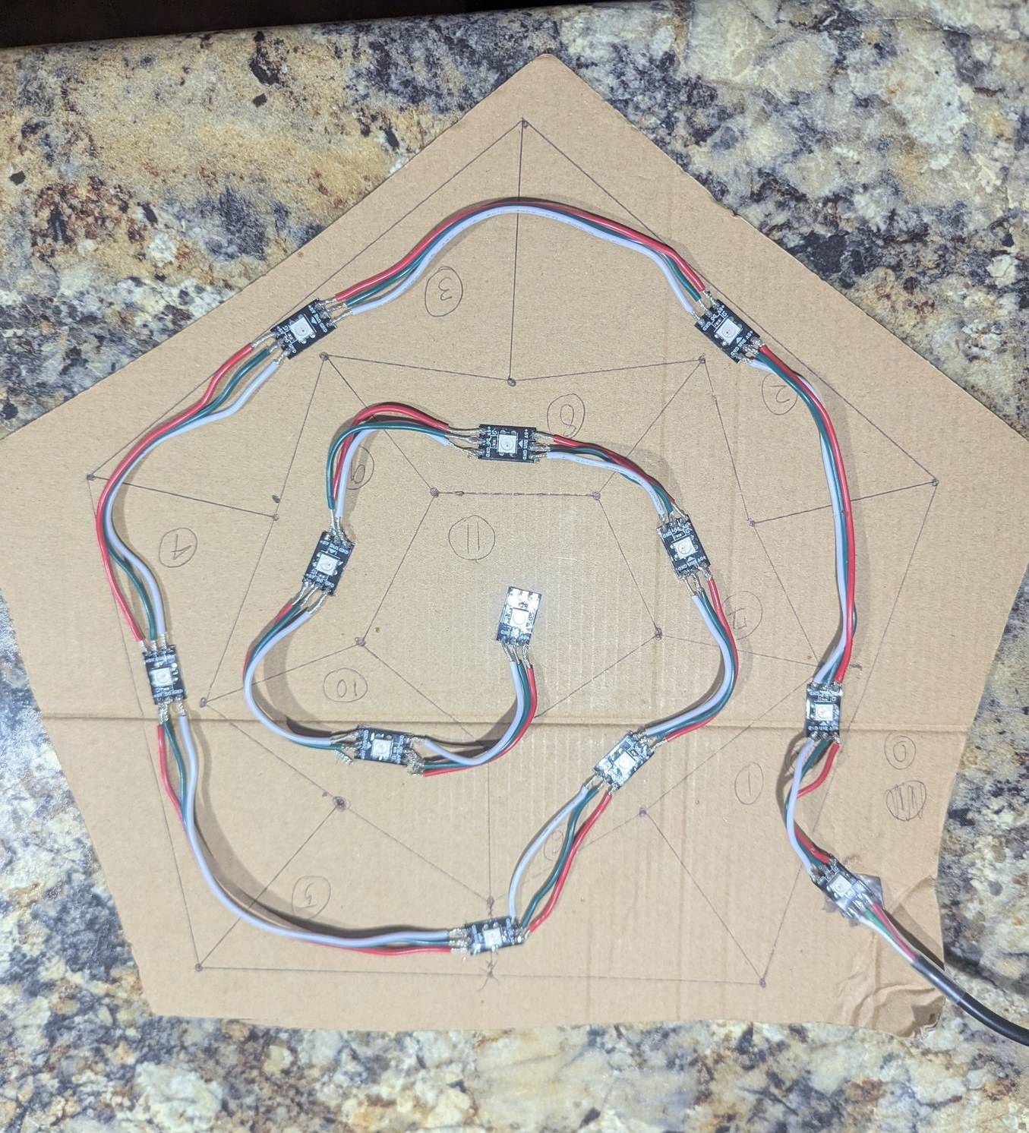
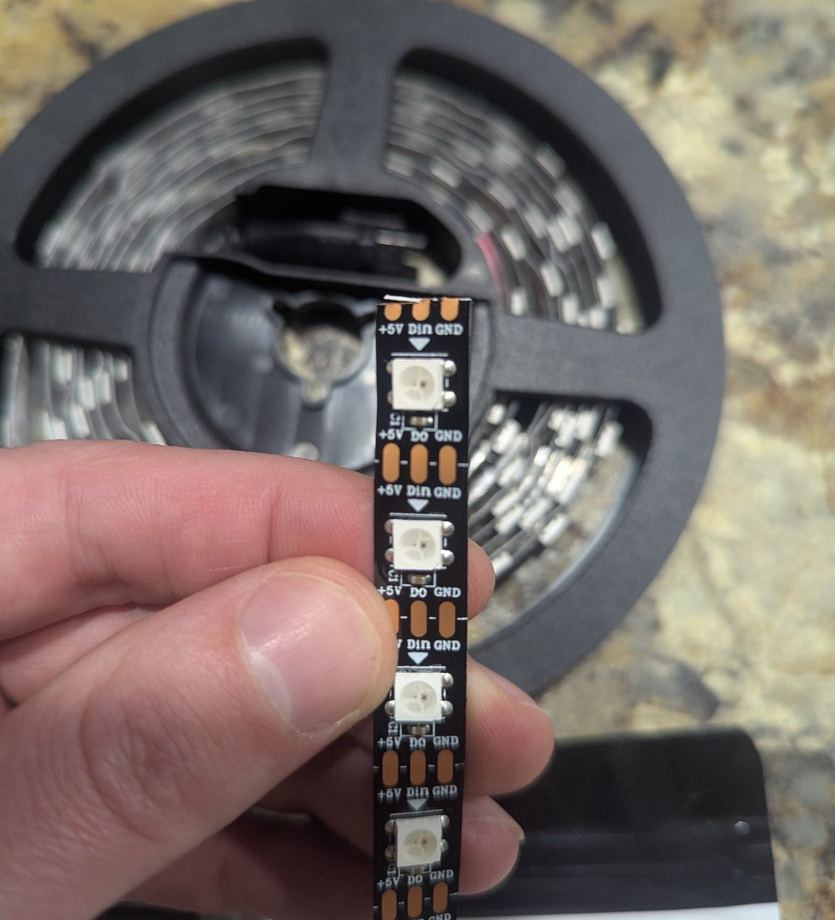
Notes:
~45 s. Wiring: the strip is cut into single pixels and chained with 3-pin wire (+5V, data, ground). Laid out and tested on a cardboard template first. 36 pixels, 3 per point, all on one ESP32 data pin.

Slide 16
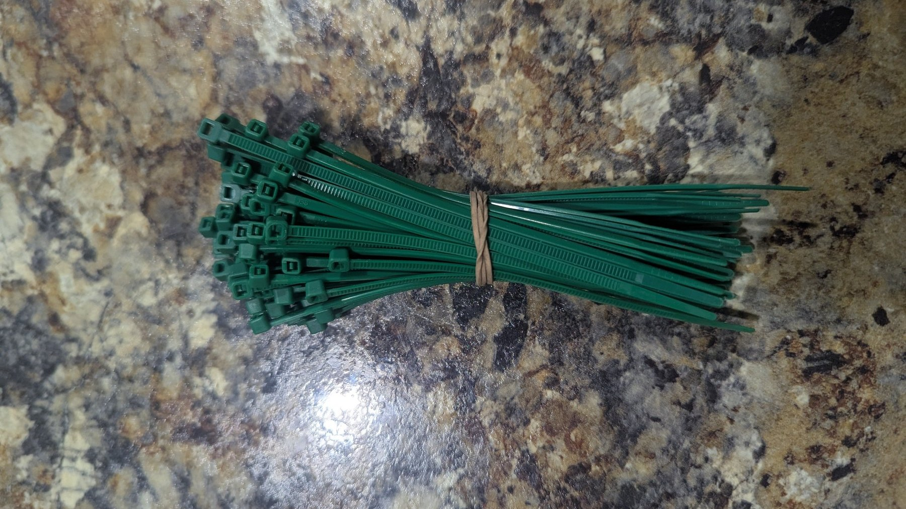
Notes:
~1 min. Next for the star:
• Beyond zip ties: designed connectors so panels join cleanly and the star comes apart for transport.
• Diffusers: soften the LED hot spots so each panel glows evenly.
• Metal: a finished version cut in metal.

Slide 17
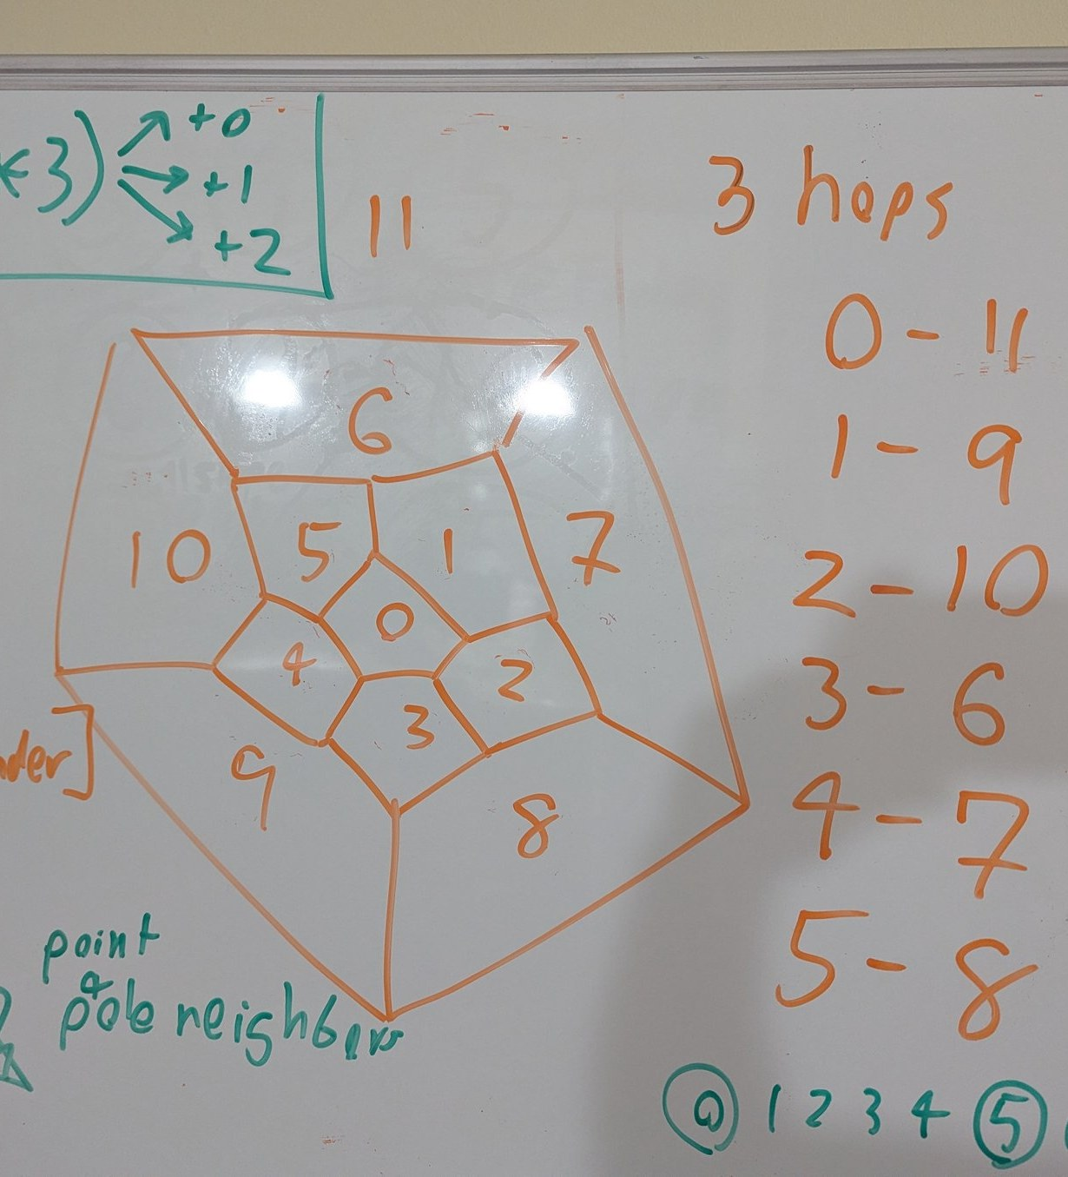
Notes:
~1.5 min. Next for me:
• More light shows: the whiteboard maps the 12 points, neighbours, and opposite pairs (0-11, 1-9, 2-10, 3-6, 4-7, 5-8).
• 3D packings & tilings: the plane has 17 wallpaper groups, space has 230 crystallographic groups.
• WebXR geometry: my new project, walking around these shapes in VR.

Slide 18
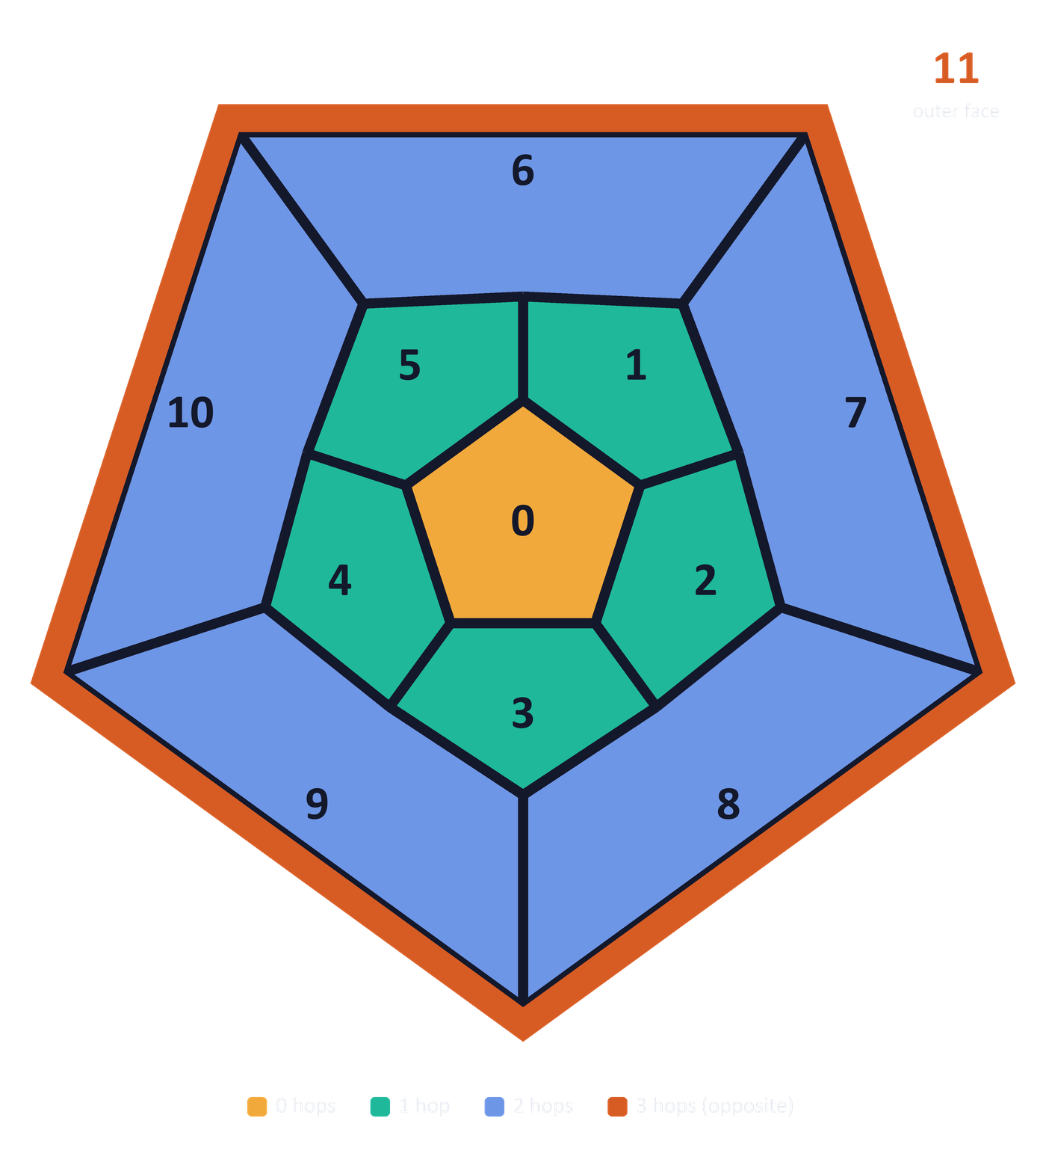
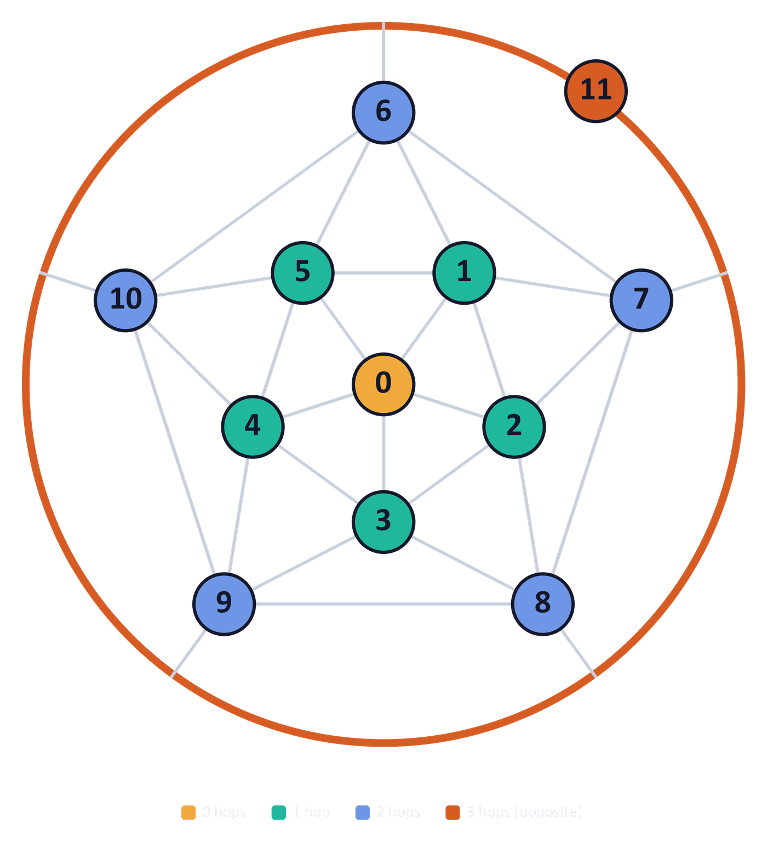
Notes:
~1 min. The whiteboard, cleaned up. Left: every star point is a face of a dodecahedron, flattened so 0 is in the middle and 11 is the outside. Right: the same thing as a graph, 12 nodes and 30 links, which is the icosahedron. These are the exact links in the light-show code (edgeList).
Colours are hops from point 0. Every point is at most 3 hops from any other, and its 3-hop partner is the point straight through the star: 0-11, 1-9, 2-10, 3-6, 4-7, 5-8 (poleList).

Slide 19
Thank you
Questions?
github.com/Kuri148/Wanderers-Star-Laser-Cutting-Summer
Notes:
Take questions. Offer to turn the light show back on.

