Slide 1


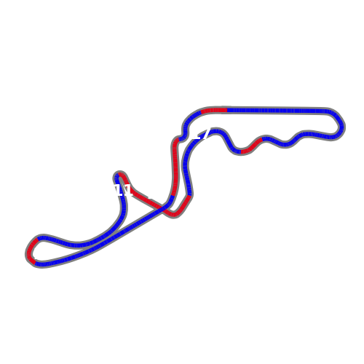
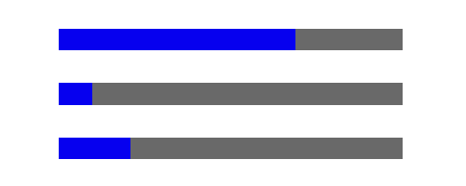

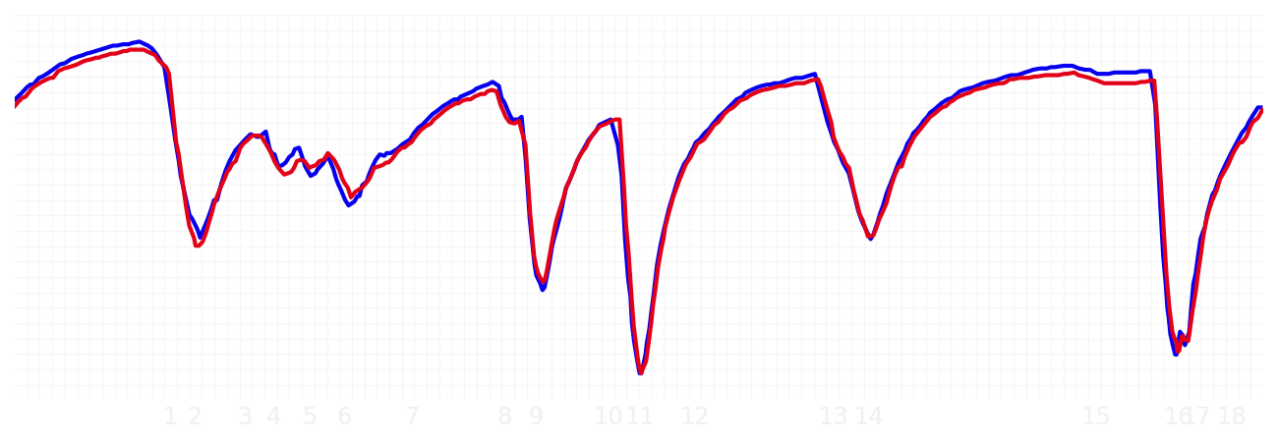
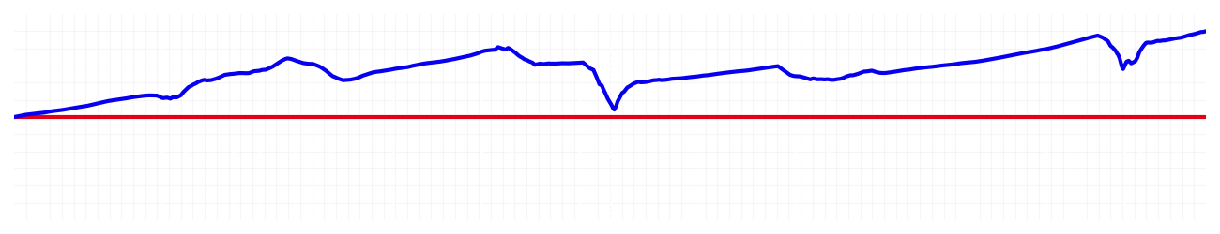
Japanese GP Qualifying Q2
Driver
Max Verstappen
Yuki Tsunoda
Driver
Lap Time
01:27.502
01:28.000
Lap Time
Sector 1
30.510
Speed Trap 1
288 kp/h
Speed Trap 1
284 kp/h
Sector 1
30.840
Sector 2
39.641
Speed Trap 2
300 kp/h
Gap
-0.498
Gap
0.498
Speed Trap 2
297 kp/h
Sector 2
39.672
Sector 3
17.351
Speed Final Line
271 kp/h
Corner Advantage
6/19
Corner Advantage
13/19
Speed Final Line
268 kp/h
Sector 3
17.488
FULL THROTTLE
69%
70%
FULL THROTTLE
HEAVY BREAKING
10%
10%
HEAVY BREAKING
%LAP TIME
CORNERING
21%
20%
CORNERING
%LAP TIME
SPEED
SPEED
DELTA TIME
DELTA TIME

Slide 2

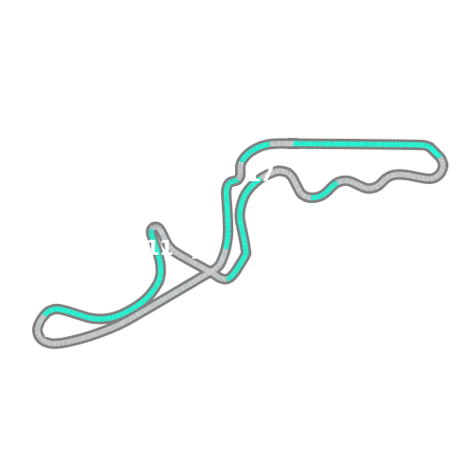
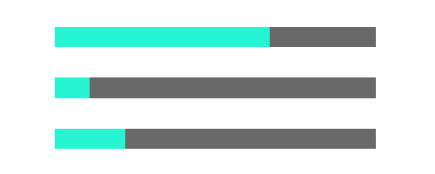
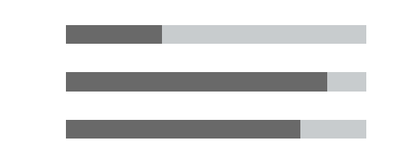
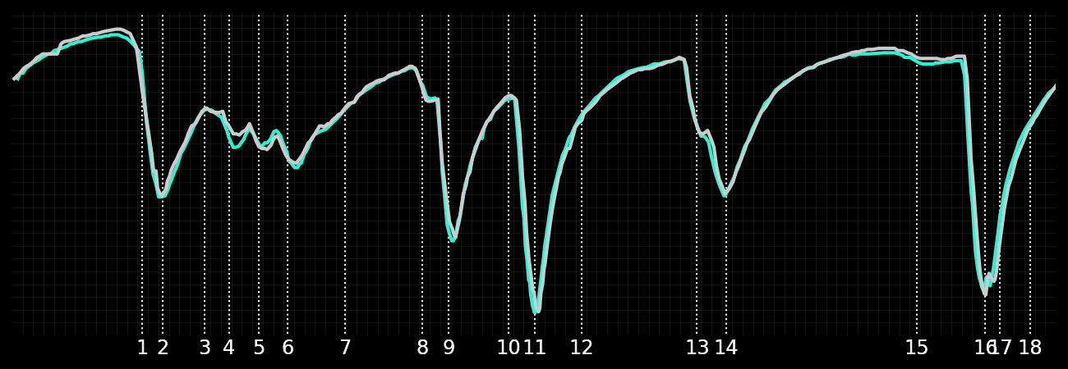
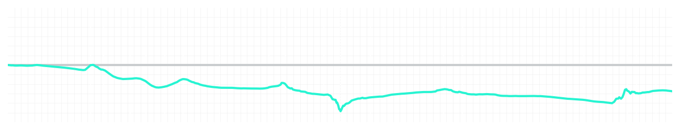
Japanese GP Qualifying Q2
Driver
Kimi Antonelli
George Russell
Driver
Lap Time
01:27.639
01:27.400
Lap Time
Sector 1
30.750
Speed Trap 1
287 kp/h
Speed Trap 1
288 kp/h
Sector 1
30.458
Sector 2
39.594
Speed Trap 2
303 kp/h
Gap
0.239
Gap
-0.239
Speed Trap 2
306 kp/h
Sector 2
39.573
Sector 3
17.295
Speed Final Line
269 kp/h
Corner Advantage
11/19
Corner Advantage
8/19
Speed Final Line
272 kp/h
Sector 3
17.369
FULL THROTTLE
67%
68%
FULL THROTTLE
HEAVY BREAKING
11%
13%
HEAVY BREAKING
%LAP TIME
CORNERING
22%
19%
CORNERING
%LAP TIME
SPEED
SPEED
DELTA TIME
DELTA TIME

Slide 3

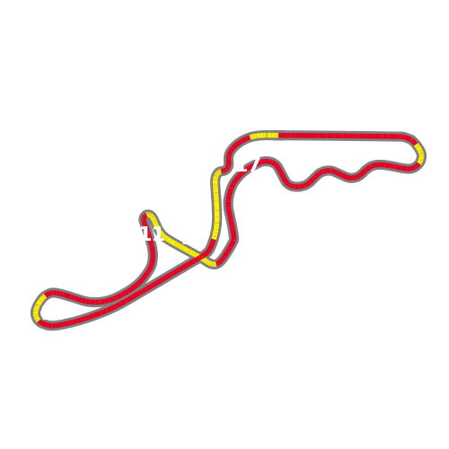

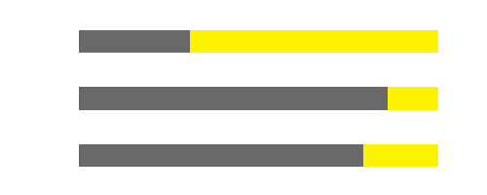
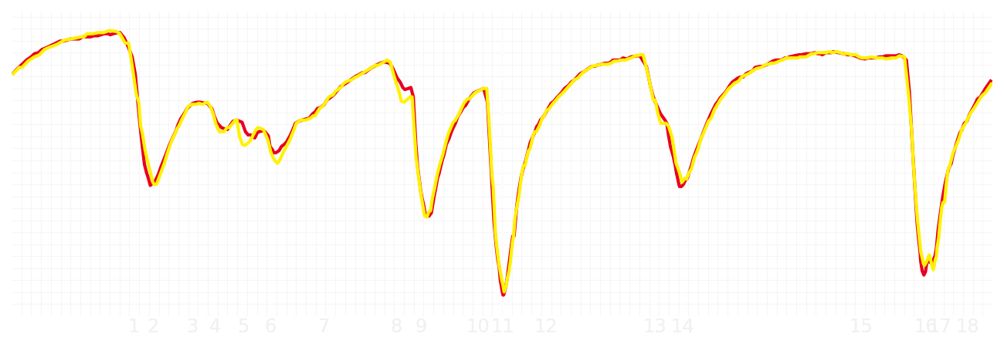
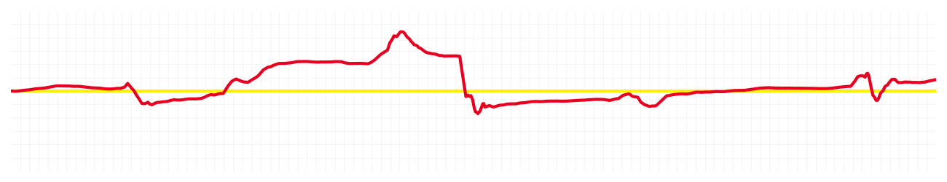
Japanese GP Qualifying Q2
Driver
Charles Leclerc
Lewis Hamilton
Driver
Lap Time
01:27.555
01:27.610
Lap Time
Sector 1
30.552
Speed Trap 1
289 kp/h
Speed Trap 1
289 kp/h
Sector 1
30.699
Sector 2
39.604
Speed Trap 2
299 kp/h
Gap
-0.055
Gap
0.055
Speed Trap 2
298 kp/h
Sector 2
39.454
Sector 3
17.399
Speed Final Line
270 kp/h
Corner Advantage
5/19
Corner Advantage
14/19
Speed Final Line
268 kp/h
Sector 3
17.457
FULL THROTTLE
66%
69%
FULL THROTTLE
HEAVY BREAKING
13%
14%
HEAVY BREAKING
%LAP TIME
CORNERING
21%
17%
CORNERING
%LAP TIME
SPEED
SPEED
DELTA TIME
DELTA TIME

Slide 4

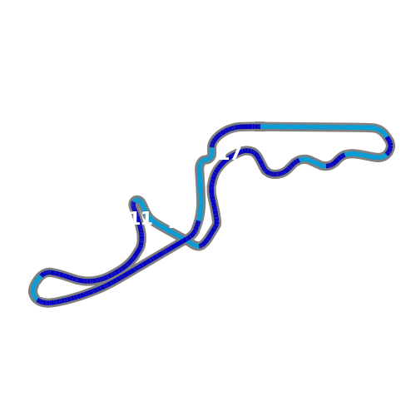
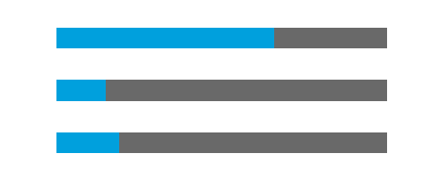
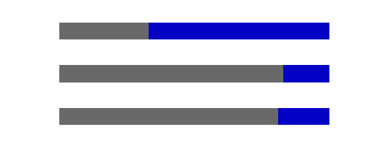
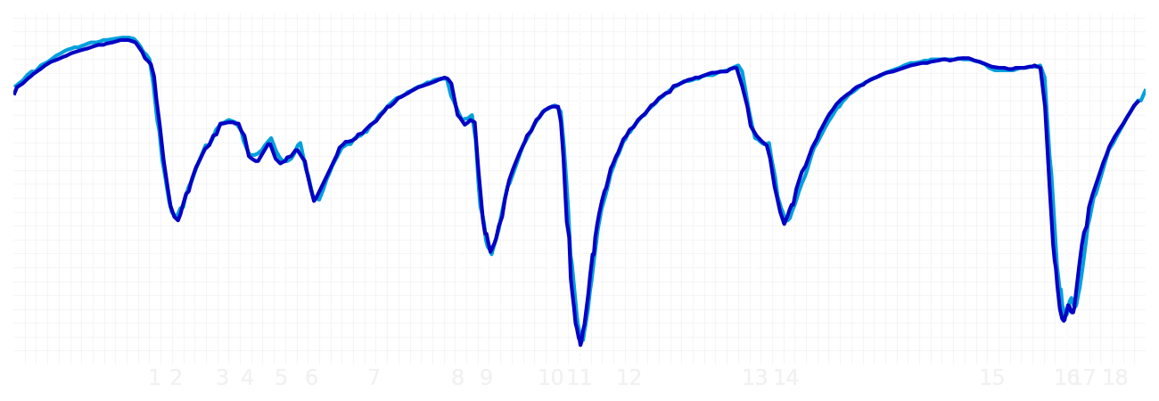
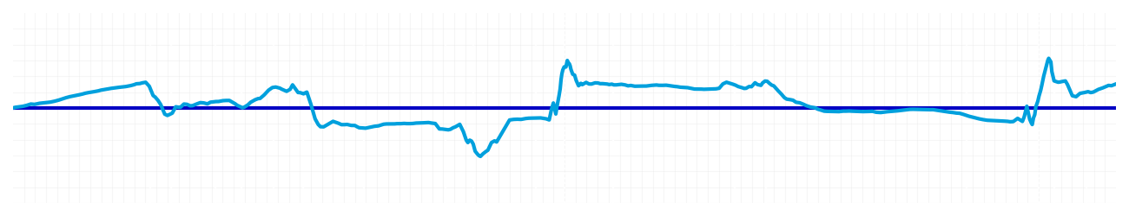
Japanese GP Qualifying Q2
Driver
Alexander Albon
Carlos Sainz
Driver
Lap Time
01:27.783
01:27.836
Lap Time
Sector 1
30.714
Speed Trap 1
288 kp/h
Speed Trap 1
287 kp/h
Sector 1
30.760
Sector 2
39.651
Speed Trap 2
305 kp/h
Gap
-0.053
Gap
0.053
Speed Trap 2
303 kp/h
Sector 2
39.579
Sector 3
17.418
Speed Final Line
273 kp/h
Corner Advantage
10/19
Corner Advantage
9/19
Speed Final Line
270 kp/h
Sector 3
17.497
FULL THROTTLE
66%
67%
FULL THROTTLE
HEAVY BREAKING
15%
17%
HEAVY BREAKING
%LAP TIME
CORNERING
19%
16%
CORNERING
%LAP TIME
SPEED
SPEED
DELTA TIME
DELTA TIME

Slide 5

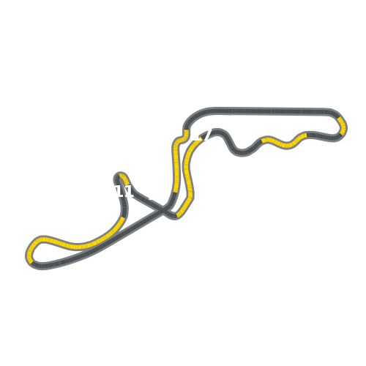


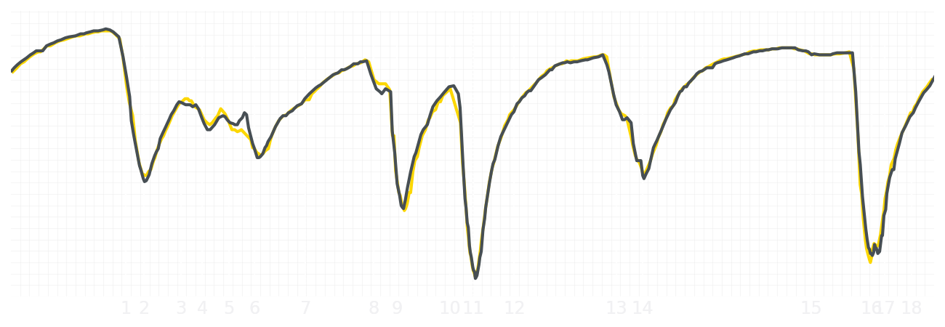
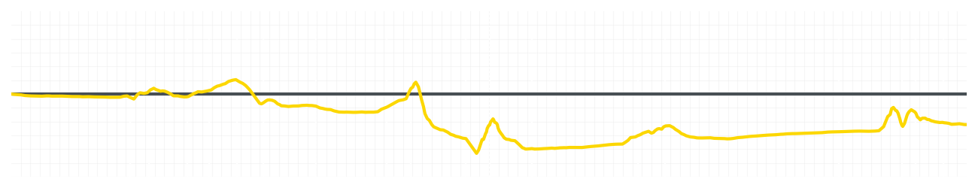
Japanese GP Qualifying Q2
Driver
Liam Lawson
Isack Hadjar
Driver
Lap Time
01:27.906
01:27.775
Lap Time
Sector 1
30.879
Speed Trap 1
287 kp/h
Speed Trap 1
287 kp/h
Sector 1
30.783
Sector 2
39.634
Speed Trap 2
302 kp/h
Gap
0.131
Gap
-0.131
Speed Trap 2
301 kp/h
Sector 2
39.591
Sector 3
17.393
Speed Final Line
271 kp/h
Corner Advantage
9/19
Corner Advantage
10/19
Speed Final Line
269 kp/h
Sector 3
17.401
FULL THROTTLE
66%
67%
FULL THROTTLE
HEAVY BREAKING
12%
13%
HEAVY BREAKING
%LAP TIME
CORNERING
22%
20%
CORNERING
%LAP TIME
SPEED
SPEED
DELTA TIME
DELTA TIME

Slide 6

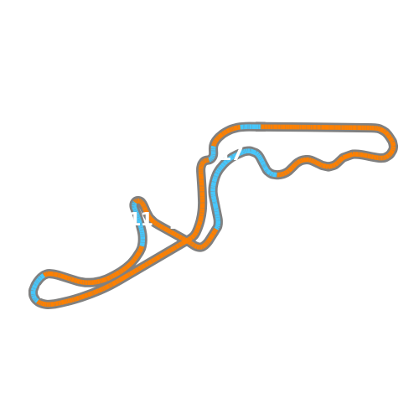

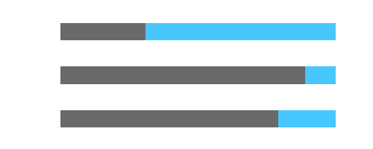
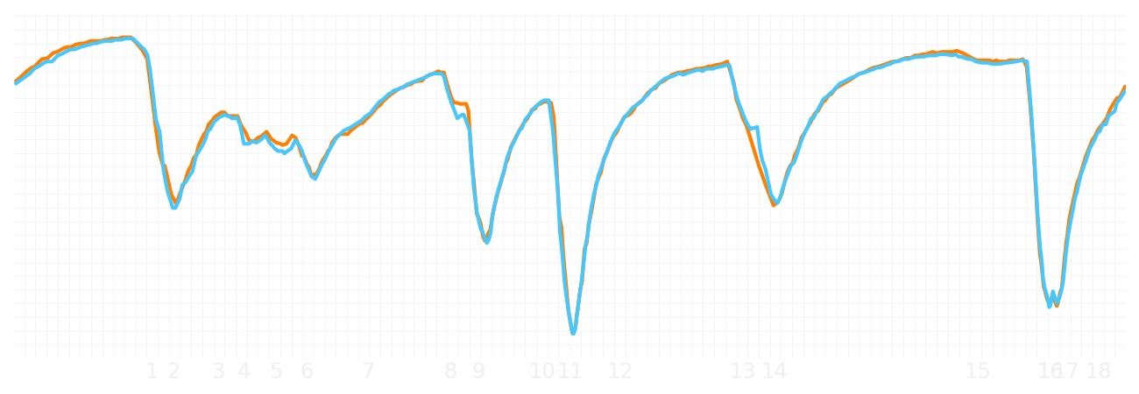
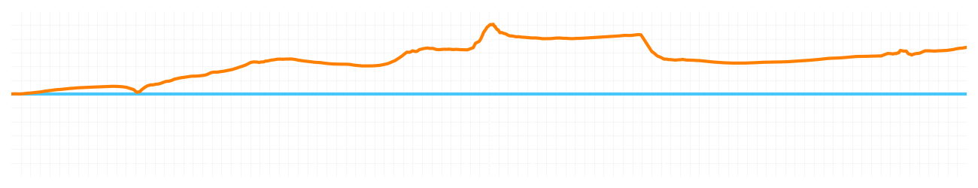
Japanese GP Qualifying Q2
Driver
Lando Norris
Oscar Piastri
Driver
Lap Time
01:27.146
01:27.507
Lap Time
Sector 1
30.451
Speed Trap 1
285 kp/h
Speed Trap 1
286 kp/h
Sector 1
30.658
Sector 2
39.388
Speed Trap 2
302 kp/h
Gap
-0.361
Gap
0.361
Speed Trap 2
302 kp/h
Sector 2
39.426
Sector 3
17.307
Speed Final Line
272 kp/h
Corner Advantage
5/19
Corner Advantage
14/19
Speed Final Line
269 kp/h
Sector 3
17.423
FULL THROTTLE
68%
69%
FULL THROTTLE
HEAVY BREAKING
11%
11%
HEAVY BREAKING
%LAP TIME
CORNERING
21%
20%
CORNERING
%LAP TIME
SPEED
SPEED
DELTA TIME
DELTA TIME

