Slide 1


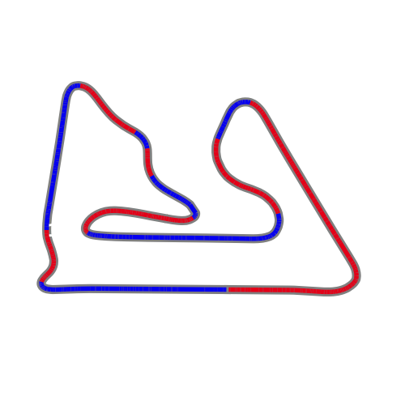
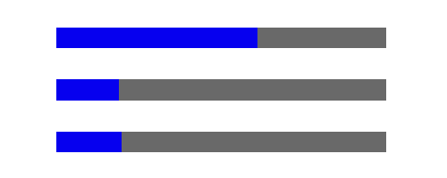

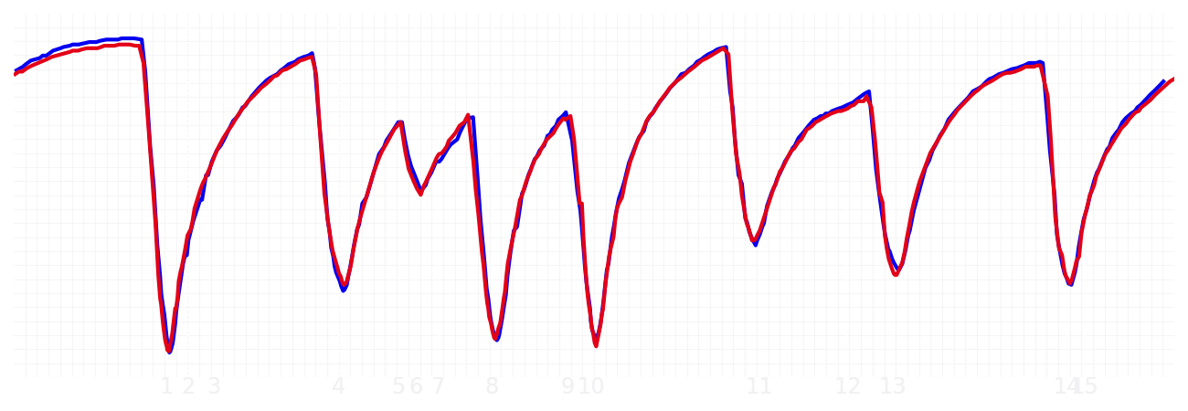
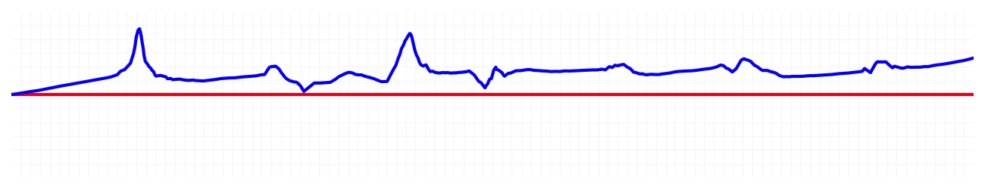
Bahrain GP Qualifying Q2
Driver
Max Verstappen
Yuki Tsunoda
Driver
Lap Time
01:31.019
01:31.228
Lap Time
Sector 1
28.998
Speed Trap 1
242 kp/h
Speed Trap 1
241 kp/h
Sector 1
29.067
Sector 2
39.064
Speed Trap 2
275 kp/h
Gap
-0.209
Gap
0.209
Speed Trap 2
272 kp/h
Sector 2
39.177
Sector 3
22.957
Speed Final Line
288 kp/h
Corner Advantage
9/16
Corner Advantage
7/16
Speed Final Line
284 kp/h
Sector 3
22.984
FULL THROTTLE
61%
61%
FULL THROTTLE
HEAVY BREAKING
19%
18%
HEAVY BREAKING
%LAP TIME
CORNERING
20%
21%
CORNERING
%LAP TIME
SPEED
SPEED
DELTA TIME
DELTA TIME

Slide 2

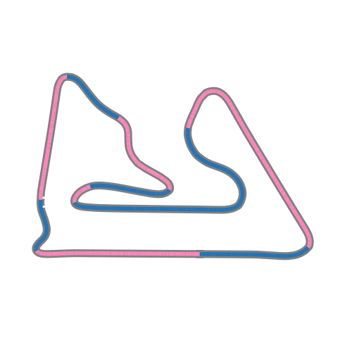


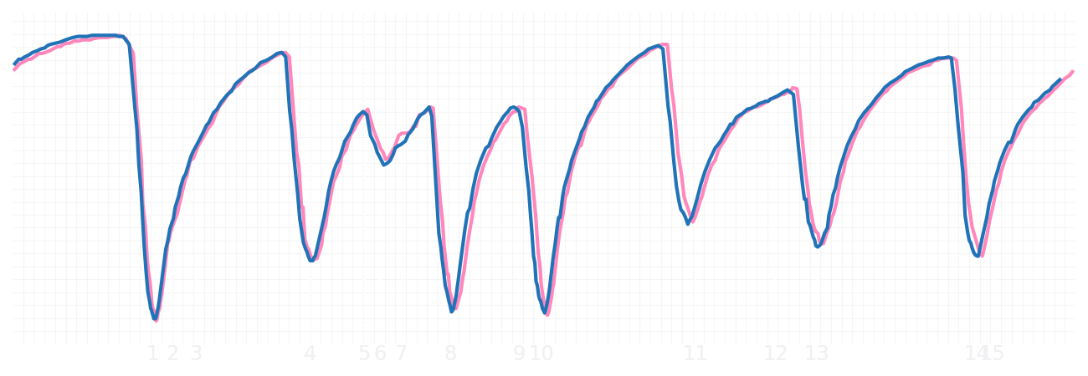
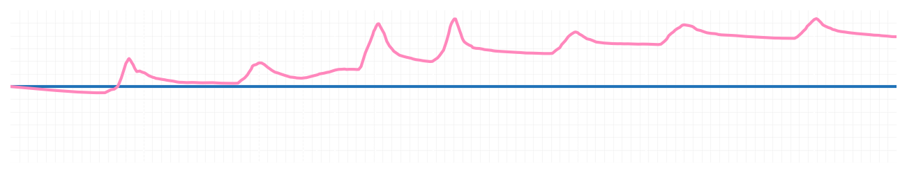
Bahrain GP Qualifying Q2
Driver
Pierre Gasly
Jack Doohan
Driver
Lap Time
01:30.643
01:31.245
Lap Time
Sector 1
29.052
Speed Trap 1
244 kp/h
Speed Trap 1
244 kp/h
Sector 1
29.094
Sector 2
38.804
Speed Trap 2
273 kp/h
Gap
-0.602
Gap
0.602
Speed Trap 2
272 kp/h
Sector 2
39.215
Sector 3
22.787
Speed Final Line
285 kp/h
Corner Advantage
8/16
Corner Advantage
8/16
Speed Final Line
285 kp/h
Sector 3
22.936
FULL THROTTLE
63%
60%
FULL THROTTLE
HEAVY BREAKING
18%
18%
HEAVY BREAKING
%LAP TIME
CORNERING
19%
22%
CORNERING
%LAP TIME
SPEED
SPEED
DELTA TIME
DELTA TIME

Slide 3

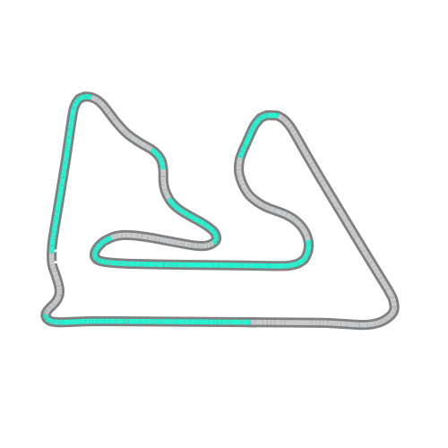


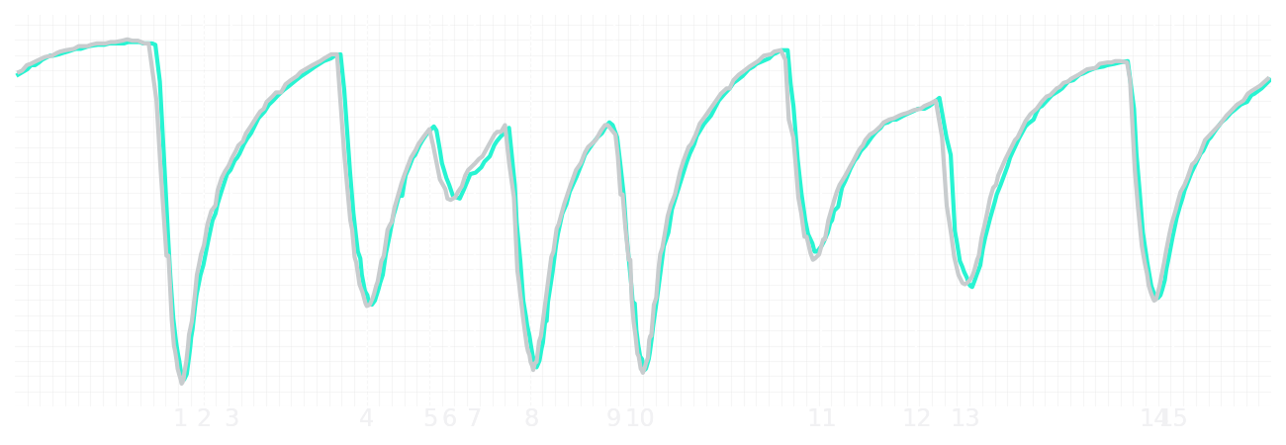
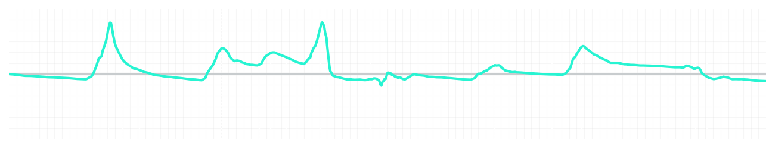
Bahrain GP Qualifying Q2
Driver
Kimi Antonelli
George Russell
Driver
Lap Time
01:30.716
01:30.664
Lap Time
Sector 1
28.977
Speed Trap 1
243 kp/h
Speed Trap 1
243 kp/h
Sector 1
28.974
Sector 2
39.107
Speed Trap 2
273 kp/h
Gap
0.052
Gap
-0.052
Speed Trap 2
273 kp/h
Sector 2
39.062
Sector 3
22.632
Speed Final Line
285 kp/h
Corner Advantage
9/16
Corner Advantage
7/16
Speed Final Line
287 kp/h
Sector 3
22.628
FULL THROTTLE
61%
60%
FULL THROTTLE
HEAVY BREAKING
19%
18%
HEAVY BREAKING
%LAP TIME
CORNERING
20%
22%
CORNERING
%LAP TIME
SPEED
SPEED
DELTA TIME
DELTA TIME

Slide 4

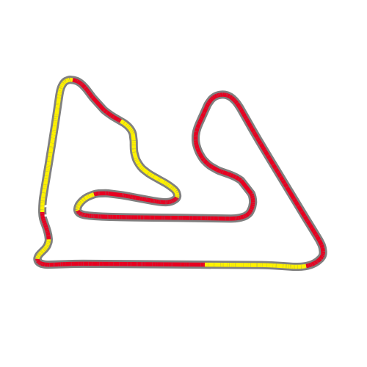


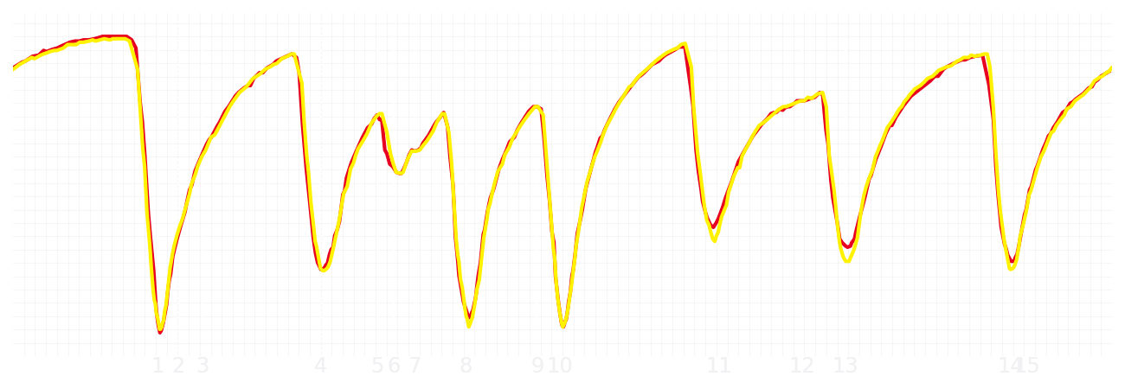
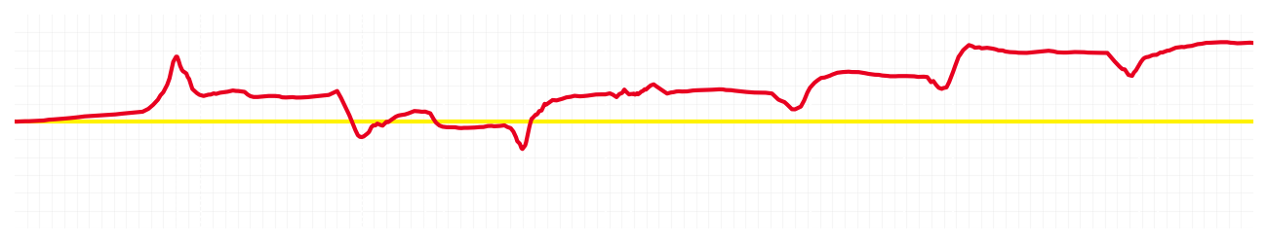
Bahrain GP Qualifying Q2
Driver
Charles Leclerc
Lewis Hamilton
Driver
Lap Time
01:30.724
01:31.009
Lap Time
Sector 1
28.984
Speed Trap 1
243 kp/h
Speed Trap 1
243 kp/h
Sector 1
29.044
Sector 2
39.054
Speed Trap 2
270 kp/h
Gap
-0.285
Gap
0.285
Speed Trap 2
271 kp/h
Sector 2
39.184
Sector 3
22.686
Speed Final Line
288 kp/h
Corner Advantage
6/16
Corner Advantage
10/16
Speed Final Line
289 kp/h
Sector 3
22.781
FULL THROTTLE
59%
61%
FULL THROTTLE
HEAVY BREAKING
17%
21%
HEAVY BREAKING
%LAP TIME
CORNERING
24%
18%
CORNERING
%LAP TIME
SPEED
SPEED
DELTA TIME
DELTA TIME

Slide 5

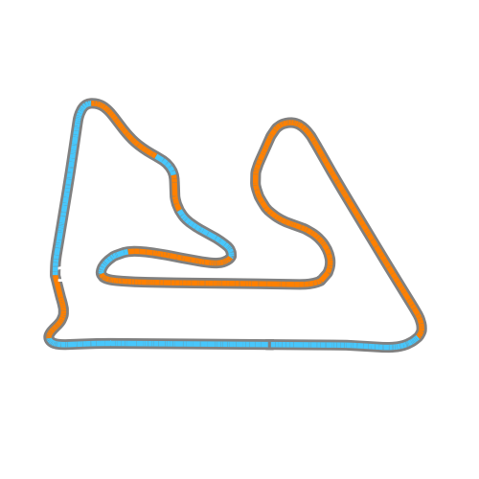


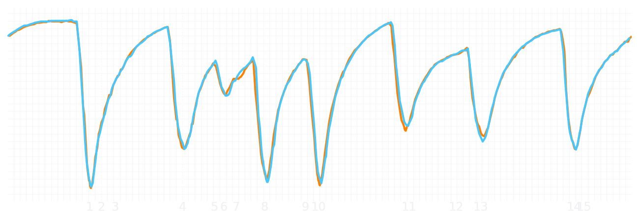
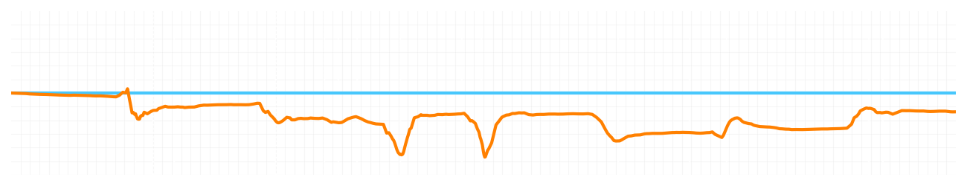
Bahrain GP Qualifying Q2
Driver
Lando Norris
Oscar Piastri
Driver
Lap Time
01:30.560
01:30.454
Lap Time
Sector 1
28.923
Speed Trap 1
242 kp/h
Speed Trap 1
244 kp/h
Sector 1
28.883
Sector 2
38.971
Speed Trap 2
272 kp/h
Gap
0.106
Gap
-0.106
Speed Trap 2
272 kp/h
Sector 2
38.853
Sector 3
22.666
Speed Final Line
287 kp/h
Corner Advantage
6/16
Corner Advantage
10/16
Speed Final Line
287 kp/h
Sector 3
22.718
FULL THROTTLE
60%
64%
FULL THROTTLE
HEAVY BREAKING
18%
17%
HEAVY BREAKING
%LAP TIME
CORNERING
22%
19%
CORNERING
%LAP TIME
SPEED
SPEED
DELTA TIME
DELTA TIME

