Slide 1


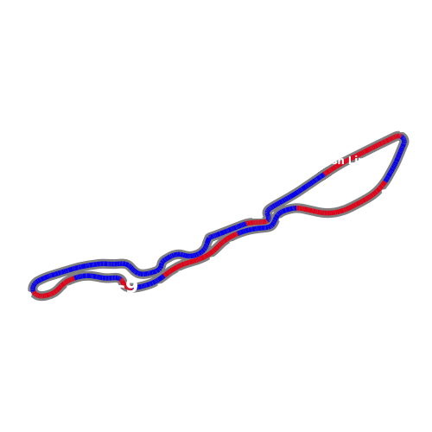
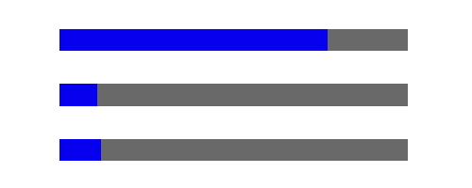
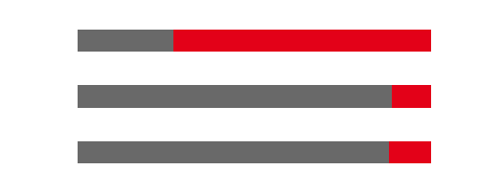
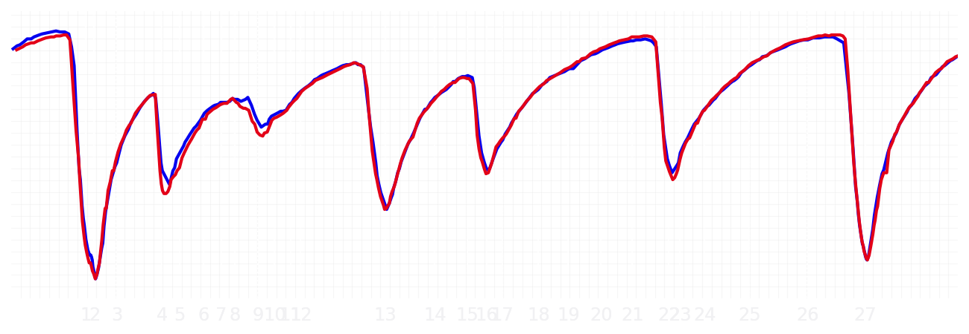
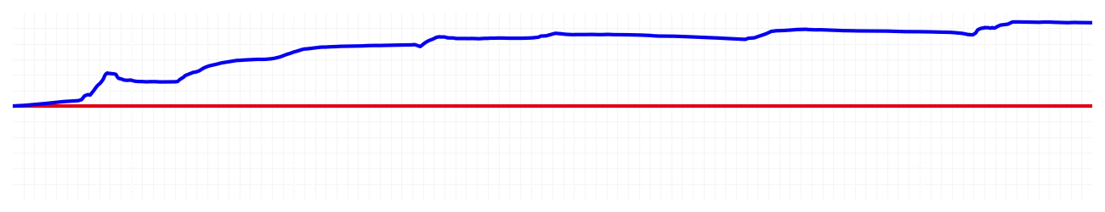
Saudi GP Qualifying Q3
Driver
Max Verstappen
Yuki Tsunoda
Driver
Lap Time
01:27.294
01:28.204
Lap Time
Sector 1
31.507
Speed Trap 1
296 kp/h
Speed Trap 1
295 kp/h
Sector 1
32.139
Sector 2
27.756
Speed Trap 2
329 kp/h
Gap
-0.91
Gap
0.91
Speed Trap 2
332 kp/h
Sector 2
27.862
Sector 3
28.031
Speed Final Line
309 kp/h
Corner Advantage
8/28
Corner Advantage
20/28
Speed Final Line
311 kp/h
Sector 3
28.203
FULL THROTTLE
77%
73%
FULL THROTTLE
HEAVY BREAKING
11%
11%
HEAVY BREAKING
%LAP TIME
CORNERING
12%
16%
CORNERING
%LAP TIME
SPEED
SPEED
DELTA TIME
DELTA TIME

Slide 2
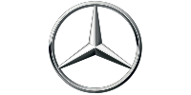
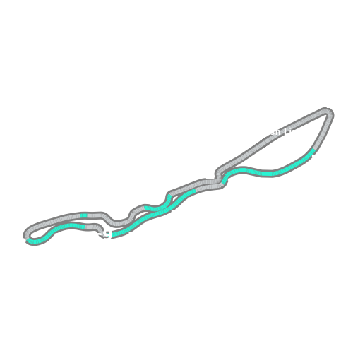
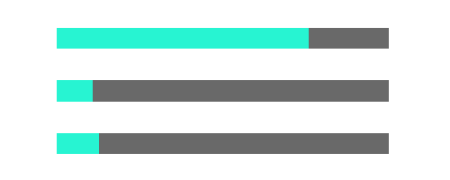
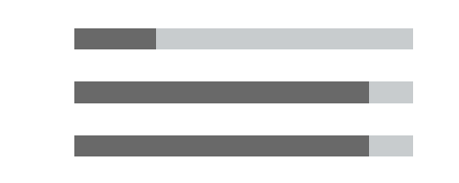
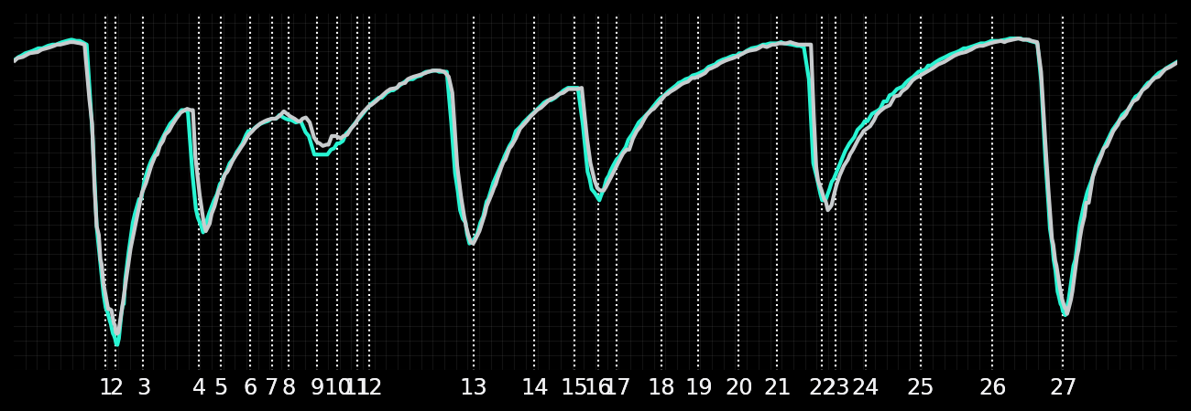
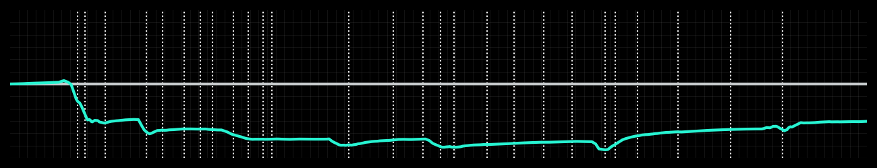
Saudi GP Qualifying Q3
Driver
Kimi Antonelli
George Russell
Driver
Lap Time
01:27.866
01:27.407
Lap Time
Sector 1
32.164
Speed Trap 1
294 kp/h
Speed Trap 1
295 kp/h
Sector 1
31.684
Sector 2
27.682
Speed Trap 2
326 kp/h
Gap
0.459
Gap
-0.459
Speed Trap 2
327 kp/h
Sector 2
27.577
Sector 3
28.020
Speed Final Line
309 kp/h
Corner Advantage
14/28
Corner Advantage
14/28
Speed Final Line
309 kp/h
Sector 3
28.146
FULL THROTTLE
76%
76%
FULL THROTTLE
HEAVY BREAKING
11%
13%
HEAVY BREAKING
%LAP TIME
CORNERING
13%
11%
CORNERING
%LAP TIME
SPEED
SPEED
DELTA TIME
DELTA TIME

Slide 3
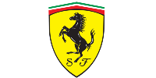
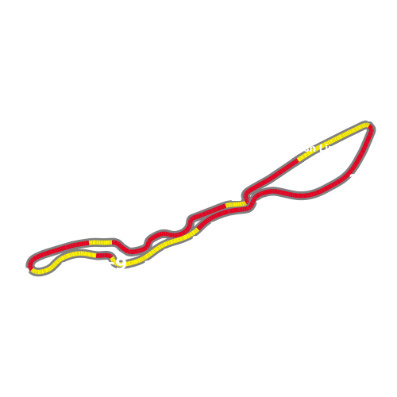
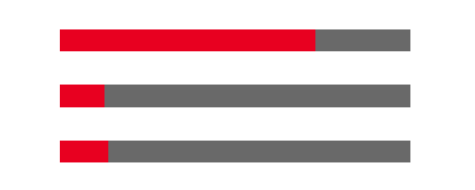
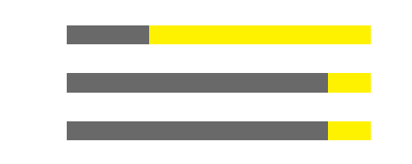
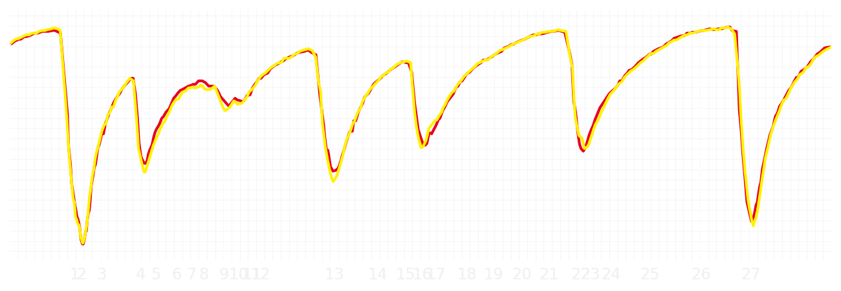
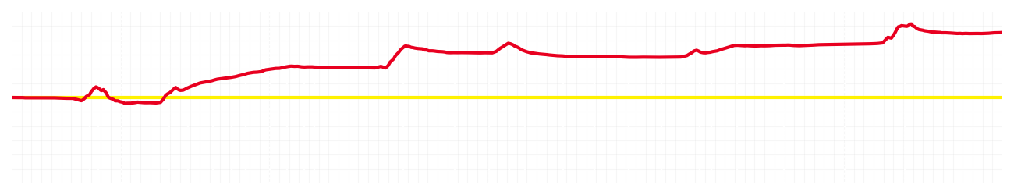
Saudi GP Qualifying Q3
Driver
Charles Leclerc
Lewis Hamilton
Driver
Lap Time
01:27.670
01:28.201
Lap Time
Sector 1
31.857
Speed Trap 1
295 kp/h
Speed Trap 1
297 kp/h
Sector 1
32.137
Sector 2
27.796
Speed Trap 2
328 kp/h
Gap
-0.531
Gap
0.531
Speed Trap 2
329 kp/h
Sector 2
27.833
Sector 3
28.017
Speed Final Line
311 kp/h
Corner Advantage
10/28
Corner Advantage
18/28
Speed Final Line
309 kp/h
Sector 3
28.231
FULL THROTTLE
73%
73%
FULL THROTTLE
HEAVY BREAKING
13%
14%
HEAVY BREAKING
%LAP TIME
CORNERING
14%
13%
CORNERING
%LAP TIME
SPEED
SPEED
DELTA TIME
DELTA TIME

