Slide 1


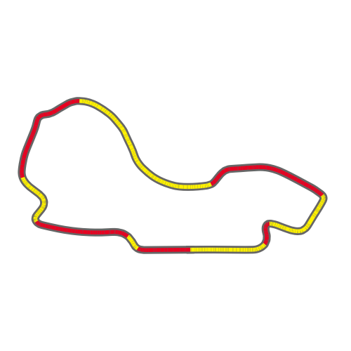

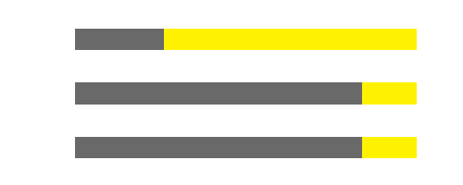
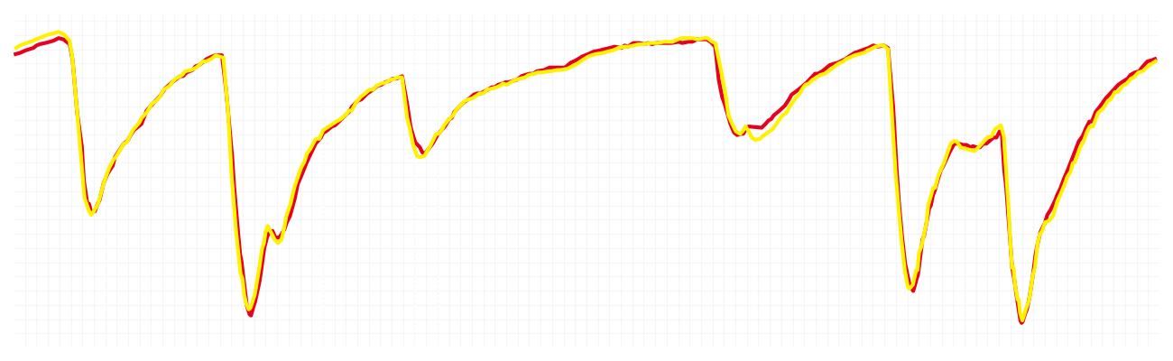
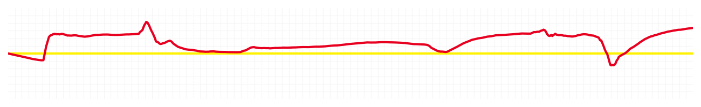
Australian GP Qualifying Q1
Driver
Charles Leclerc
Lewis Hamilton
Driver
Lap Time
01:16.029
01:16.213
Lap Time
Sector 1
26.411
Speed Trap 1
290 kp/h
Speed Trap 1
290 kp/h
Sector 1
26.347
Sector 2
17.144
Speed Trap 2
322 kp/h
Gap
-0.184
Gap
0.184
Speed Trap 2
323 kp/h
Sector 2
17.224
Sector 3
32.474
Speed Final Line
308 kp/h
Corner Advantage
9/15
Corner Advantage
6/15
Speed Final Line
305 kp/h
Sector 3
32.642
FULL THROTTLE
71%
73%
FULL THROTTLE
HEAVY BREAKING
12%
13%
HEAVY BREAKING
%LAP TIME
CORNERING
17%
14%
CORNERING
%LAP TIME
SPEED
SPEED
DELTA TIME
DELTA TIME

Slide 2
Australian GP Qualifying Q1
Driver
Charles Leclerc
Lewis Hamilton
Driver
Lap Time
01:16.029
01:16.213
Lap Time
Sector 1
26.411
Speed Trap 1
290 kp/h
Speed Trap 1
290 kp/h
Sector 1
26.347
Sector 2
17.144
Speed Trap 2
322 kp/h
Gap
-0.184
Gap
0.184
Speed Trap 2
323 kp/h
Sector 2
17.224
Sector 3
32.474
Speed Final Line
308 kp/h
Corner Advantage
9/15
Corner Advantage
6/15
Speed Final Line
305 kp/h
Sector 3
32.642
FULL THROTTLE
71%
73%
FULL THROTTLE
HEAVY BREAKING
12%
13%
HEAVY BREAKING
%LAP TIME
CORNERING
17%
14%
CORNERING
%LAP TIME
SPEED
SPEED
DELTA TIME
DELTA TIME

Slide 3
Australian GP Qualifying Q1
Driver
Charles Leclerc
Lewis Hamilton
Driver
Lap Time
01:16.029
01:16.213
Lap Time
Sector 1
26.411
Speed Trap 1
290 kp/h
Speed Trap 1
290 kp/h
Sector 1
26.347
Sector 2
17.144
Speed Trap 2
322 kp/h
Gap
-0.184
Gap
0.184
Speed Trap 2
323 kp/h
Sector 2
17.224
Sector 3
32.474
Speed Final Line
308 kp/h
Corner Advantage
9/15
Corner Advantage
6/15
Speed Final Line
305 kp/h
Sector 3
32.642
FULL THROTTLE
71%
73%
FULL THROTTLE
HEAVY BREAKING
12%
13%
HEAVY BREAKING
%LAP TIME
CORNERING
17%
14%
CORNERING
%LAP TIME
SPEED
SPEED
DELTA TIME
DELTA TIME

Slide 4
Australian GP Qualifying Q1
Driver
Charles Leclerc
Lewis Hamilton
Driver
Lap Time
01:16.029
01:16.213
Lap Time
Sector 1
26.411
Speed Trap 1
290 kp/h
Speed Trap 1
290 kp/h
Sector 1
26.347
Sector 2
17.144
Speed Trap 2
322 kp/h
Gap
-0.184
Gap
0.184
Speed Trap 2
323 kp/h
Sector 2
17.224
Sector 3
32.474
Speed Final Line
308 kp/h
Corner Advantage
9/15
Corner Advantage
6/15
Speed Final Line
305 kp/h
Sector 3
32.642
FULL THROTTLE
71%
73%
FULL THROTTLE
HEAVY BREAKING
12%
13%
HEAVY BREAKING
%LAP TIME
CORNERING
17%
14%
CORNERING
%LAP TIME
SPEED
SPEED
DELTA TIME
DELTA TIME

Slide 5
Australian GP Qualifying Q1
Driver
Charles Leclerc
Lewis Hamilton
Driver
Lap Time
01:16.029
01:16.213
Lap Time
Sector 1
26.411
Speed Trap 1
290 kp/h
Speed Trap 1
290 kp/h
Sector 1
26.347
Sector 2
17.144
Speed Trap 2
322 kp/h
Gap
-0.184
Gap
0.184
Speed Trap 2
323 kp/h
Sector 2
17.224
Sector 3
32.474
Speed Final Line
308 kp/h
Corner Advantage
9/15
Corner Advantage
6/15
Speed Final Line
305 kp/h
Sector 3
32.642
FULL THROTTLE
71%
73%
FULL THROTTLE
HEAVY BREAKING
12%
13%
HEAVY BREAKING
%LAP TIME
CORNERING
17%
14%
CORNERING
%LAP TIME
SPEED
SPEED
DELTA TIME
DELTA TIME

Slide 6
Australian GP Qualifying Q1
Driver
Charles Leclerc
Lewis Hamilton
Driver
Lap Time
01:16.029
01:16.213
Lap Time
Sector 1
26.411
Speed Trap 1
290 kp/h
Speed Trap 1
290 kp/h
Sector 1
26.347
Sector 2
17.144
Speed Trap 2
322 kp/h
Gap
-0.184
Gap
0.184
Speed Trap 2
323 kp/h
Sector 2
17.224
Sector 3
32.474
Speed Final Line
308 kp/h
Corner Advantage
9/15
Corner Advantage
6/15
Speed Final Line
305 kp/h
Sector 3
32.642
FULL THROTTLE
71%
73%
FULL THROTTLE
HEAVY BREAKING
12%
13%
HEAVY BREAKING
%LAP TIME
CORNERING
17%
14%
CORNERING
%LAP TIME
SPEED
SPEED
DELTA TIME
DELTA TIME

Slide 7
Australian GP Qualifying Q1
Driver
Charles Leclerc
Lewis Hamilton
Driver
Lap Time
01:16.029
01:16.213
Lap Time
Sector 1
26.411
Speed Trap 1
290 kp/h
Speed Trap 1
290 kp/h
Sector 1
26.347
Sector 2
17.144
Speed Trap 2
322 kp/h
Gap
-0.184
Gap
0.184
Speed Trap 2
323 kp/h
Sector 2
17.224
Sector 3
32.474
Speed Final Line
308 kp/h
Corner Advantage
9/15
Corner Advantage
6/15
Speed Final Line
305 kp/h
Sector 3
32.642
FULL THROTTLE
71%
73%
FULL THROTTLE
HEAVY BREAKING
12%
13%
HEAVY BREAKING
%LAP TIME
CORNERING
17%
14%
CORNERING
%LAP TIME
SPEED
SPEED
DELTA TIME
DELTA TIME

Slide 8
Australian GP Qualifying Q1
Driver
Charles Leclerc
Lewis Hamilton
Driver
Lap Time
01:16.029
01:16.213
Lap Time
Sector 1
26.411
Speed Trap 1
290 kp/h
Speed Trap 1
290 kp/h
Sector 1
26.347
Sector 2
17.144
Speed Trap 2
322 kp/h
Gap
-0.184
Gap
0.184
Speed Trap 2
323 kp/h
Sector 2
17.224
Sector 3
32.474
Speed Final Line
308 kp/h
Corner Advantage
9/15
Corner Advantage
6/15
Speed Final Line
305 kp/h
Sector 3
32.642
FULL THROTTLE
71%
73%
FULL THROTTLE
HEAVY BREAKING
12%
13%
HEAVY BREAKING
%LAP TIME
CORNERING
17%
14%
CORNERING
%LAP TIME
SPEED
SPEED
DELTA TIME
DELTA TIME

Slide 9
Australian GP Qualifying Q1
Driver
Charles Leclerc
Lewis Hamilton
Driver
Lap Time
01:16.029
01:16.213
Lap Time
Sector 1
26.411
Speed Trap 1
290 kp/h
Speed Trap 1
290 kp/h
Sector 1
26.347
Sector 2
17.144
Speed Trap 2
322 kp/h
Gap
-0.184
Gap
0.184
Speed Trap 2
323 kp/h
Sector 2
17.224
Sector 3
32.474
Speed Final Line
308 kp/h
Corner Advantage
9/15
Corner Advantage
6/15
Speed Final Line
305 kp/h
Sector 3
32.642
FULL THROTTLE
71%
73%
FULL THROTTLE
HEAVY BREAKING
12%
13%
HEAVY BREAKING
%LAP TIME
CORNERING
17%
14%
CORNERING
%LAP TIME
SPEED
SPEED
DELTA TIME
DELTA TIME

Slide 10
Australian GP Qualifying Q1
Driver
Charles Leclerc
Lewis Hamilton
Driver
Lap Time
01:16.029
01:16.213
Lap Time
Sector 1
26.411
Speed Trap 1
290 kp/h
Speed Trap 1
290 kp/h
Sector 1
26.347
Sector 2
17.144
Speed Trap 2
322 kp/h
Gap
-0.184
Gap
0.184
Speed Trap 2
323 kp/h
Sector 2
17.224
Sector 3
32.474
Speed Final Line
308 kp/h
Corner Advantage
9/15
Corner Advantage
6/15
Speed Final Line
305 kp/h
Sector 3
32.642
FULL THROTTLE
71%
73%
FULL THROTTLE
HEAVY BREAKING
12%
13%
HEAVY BREAKING
%LAP TIME
CORNERING
17%
14%
CORNERING
%LAP TIME
SPEED
SPEED
DELTA TIME
DELTA TIME

