Slide 1


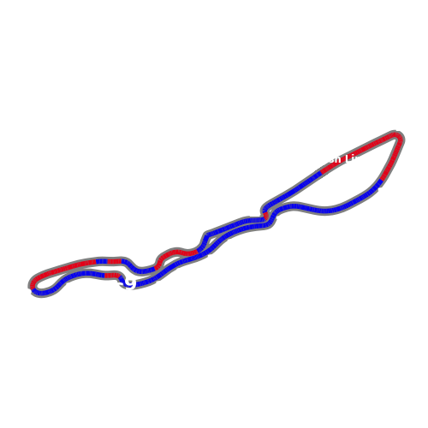
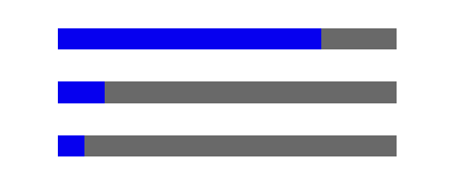

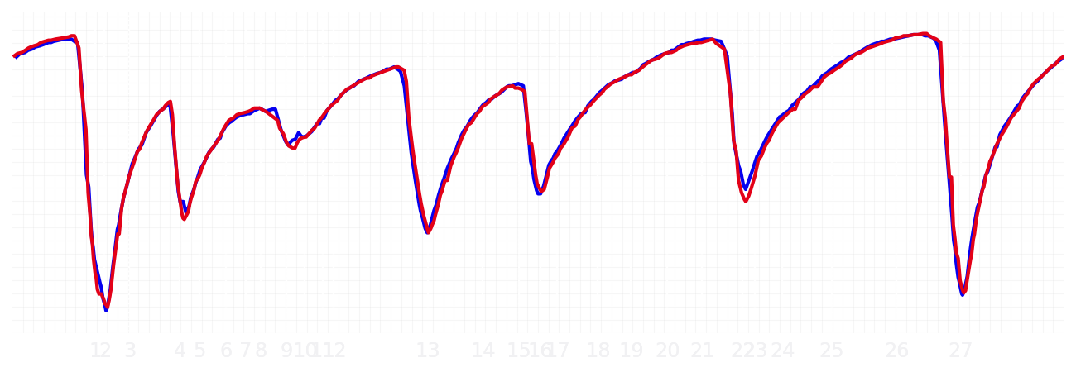
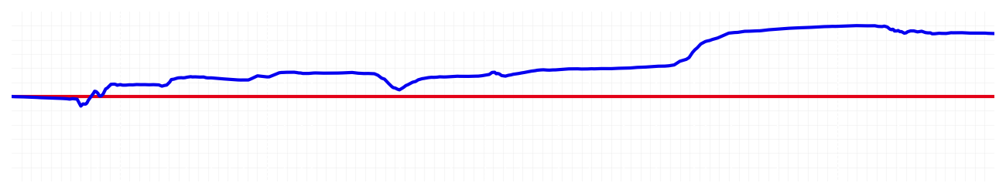
Saudi GP Qualifying Q1
Driver
Max Verstappen
Yuki Tsunoda
Driver
Lap Time
01:27.778
01:28.226
Lap Time
Sector 1
31.874
Speed Trap 1
295 kp/h
Speed Trap 1
294 kp/h
Sector 1
32.028
Sector 2
27.813
Speed Trap 2
330 kp/h
Gap
-0.448
Gap
0.448
Speed Trap 2
326 kp/h
Sector 2
27.891
Sector 3
28.091
Speed Final Line
310 kp/h
Corner Advantage
9/28
Corner Advantage
19/28
Speed Final Line
312 kp/h
Sector 3
28.307
FULL THROTTLE
78%
75%
FULL THROTTLE
HEAVY BREAKING
14%
12%
HEAVY BREAKING
%LAP TIME
CORNERING
8%
13%
CORNERING
%LAP TIME
SPEED
SPEED
DELTA TIME
DELTA TIME

Slide 2

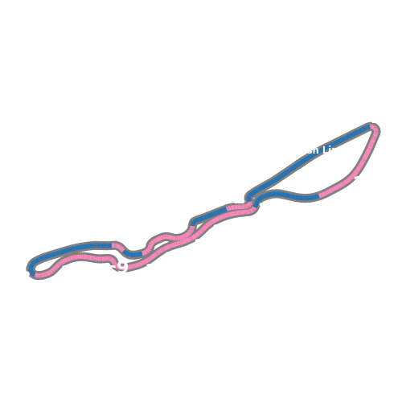
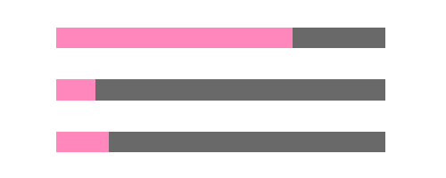
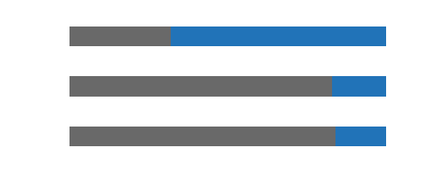
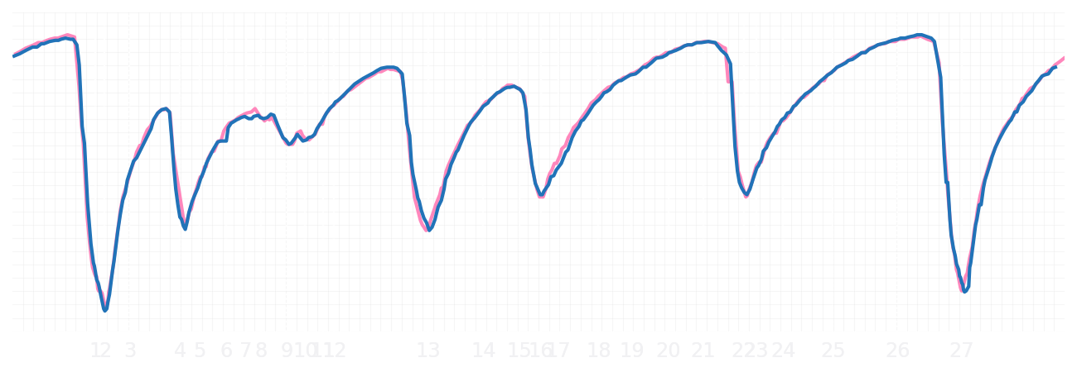
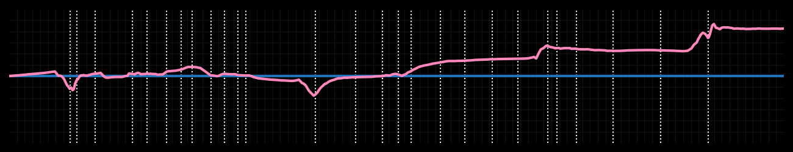
Saudi GP Qualifying Q1
Driver
Pierre Gasly
Jack Doohan
Driver
Lap Time
01:28.421
01:28.739
Lap Time
Sector 1
32.136
Speed Trap 1
294 kp/h
Speed Trap 1
297 kp/h
Sector 1
32.223
Sector 2
28.027
Speed Trap 2
327 kp/h
Gap
-0.318
Gap
0.318
Speed Trap 2
325 kp/h
Sector 2
28.123
Sector 3
28.258
Speed Final Line
311 kp/h
Corner Advantage
9/28
Corner Advantage
19/28
Speed Final Line
310 kp/h
Sector 3
28.393
FULL THROTTLE
72%
68%
FULL THROTTLE
HEAVY BREAKING
12%
17%
HEAVY BREAKING
%LAP TIME
CORNERING
16%
15%
CORNERING
%LAP TIME
SPEED
SPEED
DELTA TIME
DELTA TIME

Slide 3

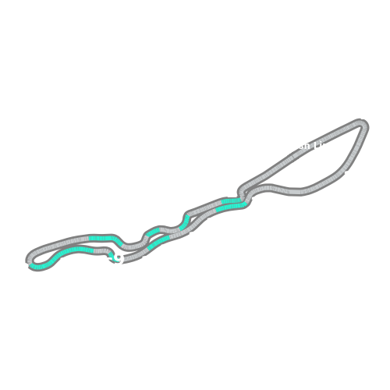
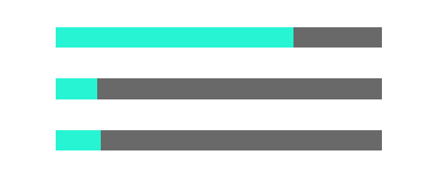
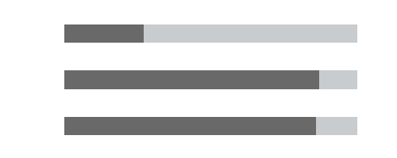
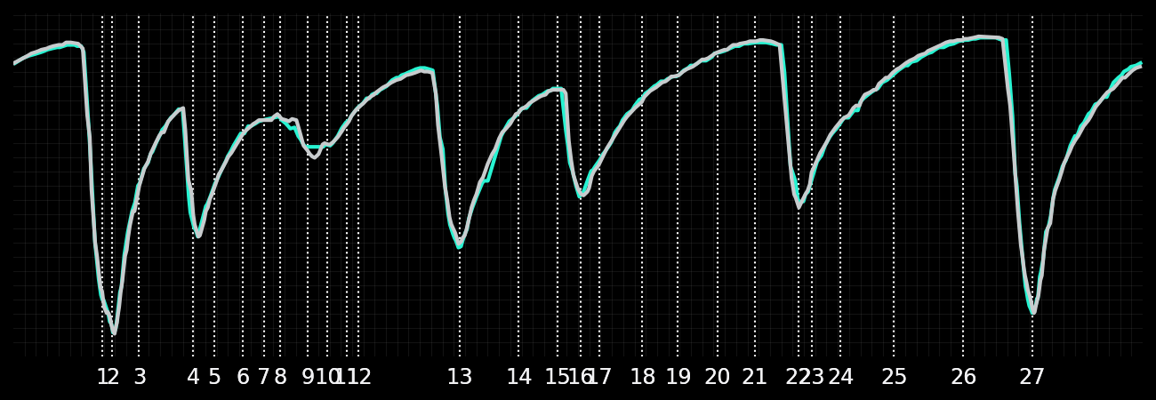
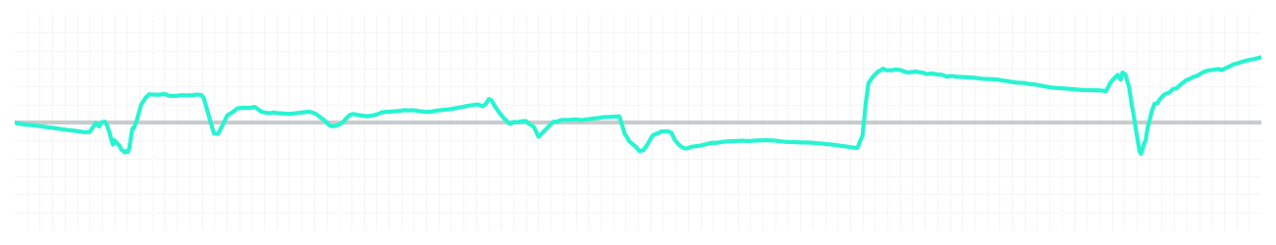
Saudi GP Qualifying Q1
Driver
Kimi Antonelli
George Russell
Driver
Lap Time
01:28.128
01:28.282
Lap Time
Sector 1
32.232
Speed Trap 1
295 kp/h
Speed Trap 1
294 kp/h
Sector 1
32.295
Sector 2
27.743
Speed Trap 2
327 kp/h
Gap
-0.154
Gap
0.154
Speed Trap 2
328 kp/h
Sector 2
27.724
Sector 3
28.153
Speed Final Line
310 kp/h
Corner Advantage
16/28
Corner Advantage
12/28
Speed Final Line
306 kp/h
Sector 3
28.263
FULL THROTTLE
73%
73%
FULL THROTTLE
HEAVY BREAKING
13%
13%
HEAVY BREAKING
%LAP TIME
CORNERING
14%
14%
CORNERING
%LAP TIME
SPEED
SPEED
DELTA TIME
DELTA TIME

Slide 4

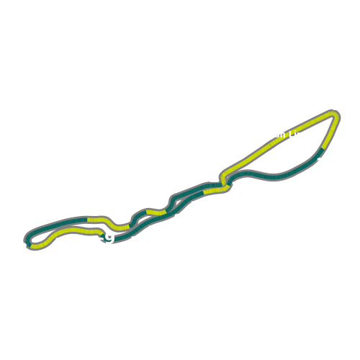


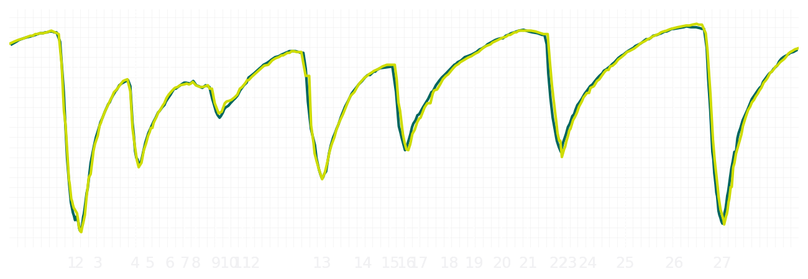
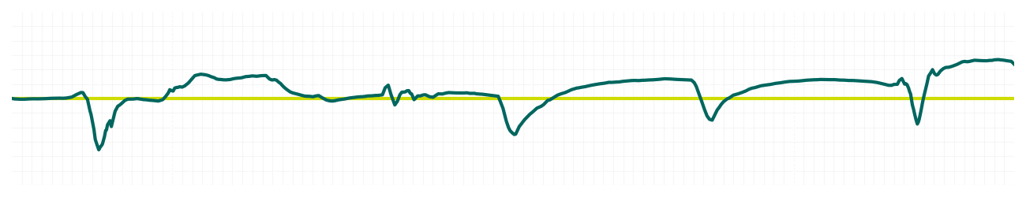
Saudi GP Qualifying Q1
Driver
Fernando Alonso
Lance Stroll
Driver
Lap Time
01:28.548
01:28.645
Lap Time
Sector 1
32.093
Speed Trap 1
295 kp/h
Speed Trap 1
293 kp/h
Sector 1
32.072
Sector 2
27.928
Speed Trap 2
323 kp/h
Gap
-0.097
Gap
0.097
Speed Trap 2
324 kp/h
Sector 2
28.054
Sector 3
28.527
Speed Final Line
303 kp/h
Corner Advantage
11/28
Corner Advantage
17/28
Speed Final Line
305 kp/h
Sector 3
28.519
FULL THROTTLE
75%
77%
FULL THROTTLE
HEAVY BREAKING
11%
14%
HEAVY BREAKING
%LAP TIME
CORNERING
14%
9%
CORNERING
%LAP TIME
SPEED
SPEED
DELTA TIME
DELTA TIME

Slide 5

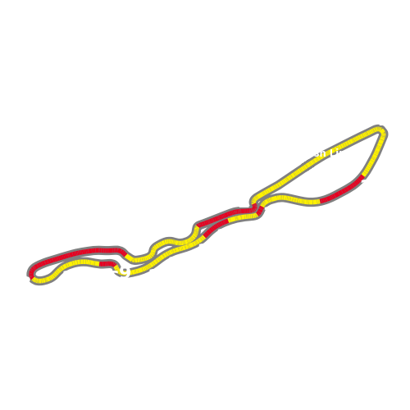

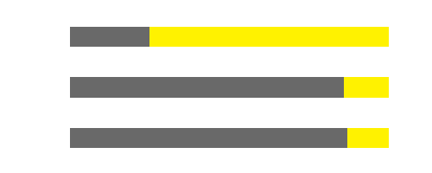
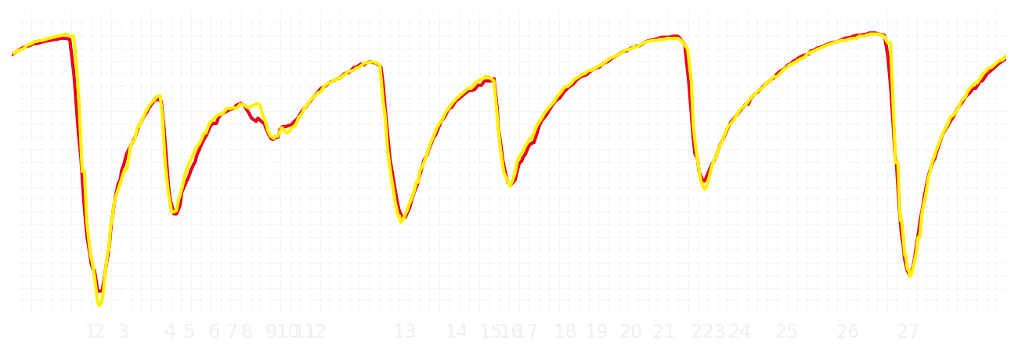
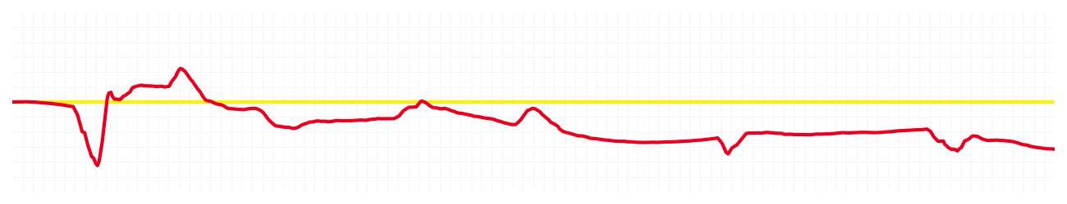
Saudi GP Qualifying Q1
Driver
Charles Leclerc
Lewis Hamilton
Driver
Lap Time
01:28.552
01:28.372
Lap Time
Sector 1
32.353
Speed Trap 1
296 kp/h
Speed Trap 1
295 kp/h
Sector 1
32.236
Sector 2
27.978
Speed Trap 2
330 kp/h
Gap
0.18
Gap
-0.18
Speed Trap 2
328 kp/h
Sector 2
27.889
Sector 3
28.221
Speed Final Line
307 kp/h
Corner Advantage
16/28
Corner Advantage
12/28
Speed Final Line
309 kp/h
Sector 3
28.247
FULL THROTTLE
72%
75%
FULL THROTTLE
HEAVY BREAKING
15%
14%
HEAVY BREAKING
%LAP TIME
CORNERING
13%
11%
CORNERING
%LAP TIME
SPEED
SPEED
DELTA TIME
DELTA TIME

Slide 6

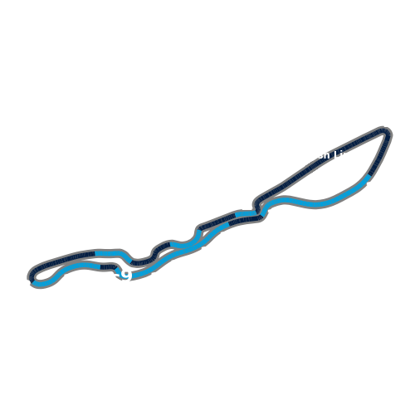
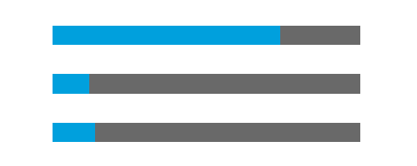
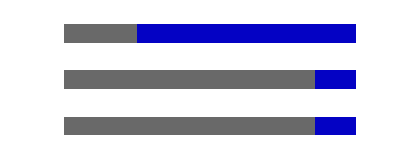
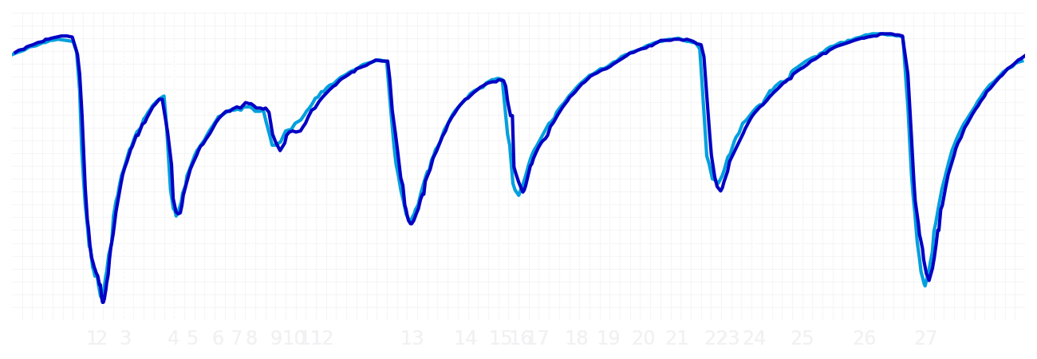
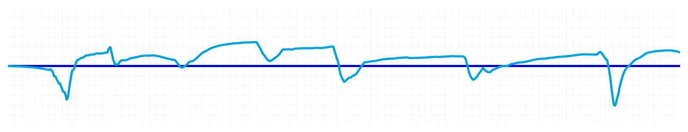
Saudi GP Qualifying Q1
Driver
Alexander Albon
Carlos Sainz
Driver
Lap Time
01:28.279
01:28.354
Lap Time
Sector 1
31.964
Speed Trap 1
297 kp/h
Speed Trap 1
297 kp/h
Sector 1
32.096
Sector 2
28.006
Speed Trap 2
324 kp/h
Gap
-0.075
Gap
0.075
Speed Trap 2
325 kp/h
Sector 2
27.952
Sector 3
28.309
Speed Final Line
306 kp/h
Corner Advantage
10/28
Corner Advantage
18/28
Speed Final Line
309 kp/h
Sector 3
28.306
FULL THROTTLE
74%
75%
FULL THROTTLE
HEAVY BREAKING
12%
14%
HEAVY BREAKING
%LAP TIME
CORNERING
14%
11%
CORNERING
%LAP TIME
SPEED
SPEED
DELTA TIME
DELTA TIME

Slide 7

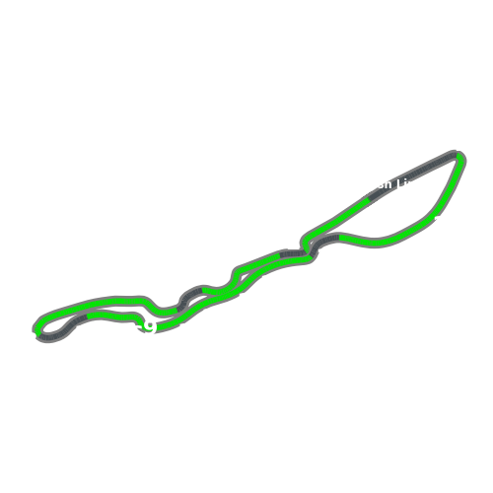
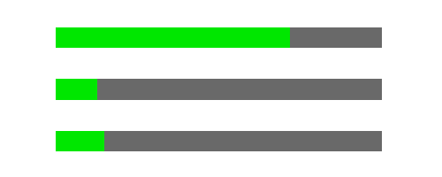

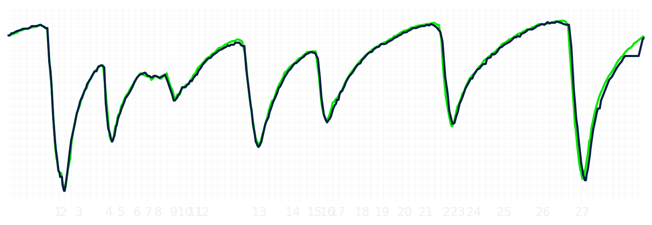
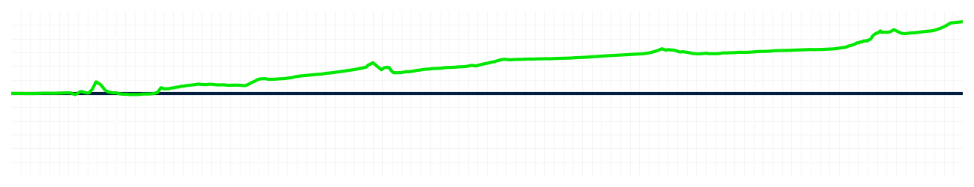
Saudi GP Qualifying Q1
Driver
Nico Hulkenberg
Gabriel Bortoleto
Driver
Lap Time
01:28.782
01:29.462
Lap Time
Sector 1
32.477
Speed Trap 1
298 kp/h
Speed Trap 1
295 kp/h
Sector 1
32.653
Sector 2
27.982
Speed Trap 2
334 kp/h
Gap
-0.68
Gap
0.68
Speed Trap 2
330 kp/h
Sector 2
28.264
Sector 3
28.323
Speed Final Line
313 kp/h
Corner Advantage
6/28
Corner Advantage
22/28
Speed Final Line
311 kp/h
Sector 3
28.545
FULL THROTTLE
72%
71%
FULL THROTTLE
HEAVY BREAKING
13%
15%
HEAVY BREAKING
%LAP TIME
CORNERING
15%
14%
CORNERING
%LAP TIME
SPEED
SPEED
DELTA TIME
DELTA TIME

Slide 8

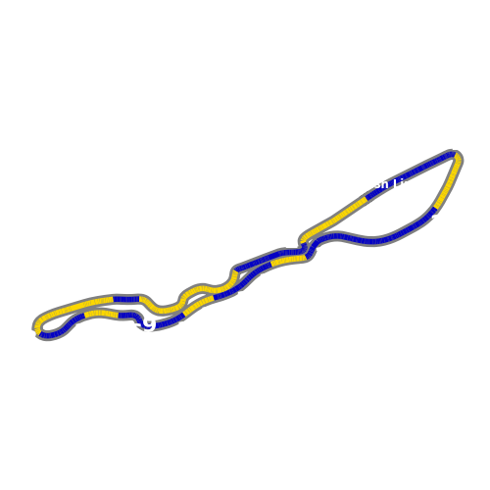


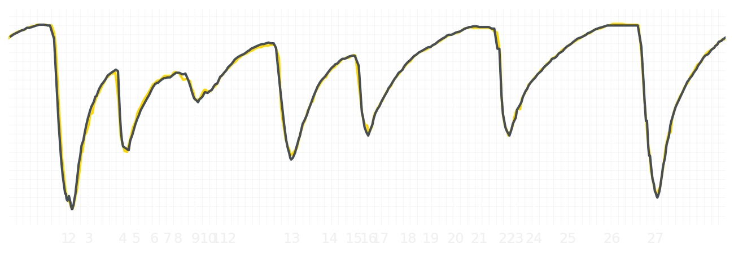
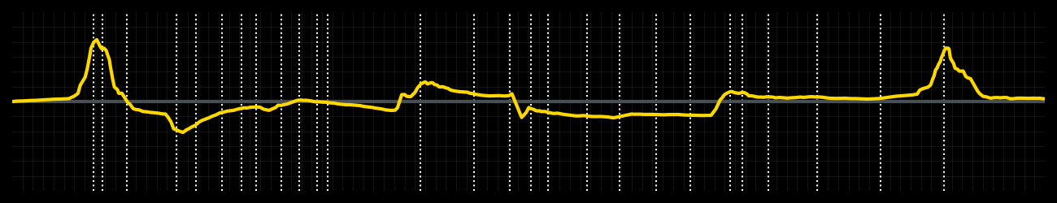
Saudi GP Qualifying Q1
Driver
Liam Lawson
Isack Hadjar
Driver
Lap Time
01:28.561
01:28.571
Lap Time
Sector 1
32.295
Speed Trap 1
295 kp/h
Speed Trap 1
296 kp/h
Sector 1
32.225
Sector 2
28.003
Speed Trap 2
325 kp/h
Gap
-0.01
Gap
0.01
Speed Trap 2
325 kp/h
Sector 2
27.994
Sector 3
28.263
Speed Final Line
310 kp/h
Corner Advantage
16/28
Corner Advantage
12/28
Speed Final Line
311 kp/h
Sector 3
28.352
FULL THROTTLE
76%
76%
FULL THROTTLE
HEAVY BREAKING
10%
12%
HEAVY BREAKING
%LAP TIME
CORNERING
14%
12%
CORNERING
%LAP TIME
SPEED
SPEED
DELTA TIME
DELTA TIME

Slide 9

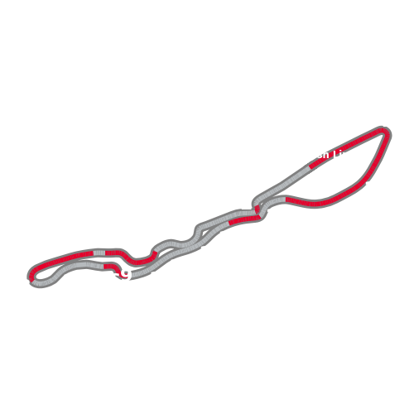
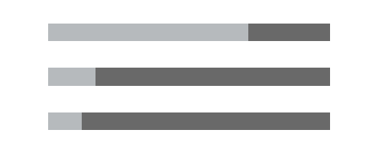

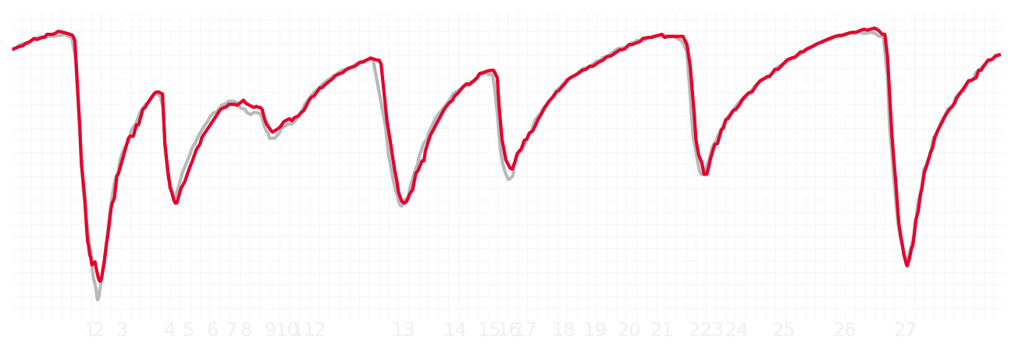
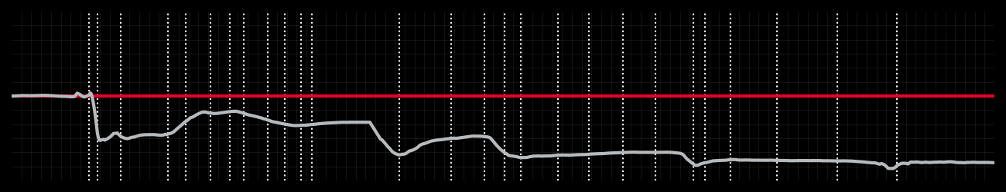
Saudi GP Qualifying Q1
Driver
Esteban Ocon
Oliver Bearman
Driver
Lap Time
01:29.092
01:28.536
Lap Time
Sector 1
32.718
Speed Trap 1
293 kp/h
Speed Trap 1
292 kp/h
Sector 1
32.497
Sector 2
28.042
Speed Trap 2
325 kp/h
Gap
0.556
Gap
-0.556
Speed Trap 2
327 kp/h
Sector 2
27.817
Sector 3
28.332
Speed Final Line
308 kp/h
Corner Advantage
12/28
Corner Advantage
16/28
Speed Final Line
309 kp/h
Sector 3
28.222
FULL THROTTLE
71%
73%
FULL THROTTLE
HEAVY BREAKING
17%
16%
HEAVY BREAKING
%LAP TIME
CORNERING
12%
11%
CORNERING
%LAP TIME
SPEED
SPEED
DELTA TIME
DELTA TIME

Slide 10

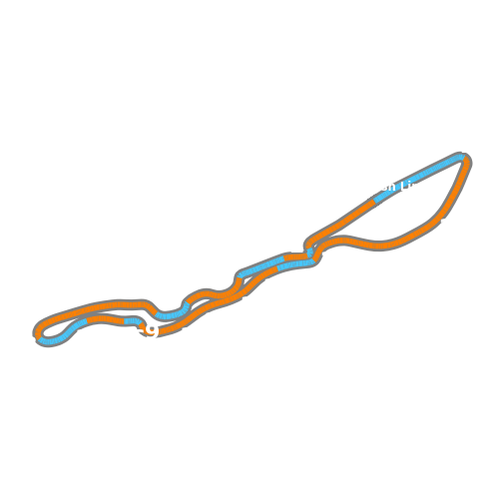
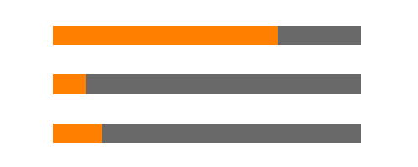
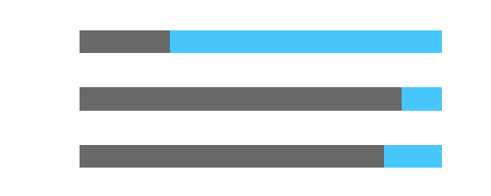
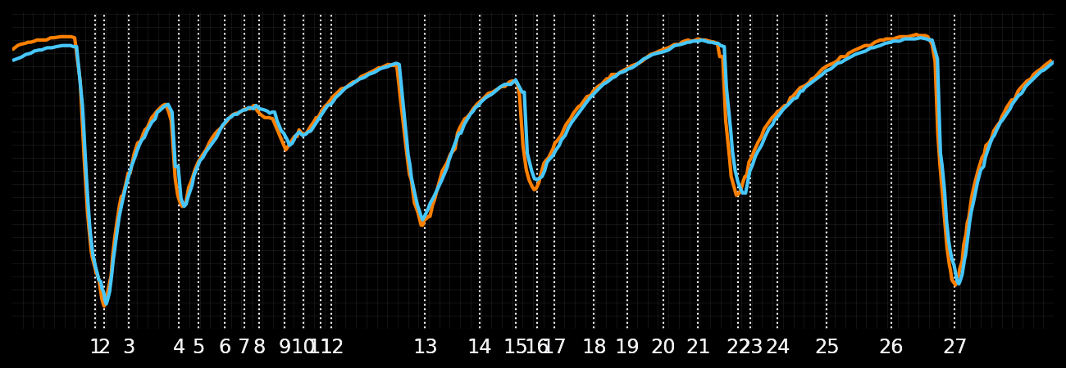
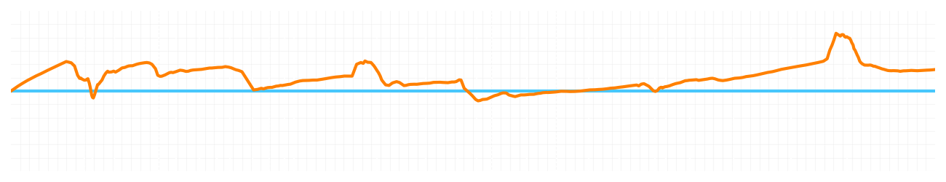
Saudi GP Qualifying Q1
Driver
Lando Norris
Oscar Piastri
Driver
Lap Time
01:27.805
01:27.901
Lap Time
Sector 1
31.801
Speed Trap 1
296 kp/h
Speed Trap 1
295 kp/h
Sector 1
31.901
Sector 2
27.831
Speed Trap 2
327 kp/h
Gap
-0.096
Gap
0.096
Speed Trap 2
325 kp/h
Sector 2
27.710
Sector 3
28.173
Speed Final Line
309 kp/h
Corner Advantage
8/28
Corner Advantage
20/28
Speed Final Line
308 kp/h
Sector 3
28.290
FULL THROTTLE
73%
75%
FULL THROTTLE
HEAVY BREAKING
11%
11%
HEAVY BREAKING
%LAP TIME
CORNERING
16%
14%
CORNERING
%LAP TIME
SPEED
SPEED
DELTA TIME
DELTA TIME

Slide 11
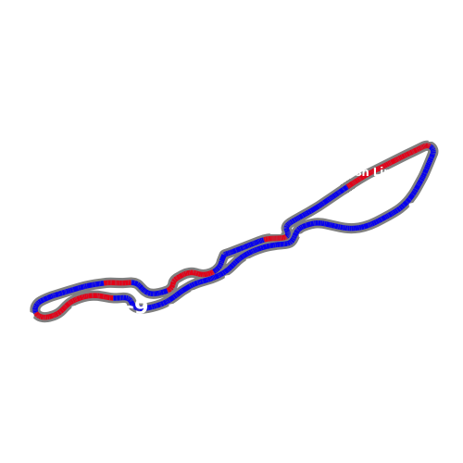
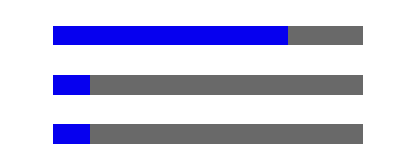

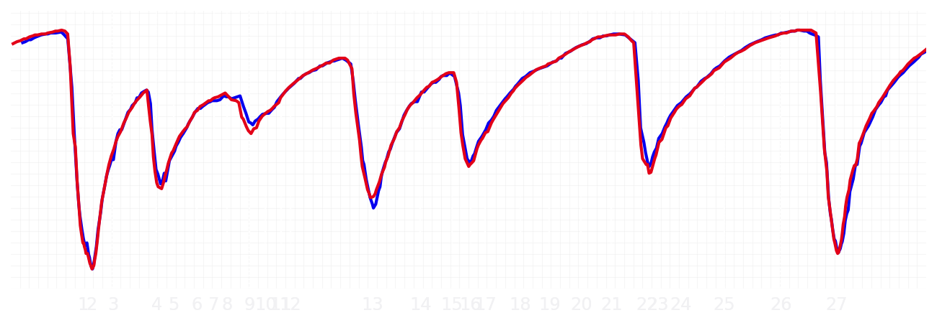
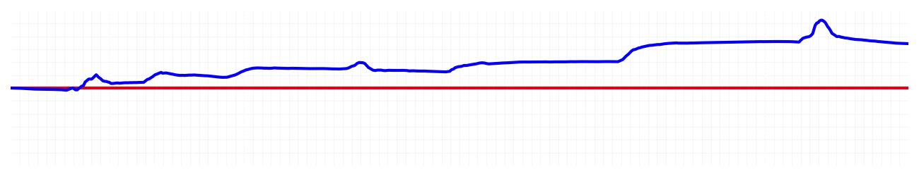
Saudi GP Qualifying Q2
Driver
Max Verstappen
Yuki Tsunoda
Driver
Lap Time
01:27.529
01:27.990
Lap Time
Sector 1
31.710
Speed Trap 1
296 kp/h
Speed Trap 1
297 kp/h
Sector 1
31.919
Sector 2
27.726
Speed Trap 2
330 kp/h
Gap
-0.461
Gap
0.461
Speed Trap 2
331 kp/h
Sector 2
27.841
Sector 3
28.093
Speed Final Line
311 kp/h
Corner Advantage
9/28
Corner Advantage
19/28
Speed Final Line
312 kp/h
Sector 3
28.230
FULL THROTTLE
76%
74%
FULL THROTTLE
HEAVY BREAKING
12%
11%
HEAVY BREAKING
%LAP TIME
CORNERING
12%
15%
CORNERING
%LAP TIME
SPEED
SPEED
DELTA TIME
DELTA TIME

Slide 12
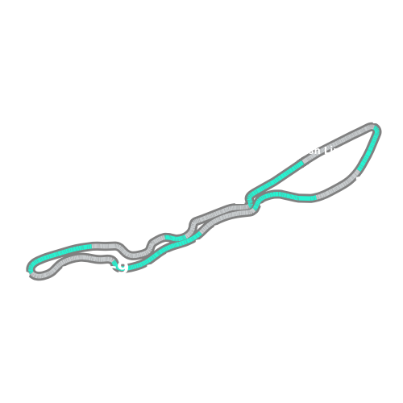
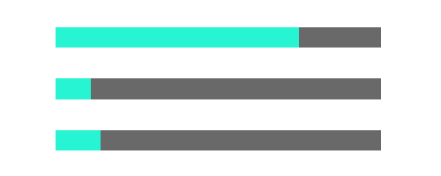
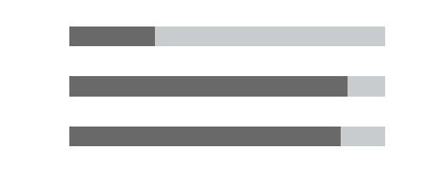
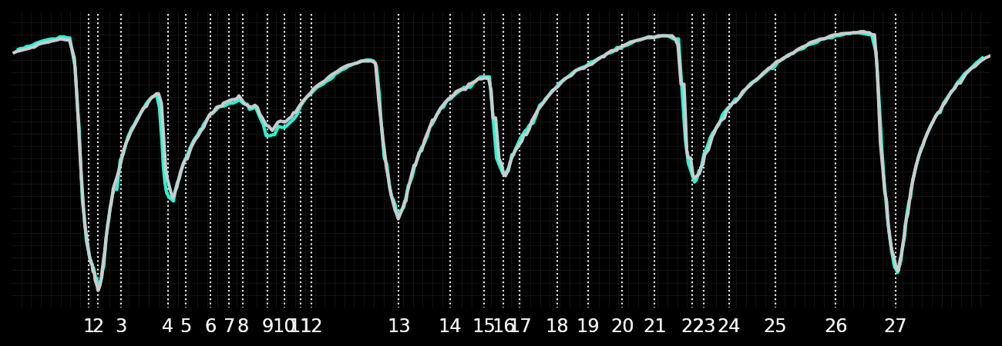

Saudi GP Qualifying Q2
Driver
Kimi Antonelli
George Russell
Driver
Lap Time
01:27.798
01:27.599
Lap Time
Sector 1
31.920
Speed Trap 1
295 kp/h
Speed Trap 1
296 kp/h
Sector 1
31.737
Sector 2
27.784
Speed Trap 2
328 kp/h
Gap
0.199
Gap
-0.199
Speed Trap 2
329 kp/h
Sector 2
27.761
Sector 3
28.094
Speed Final Line
310 kp/h
Corner Advantage
16/28
Corner Advantage
12/28
Speed Final Line
309 kp/h
Sector 3
28.101
FULL THROTTLE
75%
73%
FULL THROTTLE
HEAVY BREAKING
11%
12%
HEAVY BREAKING
%LAP TIME
CORNERING
14%
15%
CORNERING
%LAP TIME
SPEED
SPEED
DELTA TIME
DELTA TIME

Slide 13





Saudi GP Qualifying Q2
Driver
Charles Leclerc
Lewis Hamilton
Driver
Lap Time
01:27.866
01:28.102
Lap Time
Sector 1
32.019
Speed Trap 1
298 kp/h
Speed Trap 1
297 kp/h
Sector 1
31.972
Sector 2
27.753
Speed Trap 2
328 kp/h
Gap
-0.236
Gap
0.236
Speed Trap 2
329 kp/h
Sector 2
27.922
Sector 3
28.094
Speed Final Line
311 kp/h
Corner Advantage
8/28
Corner Advantage
20/28
Speed Final Line
310 kp/h
Sector 3
28.208
FULL THROTTLE
72%
72%
FULL THROTTLE
HEAVY BREAKING
16%
15%
HEAVY BREAKING
%LAP TIME
CORNERING
12%
13%
CORNERING
%LAP TIME
SPEED
SPEED
DELTA TIME
DELTA TIME

Slide 14





Saudi GP Qualifying Q2
Driver
Alexander Albon
Carlos Sainz
Driver
Lap Time
01:28.109
01:28.024
Lap Time
Sector 1
31.901
Speed Trap 1
297 kp/h
Speed Trap 1
296 kp/h
Sector 1
32.062
Sector 2
27.806
Speed Trap 2
321 kp/h
Gap
0.085
Gap
-0.085
Speed Trap 2
326 kp/h
Sector 2
27.822
Sector 3
28.402
Speed Final Line
309 kp/h
Corner Advantage
12/28
Corner Advantage
16/28
Speed Final Line
311 kp/h
Sector 3
28.140
FULL THROTTLE
76%
74%
FULL THROTTLE
HEAVY BREAKING
13%
13%
HEAVY BREAKING
%LAP TIME
CORNERING
11%
13%
CORNERING
%LAP TIME
SPEED
SPEED
DELTA TIME
DELTA TIME

Slide 15





Saudi GP Qualifying Q2
Driver
Liam Lawson
Isack Hadjar
Driver
Lap Time
01:28.191
01:28.418
Lap Time
Sector 1
32.087
Speed Trap 1
296 kp/h
Speed Trap 1
296 kp/h
Sector 1
32.209
Sector 2
27.890
Speed Trap 2
325 kp/h
Gap
-0.227
Gap
0.227
Speed Trap 2
324 kp/h
Sector 2
27.887
Sector 3
28.214
Speed Final Line
303 kp/h
Corner Advantage
9/28
Corner Advantage
19/28
Speed Final Line
311 kp/h
Sector 3
28.322
FULL THROTTLE
76%
73%
FULL THROTTLE
HEAVY BREAKING
11%
12%
HEAVY BREAKING
%LAP TIME
CORNERING
13%
15%
CORNERING
%LAP TIME
SPEED
SPEED
DELTA TIME
DELTA TIME

Slide 16





Saudi GP Qualifying Q2
Driver
Lando Norris
Oscar Piastri
Driver
Lap Time
01:27.481
01:27.545
Lap Time
Sector 1
31.745
Speed Trap 1
295 kp/h
Speed Trap 1
297 kp/h
Sector 1
31.801
Sector 2
27.684
Speed Trap 2
326 kp/h
Gap
-0.064
Gap
0.064
Speed Trap 2
325 kp/h
Sector 2
27.713
Sector 3
28.052
Speed Final Line
309 kp/h
Corner Advantage
16/28
Corner Advantage
12/28
Speed Final Line
309 kp/h
Sector 3
28.031
FULL THROTTLE
74%
77%
FULL THROTTLE
HEAVY BREAKING
11%
10%
HEAVY BREAKING
%LAP TIME
CORNERING
15%
13%
CORNERING
%LAP TIME
SPEED
SPEED
DELTA TIME
DELTA TIME

Slide 17





Saudi GP Qualifying Q3
Driver
Max Verstappen
Yuki Tsunoda
Driver
Lap Time
01:27.294
01:28.204
Lap Time
Sector 1
31.507
Speed Trap 1
296 kp/h
Speed Trap 1
295 kp/h
Sector 1
32.139
Sector 2
27.756
Speed Trap 2
329 kp/h
Gap
-0.91
Gap
0.91
Speed Trap 2
332 kp/h
Sector 2
27.862
Sector 3
28.031
Speed Final Line
309 kp/h
Corner Advantage
8/28
Corner Advantage
20/28
Speed Final Line
311 kp/h
Sector 3
28.203
FULL THROTTLE
77%
73%
FULL THROTTLE
HEAVY BREAKING
11%
11%
HEAVY BREAKING
%LAP TIME
CORNERING
12%
16%
CORNERING
%LAP TIME
SPEED
SPEED
DELTA TIME
DELTA TIME

Slide 18





Saudi GP Qualifying Q3
Driver
Kimi Antonelli
George Russell
Driver
Lap Time
01:27.866
01:27.407
Lap Time
Sector 1
32.164
Speed Trap 1
294 kp/h
Speed Trap 1
295 kp/h
Sector 1
31.684
Sector 2
27.682
Speed Trap 2
326 kp/h
Gap
0.459
Gap
-0.459
Speed Trap 2
327 kp/h
Sector 2
27.577
Sector 3
28.020
Speed Final Line
309 kp/h
Corner Advantage
14/28
Corner Advantage
14/28
Speed Final Line
309 kp/h
Sector 3
28.146
FULL THROTTLE
76%
76%
FULL THROTTLE
HEAVY BREAKING
11%
13%
HEAVY BREAKING
%LAP TIME
CORNERING
13%
11%
CORNERING
%LAP TIME
SPEED
SPEED
DELTA TIME
DELTA TIME

Slide 19





Saudi GP Qualifying Q3
Driver
Charles Leclerc
Lewis Hamilton
Driver
Lap Time
01:27.670
01:28.201
Lap Time
Sector 1
31.857
Speed Trap 1
295 kp/h
Speed Trap 1
297 kp/h
Sector 1
32.137
Sector 2
27.796
Speed Trap 2
328 kp/h
Gap
-0.531
Gap
0.531
Speed Trap 2
329 kp/h
Sector 2
27.833
Sector 3
28.017
Speed Final Line
311 kp/h
Corner Advantage
10/28
Corner Advantage
18/28
Speed Final Line
309 kp/h
Sector 3
28.231
FULL THROTTLE
73%
73%
FULL THROTTLE
HEAVY BREAKING
13%
14%
HEAVY BREAKING
%LAP TIME
CORNERING
14%
13%
CORNERING
%LAP TIME
SPEED
SPEED
DELTA TIME
DELTA TIME

