Slide 1



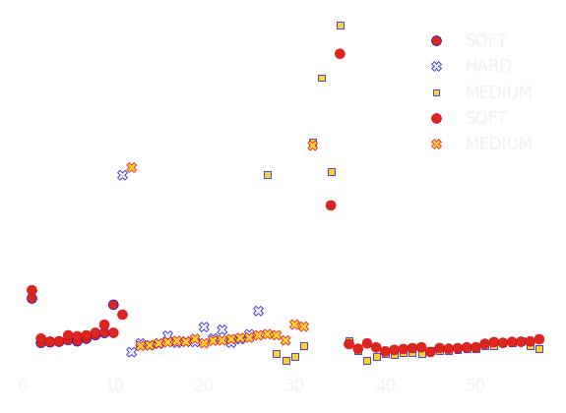

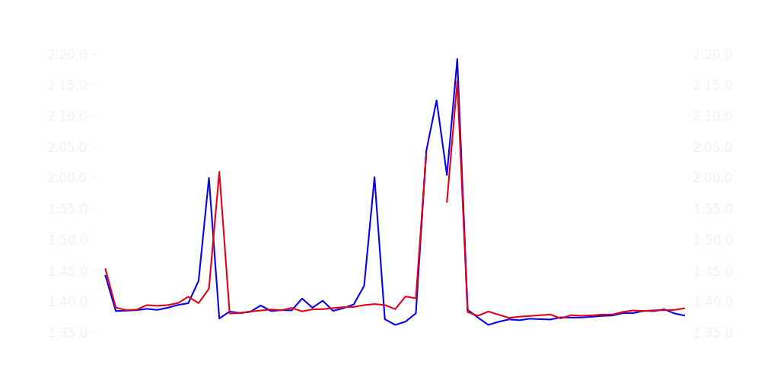
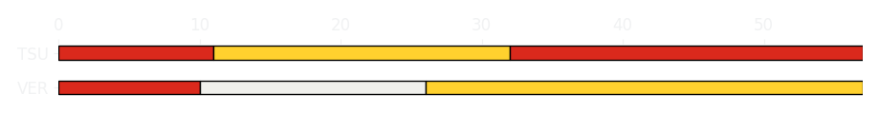
Bahrain GP Race
Driver
Race Time
Race Time
Driver
Max Verstappen
1:34:29.953
1:34:39.588
Yuki Tsunoda
Avg Lap Time
1:38.405
IQR
Gap
Gap
IQR
Avg Lap Time
1.656 s
-10.693 s
+10.693 s
1.305 s
1:38.600
Race Comparaison
Race Comparaison
Lap Advantage
37/57
Position
6
Safety Car Lap
4/57
Position
9
Lap Advantage
16/57
Lap Time Per Lap
Lap Time Per Lap
Tyre Strategy
Total Pit Stop Time
00:54.585 s
Pit Stops
2
Pit Stops
2
Total Pit Stop Time
00:51.264 s
Tyre Strategy

Slide 2


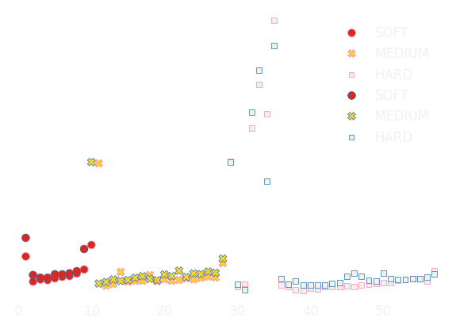

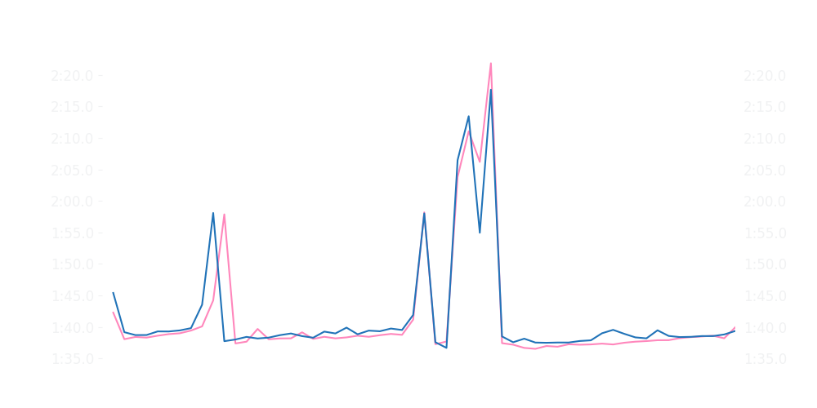
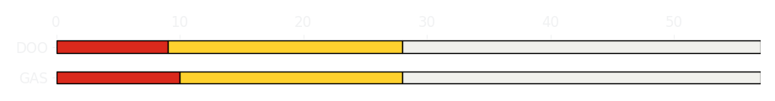
Bahrain GP Race
Driver
Race Time
Race Time
Driver
Pierre Gasly
1:34:33.387
1:34:47.069
Jack Doohan
Avg Lap Time
1:38.269
IQR
Gap
Gap
IQR
Avg Lap Time
1.299 s
-16.804 s
+16.804 s
1.189 s
1:38.766
Race Comparaison
Race Comparaison
Lap Advantage
46/57
Position
7
Safety Car Lap
4/57
Position
14
Lap Advantage
7/57
Lap Time Per Lap
Lap Time Per Lap
Tyre Strategy
Total Pit Stop Time
00:49.991 s
Pit Stops
2
Pit Stops
2
Total Pit Stop Time
00:49.884 s
Tyre Strategy

Slide 3


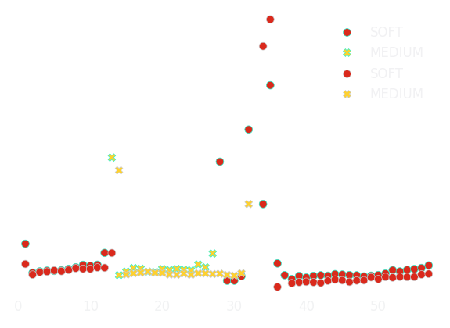

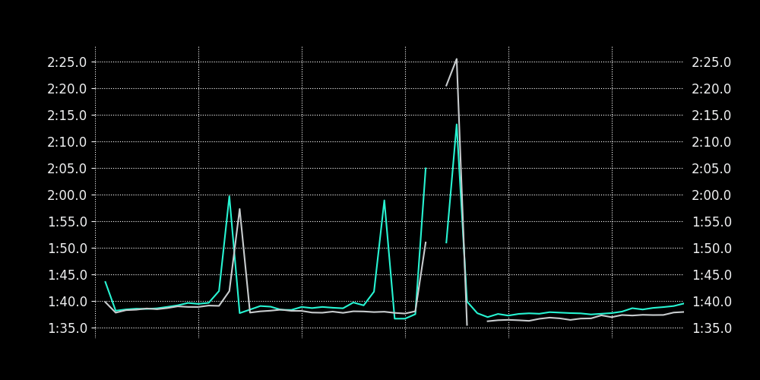
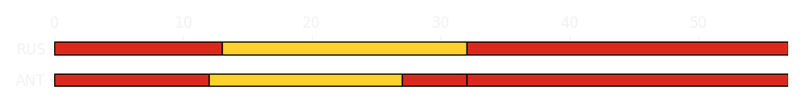
Bahrain GP Race
Driver
Race Time
Race Time
Driver
Kimi Antonelli
1:34:44.087
1:34:16.126
George Russell
Avg Lap Time
1:38.638
IQR
Gap
Gap
IQR
Avg Lap Time
1.528 s
+31.742 s
-31.742 s
1.097 s
1:37.844
Race Comparaison
Race Comparaison
Lap Advantage
6/56
Position
11
Safety Car Lap
4/56
Position
3
Lap Advantage
46/56
Lap Time Per Lap
Lap Time Per Lap
Tyre Strategy
Total Pit Stop Time
01:14.006 s
Pit Stops
3
Pit Stops
2
Total Pit Stop Time
00:48.144 s
Tyre Strategy

Slide 4


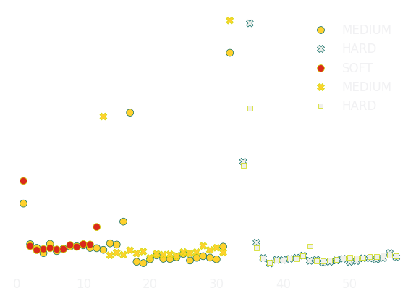

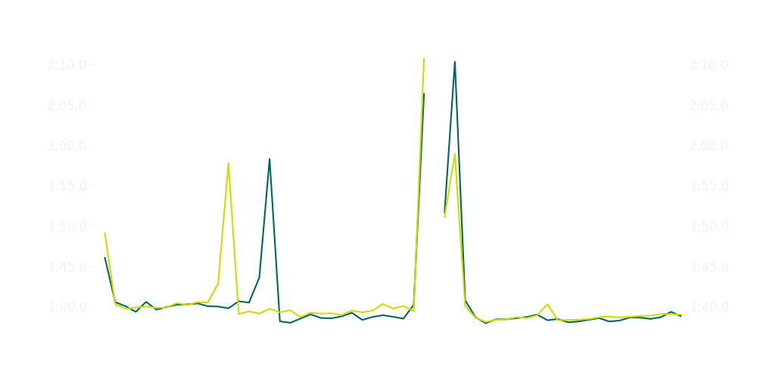
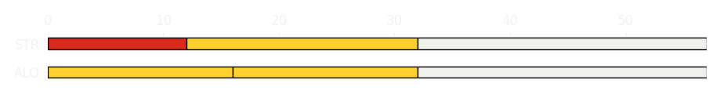
Bahrain GP Race
Driver
Race Time
Race Time
Driver
Fernando Alonso
1:34:54.025
1:34:56.119
Lance Stroll
Avg Lap Time
1:38.754
IQR
Gap
Gap
IQR
Avg Lap Time
1.718 s
-5.146 s
+5.146 s
1.305 s
1:39.262
Race Comparaison
Race Comparaison
Lap Advantage
35/57
Position
17
Safety Car Lap
4/57
Position
18
Lap Advantage
18/57
Lap Time Per Lap
Lap Time Per Lap
Tyre Strategy
Total Pit Stop Time
00:49.672 s
Pit Stops
2
Pit Stops
2
Total Pit Stop Time
00:49.203 s
Tyre Strategy

Slide 5


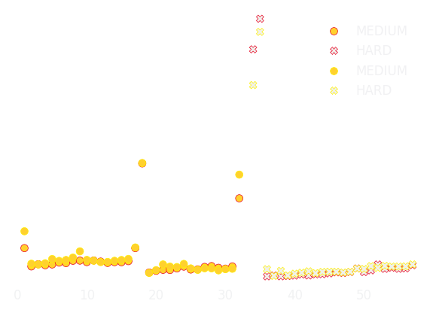

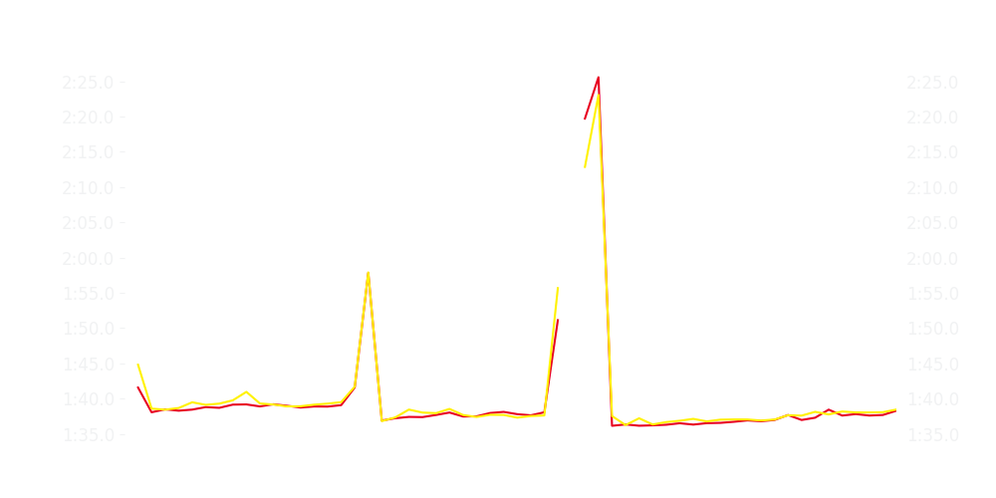
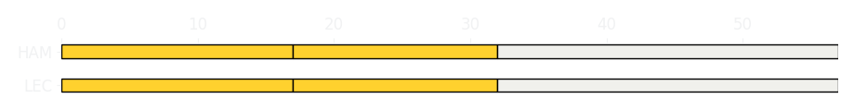
Bahrain GP Race
Driver
Race Time
Race Time
Driver
Charles Leclerc
1:34:17.787
1:34:22.869
Lewis Hamilton
Avg Lap Time
1:37.723
IQR
Gap
Gap
IQR
Avg Lap Time
1.756 s
-8.318 s
+8.318 s
1.809 s
1:38.026
Race Comparaison
Race Comparaison
Lap Advantage
40/57
Position
4
Safety Car Lap
4/57
Position
5
Lap Advantage
13/57
Lap Time Per Lap
Lap Time Per Lap
Tyre Strategy
Total Pit Stop Time
00:49.043 s
Pit Stops
2
Pit Stops
2
Total Pit Stop Time
00:48.690 s
Tyre Strategy

Slide 6


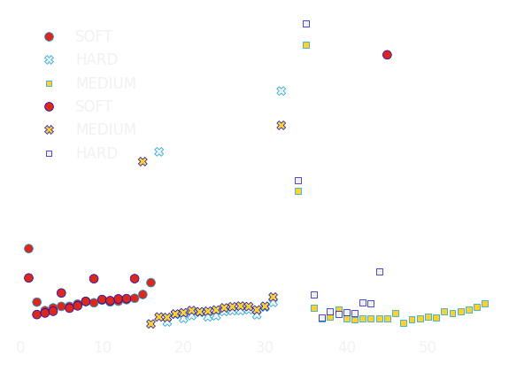

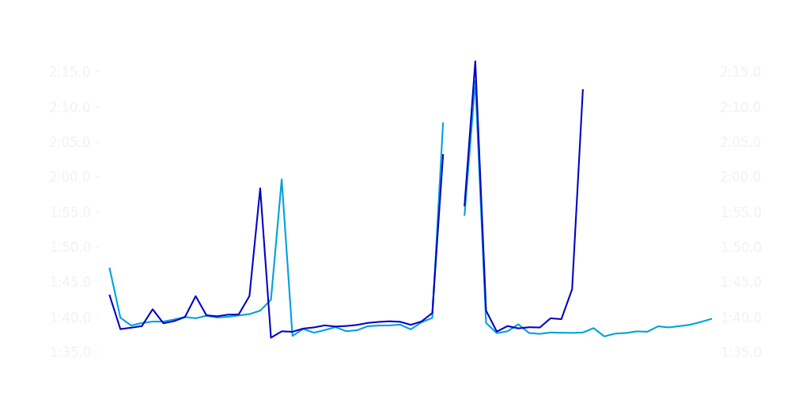
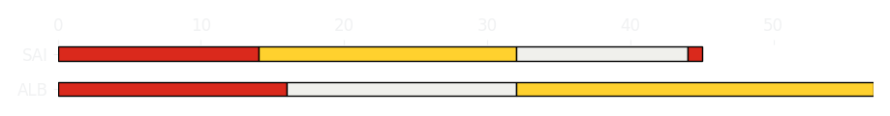
Bahrain GP Race
Driver
Race Time
Race Time
Driver
Alexander Albon
1:34:41.649
1:15:53.863
Carlos Sainz
Avg Lap Time
1:38.703
IQR
Gap
Gap
IQR
Avg Lap Time
1.922 s
-12 laps
+12 laps
1.876 s
1:39.236
Race Comparaison
Race Comparaison
Lap Advantage
43/57
Position
12
Safety Car Lap
4/57
Position
20
Lap Advantage
10/57
Lap Time Per Lap
Lap Time Per Lap
Tyre Strategy
Total Pit Stop Time
00:51.384 s
Pit Stops
2
Pit Stops
3
Total Pit Stop Time
01:26.031 s
Tyre Strategy

Slide 7


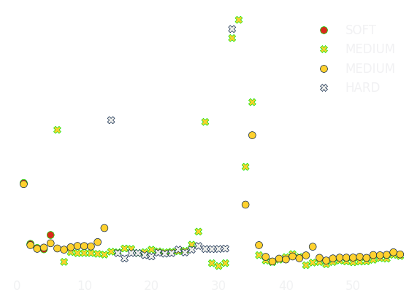

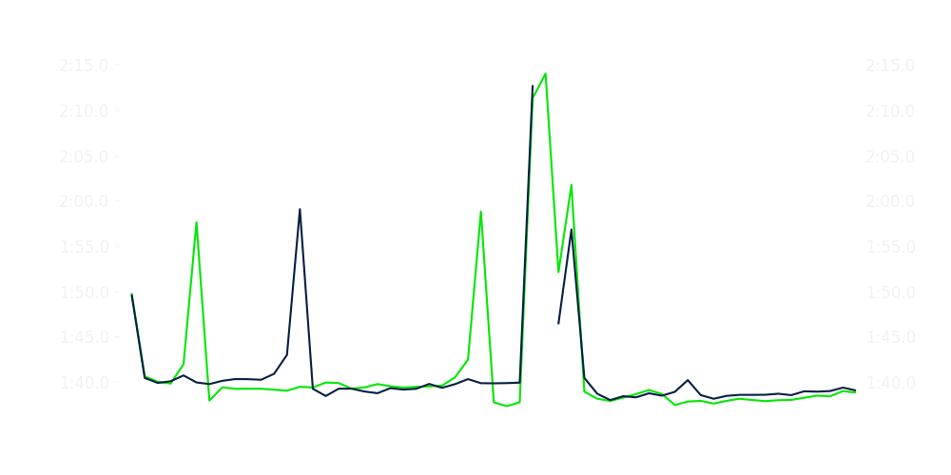
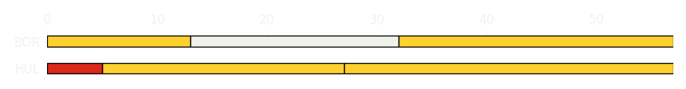
Bahrain GP Race
Driver
Race Time
Race Time
Driver
Nico Hulkenberg
1:34:43.425
1:34:57.044
Gabriel Bortoleto
Avg Lap Time
1:39.247
IQR
Gap
Gap
IQR
Avg Lap Time
1.679 s
-13.444 s
+13.444 s
1.474 s
1:39.339
Race Comparaison
Race Comparaison
Lap Advantage
32/57
Position
15
Safety Car Lap
4/57
Position
19
Lap Advantage
21/57
Lap Time Per Lap
Lap Time Per Lap
Tyre Strategy
Total Pit Stop Time
00:48.520 s
Pit Stops
2
Pit Stops
2
Total Pit Stop Time
00:49.539 s
Tyre Strategy

Slide 8


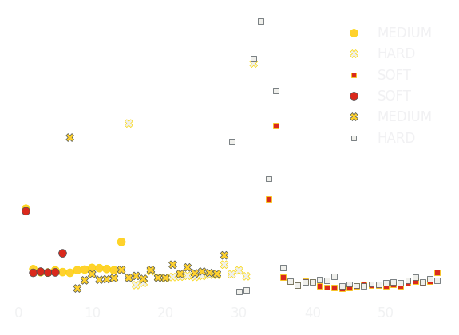

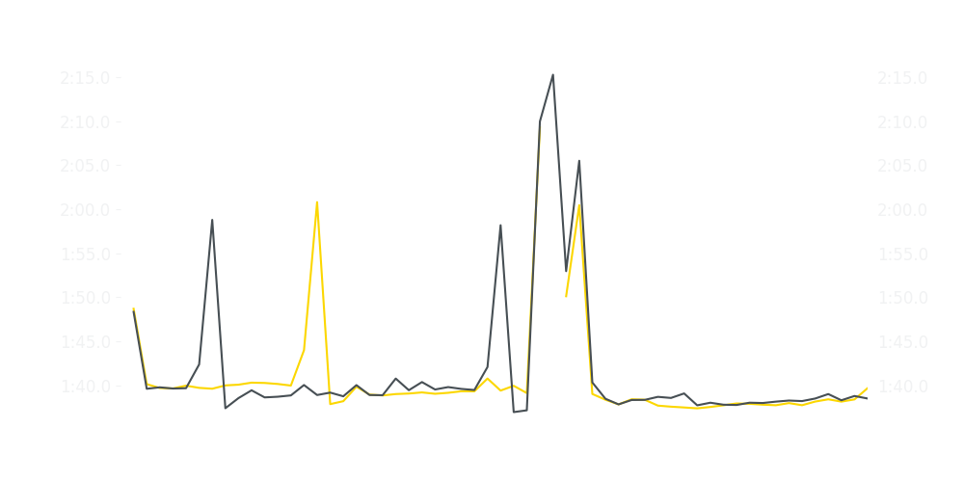
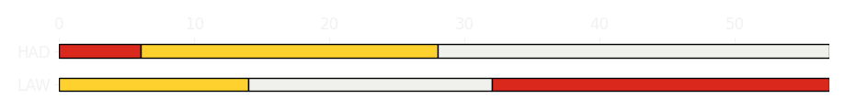
Bahrain GP Race
Driver
Race Time
Race Time
Driver
Liam Lawson
1:34:40.392
1:34:47.636
Isack Hadjar
Avg Lap Time
1:39.088
IQR
Gap
Gap
IQR
Avg Lap Time
1.859 s
-6.89 s
+6.89 s
1.466 s
1:38.893
Race Comparaison
Race Comparaison
Lap Advantage
34/57
Position
13
Safety Car Lap
4/57
Position
16
Lap Advantage
19/57
Lap Time Per Lap
Lap Time Per Lap
Tyre Strategy
Total Pit Stop Time
00:49.433 s
Pit Stops
2
Pit Stops
2
Total Pit Stop Time
00:49.905 s
Tyre Strategy

Slide 9


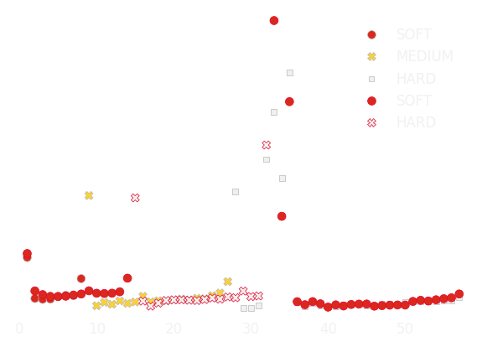

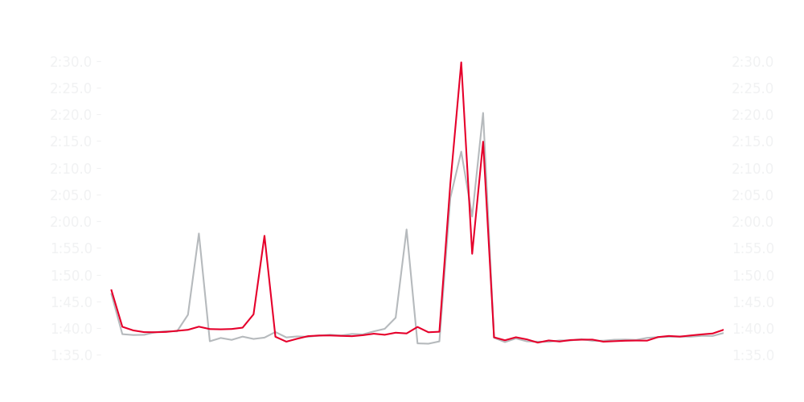
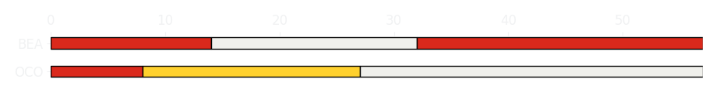
Bahrain GP Race
Driver
Race Time
Race Time
Driver
Esteban Ocon
1:34:37.523
1:34:40.155
Ollie Bearman
Avg Lap Time
1:38.419
IQR
Gap
Gap
IQR
Avg Lap Time
1.299 s
-3.35 s
+3.35 s
1.698 s
1:38.730
Race Comparaison
Race Comparaison
Lap Advantage
30/57
Position
8
Safety Car Lap
4/57
Position
10
Lap Advantage
23/57
Lap Time Per Lap
Lap Time Per Lap
Tyre Strategy
Total Pit Stop Time
00:49.708 s
Pit Stops
2
Pit Stops
2
Total Pit Stop Time
00:49.457 s
Tyre Strategy

Slide 10


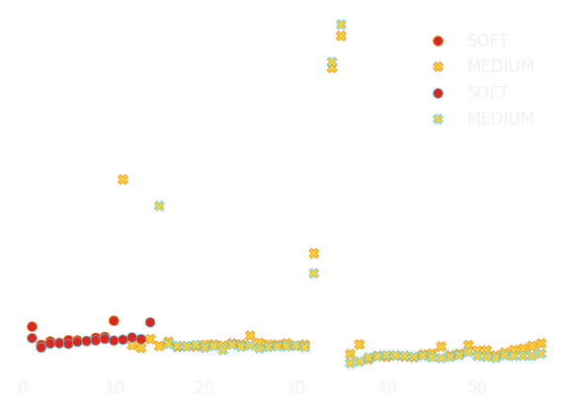

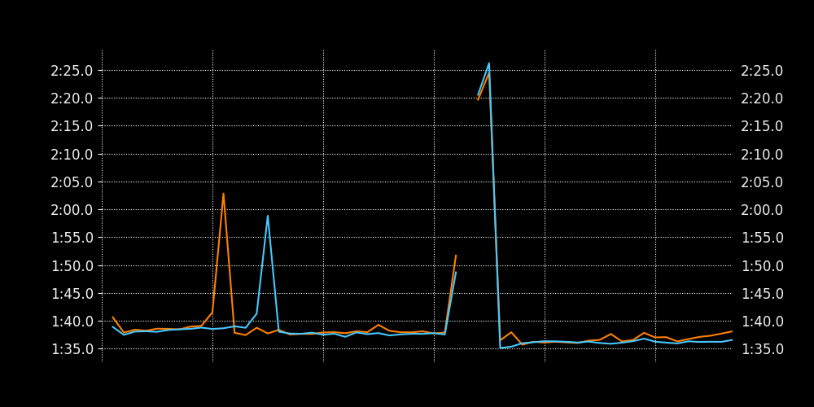
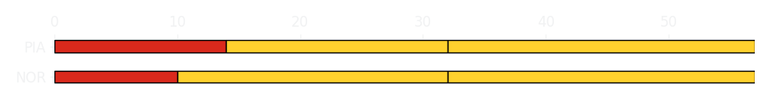
Bahrain GP Race
Driver
Race Time
Race Time
Driver
Lando Norris
1:34:15.278
1:34:00.750
Oscar Piastri
Avg Lap Time
1:37.864
IQR
Gap
Gap
IQR
Avg Lap Time
1.182 s
+16.259 s
-16.259 s
1.818 s
1:37.567
Race Comparaison
Race Comparaison
Lap Advantage
14/57
Position
2
Safety Car Lap
4/57
Position
1
Lap Advantage
39/57
Lap Time Per Lap
Lap Time Per Lap
Tyre Strategy
Total Pit Stop Time
00:53.857 s
Pit Stops
2
Pit Stops
2
Total Pit Stop Time
00:49.398 s
Tyre Strategy

