Slide 1


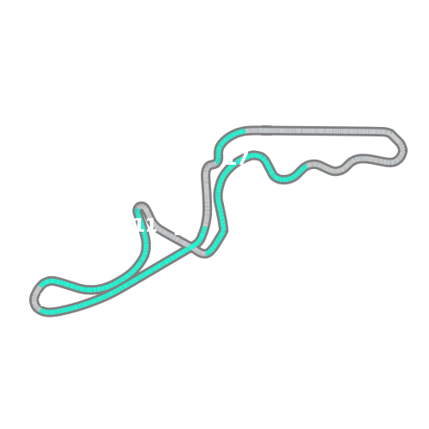
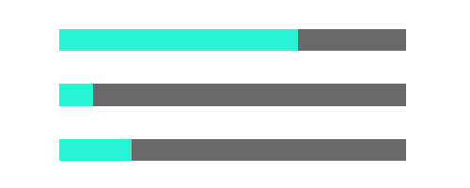
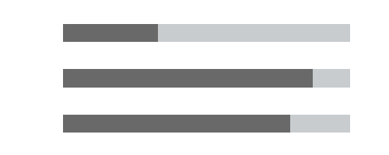
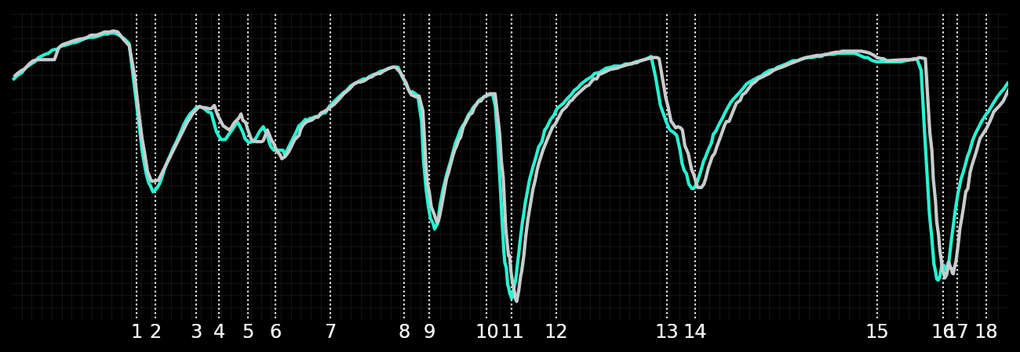
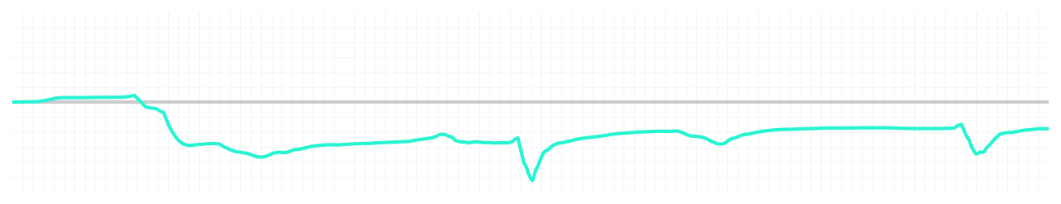
Japanese GP Qualifying Q3
Driver
Kimi Antonelli
George Russell
Driver
Lap Time
01:27.555
01:27.318
Lap Time
Sector 1
30.669
Speed Trap 1
287 kp/h
Speed Trap 1
288 kp/h
Sector 1
30.376
Sector 2
39.503
Speed Trap 2
301 kp/h
Gap
0.237
Gap
-0.237
Speed Trap 2
303 kp/h
Sector 2
39.599
Sector 3
17.383
Speed Final Line
271 kp/h
Corner Advantage
9/19
Corner Advantage
10/19
Speed Final Line
272 kp/h
Sector 3
17.343
FULL THROTTLE
69%
67%
FULL THROTTLE
HEAVY BREAKING
10%
13%
HEAVY BREAKING
%LAP TIME
CORNERING
21%
20%
CORNERING
%LAP TIME
SPEED
SPEED
DELTA TIME
DELTA TIME

Slide 2

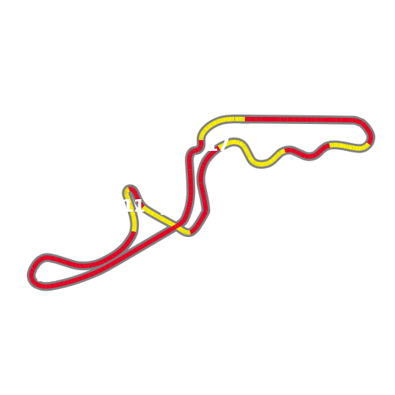

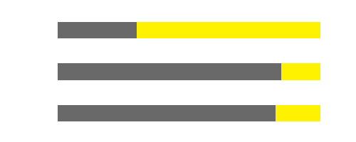
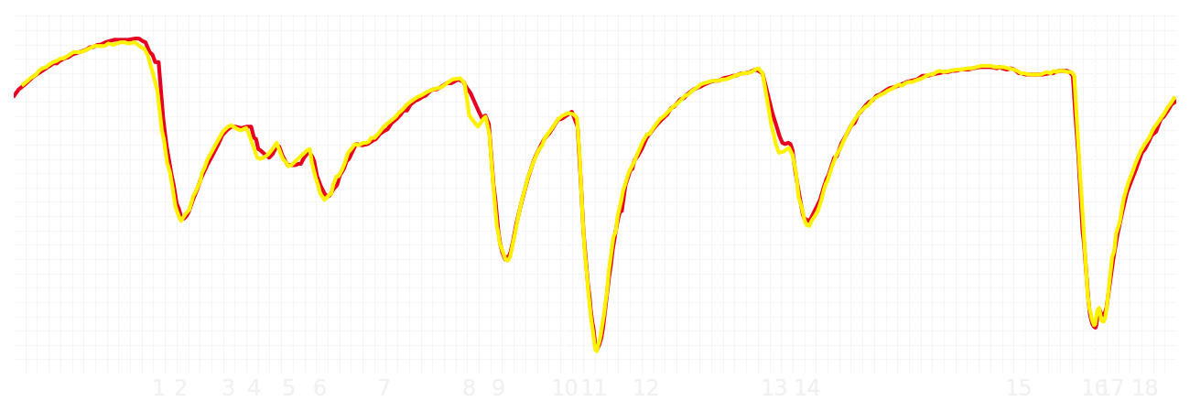
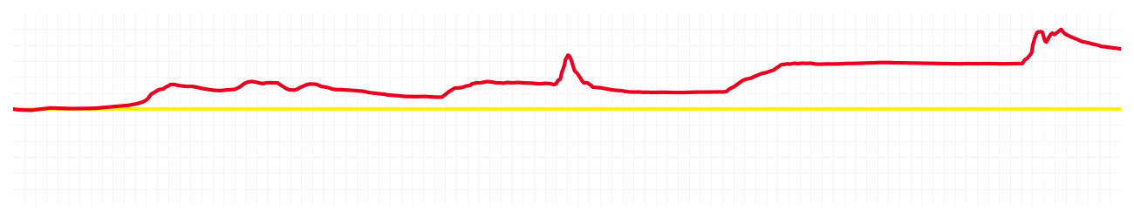
Japanese GP Qualifying Q3
Driver
Charles Leclerc
Lewis Hamilton
Driver
Lap Time
01:27.299
01:27.668
Lap Time
Sector 1
30.535
Speed Trap 1
288 kp/h
Speed Trap 1
288 kp/h
Sector 1
30.594
Sector 2
39.352
Speed Trap 2
299 kp/h
Gap
-0.369
Gap
0.369
Speed Trap 2
299 kp/h
Sector 2
39.633
Sector 3
17.412
Speed Final Line
271 kp/h
Corner Advantage
7/19
Corner Advantage
12/19
Speed Final Line
272 kp/h
Sector 3
17.441
FULL THROTTLE
67%
70%
FULL THROTTLE
HEAVY BREAKING
16%
15%
HEAVY BREAKING
%LAP TIME
CORNERING
17%
15%
CORNERING
%LAP TIME
SPEED
SPEED
DELTA TIME
DELTA TIME

Slide 3

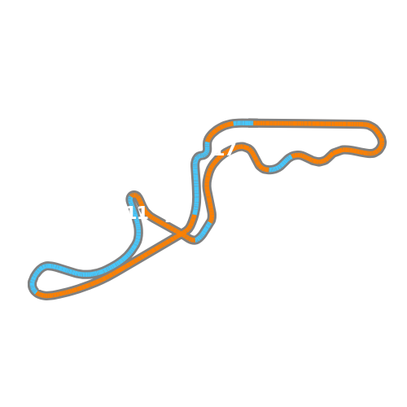

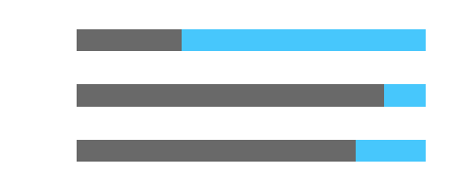
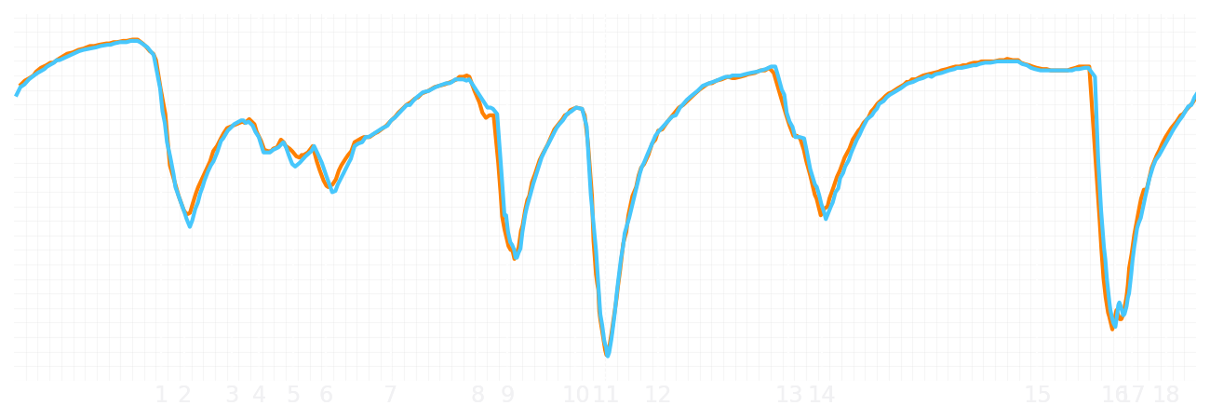
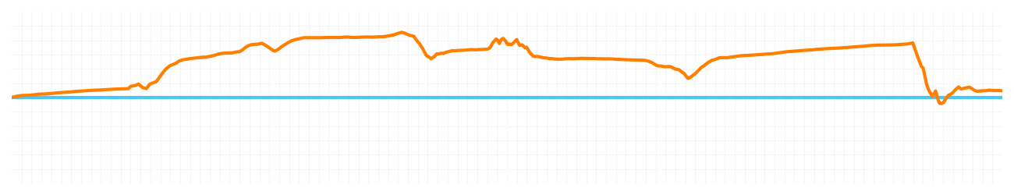
Japanese GP Qualifying Q3
Driver
Lando Norris
Oscar Piastri
Driver
Lap Time
01:26.995
01:27.027
Lap Time
Sector 1
30.358
Speed Trap 1
287 kp/h
Speed Trap 1
287 kp/h
Sector 1
30.625
Sector 2
39.301
Speed Trap 2
300 kp/h
Gap
-0.032
Gap
0.032
Speed Trap 2
299 kp/h
Sector 2
39.197
Sector 3
17.336
Speed Final Line
267 kp/h
Corner Advantage
7/19
Corner Advantage
12/19
Speed Final Line
271 kp/h
Sector 3
17.205
FULL THROTTLE
69%
70%
FULL THROTTLE
HEAVY BREAKING
11%
12%
HEAVY BREAKING
%LAP TIME
CORNERING
20%
18%
CORNERING
%LAP TIME
SPEED
SPEED
DELTA TIME
DELTA TIME

