Slide 1


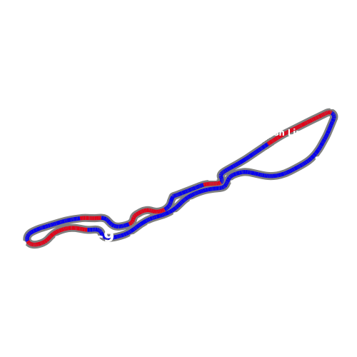
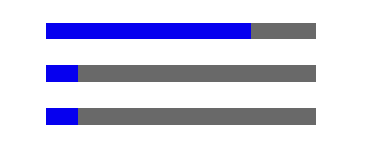

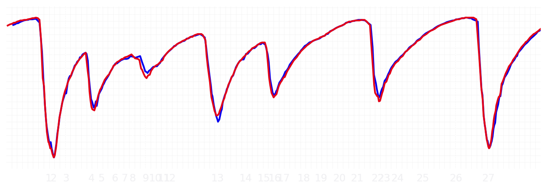
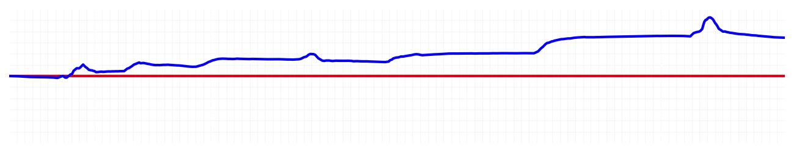
Saudi GP Qualifying Q2
Driver
Max Verstappen
Yuki Tsunoda
Driver
Lap Time
01:27.529
01:27.990
Lap Time
Sector 1
31.710
Speed Trap 1
296 kp/h
Speed Trap 1
297 kp/h
Sector 1
31.919
Sector 2
27.726
Speed Trap 2
330 kp/h
Gap
-0.461
Gap
0.461
Speed Trap 2
331 kp/h
Sector 2
27.841
Sector 3
28.093
Speed Final Line
311 kp/h
Corner Advantage
9/28
Corner Advantage
19/28
Speed Final Line
312 kp/h
Sector 3
28.230
FULL THROTTLE
76%
74%
FULL THROTTLE
HEAVY BREAKING
12%
11%
HEAVY BREAKING
%LAP TIME
CORNERING
12%
15%
CORNERING
%LAP TIME
SPEED
SPEED
DELTA TIME
DELTA TIME

Slide 2

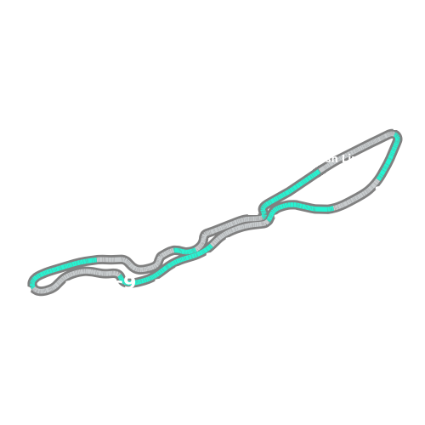
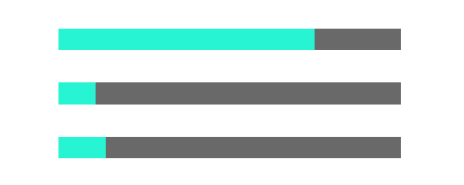
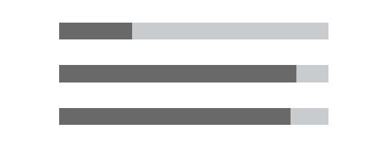
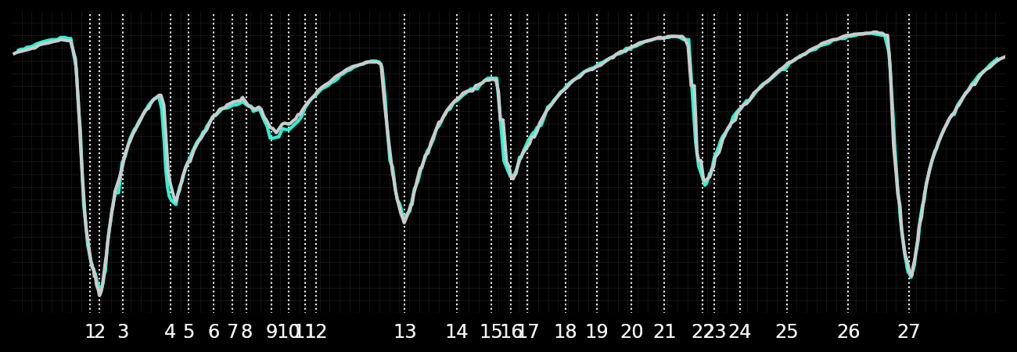
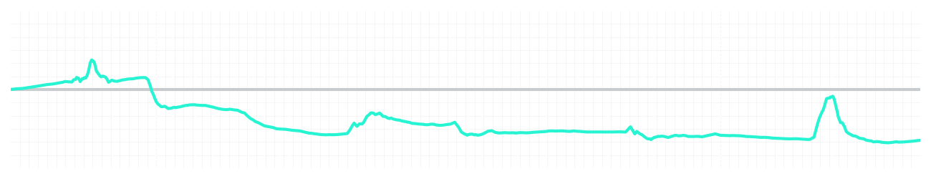
Saudi GP Qualifying Q2
Driver
Kimi Antonelli
George Russell
Driver
Lap Time
01:27.798
01:27.599
Lap Time
Sector 1
31.920
Speed Trap 1
295 kp/h
Speed Trap 1
296 kp/h
Sector 1
31.737
Sector 2
27.784
Speed Trap 2
328 kp/h
Gap
0.199
Gap
-0.199
Speed Trap 2
329 kp/h
Sector 2
27.761
Sector 3
28.094
Speed Final Line
310 kp/h
Corner Advantage
16/28
Corner Advantage
12/28
Speed Final Line
309 kp/h
Sector 3
28.101
FULL THROTTLE
75%
73%
FULL THROTTLE
HEAVY BREAKING
11%
12%
HEAVY BREAKING
%LAP TIME
CORNERING
14%
15%
CORNERING
%LAP TIME
SPEED
SPEED
DELTA TIME
DELTA TIME

Slide 3

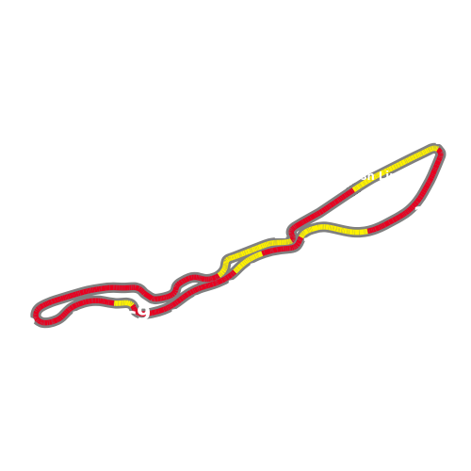
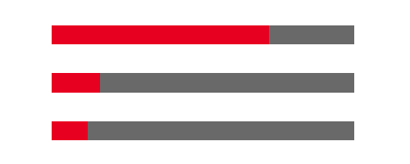
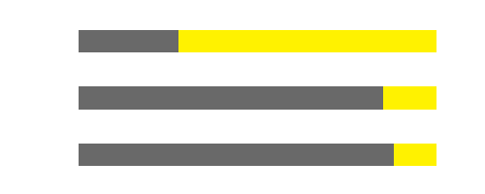
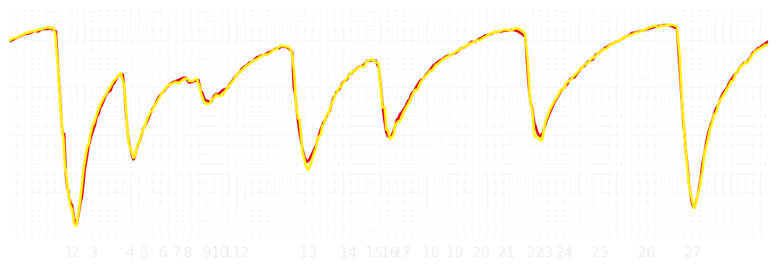
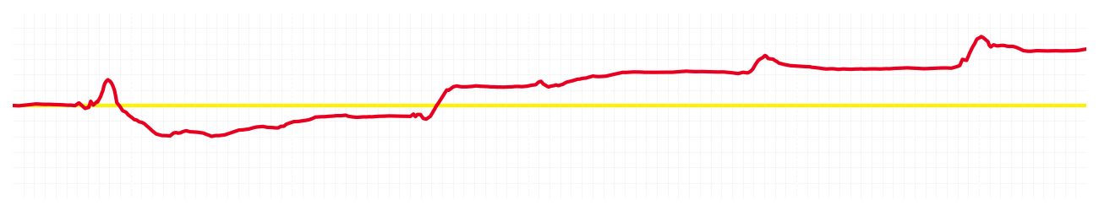
Saudi GP Qualifying Q2
Driver
Charles Leclerc
Lewis Hamilton
Driver
Lap Time
01:27.866
01:28.102
Lap Time
Sector 1
32.019
Speed Trap 1
298 kp/h
Speed Trap 1
297 kp/h
Sector 1
31.972
Sector 2
27.753
Speed Trap 2
328 kp/h
Gap
-0.236
Gap
0.236
Speed Trap 2
329 kp/h
Sector 2
27.922
Sector 3
28.094
Speed Final Line
311 kp/h
Corner Advantage
8/28
Corner Advantage
20/28
Speed Final Line
310 kp/h
Sector 3
28.208
FULL THROTTLE
72%
72%
FULL THROTTLE
HEAVY BREAKING
16%
15%
HEAVY BREAKING
%LAP TIME
CORNERING
12%
13%
CORNERING
%LAP TIME
SPEED
SPEED
DELTA TIME
DELTA TIME

Slide 4

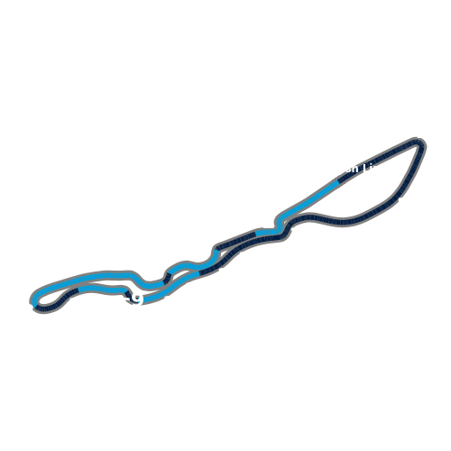
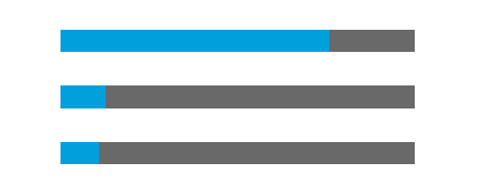
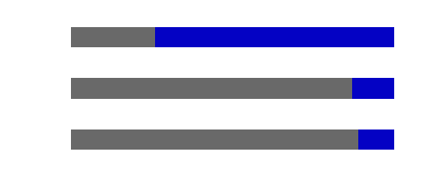
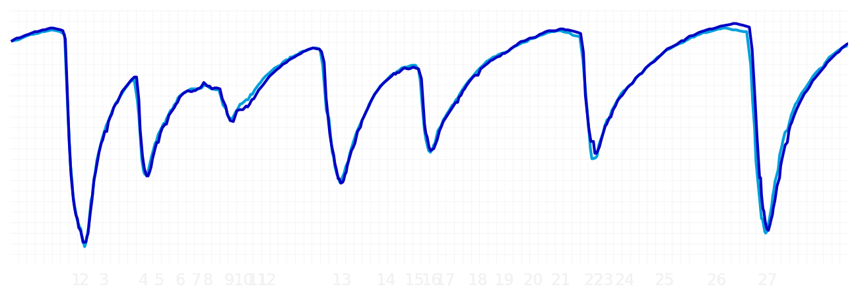
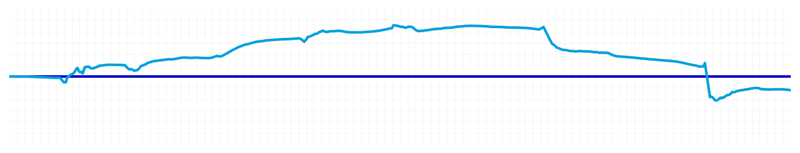
Saudi GP Qualifying Q2
Driver
Alexander Albon
Carlos Sainz
Driver
Lap Time
01:28.109
01:28.024
Lap Time
Sector 1
31.901
Speed Trap 1
297 kp/h
Speed Trap 1
296 kp/h
Sector 1
32.062
Sector 2
27.806
Speed Trap 2
321 kp/h
Gap
0.085
Gap
-0.085
Speed Trap 2
326 kp/h
Sector 2
27.822
Sector 3
28.402
Speed Final Line
309 kp/h
Corner Advantage
12/28
Corner Advantage
16/28
Speed Final Line
311 kp/h
Sector 3
28.140
FULL THROTTLE
76%
74%
FULL THROTTLE
HEAVY BREAKING
13%
13%
HEAVY BREAKING
%LAP TIME
CORNERING
11%
13%
CORNERING
%LAP TIME
SPEED
SPEED
DELTA TIME
DELTA TIME

Slide 5

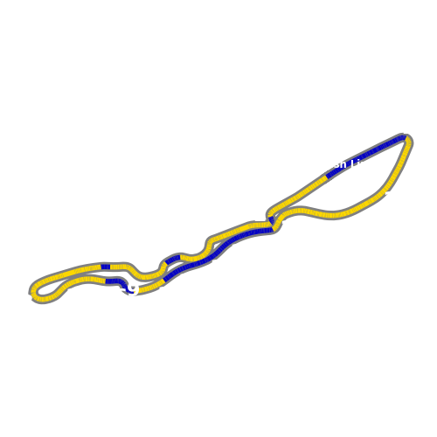


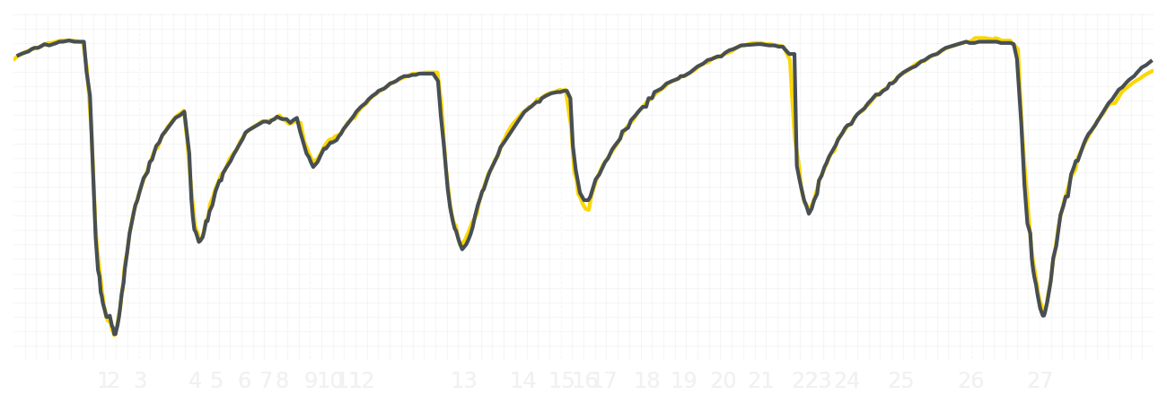
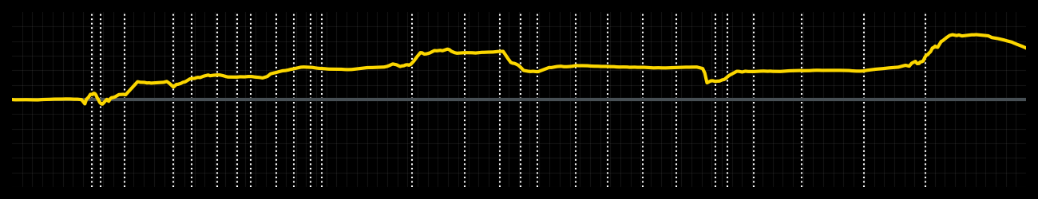
Saudi GP Qualifying Q2
Driver
Liam Lawson
Isack Hadjar
Driver
Lap Time
01:28.191
01:28.418
Lap Time
Sector 1
32.087
Speed Trap 1
296 kp/h
Speed Trap 1
296 kp/h
Sector 1
32.209
Sector 2
27.890
Speed Trap 2
325 kp/h
Gap
-0.227
Gap
0.227
Speed Trap 2
324 kp/h
Sector 2
27.887
Sector 3
28.214
Speed Final Line
303 kp/h
Corner Advantage
9/28
Corner Advantage
19/28
Speed Final Line
311 kp/h
Sector 3
28.322
FULL THROTTLE
76%
73%
FULL THROTTLE
HEAVY BREAKING
11%
12%
HEAVY BREAKING
%LAP TIME
CORNERING
13%
15%
CORNERING
%LAP TIME
SPEED
SPEED
DELTA TIME
DELTA TIME

Slide 6

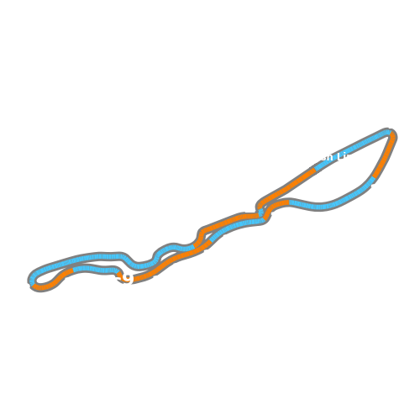

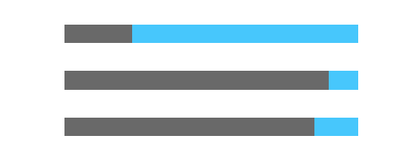
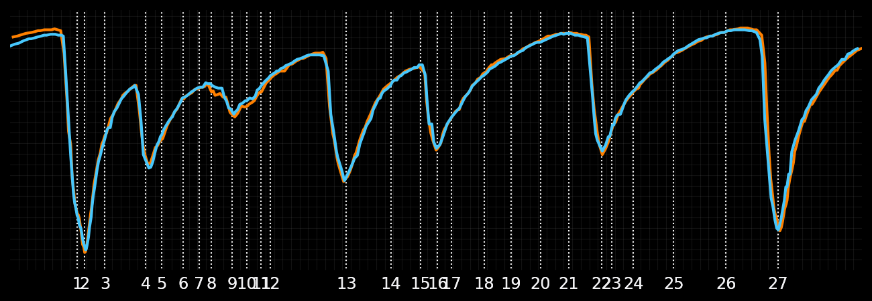
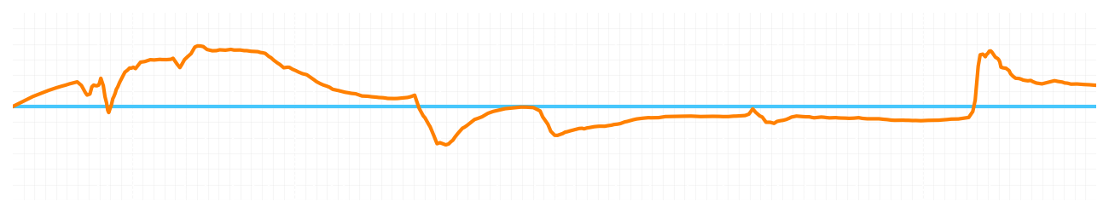
Saudi GP Qualifying Q2
Driver
Lando Norris
Oscar Piastri
Driver
Lap Time
01:27.481
01:27.545
Lap Time
Sector 1
31.745
Speed Trap 1
295 kp/h
Speed Trap 1
297 kp/h
Sector 1
31.801
Sector 2
27.684
Speed Trap 2
326 kp/h
Gap
-0.064
Gap
0.064
Speed Trap 2
325 kp/h
Sector 2
27.713
Sector 3
28.052
Speed Final Line
309 kp/h
Corner Advantage
16/28
Corner Advantage
12/28
Speed Final Line
309 kp/h
Sector 3
28.031
FULL THROTTLE
74%
77%
FULL THROTTLE
HEAVY BREAKING
11%
10%
HEAVY BREAKING
%LAP TIME
CORNERING
15%
13%
CORNERING
%LAP TIME
SPEED
SPEED
DELTA TIME
DELTA TIME

