Slide 1
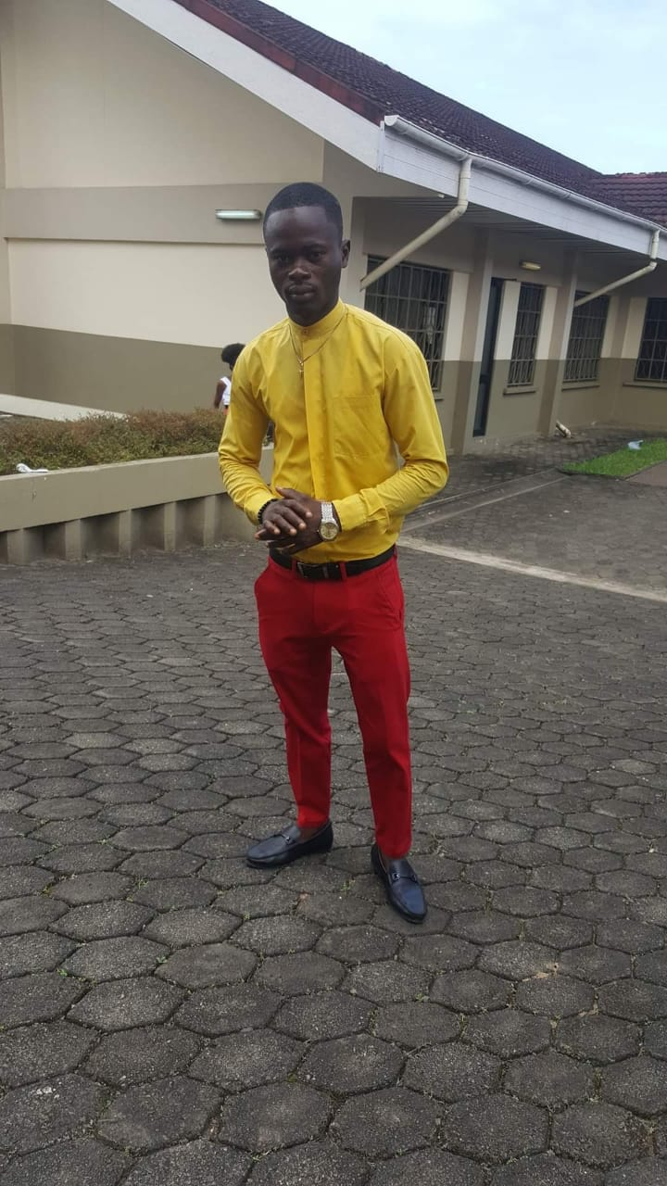
Johnsino
Transport Service
Whatsapp:+905338216576
+231770453789
Am available 24hurs

