Slide 1
Chapter 6
Data Types

Slide 2
Chapter 6 Topics
Introduction
Primitive Data Types
Character String Types
Enumeration Types
Array Types
Associative Arrays
Record Types
Tuple Types
List Types
Union Types
Pointer and Reference Types
Optional Types
Type Checking
Strong Typing
Type Equivalence
Theory and Data Types

Slide 3
Introduction
A data type defines a collection of data objects and a set of predefined operations on those objects
A descriptor is the collection of the attributes of a variable
An object represents an instance of a user-defined (abstract data) type
One design issue for all data types: What operations are defined and how are they specified?

Slide 4
Primitive Data Types
Almost all programming languages provide a set of primitive data types
Primitive data types: Those not defined in terms of other data types
Some primitive data types are merely reflections of the hardware
Others require only a little non-hardware support for their implementation

Slide 5
Primitive Data Types: Integer
Almost always an exact reflection of the hardware so the mapping is trivial
There may be as many as eight different integer types in a language
Java’s signed integer sizes: byte, short, int, long

Slide 6
Primitive Data Types: Floating Point
Model real numbers, but only as approximations
Languages for scientific use support at least two floating-point types (e.g., float and double; sometimes more
Usually exactly like the hardware, but not always
IEEE Floating-Point
Standard 754

Slide 7
Primitive Data Types: Complex
Some languages support a complex type, e.g., C99, Fortran, and Python
Each value consists of two floats, the real part and the imaginary part
Literal form (in Python):
(7 + 3j), where 7 is the real part and 3 is the imaginary part

Slide 8
Primitive Data Types: Decimal
For business applications (money)
Essential to COBOL
C# offers a decimal data type
Store a fixed number of decimal digits, in coded form (BCD)
Advantage: accuracy
Disadvantages: limited range, wastes memory

Slide 9
Primitive Data Types: Boolean
Simplest of all
Range of values: two elements, one for “true” and one for “false”
Could be implemented as bits, but often as bytes
Advantage: readability

Slide 10
Primitive Data Types: Character
Stored as numeric codings
Most commonly used coding: ASCII
An alternative, 16-bit coding: Unicode (UCS-2)
Includes characters from most natural languages
Originally used in Java
Now supported by many languages
32-bit Unicode (UCS-4)
Supported by Fortran, starting with 2003

Slide 11
Character String Types
Values are sequences of characters
Design issues:
Is it a primitive type or just a special kind of array?
Should the length of strings be static or dynamic?

Slide 12
Character String Types Operations
Typical operations:
Assignment and copying
Comparison (=, >, etc.)
Catenation
Substring reference
Pattern matching

Slide 13
Character String Type in Certain Languages
C and C++
Not primitive
Use char arrays and a library of functions that provide operations
SNOBOL4 (a string manipulation language)
Primitive
Many operations, including elaborate pattern matching
Fortran and Python
Primitive type with assignment and several operations
Java (and C#, Ruby, and Swift)
Primitive via the String class
Perl, JavaScript, Ruby, and PHP
- Provide built-in pattern matching, using regular
expressions

Slide 14
Character String Length Options
Static: COBOL, Java’s String class
Limited Dynamic Length: C and C++
In these languages, a special character is used to indicate the end of a string’s characters, rather than maintaining the length
Length can change, subject to a max of the original amount of memory allocated.
Dynamic (no maximum): SNOBOL4, Perl, JavaScript

Slide 15
Character String Type Evaluation
Aid to writability
As a primitive type with static length, they are inexpensive to provide--why not have them?
Dynamic length is nice, but is it worth the expense?

Slide 16
Character String Implementation
Static length: compile-time descriptor
Limited dynamic length: may need a run-time descriptor for length (but not in C and C++)
Dynamic length: need run-time descriptor; allocation/deallocation is the biggest implementation problem

Slide 17
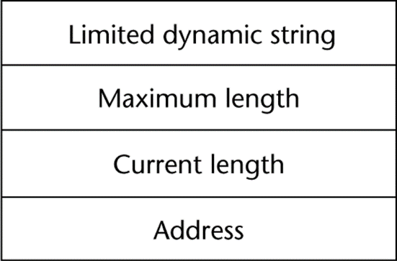
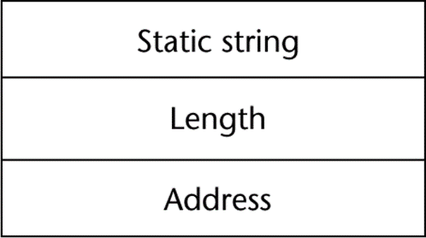
Compile- and Run-Time Descriptors
Compile-time descriptor for static strings
Run-time descriptor for limited dynamic strings

Slide 18
User-Defined Ordinal Types
An ordinal type is one in which the range of possible values can be easily associated with the set of positive integers
Examples of primitive ordinal types in Java
integer
char
boolean

Slide 19
Enumeration Types
All possible values, which are named constants, are provided in the definition
C# example
enum days {mon, tue, wed, thu, fri, sat, sun};
Design issues
Is an enumeration constant allowed to appear in more than one type definition, and if so, how is the type of an occurrence of that constant checked?
Are enumeration values coerced to integer?
Any other type coerced to an enumeration type?

Slide 20
Evaluation of Enumerated Type
Aid to readability, e.g., no need to code a color as a number
Aid to reliability, e.g., compiler can check:
operations (don’t allow colors to be added)
No enumeration variable can be assigned a value outside its defined range
C#, F#, Swift, and Java 5.0 provide better support for enumeration than C++ because enumeration type variables in these languages are not coerced into integer types

Slide 21
Array Types
An array is a homogeneous aggregate of data elements in which an individual element is identified by its position in the aggregate, relative to the first element.
C/C++ simple pointer to beginning of data
Most other languages: An object that contains a C-style array.

Slide 22
Array Design Issues
What types are legal for subscripts?
Are subscripting expressions in element references range checked?
When are subscript ranges bound?
When does allocation take place?
Are ragged or rectangular multidimensional arrays allowed, or both?
What is the maximum number of subscripts?
Can array objects be initialized?
Are any kind of slices supported?

Slide 23
Array Indexing
Indexing (or subscripting) is a mapping from indices to elements
array_name (index_value_list) → an element
Index Syntax
Fortran and Ada use parentheses
Ada explicitly uses parentheses to show uniformity between array references and function calls because both are mappings
Most other languages use brackets

Slide 24
Arrays Index (Subscript) Types
FORTRAN, C: integer only
Java: integer types only
Index range checking
- C, C++, Perl, and Fortran do not specify
range checking
- Java, ML, C# specify range checking

Slide 25
Subscript Binding and Array Categories
Static: subscript ranges are statically bound and storage allocation is static (before run-time)
Advantage: efficiency (no dynamic allocation)
Fixed stack-dynamic: subscript ranges are statically bound, but the allocation is done at declaration time
Advantage: space efficiency

Slide 26
Subscript Binding and Array Categories (continued)
Fixed heap-dynamic: similar to fixed stack-dynamic: storage binding is dynamic but fixed after allocation (i.e., binding is done when requested and storage is allocated from heap, not stack)

Slide 27
Subscript Binding and Array Categories (continued)
Heap-dynamic: binding of subscript ranges and storage allocation is dynamic and can change any number of times
Advantage: flexibility (arrays can grow or shrink during program execution)

Slide 28
Subscript Binding and Array Categories (continued)
C and C++ arrays that include static modifier are static
C and C++ arrays without static modifier are fixed stack-dynamic
C and C++ provide fixed heap-dynamic arrays
C# includes a second array class ArrayList that provides fixed heap-dynamic
Perl, JavaScript, Python, and Ruby support heap-dynamic arrays

Slide 29
Array Initialization
Some language allow initialization at the time of storage allocation
C, C++, Java, Swift, and C#
C# example:
int list [] = {4, 5, 7, 83}
Character strings in C and C++
char name [] = ″freddie″;
Arrays of strings in C and C++
char *names [] = {″Bob″, ″Jake″, ″Joe″];
Java initialization of String objects
String[] names = {″Bob″, ″Jake″, ″Joe″};

Slide 30
Heterogeneous Arrays
A heterogeneous array is one in which the elements need not be of the same type
Supported by Perl, Python, JavaScript, and Ruby

Slide 31
Array Initialization
C-based languages
int list [] = {1, 3, 5, 7}
char *names [] = {″Mike″, ″Fred″, ″Mary Lou″};
Python
List comprehensions
list = [x ** 2 for x in range(12) if x % 3 == 0]
puts [0, 9, 36, 81] in list

Slide 32
Arrays Operations
APL provides the most powerful array processing operations for vectors and matrixes as well as unary operators (for example, to reverse column elements)
Python’s array assignments, but they are only reference changes. Python also supports array catenation and element membership operations
Ruby also provides array catenation

Slide 33
Rectangular and Jagged Arrays
A rectangular array is a multi-dimensioned array in which all of the rows have the same number of elements and all columns have the same number of elements
A jagged matrix has rows with varying number of elements
Possible when multi-dimensioned arrays actually appear as arrays of arrays
C, C++, and Java support jagged arrays
F# and C# support rectangular arrays and jagged arrays

Slide 34
Slices
A slice is some substructure of an array; nothing more than a referencing mechanism
Slices are only useful in languages that have array operations

Slide 35
Slice Examples
Python
vector = [2, 4, 6, 8, 10, 12, 14, 16]
mat = [[1, 2, 3], [4, 5, 6], [7, 8, 9]]
vector (3:6) is a three-element array
mat[0][0:2] is the first and second element of the first row of mat
Ruby supports slices with the slice method
list.slice(2, 2) returns the third and fourth elements of list

Slide 36
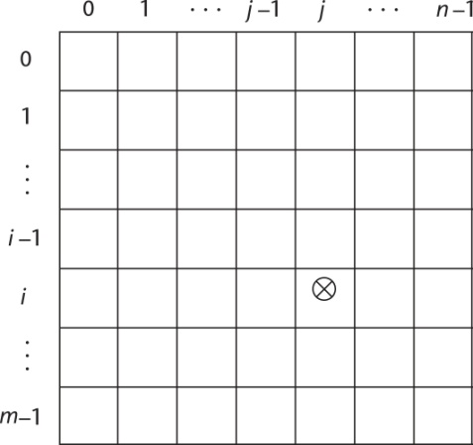
Implementation of Arrays
Access function maps subscript expressions to an address in the array
Access function for single-dimensioned arrays:
address(list[k]) = address (list[lower_bound])
+ ((k-lower_bound) * element_size)

Slide 37
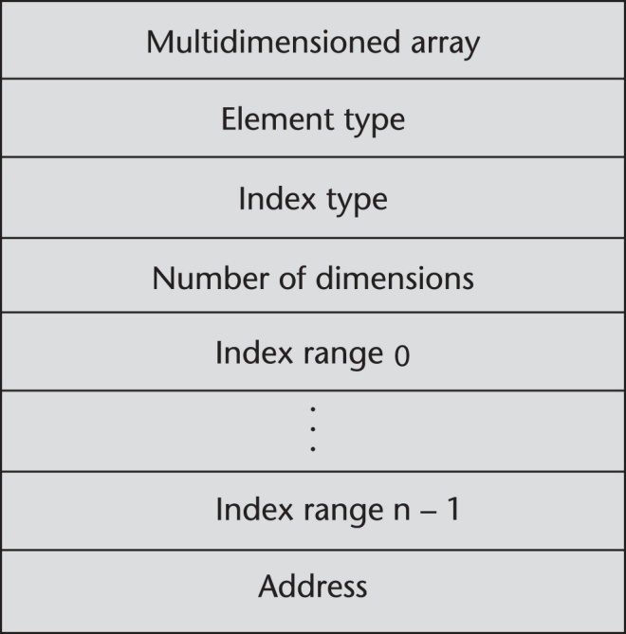
Accessing Multi-dimensioned Arrays
Two common ways:
Row major order (by rows) – used in most languages
Column major order (by columns) – used in Fortran
A compile-time descriptor
for a multidimensional
array

Slide 38
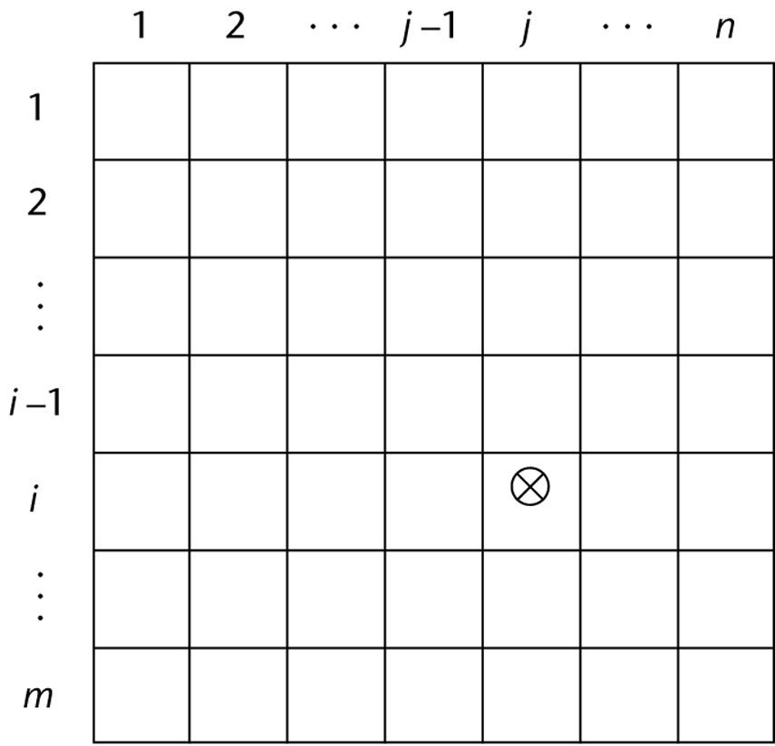
Locating an Element in a Multi-dimensioned Array
General format
Location (a[I,j]) = address of a [row_lb,col_lb] + (((I - row_lb) * n) + (j - col_lb)) * element_size

Slide 39
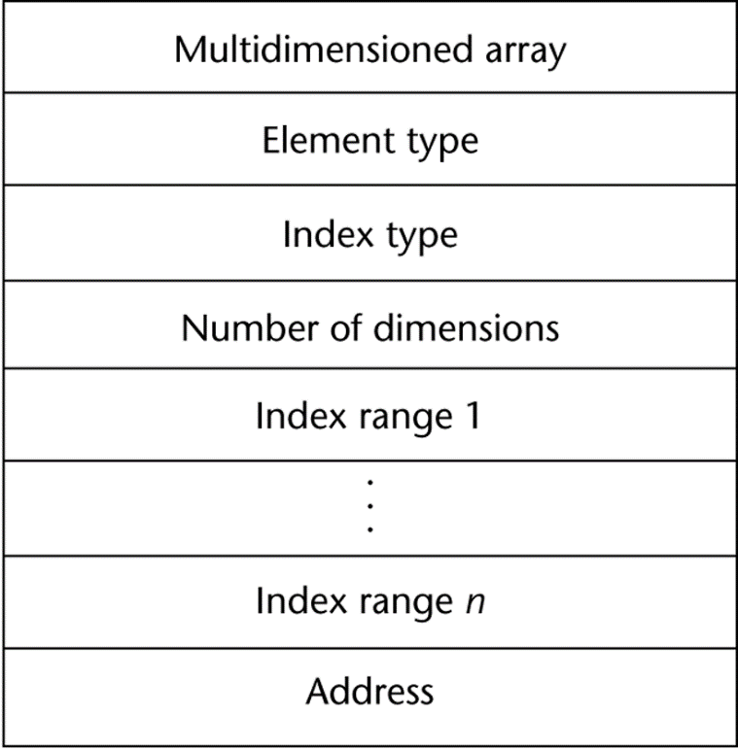
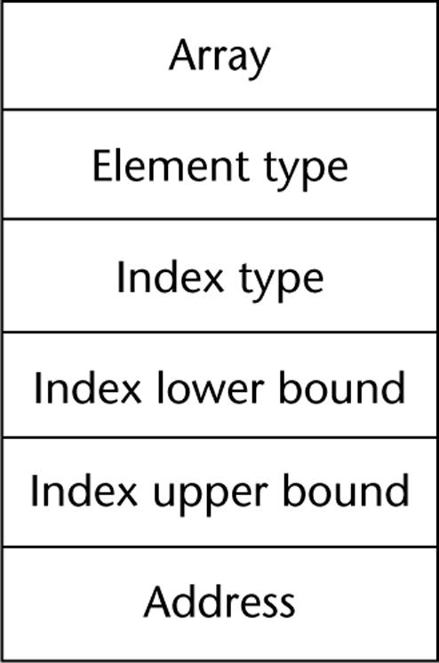
Compile-Time Descriptors
Single-dimensioned array
Multidimensional array

Slide 40
Associative Arrays
An associative array is an unordered collection of data elements that are indexed by an equal number of values called keys
User-defined keys must be stored
Design issues:
- What is the form of references to elements?
- Is the size static or dynamic?
Built-in type in Perl, Python, Ruby, and Swift

Slide 41
Associative Arrays in Perl
Names begin with %; literals are delimited by parentheses
%hi_temps = ("Mon" => 77, "Tue" => 79, "Wed" => 65, …);
Subscripting is done using braces and keys
$hi_temps{"Wed"} = 83;
Elements can be removed with delete
delete $hi_temps{"Tue"};

Slide 42
Record Types
A record is a possibly heterogeneous aggregate of data elements in which the individual elements are identified by names
Design issues:
What is the syntactic form of references to the field?
Are elliptical references allowed

Slide 43
Definition of Records in COBOL
COBOL uses level numbers to show nested records; others use recursive definition
01 EMP-REC.
02 EMP-NAME.
05 FIRST PIC X(20).
05 MID PIC X(10).
05 LAST PIC X(20).
02 HOURLY-RATE PIC 99V99.

Slide 44
References to Records
Record field references
1. COBOL
field_name OF record_name_1 OF ... OF record_name_n
2. Others (dot notation)
record_name_1.record_name_2. ... record_name_n.field_name
Fully qualified references must include all record names
Elliptical references allow leaving out record names as long as the reference is unambiguous, for example in COBOL
FIRST, FIRST OF EMP-NAME, and FIRST of EMP-REC are elliptical references to the employee’s first name

Slide 45
Evaluation and Comparison to Arrays
Records are used when collection of data values is heterogeneous
Access to array elements is much slower than access to record fields, because subscripts are dynamic (field names are static)
Dynamic subscripts could be used with record field access, but it would disallow type checking and it would be much slower

Slide 46
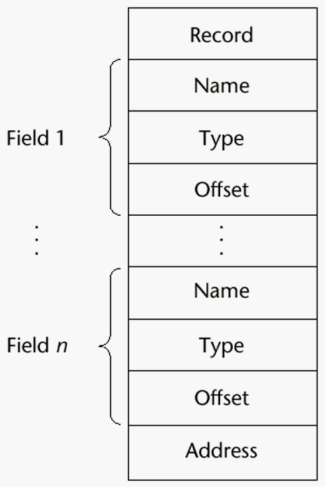
Implementation of Record Type
Offset address relative to the beginning of the records is associated with each field

Slide 47
Tuple Types
A tuple is a data type that is similar to a record, except that the elements are not named
Used in Python, ML, and F# to allow functions to return multiple values
Python
Closely related to its lists, but immutable
Create with a tuple literal
myTuple = (3, 5.8, ′apple′)
Referenced with subscripts (begin at 1)
Catenation with + and deleted with del

Slide 48
Tuple Types (continued)
ML
val myTuple = (3, 5.8, ′apple′);
- Access as follows:
#1(myTuple) is the first element
- A new tuple type can be defined
type intReal = int * real;
(The asterisk is just a separator)
F#
let tup = (3, 5, 7)
let a, b, c = tup
This assigns a tuple to a tuple pattern (a, b, c)

Slide 49
List Types
Lists in Lisp and Scheme are delimited by parentheses and use no commas
(A B C D) and (A (B C) D)
Data and code have the same form
As data, (A B C) is literally what it is
As code, (A B C) is the function A applied to the
parameters B and C
The interpreter needs to know which a list is, so if it is data, we quote it with an apostrophe
′(A B C) is data

Slide 50
List Types (continued)
List Operations in Scheme
CAR returns the first element of its list parameter
(CAR ′(A B C)) returns A
CDR returns the remainder of its list parameter after the first element has been removed
(CDR ′(A B C)) returns (B C)
- CONS puts its first parameter into its second parameter, a list, to make a new list
(CONS ′A (B C)) returns (A B C)
LIST returns a new list of its parameters
(LIST ′A ′B ′(C D)) returns (A B (C D))

Slide 51
List Types (continued)
List Operations in ML
Lists are written in brackets and the elements are separated by commas
List elements must be of the same type
The Scheme CONS function is a binary operator in ML, ::
3 :: [5, 7, 9] evaluates to [3, 5, 7, 9]
The Scheme CAR and CDR functions are named hd and tl, respectively

Slide 52
List Types (continued)
F# Lists
Like those of ML, except elements are separated by semicolons and hd and tl are methods of the List class
Python Lists
The list data type also serves as Python’s arrays
Unlike Scheme, Common Lisp, ML, and F#, Python’s lists are mutable
Elements can be of any type
Create a list with an assignment
myList = [3, 5.8, "grape"]

Slide 53
List Types (continued)
Python Lists (continued)
List elements are referenced with subscripting, with indices beginning at zero
x = myList[1] Sets x to 5.8
List elements can be deleted with del
del myList[1]
List Comprehensions – derived from set notation
[x * x for x in range(6) if x % 3 == 0]
range(12) creates [0, 1, 2, 3, 4, 5, 6]
Constructed list: [0, 9, 36]

Slide 54
List Types (continued)
Haskell’s List Comprehensions
The original
[n * n | n <- [1..10]]
F#’s List Comprehensions
let myArray = [|for i in 1 .. 5 -> [i * i) |]
Both C# and Java supports lists through their generic heap-dynamic collection classes, List and ArrayList, respectively

Slide 55
Unions Types
A union is a type whose variables are allowed to store different type values at different times during execution
Design issue
Should type checking be required?

Slide 56
Discriminated vs. Free Unions
C and C++ provide union constructs in which there is no language support for type checking; the union in these languages is called free union
Type checking of unions require that each union include a type indicator called a discriminant
Supported by ML, Haskell, and F#

Slide 57
Unions in F#
Defined with a type statement using OR
type intReal =
| IntValue of int
| RealValue of float;;
intReal is the new type
IntValue and RealValue are constructors
To create a value of type intReal:
let ir1 = IntValue 17;;
let ir2 = RealValue 3.4;;

Slide 58
Unions in F# (continued)
Accessing the value of a union is done with
pattern matching
match pattern with
| expression_list₁ -> expression₁
| …
| expression_list_{n} -> expression_{n}
- Pattern can be any data type
- The expression list can have wild cards (_)

Slide 59
Unions in F# (continued)
Example:
let a = 7;;
let b = ″grape″;;
let x = match (a, b) with
| 4, ″apple″ -> apple
| _, ″grape″ -> grape
| _ -> fruit;;

Slide 60
Unions in F# (continued)
To display the type of the intReal union:
let printType value =
match value with
| IntVale value -> printfn ″int″
| RealValue value -> printfn ″float″;;
If ir1 and ir2 are defined as previously,
printType ir1 returns int
printType ir2 returns float

Slide 61
Evaluation of Unions
Free unions are unsafe
Do not allow type checking
Java and C# do not support unions
Reflective of growing concerns for safety in programming language

Slide 62
Pointer and Reference Types
A pointer type variable has a range of values that consists of memory addresses and a special value, nil
Provide the power of indirect addressing
Provide a way to manage dynamic memory
A pointer can be used to access a location in the area where storage is dynamically created (usually called a heap)

Slide 63
Design Issues of Pointers
What are the scope of and lifetime of a pointer variable?
What is the lifetime of a heap-dynamic variable?
Are pointers restricted as to the type of value to which they can point?
Are pointers used for dynamic storage management, indirect addressing, or both?
Should the language support pointer types, reference types, or both?

Slide 64
Pointer Operations
Two fundamental operations: assignment and dereferencing
Assignment is used to set a pointer variable’s value to some useful address
Dereferencing yields the value stored at the location represented by the pointer’s value
Dereferencing can be explicit or implicit
C++ uses an explicit operation via *
j = *ptr
sets j to the value located at ptr

Slide 65
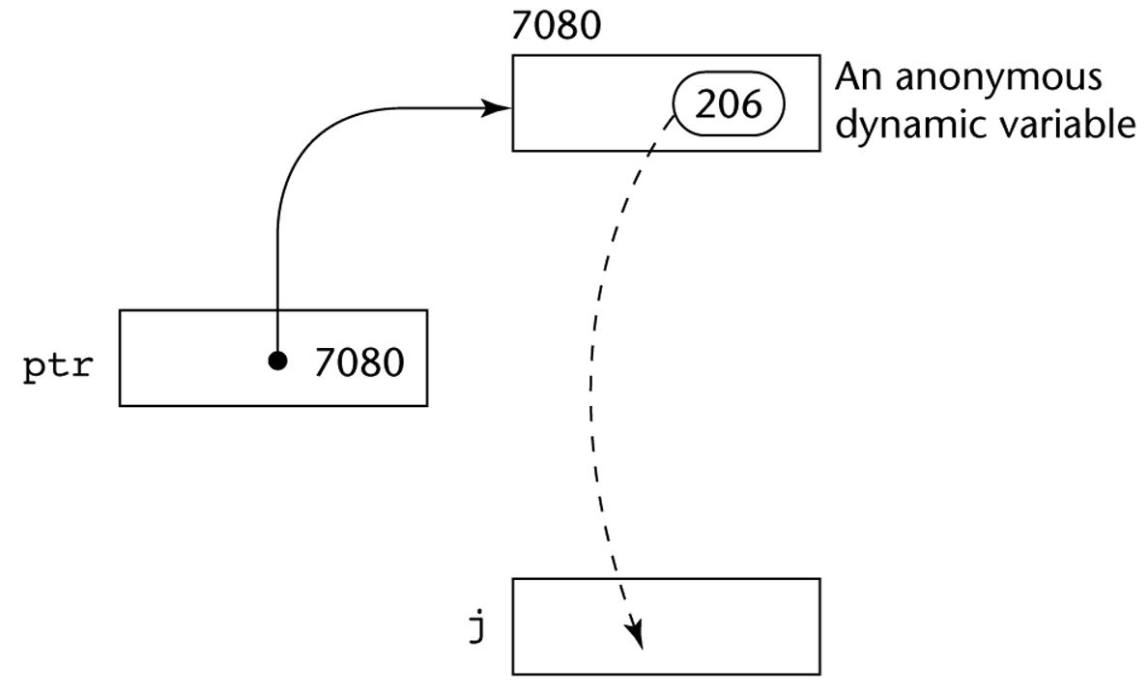
Pointer Assignment Illustrated
The assignment operation j = *ptr

Slide 66
Problems with Pointers
Dangling pointers (dangerous)
A pointer points to a heap-dynamic variable that has been deallocated
Lost heap-dynamic variable
An allocated heap-dynamic variable that is no longer accessible to the user program (often called garbage)
Pointer p1 is set to point to a newly created heap-dynamic variable
Pointer p1 is later set to point to another newly created heap-dynamic variable
The process of losing heap-dynamic variables is called memory leakage

Slide 67
Pointers in C and C++
Extremely flexible but must be used with care
Pointers can point at any variable regardless of when or where it was allocated
Used for dynamic storage management and addressing
Pointer arithmetic is possible
Explicit dereferencing and address-of operators
Domain type need not be fixed (void *)
void * can point to any type and can be type
checked (cannot be de-referenced)

Slide 68
Pointer Arithmetic in C and C++
float stuff[100];
float *p;
p = stuff;
*(p+5) is equivalent to stuff[5] and p[5]
*(p+i) is equivalent to stuff[i] and p[i]

Slide 69
Reference Types
C++ includes a special kind of pointer type called a reference type that is used primarily for formal parameters
Advantages of both pass-by-reference and pass-by-value
Java extends C++’s reference variables and allows them to replace pointers entirely
References are references to objects, rather than being addresses
C# includes both the references of Java and the pointers of C++

Slide 70
Evaluation of Pointers
Dangling pointers and dangling objects are problems as is heap management
Pointers are like goto's--they widen the range of cells that can be accessed by a variable
Pointers or references are necessary for dynamic data structures--so we can't design a language without them

Slide 71
Representations of Pointers
Large computers use single values
Intel microprocessors use segment and offset

Slide 72
Dangling Pointer Problem
Tombstone: extra heap cell that is a pointer to the heap-dynamic variable
The actual pointer variable points only at tombstones
When heap-dynamic variable de-allocated, tombstone remains but set to nil
Costly in time and space
. Locks-and-keys: Pointer values are represented as (key, address) pairs
Heap-dynamic variables are represented as variable plus cell for integer lock value
When heap-dynamic variable allocated, lock value is created and placed in lock cell and key cell of pointer

Slide 73
Heap Management
A very complex run-time process
Single-size cells vs. variable-size cells
Two approaches to reclaim garbage
Reference counters (eager approach): reclamation is gradual
Mark-sweep (lazy approach): reclamation occurs when the list of variable space becomes empty

Slide 74
Reference Counter
Reference counters: maintain a counter in every cell that store the number of pointers currently pointing at the cell
Disadvantages: space required, execution time required, complications for cells connected circularly
Advantage: it is intrinsically incremental, so significant delays in the application execution are avoided

Slide 75
Mark-Sweep
The run-time system allocates storage cells as requested and disconnects pointers from cells as necessary; mark-sweep then begins
Every heap cell has an extra bit used by collection algorithm
All cells initially set to garbage
All pointers traced into heap, and reachable cells marked as not garbage
All garbage cells returned to list of available cells
Disadvantages: in its original form, it was done too infrequently. When done, it caused significant delays in application execution. Contemporary mark-sweep algorithms avoid this by doing it more often—called incremental mark-sweep

Slide 76
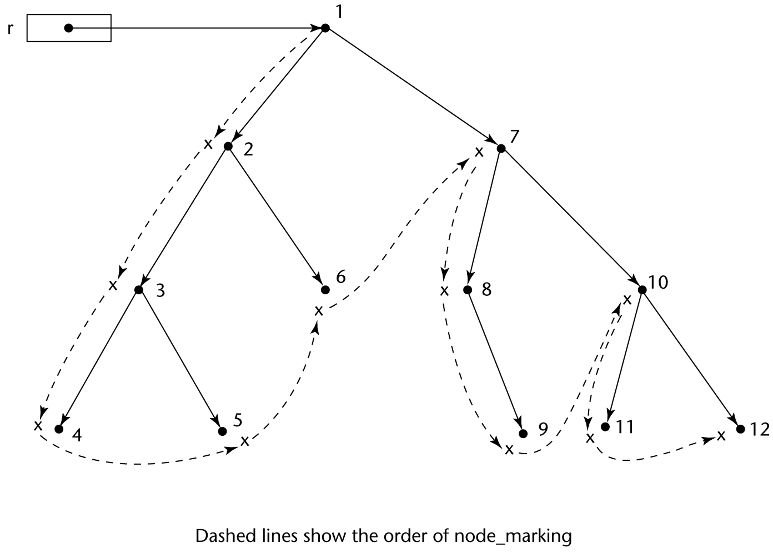
Marking Algorithm

Slide 77
Variable-Size Cells
All the difficulties of single-size cells plus more
Required by most programming languages
If mark-sweep is used, additional problems occur
The initial setting of the indicators of all cells in the heap is difficult
The marking process in nontrivial
Maintaining the list of available space is another source of overhead

Slide 78
Optional Types
Optional types are useful when there is a need for a variable to indicate that it currently has no value
C#, F#, and Swift, among others, have optional types
Reference types in C# are already optional types (use null for no value)
Value types in C# (struct types) can be declared to be optional by attaching a question mark to the type name in their declaration
int? x;
The no-value is null, which can be assigned to x and x can be tested for it
In Swift, nil is used instead of null

Slide 79
Type Checking
Generalize the concept of operands and operators to include subprograms and assignments
Type checking is the activity of ensuring that the operands of an operator are of compatible types
A compatible type is one that is either legal for the operator, or is allowed under language rules to be implicitly converted, by compiler- generated code, to a legal type
This automatic conversion is called a coercion.
A type error is the application of an operator to an operand of an inappropriate type

Slide 80
Type Checking (continued)
If all type bindings are static, nearly all type checking can be static
If type bindings are dynamic, type checking must be dynamic
A programming language is strongly typed if type errors are always detected
Advantage of strong typing: allows the detection of the misuses of variables that result in type errors

Slide 81
Strong Typing
Language examples:
C and C++ are not: parameter type checking can be avoided; unions are not type checked
Java and C# are, almost (because of explicit type casting)
- ML and F# are

Slide 82
Strong Typing (continued)
Coercion rules strongly affect strong typing--they can weaken it considerably (C++ versus ML and F#)
Although Java has just half the assignment coercions of C++, its strong typing is still far less effective than that of Ada

Slide 83
Name Type Equivalence
Name type equivalence means the two variables have equivalent types if they are in either the same declaration or in declarations that use the same type name
Easy to implement but highly restrictive:
Subranges of integer types are not equivalent with integer types
Formal parameters must be the same type as their corresponding actual parameters

Slide 84
Structure Type Equivalence
Structure type equivalence means that two variables have equivalent types if their types have identical structures
More flexible, but harder to implement

Slide 85
Type Equivalence (continued)
Consider the problem of two structured types:
Are two record types equivalent if they are structurally the same but use different field names?
Are two array types equivalent if they are the same except that the subscripts are different?
(e.g. [1..10] and [0..9])
Are two enumeration types equivalent if their components are spelled differently?
With structural type equivalence, you cannot differentiate between types of the same structure (e.g. different units of speed, both float)

Slide 86
Theory and Data Types
Type theory is a broad area of study in mathematics, logic, computer science, and philosophy
Two branches of type theory in computer science:
Practical – data types in commercial languages
Abstract – typed lambda calculus
A type system is a set of types and the rules that govern their use in programs

Slide 87
Theory and Data Types (continued)
Formal model of a type system is a set of types and a collection of functions that define the type rules
Either an attribute grammar or a type map could be used for the functions
Finite mappings – model arrays and functions
Cartesian products – model tuples and records
Set unions – model union types
Subsets – model subtypes

Slide 88
Summary
The data types of a language are a large part of what determines that language’s style and usefulness
The primitive data types of most imperative languages include numeric, character, and Boolean types
The user-defined enumeration and subrange types are convenient and add to the readability and reliability of programs
Arrays and records are included in most languages
Pointers are used for addressing flexibility and to control dynamic storage management

