Slide 1
Chapter 1
Preliminaries

Slide 2
Language Evaluation Criteria
What things should we look at when deciding how “good” a language is?
Readability: the ease with which programs can be read and understood
Writability: the ease with which a language can be used to create programs
Reliability: how well then language helps programmer avoid failures
(or at least avoids “silent” failures)
Cost: the ultimate total cost

Slide 3
Evaluation Criteria: Readability
What makes a language “Readable”?
Overall simplicity
A manageable set of features and constructs
Minimal feature multiplicity
(Do we need count = count + 1 , count +=1 , and count++, and ++count?)
In what sense is this less readable (since all are relatively simple)?
Sensible operator overloading
Should “+” be both addition and string concatenation?
Orthogonality
A relatively small set of primitive constructs can be combined in a relatively small number of ways
Different combinations behave consistently
Counterexample: primitive vs. object parameters in Java
Data types
Adequate predefined data types (are Strings built in)?
Syntax considerations
Form and meaning: self-descriptive constructs, meaningful keywords
What does “static” mean in C? Is this term used consistently?
Does the “*” operator have a consistent meaning in C?
What does “grep” mean in the UNIX environment? Can you figure this out based on general computing knowledge?

Slide 4
Evaluation Criteria: Readability
Should keywords be reserved words?
In other words, is it reasonable to allow “for” “while”, etc. to be variable names?
Should blocks use braces, or words:
for (int j = 0; j < array.length; ++j) {
sum = sum + array[j];
}
for (int j = 0; j < array.length; ++j)
sum = sum + array[j];
end
for (int j = 0; j < array.length; ++j)
begin
sum = sum + array[j];
end

Slide 5
Evaluation Criteria: Writability
Expressivity
A set of relatively convenient ways of specifying operations
“Simple things should be simple. Complex things should be possible”
Strength and number of operators and predefined functions
“Right tools for the job”
Simplicity and orthogonality
Few constructs, a small number of primitives, a small set of rules for combining them
Why is this important? Why not have many options and just ignore the ones you don’t want/need?
Support for abstraction
The ability to define and use complex structures or operations in ways that allow details to be ignored
Avoid unnecessary repetition (DRY)
Who said it?
What is he known for?

Slide 6
Evaluation Criteria: Reliability
Reliability:
Language should help you avoid errors
If you make an error, it should be immediately obvious
Type checking
Testing for type errors
Exception handling
Intercept run-time errors and take corrective measures
Aliasing
Presence of two or more distinct referencing methods for the same memory location
Readability and writability
A language that does not support “natural” ways of expressing an algorithm will require the use of “unnatural” approaches, and hence reduced reliability

Slide 7
Evaluation Criteria: Cost
What are some example “costs”?
Training programmers to use the language
Writing programs
(depends on the domain --- “right tool for job”)
Executing programs
Performance
Reliability: poor reliability leads to high costs
Maintaining programs
Readability is a big factor here

Slide 8
Evaluation Criteria: Others
Portability
The ease with which programs can be moved from one implementation to another
Generality
The applicability to a wide range of applications
Well-definedness
The completeness and precision of the language’s official definition

Slide 9
Tradeoffs
How does improving one area affect others?
Readability vs. Writability
use v5.10;
while (<STDIN>) {
chomp;
say if (/z/)
}
use v5.10;
while ($_ = <STDIN>)
{
chomp $_;
if ($_ =~ /MATCH/) {
say $_;
}
}

Slide 10
Tradeoffs
Writability vs. Performance?
Writability vs. Reliability?
Reliability vs. Performance?
Do in-class exercise!!!

Slide 11
Language Design Trade-Offs
Reliability vs. cost of execution
Example: Java demands all references to array elements be checked for proper indexing, which leads to increased execution costs
Readability vs. writability
Example: APL provides many powerful operators (and a large number of new symbols), allowing complex computations to be written in a compact program but at the cost of poor readability
Writability (flexibility) vs. reliability
Example: C++ pointers are powerful and very flexible but are unreliable

Slide 12
Origins of Modern Programming Languages
First electronic computers of the 1940s used machine language
Sequence of 1s and 0s that correspond directly to wires in the CPU.
a₁ and a₂
a₁ and a₂
a₁ a₂ a₃
000000000100001100001000000000
unused
Register File
5
a₁
rd₁
32
5
Register 0
a₂
32
ALU Op Code
5
a₃
Register 1
32
…
32
wd
Register 2
rd₂
add r1 ← r2, r3
clock
Register 31

Slide 13
Assembly the obvious next step
Use words/numbers to represent each section of 1s and 0s
Replace memory addresses with labels
Originally each assembly instruction corresponded to exactly one machine instruction
Parameters are registers
More short-cuts (macros, pseudoinstructions) added later
add r1 ← r2, r3
op code | rs | rt | rd | <unused>
000000 | 00010 | 00011 | 00001 | 000000000
6
5
5
5
9
= 32

Slide 14
Next steps: Fortran, C, etc.
Each line of code corresponds to multiple machine instructions.
Use variables instead of registers
Compiler keeps track of which variables are currently in which register.
Much easier to read and write
Compiler can do helpful error checking
e.g., raise error if you try to treat a float as an int.
This increases reliability
These language are called imperative languages
They tell the CPU specifically what to do (like an imperative sentence)
Require programmers to “think like the CPU”
Must rephrase the problem in your head to align with the way the CPU solves problems.
x = a + b + c

Slide 15
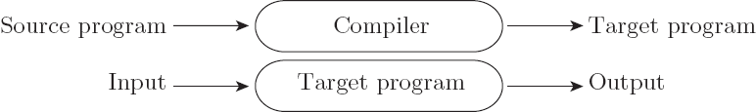
Compilation vs. Interpretation
Compilation vs. interpretation
not opposites
not a clear-cut distinction
Pure Compilation
The compiler translates the high-level source program into an equivalent target program (typically in machine language), and then goes away:
Copyright © 2009 Elsevier

Slide 16
Pure Interpretation
Think of a UNIX shell (e.g., bash)
It is a programming language.
Runs sequence of commands
Has variables, if, loops, functions, etc.
This code usually can’t be compiled beforehand because you are “writing” the code one line at a time.
This type of programming language is “interpreted”
Lines of code are processed and executed one a time.
Needs an executable called an Interpreter
E.g, /bin/bash

Slide 17

Compilation vs. Interpretation
Pure Interpretation
Interpreter stays around for the execution of the program
Interpreter is the locus of control during execution
Copyright © 2009 Elsevier

Slide 18
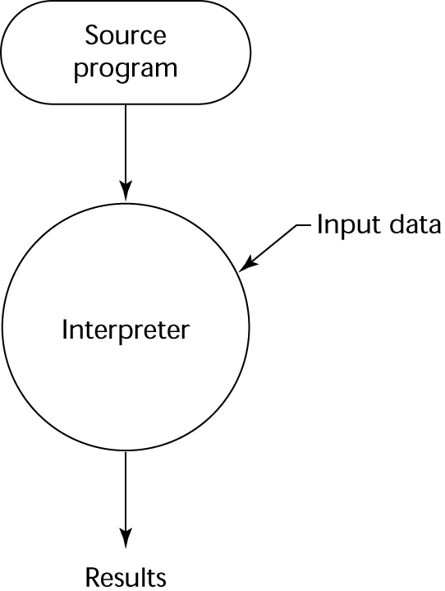
Pure Interpretation Process

Slide 19
Pure Interpretation
Examples: Python, Ruby, PHP, JavaScript.
Cons:
10 to 100 times slower than compiled programs
Often uses more RAM
Pros:
Source code is often more portable
Interpreter must be ported, but source code should run on (almost) any machine with an interpreter
Simplifies distribution because user need not recompile for his specific processor/OS combination.
Interpreted languages are often more writable.
In order to improve performance, compiled languages tend to be very “picky”.
Interpreted languages are already slow, so they aren’t as “picky”

Slide 20
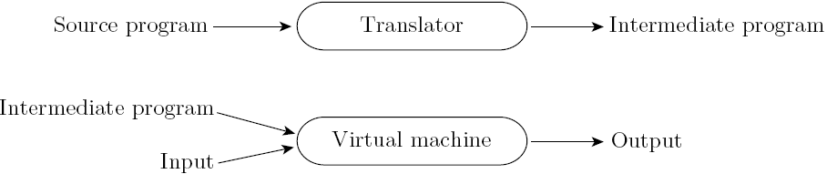
Hybrid
Common case is compilation or simple pre-processing, followed by interpretation
Most language implementations include a mixture of both compilation and interpretation
Copyright © 2009 Elsevier

Slide 21
Hybrid Implementation Systems
A compromise between compilers and pure interpreters
A high-level language program is translated to an intermediate language that allows easy interpretation
Faster than pure interpretation
Examples
Perl programs are partially compiled to detect errors before interpretation
Initial implementations of Java were hybrid; the intermediate form, byte code, provides portability to any machine that has a byte code interpreter and a run-time system (together, these are called Java Virtual Machine)

Slide 22
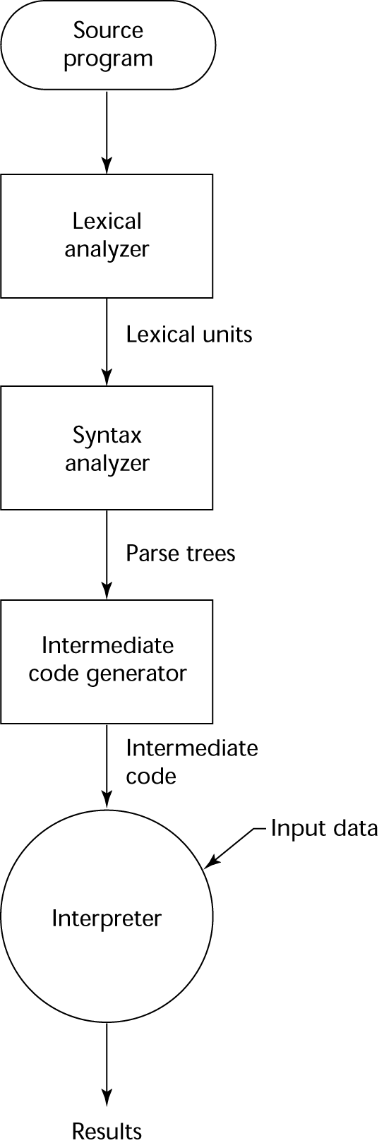
Hybrid Implementation Process

Slide 23
Compilation
Translate high-level program (source language) into machine code (machine language)
Slow translation, fast execution
Everything is “ready to go” when the program starts
Each processor/OS combination needs its own binary
Compilation process has several phases:
lexical analysis: converts characters in the source program into lexical units
syntax analysis: transforms lexical units into parse trees which represent the syntactic structure of program
Semantics analysis: generate intermediate code
In C, this is assembly
code generation: machine code is generated

Slide 24
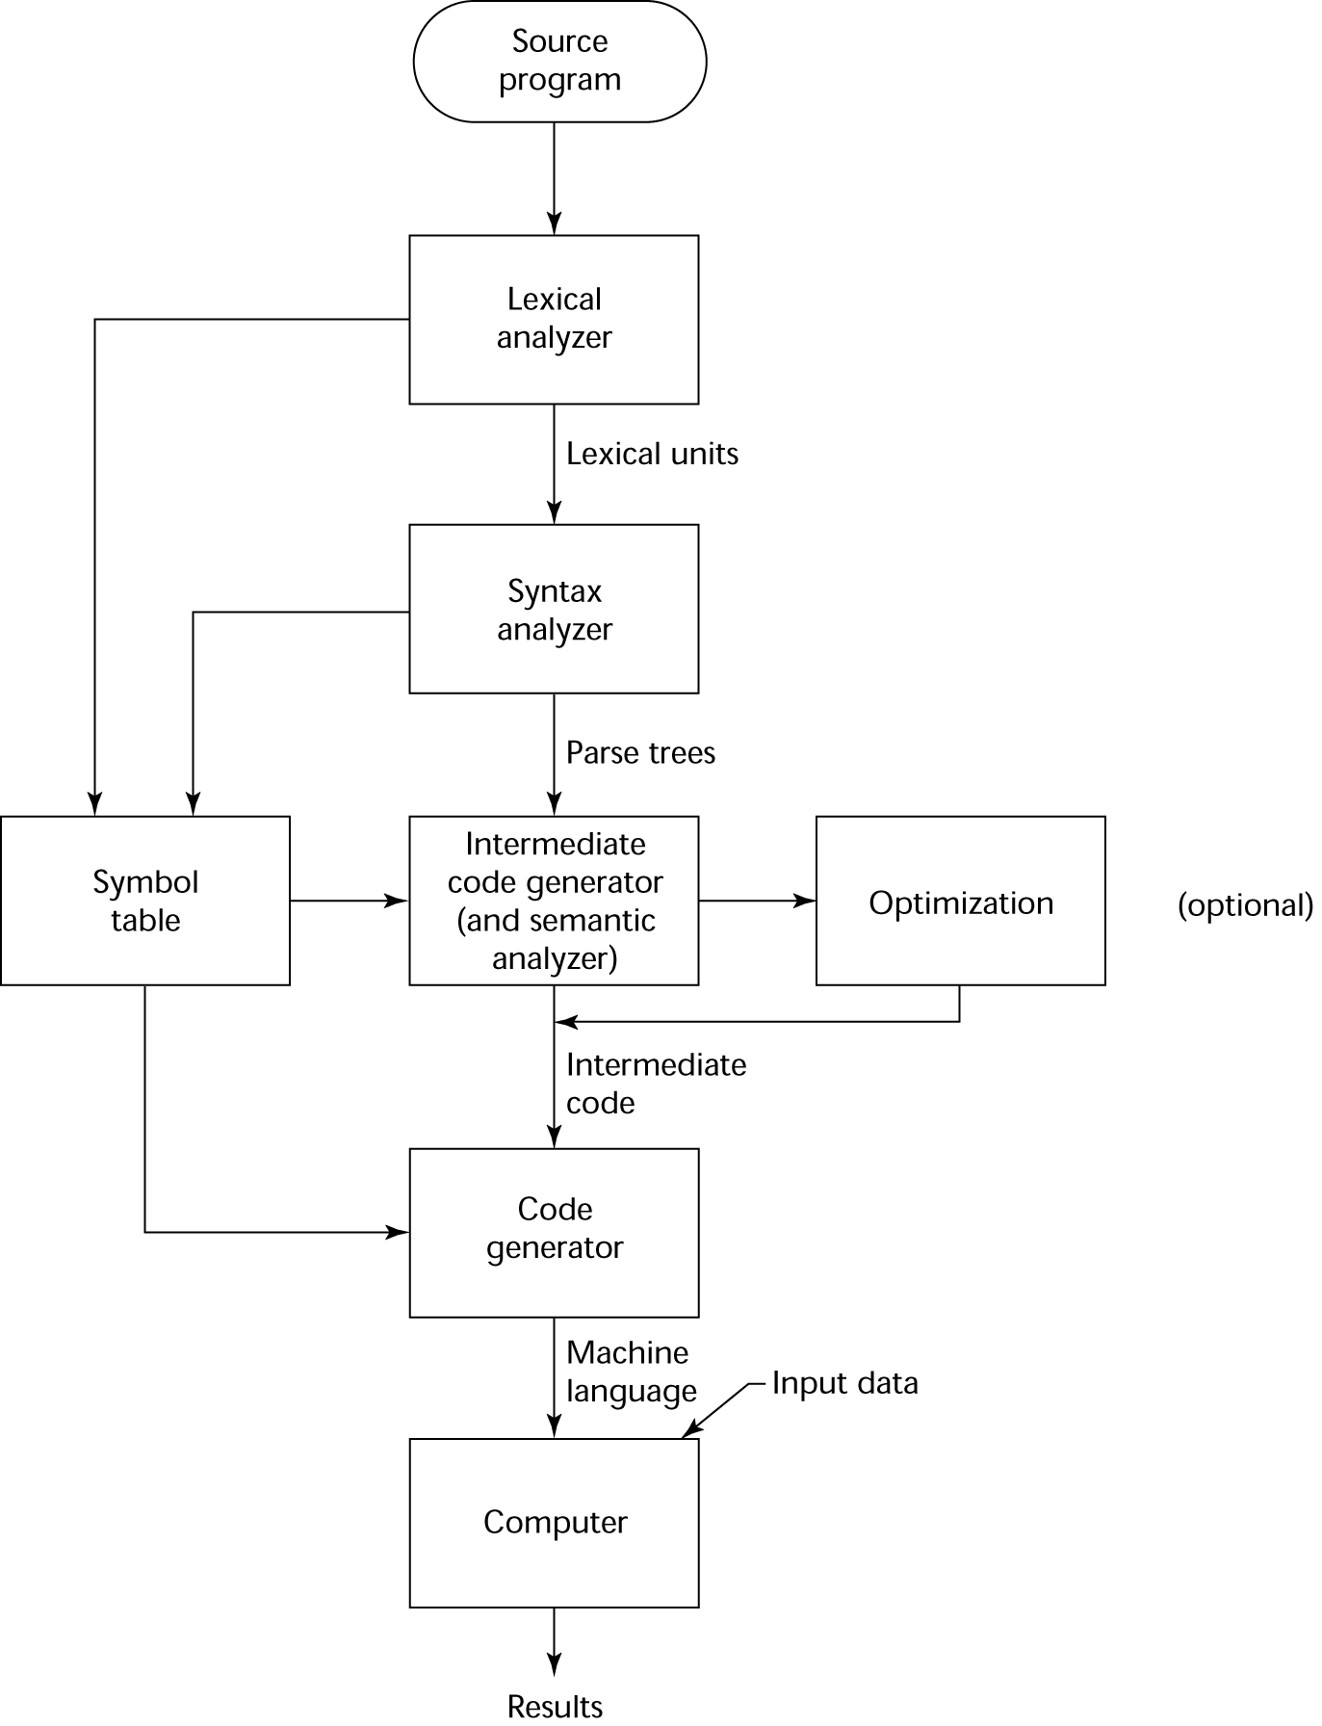
The Compilation Process

Slide 25
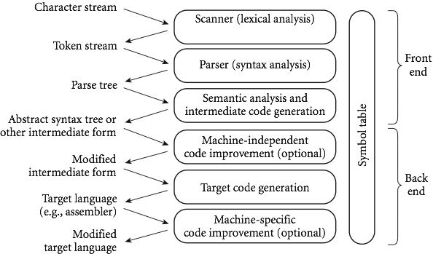
Another view of Compilation
Copyright © 2009 Elsevier

Slide 26
An Overview of Compilation
Scanning:
divides the program into "tokens", which are the smallest meaningful units; this saves time, since character-by-character processing is slow
we can tune the scanner better if its job is simple; it also saves complexity (lots of it) for later stages
you can design a parser to take characters instead of tokens as input, but it isn't pretty
scanning is recognition of a regular language, e.g., via DFA

Slide 27
An Overview of Compilation
Parsing is recognition of a context-free language, e.g., via PDA
Parsing discovers the "context free" structure of the program
Informally, it finds the structure you can describe with syntax diagrams (the "circles and arrows" in a Pascal manual)

Slide 28
An Overview of Compilation
Semantic analysis is the discovery of meaning in the program
The compiler actually does what is called STATIC semantic analysis. That's the meaning that can be figured out at compile time
Some things (e.g., array subscript out of bounds) can't be figured out until run time. Things like that are part of the program's DYNAMIC semantics
Also looks for things like
Functions called actually exist
Variables referenced have been declared

Slide 29
Static vs. Dynamic typing

Slide 32
Instruction
a₁ and a₂
a₁ and a₂
a₁ a₂ a₃
000000000100001100001000000000
unused
Register File
5
a₁
rd₁
32
5
Register 0
a₂
32
ALU Op Code
5
a₃
Register 1
32
…
32
wd
Register 2
rd₂
add r1 ← r2, r3
clock
Register 31

Slide 33
Influences on Language Design
Computer Architecture
Languages are developed around the prevalent computer architecture, known as the von Neumann architecture
Program Design Methodologies
New software development methodologies (e.g., object-oriented software development) led to new programming paradigms and by extension, new programming languages

Slide 34
Computer Architecture Influence
Well-known computer architecture: Von Neumann
Imperative languages, most dominant, because of von Neumann computers
Data and programs stored in memory
Memory is separate from CPU
Instructions and data are piped from memory to CPU
Basis for imperative languages
Variables model memory cells
Assignment statements model piping
Iteration is efficient

Slide 35
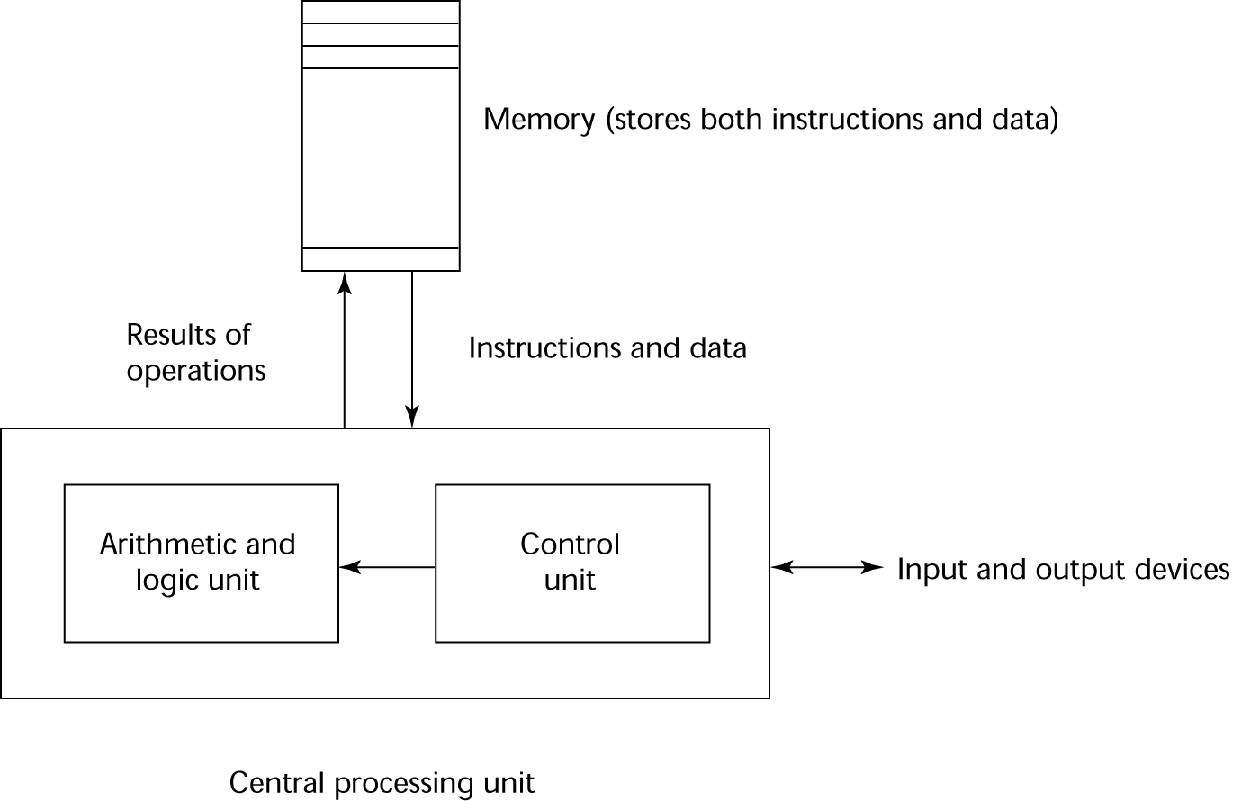
The von Neumann Architecture

Slide 36
The von Neumann Architecture
Fetch-execute-cycle (on a von Neumann architecture computer)
initialize the program counter
repeat forever
fetch the instruction pointed by the counter
increment the counter
decode the instruction
execute the instruction
end repeat

Slide 37
Programming Methodologies Influences
1950s and early 1960s: Simple applications; worry about machine efficiency
Late 1960s: People efficiency became important; readability, better control structures
structured programming
top-down design and step-wise refinement
Late 1970s: Process-oriented to data-oriented
data abstraction
Middle 1980s: Object-oriented programming
Data abstraction + inheritance + polymorphism

Slide 38
Language Categories
Imperative
Central features are variables, assignment statements, and iteration
Include languages that support object-oriented programming
Include scripting languages
Include the visual languages
Examples: C, Java, Perl, JavaScript, Visual BASIC .NET, C++
Functional
Main means of making computations is by applying functions to given parameters
Examples: LISP, Scheme, ML, F#
Logic
Rule-based (rules are specified in no particular order)
Example: Prolog
Markup/programming hybrid
Markup languages extended to support some programming
Examples: JSTL, XSLT

Slide 39
Implementation Methods
Compilation
Programs are translated into machine language; includes JIT systems
Use: Large commercial applications
Pure Interpretation
Programs are interpreted by another program known as an interpreter
Use: Small programs or when efficiency is not an issue
Hybrid Implementation Systems
A compromise between compilers and pure interpreters
Use: Small and medium systems when efficiency is not the first concern

Slide 40
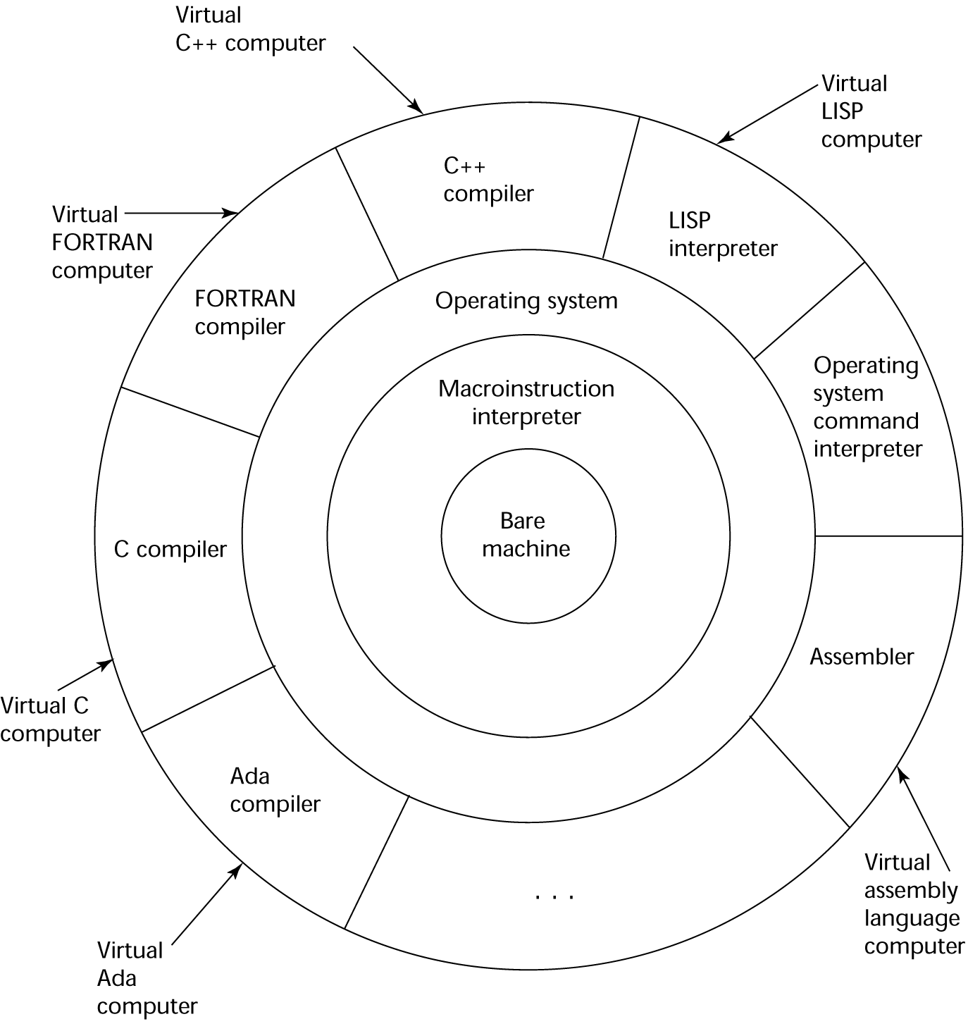
Layered View of Computer
The operating system and language implementation are layered over
machine interface of a computer

Slide 41
Compilation
Translate high-level program (source language) into machine code (machine language)
Slow translation, fast execution
Compilation process has several phases:
lexical analysis: converts characters in the source program into lexical units
syntax analysis: transforms lexical units into parse trees which represent the syntactic structure of program
Semantics analysis: generate intermediate code
code generation: machine code is generated

Slide 42
The Compilation Process

Slide 43
Additional Compilation Terminologies
Load module (executable image): the user and system code together
Linking and loading: the process of collecting system program units and linking them to a user program

Slide 44
Von Neumann Bottleneck
Connection speed between a computer’s memory and its processor determines the speed of a computer
Program instructions often can be executed much faster than the speed of the connection; the connection speed thus results in a bottleneck
Known as the von Neumann bottleneck; it is the primary limiting factor in the speed of computers

Slide 45
Pure Interpretation
No translation
Easier implementation of programs (run-time errors can easily and immediately be displayed)
Slower execution (10 to 100 times slower than compiled programs)
Often requires more space
Now rare for traditional high-level languages
Significant comeback with some Web scripting languages (e.g., JavaScript, PHP)

Slide 46
Pure Interpretation Process

Slide 47
Hybrid Implementation Systems
A compromise between compilers and pure interpreters
A high-level language program is translated to an intermediate language that allows easy interpretation
Faster than pure interpretation
Examples
Perl programs are partially compiled to detect errors before interpretation
Initial implementations of Java were hybrid; the intermediate form, byte code, provides portability to any machine that has a byte code interpreter and a run-time system (together, these are called Java Virtual Machine)

Slide 48
Hybrid Implementation Process

Slide 49
Just-in-Time Implementation Systems
Initially translate programs to an intermediate language
Then compile the intermediate language of the subprograms into machine code when they are called
Machine code version is kept for subsequent calls
JIT systems are widely used for Java programs
.NET languages are implemented with a JIT system
In essence, JIT systems are delayed compilers

Slide 50
Preprocessors
Preprocessor macros (instructions) are commonly used to specify that code from another file is to be included
A preprocessor processes a program immediately before the program is compiled to expand embedded preprocessor macros
A well-known example: C preprocessor
expands #include, #define, and similar macros

Slide 51
Programming Environments
A collection of tools used in software development
UNIX
An older operating system and tool collection
Nowadays often used through a GUI (e.g., CDE, KDE, or GNOME) that runs on top of UNIX
Microsoft Visual Studio.NET
A large, complex visual environment
Used to build Web applications and non-Web applications in any .NET language
NetBeans
Related to Visual Studio .NET, except for applications in Java

Slide 52
Summary
The study of programming languages is valuable for a number of reasons:
Increase our capacity to use different constructs
Enable us to choose languages more intelligently
Makes learning new languages easier
Most important criteria for evaluating programming languages include:
Readability, writability, reliability, cost
Major influences on language design have been machine architecture and software development methodologies
The major methods of implementing programming languages are: compilation, pure interpretation, and hybrid implementation

