Slide 1

Chapter 1 :: Introduction
Programming Language Pragmatics
Michael L. Scott
Copyright © 2009 Elsevier

Slide 2
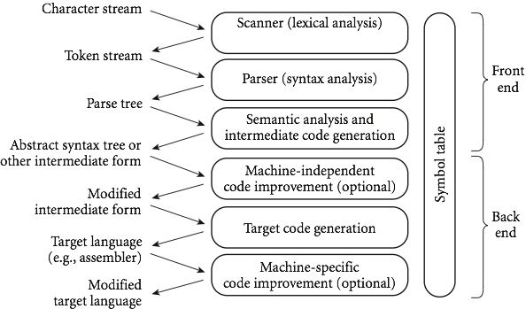
An Overview of Compilation
Phases of Compilation
Copyright © 2009 Elsevier

Slide 3
An Overview of Compilation
Scanning:
divides the program into "tokens", which are the smallest meaningful units; this saves time, since character-by-character processing is slow
we can tune the scanner better if its job is simple; it also saves complexity (lots of it) for later stages
you can design a parser to take characters instead of tokens as input, but it isn't pretty
scanning is recognition of a regular language, e.g., via DFA
Copyright © 2009 Elsevier

Slide 4
An Overview of Compilation
Parsing is recognition of a context-free language, e.g., via PDA
Parsing discovers the "context free" structure of the program
Informally, it finds the structure you can describe with syntax diagrams (the "circles and arrows" in a Pascal manual)
Copyright © 2009 Elsevier

Slide 5
An Overview of Compilation
Semantic analysis is the discovery of meaning in the program
The compiler actually does what is called STATIC semantic analysis. That's the meaning that can be figured out at compile time
Some things (e.g., array subscript out of bounds) can't be figured out until run time. Things like that are part of the program's DYNAMIC semantics
Copyright © 2009 Elsevier

Slide 6
An Overview of Compilation
Intermediate form (IF) done after semantic analysis (if the program passes all checks)
IFs are often chosen for machine independence, ease of optimization, or compactness (these are somewhat contradictory)
They often resemble machine code for some imaginary idealized machine; e.g. a stack machine, or a machine with arbitrarily many registers
Many compilers actually move the code through more than one IF
Copyright © 2009 Elsevier

Slide 7
An Overview of Compilation
Optimization takes an intermediate-code program and produces another one that does the same thing faster, or in less space
The term is a misnomer; we just improve code
The optimization phase is optional
Code generation phase produces assembly language or (sometime) relocatable machine language
Copyright © 2009 Elsevier

Slide 8
An Overview of Compilation
Certain machine-specific optimizations (use of special instructions or addressing modes, etc.) may be performed during or after target code generation
Symbol table: all phases rely on a symbol table that keeps track of all the identifiers in the program and what the compiler knows about them
This symbol table may be retained (in some form) for use by a debugger, even after compilation has completed
Copyright © 2009 Elsevier

Slide 9
An Overview of Compilation
Lexical and Syntax Analysis
GCD Program (in C)
int main() {
int i = getint(), j = getint();
while (i != j) {
if (i > j) i = i - j;
else j = j - i;
}
putint(i);
}
Copyright © 2009 Elsevier

Slide 10
An Overview of Compilation
Lexical and Syntax Analysis
GCD Program Tokens
Scanning (lexical analysis) and parsing recognize the structure of the program, groups characters into tokens, the smallest meaningful units of the program
int main ( ) {
int i = getint ( ) , j = getint ( ) ;
while ( i != j ) {
if ( i > j ) i = i - j ;
else j = j - i ;
}
putint ( i ) ;
}
* Note names vs keywords
Copyright © 2009 Elsevier

Slide 11
An Overview of Compilation
Lexical and Syntax Analysis
Context-Free Grammar and Parsing
Parsing organizes tokens into a parse tree that represents higher-level constructs in terms of their constituents
Potentially recursive rules known as context-free grammar define the ways in which these constituents combine
Copyright © 2009 Elsevier

Slide 12
An Overview of Compilation
Context-Free Grammar and Parsing
Example (while loop in C)
iteration-statement → while ( expression ) statement
statement, in turn, is often a list enclosed in braces:
statement → compound-statement
compound-statement → { block-item-list opt }
where
block-item-list opt → block-item-list
or
block-item-list opt → ϵ
and
block-item-list → block-item
block-item-list → block-item-list block-item
block-item → declaration
block-item → statement
Copyright © 2009 Elsevier

Slide 13
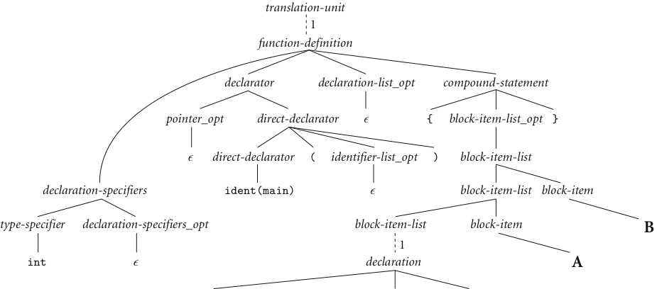
An Overview of Compilation
Context-Free Grammar and Parsing
GCD Program Parse Tree
B
A
Copyright © 2009 Elsevier
next slide

Slide 14
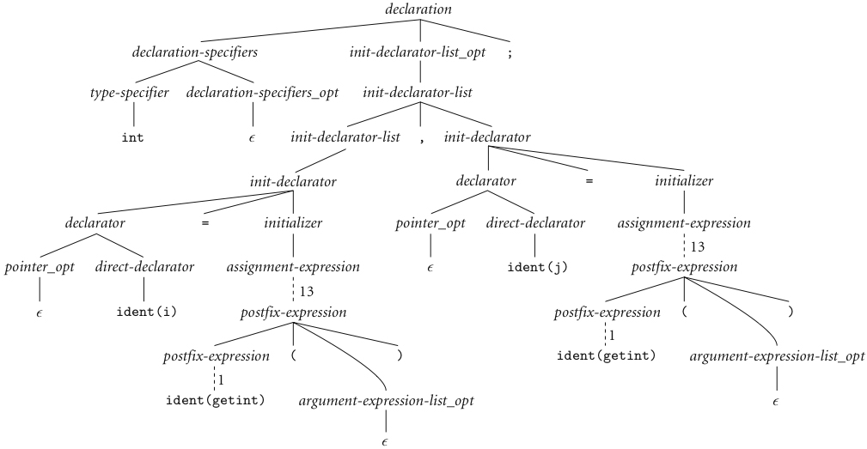
An Overview of Compilation
Context-Free Grammar and Parsing (continued)
Copyright © 2009 Elsevier

Slide 15
An Overview of Compilation
Context-Free Grammar and Parsing (continued)
A
B
Copyright © 2009 Elsevier

Slide 16
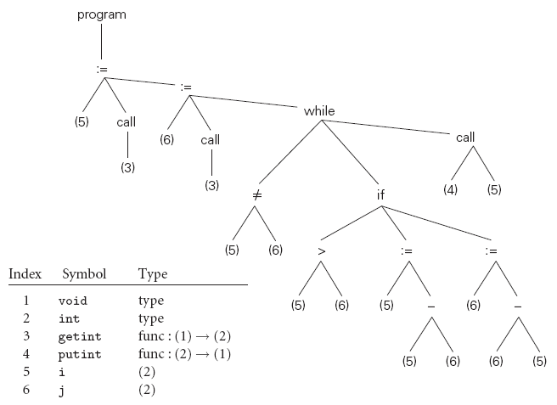
An Overview of Compilation
Syntax Tree
GCD Program Parse Tree
Copyright © 2009 Elsevier

