Slide 1
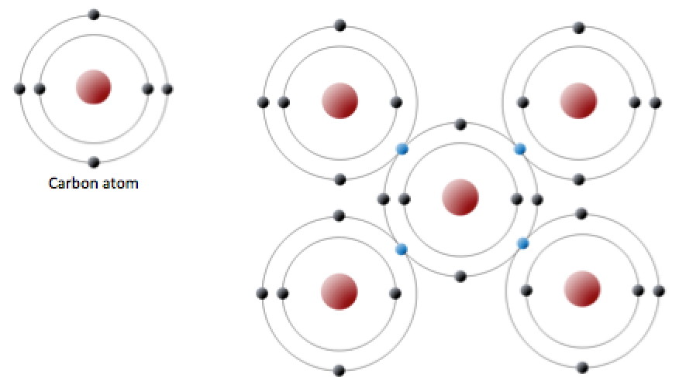
Carbon crystal -- insulator

Slide 2
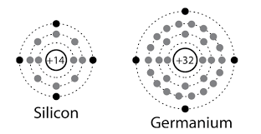
Silicon behaves similarly
14 total electrons
2 in the inner shell
8 in the middle shell
4 in the outer shell

Slide 3
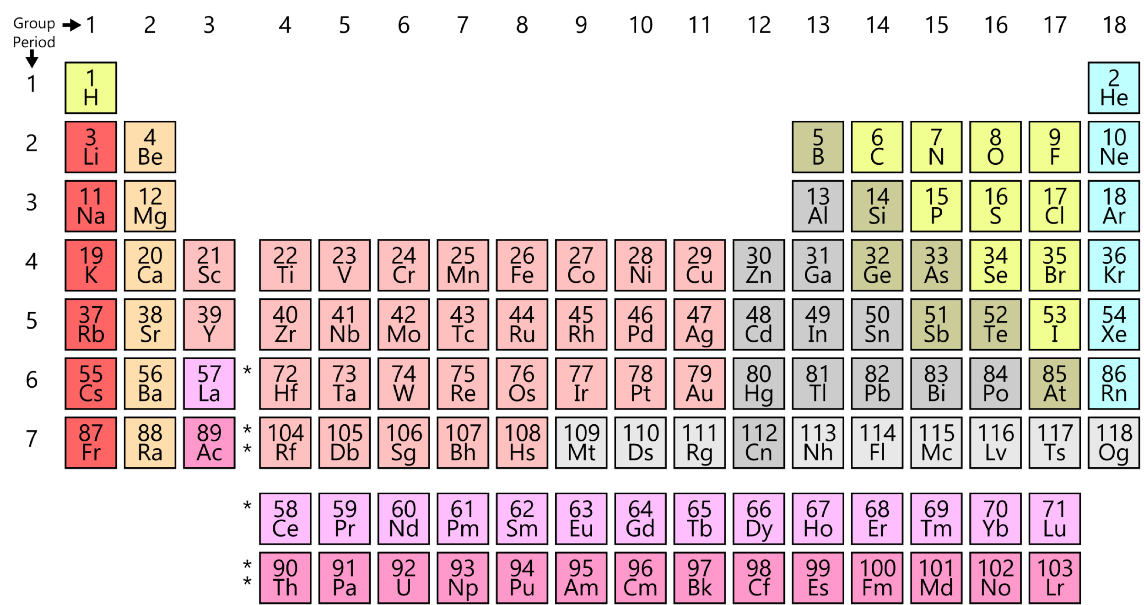
Boron and Phosphorous

Slide 4
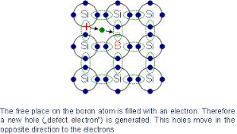
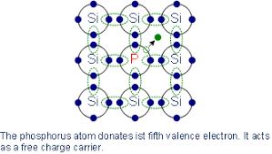
Doped Silicon

Slide 5
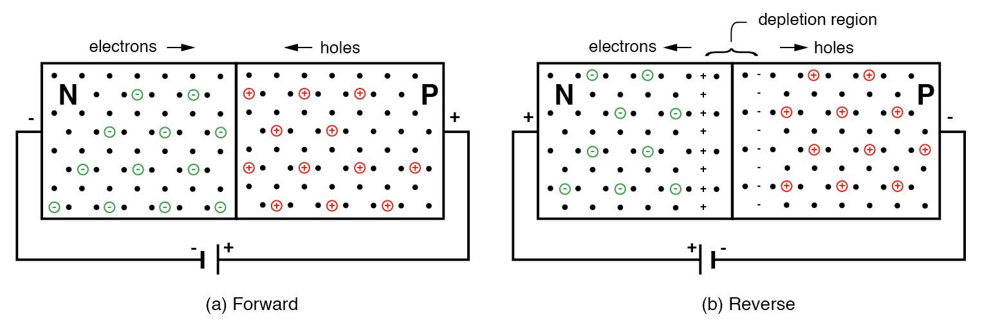
PN Junction (diode)

Slide 6
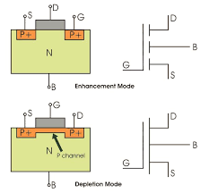

Slide 7
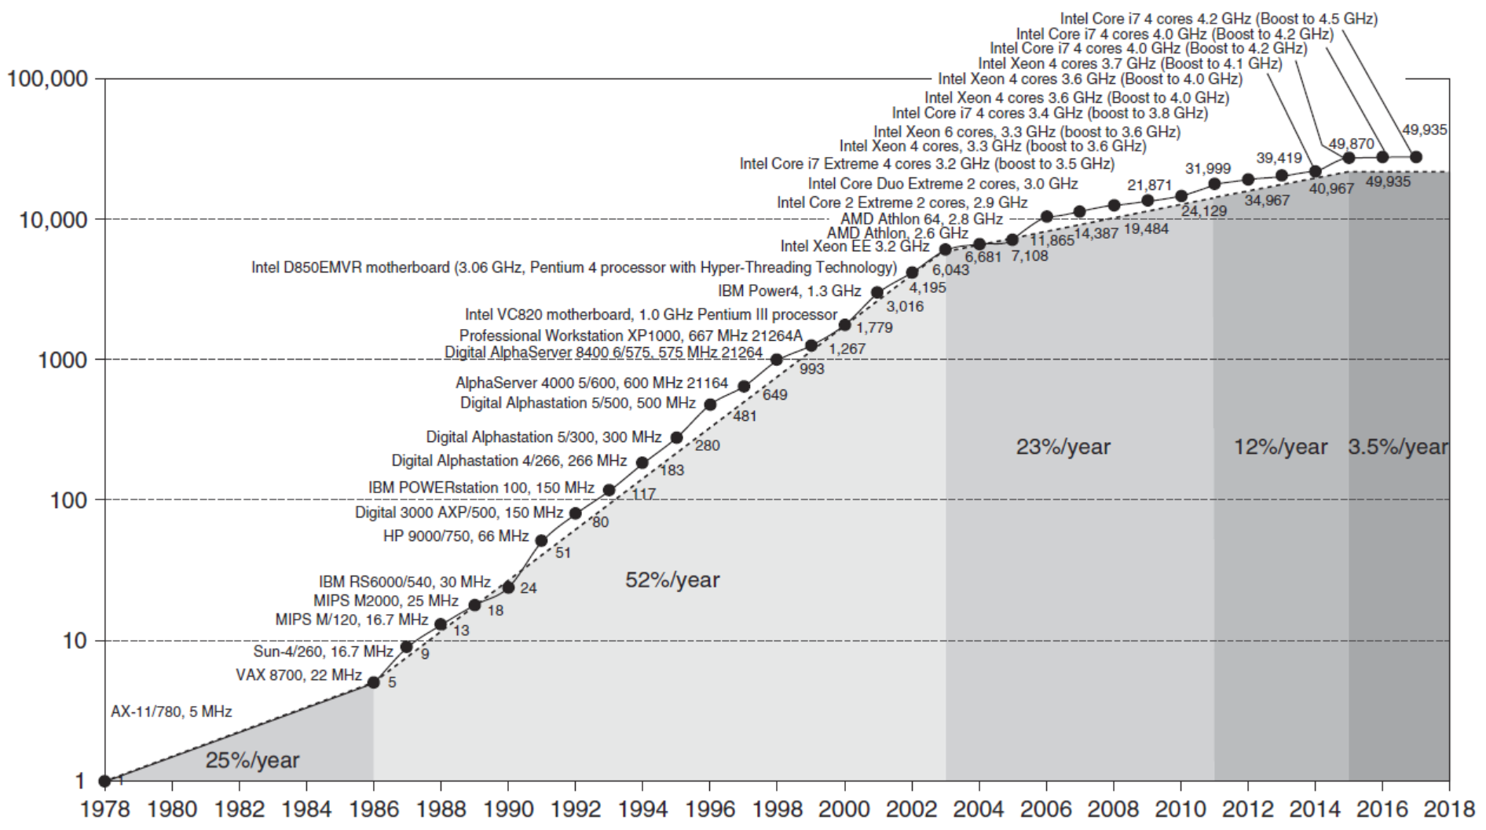
Single Processor Performance
Introduction

Slide 8
Sample DVFS
Example P-State Table
Voltage | Frequency
1.21 V | 2.8 GHz (HFM)
1.18 V | 2.4 GHz
1.05 V | 2.0 GHz
0.96 V | 1.6 GHz
0.93 V | 1.3 GHz
0.86 V | 900 MHz
0.80 V | 600 MHz (LFM)
https://en.wikichip.org/wiki/intel/frequency_behavior

Slide 9
Sample DVFS
Example P-State Table
Voltage | Frequency | Cost | Relative Cost | Time / CPU increase
1.21 V | 2.8 GHz (HFM) | 1.46 | 1.0 | 1.0
1.18 V | 2.4 GHz | 1.39 | 0.95 | 1.16
1.05 V | 2.0 GHz | 1.10 | 0.75 | 1.4
0.96 V | 1.6 GHz | 0.92 | 0.63 | 1.75
0.93 V | 1.3 GHz | 0.86 | 0.59 | 2.15
0.86 V | 900 MHz | 0.74 | 0.51 | 3.11
0.80 V | 600 MHz (LFM) | 0.64 | 0.43 | 4.66
https://en.wikichip.org/wiki/intel/frequency_behavior

Slide 10
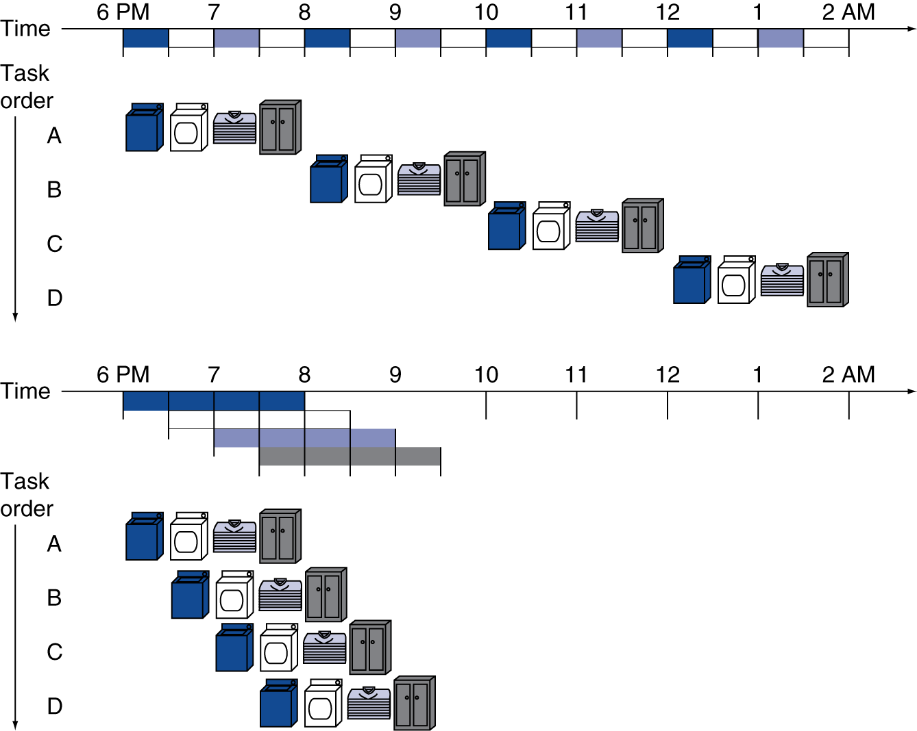
Pipelining Analogy
Pipelined laundry: overlapping execution
Parallelism improves performance

Slide 11
Single-Cycle vs. Pipelined Performance

Slide 12
Fallacies and Pitfalls
Microprocessors are a silver bullet
Performance is now a programmer’s burden
Falling prey to Amdahl’s Law
A single point of failure
Hardware enhancements that increase performance also improve energy efficiency, or are at worst energy neutral
Benchmarks remain valid indefinitely
Compiler optimizations target benchmarks

Slide 13
Fallacies and Pitfalls
The rated mean time to failure of disks is 1,200,000 hours or almost 140 years, so disks practically never fail
MTTF value from manufacturers assume regular replacement
Peak performance tracks observed performance
Fault detection can lower availability
Not all operations are needed for correct execution

