Slide 1
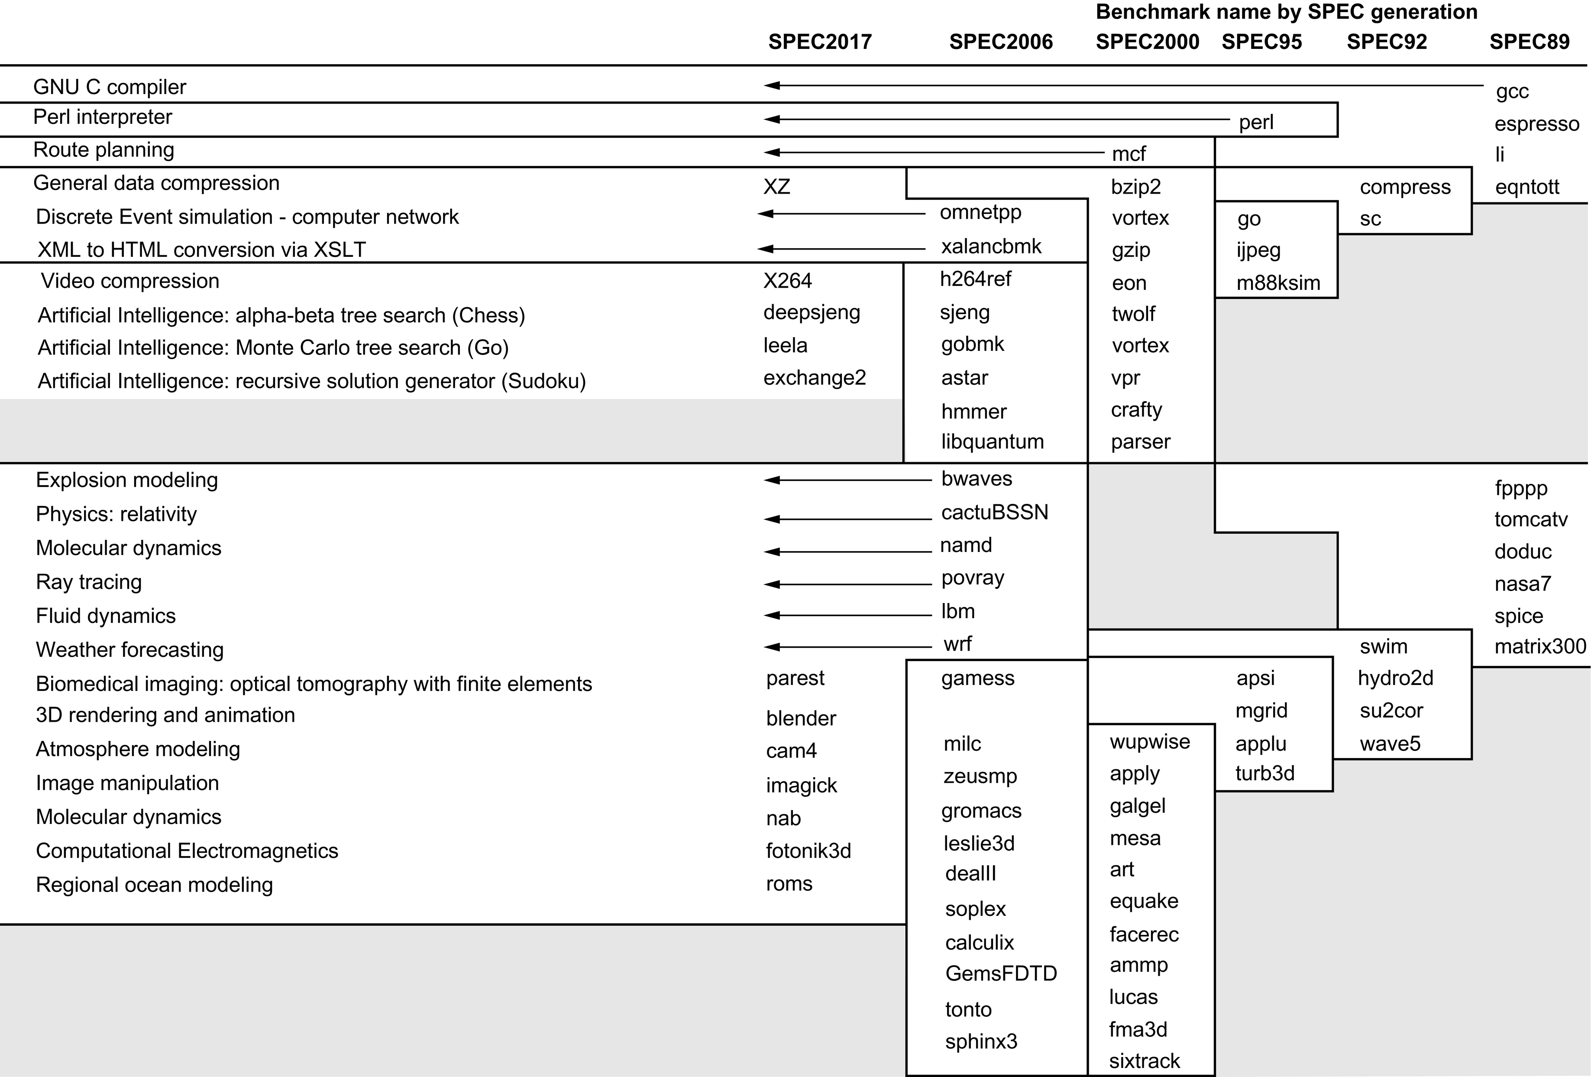
Figure 1.17 SPEC2017 programs and the evolution of the SPEC benchmarks over time, with integer programs above the line and floating-point programs below the line. Of the 10 SPEC2017 integer programs, 5 are written in C, 4 in C++., and 1 in Fortran. For the floating-point programs, the split is 3 in Fortran, 2 in C++, 2 in C, and 6 in mixed C, C++, and Fortran. The figure shows all 82 of the programs in the 1989, 1992, 1995, 2000, 2006, and 2017 releases. Gcc is the senior citizen of the group. Only 3 integer programs and 3 floating-point programs survived three or more generations. Although a few are carried over from generation to generation, the version of the program changes and either the input or the size of the benchmark is often expanded to increase its running time and to avoid perturbation in measurement or domination of the execution time by some factor other than CPU time. The benchmark descriptions on the left are for SPEC2017 only and do not apply to earlier versions. Programs in the same row from different generations of SPEC are generally not related; for example, fpppp is not a CFD code like bwaves.

Slide 2
SPEC CPU Benchmark
Programs used to measure performance
Supposedly typical of actual workload
Standard Performance Evaluation Corp (SPEC)
Develops benchmarks for CPU, I/O, Web, …
SPEC CPU2006
Elapsed time to execute a selection of programs
Negligible I/O, so focuses on CPU performance
Normalize relative to reference machine
Summarize as geometric mean of performance ratios
CINT2006 (integer) and CFP2006 (floating-point)

Slide 3
CINT2006 for Opteron X4 2356
Name | Description | IC×10⁹ | CPI | Tc (ns) | Exec time | Ref time | SPECratio
perl | Interpreted string processing | 2,118 | 0.75 | 0.40 | 637 | 9,777 | 15.3
bzip2 | Block-sorting compression | 2,389 | 0.85 | 0.40 | 817 | 9,650 | 11.8
gcc | GNU C Compiler | 1,050 | 1.72 | 0.47 | 24 | 8,050 | 11.1
mcf | Combinatorial optimization | 336 | 10.00 | 0.40 | 1,345 | 9,120 | 6.8
go | Go game (AI) | 1,658 | 1.09 | 0.40 | 721 | 10,490 | 14.6
hmmer | Search gene sequence | 2,783 | 0.80 | 0.40 | 890 | 9,330 | 10.5
sjeng | Chess game (AI) | 2,176 | 0.96 | 0.48 | 37 | 12,100 | 14.5
libquantum | Quantum computer simulation | 1,623 | 1.61 | 0.40 | 1,047 | 20,720 | 19.8
h264avc | Video compression | 3,102 | 0.80 | 0.40 | 993 | 22,130 | 22.3
omnetpp | Discrete event simulation | 587 | 2.94 | 0.40 | 690 | 6,250 | 9.1
astar | Games/path finding | 1,082 | 1.79 | 0.40 | 773 | 7,020 | 9.1
xalancbmk | XML parsing | 1,058 | 2.70 | 0.40 | 1,143 | 6,900 | 6.0
Geometric mean |  |  |  |  |  |  | 11.7
High cache miss rates

Slide 4
Single Cycle CPU (from Harris and Harris)

Slide 5
Element | Param | Delay
Register clock-to-Q | t_{pcq_PC} | 30
Register setup | t_{setup} | 20
Multiplexer | t_{mux} | 25
ALU | t_{ALU} | 200
Memory read | t_{mem} | 250
Register file read | t_{RFread} | 150
Register file setup | t_{RFsetup} | 20
Control Unit | t_{control} | 75
Single Cycle CPU (with component timings)

Slide 6
Multicycle Processor Control

