Slide 1
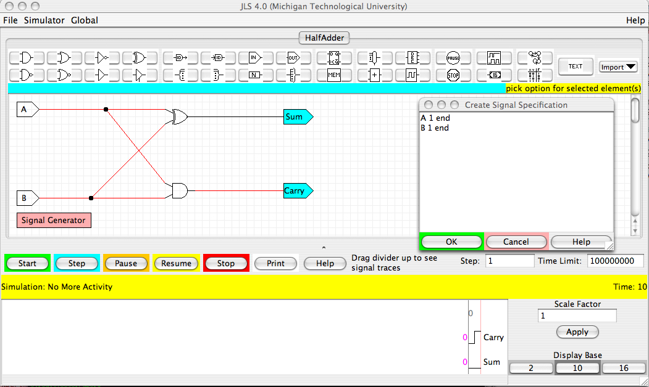


Automated Testing of Simulated Digital Circuits and CPUs Using JLSCircuitTester
Zachary Kurmas Grand Valley State University
What is JLSCircuitTester?
JLSCircuitTester helps automate the testing and grading of circuits built using digital logic simulators.
In particular it:
  provides a means for students and teachers to specify multiple sets of input values and the corresponding expected outputs, then
  automatically simulates the circuit under test using each of the input sets and reports any unexpected output values.
Why did we create JLSCircuitTester?
With many simulators, the testing and grading of circuits is tedious and time consuming enough that students do not test their circuits thoroughly. For example, with JLS:
Users must enter the
input values for each
test manually.
Motivation
Then manually verify
that the output is correct.
This process is tedious, therefore most students cut-corners and test their projects poorly.
Sample Test #1 (Half-adder)
Sample Output: Broken Circuit
BEGIN test1
INPUTS
A [0, 1]
B [0, 1]
OUTPUTS
Sum [0, 1, 1, 0 ]
Carry [0, 0, 0, 1 ]
Test name
(actually a group of 4 tests)
Prompt$ jlsCircuitTester SignedAdder_broken.jls testSignedAdder
jlsCircuitTester version 0.9.5.
Current build Sat Feb 16 15:44:45 EST 2008
Using kurmasUtil Wed Dec 19 14:35:16 EST 2007
Run "jlsCircuitTester --license" to see full license.
Errors detected for InputSet test2-0-0:
Name: "test2-0-0"
Time Limit: 100000000
Gate Delays:
Element Delays:
Inputs:
InputA: (time 0): [17, 0x11]
InputB: (time 0): [17, 0x11]
Memory:
Errors found:
Output at END is 0x23 (35), which differs from the expected 0x22 (34)
List of values that each
input pin should take
Expected output for
each input combination
This test format is useful when circuit under test is small, and outputs can be easily calculated and enumerated.
Sample Test #2 (Unsigned 16-bit adder)
OR
OR
OUTPUT_SET_TYPE UnsignedAdderOutputSet
NAMED_VALUE_LISTS
# The sum of any two smallPositive integers will not cause an overflow.
smallPositive [ 0, 1, 2, 3, 4, 5, 10, 15, 16, 17, 30000, 2^15 - 1 ]
allPositive [ smallPositive, 2^15, 2^15 + 1, 2^15 + 16385,
2^16 - 2, 2^16 -1 ]
# These tests should not produce any overflow
BEGIN no_overflow
INPUTS
InputA smallPositive
InputB smallPositive
CarryIn [ 0, 1 ]
# These tests may produce overflow.
BEGIN overflow
INPUTS
InputA allPositive
InputB allPositive
CarryIn [0, 1]
Use Java class to calculate
output for given inputs
Create and name
lists of numbers for
later reference
Sample Output: Success
smallPositive contains 12 numbers.
Thus, this is a set of 12*12*2 = 288 tests
Prompt$ jlsCircuitTester SignedAdder.jls testSignedAdder
jlsCircuitTester version 0.9.5.
Current build Sat Feb 16 15:44:45 EST 2008
Using kurmasUtil Wed Dec 19 14:35:16 EST 2007
Run "jlsCircuitTester --license" to see full license.
All 4 tests passed
This test format is useful when there is a large number of tests, or It would be difficult to correctly compute the output.
What happened when we used JLSCircuitTester?
Students submitted projects with fewer mistakes
  Major mistakes down 50% during pilot semester
Assumed benefit: Students who take time to find and correct more mistakes not only receive better grades, but also have an opportunity to discover and correct misunderstandings about the construction of the circuits or CPU they are building.
Additional features
Ability to specify sets of input values using
  Wildcards (e.g., 101????00 )
  Ranges (all values from 0 to 127)
  “Corner cases” (e.g., 0, 1, 2, 3 4, 5, 7,8,9, 15, 16, 17, 31, 32, 33)
  Random values
Support for testing MIPS-like CPUs (e.g., those presented in the Patterson and Hennessy text) using assembly code as input.
What are our future plans with JLSCircuitTester?
Prepare assignments (including sample circuits and tests) to complement additional textbooks.
Add support for several additional compatible simulators. Compatible simulators must:
  Present a Java API, or
  Have a batch mode that can be reasonably parsed.

