Slide 1
Generating Synthetic Workloads Using Iterative Distillation
Zachary Kurmas – Georgia Tech
Kimberly Keeton – HP Labs
Kenneth Mackenzie – Reservoir Labs

Slide 2
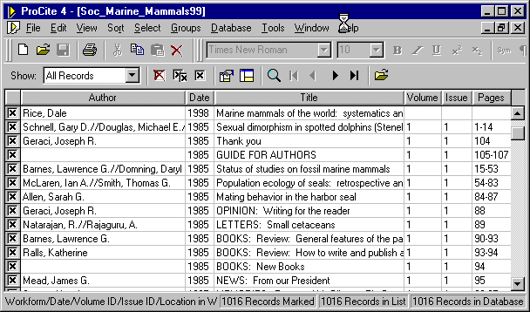


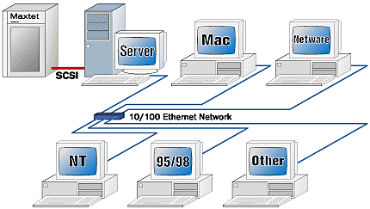
Storage system hardware / configuration decisions must be evaluated with respect to many workloads.
% I/Os
Database workload
seconds
% I/Os
Email server workload
seconds
Workloads
% I/Os
New disk array
File server workload
seconds
Example Workloads
Performance
(CDF of latency)
Changes may be beneficial to some users and detrimental to others.
Notes:
When you come up with a great, new idea for a disk array, you need to test it against many different workloads; because, what works well for a Database or an Email server may not work well for a file system

Slide 3


Two sources for evaluation workloads
Trace of real workloads
List of I/O requests made by production workload
Large
Inflexible
Difficult to obtain (due to security concerns)
Perfectly accurate
Synthetic workloads
Randomly generated to maintain high-level properties
Compact representation
Easily modified
Compact representation contains no specific data
Rarely accurate
Notes:
There are two main sources for these evaluation workloads: First, we can go out, watch what a disk array does in the real world, and have our new array do the same thing. Second, we can just make up things for our disk array to do. Traces are large and inflexible. The are a complete list of what happened in the past, and cannot easily represent the future. They are also hard to obtain, because people are afraid you will glean sensitive information from them. Synthetic workloads don’t have these problems, but they are very inaccurate

Slide 4
Goal: Make production and synthetic workloads interchangeable
Production Workload
Synthetic Workload
Attribute-values
(R,1024,120932,124)
(W,8192,120834,126)
(W,8192,120844,127)
(R,2048,334321,131)
(R,1024,120932,124)
(W,8192,120834,126)
(W,8192,120844,127)
(R,2048,334321,131)
(R,1024,120932,124)
(W,8192,120834,126)
(W,8192,120844,127)
(R,2048,334321,131)
...
Mean Request Size: 8Kb
(R,1024,120932,124)
(W,8192,120834,126)
(W,8192,120844,127)
(R,2048,334321,131)
(R,1024,120932,124)
(W,8192,120834,126)
(W,8192,120844,127)
(R,2048,334321,131)
(R,1024,120932,124)
(W,8192,120834,126)
(W,8192,120844,127)
(R,2048,334321,131)
...
Mean interarrival Time: .04ms
Read Percentage: 78%
Location Distribution:
(.01,.02,.0,.09,.14, .03,.12,…
…
$64,000 question:
What goes in here?

Slide 5
Related work
Literature contains many attributes and synthesis techniques
  Entropy / “fractalness” (Wang et. al)
  Entropy and locality (PQRS) (Wang et. al)
  Clustering (Hong and Madhyastha)
  LRU stack distance (several sources)

Slide 6
Solution: The Distiller
Input:
  Workload trace
  List of candidate attributes
Output: Attributes that specify synthetic workload
Features:
  Automatic: Requires little or no human intervention
  Helps direct search for new attributes when necessary

Slide 7
High level (iterative) approach
Evaluate resulting
synthetic workload
Initial
attribute list
Evaluate resulting
synthetic workload
Initial
attribute list
Add new
attribute to list
Add new
attribute to list
Attribute-value List
Within
threshold?
Within
threshold?
Yes
CDF of Response Time
No
Done
Choose additional
attribute
Choose additional
attribute
Library of
attributes

Slide 8
Example execution
Workload
  Trace of OpenMail Email server
  19,769 I/Os over 900 seconds (22 per second)
  Throughput 164 KB/s
Disk Array
  HP FC-60
  30 disks (18 GB each) 500GB total
  256 MB NVRAM write-back cache

Slide 9
Initial attributes
Initial
Attribute List
Evaluate
Synthetic Workload
Add new
attribute to List
Within
Threshold?
Yes
Library of
Attributes
No
Done
Choose additional
Attribute
Block-level I/O workload comprises I/O requests.
Each request has four parameters.
Initial attributes: observed distribution of each parameter.
  Implicit dists. Inaccurate
Open workload model
R/W
Size
Location
Time
(R,
1024,
42912
,
10)
(W,
8192,
12493
,
12)
(W,
2048,
20938
,
15)
(R,
2048,
43943
,
22)
(W
8192,
98238
,
23)
(W
8192,
76232
,
24)
bytes
sectors
ms

Slide 10
Evaluate synthetic workload
Initial
Attribute List
Evaluate
Synthetic Workload
Add new
attribute to List
Within
Threshold?
Yes
Library of
Attributes
No
Done
Choose additional
Attribute
Production Workload
Synthetic Workload
Attribute-values
(R,1024,120932,124)
(W,8192,120834,126)
(W,8192,120844,127)
(R,2048,334321,131)
(R,1024,120932,124)
(W,8192,120834,126)
(W,8192,120844,127)
(R,2048,334321,131)
(R,1024,120932,124)
(W,8192,120834,126)
(W,8192,120844,127)
(R,2048,334321,131)
...
Mean Request Size: 8Kb
(R,1024,120932,124)
(W,8192,120834,126)
(W,8192,120844,127)
(R,2048,334321,131)
(R,1024,120932,124)
(W,8192,120834,126)
(W,8192,120844,127)
(R,2048,334321,131)
(R,1024,120932,124)
(W,8192,120834,126)
(W,8192,120844,127)
(R,2048,334321,131)
...
Mean interarrival Time: .04ms
Read Percentage: 78%
Location Distribution:
(.01,.02,.0,.09,.14, .03,.12,…
…
CDF of response time latency
Similarity quantified using RMS of horizontal distance

Slide 11
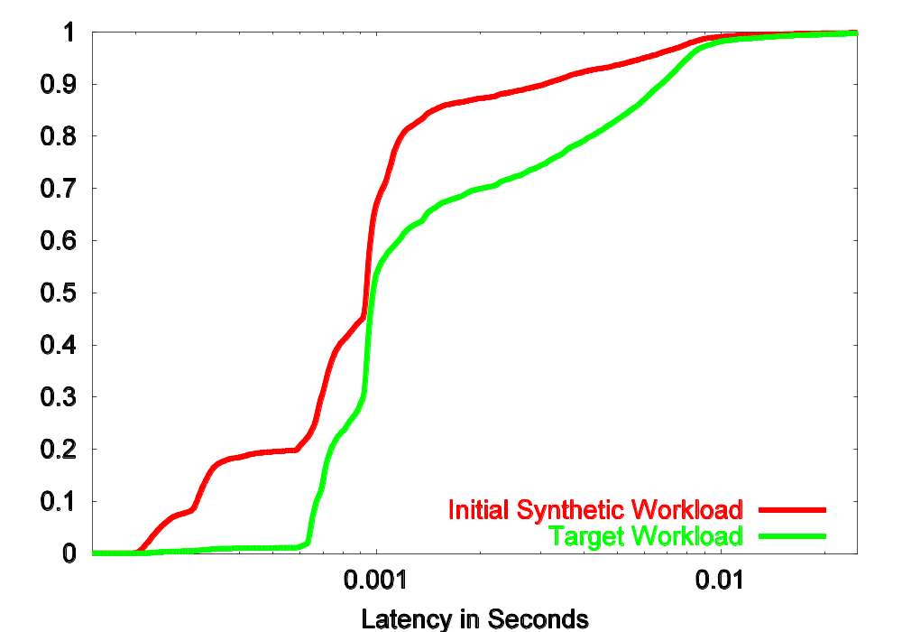
Initial State
Initial
Attribute List
Evaluate
Synthetic Workload
Add new
attribute to List
Within
Threshold?
Yes
Library of
Attributes
No
Done
Choose additional
Attribute
RMS Error: 65%
% of I/Os
Note log scale on x axis

Slide 12
Independent of evaluation method
Initial
Attribute List
Evaluate
Synthetic Workload
Add new
attribute to List
Within
Threshold?
Yes
Library of
Attributes
No
Done
Choose additional
Attribute
Can measure any disk array behavior
  Power consumption
  Cache hit ratio
Can use any comparison metric
  Root-mean-square
  Mean response time
  Area between curves
  Area between curves on log scale

Slide 13
How to choose attribute?
Initial
Attribute List
Evaluate
Synthetic Workload
Add new
attribute to List
Within
Threshold?
Yes
Library of
Attributes
No
Done
Choose additional
Attribute
Choose attribute group
Problem
  Many attributes not useful
  Some attributes redundant or incompatible
  Testing every attribute slow
Solution
  Partition attributes into groups
  Estimate benefit of entire group
  Choose attribute from most promising group
Initial
attribute list
Evaluate
synthetic workload
Add new
attribute to list
Within
threshold?
Yes
Library of
attributes
No
Done
Choose additional
attribute
Choose attribute group

Slide 14
Attribute groups
Initial
Attribute List
Evaluate
Synthetic Workload
Add new
attribute to List
Within
Threshold?
Yes
Library of
Attributes
No
Done
Choose additional
Attribute
Choose attribute group
Location, Request Size
Joint Dist.
Req. size conditioned upon chosen location
Location
Dist. of location
LRU stack distance
Jump Distance
Run Count
Location
Location, Op. Type
Dist. of read locations
Dist. of write locations
Joint Dist.
Op.
Type
Size
Op Type
Read Pct •Markov model
Request Size
Dist. of request size
Markov model
Op Type, Arrival Time
Arrival Time
Op Type, Arrival Time, Req. Size
Arrival Time
Distribution of interarrival time
Markov model of interarrival time
Clustering
Request Size, Arrival Time

Slide 15
Key ideas
Initial
Attribute List
Evaluate
Synthetic Workload
Add new
attribute to List
Within
Threshold?
Yes
Library of
Attributes
No
Done
Choose additional
Attribute
Choose attribute group
Attributes within the same group describe similar relationships
  Arrival time ➔ Burstiness
  Location ➔ Locality
  {Arrival time, Location} ➔ relationship between locality and burstiness
We can test effects of a relationship by “subtracting” it from target workload.

Slide 16
Subtractive method
Initial
Attribute List
Evaluate
Synthetic Workload
Add new
attribute to List
Within
Threshold?
Yes
Library of
Attributes
No
Done
Choose additional
Attribute
Choose attribute group
Rotating locations breaks only relationships between location and other parameters
Permuting the locations destroys all relationships involving location
(W, 1024, 334321, .111 )
(R, 8192, 120850, .126 )
(R, 8192, 201223, .127 )
(W, 2048, 120842, .131 )
(W, 1024, 120858, .137 )
(R, 8192, 195932, .143 )
(R, 8192, 120834, .144 )
(W, 1024, , .111 )
(R, 8192, , .126 )
(R, 8192, 120842, .127 )
(W, 2048, 334321, .131 )
(W, 1024, 195932, .137 )
(R, 8192, 120850, .143 )
(R, 8192, 120858, .144 )
334321,
201223,
120834,
120842,
334321,
195932,
120850,
120858,
201223,
120834,
120842,
334321,
195932,
120850,
120858,
120850,
201223,
120834,
120842,
334321,
195932,
120850,
120858,
201223,
120842,
120858,
201223,
195932,
Difference in performance is estimate of effect of location attributes
Workloads maintain same relationships except location

Slide 17
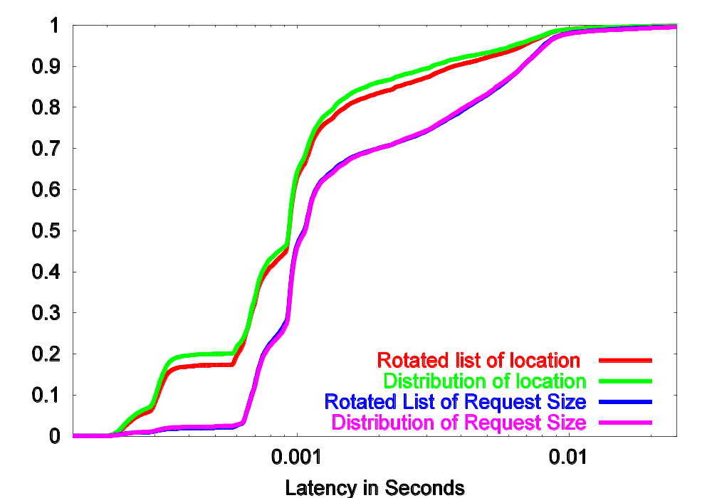
Subtractive method
Initial
Attribute List
Evaluate
Synthetic Workload
Add new
attribute to List
Within
Threshold?
Yes
Library of
Attributes
No
Done
Choose additional
Attribute
Choose attribute group
RMS difference for location: 15%
% of I/Os
RMS difference for request size: 8%

Slide 18
Evaluate individual attribute
Initial
Attribute List
Evaluate
Synthetic Workload
Add new
attribute to List
Within
Threshold?
Yes
Library of
Attributes
No
Done
Choose additional
Attribute
Choose attribute group
To test specific location attribute, generate synthetic workload using that attribute, and compare it to “rotated” location workload.
(W, 1024, 334321, .111 )
(R, 8192, 120850, .126 )
(R, 8192, 201223, .127 )
(W, 2048, 120842, .131 )
(W, 1024, 120858, .137 )
(R, 8192, 195932, .143 )
(R, 8192, 120834, .144 )
195932,
334321,
120834,
120842,
334321,
120850,
120858,
(W, 1024, , .111 )
(R, 8192, , .126 )
(R, 8192, 120842, .127 )
(W, 2048, 334321, .131 )
(W, 1024, 195932, .137 )
(R, 8192, 120850, .143 )
(R, 8192, 120858, .144 )
201223,
120834,
120842,
334321,
195932,
120850,
120858,
Location generated by attribute that measures runs. (Runs preserved, other locs random.)
Compare with “rotated” workload because relationships with other parameters still broken

Slide 19
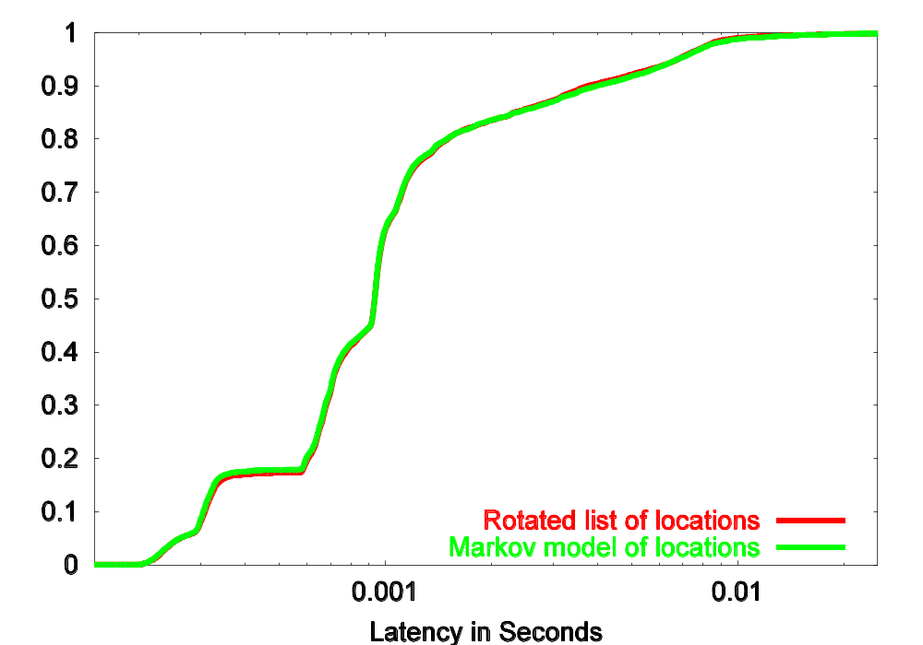
Improved location
Initial
Attribute List
Evaluate
Synthetic Workload
Add new
attribute to List
Within
Threshold?
Yes
Library of
Attributes
No
Done
Choose additional
Attribute
Choose attribute group
RMS Error: 6%
Markov model of location produces representative sequence of locations
% of I/Os

Slide 20
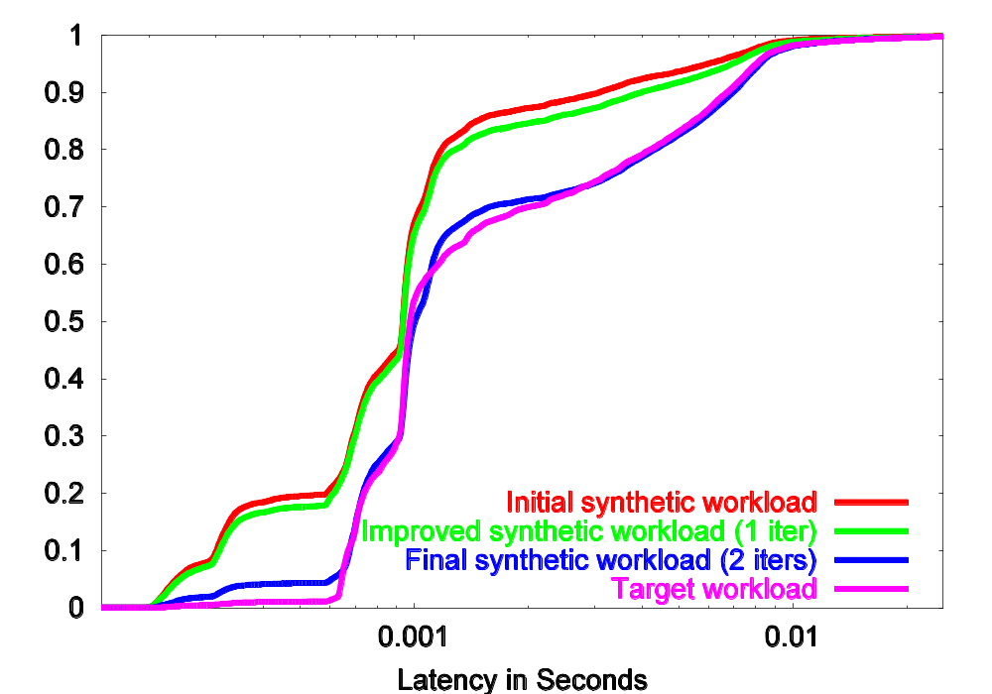
Final result
Initial
Attribute List
Evaluate
Synthetic Workload
Add new
attribute to List
Within
Threshold?
Yes
Library of
Attributes
No
Done
Choose additional
Attribute
Choose attribute group
% of I/Os

Slide 21
Experiments
Used Distiller to find synthetic versions of:
  OpenMail: (10% error)
  TPC-C: (8% error)
  TPC-H: (12% error)
  artificial workloads: (2% to 12% error)
Artificial workloads used to
  “stress test” the Distiller
  Test Distiller apart from its library

Slide 22
Future work
Test synthetic workloads against real design decisions (e.g. prefetch length)
Evaluate different methods for selecting specific attributes (e.g. first-fit vs. best-fit)
Evaluate tradeoff between size of synthetic workload descriptions and accuracy of resulting synthetic workload
Incorporate closed workload model
  Evaluate from application perspective
Automatically develop new attributes
  Genetic and/or data mining techniques

Slide 23
Conclusions
Distiller is able to specify accurate synthetic workloads
  Needs little human intervention
  Provides framework for new attributes
  Helps direct development of new attributes
Zack Kurmas
kurmasz@cc.gatech.edu
http://www.cc.gatech.edu/~kurmasz

Slide 24
End Of Talk

Slide 25
To Note:
Anything that is not clear
Any time I belabor a point
  i.e. If you start thinking “move on already”, make a note of it.
Anytime I talk about an issue that is perfectly obvious, or completely irrelevant.
  i.e. If you get bored, make a note of where.

Slide 26
Goal: Make production workload trace and
synthetic workload interchangeable
Production Workload
Synthetic Workload
Best of both worlds
(R,1024,120932,124)
(W,8192,120834,126)
(W,8192,120844,127)
(R,2048,334321,131)
(R,1024,120932,124)
(W,8192,120834,126)
(W,8192,120844,127)
(R,2048,334321,131)
(R,1024,120932,124)
(W,8192,120834,126)
(W,8192,120844,127)
(R,2048,334321,131)
...
(R,1024,120932,124)
(W,8192,120834,126)
(W,8192,120844,127)
(R,2048,334321,131)
(R,1024,120932,124)
(W,8192,120834,126)
(W,8192,120844,127)
(R,2048,334321,131)
(R,1024,120932,124)
(W,8192,120834,126)
(W,8192,120844,127)
(R,2048,334321,131)
...
Specific Goal:
Both workloads have similar response times
General Goal:
Both workloads should lead to similar design decisions

Slide 27
Iterative approach (version 2)
Production Workload
Attribute-value List
Synthetic Workload
(R,1024,120932,124)
(W,8192,120834,126)
(W,8192,120844,127)
(R,2048,334321,131
...
(R,1024,120932,124)
(W,8192,120834,126)
(W,8192,120844,127)
(R,2048,334321,131
...
CDF of Response Time

Slide 28
Initial attributes (old)
Initial
Attribute List
Evaluate
Synthetic Workload
Add new
attribute to List
Within
Threshold?
Yes
Library of
Attributes
No
Done
Choose additional
Attribute
All parameter values drawn independently at random from observed distribution
  Read / write percentage
  Observed distribution of request size
  Observed distribution of location
  Observed distribution of interarrival time
Observed distributions are as simple as possible without using implicit distributions
  Experience shows implicit distributions are incorrect
  It doesn’t take that may bits to do it correctly

Slide 29
Attribute groups
Initial
Attribute List
Evaluate
Synthetic Workload
Add new
attribute to List
Within
Threshold?
Yes
Library of
Attributes
No
Done
Choose additional
Attribute
Choose attribute group
Attributes measure one or more parameters
  Mean Request Size Request Size
  Distribution of Location Location
  Burstiness Interarrival Time
  Request Size
  Read/Write
Attributes grouped by parameter(s) measured
  Location = {mean location, distribution of location, locality, mean jump distance*, mean run length*, ...}
  Arrival Time = {mean interarrival time, Markov model of interarrival time, Hurst parameter, etc. }
Distribution of Read Size

Slide 30
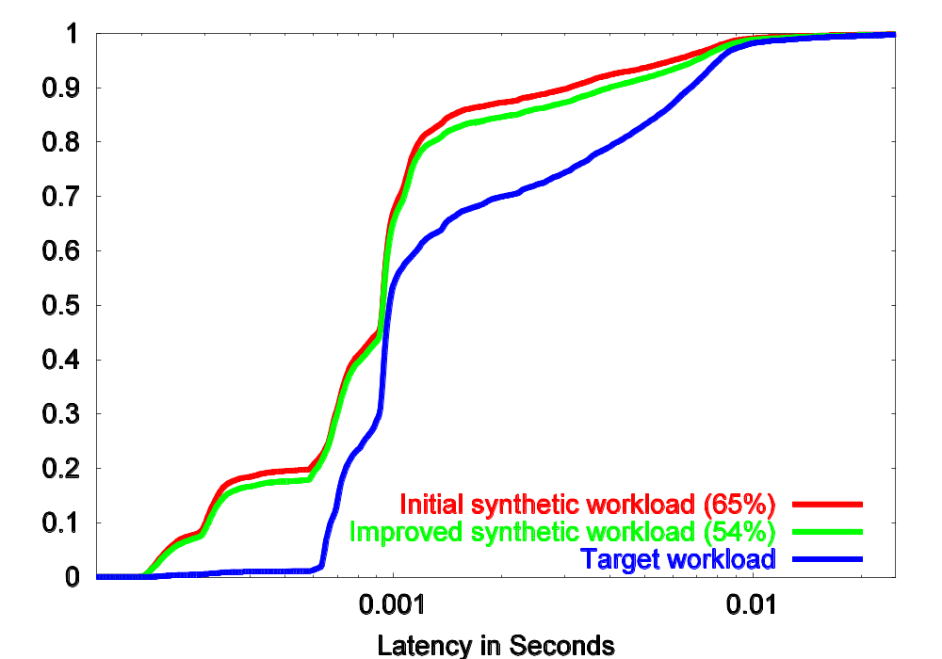
Improved synthetic workload
% of I/Os
Improvement small, but in proportion to total location error.

Slide 31
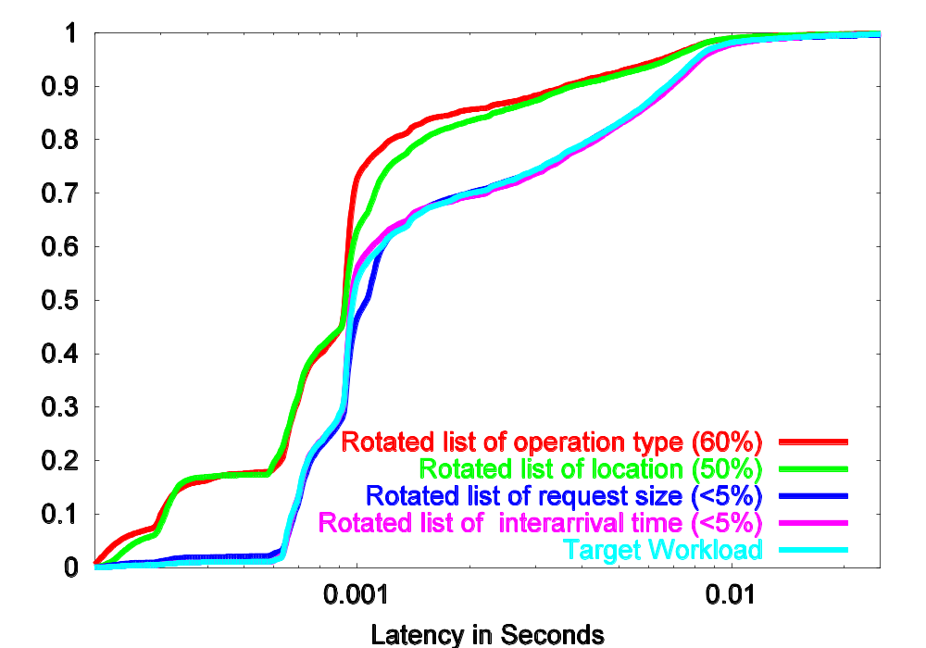
Subtractive method – iteration 2
Only location and operation type have important inter-parameter relationships
% of I/Os

Slide 32
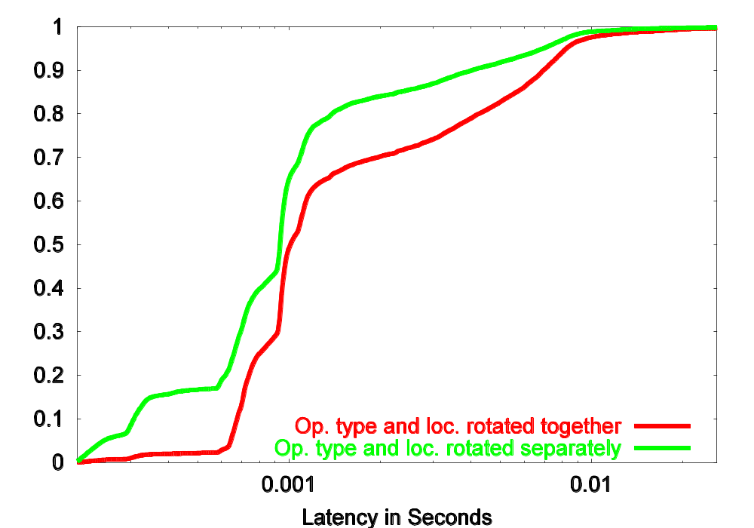
Test relationship between location and op. type
% of I/Os
Differences similar to differences between target and initial synthetic workloads
Differences similar to differences between target and initial synthetic workloads

Slide 33
Key observations
Initial
Attribute List
Evaluate
Synthetic Workload
Add new
attribute to List
Within
Threshold?
Yes
Library of
Attributes
No
Done
Choose additional
Attribute
Choose attribute group
Workload performance determined by
  Relationships between different requests
  relationships between a single request’s parameters
Attributes within the same group describe similar relationships
We can test effects of a relationship by “subtracting” it from target workload.
(Op Size Location Time)
(W, 1024, 201223, .111 )
(R, 8192, 120834, .126 )
(R, 8192, 120842, .127 )
(W, 2048, 334321, .131 )
(W, 1024, 195932, .137 )
(R, 8192, 120850, .143 )
(R, 8192, 120858, .144 )
Patterns between locations may produce locality
Patterns between arrival times may produce burstiness
Patterns between location and arrival time may offset burstiness

Slide 34
Contributions
  More workloads available to storage researchers
    Companies more likely to release synthetic workloads.
    Synthetic workloads may allow for hypothetical studies
  Framework for new attributes / generation techniques

