Slide 1
Network Attached Tape Drive
Zachary Kurmas
Quantum Corporation

Slide 2
What I did for Summer Vacation
Complained about Hardware
Complained about IS
Made a mess out of my cube
Made a mess out of Geoff’s cube
Tore apart Ross’s and Satish’s computers
Strung wires all over the place for no obvious reason

Slide 3
What I did for Summer Vacation
Investigated concept of Network Attached Tape Drive
  How to integrate easily with legacy systems
  How to stream tape under ordinary conditions
  What hardware is necessary or useful
  Expected performance
Notes:
This is industry. Must be marketable. Thus,
Must be “backward compatible”
Must give us an advantage we don’t already have.
How do we do this?

Slide 4
tar
tar cbf 256 /dev/nst0 /usr/data/zack
  Backs up /usr/data/zack to the local tape drive writing blocks of 256*512bytes = 128KB
  /dev/nst0 can be any file (e.g. /usr/backup/zack.September.tar)
  To write to other machines, tar uses rmt
  rmt allows file to be on any system
    tar cbf 256 gpeck2:/backups/zack /usr/data/zack

Slide 5
Interleaving on Tape
Write: Interleave data streams, surround “packets” with metadata (like the Internet)
Read: Deliver data from appropriate “packets” to client backup program
aaaaaaa
Streamer
MaaM
MbbM
MccM
MaaM
MccM
bbbbbbb
cccccccc
Notes:
DLT 7000 and Super DLT will be faster than all but the most optimized hard
Disks. Thus, we want to give the drive something to do while it waits on a client.
That thing would be back up other clients.
Naively, Each client has its own backup program which sends a stream of data to the
Streamer. Streamer interleaves data and surrounds it with metadata (like a
network). A restore works by having the streamer regenerate the stream to
the client’s original restore program.

Slide 6
Metadata
Struct header
  {
    uuid bfid; Unique Id for data stream
    int logical_block; Block # from client’s view
    int physical block; Physical location on tape
    int client_block_size; e.g. tar -b256
    int streamer_block_size; “packet” size
    int version; Used if client “backs up”
    char end_of_bitfile;
  };
Notes:
This works for only the most basic backup that sends data only once, and with
regular block size. A more robust system will allow for “backing up”
(which is why we have the version number), and different block sizes (which we
would put in a trailer).

Slide 7
Current rmt
Client (tar, rdump)
  Open two pipes
  fork();
  In child, dup() stdin/stdout to pipes
  exec(“rsh client /etc/rmt”);
  write(pipe, “O /dev/tape”);
  write(pipe, “W size”);
  fill buffer
  write (pipe, buffer, size);
Current rmt
  read(stdin, cmd);
  switch(cmd[0])
  case ‘O’:
    fp = open(cmd[2]);
    break;
  case ‘W’:
    read(stdin, buf, cmd[2]);
    write(fp, buf, cmd[2]);
tar
tar
rmt
rsh
Notes:
We want many clients writing to the tape at once, but only one process can
open tape at once, Therefore, we modified rmt as follows:

Slide 8
New rmt
while (!quit) {
  read(stdin, cmd);
  switch(cmd[0])
  case ‘O’:
    setup_shm(); break;
  case ‘W’:
    buf = get_fill();
    read(stdin, shm[buf], cmd[2]);
    send_full(buff, metadata);
    break;
  }
NATD
newRMT
shm[0]
streamer
shm[1]
newRMT
shm[2]
shm[3]
newRMT
shm[4]
shm[5]
newRMT
shm[N]
newRMT
newRMT
mesg[0]
mesg[1]

Slide 9
Streamer
NATD
setup_shm(create);
for x = 1 to n
  send_fill(n);
while (1) {
  get_full(buf, metadta);
  writev(tape, metadta, shm[buf], size);
  send_fill(buf);
}
newRMT
shm[0]
streamer
shm[1]
newRMT
shm[2]
shm[3]
newRMT
shm[4]
shm[5]
newRMT
shm[N]
newRMT
newRMT
mesg[0]
mesg[1]

Slide 10
Client View
tar cbf 8192 drive:bfid0123456789ABC/key stuff
  UUIDs are 128 bits: 8 bits/char = 16 chars
  -b8192: Determines the write size used by streamer (size of the shared memory buffers)
  key: Authentication string (not implemented in prototype)
  drive:bfid/key: Determined by rmtMount command, rmtd, and bitfile system (bfs)
Notes:
Currently a 16 character string, but there are some considerations with
whitespace and other delimiting characters.
Block size issue not necessarily cut and dry. Implementation of TCP may
dictate a better block size.
Now, you may ask how a user is supposed to come up with such a bfid, ...

Slide 11
rmtMount
rmtMount -w -k key -h rmtd backup1
  -w = write
  -k is a key for authentication
  -h is the host that runs the rmt daemon
  backup1 is the “human readable” name of backup

Slide 12
Full System
Tar cbf 8192 `rmtMount -w -k key -h rmtd backup1` /stuff
Client
RMTD
Library
rmtMount
tar
newRMT
Streamer
MM
rmtd
bfs
bfid1 l:p l:p
VTA
bfid1 file1
bfid2 file2
bfid1 tape1 tape2 tape4 tape5
bfid2 tape1 tape3 tape4 tape7
drive1
drive2

Slide 13
BFS Read Sequence
Get message from rmtd
  i.e. LOAD R bfid key client
Consult database for bfid ⇒ tapid mapping
Ask VTA to choose a tape drive
  Once a tape drive is chosen, the bfs will block until that tape drive is free
    (A tape drive may only serve one client at a time while reading.)
Ask IEEE Media Manager (MM) to load tape
Launch streamer on tape drive, if necessary
Open a socket to streamer, and send GET command
Wait for data on socket and process that data (e.g. tape full messages)

Slide 14
BFS Write Sequence
Get message from rmtd
  i.e. LOAD W bfid key client
Assign valid bfid
Ask VTA to assign a tape drive
If tape drive is idle,
  Have MM choose and load a new blank tape
  Launch streamer
If tape drive is running and interleaving writes from several clients,
  Return uuid of tape onto which the data will be streamed
Open a socket to streamer and send ACCEPT command
Write new bfid ⇒ tapeid mapping to database
Send bfid/key message to rmtd
Wait for data on socket and process that data (e.g. tape full)

Slide 15
DLT 7000 Speed Test
Filled a 128KB buffer with random data
  (or first 128KB of the Ethernet-HOWTO to measure speed of writing text)
Wrote buffer 8192 times (1GB total)
Data sent from remote machine to local machine over 100Mb/s Ethernet.
  Old rmt requires block size of < 128KB
  New rmt/streamer can use 4MB

Slide 16
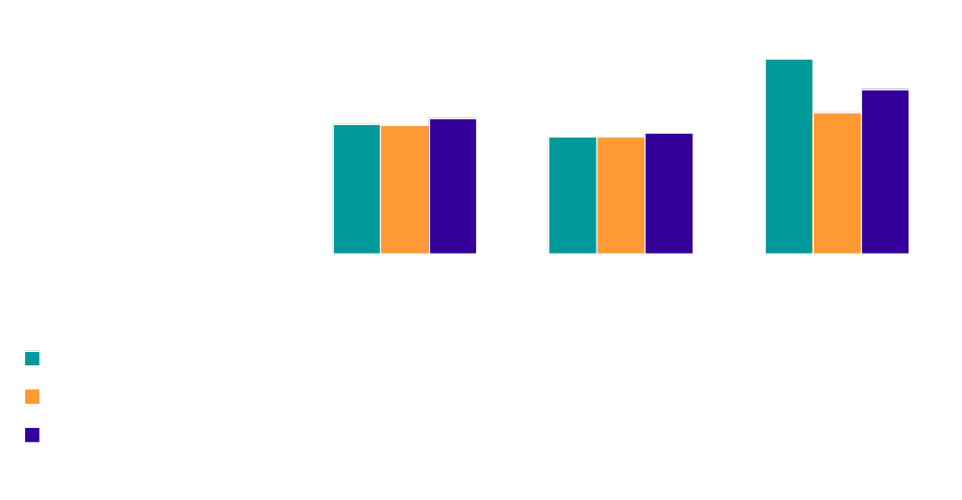
Speed of DLT7000 (MB/s)
*Data written from memory: No disk or file system overhead
*All experiments with random data made tape stream

Slide 17
Interpretation of Results
DLT7000 streams random data at about 4.85MB/s
No network bottleneck, 100MB/s Ethernet faster than tape drive
Speed of writing text to to tape using rmt is slow because of the 128KB block limit
  Speed of sending random data to /dev/null in 128K chunks: 6.02MB/s. This is an upper bound on speed to tape

Slide 18
Test Setup
Clients
gpeck
k6-200
2
3
hub
Network Tape Drive
ibm
P-Pro 200
*
vx
k6-166
vx
vy
hub
spot
Origin 2000
*Ibm occasionally switched hubs

Slide 19
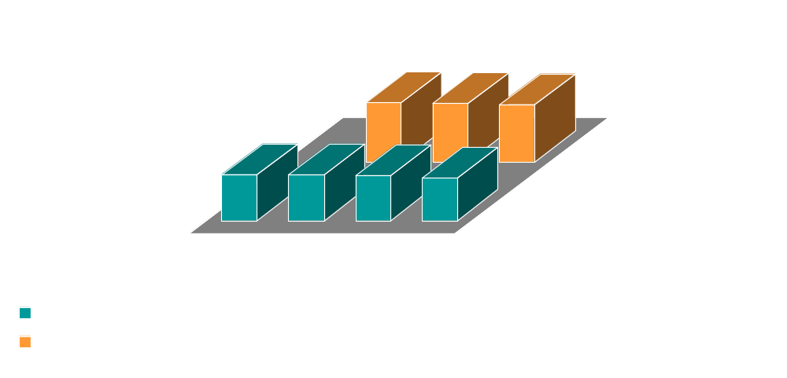
Potential Speed of Streamer
Memory data ⇒ Ethernet(s) ⇒ streamer ⇒ /dev/null
MB/s

Slide 20
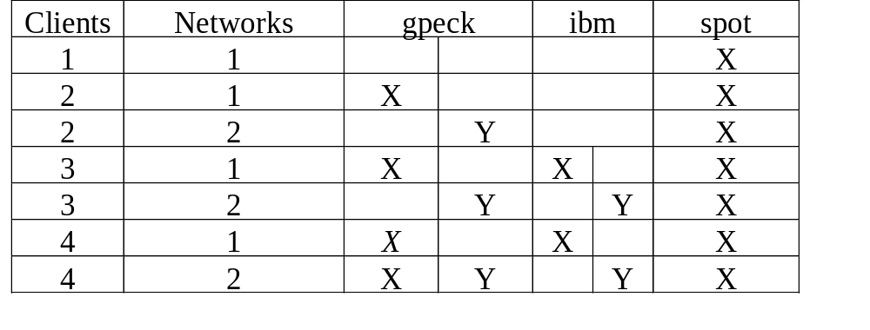
Parameters
Used process to generate data as fast as possible and write it using new rmt/streamer
Data rate is recorded when first client finishes
4 clients on 1 network include 2 on gpeck2

Slide 21
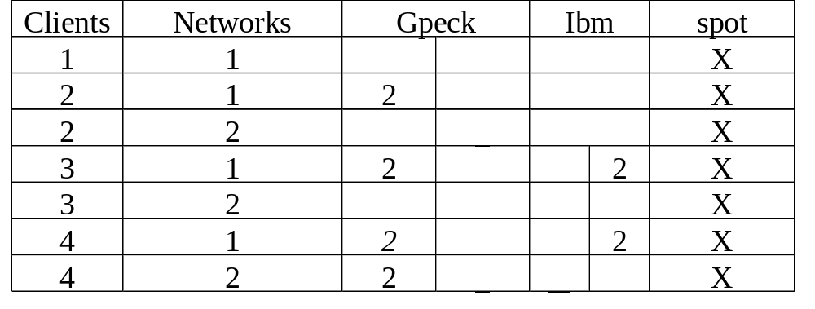
Parameters

Slide 22
Interpretation of Results
Client CPU utilization hits 95% when two clients send data at once
100Mb/s = 12.5MB/s. Thus, the second Ethernet card does improve performance
A faster CPU and/or optimized code should produce even better results

Slide 23
Curiosities
In the 3 and 4 client cases, the streamer actually speeds up after the first client terminates
The streamer’s CPU utilization is also lower
This appears to be caused by network congestion

Slide 24
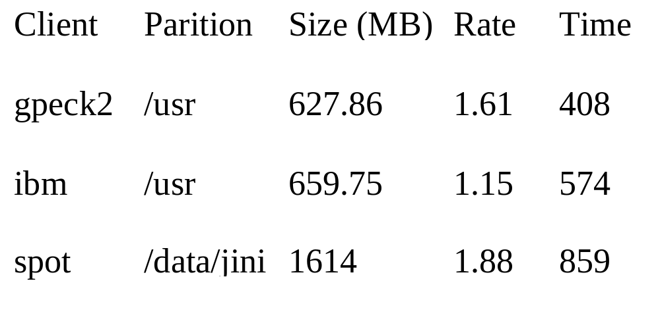
Clients Used

Slide 25
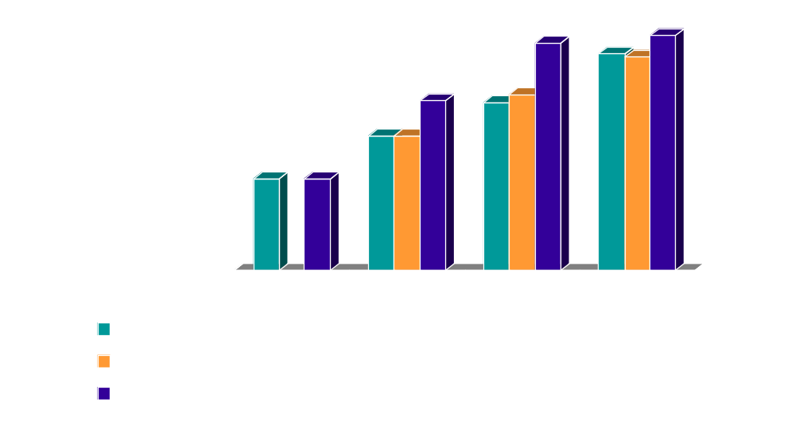
Rate Performance
MB/s
Notes:
1.88 was the /data/jini partition on spot. We wanted a fairly representative
partition. I could take a newly created 1/2 GB file on spot and make it stream
Ran two clients togetehr. Compared to sum of two data rates
(I.e. perfect paralelism.)
3 clients do a little better, but not as much as I expected. (Not sure why). It
isn’t network conjestion, because 4 do quite well. partially because ibm slow,
but this doesn’t explain the difference from ideal.
4 clients nearly make the take drive stream. You can even hear it.

Slide 26
Rate Experiment Parameters
Simply used new rmt/streamer to archive aforementioned partitions
Time for single client is spot (fastest)
“Ideal” is either the sum of maximum tar rates or the rate which makes the tape stream
For multiple clients, rate is read when first client finishes

Slide 27
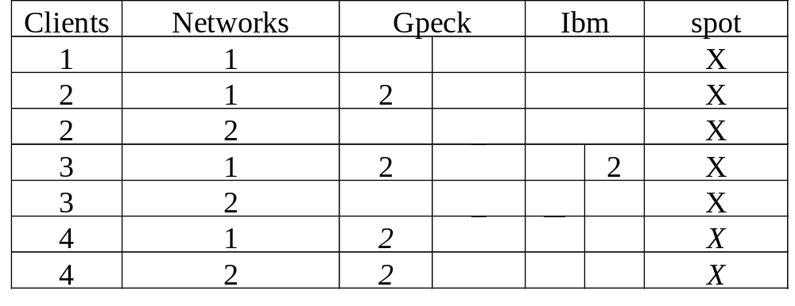
Time/Rate Parameters
4 clients are 2 on gpeck and 2 on spot

Slide 28
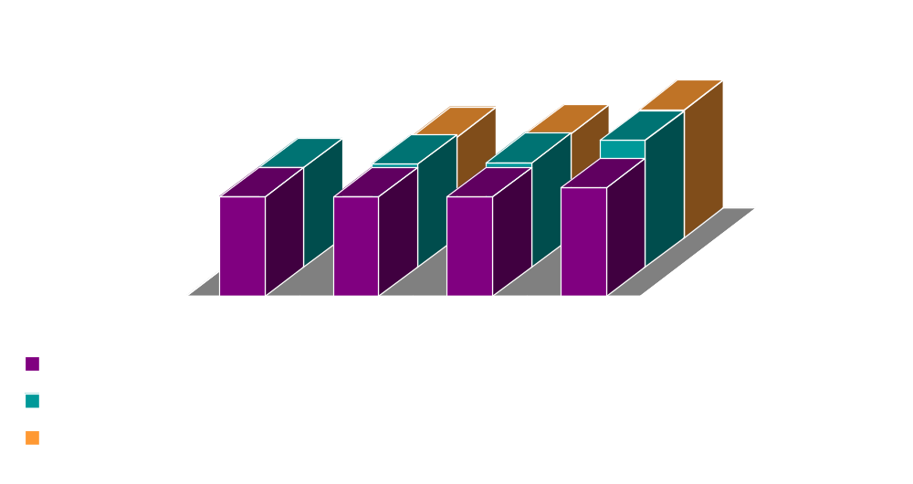
Performance by Time
Seconds

Slide 29
Time Experiment Parameters
Machines used are the same as for the Rate Experiment
“Ideal” is the time required for the longest single tar, or the time required of the tape drive to stream all the data

Slide 30
Interpretation
Notice that increase is nearly linear; however, because of inefficient pipelining it isn’t exactly linear
When we run 4 clients together, there is almost enough data to make the drive stream

Slide 31
Conclusions
A NATD should have at least 2 Ethernet ports
Interleaving several backups together is an effective method of increasing the utilization of a high-speed tape drive

Slide 32
Future Work
Investigate effects of heavy network traffic
Finish and optimize streamer
  How well does streamer “pipeline”?
  What is the optimal block size given TCP implementation, and hardware buffers?
  What happens when there are irregular block sizes or tape movements?
Investigate possible benefits of compression on client

Slide 33
Future Work
Take the Ethernet cables down

