Slide 1
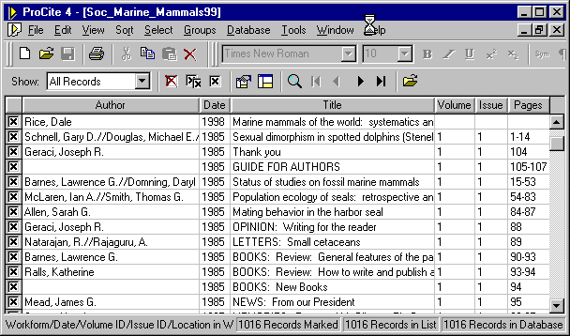



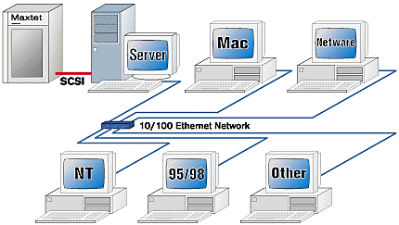

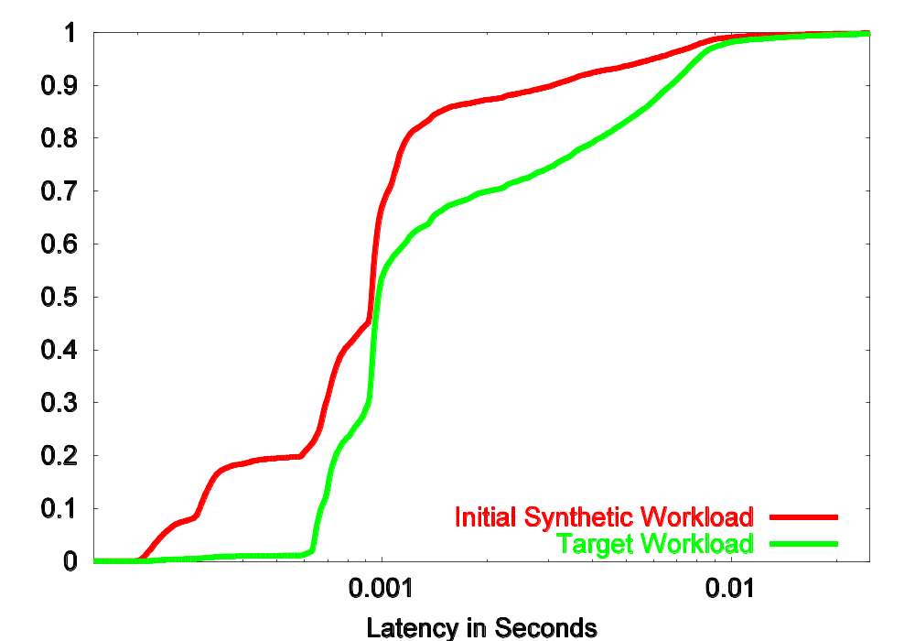
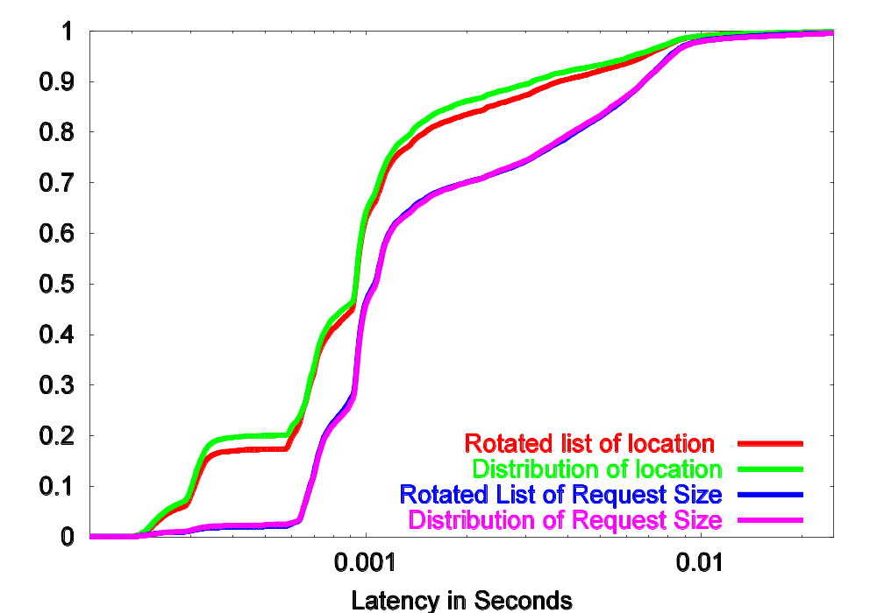
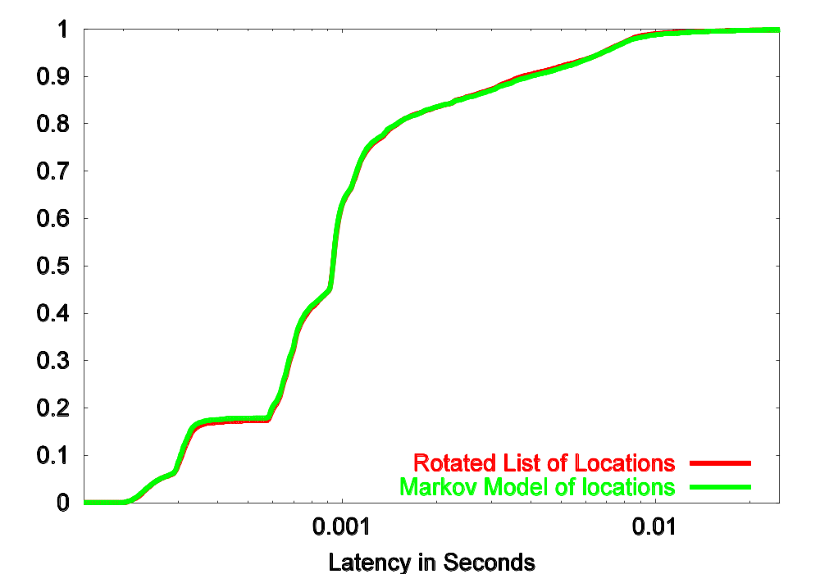
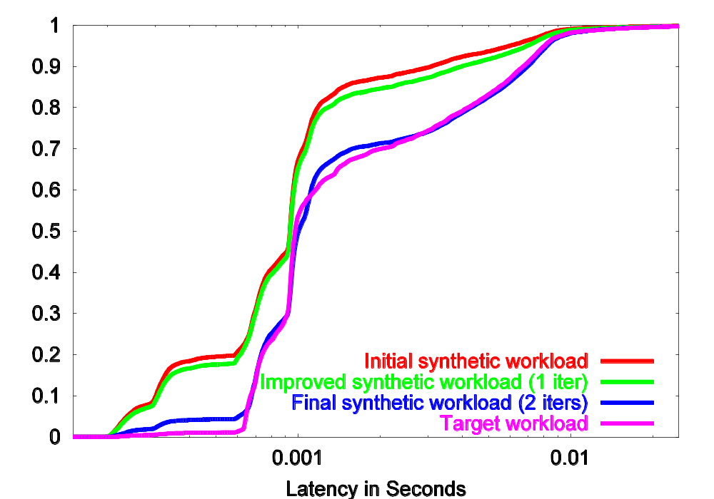
Generating Synthetic Workloads Using Iterative Distillation
Zachary Kurmas
Georgia Tech
Kimberly Keeton
HP Labs
Kenneth Mackenzie
Reservoir Labs, Inc.
Storage system designs must be evaluated with respect to many workloads
Two sources for evaluation workloads
Real vs. Synthetic
Goal: Workload trace and
synthetic workload interchangeable
Trace of real workloads
List of I/O requests made by production workload
Large
Inflexible
Difficult to obtain (due to security concerns)
Perfectly accurate
Synthetic Workloads
Randomly generated to maintain high-level properties
Compact representation
Easily modified
Compact rep. contains no specific data
Rarely accurate
Production Workload
Attribute-values
Synthetic Workload
(R,1024,120932,124)
(W,8192,120834,126)
(W,8192,120844,127)
(R,2048,334321,131)
(R,1024,120932,124)
(W,8192,120834,126)
(W,8192,120844,127)
(R,2048,334321,131)
(R,1024,120932,124)
(W,8192,120834,126)
(W,8192,120844,127)
(R,2048,334321,131)
(R,1024,120932,124)
(W,8192,120834,126)
(W,8192,120844,127)
(R,2048,334321,131)
...
Mean Request Size: 8Kb
(R,1024,120932,124)
(W,8192,120834,126)
(W,8192,120844,127)
(R,2048,334321,131)
(R,1024,120932,124)
(W,8192,120834,126)
(W,8192,120844,127)
(R,2048,334321,131)
(R,1024,120932,124)
(W,8192,120834,126)
(W,8192,120844,127)
(R,2048,334321,131)
(R,1024,120932,124)
(W,8192,120834,126)
(W,8192,120844,127)
(R,2048,334321,131)
...
% I/Os
Mean interarrival Time: .04ms
Read Percentage: 78%
Database workload
seconds
Location Distribution:
(.01,.02,.0,.09,.14, .03,.12,…
% I/Os
…
Email server workload
seconds
Workloads
New Disk Array
% I/Os
Measure target workload’s high-level characteristics
Generate synthetic workload with same characteristics
File server workload
seconds
Example Workloads
Performance
(CDF of latency)
Changes may be beneficial to some users and detrimental to others.
PROBLEM
We don’t know what high-level characteristics will lead to representative workloads
  Workloads that “look” alike do not necessarily behave alike.
Both workloads have similar response times
Both workloads should lead to similar design decisions
Choose Specific Attribute
High-Level Approach
Evaluate Synthetic Workload
To test specific location attribute, we generate synthetic workload using that attribute, and compare it to the “rotated” location workload.
Initial
Attribute List
Iteratively add attributes
Evaluate
Synthetic Workload
Production Workload
Attribute-values
Synthetic Workload
(R,1024,120932,124)
(W,8192,120834,126)
(W,8192,120844,127)
(R,2048,334321,131)
(R,1024,120932,124)
(W,8192,120834,126)
(W,8192,120844,127)
(R,2048,334321,131)
(R,1024,120932,124)
(W,8192,120834,126)
(W,8192,120844,127)
(R,2048,334321,131)
(R,1024,120932,124)
(W,8192,120834,126)
(W,8192,120844,127)
(R,2048,334321,131)
...
I
(R,1024,120932,124)
(W,8192,120834,126)
(W,8192,120844,127)
(R,2048,334321,131)
(R,1024,120932,124)
(W,8192,120834,126)
(W,8192,120844,127)
(R,2048,334321,131)
(R,1024,120932,124)
(W,8192,120834,126)
(W,8192,120844,127)
(R,2048,334321,131)
(R,1024,120932,124)
(W,8192,120834,126)
(W,8192,120844,127)
(R,2048,334321,131)
...
Initial Attributes
Mean interarrival Time: .04ms
Add new
Attribute to List
1
2
(W, 1024, , .111 )
(R, 8192, , .126 )
(R, 8192, 120842, .127 )
(W, 2048, 334321, .131 )
(W, 1024, 195932, .137 )
(R, 8192, 120850, .143 )
(R, 8192, 120858, .144 )
(W, 1024, 334321, .111 )
(R, 8192, 120850, .126 )
(R, 8192, 201223, .127 )
(W, 2048, 120842, .131 )
(W, 1024, 120858, .137 )
(R, 8192, 195932, .143 )
(R, 8192, 120834, .144 )
Read Percentage: 78%
195932,
334321,
120834,
120842,
334321,
120850,
120858,
Location Distribution:
(.01,.02,.0,.09,.14, .03,.12,…
201223,
120834,
120842,
334321,
195932,
120850,
120858,
Within
Threshold?
3
Library of
Attributes
Yes
…
No
Done
As attributes added, performance becomes more similar
Initial 50% error
Iteration 1 25% error
Iteration 2 7% error
Iteration 3 3% error
Target performance
Compare with “rotated” workload because relationships with other parameters still broken
Location generated by attribute that measures runs. (Runs preserved, other locs random.)
Choose Specific
Attribute
Choose
Attribute Group
Choose Attribute Group
1
Problem
  Testing every attribute in library takes too long
  Some attributes redundant or incompatible
  Many attributes not useful
3
Solution (part 1):
Partition attributes into groups
  Each group of attributes measures the same set of request parameters
  Each group of attributes describes the same relationships
Location, Request Size
Joint distribution
Request size conditioned upon chosen location.
Attribute groups
Location
Distribution of location
LRU stack distance
Jump Distance
Run Count
2
Key Observations
Workload performance determined by relationships within sequence of requests and between different requests
Attributes that measure the same parameters describe the same relationships
We can test effects of a relationship by “subtracting” it from target workload.
Request Size
Distribution of request size
Markov model of request size
Location
Location, Op. Type
Distribution of read locations
Distribution of write locations
Joint distribution
Request Size, Arrival Time
Size
Op.
Type
Op Type
Read Percentage
Markov model
Arrival Time
Distribution of interarrival time
Markov model of interarrival time
Clustering
Arrival Time
Op Type, Arrival Time
4
Solution (part 2)
  Evaluate all attributes in an attribute group using only two workloads
    One workload maintains the relationship under test
    The other workload does not.
Subtractive Method
Op Type, Arrival Time, Request Size
(Op Size Location Time)
(W, 1024, 201223, .111 )
(R, 8192, 120834, .126 )
(R, 8192, 120842, .127 )
(W, 2048, 334321, .131 )
(W, 1024, 195932, .137 )
(R, 8192, 120850, .143 )
(R, 8192, 120858, .144 )
Short interarrival times produce bursts
Short interarrival times produce bursts
Rotating location column breaks relationships between location and other parameters, but preserves relationships between locations
Permuting the locations destroys all relationships involving location
(W, 1024, 334321, .111 )
(R, 8192, 120850, .126 )
(R, 8192, 201223, .127 )
(W, 2048, 120842, .131 )
(W, 1024, 120858, .137 )
(R, 8192, 195932, .143 )
(R, 8192, 120834, .144 )
(W, 1024, , .111 )
(R, 8192, , .126 )
(R, 8192, 120842, .127 )
(W, 2048, 334321, .131 )
(W, 1024, 195932, .137 )
(R, 8192, 120850, .143 )
(R, 8192, 120858, .144 )
334321,
Underlined locations are spatial local, and form a “run”
201223,
120834,
120842,
334321,
195932,
120850,
120858,
120850,
201223,
120842,
Attributes describe these patterns
120858,
Attributes describe these patterns
Attributes describe these patterns
Patterns between arrival times may produce burstiness
201223,
195932,
Patterns between location and arrival time may offset burstiness
Workloads maintain same relationships except location
Difference in performance estimate of effect of location attributes
Patterns between locations may produce locality
Results
Distiller cannot accurately synthesize the target Email workload using only empirical distributions for I/O request parameters.
Difference between lines for location indicates location attribute needed. Similarity of request size lines indicates no request size attribute needed
Markov model able to generate representative list of location values.
Markov model results in slightly more accurate synthetic workload. Attributes chosen in later iterations produce very accurate synthetic workload.

Slide 2
(Op Size Location IAT )
(W, 1024, 201223, .111 )
(R, 8192, 120834, .126 )
(R, 8192, 120842, .127 )
(W, 2048, 334321, .131 )
(W, 1024, 195932, .137 )
(R, 8192, 120850, .143 )
(R, 8192, 120858, .144 )
Trace of production workload maintains all relationships
(Op Size Location Time)
(W, 1024, 201223, .111 )
(R, 8192, 120834, .126 )
(R, 8192, 120842, .127 )
(W, 2048, 334321, .131 )
(W, 1024, 195932, .137 )
(R, 8192, 120850, .143 )
(R, 8192, 120858, .144 )
Operation Type, Request Size, Location, Arrival Time
(time, in seconds, from beginning of trace)
Read or
write
Number of bytes accessed
Identifies location of data on disk
Time request made

