Slide 1

Distillation of Performance-Related Characteristics
kurmasz@cc.gatech.edu
Notes:
An Iterative Technique for Distilling a Workload’s Important Performance Information

Slide 2
Introduction
Want synthetic workload to maintain certain realistic properties or attributes
  Want representative behavior (performance)
Research Question:
  How do we identify needed attributes?
We have a method ...
Notes:
As I am sure everyone here knows, when we generate synthetic I/O workloads, we want more than just a set of random numbers. We want the synthetic workload to have certain properties (or attributes) so that it behaves like some workload or set of workloads. (For example, a database workload).
The challenge is to find and identify the attributes must be included for the synthetic workload to have the desired behavior.
This talk will present our method of doing that

Slide 3
Goal
Original Workload
Attribute List ω
SyntheticWorkload
(R,1024,120932,124)
(W,8192,120834,126)
(W,8192,120844,127)
(R,2048,334321,131
...
(R,1024,120932,124)
(W,8192,120834,126)
(W,8192,120844,127)
(R,2048,334321,131
...
CDF of Response Time
Given a workload and storage system,
automatically find a list of attributes ω, so
synthetic workloads based on values for ω
will have performance similar to original.
Notes:
Can you think of a better way to convey the compression and expansion (The sets of arrows on either side of the Attribute List
Also, notice that the distinction between attribute and attribute-value is complete missing. I assume that this is not a problem.
Given a workload and storage system,
we want to automatically find a list of attributes (that is a list of measurements we can make of the workload)
such that any synthetic workload with those measurements has similar performance.
“In other words, we are looking for the set of properties that a synthetic workload needs to share with the original in order to have the same performance”

Slide 4
Why?
Predicting performance of complex disk arrays is extremely difficult.
  Many unknown interactions to account for.
List of attributes much easier to analyze than large, bulky workload trace.
List of attributes tells us:
  Which patterns in a workload affect performance
  How those patterns affect performance
Possible uses of attribute lists:
  One possible basis of “similarity” for workloads
  Starting point for performance prediction model
Notes:
Picutre the analytical performance model as one of those annoying jig saw pozzles with a picture on both sides, no edges, and extra pieces. We see our work as putting together a few pieces and throwing away the extras.
Unfortunately, I don’t have time to say this in the WIP talk.
We are searching for an attribute list attribute list is such that the attribute values constrain the our workload generator to workloads with the same performance as the original. We hypothesize that this set of information contains everything we need to know to predict the performance of the workload

Slide 5
Challenge
Original Workload
Attribute List ω
SyntheticWorkload
(R,1024,120932,124)
(W,8192,120834,126)
(W,8192,120844,127)
(R,2048,334321,131
...
(R,1024,120932,124)
(W,8192,120834,126)
(W,8192,120844,127)
(R,2048,334321,131
...
CDF of Response Time
Attribute List may be different for every workload/storage system pair
Require general method of finding list of attributes
  not just one workload’s attribute-values
Useful method will require little human attention

Slide 6
Road Map
Introduction
  Goal
  Challenges
Description of Method
Implementation of Method
Case Analysis
Locality Attributes
Conclusion
Notes:
Unused in WIP talk.

Slide 7
Basic Idea
Original Workload
Attribute List ω
SyntheticWorkload
(R,1024,120932,124)
(W,8192,120834,126)
(W,8192,120844,127)
(R,2048,334321,131
...
(R,1024,120932,124)
(W,8192,120834,126)
(W,8192,120844,127)
(R,2048,334321,131
...
Basic Idea: Add attributes until performance of original and synthetic workloads is similar.

Slide 8
Choosing Attribute Wisely
Problem:
  Not all attributes useful
  Can’t test all attributes
Solution:
  Group attributes
  Evaluate entire groups at once
Attributes
Mean Request Size
Mean Request Size
Mean Arrival Time
Mean Arrival Time
Request Size Dist.
Request Size Dist.
Arrival Time Dist.
Arrival Time Dist.
Request Size Attrib 3
Request Size Attrib 3
Hurst Parameter
Hurst Parameter
Request Size Attrib 4
Request Size Attrib 4
COV of Arrival Time
COV of Arrival Time
Dist. of Locations
Dist. of Locations
Read/Write ratio
Read/Write ratio
Mean run length
Mean run length
Markov Read/Write
Markov Read/Write
Jump Distance
Jump Distance
R/W Attrib. #3
R/W Attrib. #3
Proximity Munge
Proximity Munge
R/W Attrib #4
R/W Attrib #4
How are they grouped?
How are they evaluated?
Mean Read Size
Mean Read Size
D. of (R,W) Locations
D. of (R,W) Locations
Read Rqst. Size Dist.
Read Rqst. Size Dist.
Mean R,W run length
Mean R,W run length
Mean (R, W) Sizes
Mean (R, W) Sizes
R/W Jump Distance
R/W Jump Distance
(R, W) Size Dists.
(R, W) Size Dists.
R/WProximity Munge
R/WProximity Munge
Notes:
These colors look bad on the screen, but they look fine when projected.
I adjusted them while using a Proxima.

Slide 9
Iterative Process
Original Workload
Are we done yet?
Does ω contain
enough info?
Are we done yet?
Does ω contain
enough info?
(R,1024,120932,124)
(W,8192,120834,126)
(W,8192,120844,127)
(R,2048,334321,131
...
Evaluate ω
Evaluate ω
ω
List of Attributes
Choose Attribute
Chose Attribute Group
Which attribute
should we add?
Which attribute group contains
the attribute we should add?

Slide 10
Evaluation
Original Workload
Attribute List ω
SyntheticWorkload
(R,1024,120932,124)
(W,8192,120834,126)
(W,8192,120844,127)
(R,2048,334321,131
...
(R,1024,120932,124)
(W,8192,120834,126)
(W,8192,120844,127)
(R,2048,334321,131
...
CDF of Response Time
Take original workload
Obtain attribute-values specified by ω
Generate Synthetic workload using ω
Quantify difference between response time distributions
Notes:
Can you think of a better way to convey the compression and expansion (The sets of arrows on either side of the Attribute List
Also, notice that the distinction between attribute and attribute-value is complete missing. I assume that this is not a problem.
Given a workload and storage system,
we want to automatically find a list of attributes (that is a list of measurements we can make of the workload)
such that any synthetic workload with those measurements has similar performance.
“In other words, we are looking for the set of properties that a synthetic workload needs to share with the original in order to have the same performance”

Slide 11
Quantify Difference
We use root-mean-square metric
  Square root of sum of squares of horizontal differences.
  Used by Ruemmler and Wilkes, Ganger, etc.
Any reasonable metric will work.
Is RMS the best metric?
  Differences at all scales weighted equally
  Therefore, differences in cache behavior are emphasized less than differences in seek time
  Can be good or bad
Is there a non-arbitrary stopping point?

Slide 12
Iterative Process
Original Workload
Are we done yet?
Does ω contain
enough info?
(R,1024,120932,124)
(W,8192,120834,126)
(W,8192,120844,127)
(R,2048,334321,131
...
Evaluate ω
ω
List of Attributes
Choose Attribute
Chose Attribute Group
Which attribute
should we add?
Which attribute group contains
the attribute we should add?

Slide 13
How Attributes Grouped
Workload is series of requests
  (Read/Write Type, Size, Location, Interarrival Time)
Attributes measure one or more parameters
  Mean Request Size Request Size
  Distribution of Location Location
  Burstiness Interarrival Time
  Request Size
  Read/Write
Attributes grouped by parameter(s) measured
  Location = {mean location, distribution of location, locality, mean jump distance, mean run length, ...}
Distribution of Read Size
Notes:
This slide took over 90 seconds. Unless you have a better idea, I’m going to skip talking about everything except the last point.
15 Attribute groups total
I’ll say something like:
A workload is a series of requests with 4 parameters. Attributes specify measurements of one or more of these parameters. We group attributes according to which parameter is measured. For example mean Request Size measures Request Size. A burstiness attribute will probably only measure Arrival Time. A few attributes measure both e.g. a distribution of Read Size

Slide 14
“Additive” Method
Add “every” attribute in group at once and observe change in performance.
Amount of change in performance estimator of most effective attribute
“All” Request Size
“All” Location
“All” (Size, R/W)

Slide 15
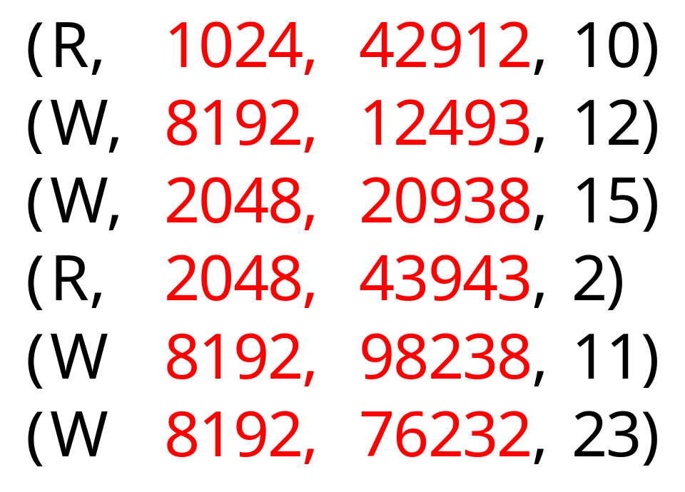
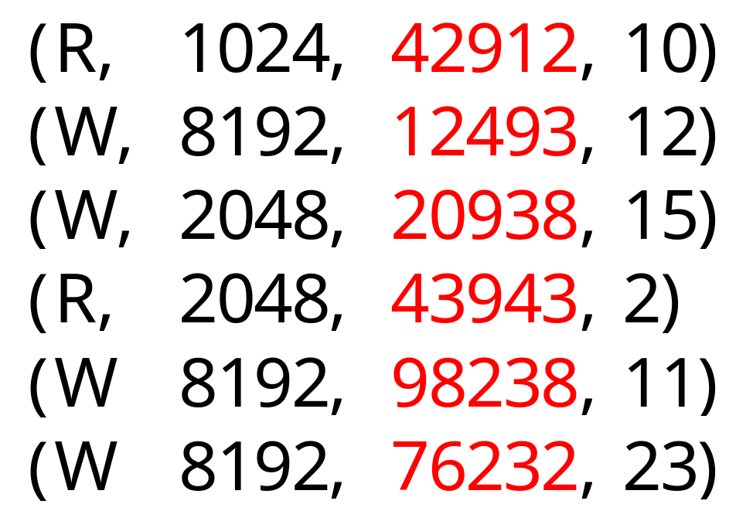
The “All” Attribute
The list of values for some parameter contains every attribute in that group
Attributes in that group will have same value for both original and synthetic workload
  List represents “perfect knowledge” of group
“All” (Location, Request Size) attribute
“All” Location attribute

Slide 16
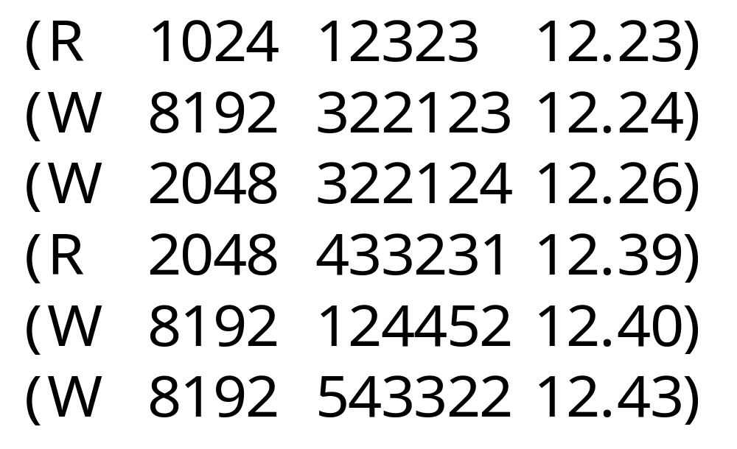
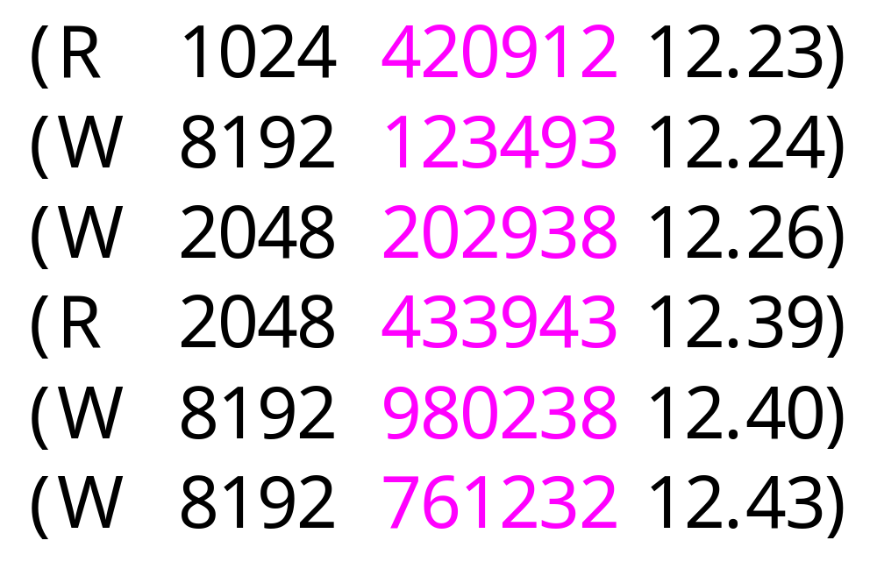
“Subtractive” Method
Remove “All” attribute from original workload.
  Replace an observed list of request parameters with randomly generated values.
Remove “all” location attributes by making all locations random

Slide 17
Challenges
Subtleties to applying methods
  Must avoid mutually exclusive attributes
Change in performance can be ambiguous
  Resulting workload can be faster or slower
  Effects of attributes in same group can cancel each other. (Have net effect of zero.)
Not looking for strictly decreasing RMS
“Faster”
Workload
“Slower”
Workload

Slide 18
Current Focus
Thus far, solutions have been apparent
However, we want to reduce human involvement
Current Focus:
  Find general description of ambiguities
  Develop algorithms to recognize and address them

Slide 19
Iterative Process
Original Workload
Are we done yet?
Does ω contain
enough info?
(R,1024,120932,124)
(W,8192,120834,126)
(W,8192,120844,127)
(R,2048,334321,131
...
Evaluate ω
ω
List of Attributes
Choose Attribute
Chose Attribute Group
Which attribute
should we add?
Which attribute group contains
the attribute we should add?

Slide 20
Add from chosen group
This is most difficult part.
  Only a few useful attributes known, so we must develop most attributes from scratch.
  Suggestions for attributes?
  Suggestions for related work?
This should get easier as technique used and “attribute library” grows.
  Future Work: We will eventually need an intelligent method of searching library.

Slide 21
Road Map
Introduction
  Goal
  Challenges
Method
Current Status / Implementation
Case Analysis
Locality
Conclusion
Notes:
Unused in WIP talk.

Slide 22
New Programs
“Distiller”
  Perl program that prepares Rome input and parses resulting output of SSP tools.
    Rubicon, Buttress, Rome, srtLite, etc.
“GenerateSRT”
  C++ program that generates SRT trace given set of attribute-values in Rome format.
  Vaguely like Pylon without capacity to run workload.
Both programs need better names!

Slide 23
Functionality
Input:
  Workload description (SRT file, list of LUNS)
  Attribute list (in Rome format)
Make Rubicon configuration
Run Rubicon
Make attribute-value list (Rome format)
Run Generate SRT
Run Buttress
Process miio file (mi2srt)
Collect Performance (CDF in Rome format)
Notes:
Skip in Tech talk

Slide 24
Future Functionality
Currently the user must:
  Apply additive or subtractive method and generate a new attribute list.
  Look at resulting CDFs and choose attribute group by hand.
  Choose specific attribute.
    This could easily done by brute force.
  Develop new attributes when needed.
At these points Distiller application asks user for answer. (Actually, sends me e-mail.)

Slide 25
Incremental Implementation
Distiller application designed to allow incremental implementation.
  We can implement code to recognize handle specific cases, and leave the rest to the user.
Plan: Implement code to recognize additional cases until distiller application runs with almost no human intervention.
  Will probably always require a occasional help.

Slide 26
Road Map
Introduction
  Goal
  Challenges
Method
Current Status / Implementation
Case Analysis
Locality
Conclusion
Notes:
Unused in WIP talk.

Slide 27
Experimental Environment
Workload: Trace of Open Mail
  e-mail application for 4,500 users
  1400 active users during trace collection
  Mean request rate: 75.52 I/Os per second
  Mean request size: 7115 bytes
  Mean throughput: 524.5KB per second
Storage System: Optimus disk array
  Thirty 18GB disks (.5 TB total)
  Two disk controllers each with Fibre Channel port
  Max I/Os per second: about 100
  256 MB Write-back cache backed by non-volatile RAM
    Thus, writes are “free”

Slide 28
Starting Point
Original attribute list (ω) is simply four distributions, one for each parameter.
Simplest possible explicit attribute list
  Anything simpler must make implicit assumptions about distribution for random numbers.
  This would cause mis-information, not missing information.

Slide 29
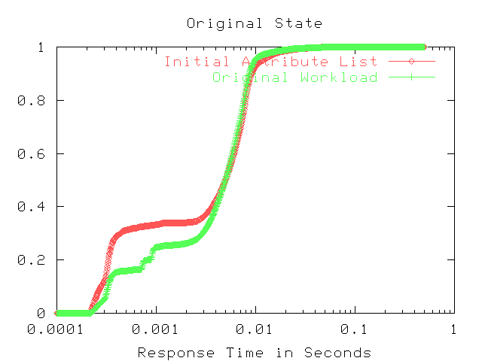
Synthetic workload
Values chosen independently at random
RMS: .9477
RMS/Mean: .1877
Performance of real workload

Slide 30
First Iteration
Apply additive method to 4 single-parameter attribute groups.
This allows us to examine intra-parameter relationships.
  e.g. “What would performance be if locality was correctly generated?”
No inter-parameter relationships present in synthetic workload.
  e.g. only relationships within location created.
Notes:
When we add list of locations, we only add intra-location relationships.
Inter-parameter relationships still broken because second parameter is still random.
This doesn’t work as well in later iterations because the “smarter” generators may create some inter-parameter relationships.

Slide 31
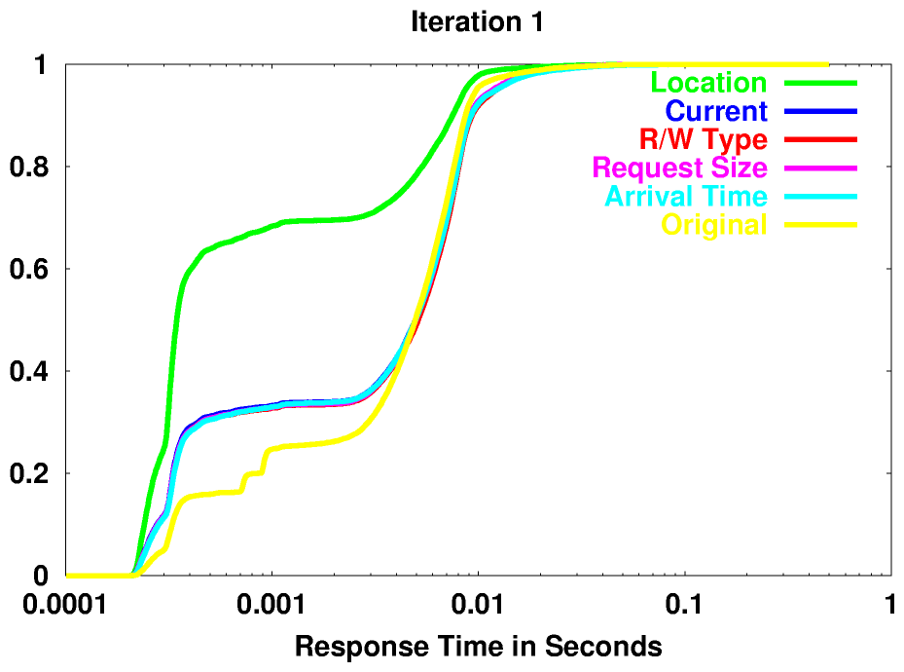
* Big change for Location
* Small changes for
everything else
* Goal: Choose locations so they exhibit locality like this
Notes:
This tells us that the order in which locations is chosen is important. We know this intuitively because of spatial and temporal locality.
Tells us that the order of other parameters by themselves is not important for this workload. i.e. it doesn’t matter of all the 1024 request sizes come first. now, it may matter latter when the location of those requests is considered, but that case is handled by a (request size, location) parameter.
Now, the results above show that the order of request sizes i snot important. This is true only for this workload. (because it is not too bursty) Of course a burstier or busier workload will probably show different results.

Slide 32
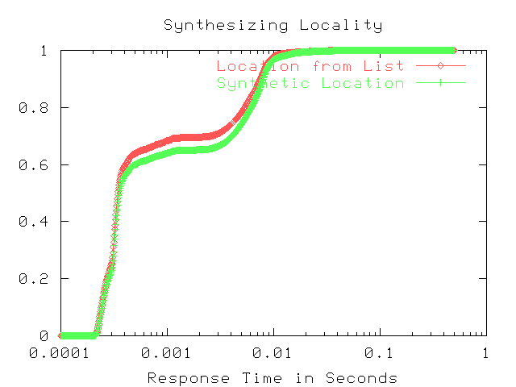
RMS: .7739
RMS/Mean: .3143

Slide 33
Second Iteration
Use subtractive method to check for inter-parameter relationships.
Now that all intra-parameter relationships are included in attribute-list, replacing perfect attribute with current attribute should only result in a change in performance if there are inter-parameter relationships

Slide 34
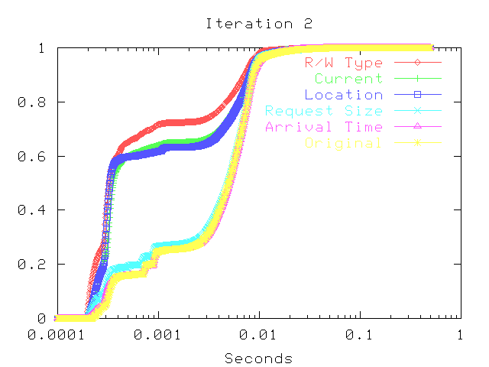
Large change for Location and R/W Type
Small change for Request Size and Arrival Time

Slide 35
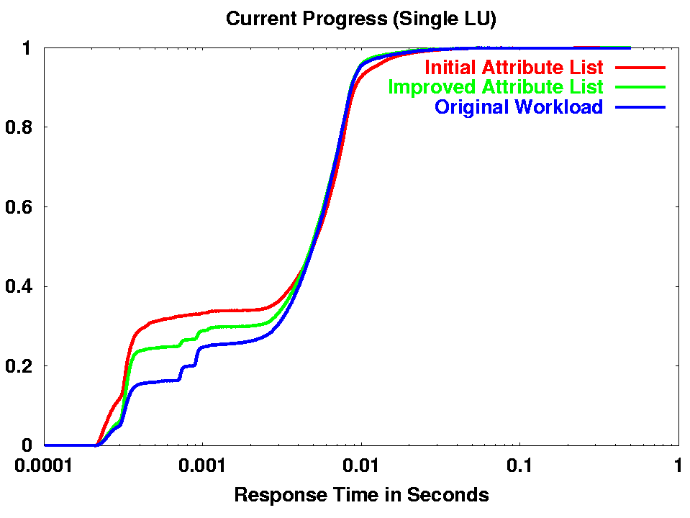
RMS/Mean :
Original: .1877
Current: .0918

Slide 36
Road Map
Introduction
  Goal
  Challenges
Method
Current Status / Implementation
Results
Locality
Conclusion
Notes:
Unused in WIP talk.

Slide 37
Failed Attempts
Jump Distance
  Choose jump distance instead of location.
  Difficult to choose intelligently.
Jump Distance Markov
  Markov model for zero, and non-zero jumps
  Also tried zero, forward, and backward jumps
Proximity
  Consider distance between 25 most recent requests, not just most recent request.
Notes:
Jump distance difficult to choose intelligently because you need to stay within disk bounds, and disk bounds not centered around zero.

Slide 38
Common Problem: Footprint
Two parts to choosing locations:
  Footprint --- Which sectors of disk accessed
  Locality --- In which order sectors accessed
Locality schemes will fail on FC-60 unless footprint is correct
  FC-60 has a huge cache.
  Cache hits and cache misses have order of magnitude difference in response time
  Small footprint results in faster workload
  Large footprint results in slower workload

Slide 39
“Loose Histogram” Problem
Histogram of location had fewer bins than number of unique locations
RNG chooses bin according to distribution. Specific value chosen uniformly from bin
In reality, request locations are not uniformly distributed through bins
Observed Location Distribution
Synthetic Location Distribution

Slide 40
“Tight” Histogram Problem
Give each unique location value its own bin
Makes footprint too small
  Not every bin gets chosen
    (when number of bins ≈ number of requests)
  Yahtzee “Large Straight” problem
Also too large to be useful attribute-value
Observed Location Distribution
Synthetic Location Distribution

Slide 41
Choose Footprint Explicitly
Explicitly choose set of unique location values for correct footprint
Histogram must be tight
However; distribution is “bursty”
This makes pre-determined bin-widths inefficient.
  Many empty fixed-width bins
  “log” histogram makes bins too large at end

Slide 42
Location Percentile
We fix the number of unique location values in each bin.
  Specify starting and ending sector for each bin.
Alternatively, we fix the number of requests in each bin.
  When we do this, heavily used unique location values are placed in smaller (more precise) bins

Slide 43
Evaluate Footprint Generator
If we simply permute locations, footprint is exactly correct, but no locality
  Too large to be a practical attribute-value
  Useful to evaluate other attributes describing the footprint

Slide 44
Main Ideas
New method of automatically finding performance-related attributes:
  Measure completeness of list by comparing performance of synthetic workloads
  Useful method of grouping attributes
  Effective method of evaluating entire groups of attributes
  Avoid evaluation of useless attributes
kurmasz@cc.gatech.edu
www.cc.gatech.edu/~kurmasz

Slide 45
END OF LONG TALK
Remaining Slides are extra

Slide 46
Goal (v1)
Given a workload,
automatically find the set of characteristics ω, such that
any synthetic workload based only on ω
will have performance similar to original.
Original
Workload
Synthetic
Workload
(R,1024,120932,124)
(W,8192,120834,126)
(W,8192,120844,127)
(R,2048,334321,131
...
ω
(R,1024,120932,124)
(W,8192,120834,126)
(W,8192,120844,127)
(R,2048,334321,131
...
Response Time

Slide 47
(unused)
Add attributes until performance is similar
Original
Workload
Synthetic
Workload
ω4
(R,1024,120932,124)
(W,8192,120834,126)
(W,8192,120844,127)
(R,2048,334321,131
...
ω2
ω1
(R,1024,120932,124)
(W,8192,120834,126)
(W,8192,120844,127)
(R,2048,334321,131
...
ω3
Response Time

Slide 48
New Application
Original Workload
Collect performance info
Compute RMS of CDFs
(R,1024,120932,124)
(W,8192,120834,126)
(W,8192,120844,127)
(R,2048,334321,131
...
Evaluate ω
ω
List of Attributes
Choose Attribute
Chose Attribute Group
Which attribute
is best?
Prepare synthetic workloads
Run synthetic workloads
Compute

Slide 49
Goal (used for parts)
Original Workload
Attribute List ω
SyntheticWorkload
(R,1024,120932,124)
(W,8192,120834,126)
(W,8192,120844,127)
(R,2048,334321,131
...
(R,1024,120932,124)
(W,8192,120834,126)
(W,8192,120844,127)
(R,2048,334321,131
...
CDF of Response Time
Given a workload and storage system,
automatically find a list of attributes ω, so
synthetic workloads based on values for ω
will have performance similar to original.
Notes:
Can you think of a better way to convey the compression and expansion (The sets of arrows on either side of the Attribute List
Also, notice that the distinction between attribute and attribute-value is complete missing. I assume that this is not a problem.
Given a workload and storage system,
we want to automatically find a list of attributes (that is a list of measurements we can make of the workload)
such that any synthetic workload with those measurements has similar performance.
“In other words, we are looking for the set of properties that a synthetic workload needs to share with the original in order to have the same performance”

Slide 50
Original Workload
Attribute List ω
SyntheticWorkload
(R,1024,120932,124)
(W,8192,120834,126)
(W,8192,120844,127)
(R,2048,334321,131
...
(R,1024,120932,124)
(W,8192,120834,126)
(W,8192,120844,127)
(R,2048,334321,131
...
CDF of Response Time

