Slide 1

Distillation of Performance-Related Characteristics
kurmasz@cc.gatech.edu
Notes:
An Iterative Technique for Distilling a Workload’s Important Performance Information

Slide 2
Introduction
Want synthetic workload to maintain certain realistic properties or attributes
  Want representative behavior (performance)
Research Question:
  How do we identify needed attributes?
We have a method ...
Notes:
As I am sure everyone here knows, when we generate synthetic I/O workloads, we want more than just a set of random numbers. We want the synthetic workload to have certain properties (or attributes) so that it behaves like some workload or set of workloads. (For example, a database workload).
The challenge is to find and identify the attributes must be included for the synthetic workload to have the desired behavior.
This talk will present our method of doing that

Slide 3
Goal
Original Workload
Attribute List
SyntheticWorkload
(R,1024,120932,124)
(W,8192,120834,126)
(W,8192,120844,127)
(R,2048,334321,131
...
(R,1024,120932,124)
(W,8192,120834,126)
(W,8192,120844,127)
(R,2048,334321,131
...
CDF of Response Time
• Given a workload and storage system,
• automatically find a set of attributes, so
• synthetic workloads with the same values
• will have performance similar to original.

Slide 4
Why?
Predicting performance of complex disk arrays is extremely difficult.
  Many unknown interactions to account for.
List of attributes much easier to analyze than large, bulky workload trace.
List of attributes tells us:
  Which patterns in a workload affect performance
  How those patterns affect performance
Possible uses of attribute lists:
  One possible basis of “similarity” for workloads
  Starting point for performance prediction model
Notes:
Picutre the analytical performance model as one of those annoying jig saw pozzles with a picture on both sides, no edges, and extra pieces. We see our work as putting together a few pieces and throwing away the extras.
Unfortunately, I don’t have time to say this in the WIP talk.
We are searching for an attribute list attribute list is such that the attribute values constrain the our workload generator to workloads with the same performance as the original. We hypothesize that this set of information contains everything we need to know to predict the performance of the workload

Slide 5
Basic Idea
Original Workload
Attribute List
SyntheticWorkload
(R,1024,120932,124)
(W,8192,120834,126)
(W,8192,120844,127)
(R,2048,334321,131
...
(R,1024,120932,124)
(W,8192,120834,126)
(W,8192,120844,127)
(R,2048,334321,131
...
Attribute list may be different for every workload/storage system pair
  Require general method of finding attributes
  Must require little human intervention
Basic Idea: Add attributes until performance of original and synthetic workloads is similar.

Slide 6
Choosing Attribute Wisely
Problem:
  Not all attributes useful
  Can’t test all attributes
Our Solution:
  Group attributes
  Evaluate entire groups at once
Attributes
Mean Request Size
Mean Request Size
Mean Arrival Time
Mean Arrival Time
Request Size Dist.
Request Size Dist.
Arrival Time Dist.
Arrival Time Dist.
Request Size Attrib 3
Request Size Attrib 3
Hurst Parameter
Hurst Parameter
Request Size Attrib 4
Request Size Attrib 4
COV of Arrival Time
COV of Arrival Time
Dist. of Locations
Dist. of Locations
Read/Write ratio
Read/Write ratio
Mean run length
Mean run length
Markov Read/Write
Markov Read/Write
Jump Distance
Jump Distance
R/W Attrib. #3
R/W Attrib. #3
Proximity Munge
Proximity Munge
R/W Attrib #4
R/W Attrib #4
How are they grouped?
How are they evaluated?
Mean Read Size
Mean Read Size
D. of (R,W) Locations
D. of (R,W) Locations
Read Rqst. Size Dist.
Read Rqst. Size Dist.
Mean R,W run length
Mean R,W run length
Mean (R, W) Sizes
Mean (R, W) Sizes
R/W Jump Distance
R/W Jump Distance
(R, W) Size Dists.
(R, W) Size Dists.
R/WProximity Munge
R/WProximity Munge
Notes:
These colors look bad on the screen, but they look fine when projected.
I adjusted them while using a Proxima.

Slide 7
Attribute Group
Workload is series of requests
  (Read/Write Type, Size, Location, Interarrival Time)
Attributes measure one or more parameters
  Mean Request Size Request Size
  Distribution of Location Location
  Burstiness Interarrival Time
  Request Size
  Read/Write
Attributes grouped by parameter(s) measured
  Location = {mean location, distribution of location, locality, mean jump distance, mean run length, ...}
Distribution of Read Size
Notes:
This slide took over 90 seconds. Unless you have a better idea, I’m going to skip talking about everything except the last point.
15 Attribute groups total
I’ll say something like:
A workload is a series of requests with 4 parameters. Attributes specify measurements of one or more of these parameters. We group attributes according to which parameter is measured. For example mean Request Size measures Request Size. A burstiness attribute will probably only measure Arrival Time. A few attributes measure both e.g. a distribution of Read Size

Slide 8
Evaluate Attribute Group
Add “every” attribute in group at once and observe change in performance.
Amount of change in performance estimator of most effective attribute
“All” Request Size
“All” Location
“All” (Size, R/W)

Slide 9
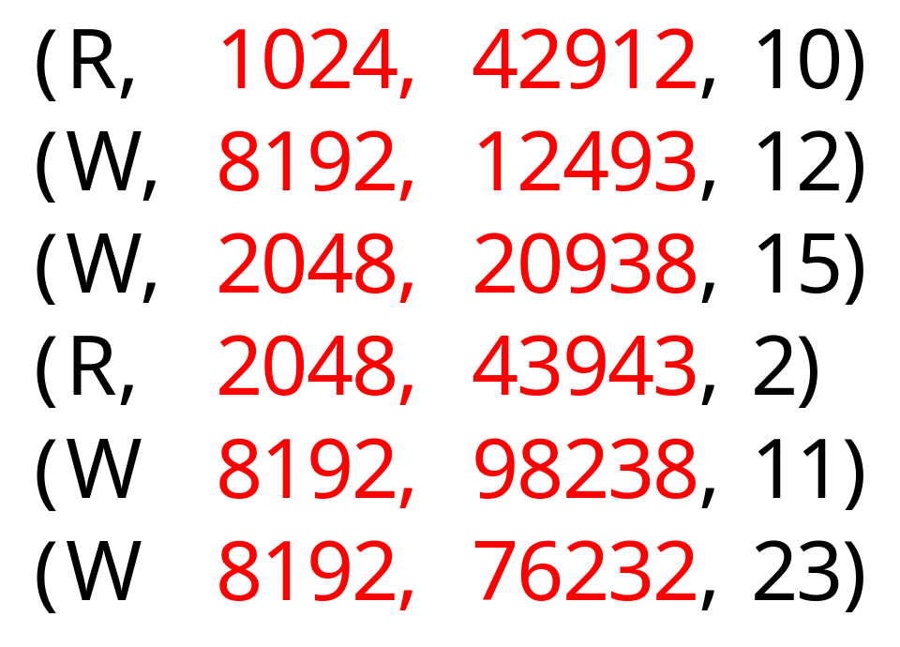
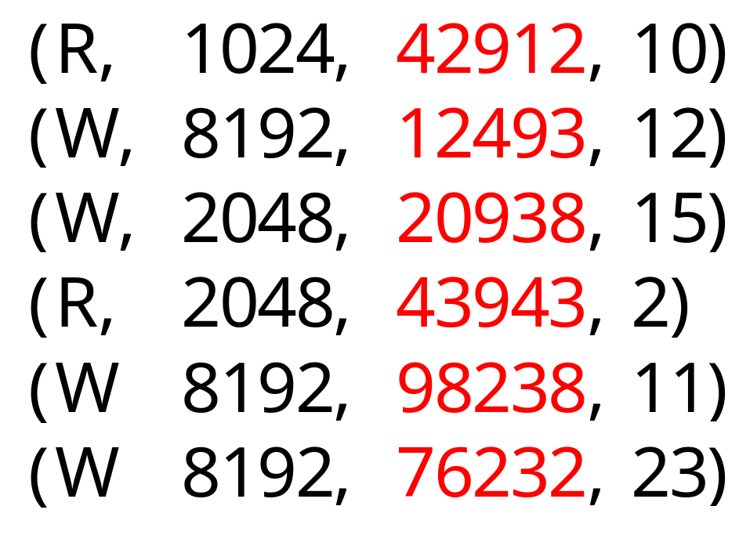
The “All” Attribute
The list of values for a set of parameters contains every attribute in that group
Attributes in that group will have same value for both original and synthetic workload
  List represents “perfect knowledge” of group
“All” (Location, Request Size) attribute
“All” Location attribute

Slide 10
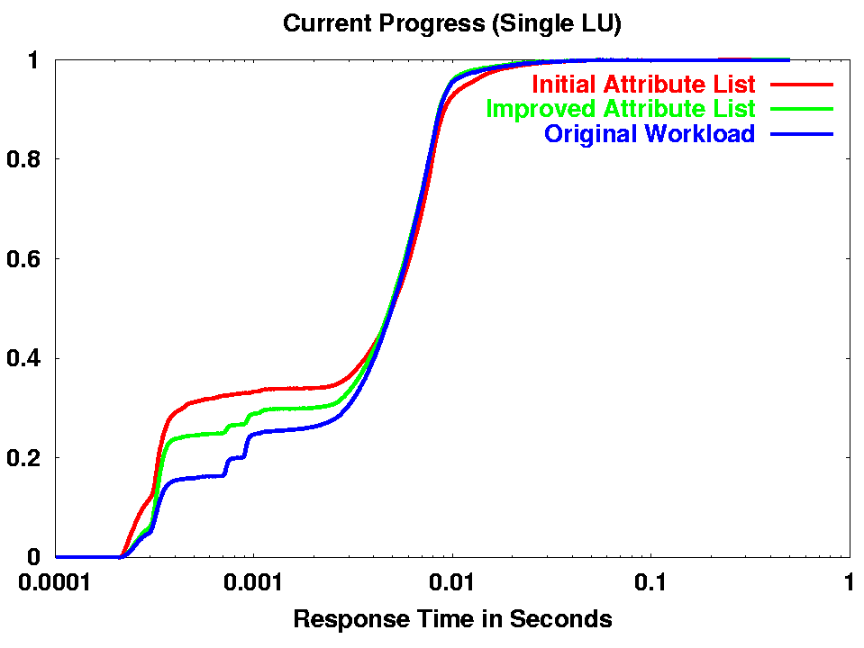
RMS/Mean :
Original: .1877
Current: .0918

Slide 11
Main Ideas
New method of automatically finding performance-related attributes:
  Measure completeness of list by comparing performance of synthetic workloads
  Useful method of grouping attributes
  Effective method of evaluating entire groups of attributes
  Avoid evaluation of useless attributes
kurmasz@cc.gatech.edu
www.cc.gatech.edu/~kurmasz

Slide 12
END OF SHORT TALK
The rest of the slides are for the full talk.
Current 26 January, 6:44 pm

Slide 13
Implement Improvement
Add attribute from chosen group
This is most time-consuming part
  Only a few attributes known, so we must develop most attributes from scratch
This should get easier as technique used and “attribute library” grows
  Future Work: We will eventually need an intelligent method of searching library

Slide 14
Main Research Focus
1). How to automatically choose and apply “additive” or “subtractive” method
2). How to automatically evaluate results and choose single attribute group
In practice, there are subtleties that are easily addressed by hand, but difficult to generalize for algorithm.

Slide 15
Current Progress
We have working application
  Ambiguous cases still done by hand
  Application stops and asks for a hint
  Algorithm being improved incrementally so that it needs fewer hints
Application used on Open Mail Workload

Slide 16
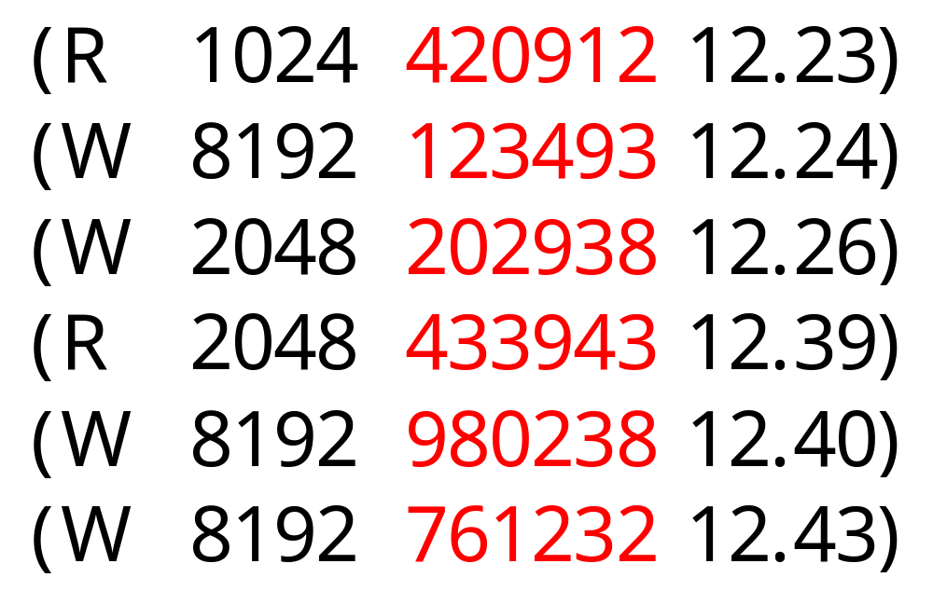
The “All” Attribute
The list of values for a set of parameters contains every attribute in that group
  Attributes in that group will have same value for both original and synthetic workload
“All” attribute
for location

