Slide 1
CIS 343
Structure of Programming Languages

Slide 2
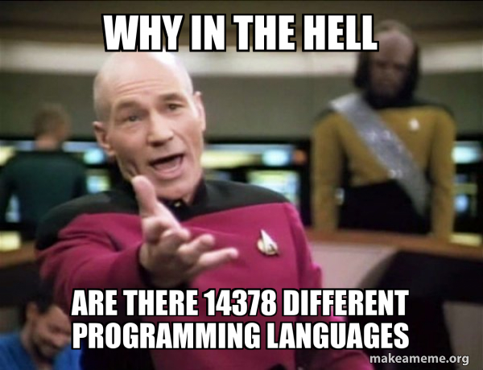
(There are “good” reasons and “bad” reasons)

Slide 3
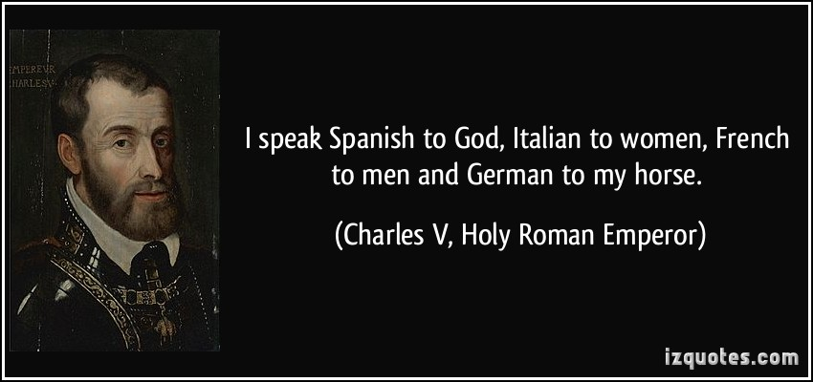
Use the right tool for the job
Different ideas more easily expressed in different languages
Especially when considering special-purpose languages and hardware

Slide 4
Programming Languages Evolve
We've learned better ways of doing things
Better ways of expressing ideas
Object-Oriented
First-class functions (i.e., “lambdas”)
Better implementation ideas
Int size in Java is not implementation dependent
Improvements in technology provide cost-efficient implementations for better ideas
Garbage collection
Bytecode (and other virtual intermediate representations)
Type inference
Examples?

Slide 5
Bad Reasons for many languages
Proprietary interests, commercial advantage
Attempt to drive consumers toward specific products
Desire to make money off language
So, somebody writes a “free” version
Backward compatibility limits improvements
Java and C++’s attempts at lambdas
Is this always bad? Consider Java vs. C#
Originally a “turf war” between Sun and Microsoft

Slide 6
Other Reasons
Tradeoff between ease of use and efficiency
Assembly vs Python
Some people write languages for “fun”

Slide 7
What makes languages successful? (Think of “good” and “bad” reasons)
easy to learn (BASIC, Pascal, LOGO, Scheme, Python)
easy to express things, easy use once fluent, "powerful”
(C, Common Lisp, APL, Algol-68, Perl)
easy to implement (BASIC, Forth)
possible to compile to very good (fast/small) code
(Fortran)
“cheap:” wide dissemination at minimal cost
(most languages today)
backing of a powerful sponsor
(COBOL, PL/1, Ada, Visual Basic)

Slide 8
Why study programming languages?
Help you choose the right language (i.e., “tool”) for the job.
If you don’t know about a wide variety of languages, you won’t necessarily know when you should be looking for a better fit.
Make it easier to learn new languages.
Somebody fluent in French can almost read Spanish.
Knowing LISP helped me learn both Ruby and asynchronous JavaScript
Knowing many provides some of these benefits, but studying languages provides more benefits
A framework and vocabulary you can use to ask and reason about problems
You can ask for a missing feature by name rather than trying to describe it
A means of asking others “what’s going on” rather than “what are the magic words to make my code work”

Slide 9
Why study programming languages?
Increased capacity to express ideas
“It is widely believed that the depth at which people can think is influenced by the expressive power of the language in which they communicate their thoughts”.
“It is difficult for people to conceptualize structures they cannot describe verbally or in writing”
Learning many languages gives you more choices for expressing your algorithmic ideas, in theory helping you writing more complex code.
This is true even if you are limited in your choice of language: The expressiveness of the other language can help you conceptualize algorithms even if you implement them in another language.
Consider dynamic programming (e.g., recursive Fibonacci with cache)
This algorithm is much easier to implement in a language that has dictionaries built in (e.g., Python).
You can implement this algorithm in C; but, if you aren’t familiar with Python (or some other language with dictionaries), the approach may not occur to you.

Slide 10
Why study programming languages?
Studying many languages helps you better use the languages you already know.
I learned a lot about how to write English well by studying German
There are ways to use Ruby/Lisp programming techniques in Java, C++, and JavaScript. They are most easily learned by learning Ruby/Lisp, but once learned can translate into many languages
For example: It is very difficult to learn to use function pointers when you only know C because you must learn the complex typing at the same time as learning about first-class functions. But if you learn about first-class functions in Lisp, you have less new material to master when learning function pointers in C.
You can apply a technique common in one language to a different language
C doesn’t have associative arrays (hash maps). How best to mimic this feature when needed? (e.g., does lack of garbage collection affect our decision?)

