Slide 1

Four Common Algorithms for Path Finding of a Know Maze
Boston University Metropolitan College
JianKun Dong, Lingjie Yuan

Slide 2
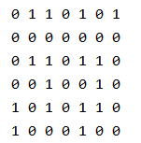
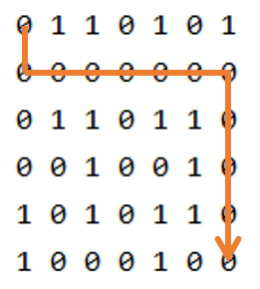
Introduction
S
S
find a path
E
E
maze
maze with its shortest path

Slide 3
Introduction
Depth-First Search
Breadth-First search
Dijkstra’s Algorithm
A* Algorithm
Shortest Path
Problem
solutions

Slide 4
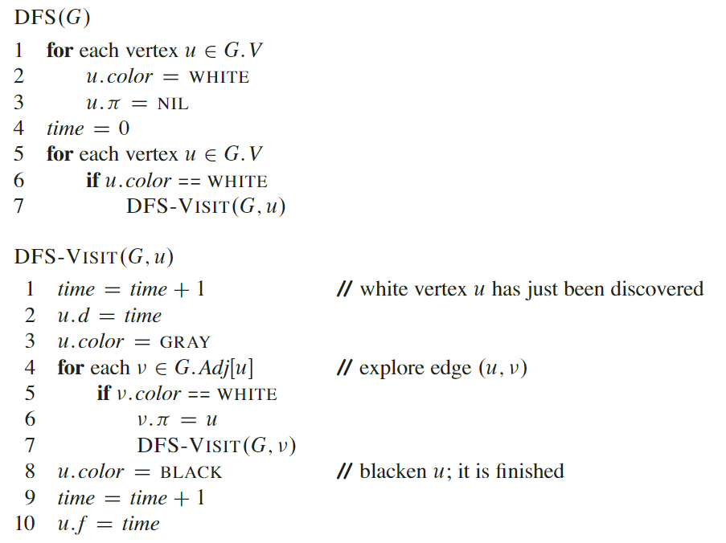
Depth-First Search (DFS)
Does NOT yield shortest path in undirected graph
Time complexity for finding A path:
O(v)
Space complexity
O(V)
Notes:
Modification of DFS to gradually increase the depths can find a shortest path

Slide 5
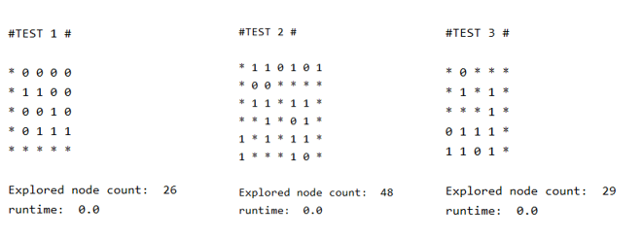
Depth-First Search (DFS)

Slide 6
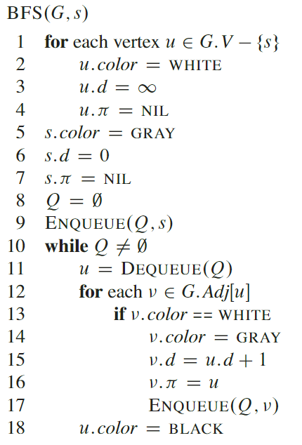

Breadth-First Search (BFS)
Time complexity
$4 × Vertex Number$
$O(V)$
Space complexity
$O(n)$
n depends on the queue size

Slide 7
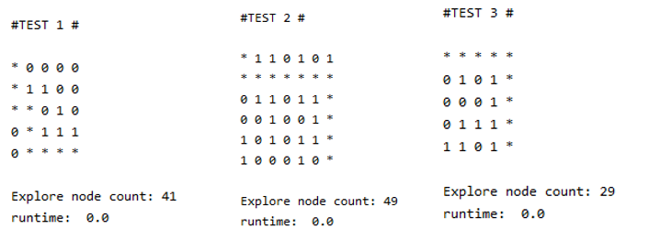
Breadth-First Search (BFS)

Slide 8
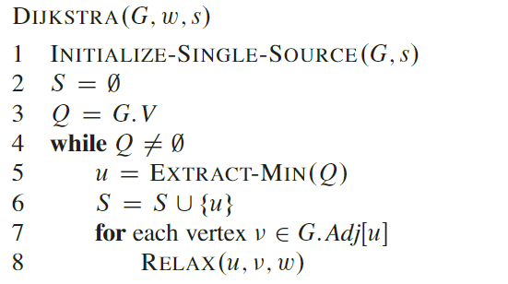

Dijkstra’s Algorithm
Time complexity
$4 × Vertex Number × Vertex Number$
$O(V^{2})$
Space complexity
$O(V)$
=> S, Q

Slide 9
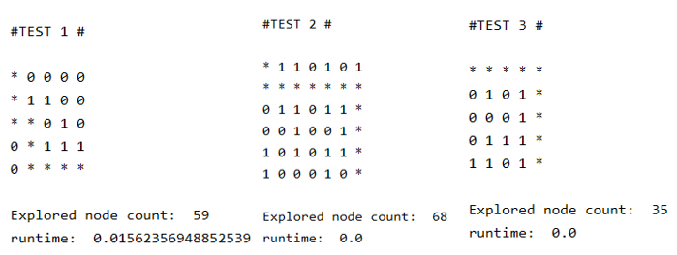
Dijkstra’s Algorithm

Slide 10
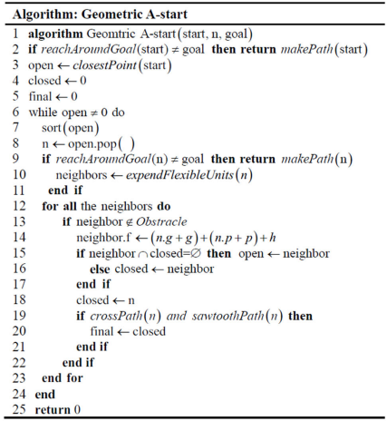
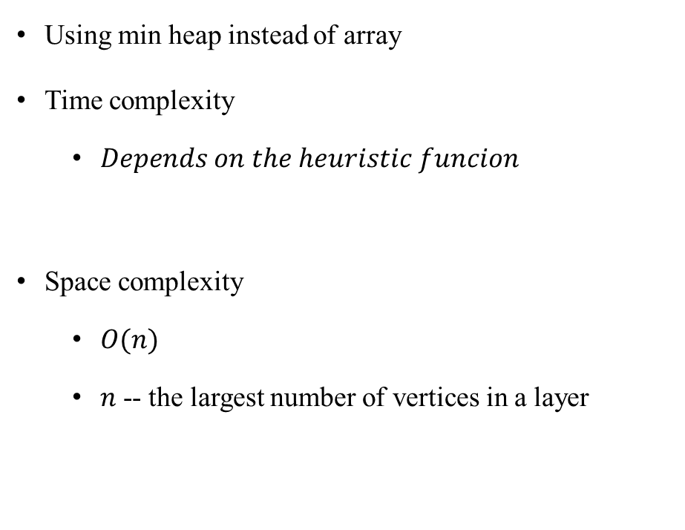
A*
Using min heap instead of array
Time complexity
$Depends on the heuristic funcion$
Space complexity
$O(n)$
𝑛 -- the largest number of vertices in a layer
Notes:
Manhattan distance

Slide 11
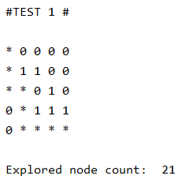
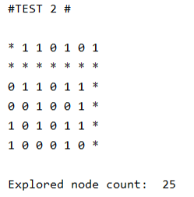
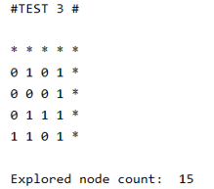
A*

Slide 12
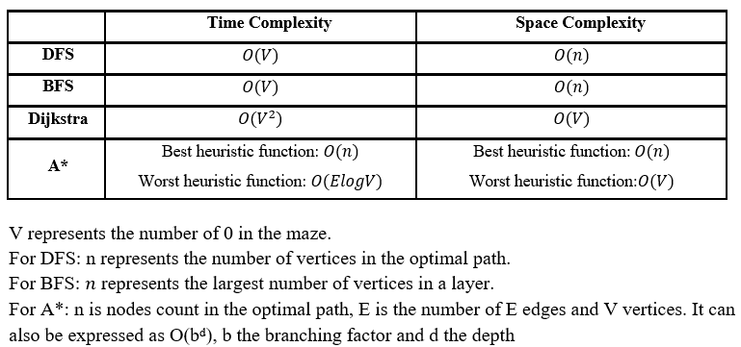
Conclusion

