Slide 1
Enhancing Performance through Advanced Memory Allocation Techniques
CS575 Jiankun Dong
Link to presentation
https://drive.google.com/file/d/1YPor4N25kyNe1Lkqd_276k0fV_hRU5JR/view?usp=drive_link

Slide 2
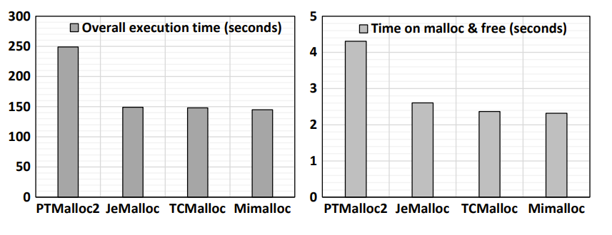
Challenges for current system

Slide 3
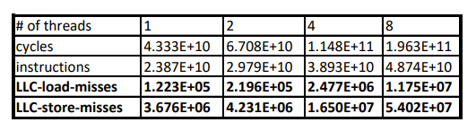
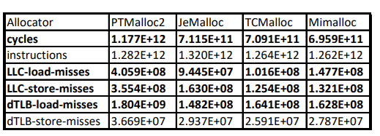
Challenges for current system

Slide 4
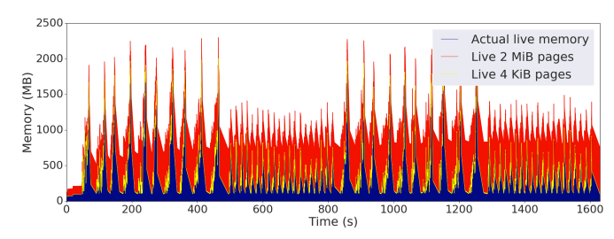
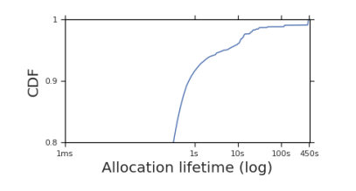
Challenges for current system

Slide 5

Nextgen-Malloc

Slide 6
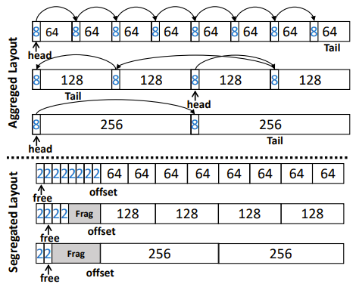
Nextgen-Malloc

Slide 7
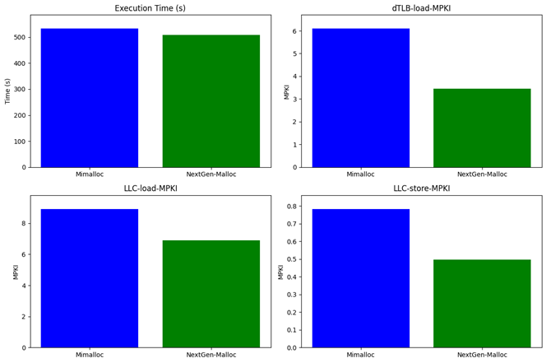
Nextgen-Malloc

Slide 8
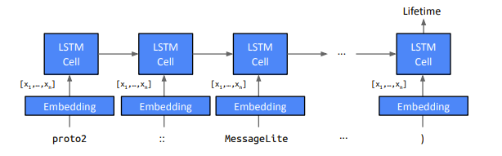
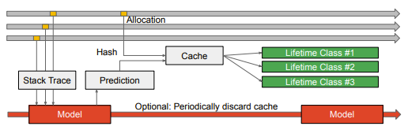
Llama

Slide 9
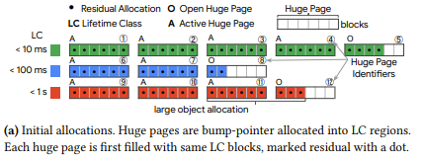
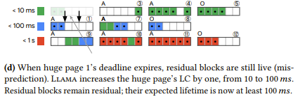
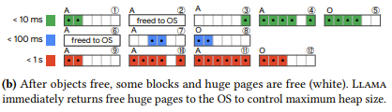
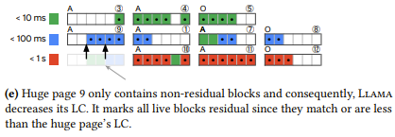
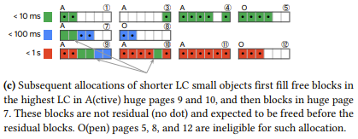
Llama

Slide 10
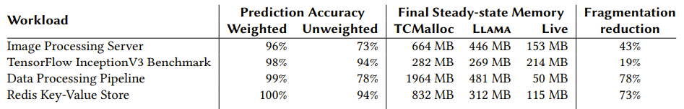
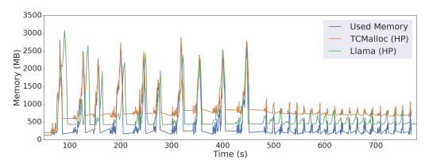
Llama

Slide 11
Reference
[1] Ruihao Li, Qinzhe Wu, Krishna Kavi, Gayatri Mehta, Neeraja J. Yadwadkar, and Lizy K. John. 2023. NextGen-Malloc: Giving Memory Allocator Its Own Room in the House. In Proceedings of the 19th Workshop on Hot Topics in Operating Systems (HOTOS '23). Association for Computing Machinery, New York, NY, USA, 135–142. https://doi.org/10.1145/3593856.3595911
[2] Hermann Schweizer, Maciej Besta, and Torsten Hoefler. 2015. Evaluating the cost of atomic operations on modern architectures. In 2015 International Conference on Parallel Architecture and Compilation (PACT). IEEE, 445–456.https://doi.org/10.48550/arXiv.2010.09852
[3] Svilen Kanev, Juan Pablo Darago, Kim Hazelwood, Parthasarathy Ranganathan, Tipp Moseley, Gu-Yeon Wei, and David Brooks. 2015. Profiling a warehouse-scale computer. In 2015 ACM/IEEE 42nd Annual International Symposium on Computer Architecture (ISCA). 158–169. https://doi.org/10.1145/2749469.2750392
[4] Svilen Kanev, Sam Likun Xi, Gu-Yeon Wei, and David Brooks. 2017. Mallacc: Accelerating Memory Allocation. In Proceedings of the TwentySecond International Conference on Architectural Support for Programming Languages and Operating Systems (Xi’an, China) (ASPLOS ’17).
[5] Martin Maas, David G. Andersen, Michael Isard, Mohammad Mahdi Javanmard, Kathryn S. McKinley, and Colin Raffel. 2020. Learning-based Memory Allocation for C++ Server Workloads. In Proceedings of the Twenty-Fifth International Conference on Architectural Support for Programming Languages and Operating Systems (ASPLOS '20). Association for Computing Machinery, New York, NY, USA, 541–556. https://doi.org/10.1145/3373376.3378525

