Slide 1
MyLittleShop Project
Team E
Nguyen Hai Duc – 9701
Tran Minh Hoang – 11112
Le Hoang Quan – 9307
Nguyen The Viet – 9990

Slide 2
DESIGN STRUCTURE

Slide 3
Tools
JavaEE – Dynamic Web Project
Axis2 Web service and client web service (SOAP Implementation)
Services: run on Tomcat server
Database: phpMyAdmin (MySQL), XAMPP: Apache web server

Slide 4
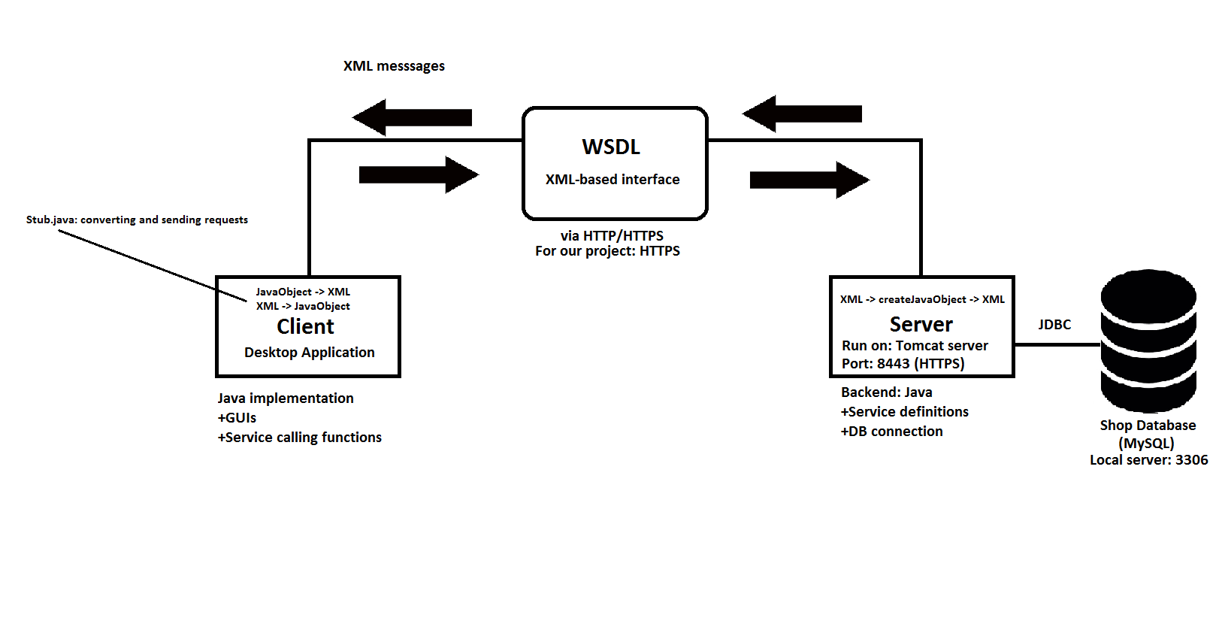
Project Structure

Slide 5
Incomplete features
Price: history, discount, revenue
Employee and manager system extension
Token-based authentication: WS-Security

Slide 6
DEMO

Slide 7
Client – Server connection: Example
Create service – Service side:
com.service.MyService.java
method: calculateSum(int firstParam, int secondParam):
return (firstParam+secondParam)
Call service – Client side:
com.service.MyServiceStub.CalculateSum.java
methods: setFirstParam(int), setSecondParam(int)
com.service.MyServiceStub.CalculateSumResponse.java
method: get_return(): return response from server

Slide 8
WS-Security: Lampart
What do be done:
Install Apacha Lampart (config axis2.xml (client), service.xml (server)
User token is generated in service.xml (username+password)
Additional encryption methods can be added here (hash, RSA)
When token is received: callback-handler (service.xml in server) returns all valid usernames and passwords to compare with data in the received messages => validate to use service functions

Slide 9
WS-Security: Lampart
Each request:
Password (logged in) is sent to server
Callback-handler retrieves password from DB
Compare and authenticate => Grant access if data matches

Slide 10
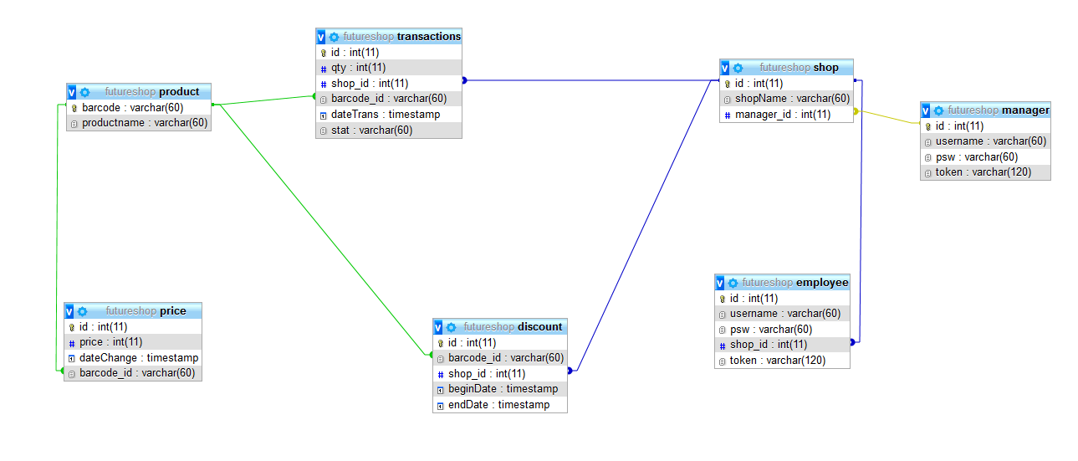
Database

Slide 11
“Note that using the service is simply a matter of creating and populating the appropriate type of request using the names defined in the WSDL file, and then using the stub to actually send the request to the appropriate method. For example, to call the DoInOnly operation, you create a DoInOnlyRequest, use its setMessageString() method to set the contents of its messageString element, and pass it as an argument to stub.DoInOnly().”
(https://axis.apache.org/axis2/java/core/docs/userguide-creatingclients.html#createclients)

Slide 12
THANK YOU!

