Slide 1


Towards a Profiling View for Unsupervised Traffic Classification by Exploring the Statistic Features and Link Patterns
Meng Qin¹, Kai Lei^{1,*}, Bo Bai², Gong Zhang²
¹ ICNLAB, SECE, Peking University Shenzhen Graduate School
² Future Network Theory Lab, 2012 Labs, Huawei Technologies Co. Ltd
2019-8-23 (Friday)

Slide 2
Outline
Motivation
Problem Definition
Methodology
Experimental Evaluation
Conclusion
Network Traffic Classification
Co-Clustering Problem with
Network Topology & Edge Attributes
Flow Statistic Features & Link Patterns
Unsupervised Profiling-Based Class. & Control

Slide 3
Motivation

Slide 4
Motivation
Traffic Classification
Identify the categories of flows (with different app. & protocols)
Essential for Network Management
Effectively support the downstream applications
e.g., QoS Guarantee [Zhang et al. TON’15; Shafiq et al. ICCC'16]
e.g., Network Accounting [Hu et al. JICS'12]
e.g., Intrusion Detection [Shafiq et al. ICCC’16; Wang et al. ICOIN’17]
etc.

Slide 5


Motivation (Cont)
Existing Traffic Classification Tech.
Reviewed in [Hu et al, JICS'12; Zhang et al. TON’15]
Port-based approaches
Not always reliable due to the uncertainty & dynamics of ports
Payload-based approaches
Fails with encrypted traffic
Statistics-based approaches (with ML Tech.)
Emerge as a significant topic due to the high performance & strong adaption
e.g., SVM, AdaBoost, Naive Bayes, Auto-Encoder, CNN, etc.
[Zhang, et al., TPDS’12; Shafiq, et al. ICCC16; Lotfollahi, et al. Soft Comp.’17; Sun, et al., CEE’18]

Slide 6
Motivation (Cont)
Limitations of Stat.-Based ML Methods
Utilization of limited info. src.
Only focus on flow statistic feature
Inherently ignore the available linkage patterns
Fails with zero-day traffic
Typical supervised learning paradigm
With traffic labels assumed to be known in adv.
Explore traffic feat. in a long period (e.g., hours or days)
Zero-day traffic
New unknown traffic gen. in a short time win.
without enough prior knowledge in the training data
e.g., Stat. Feat.
Flow | #Pkt | … | RTT
#1 | 31 | … | 15
… | … | … | …
#N | 4 | … | 2
e.g., Link. Patt.

Slide 7
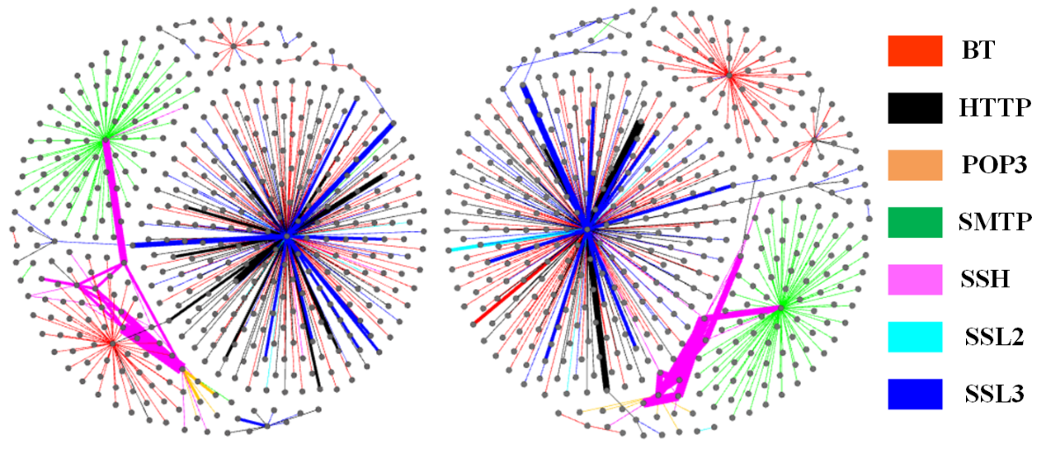
Motivation (Cont)
About Link Patterns
Observation on public real traffic datasets
Keio, WIDE, ISP [Zhang et al. TON'15]
Construct Traffic Activity Graph (TAG)
Visualization of link patterns
End Host → Node
Flow → Edge
Edge Color → Flow Class
Obvious link cluster structures in TAGs
Link pattern provides add. info. beyond stat. feat.
Can be fully utilized to improve flow classification
e.g., Two sampled TAGs of the ISP dataset

Slide 8
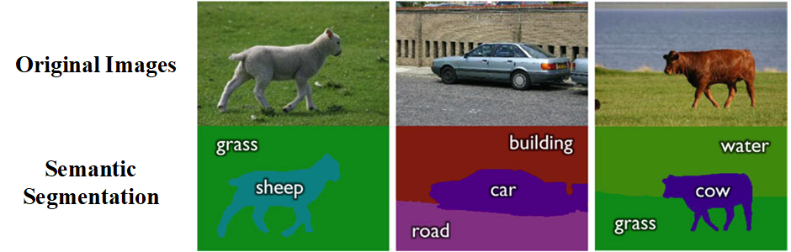
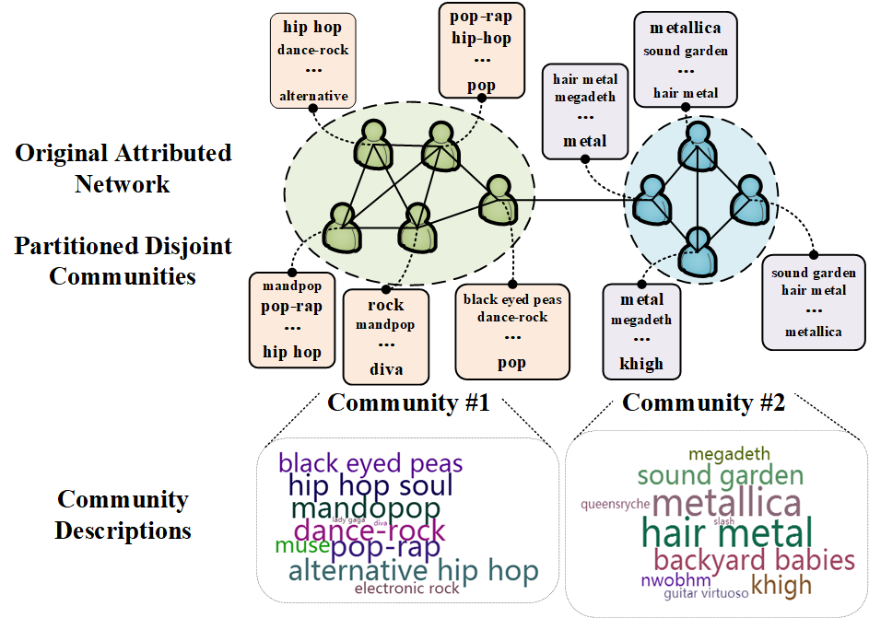
Motivation (Cont)
About Zero-Day Traffic
Inspired from other research communities
Semantic Segmentation (CV)
Image segmentation & semantic annotation
Semantic Community Detection (KDD & Net. Aly.)
Community detection & description generation
In attributed networks
Unsupervised co-clustering
Reveal the network’s deep semantic

Slide 9

Motivation (Cont)
About Zero-Day Traffic (Cont)
Labels in training data for supervised classification
Semantic & knowledge in the past long period
Manually inspected by experts
Semantic Description via unsupervised clustering
Semantic & knowledge even in a short time window
Automatically generated !!!!!
Our Solution to zero-day traffic
Unsupervised Flow Clustering & Profiling
With Stat. Feat. & Link Patterns

Slide 10
Problem Definition

Slide 11
Problem Definition
Unsupervised Clustering & Profiling
Flow → Graph with edge-induced feat.
Clustering – Flow Membership
Partition the flow set into K subsets
With dense linage & similar feat.
Profiling
Representative feat. & dominant link cluster
For each flow class

Slide 12
Methodology

Slide 13
Methodology
Our model: Hybrid Flow Clustering (HFC)
Based on Non-negative Matrix Factorization (NMF) [Lee, et al. Nature'98]
NMF’s equivalent views
K-means clustering
Probabilistic models
Intro. Hidden Space
(Observable) Feature Matrix
Non-negative Constraints

Slide 14
Methodology (Cont)
Modeling the Stat. Feat.
Divide the continuous feat. into mult. discrete levels
Clearer semantic & Better Performance
Flow Feat. Mat. F
F_{i,:} - flow F_{i}’s discrete features
Feat. Membership Mat. X; Feat. Description Mat. Y
X_{ir} - pro. that Flow F_{i} is a member of Class C_{r}
Y_{jr} - pro. that Class C_{r} can be described by (disc.) feat. a_{j}
Obj.:
NMF’s prob. view
NMF’s Clustering. view
Cluster Mem. Ind.
Cluster Centers
Sparse Constraint

Slide 15
Methodology (Cont)
Modeling the Link Patterns
Link Structure Mat. B
B_{il} = 1, if h_{l} is an induced host of flow F_{i}
B_{il} = 0, otherwise
Edge Mem. Mat. Z; Node Mem. Mat. R
Z_{ik} - pro. that edge (i.e., flow) F_{i} belongs to link. cluster L_{k}
R_{lk} – pro. that node (i.e., edge host) h_{l} belongs to link. cluster L_{k}
Expectation that h_{l} is the edge host of flow F_{i} -
Obj.:

Slide 16
Methodology (Cont)
Unified HFC Model (Feat. + Link)
View of Separated Clustering Membership
Link cluster with mixture of mult. classes
Treat stat. feat. as the dominant src.
With link patt. as the auxiliary src.
(Insp. Markov Trans.) Attention-like Trans. Mat. U
U_{rk} trans. propensity from feat. clus. C_{r} to link clus. L_{k}
Z=XU i.e., replace Z with XU
Obj.:
e.g., Mixture of Classes
(1) Flow Class Mem.
(2) Rep. Feat. of Each Class
(3) Distribution. of Link Cluster
(4) Rep. End Hosts of Each Link Clus.

Slide 17
Methodology (Cont)
Model Optimization
NNDSVD initialization [Boutsidis, et al. PR'08]
Iterative Updating (with multiplicative rules) until converge
In terms update one variable (with others fixed)
X-Step
Y-Step
U-Step
R-Step

Slide 18
Experimental Evaluation

Slide 19
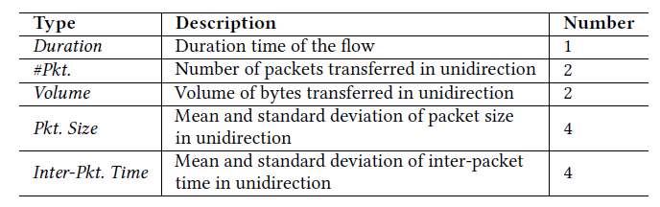
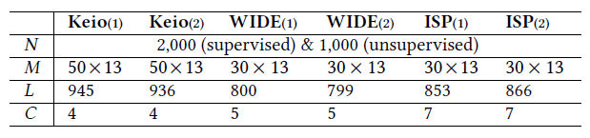
Experimental Evaluation
Dataset
3 public real traffic datasets
Keio, WIDE, ISP [Zhang et al. TON’15]
Average #flow per second
Keio: 97.43; WIDE: 133.55; ISP: 5.59
Assume there are ≤ 1,000 flows in 5 Sec.
For each dataset
Sample 1,000 flows for unsupervised meth.
Sample 2,000 flows for supervised meth.
First 1,000 as training set
Last 1,000 as testing set – same set with unsupervised meth. !!
Repeat the sampling twice → 6 testing datasets
13 Feat.
Stat. of the 6 testing datasets

Slide 20
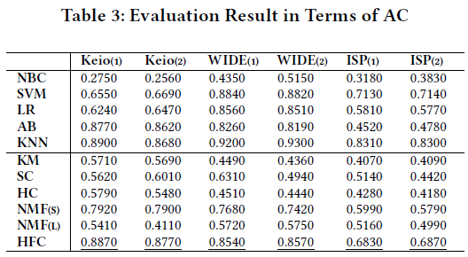
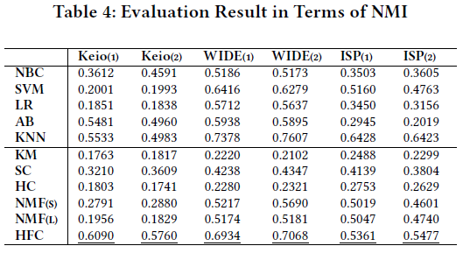
Experimental Evaluation (Cont)
Performance evaluation
Clus. mem. learned by HFC v.s. Manual inspected traffic categories
5 supervised baselines (with first 1,000 flows as training set)
3 unsupervised baselines
Basic NMF model regarding (1) stat. feat. & (2) link patterns
NMF_{(S)}, NMF_{(L)}
Competitive to Supervised Base.
13.73% & 38.04% improv.

Slide 21
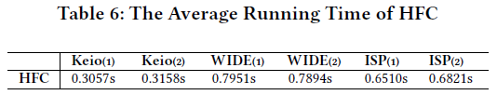
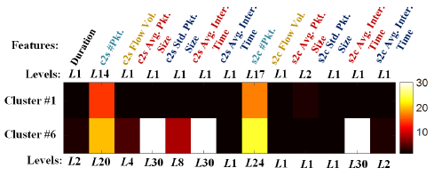
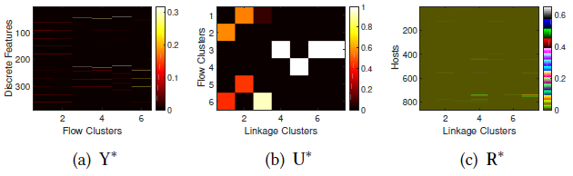
Experimental Evaluation
Time Analysis
Running time <1sec. on all the datasets
<5 sec. (i.e., the assumed time win.)
Case Study (Unsupervised Flow Profiling)
Example res. on ISP₍₂₎
NMF-Based Model Selection [Jean et al. PNAS’04]
K₁=6, K₂=7
Y* for rep. feat. of each class
e.g., Class #1 & Class #6
U* for dom. link. clus. of each class
e.g, link clus. #2 & #3 for class #1
R* for rep. end host of each link clus.

Slide 22
Conclusion

Slide 23
Conclusion
This study
Formulate the classic traffic classification task
Unsupervised co-clustering problem
With stat. feat. & link patterns
Unsupervised flow profiling
Automatically reveal the deep semantic of net. Traffic in just a short time win.
Future Work
Semi-supervised parameter adjust. strategy
Reduce parameter's search space
Distributed & Parallel NMF
Further speed up computation

Slide 24
Towards a Profiling View for Unsupervised Traffic Classification by Exploring the Statistic Features and Link Patterns
Thank You Very Much!
Q&A
Meng Qin (megnqin_az@foxmail.com)

