Slide 1

Identifying Interpretable Link Communities with User Interactions and Messages in Social Networks
Meng Qin^{1,2,#}, Wei Li^{1,2,#}, Kai Lei^{1,2}
¹ ICNLAB, SECE, Peking University (Shenzhen Graduate School)
² PCL Research Center of Networks and Communications, Peng Cheng Lab
2019-12-16 (Mon.)

Slide 2
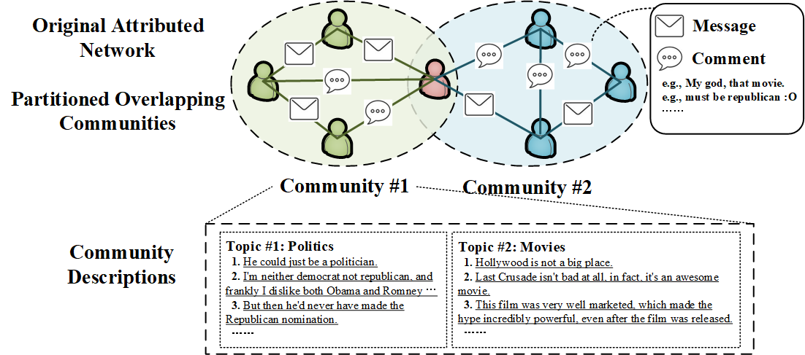
Outline
Motivation
Problem Definition
Methodology
Experimental Evaluation
Conclusion
Semantic Link Community Detection
Partition with topology & link content
Link-based overlapping community detection
Multi-view & fine-grained semantic descriptions

Slide 3
Motivation

Slide 4
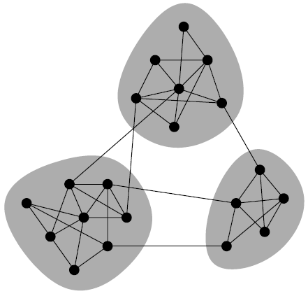
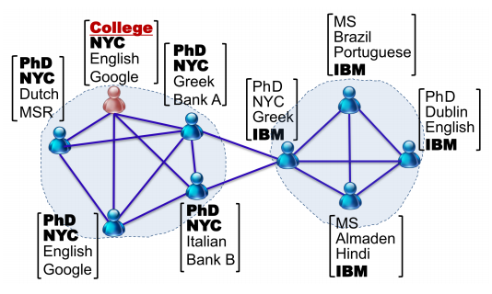
Motivation
Community #1
Community Detection
Community struct. → Significant group/organization in real net.
Reveals network’s structure, function & semantic
Conventional methods
Partitions node groups with dense linkage [Newman et al. 2002]
Consider network topology (e.g., user interactions) alone
State-of-the-art techniques
Tries to combine net. topology & content
(1) Further improve the community partition
Content provides complementary info. beyond topology
(2) Derive interpretable communities
Generate semantic descriptions for each community
By exploring the user-generated content
e.g., interest tags, profiling features, message, etc.
Community #2
Community #3

Slide 5
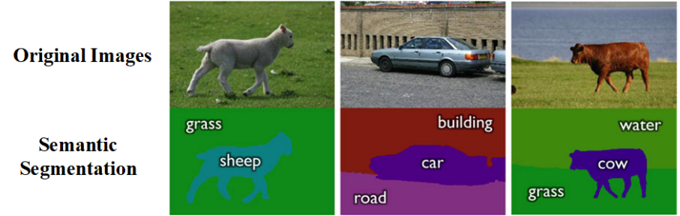
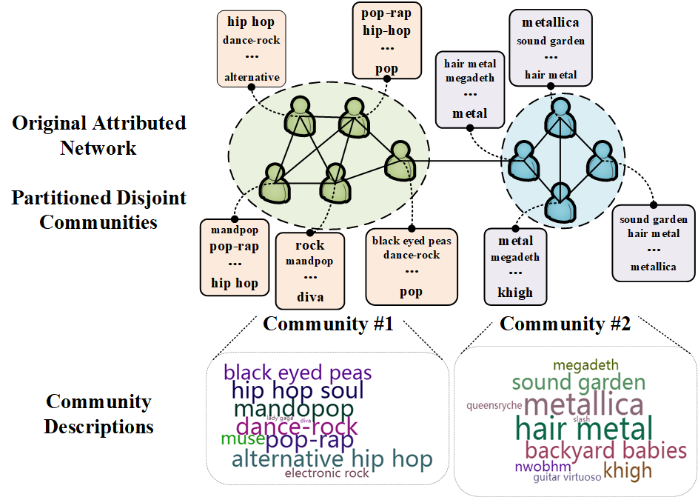
Motivation (Cont)
Semantic Community Detection (SCD)
Inspired by Semantic Segmentation in CV
Simultaneous image segmentation & semantic annotation
Reveal deep knowledge & semantic of the image
New concept of SCD
Consider both network topology & content
Simultaneously & Unsuperivsedly !!
Partitioning the network into several communities
Generating semantic descriptions for each community
Limitations
Node-induced content for disjoint node communities
Can’t deal with edge-induced content & overlapping CD
Word-level content for coarse-grained descriptions
Ignore sentence-level cont.; Can’t reflect cont. diversity
Semantic Segmentation
Inspired to!
Existing SCD

Slide 6
Motivation (Cont)
Our Contributions
A novel Semantic Link Community Detection (SCLD) model
Integrate edge-induced content for overlapping CD
User interactions (topo.) & messages (edge-induced cont.)
Partition (disjoint) link communities
Transformed into overlapping node communities
Strongly interpretable & multi-view community desc.
Both word-level & sentence-level content
Multi desc. for each community
With each desc. corresponding to one view/topic
Sentences (i.e., summarization) for each desc.
With stronger interpretability (v.s. word-cloud)
Existing SCD
Novel SLCD !!

Slide 7
Problem Definition

Slide 8
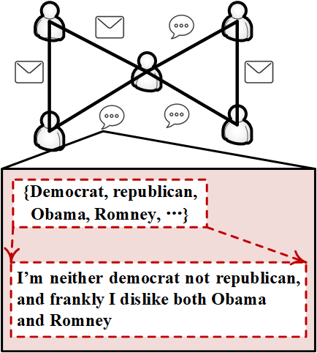
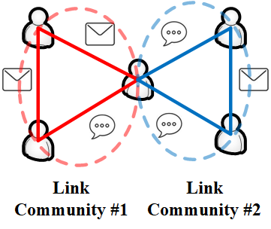
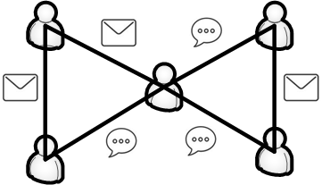
Problem Definition
Social networks (with user messages) → Attributed graph (with edge-induced cont.)
G={V, E, A, F_{A}, C, F_{C}}
Node set: V={v₁, …, v_{M}}; Edge set E={e_{l}(v_{i}, v_{j})};
Word set: A={a₁, …, a_{W}}; Sentence set: C={c₁, …, c_{S}}
Edge-word map: F_{A}={F_{A}(e_{l})}; Edge-sentence map: F_{C}={F_{C}(e_{l})}
Identification of Link Communities
Partition E into K disjoint subsets (i.e., link communities) R={R₁, …, R_{K}}
Based on linkage (i.e., E) and content (i.e., {F_{A}, F_{C}})
Within each community: dense linkage & similar content semantic
Between different communities: relatively loose linkage & distinct content semantic
R_{r}∩R_{t} = ∅ for arbitrary r ≠ t

Slide 9
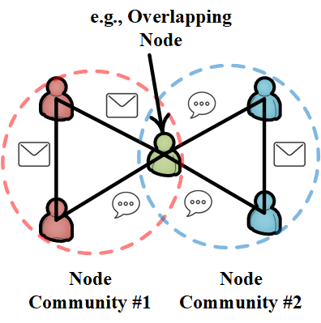
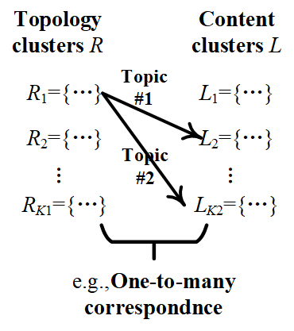
Problem Definition (Cont)
Transforming to Node Communities
If edge e_{l}(v_{i}, v_{j}) belongs to the link community R_{r}
Let induced nodes {v_{i}, v_{j}} belong to node com. R’r
Forming overlapping node partition
R’={R’₁, …, R’_{K}}
There exist r ≠ t that R’_{r}∩R’_{t} ≠ ∅
Correlation between Topology and Content
Separated clustering membership view to support multi-view community desc.
Partition E into K₁ topo. clusters only based on user interactions
R = {R₁, …, R_{K1}}
Partition E into K₂ cont. clusters only based on user messages
L = {L₁, …, L_{K2}}
Explore the correlation between R & L
Extract the one-to-many correspondence from R to L

Slide 10
Methodology

Slide 11
Methodology
The SLCD Model
Probability view of non-negative matrix factorization (NMF) [Lee et al. Nature]
e.g.,
Modeling Network Topology
Network with M nodes, N edges & K₁ topology clusters
Network topology: link structure matrix: B∈R^{N×M}
B_{li} = 1 if v_{i} is an end node of edge e_{l}; B_{li} = 0 otherwise
Edge partition: link membership matrix: X∈R^{N×K1}
X_{lr}: propensity that edge e_{l} belongs to topo. cluster R_{r}
Node partition: node membership matrix: Y∈R^{M×K1}
Y_{ir}: propensity that node v_{i} belongs to topo. cluster R_{r}
Σ_{r}X_{lr}Y_{ir}: propensity that v_{i} is an end node of edge e_{l}
Fit XY to B !!
Objective:
Extract link-based topology clusters

Slide 12
Methodology (Cont)
Modeling Edge-Induced Content
Topic-enhanced multi-document summarization
Observable distributions: p(a_{w}|e_{l}), p(a_{s}|c_{s})
Distributions to be inferred: p(c_{s}|L_{t}), p(L_{t}|e_{l})
Transforming to equivalent NMF objective
Messages with W words, S sen. & K₂ cont. clusters
Link-word matrix: C∈R^{N×M}
C_{lw}=1 if edge e_{l} has word a_{w}; C_{lw}=0 otherwise
Content membership matrix: Z∈R^{N×K2}
Z_{lt}: prop. edge e_{l} belongs to cluster L_{t}
Sentence description matrix: U∈R^{S×K2}
U_{st}: prop. topic L_{t} can be described by sen. c_{s}
Content relation matrix: V∈R^{S×W}
V_{sw}=1/|c_{s}| if c_{s} has a_{w}; V_{sw}=0 otherwise
Fit ZU^{T}V to C !!
Observations
Latent variables
Word a_{w}
Edge e_{l}
Sentence c_{s}
Topic L_{t}
C
V
U
Z
Extract link-based content clusters
Derive semantic desc. (representative sentence)

Slide 13
Methodology (Cont)
Unified Model
Combine topo. obj. & cont. obj. (separated clustering membership view)
Consider the correlation between topo. clusters & cont. clusters
i.e., correspondence between X & Z
Attention-like transition relation
Membership transition matrix: R∈R^{K1×K2}
R_{rt}: trans. prop. from topo. clus. R_{r} to cont. clus. L_{t}
Transition relation: Z=XR !!
Combine
(with Z=XR)
Extract disjoint link communities
Find dominant topics/view for each community
Derive summarization (i.e., semantic desc.) for each topic/view
Transform into overlapping node communities

Slide 14
Methodology (Cont)
Model Optimization
Block coordinate descent for the non-convex obj.
Use NNDSVD for initialization
Iteratively update {X, Y, U, R} until converge
i.e., in terms update one variable (with others fixed)
X-Step
Y-Step
R-Step
U-Step
Time complexity
Much less than O(T(NMK₁ + WSK₂ + NWK₂)) by considering {B, C}’s sparsity
max{K₁, K₂} << min{N, M, W, S}; N << M²

Slide 15
Experimental Evaluation

Slide 16
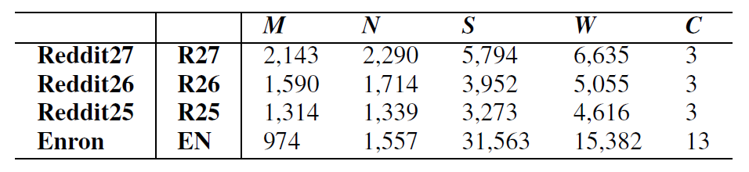
Experimental Evaluation
Dataset
Enron (EN): Email network
Node ← User
Edge ← Email interactions
Edge-induced cont. ← Email text
(1) Extract sentences from raw text
(2) Removing stop words & Stemming
Ground-truth ← Transformed overlapping node-induced labels ← Manually annotated (edge-induced) email labels
Reddit: Social news forums network (3 time slices, i.e., R27, R26 & R25)
Node ← User
Edge ← Comment interactions
Edge-induced cont. ← Comment text: (1) Extract sen.; (2) Removing stop words & Stemming
Ground-truth ← Overlapping node-induced ← Subforums where a user post cont.
#Node
#Edge
#Sentence
#Word
#Com.

Slide 17
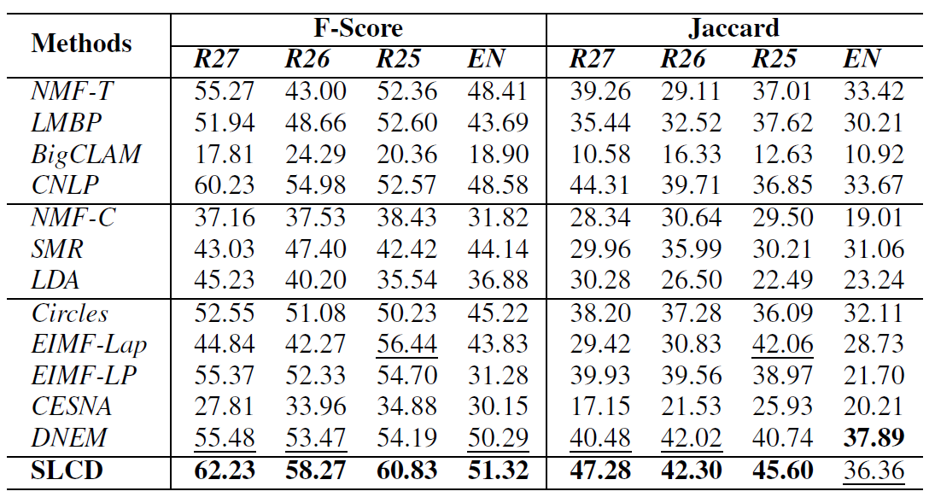
Experimental Evaluation (Cont)
Performance Evaluation (for overlapping community detection)
Metrics
Generalized Jaccard sim. & F-Score (i.e., f(R_{r}, G_{t}))
Partition result R={R₁, …, R_{K}} v.s. Ground-truth G={G₁, …, G_{K}}
Baselines
Topology-based meth.
NMF-T, LMBP, BigCLAM, CNLP
Content-based meth.
NMF-C, SMR, LDA
Meth. with topo. & cont.
Circles, EIMF-Lap, EIMF-LP
CESNA, DNEM
Settings of SLCD
K₁=K₂=C; Adjust {α, β}

Slide 18
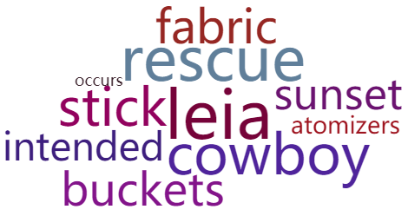
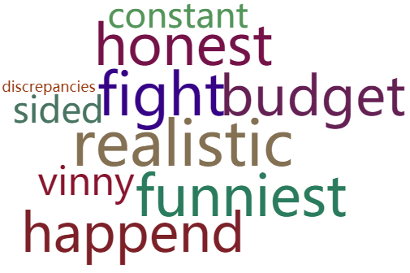
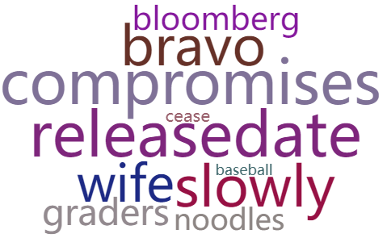
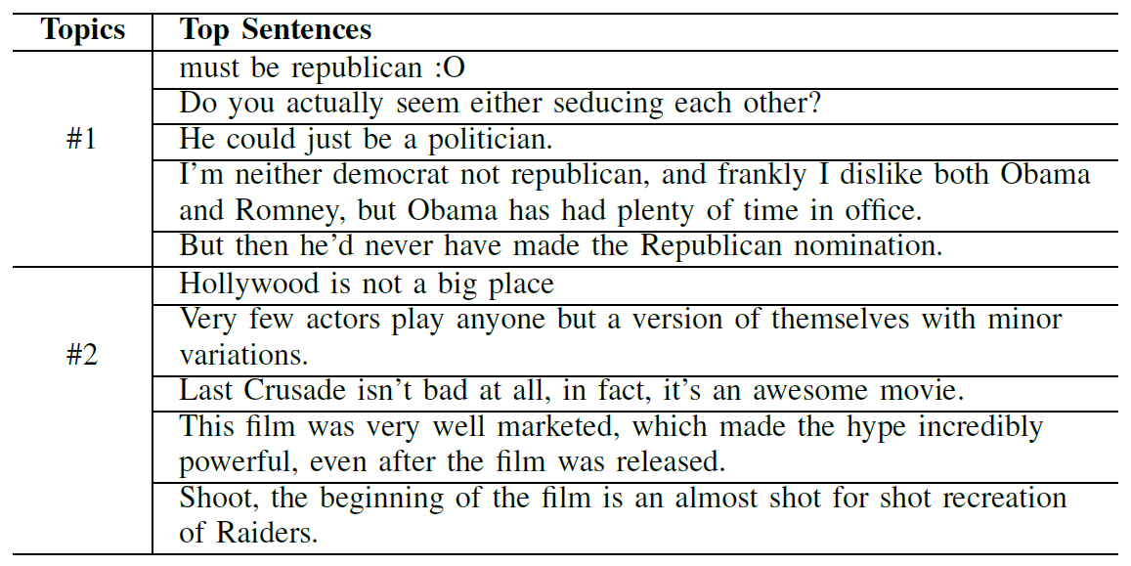
Experimental Evaluation (Cont)
Case study (for semantic description)
On Reddit25 (R25)
3 distinct topics: Movie, Politics & Science
To verify the interpretability
Baseline: SCI [Jin et al. 2016]
Integrate node-induced word-level
Only one comp. desc. for each community
With word-cloud (representative keywords)
Our SLCD
Multi-view & strongly interpretable desc.
Multiple topics/views for each comm.
Desc. in form of summarization
SCI, Com. #1
SCI, Com. #2
SCI, Com. #3
Topic #1
(Politics)
Topic #2
(Movie)
e.g., Semantic Description
(i.e., summ., representative sen.)
Community #1
e.g., Transition matrix R

Slide 19
Conclusion

Slide 20
Conclusion
This study
Focus on overlapping semantic communities with edge-induced content
Propose SLCD model
Derive overlapping node communities via disjoint link communities
Consider both word-level & sentence-level edge-induced content
Explore the intrinsic correlation between topo. & cont.
Derive multi-view & strongly interpretable semantic desc.
Future work
Consider both the node-induced & edge-induced content
Better strategy for hyper-parameter setting
Further speed up the computation

Slide 21
Identifying Interpretable Link Communities with User Interactions and Messages in Social Networks
Thank You Very Much!
Q&A
Meng Qin (megnqin_az@foxmail.com)

