Slide 1

LOOP WP1 Ontology implementation and examples
^{Stephen Richard}
^{Boyan Brodaric}

Slide 2
Outline
Notes on implementation process
Deep dive into encoding geology

Slide 3
Implementation
OWL
UML model
Turtle encoding
Tools
Enterprise Architect
Notepad ++
Protégé 5.5
TopBraid Composer Free Edition
GitHub

Slide 4
Development approach
Start with UML
Manual implementation of OWL
Incremental, build up from common, base geology, extensions…
Implement example instance documents in parallel to test
Iterate
Add vocabularies

Slide 5
Turtle encoding
Tom
a ex:human ;
ex:hasBrother <http://orcid.org/349460> ;
ex:eyeColor “brown”
.
Subject
a ns:thing ;
Predicate1 object1 ;
Predicate2 object 2
.

Slide 6
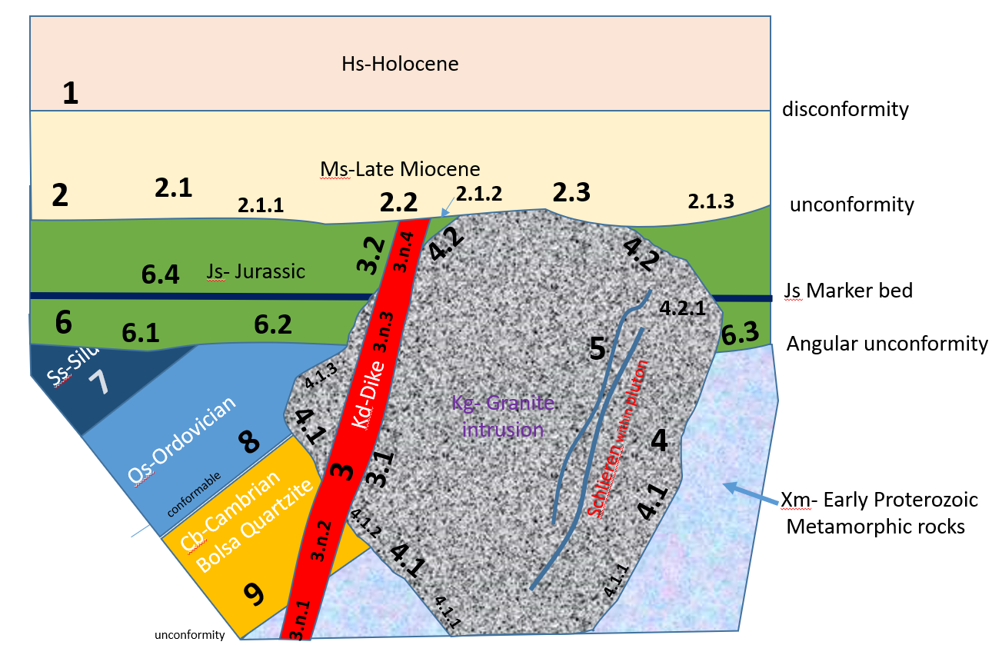
Deposition (Ms, Hs)
Erosion
Dike intrusion (Kd)
Pluton intrusion (Kg)
Deposition (Js)
Erosion
Tilting
Deposition (Cb, Os, Ss)
Erosion
Metamorphism (Xm)
????
Xm
Xm

Slide 7
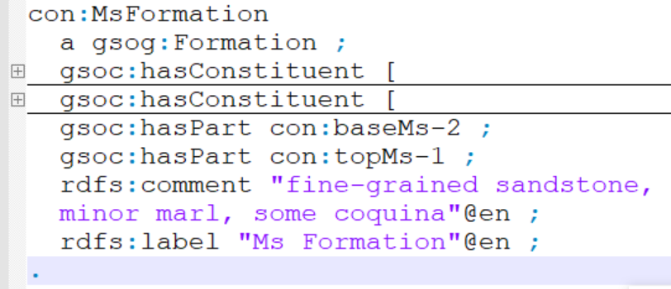
Define Formation
Namespaces

Slide 8
Define Formation
Link by reference

Slide 9
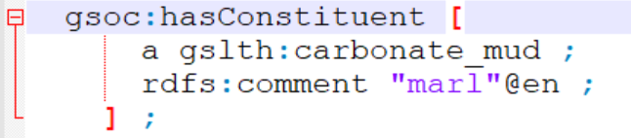
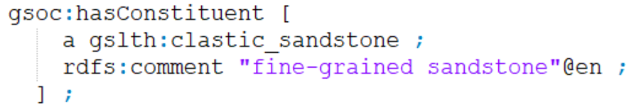
Constituents
Blank node:
An instance of a class that is not independently identified

Slide 10
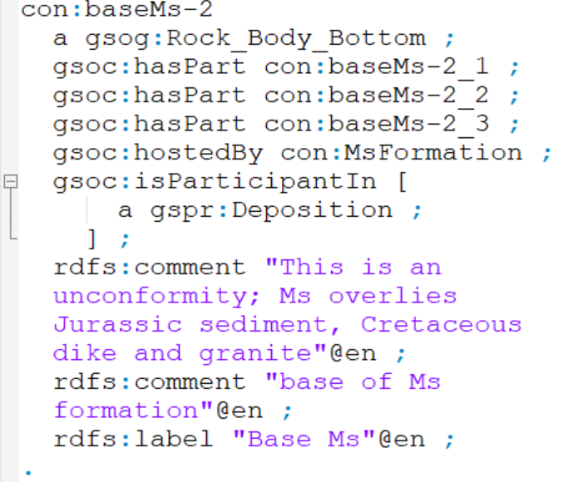
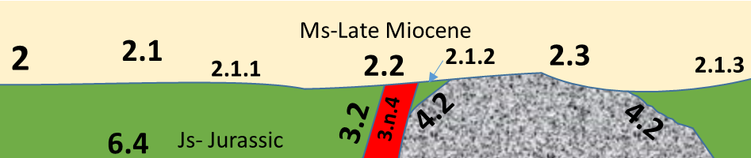
Contact has parts
Deposition
Erosion

Slide 11
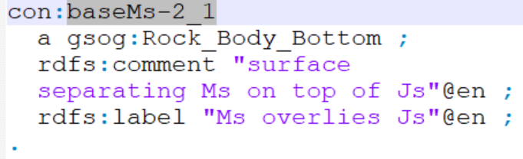
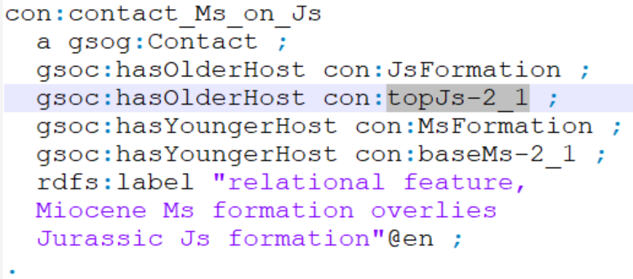
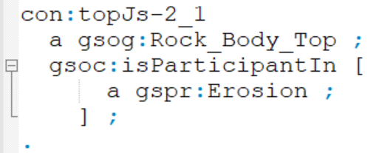
Boundaries, Contacts, Events
Rock_Body_Bottom a Geologic unit part
Contact is derived from relation between two hosts

Slide 12
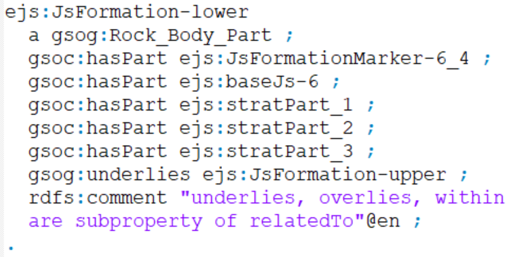
More detailed stratigraphy
Define stratigraphic parts
Thickness, fossils, clast types, lithology

Slide 13
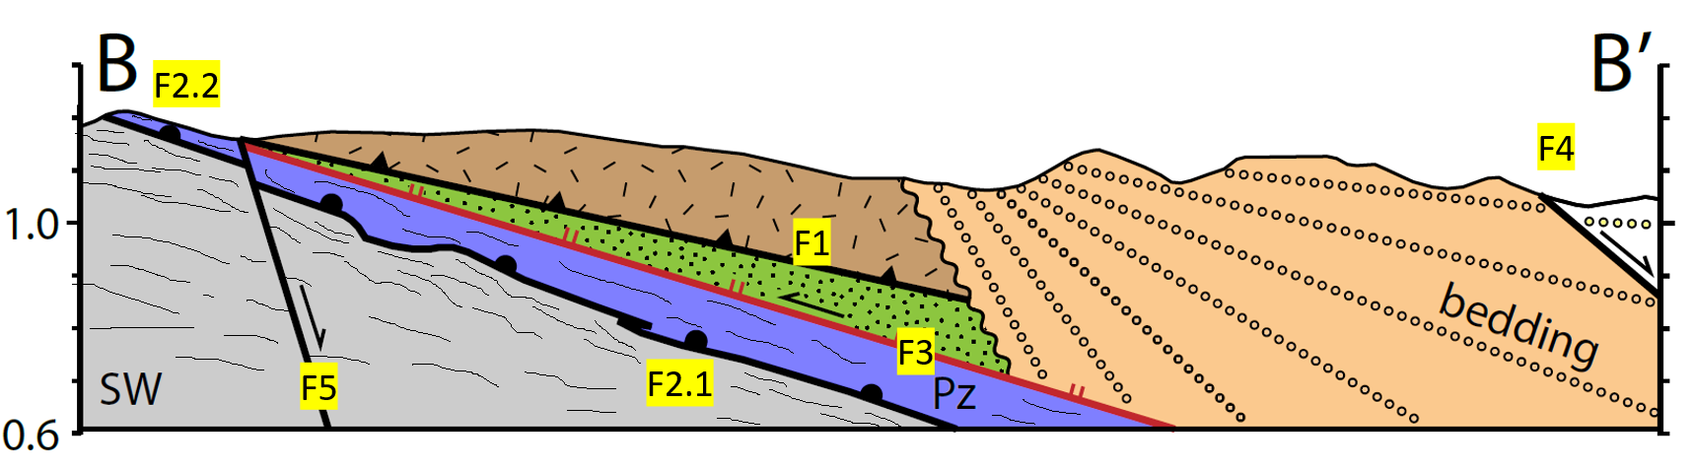
Events:
Proterozoic intrusion
Paleozoic deposition
Mesozoic deposition
Thrust– pC on Mz, burial of Phanerozoic supracrustals
Tilting of Mz Orogenic complex
normal faulting and growth-fault sedimentation
Shear along Pz- pC contact
Ductile deformation in basement
Late-stage Down to east normal faults

Slide 14
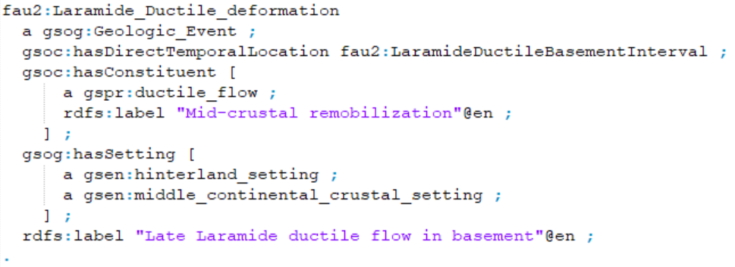
Event descriptions
when
what
where

Slide 15
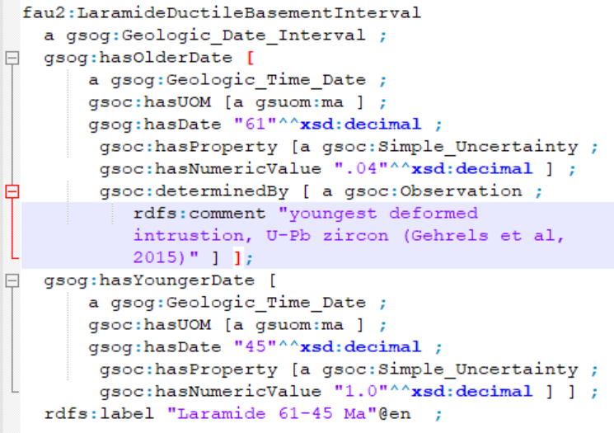
Geochronology: Dates
Numeric value and Units
Uncertainty
Provenance

Slide 16
Query examples
Find units that intrude Js:
SELECT ?sub WHERE { ?sub gsog:intrudes con:JsFormation . }
?sub
con:KdDike
con:KgGranite

Slide 17
Query examples
Find all the parts of Js formation:
SELECT ?obj WHERE { ejs:JsFormation gsoc:hasPart* ?obj . }
[sub]
<@33ecf45….f784a56890d9e>
con:KdInJsDikeContact-3_1_4
con:KdInJsDikeContact-3_2_4
con:KgInJsIntrusiveContact-4_2
ejs:baseJs-6
ejs:JsFormation-upper
ejs:lith_1
ejs:topJs-2
[obj]

Slide 18
Vocabularies
Transform CGI Geoscience Terminology Workgroup SKOS vocabularies to OWL
skos:Concept → owl:Class
skos:broader → rdfs:subClassOf
Some refactoring
Rock body parts, geologic process
Settings– some ‘broader’ relations → part of
17 vocabularies converted so far

Slide 19
Vocabularies
Elements: extract from Wikipedia
Minerals: extract from RRUFF and Wikipedia
Imported properties are all annotation properties

Slide 20
What’s Next?
Test with actual data
More vocabularies
Refine with specific use cases
Rules for data validation
Application for implicit model generation
Thanks!

