Slide 1

The GeoScience Ontology (GSO)
Boyan Brodaric* and Stephen Richard⁺
*Geological Survey of Canada, Ottawa, ON, Canada
⁺USGIN Foundation, Tucson, AZ, USA

Slide 2
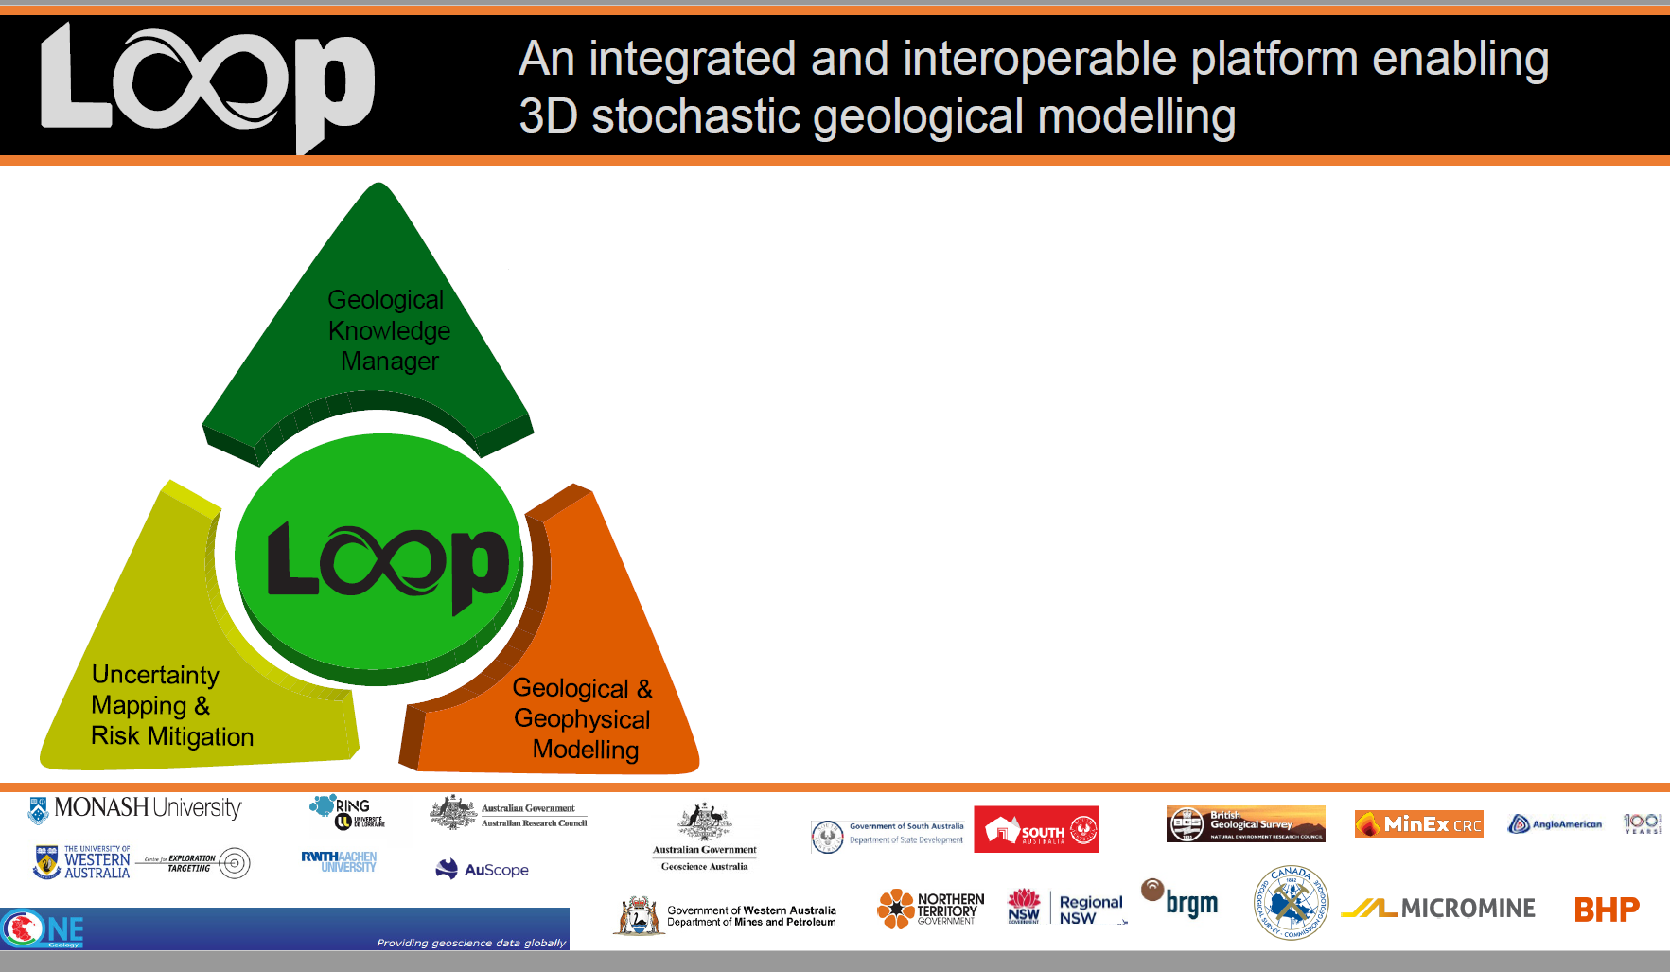
Work Package 1
Knowledge Extraction
Knowledge Structure
GeoScience Ontology
Knowledge Repository
Knowledge Use

Slide 3
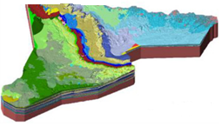
Geoscience Knowledge Manager Concept
Geoscience Knowledge Manager
textbook knowledge
interpretations
Modelling
models
Data
laws, rules, theories
stratigraphy
event history
topology
…
observations
- boreholes, field data, geophys,…

Slide 4
GSO vs GeoSciML
apples and oranges
GSO
Re-conceptualization
Conceptual Schema
Not syntax difference (owl vs xml)
GeoSciML UML
Logical Schema
GeoSciML XSD
Application Schema

Slide 5
GSO Development
Requirements
Broad and Deep: basic geologic entities (min GeoSciML)
Modular: core ontology + plug-and-play modules
Stand-alone: no imports – for compactness and consistency
Methods
✓ GKM GitHub https://github.com/Loop3D/GKM
✓ Ontological analysis (First-Order Logic, Dolce, BFO, UFO)
✓ UML diagrams (Enterprise Architect)
✓ OWL encoding (ttl: TopBraid, Protégé)
✓ Examples (ttl: Units, Faults, Folds, Time Scale)
✓ Testing (more synthetic examples)
✓ Implementation (triplestore, graph db, real data)
3D Integration (with modelling code)

Slide 6
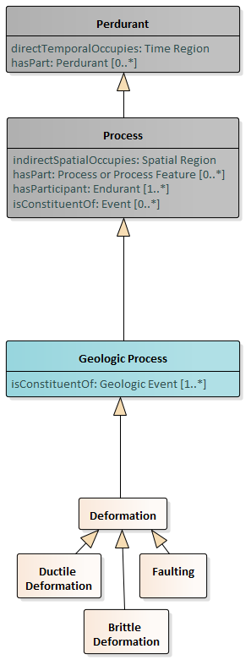
GSO Modular Organization
Layercake Ontology
Common (static) after BFO, DOLCE, UFO, other + GSO
general framework: e.g. object, process, quality, space, time,…
Geology (static) after NADM, GeoSciML, DOLCE Rocks
geology framework: e.g. geologic unit, structure, event, time scale,…
Modules (extensible, exchangeable) after GeoSciML,…
geology modules: e.g. qualities, settings, structures, lithologies, minerals, elements, time scales,…

Slide 7


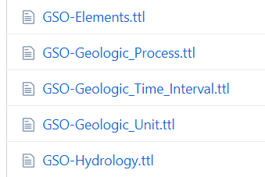
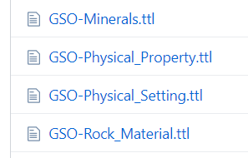
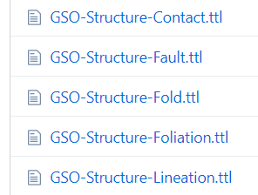
GSO GitHub (https://github.com/Loop3D/GKM)
Layercake Ontology
Common
general framework
Geology
geology framework
Modules
geology modules

Slide 8
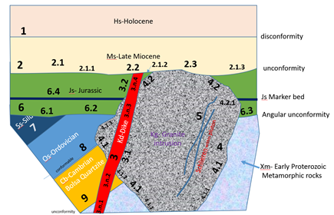
Example 1
Geologic Unit
ejs:JsFormation
a gsog:Formation ;
gsoc:indirectTemporalOccupies
gstime:LowerJurassic2020 ;
gsoc:hasPart ejs:JsFormation-upper ;
gsoc:hasPart ejs:JsFormation-lower ;
gsoc:hasPart ejs:baseJs-6 ;
gsoc:hasPart ejs:topJs-2 ;
gsoc:hasQuality [
a gsgu:Bedding_Thickness ;
gsoc: hasQuality [
a gsoc: Quality_Range [
gsoc:hasStartValue [a gsoc:Thin ] ;
gsoc:hasEndValue [a gsoc:Medium ] ;
]
]
] ;
.
Js
JsFormation-upper
JsFormation-lower
Notes:
Age is assigned to an event, formation only has age indirectly.
Parts include stratigraphic parts and bounding surfaces

Slide 9
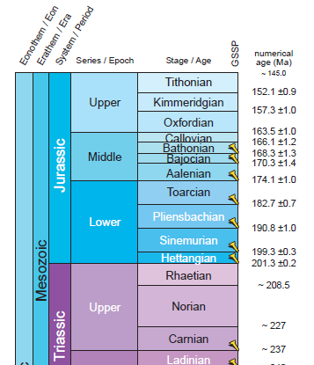
gstime:LowerJurassic2017
a gsog:Epoch ;
gsoc:hasQuality [ a gstime:Time_Interval_Location ;
gsoc: hasValue [ a gsoc:Quality_Range;
gsosc hasStartValue [ a Measure_Value ;
hasDataValue “201.3” ^^xsd:float ;
hasUOM [a Ma ; ] ;
]
gsosc hasEndValue [ a Measure_Value ;
hasDataValue “174.1” ^^xsd:float ;
hasUOM [a Ma ; ] ;
]
] ]
gsoc:isPartOf gstime:isc2020-01 ;
gsoc:isPartOf gst:LowerJurassicEpoch
gsoc:time_interval_finished_by gstime:BaseMiddleJurassic2017;
gsoc:time_interval_contains gstime:Pliensbachian2017;
gsoc:time_interval_contains gstime:Sinemurian2017 ;
gsoc:time_started_by gstime:Hettangian2017 ;
gsoc:time_starts gstime:Jurassic2017 ;
gsog:nextTimeInterval gstime:Aalenian2017 ;
gsog:nextTimeInterval gstime:MiddleJurassic2017 ;
gsog:previousTimeInterval gstime:Rhaetian2017 ;
gsog:previousTimeInterval gstime:UpperTriassic2017 ;
gsog:time_finished_by gstime:BaseMiddleJurassic2017 ;
gsog:time_started_by gstime:BaseJurassic2017 ; .
Example 2
Time Scale
Notes:
Time scale evolves over time
Include a conceptual time scale based on original qualitative chronology
Implement various versions, currently 2004, 2017, 2020.

Slide 10
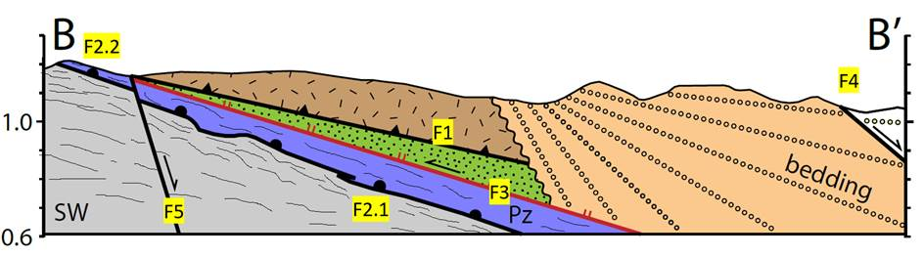
Example 3
Geologic Events
EarlyMioceneSedimentation
fau2:EarlyMioceneSedimentation
a gsog:Geologic_Event ;
gsoc:hasConstituent [ a gspr:Debris_Flow_Deposition ; ] ;
gsoc:hasConstituent [ a gspr:Mass_Wasting_Deposition ; ] ;
gsoc:directTemporalOccupies fau2:TertiaryExtensionBasinFillInterval ;
gsoc:time_starts fau2:Basin_Fill_Tilting_Event ;
gsoc:time_finishes fau2:Detachment_Faulting_Event ;
rdfs:label "Oligocene to Mid Miocene Sediment accumulation"@en ; .
fau2:Basin_Fill_Tilting_Event
a gsog:Geologic_Event ;
gsoc:hasConstituent [ a gspr:Faulting ; ] ;
gsoc:directTemporalOccupies fau2:TertiaryExtensionBasinFillInterval ;
gsog:hasSetting [ a gsen:Extended_Terrane ; ] ;
rdfs:label "Oligocene-Mid-Miocene faulting and tilting"@en ; .
fau2:Detachment_Faulting_Event
a gsog:Geologic_Event ;
gsoc:hasConstituent [ a gspr:Faulting ; ] ;
gsoc:time_during fau2:Middle_Tertiary_Extension_Event ;
rdfs:label "San Pedro Detachment Faulting (F3) "@en ; .

Slide 11
Final Thoughts
Progress toward a Geoscience Knowledge Manager
Draft v1 of the GeoScience Ontology
https://github.com/Loop3D/GKM (private)
Next Steps
more internal testing… then public release and testing
knowledge repository testing (semantic db)
integration with LOOP 3D modelling code
Thanks!

Slide 12
GeoScience Ontology (GSO)
Related Work
Predecessors
NADM (NADM 2004) conceptual only
GeoSciML (GeoSciML 2017) data language
DOLCE Rocks (Brodaric & Probst 2009) DOLCE, broad not deep
Recent work
GeoSciML ontology (OGC SWG, in progress) no upper ontology
OntoGeonous ontology (Lombardo et al. 2018) no upper ontology
GeoCore ontology (Garcia, Abel, Perrin 2020) BFO, broad not deep
GSO
GeoScience Ontology (in progress) DOLCE + BFO + UFO + GeoSciML

Slide 13



3D Knowledge Challenge
Knowledge-rich
Maps, x-sections, articles, diagrams, rules, …
- partially integrated into modelling
Data-poor
Few subsurface observations relative to area
- highly integrated into modelling
Challenge
Better leverage knowledge
- use more knowledge
- use knowledge more
Knowledge
Data

Slide 14
Geoscience Knowledge Manager Functions
extract
Geoscience Knowledge Manager
use
store
-unstructured info:
text documents
-databases
-ontologies/k graphs
-Select algorithm
-Assign weights
-Infer event history
-Infer data points
-Consistency check
Structure
Repository
Reason
know structure: GeoScience Ontology
know repository: semantic db
load, store, find, reason, get
BGS
GSC, GA
GSC

