Slide 1

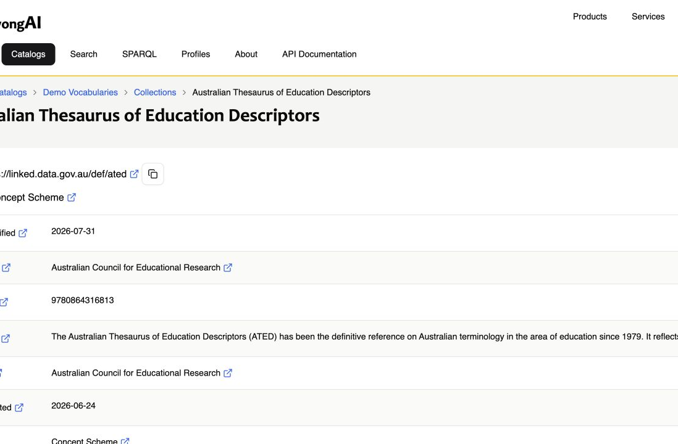
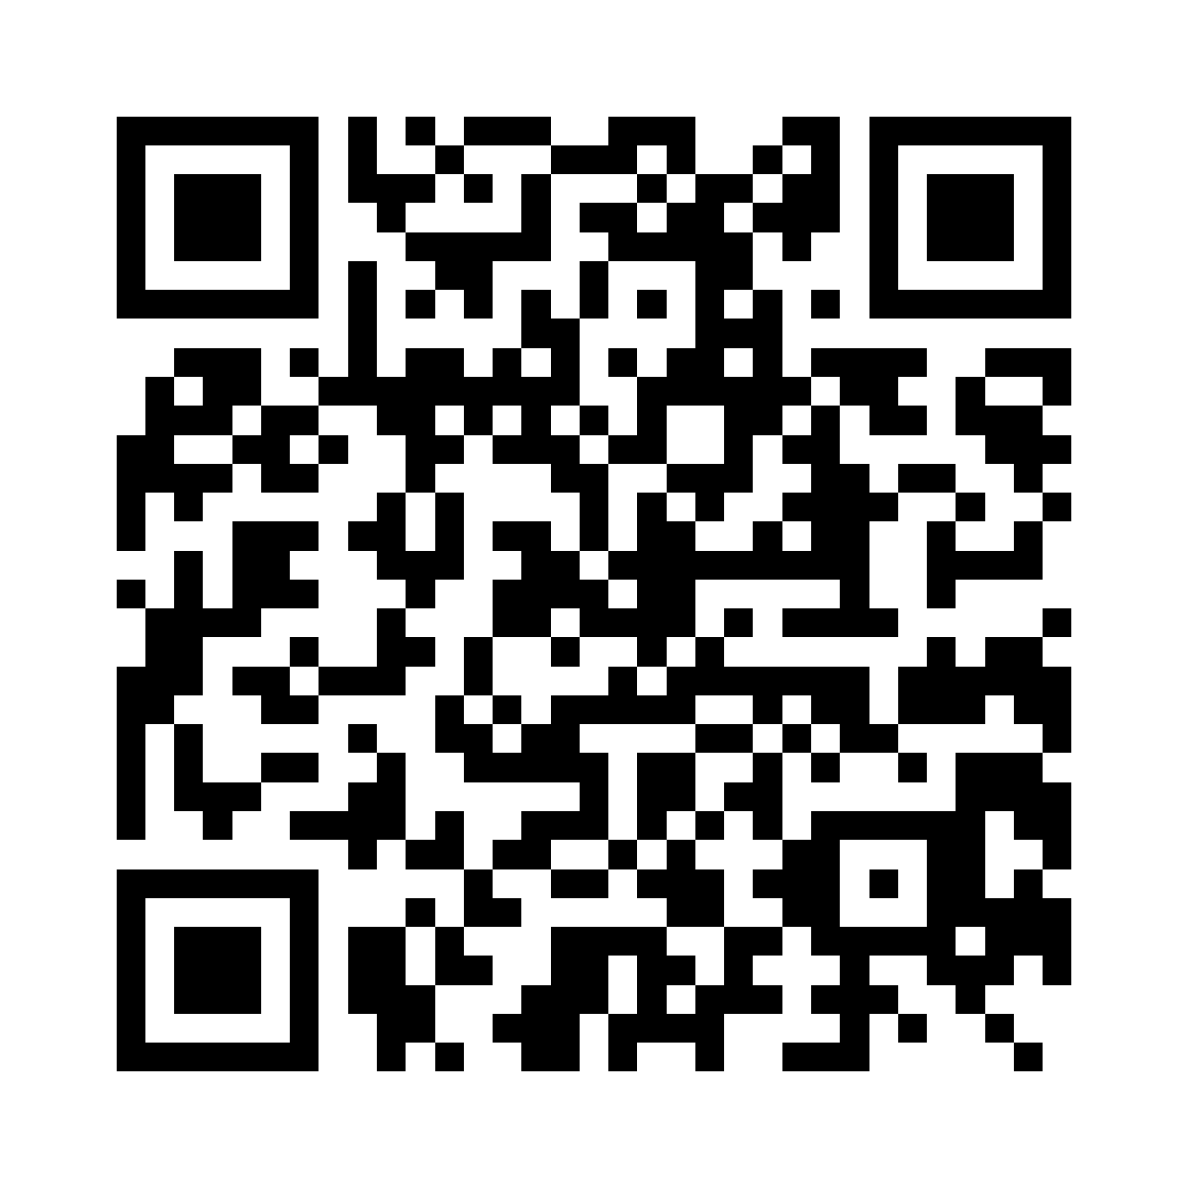

AUSTRALIAN THESAURUS OF EDUCATION DESCRIPTORS
Modelling was simple. Making it durable = the project
01
MultiTes
02
Explicit modelling choices
03 Demo Prez = Human + machine access
Implicit XML structure
Label-based relationships
Legacy term numbers
Packaged web interface
Descriptors → skos:Concept
TNR → stable IRI + notation
USE → skos:altLabel
BT / NT / RT → SKOS links
Subject Categories → 2nd scheme
Boilerplate skos:definition s
….captured in repeatable YAML
5,280 concepts · 41 subject categories · portable RDF delivery
WHAT TOOK THE WORK
Repeatable YAML → RDFLib → SHACL build · resolving label-based links · ‘matched on’ deduplication UX
CODEX ASSISTED… START TO END
Hosting can change; identifiers should not.
RDF handover → managed, shared OR installed Prez + K-Maker → dedicated / client-hosted
Notes:
ATED has been core Australian education terminology since 1979. ACER gave us a MultiTes XML export. The XML was structurally consistent, but it did not carry a published Semantic Web model: relationships were expressed through labels, non-descriptors pointed to preferred terms using USE, and the durable term numbers were buried in the records.
So the modelling was intentionally conservative. Descriptor records became SKOS concepts. The MultiTes term number became both the stable IRI suffix and the notation. USE terms became alternative labels, and broader, narrower and related-term links became ordinary SKOS relationships. Subject categories remain a small, separate scheme. The result is 5,280 concepts and 41 categories.
The surprisingly interesting part was not ontology design; it was making the conversion repeatable and the publication usable. We moved the mapping rules into YAML, kept static scheme metadata in Turtle, generated the graph with RDFLib, and validate it with SHACL and graph-equivalence tests. That makes the transformation inspectable and repeatable rather than a one-off script. The source also exposed practical edge cases: resolving label-based links safely, preserving identifiers, and avoiding duplicate or confusing search results when a concept matches through more than one label.
The result is now visible in Prez, giving people a browsable vocabulary and machines RDF and API access. ACER also receives the self-contained RDF file, so the asset is not locked to a hosting choice. The next-stage options range from file handover, through a shared managed Prez and K-Maker service, to dedicated or client-hosted deployment. The key point is that the identifiers and data remain stable even when the hosting model changes.
[Sources]
- https://github.com/Kurrawong/ated (conversion implementation, mappings, SHACL shapes and dataset counts; accessed 2026-08-12)
- https://demo.dev.kurrawong.ai/catalogs/exm:demo-vocabs/collections/ns18:ated (Prez screenshot and published ATED metadata; captured 2026-08-12)
- https://www.w3.org/TR/skos-reference/ (SKOS terminology; accessed 2026-08-12)
[/Sources]

