Slide 1
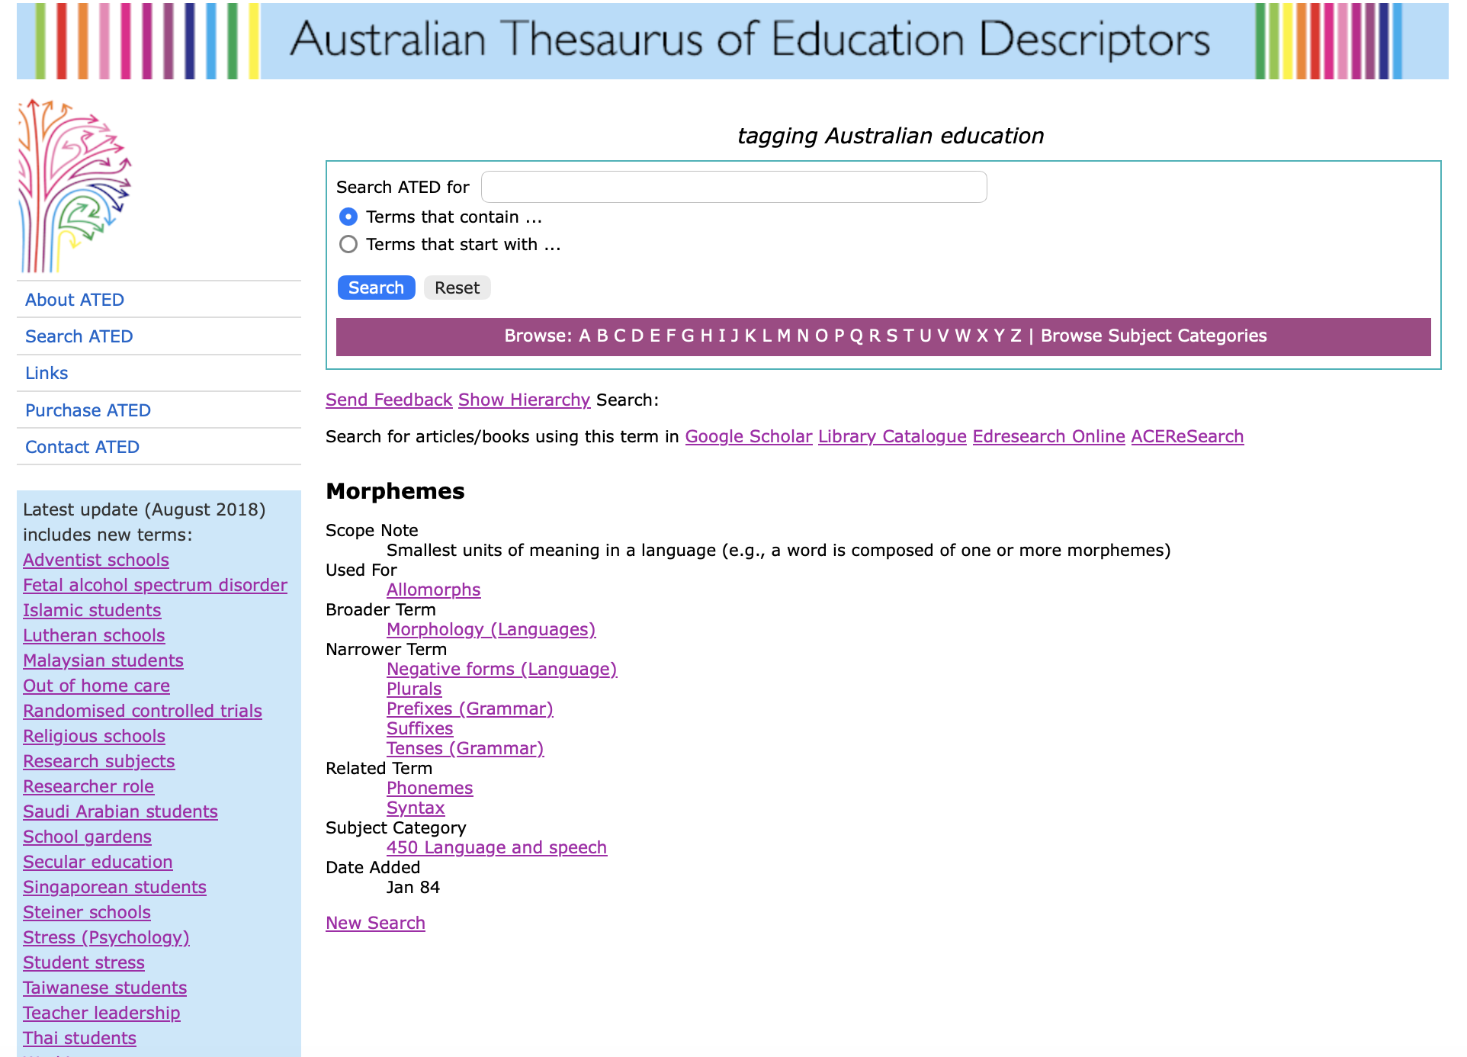
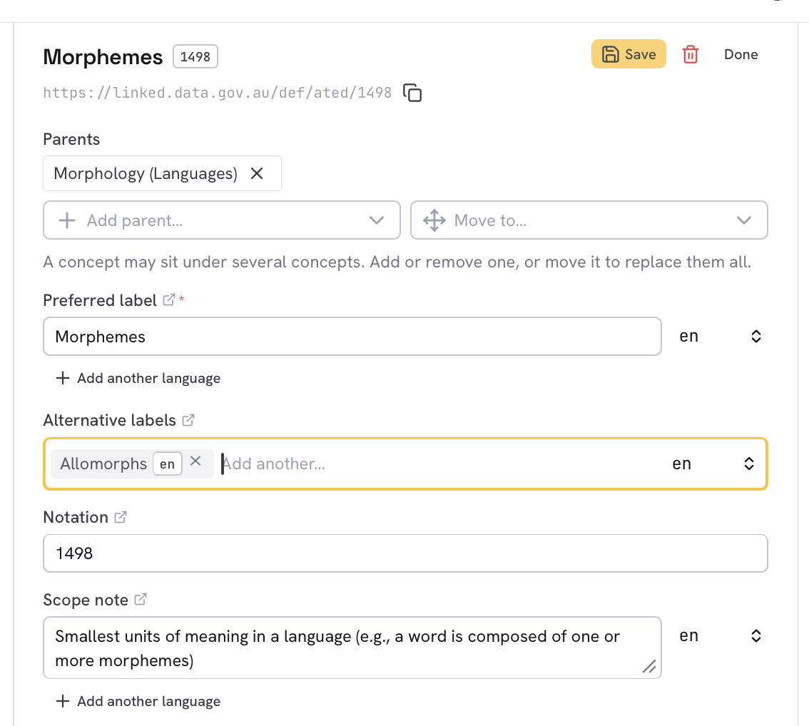
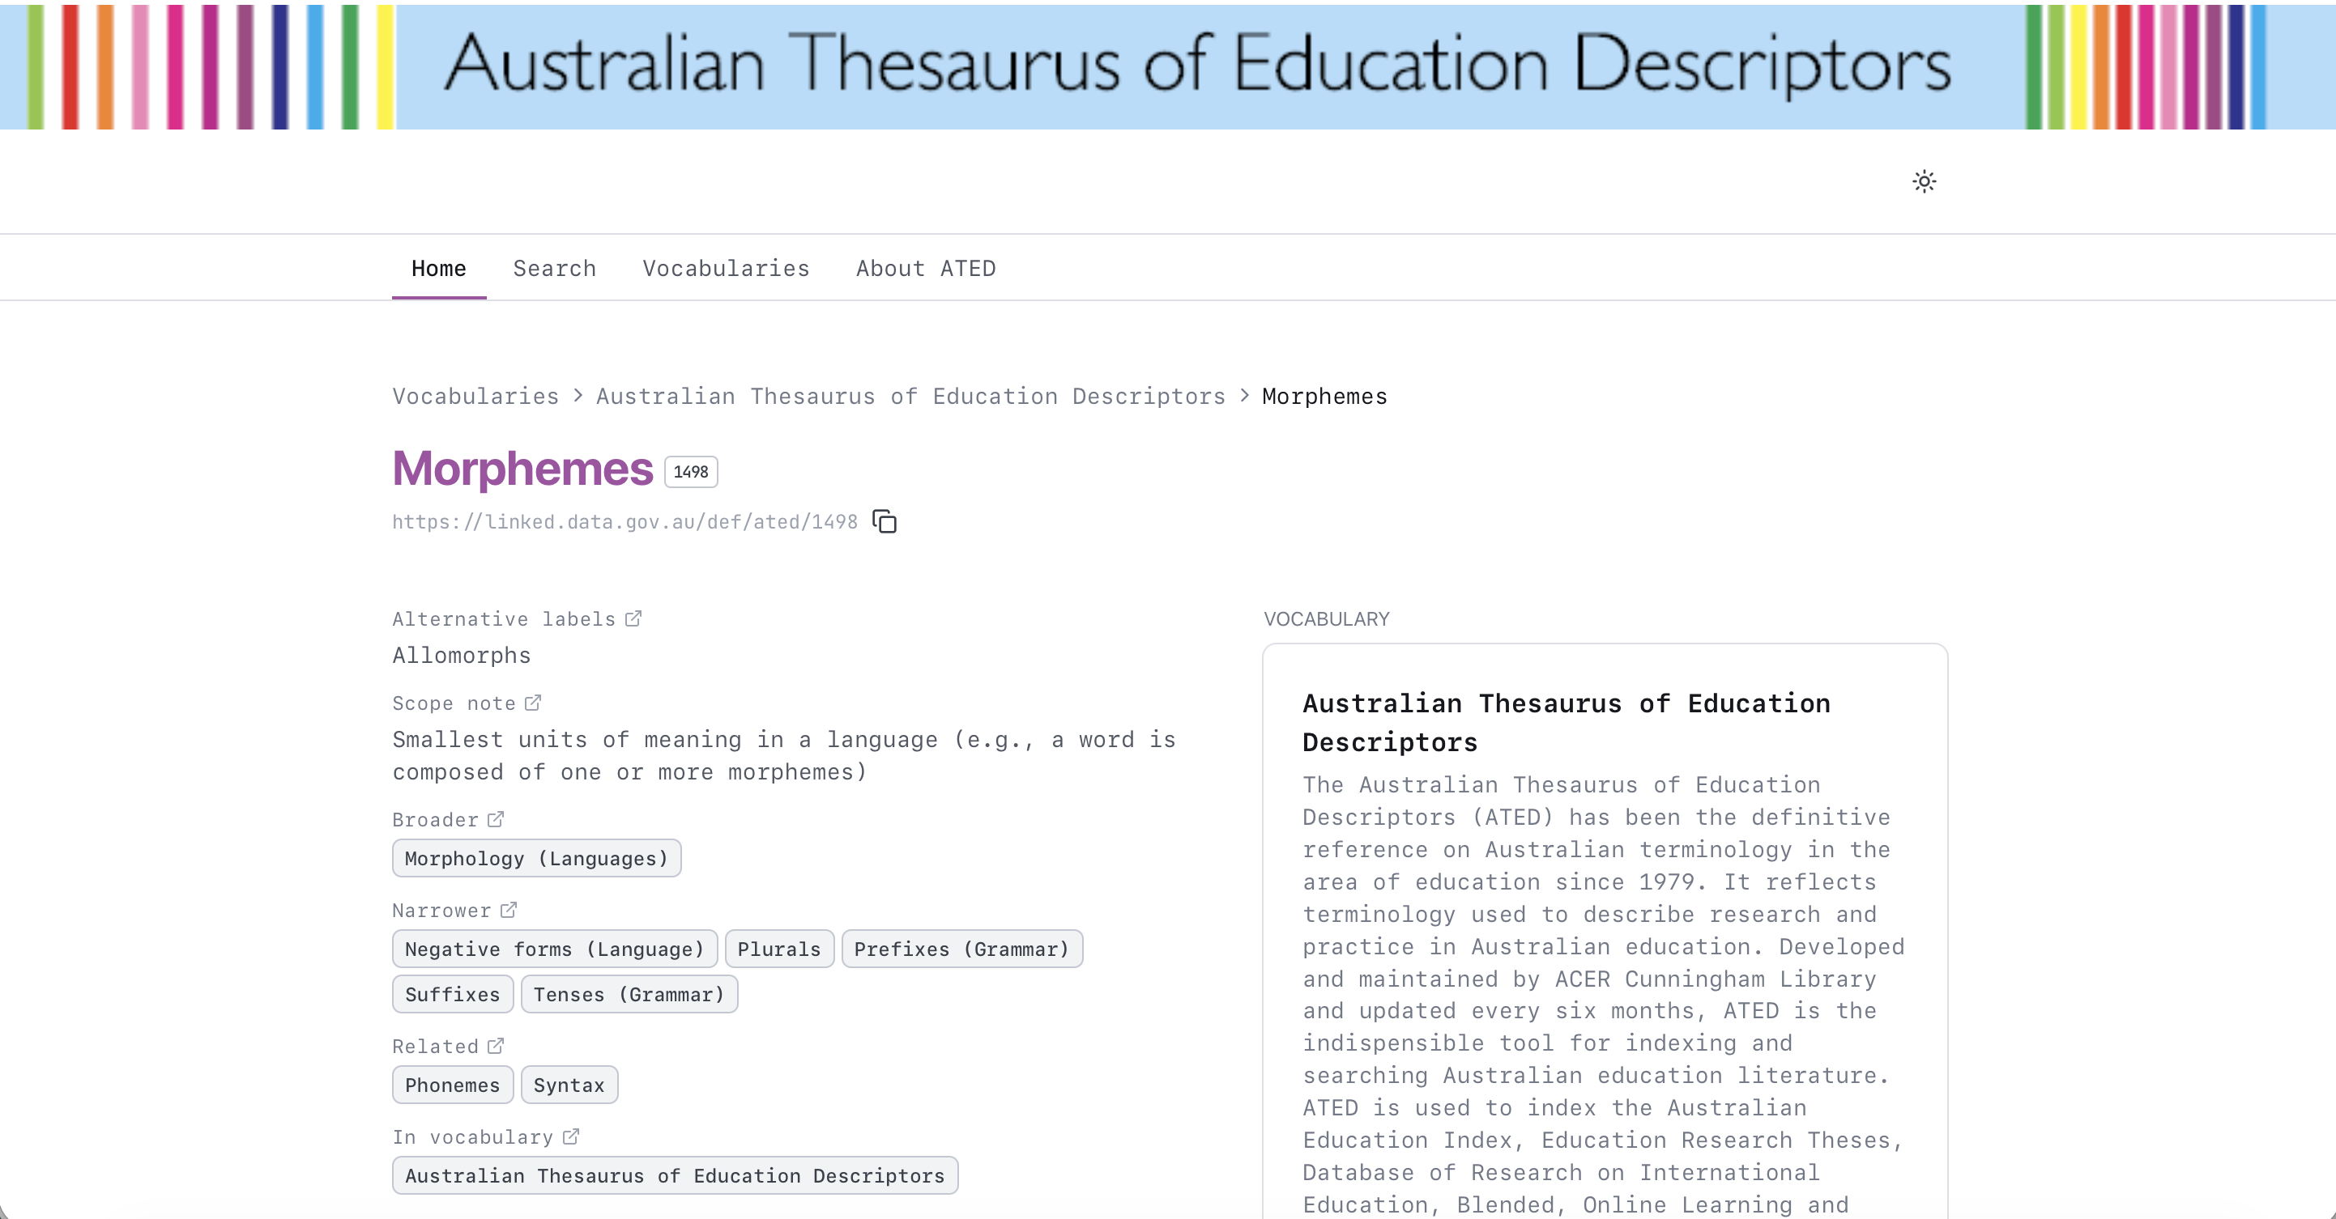
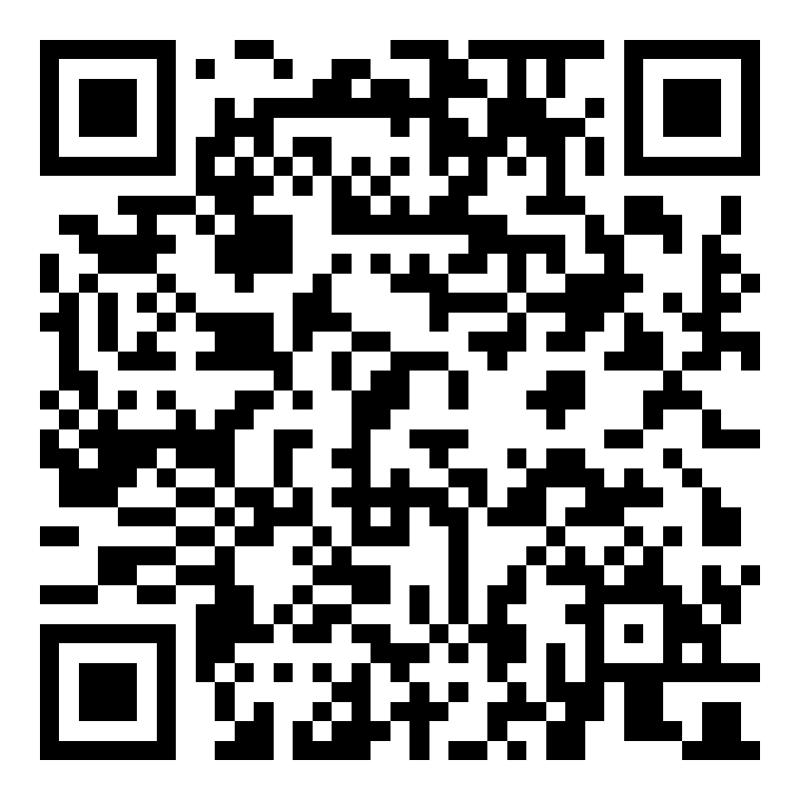
eRESEARCH AUSTRALASIA · 2026
POSTER PRESENTATION
Governed vocabulary publishing with K‑Maker
The Australian Thesaurus of Education Descriptors as a practical case study
Les Kneebone · KurrawongAI
THE PLATFORM STORY
K‑Maker turns legacy thesaurus data into a vocabulary that remains portable across hosting options.
01
Legacy expression
02
Governed editing
03
Published vocabulary
MultiTes HTML: meaning visible to people, but implicit to machines
K‑Maker: identifiers, labels, notes and relationships maintained together
A branded site for discovery, with the same RDF available to systems
Existing content and familiar thesaurus relationships
Edit, review and validate one governed source
Publish for humans and machines without changing identifiers
Making implicit meaning explicit
What required work
The migration preserves ATED’s meaning while expressing it with durable Web identifiers and standard SKOS semantics.
YAML mapping rules
RDFLib transformation
SHACL validation
Resolution of label-based links
Search deduplication and clear “matched on” presentation
Legacy expression | Semantic Web expression
TNR 1498 | stable HTTP IRI + skos:notation "1498"
Used For / UF | skos:altLabel
Broader Term / BT | skos:broader
Narrower Term / NT | skos:narrower
Related Term / RT | skos:related
Date Added Jan 84 | "1984-01"^^xsd:gYearMonth
English display text | "Morphemes"@en
5,280 CONCEPTS · PORTABLE RDF
Hosting can change; identifiers do not.
RDF handover | managed K‑Maker | dedicated or client-hosted
A maintainable vocabulary, not a one-off conversion
ATED demonstrates a reusable path from legacy thesaurus data to governed editing, validation and publication. K‑Maker keeps the data portable while giving vocabulary owners a practical place to maintain it.
les@kurrawong.ai · kurrawong.ai/products/k-maker
Explore K‑Maker
Screenshots: Australian Council for Educational Research ATED and K‑Maker demonstration environment. Draft QR target: K‑Maker product page.
Notes:
[Sources]
- KurrawongAI A0 poster template and logo artwork: /Users/leskneebone/Projects/Kurrawong/docs-internal/poster-template/, accessed 12 October 2026.
- ATED legacy website screenshot: https://cunningham.acer.edu.au/multites2007/index.html, supplied by the author, 2026.
- K-Maker edit and site screenshots: https://kmaker.app/s/acer, supplied by the author, 2026.
- K-Maker product page and QR target: https://kurrawong.ai/products/k-maker, accessed 12 October 2026.
- ATED project repository: https://github.com/Kurrawong/ated, accessed 12 October 2026.
[/Sources]

