Slide 1
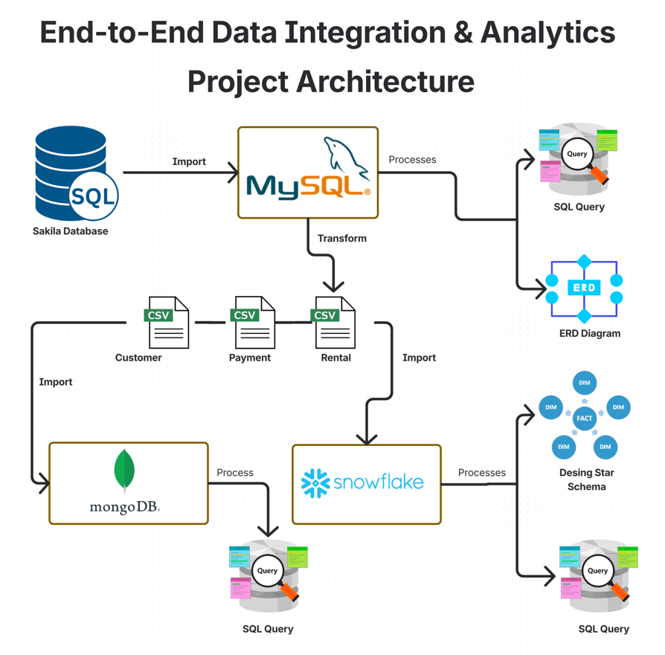

Slide 2
MongoDB Tasks:
Create MongoDB Atlas cluster
Download MongoDB Compass
Import CSVs into collections
Design embedded/referenced document structures
Define indexes
Write 3 aggregation queries (e.g., rentals per country, total payments)

Slide 3
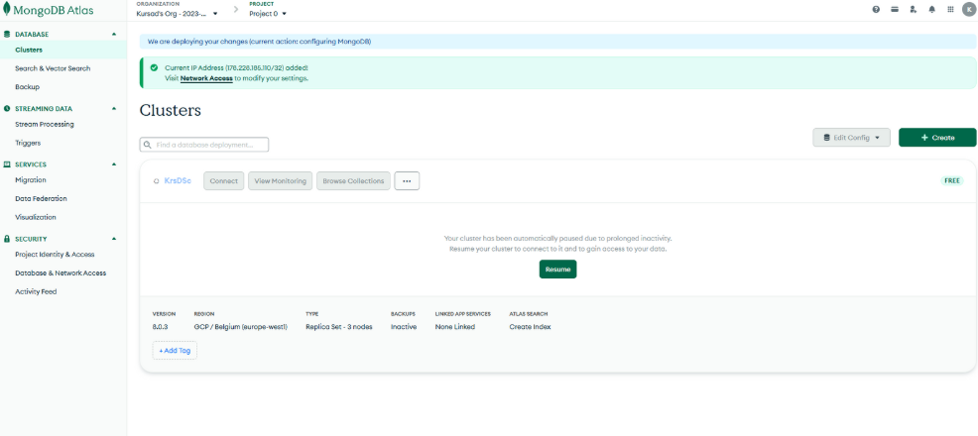
Create MongoDB Atlas cluster

Slide 4
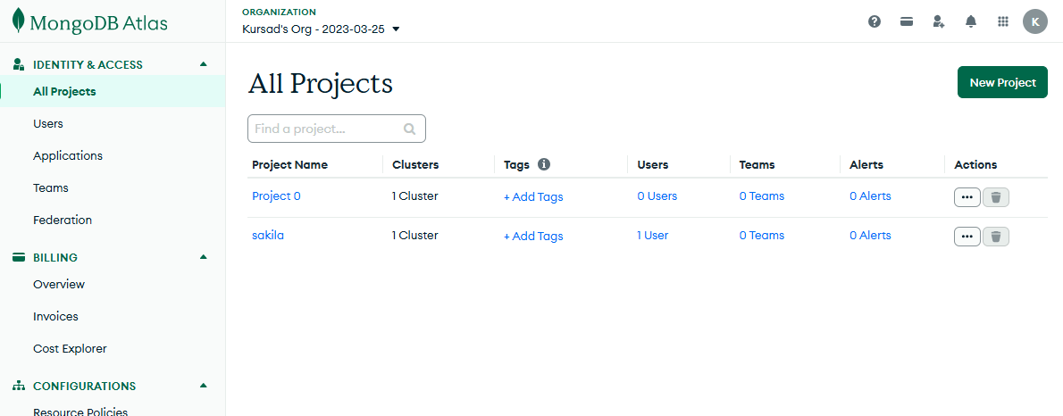

Slide 5
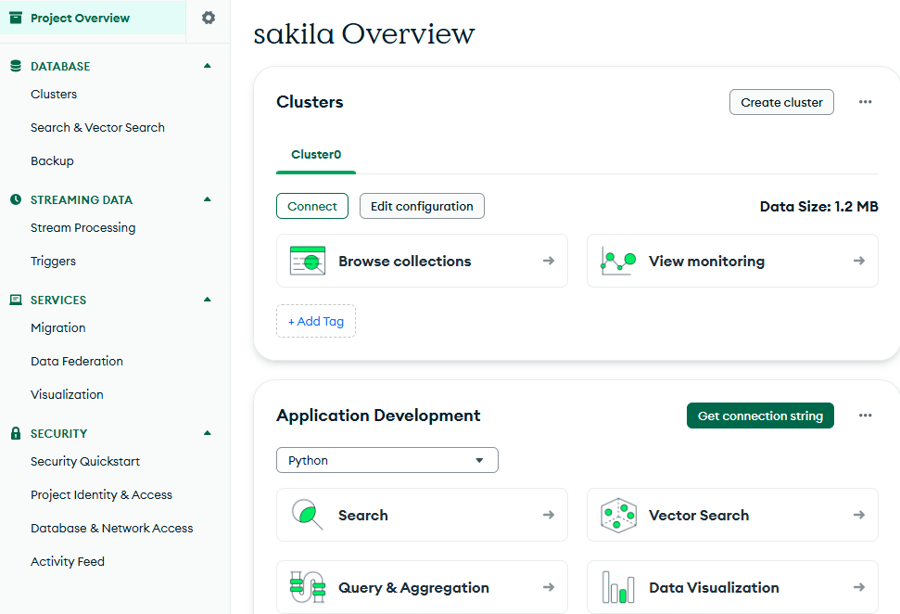
Project Overview

Slide 6


Slide 7
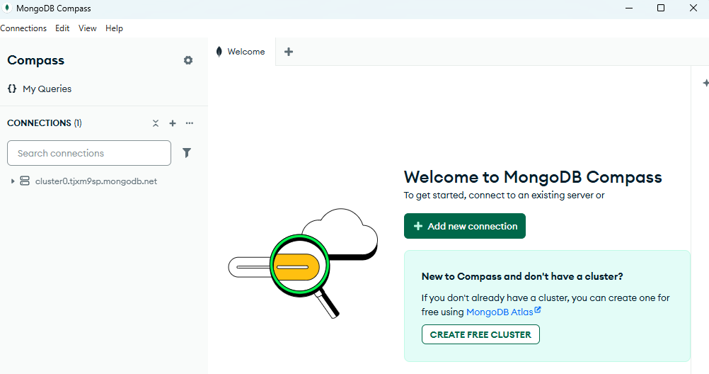
Add Connection

Slide 8
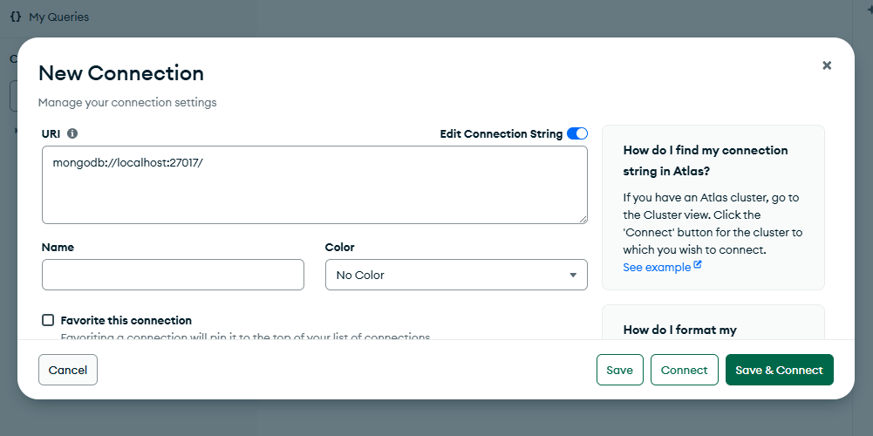
Enter Connection String

Slide 9
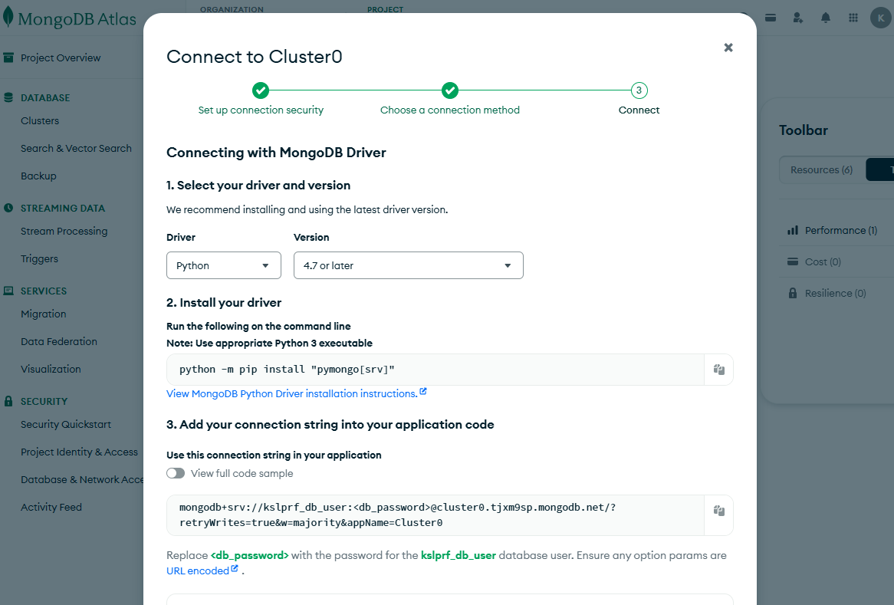

Slide 10
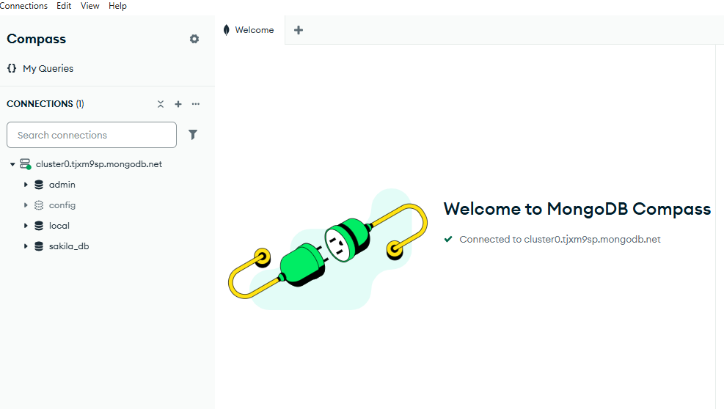

Slide 11
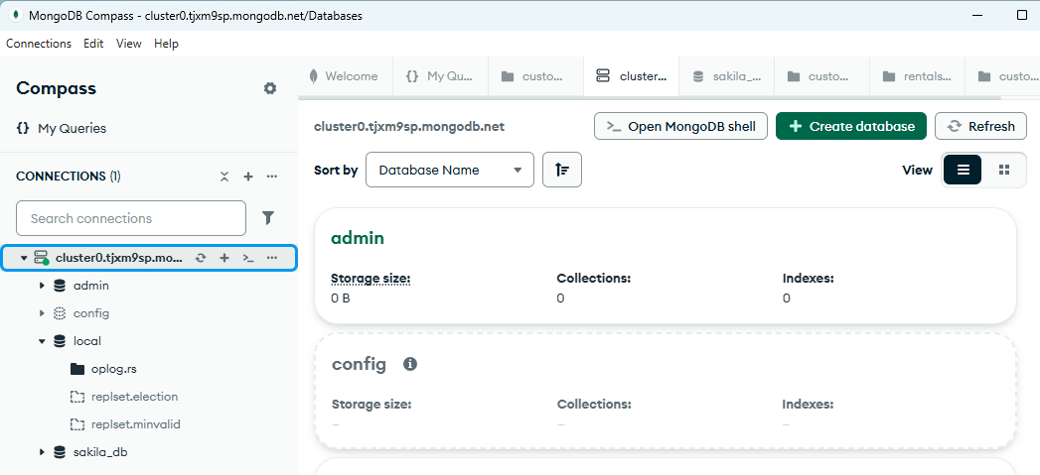
Create Database

Slide 12
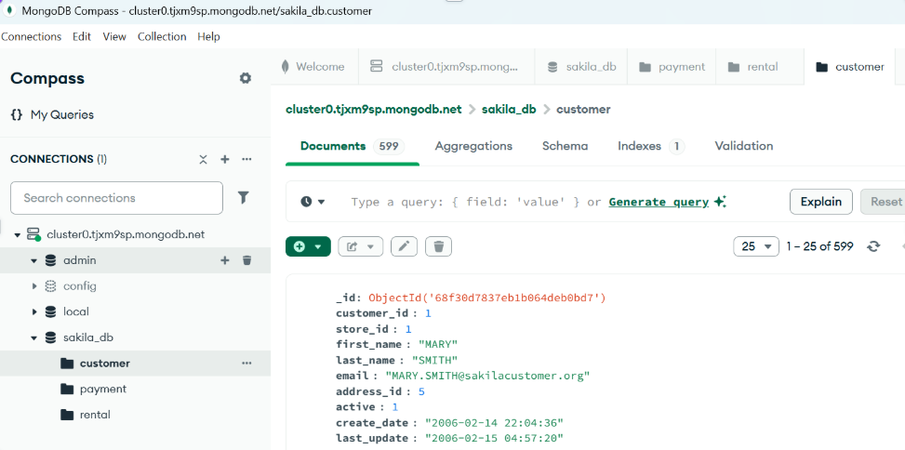
Import CSVs into collections

Slide 13
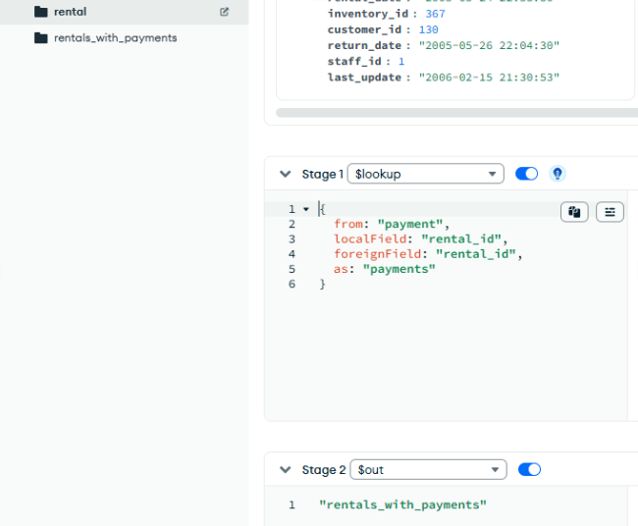
NoSQL Data Modeling: Embedding Payments into Rentals

Slide 14
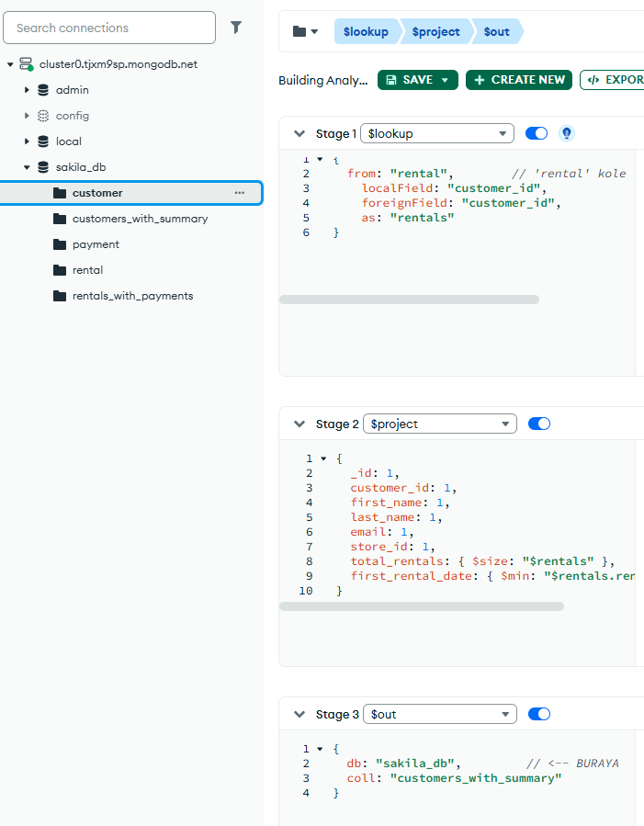
Building Analytical Customer Profiles

Slide 15
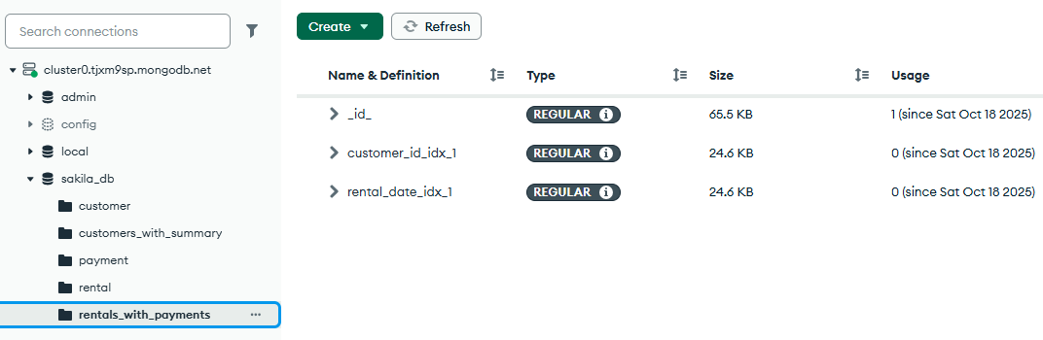
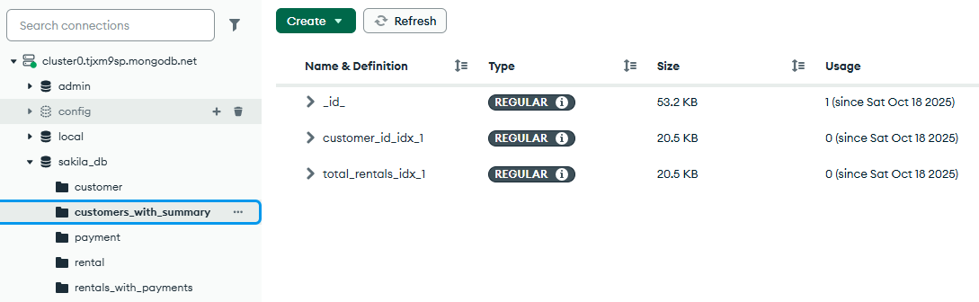
Create indexes

Slide 16
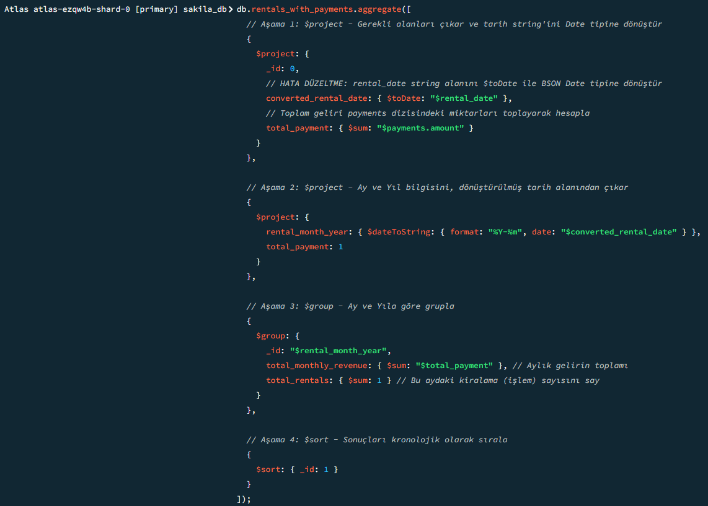
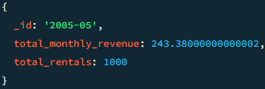
Query-1:
Monthly Revenue Trend

Slide 17
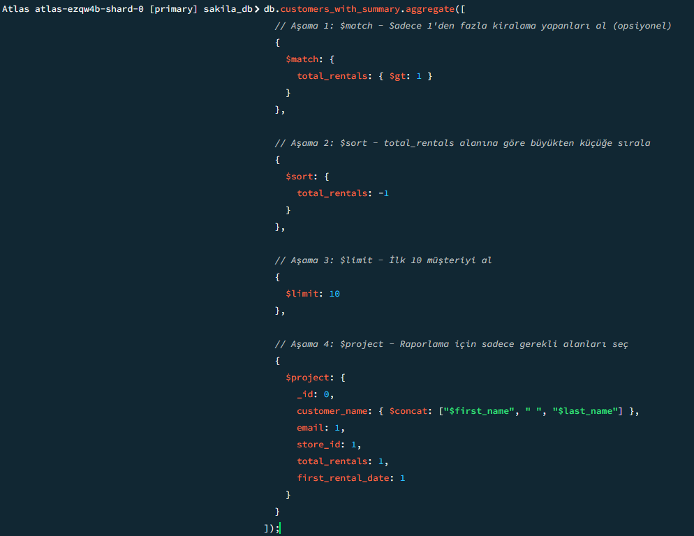
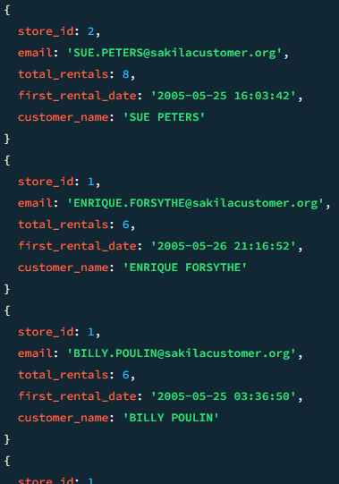
Query-2:
Top 10 High-Frequency Customers

Slide 18
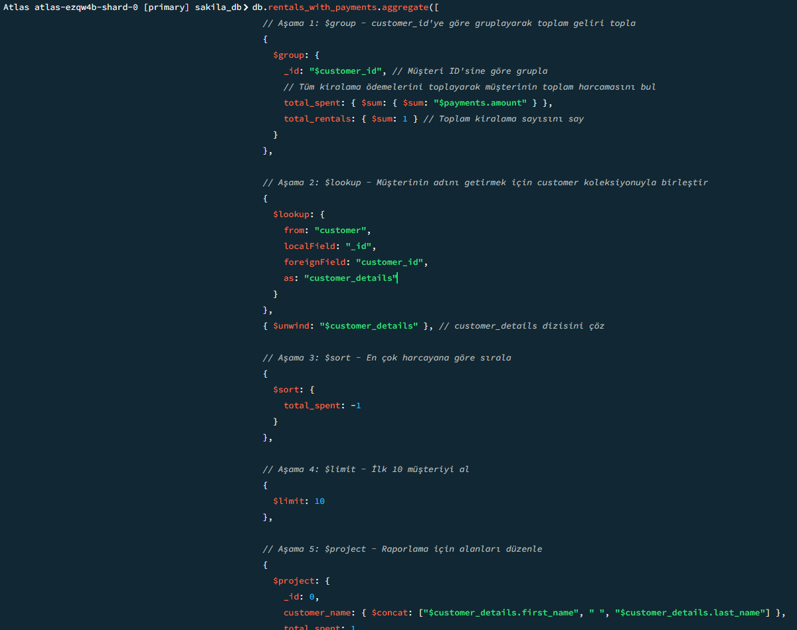
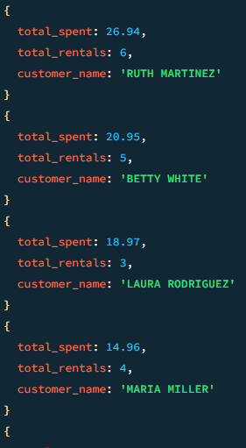
Query-3:
Purchase Frequency Interval

