Slide 1
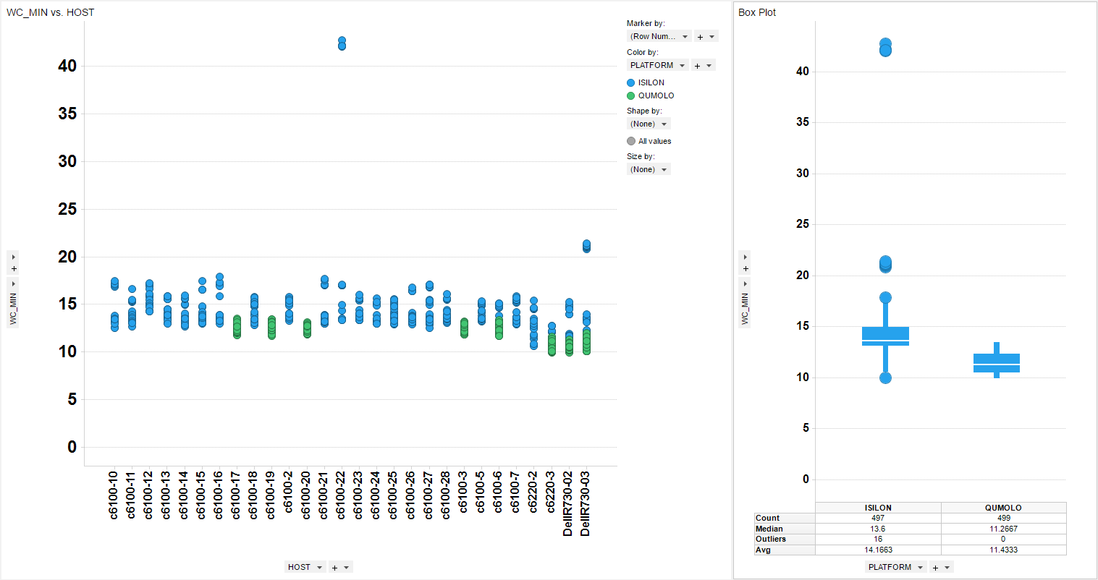
Joint calling pipeline. Wall clock times for combine gvcfs (91 samples).

Slide 2
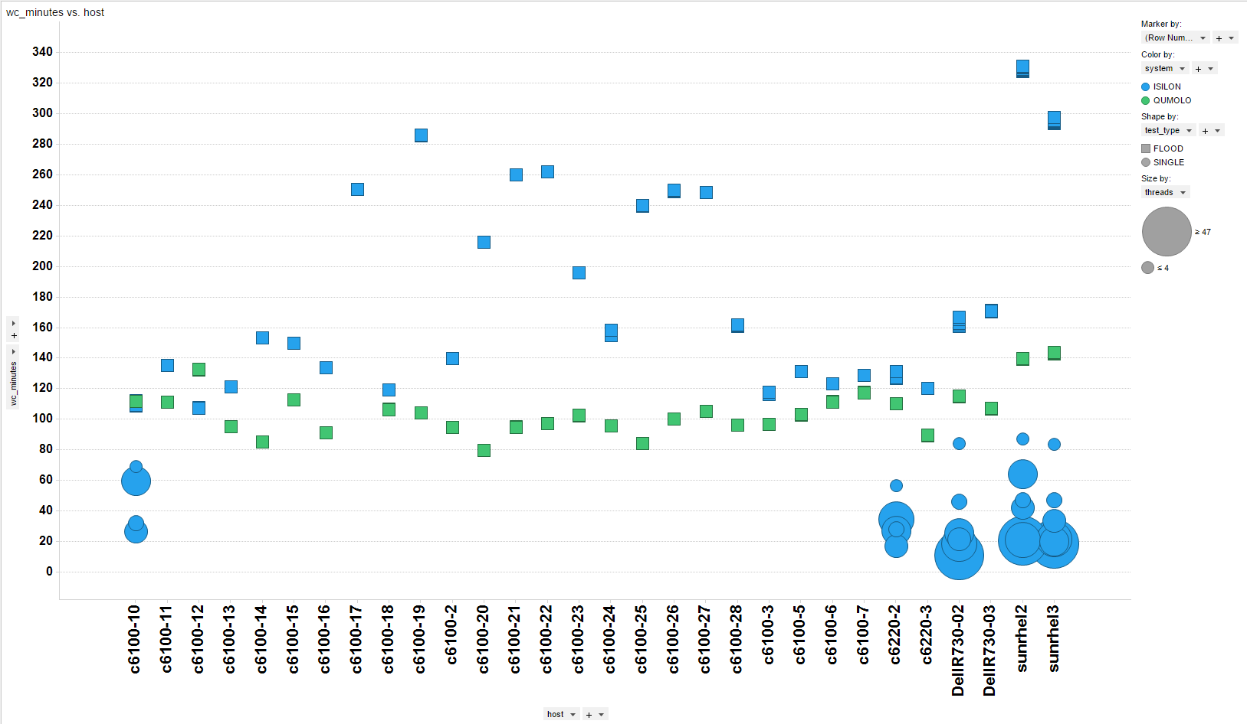
Bwa mem flood tests. Full non-clinical compute node saturation with each job using 4 cpu threads are the square data points. Single instance jobs with increasing cpu thread number used are circles and sized by thread count.

Slide 3
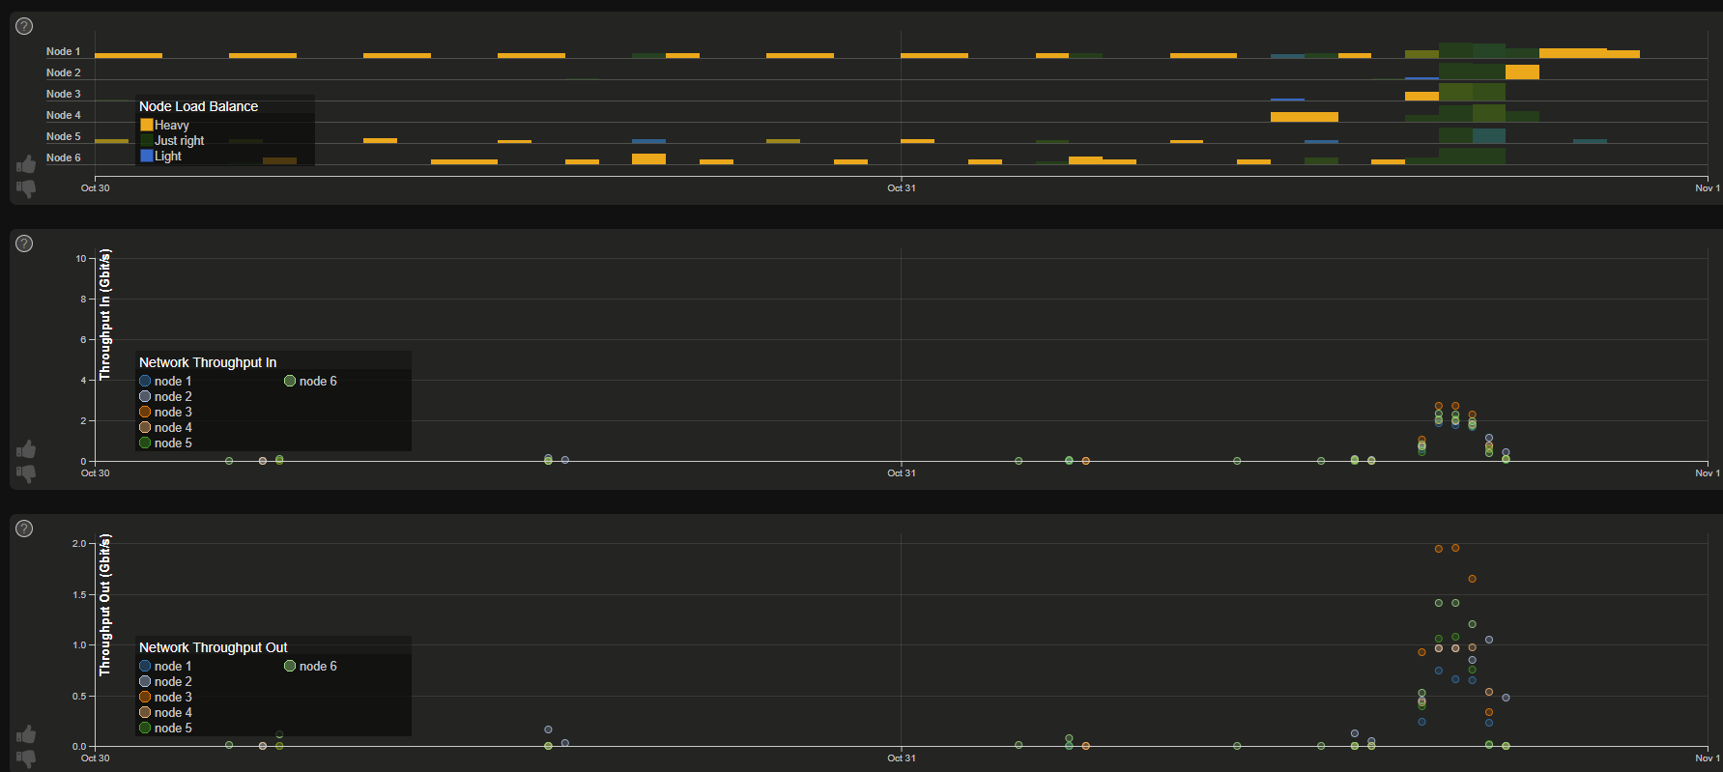
Qumolo load balancing and throughput for production level bwa mem flood test (165 instances utilizing 4 cpus for each instance). The window would have been b/w 4 to 6 p.m.

Slide 4
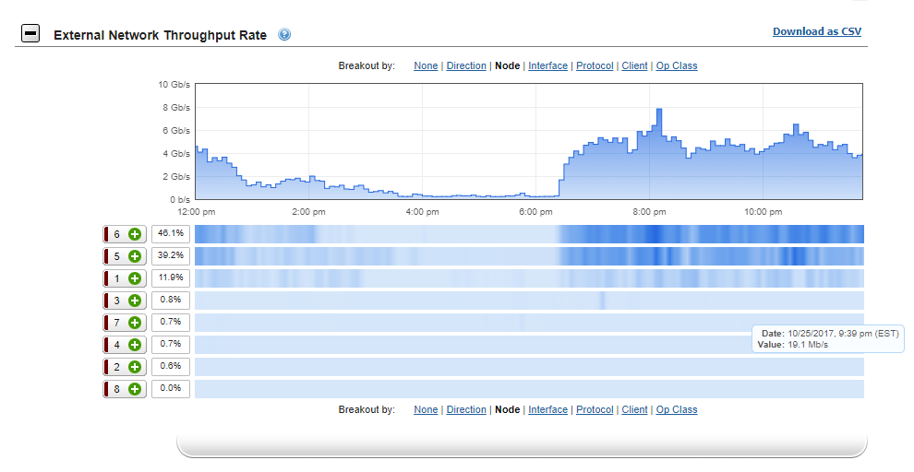
Isilon external network throughput by node during bwa mem production level flood test (170 instances utilizing 4 cpus for each instance). The window would have been b/w 2 to 4 p.m.

