Slide 1
CUS1166 – Software Engineering
Technology Presentation
Flask-Admin
Kurtis Bassmann
March 20th 2019

Slide 2
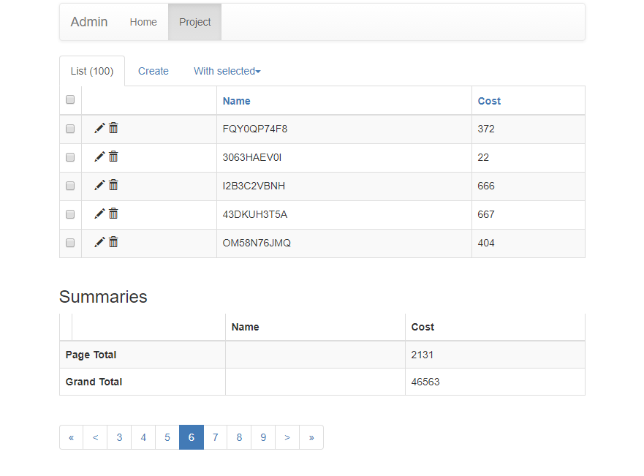
Overview
Flask Admin allows one to manage their database through a route on their website.
Notes:
Provide any information need to orient the audience what topic you are about to present.

Slide 3
Purpose/Goal of Technology
Solves the problem of building an admin interface on top of an existing data model
Lets one manage a website/web-service’s data through a user-friendly user interface
Notes:
Motivate. what problem does this technology tries to solve; What is its purpose

Slide 4
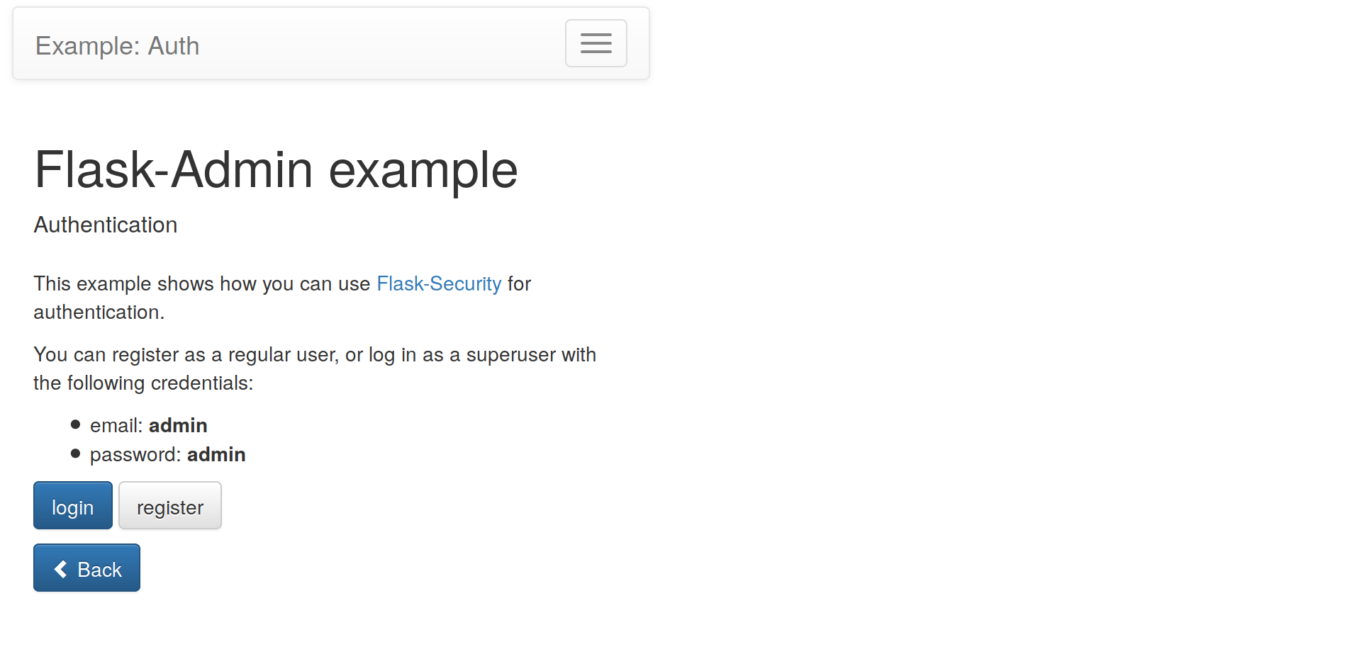
Use Cases / Examples / Applications
→ SoftEng/flask-admin/examples/auth/app.py
Notes:
Identify possible use cases, examples, problems someone could consider using this technology.

Slide 5
Background – Key Concepts
Initialization
Adding Model Views
Adding Content to the Index Page
Authorization and Permissions
Customizing Built-In Views
Notes:
Introduce any background, key concepts and terminology needed for the audience to understand the technology your are presenting.

Slide 6
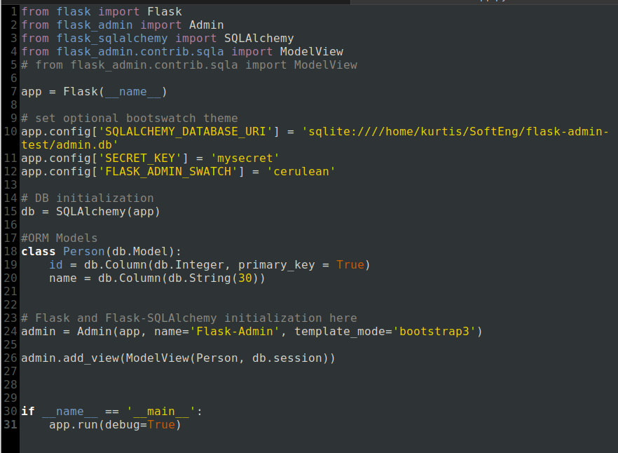
Getting Started Tutorial
app.py
Notes:
Present a getting tutorial; this should cover the basic activities for someone to start using the technology and solving a basic problem using this technology (This might need more that one slides)

Slide 7
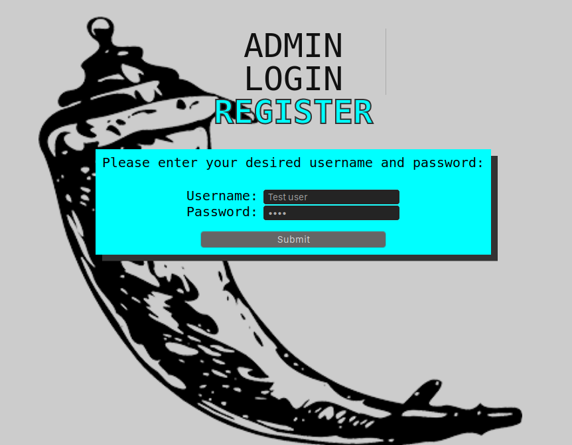
Non-Trivial Application
https://github.com/Kurt1s/flask-admin-test
Notes:
Demonstrate a non-trivial use case/application of the technology that you coded/prepared. This should be a custom example you coded yourself. Possibly this can be an example demonstrating how you could use this technology in your team’s project. You might need more that one slide for this section.

Slide 8
Resources
https://github.com/flask-admin/flask-admin
https://flask-admin.readthedocs.io/en/latest/introduction/
https://www.youtube.com/watch?v=ysdShEL1HMM&list=PLO7QWP6BOQuF_twaL7DBQJ4q8gGt0YpS0
https://www.github.com/humiaozuzu/awesome-flask
Notes:
Resources for further reading. Provide a list of resources to help your classmates to learn more about this technolgy.

Slide 9


Q&A
Feel free to ask any questions
Notes:
Open the floor for your classmates and the instructor to ask question about your presentaiton.

Slide 10
Thank you!!!

