Slide 1

From Code to EM Signals: A Generative Approach to Side Channel Analysis-based Anomaly Detection
BY: KURT A. VEDROS
MAJOR ADVISORS: DR. CONSTANTINOS KOLIAS AND DR. MIN XIAN
SPONSORED BY: DEPARTMENT OF ENERGY (DOE) IDAHO OPERATIONS OFFICE CONTRACT, AS PART OF LABORATORY DIRECTED RESEARCH AND DEVELOPMENT (LDRD) PROGRAM OF IDAHO NATIONAL LABORATORY (INL).

Slide 2
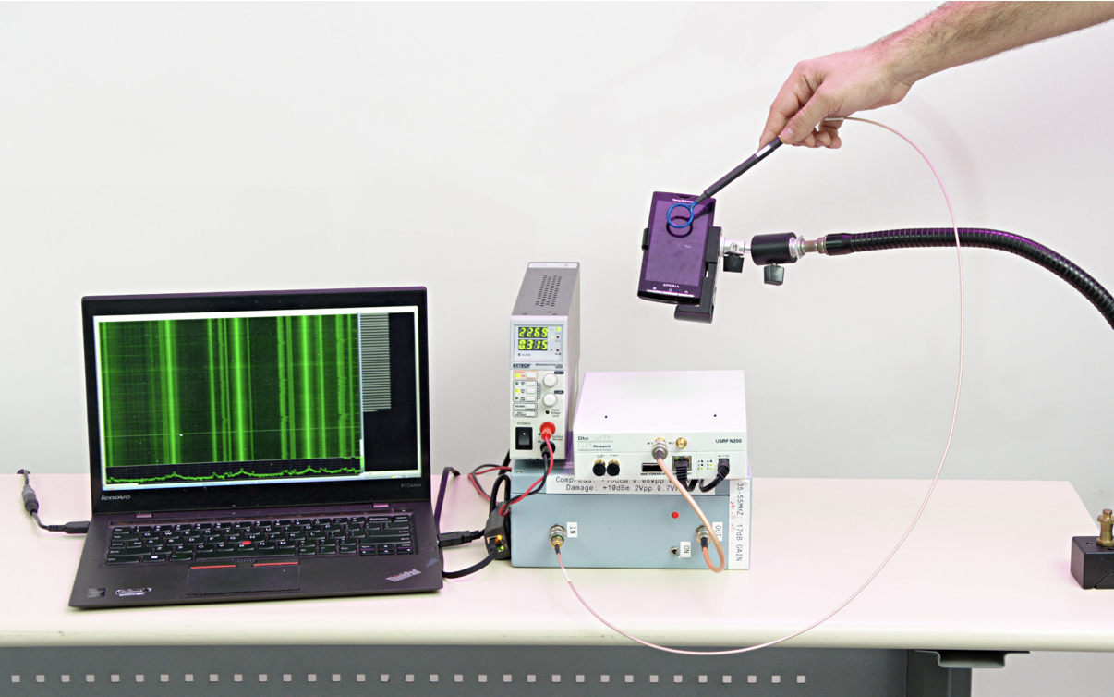
Side-Channel Analysis for Anomaly Detection
New type of hardware security
External
Non-nonintrusive
Cybersecurity for devices with limited resources (e.g., embedded devices)
No crypto libraries
No protection tools (antivirus software)
Emission types
Power
Thermal
Acoustic
Electromagnetic (higher bandwidth and sampling rates)

Slide 3
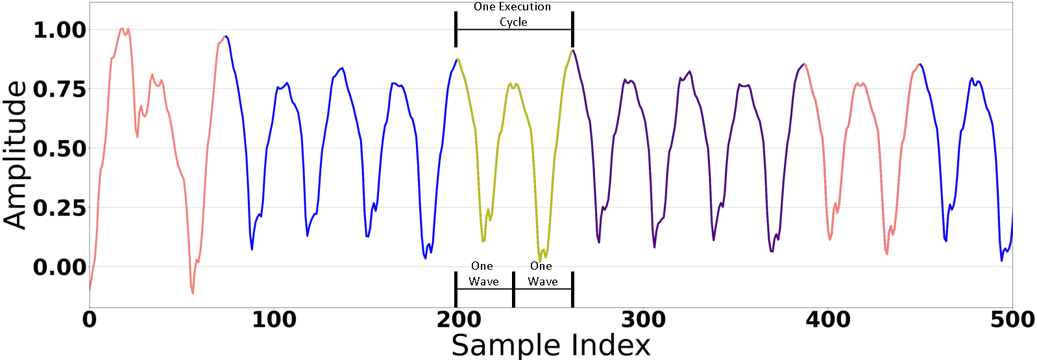
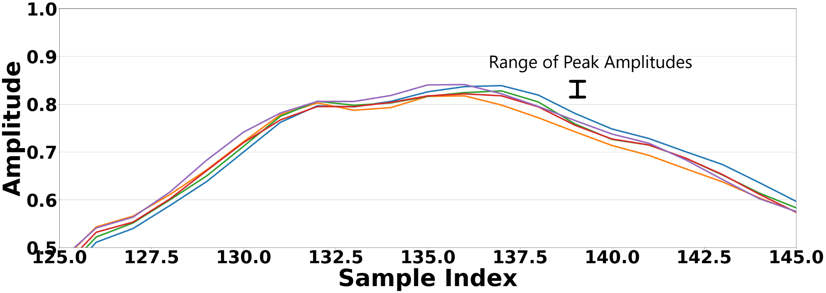
Morphology of EM Signals from Embedded Devices
Produced by the EM field created when the magnetic and electrical fields interact.
Caused by the change in flow of electrical current inside the device’s circuitry.
Amplitude Modulated by the execution of instructions
Each instruction takes a set amount of cycles (two waves).
It is common for each instruction to span one to three cycles (depends on the CPU type).
Main difference is the peak amplitude values.
Amplitudes are not static in nature
slight variations between each run.
Base frequency modulated to that of the clock of the monitored CPU.

Slide 4
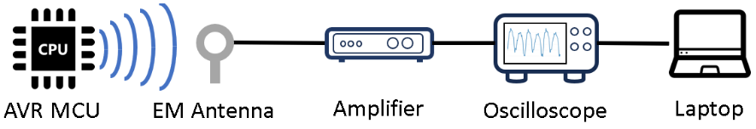
Test Bed
Equipment
ATmega 2560 AVR MCU.
EMRSS RF Explorer H-Loop EM Probe.
Behive 150A EMC probe amplifier.
PicoScope 3403D oscilloscope.
Laptop.
Parameters.
Sample Rate: 500 MSamples/sec
Sampling Interval: 2nsec
Duration: < 1 μsec

Slide 5
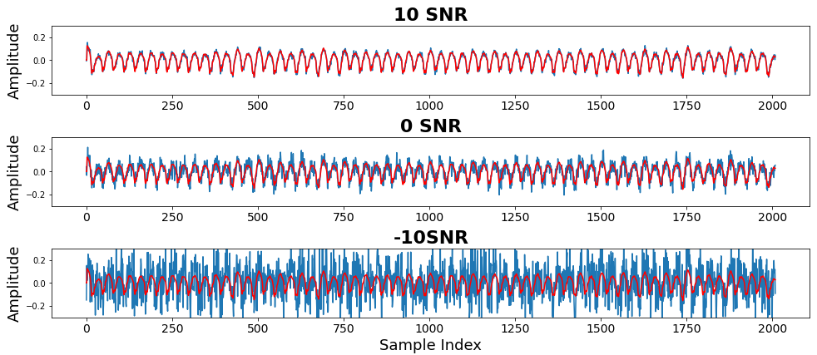
Challenges of EM-based Side-Channel Analysis
Red : Clean Signal Blue: Noisy version of same signal

Slide 6
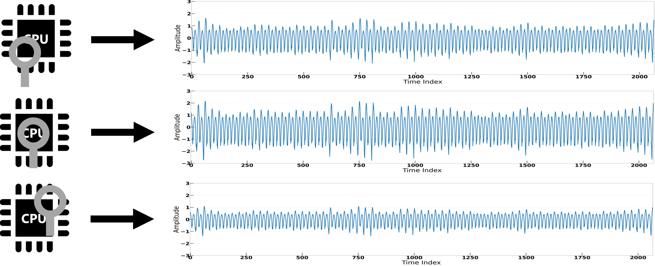
Challenges of EM-based Side-Channel Analysis
Careful positioning of probe!

Slide 7
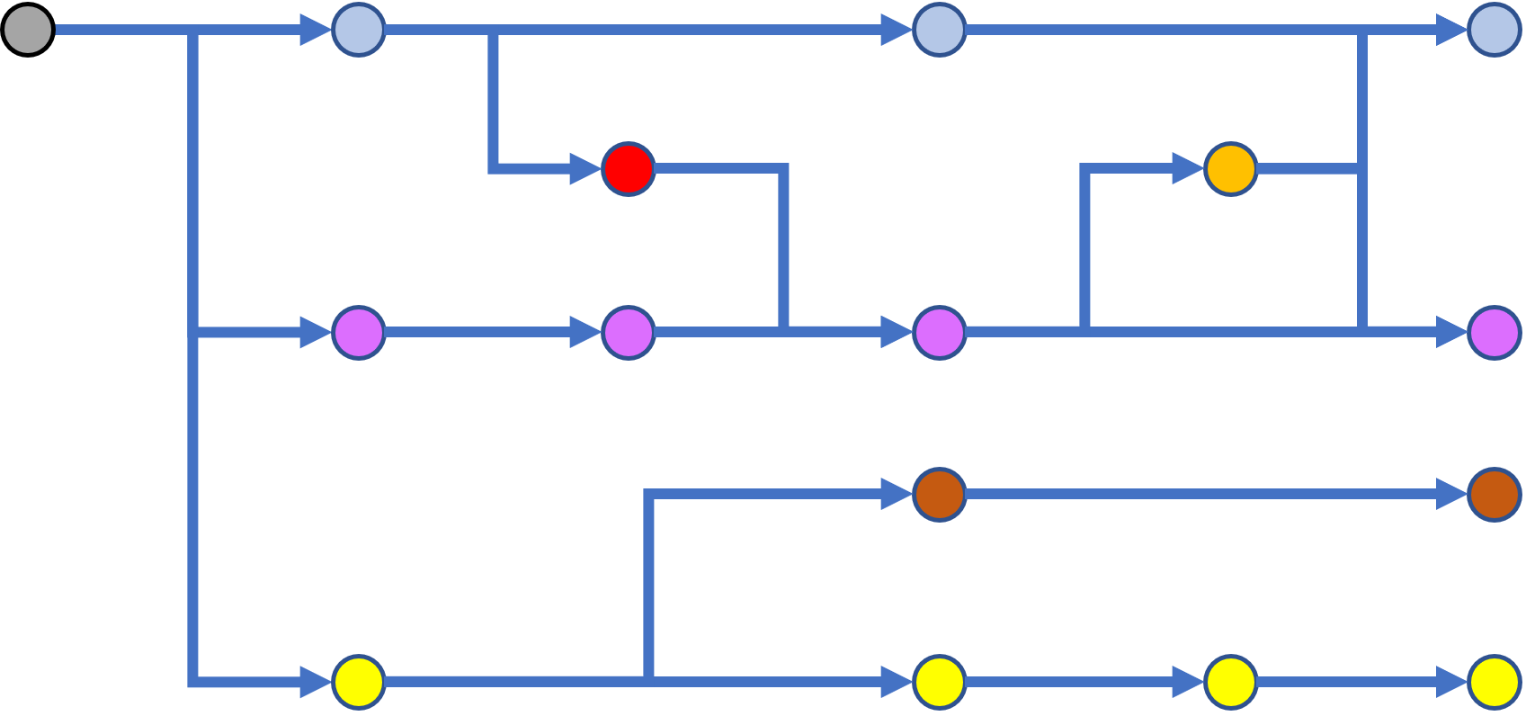
Challenges of EM-based Side-Channel Analysis

Slide 8
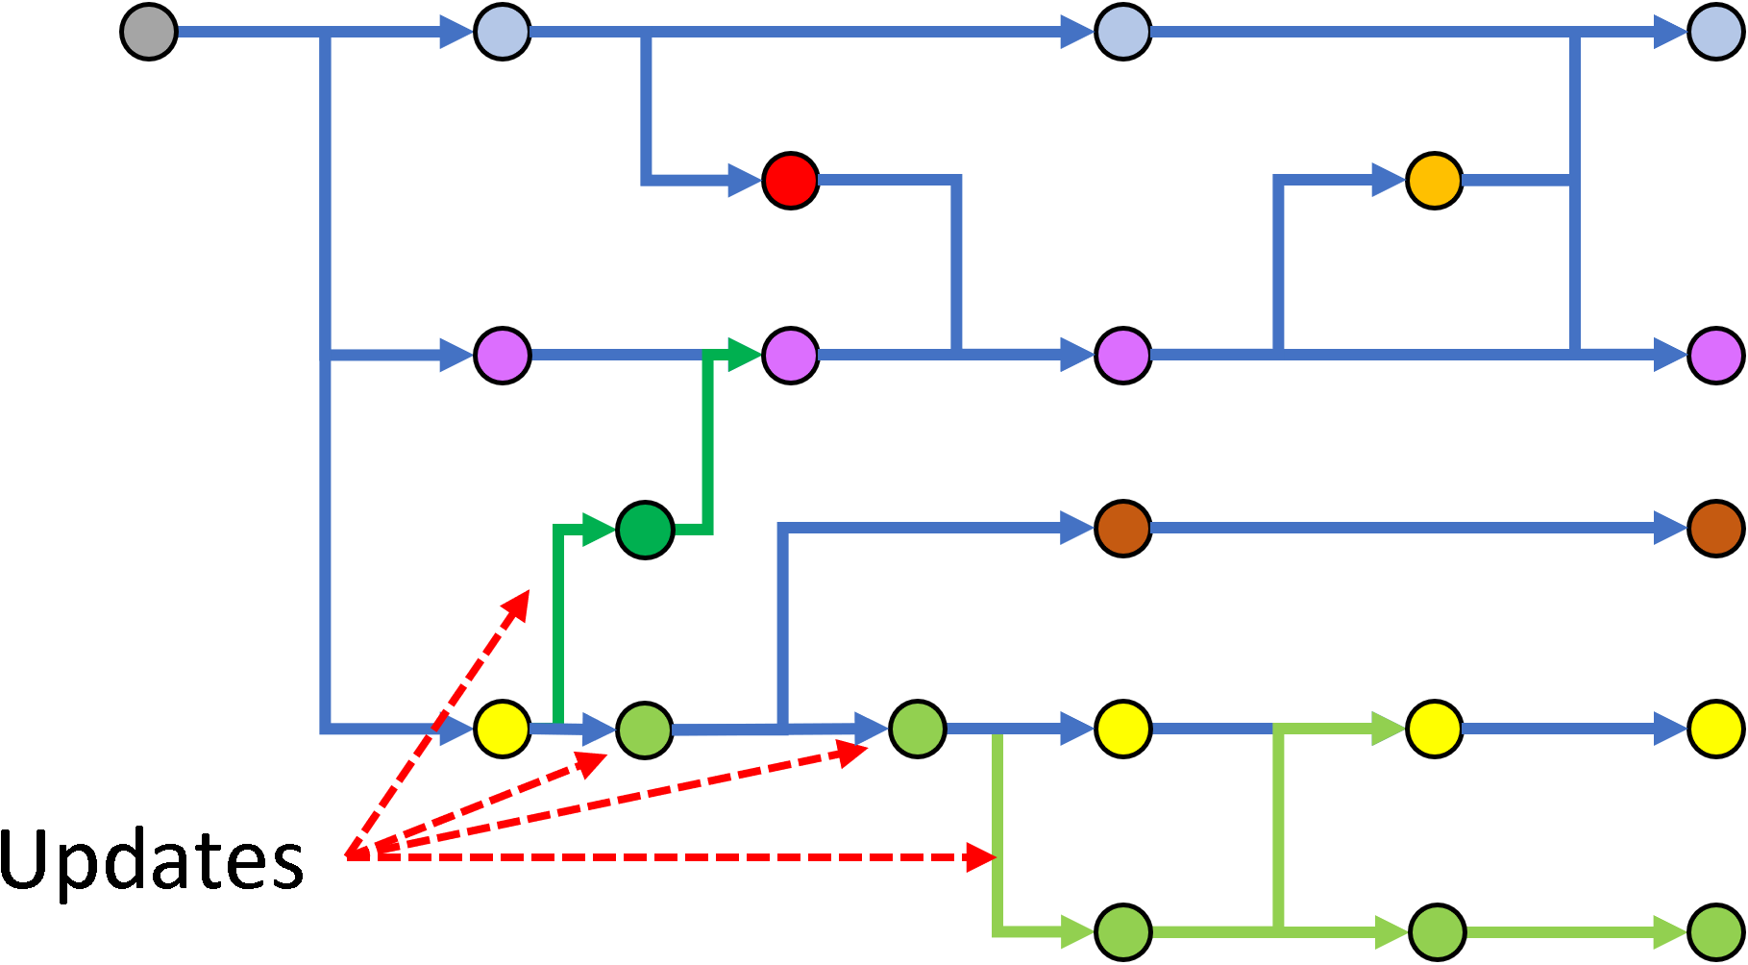
Challenges of EM-based Side-Channel Analysis

Slide 9
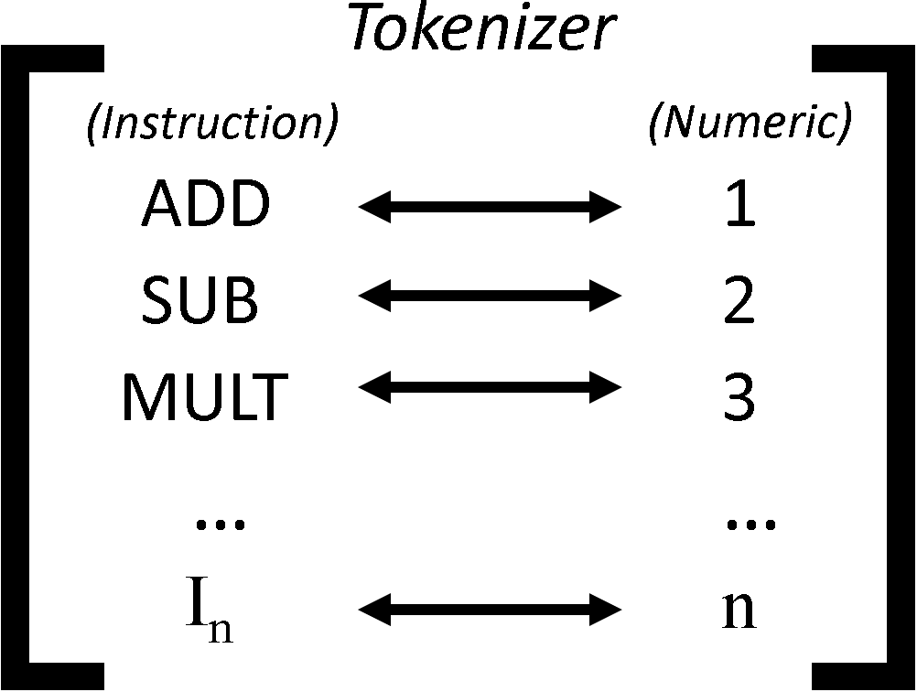
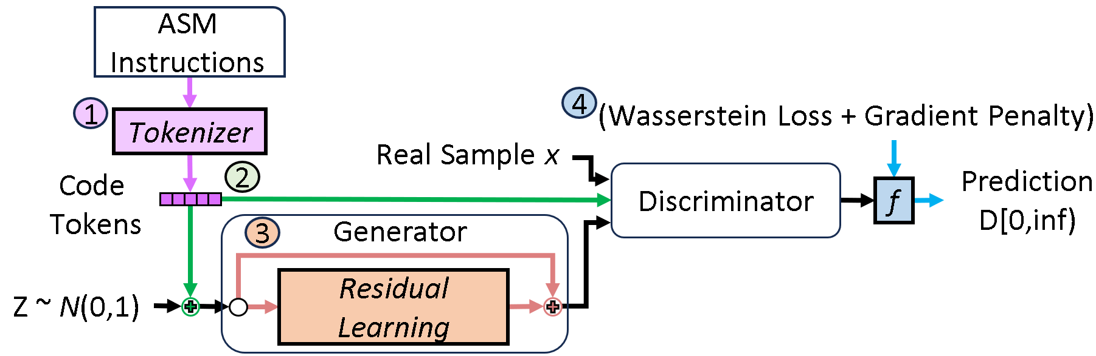
Code-to-EM Signal Synthesis using GANs
Tokenizer
Conditional GANs
ResGANs
Wasserstein GAN with Gradient Penalty

Slide 10
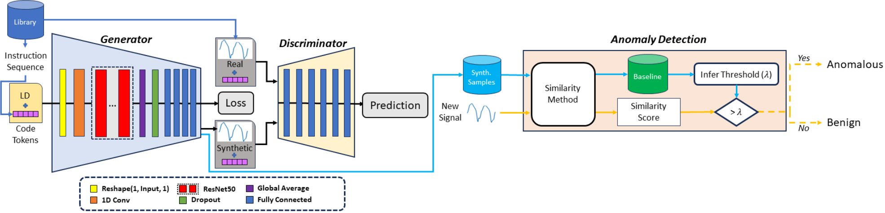
Workflow for EM-based anomaly detection

Slide 11
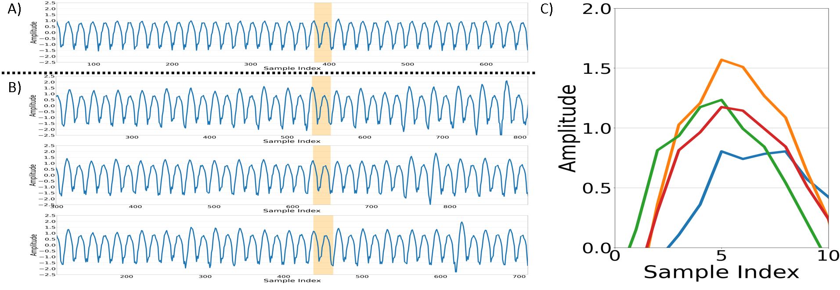
Complicated due to Active Device State
Different amplitude peaks
Residual electrical charge

Slide 12
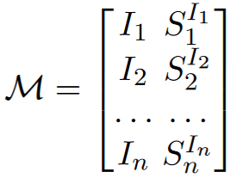
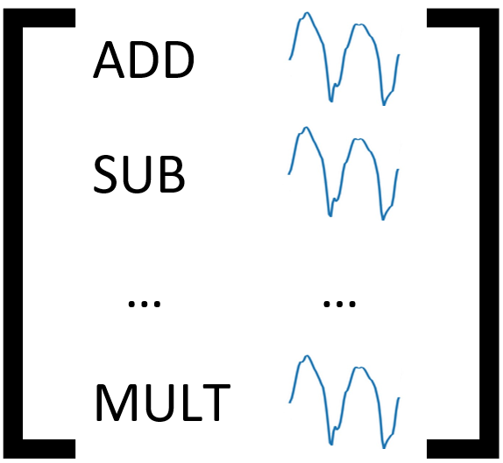
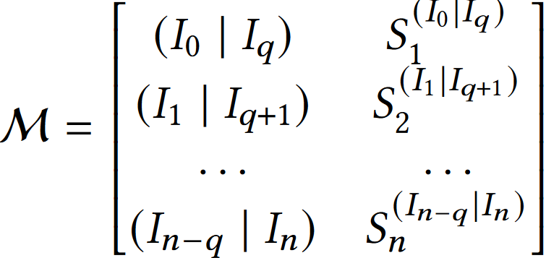
Accounting for Active Device State
Library of instructions to signals.
Not realistic to locate and harvest signals of very large sequences
Example: ATmega2560 contains 123 executable instructions.
Increases the total possible sequences by the power the number of prior instructions plus 1.
Total possible sequences…
1 prior instruction: 123² = 15,129
2 prior instructions: 123³ = 1,860,867
3 prior instructions: 123⁴ = 228,886,641
No Influence Case
Real Case (account for prior instructions)

Slide 13
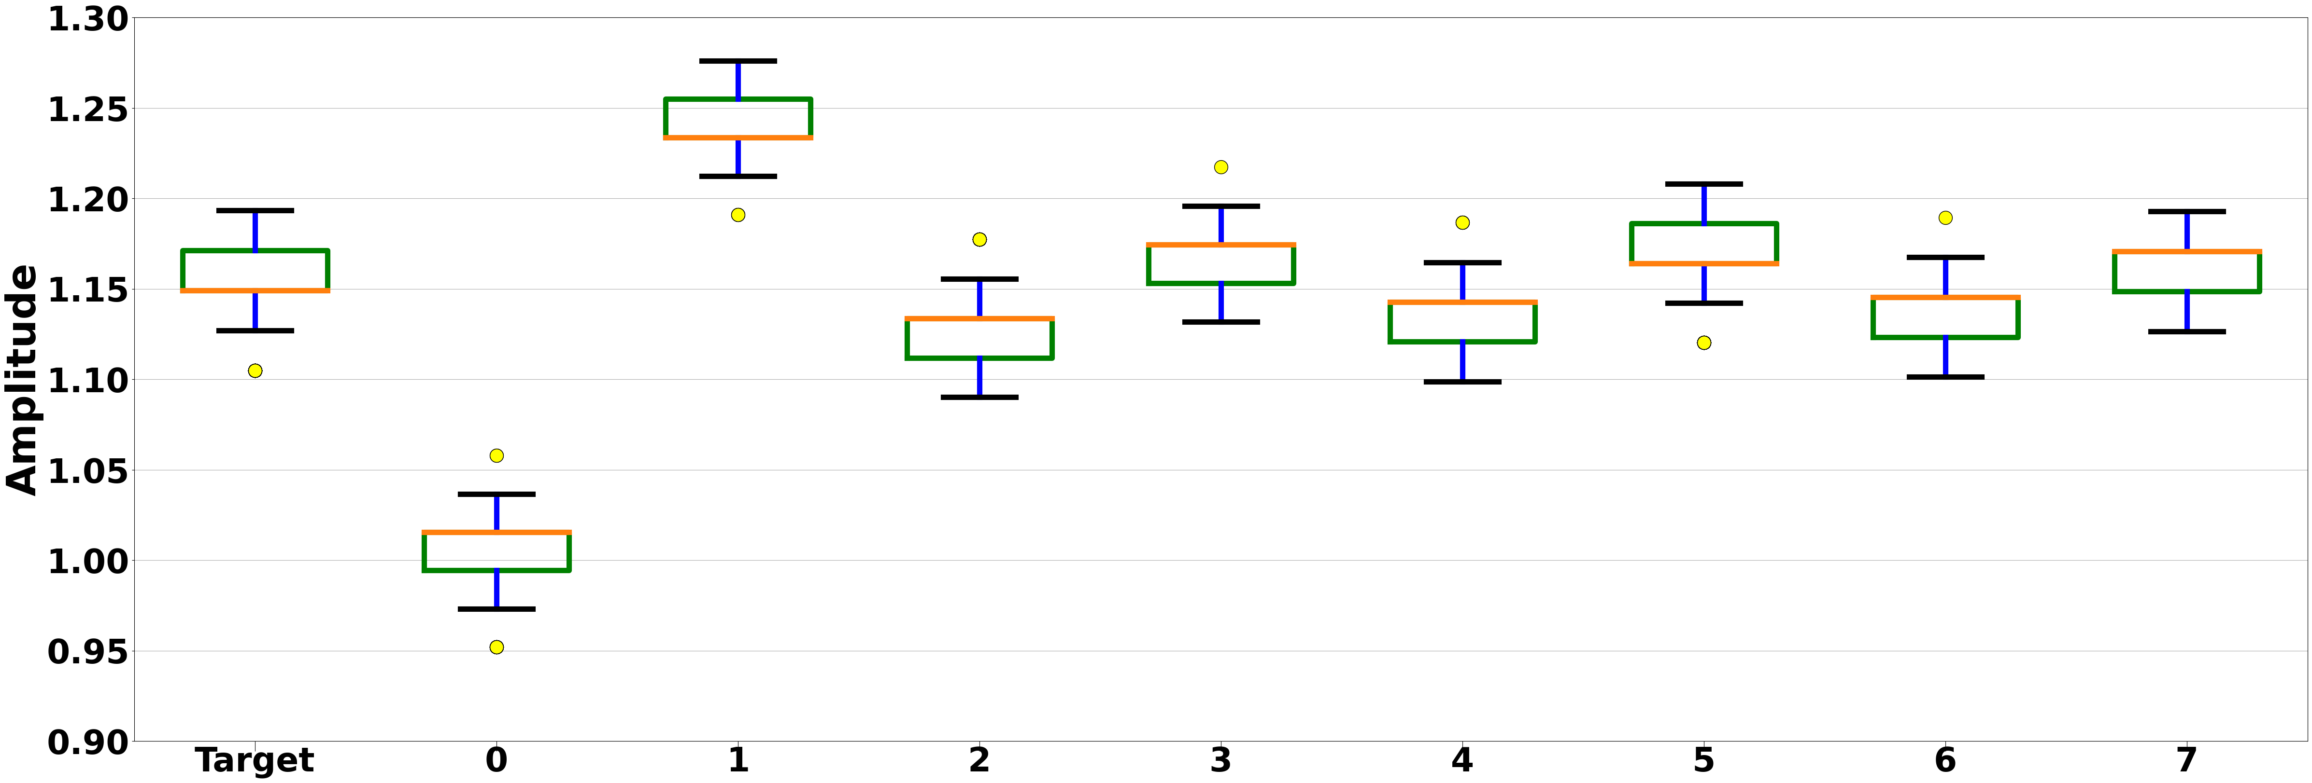
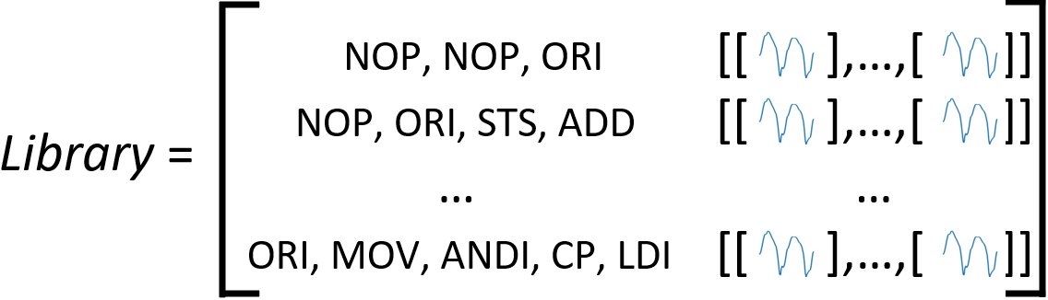
Accounting for Active Device State

Slide 14
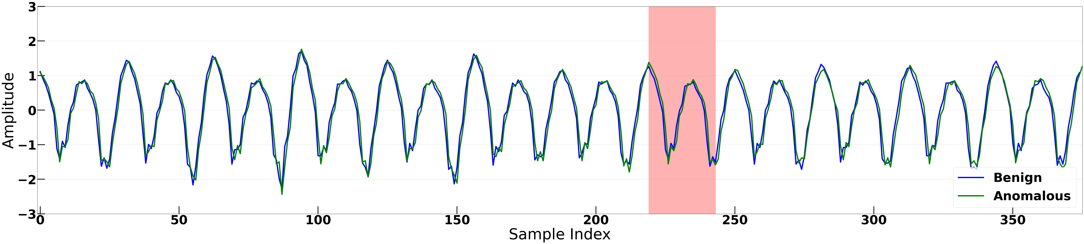
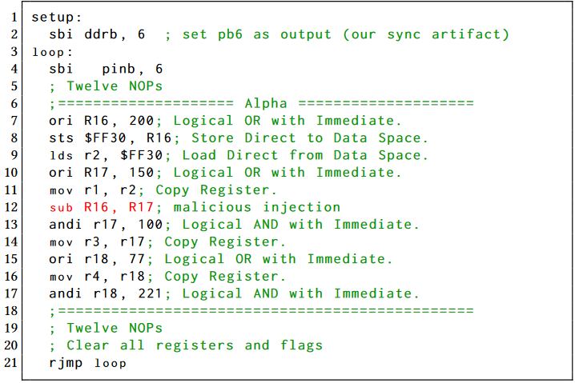
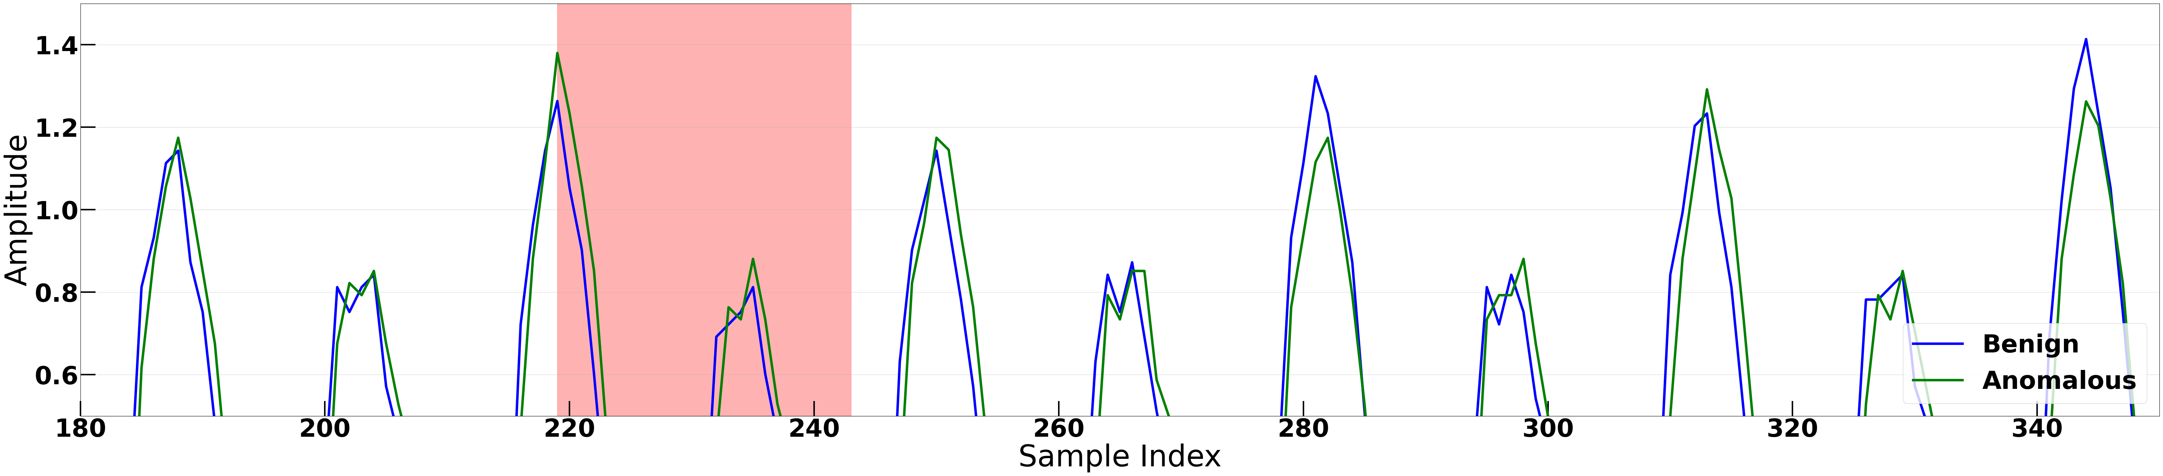
Programs
Program
Benign program created from common sequences of popular Arduino ATmega 2560 programs found on Github
Applied White Gaussian Noise
Obtained 25, 20, 15 Signal to Noise Ratio (SNR) samples

Slide 15
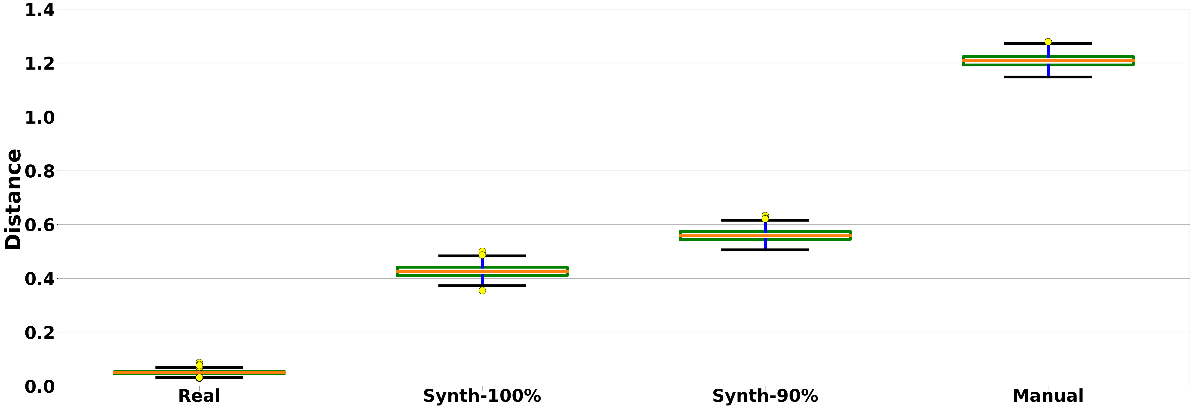
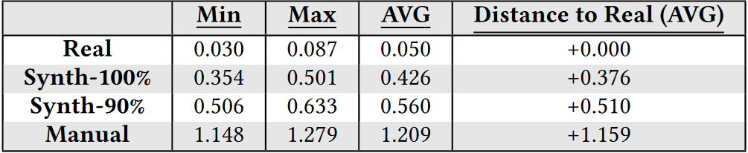
Evaluation of Fidelity

Slide 16
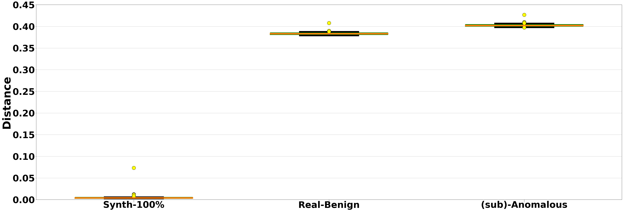
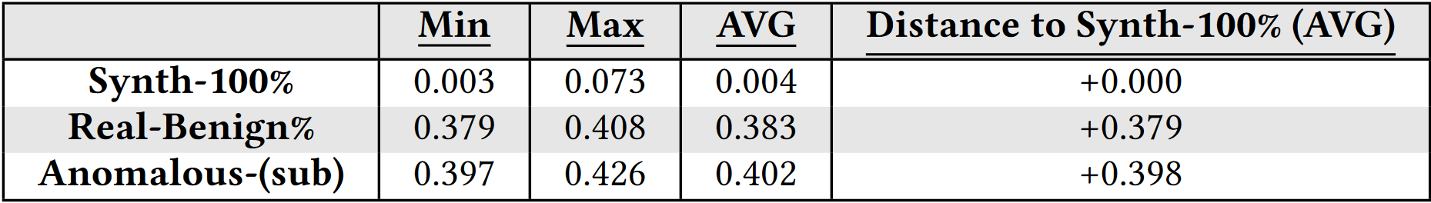
Evaluation for Anomaly Detection

Slide 17
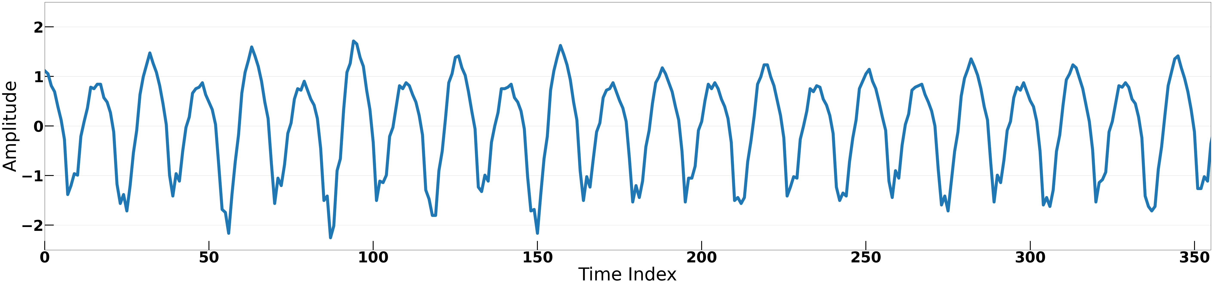
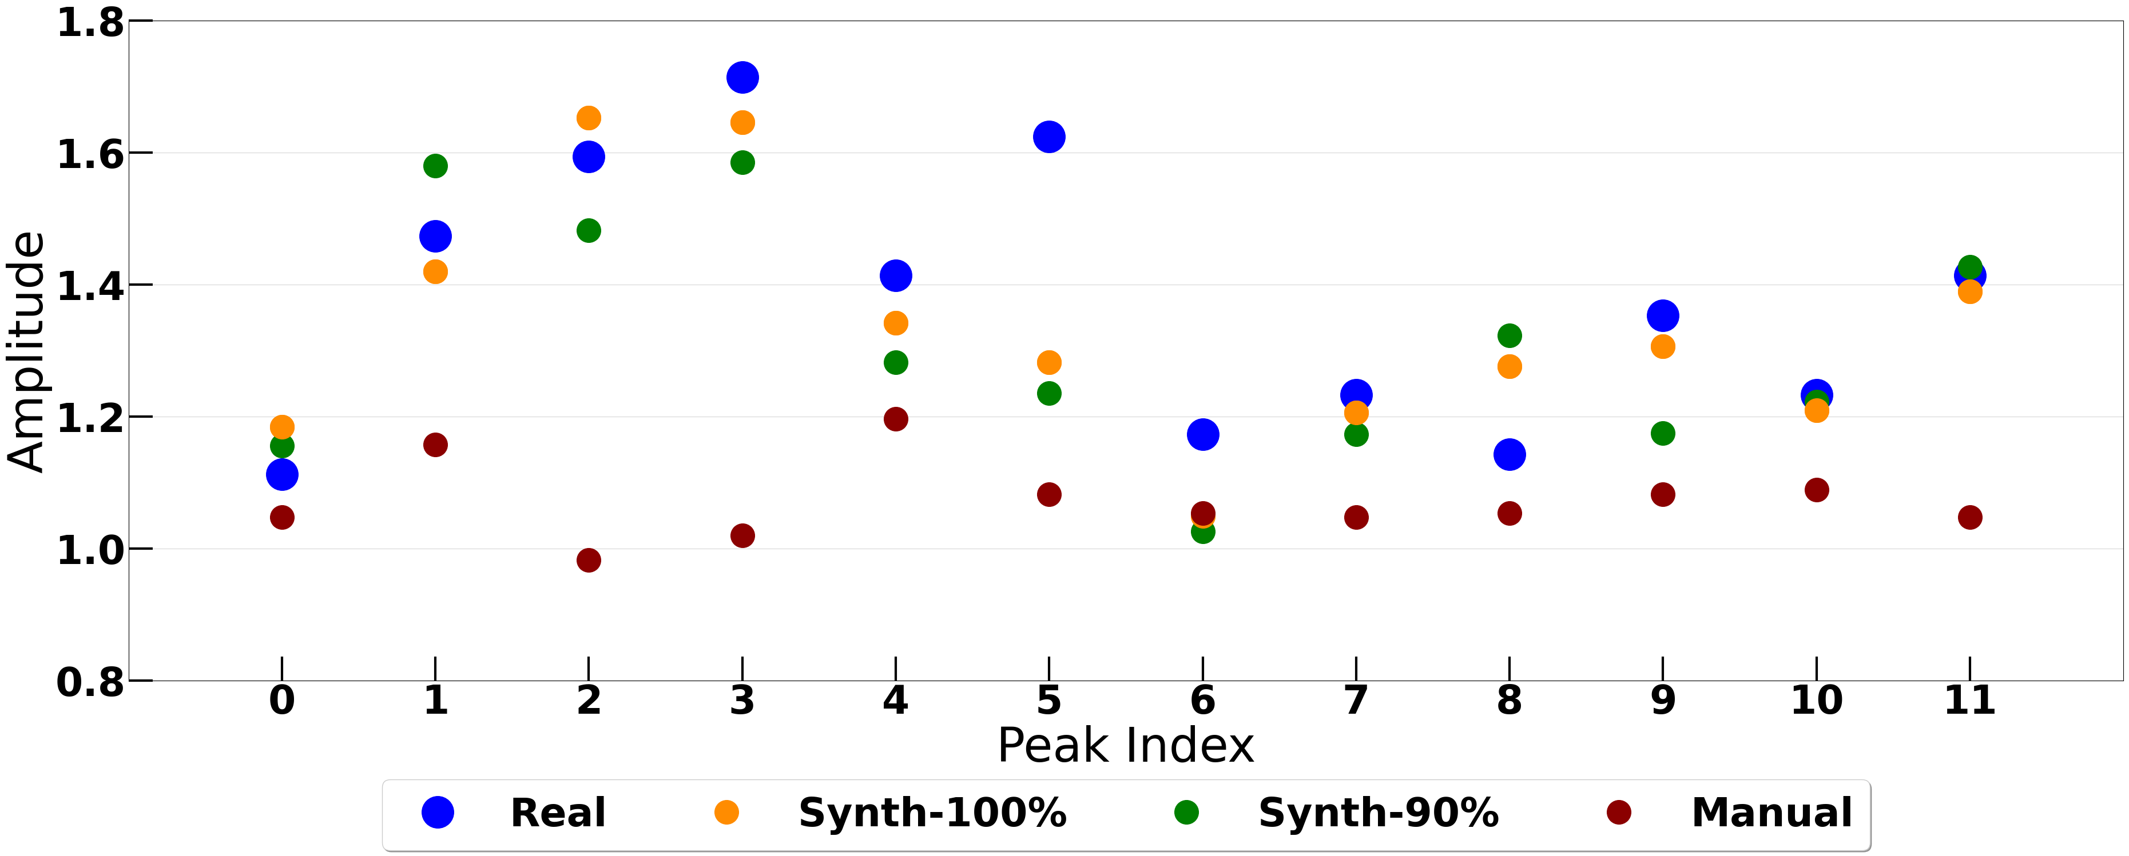
Visual Comparison
Retain only first peak amplitudes
Reduces resources
Focuses model to improve performance

Slide 18
Visual Comparison

Slide 19
Detection Models
K-NN
lazy-learning
Simple
Decision based on the Euclidean Distance of the kth neighbor to the baseline.
Low distance score = Normal
High distance score = Anomalous
Autoencoder
Dimensionality reduction
Decision based on reconstruction error, (mean square error between the input and output)
Low reconstruction error = Normal
High reconstruction error = Anomalous

Slide 20
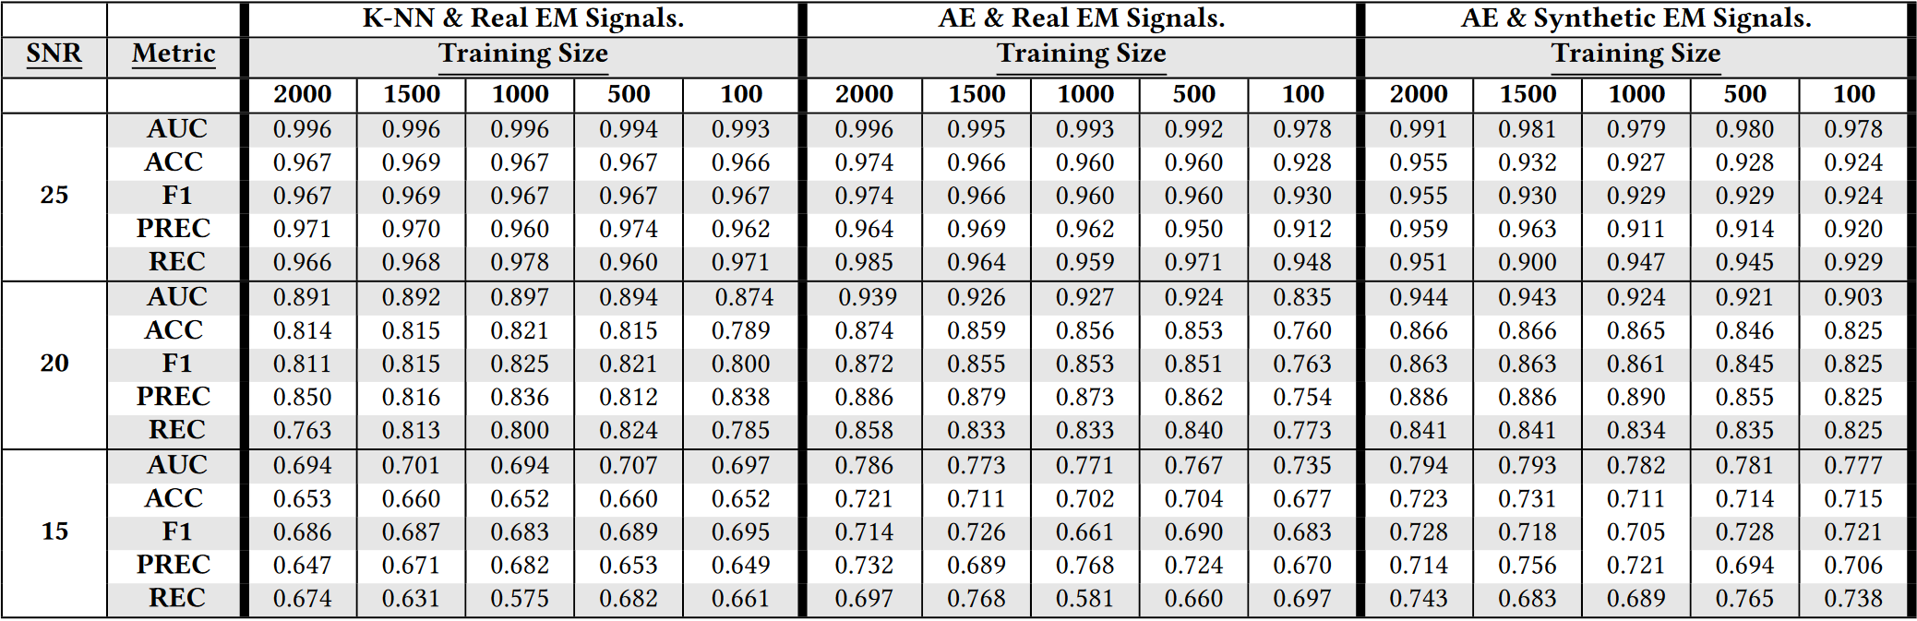
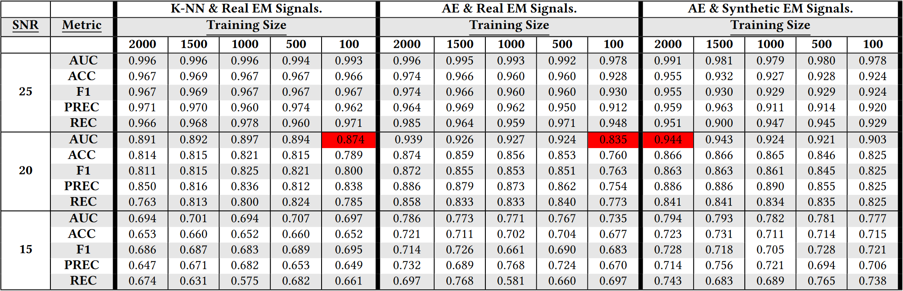
Anomaly Detection

Slide 21
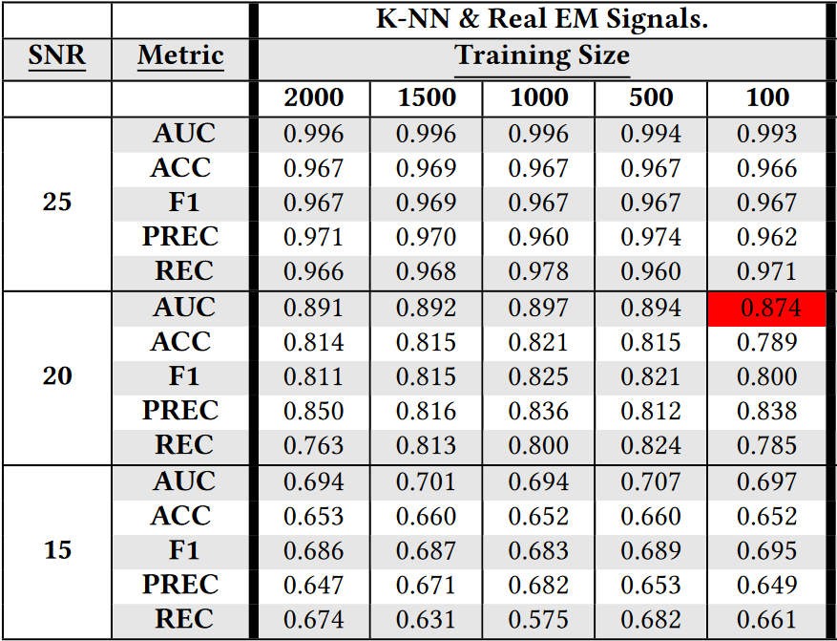
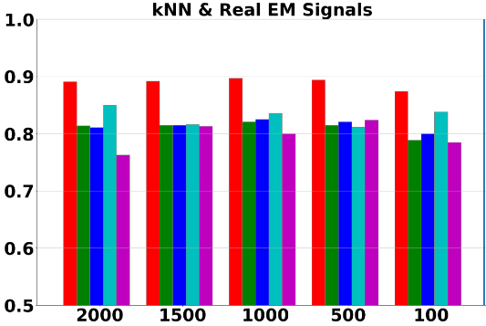
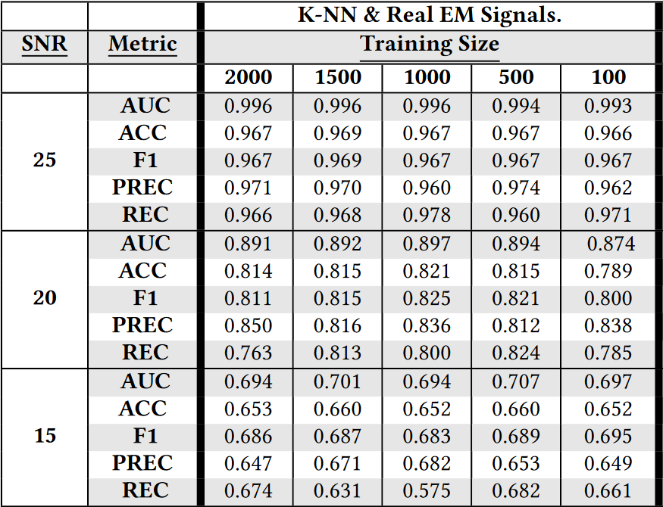
Q1: What is the performance of traditional methods?
Works well in low noise level environments.
Peak performance with relatively few samples
Suffers in high noise environments.

Slide 22
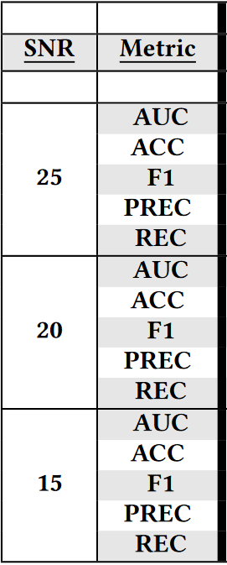
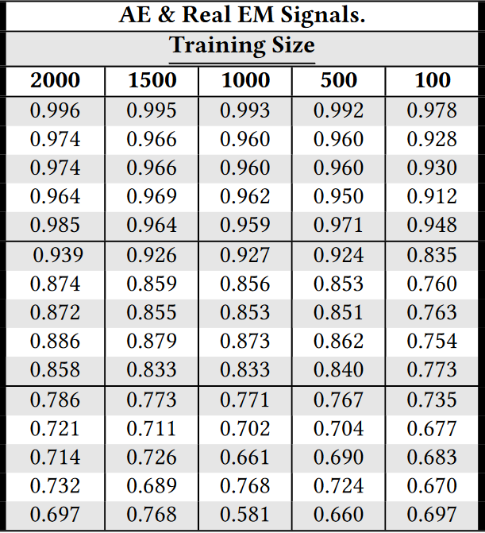
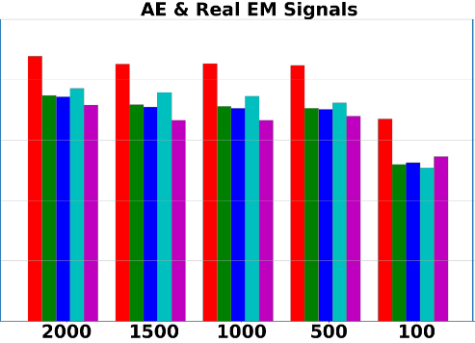
Q2: Can we improve traditional methods using AEs?
Near perfect results at 25 SNR.
Outperforms k-NN at lower SNRs.
Requires large samples (2000) to reach peak performance.

Slide 23
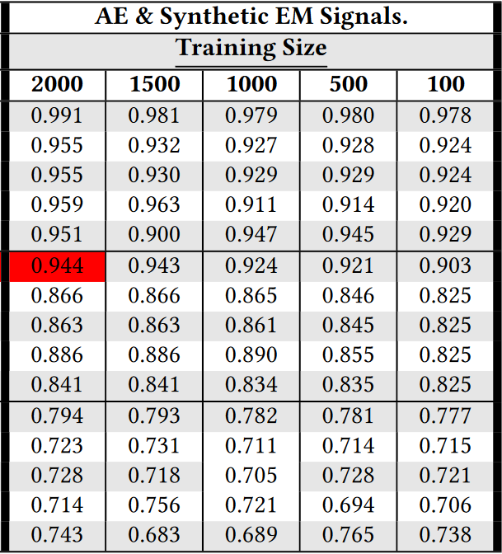
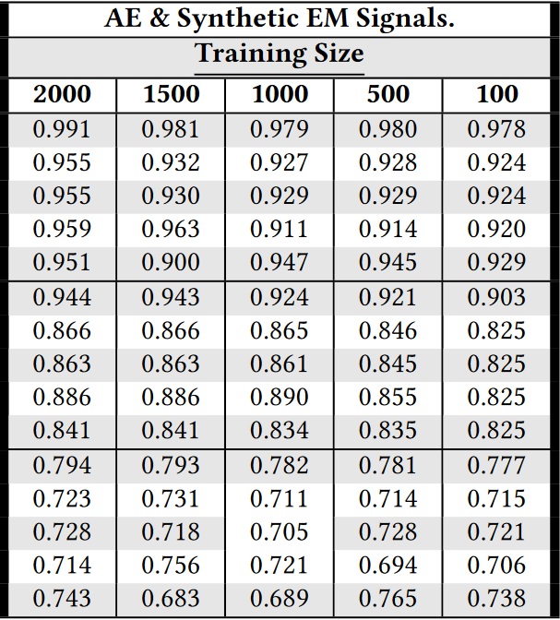
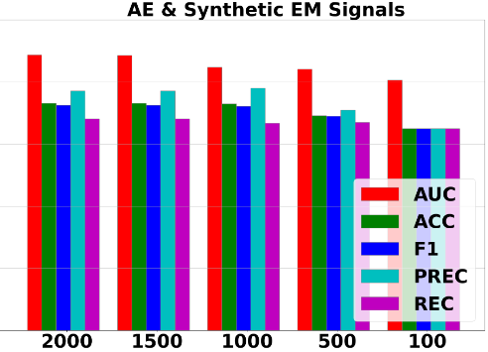
Q3: Can we obtain similar results using our framework?
Similar results to when training on Real EM signals.
Still outperforms k-NN at lower SNRs.
Able to feasibly obtain large training samples.

Slide 24
Final Conclusions
Our framework can generate synthetic signals that accurately approximate the real captured EM signals for a given program.
The synthetic signals created from our generative model can be utilized to train an EM-based anomaly detection model to the point that it outperforms other models that were trained using real signals.

Slide 25
Future works
Transfer learning methods for accounting for changes in EM-probe, type of EM-probe, or device model.
Domain adaptation
Different generative models for EM synthesis.
Transformers
Denoise Diffusion
Space State Models (SSM) with in Deep Learning
Feature Engineering
Improve generative performance.
Instruction + Input values
X2 improvement on fidelity (half the Euclidean distance)

Slide 26

Thank you for your attention. Questions?
From Code to EM Signals: A Generative Approach to Side Channel Analysis-based Anomaly Detection
Speaker: Kurt Vedros
Email: kvedros@uidaho.edu

