Slide 1

Montreal PowerShell User Group
#MTLPUG
@MTLPOwershell
meetup.com/MontrealPowerShellUserGroup/

Slide 2


Thanks to our sponsors

Slide 3
Introduction to PowerShell
Montreal PowerShell User Group – 2015/09/15

Slide 4


Get-Help “About_presenter”
Francois-Xavier Cat
SysAdmin for Warner Brothers Games
Blogger on lazywinadmin.com
Microsoft MVP PowerShell
Sapien MVP 2015
PowerShell.org Hero 2014
@lazywinadm

Slide 5
What is PowerShell ?
A scripting language object-oriented
A command-line Shell (similar to the Command Prompt)
Interactive editor
Integrated with the .NET framework
Access to COM, WMI, …
Both local and remote
Extensible
PowerShell is part of the Common Engineering Criteria (Microsoft)

Slide 6
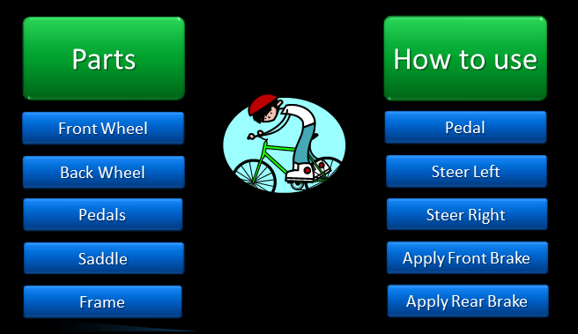
Oriented-Object ?

Slide 7
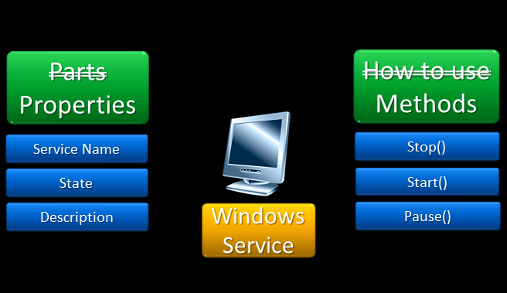
PowerShell Object

Slide 8
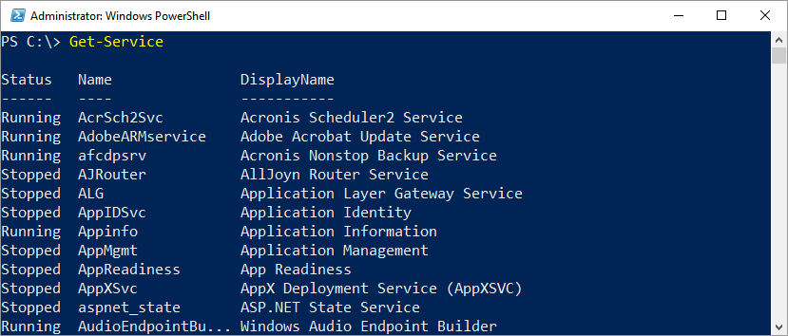
DEMO #1

Slide 9
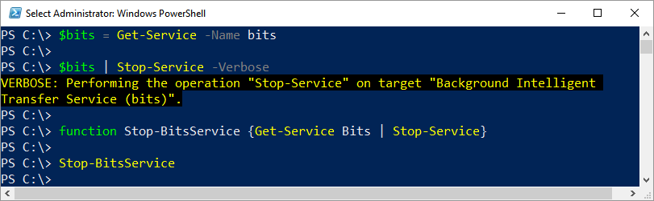
Important terminology
Cmdlets (Pronounce Command-Lets)
Pipeline
Variable

Slide 10
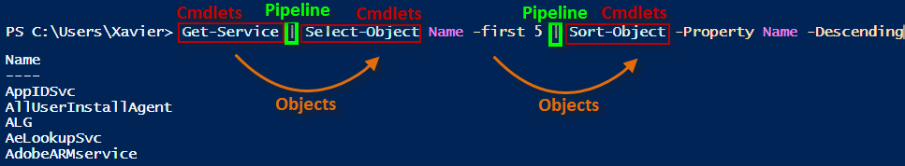
Pipeline

Slide 11
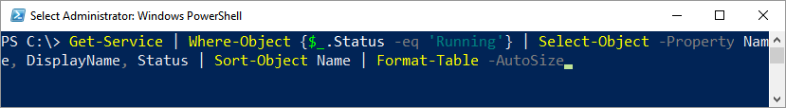
DEMO #2

Slide 12
The 3 important Cmdlets
Get-Command
Get-Help
Get-Member

Slide 13
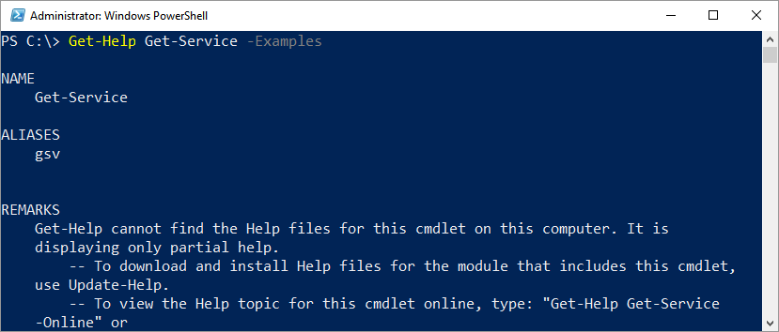
DEMO #3

Slide 14
Other cool examples
Importing and exporting data (TXT, XML, CSV, HTML, …)
Active Directory
WMI
Other
PowerShell Remoting
Parsing
Logs
File and Folder Permissions
…

Slide 15
Questions ?

Slide 16
Topics for the next meeting(s)
Do you want to present ?
Creating tools (Function/advanced function)
Parsing output of a traditional command
Creating a GUI Tool
Playing with Vmware PowerCLI

