Slide 1
Why EnergyCAP Developers should love Powershell
Kurt Kroeker

Slide 2



Slide 3
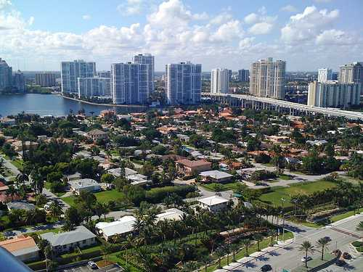


My Background with PowerShell
EDI
apis
audits
reformatter
reformatter
reformatter
reformatter

Slide 4

Why should I care about PowerShell?
It is POWERFUL
It is EVERYWHERE
It is FAMILIAR

Slide 5
What is PowerShell?

Slide 6

Brief History
MS-DOS CLI
Command Prompt (cmd.exe)
1998 - Windows Script Host (with VBScript!)
2002 - Monad
2006 - Monad => PowerShell v1.0
2008 – PowerShell v2.0
2015 - Pester – Unit testing framework for PowerShell
2016 - PowerShell Core
This Photo by Unknown Author is licensed under CC BY-SA

Slide 7
PowerShell Concepts
PowerShell Console
Commandlets
Aliases
Variables
Script files
Functions
Operators
Pipelines

Slide 8
Tips Working with PowerShell
Love the tab key
Love pipelines and $_.
Love your PowerShell Profile
Love the up-arrow
Love hash tables
Love working with JSON, CSV, and XML formats
Love the PowerShell ISE

Slide 9
Gotchas
Working with strings
Old code on the internet
Is it an array or not?
. Vs. .\

Slide 10
Subjects Not Covered
Execution policies
Azure resource interactions
PC user and administrative management
GUIs and PowerShell
PSCustomObject creation
Using external DLL dependencies (Add-Type, .NET [reflection.assembly])

Slide 11
Q & A

Slide 12

Kurt Kroeker Sr. Software Engineer EnergyCAP, Inc.
Email: kurt.kroeker@energycap.com
Twitter: KurtKroeker

